Slide 1
Code Reuse Through Hierarchies
Part 3: you will learn how interfaces provide a design guide while abstract classes can specify design (abstract methods) but also an common implementation (non-abstract methods)

Slide 2
Java Interfaces
public interface BankAccount
{
public final static int MIN_BALANCE = 0;
public void displayBalance();
public void deposit(double amount);
public void withdraw(double amount);
}
Similar to a class
Provides a design guide rather than implementation details
Specifies what methods should be implemented but not how (i.e. method signature but not method body)
  (Specify the signature of methods so each part of the project can proceed with minimal coupling between classes).
  An important design tool: Agreement for the interfaces should occur very early before program code has been written.
  Changing the method body rather than the method signature won’t ‘break’ code.
It’s a design tool so interfaces cannot be instantiated
  Q: What if one could instantiate an interface directly?
Name of the folder containing the complete online example: 8hierarchiesInterfaces

Slide 3
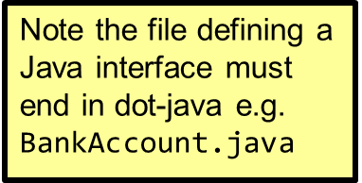
Interfaces: Format
Format for defining an interface
public interface <name of interface>
{
constants
methods to be implemented by the class that realizes
(provides a body) this interface
}
Example for defining an interface
public interface BankAccount
{
public final static int MIN_BALANCE = 0;
public void displayBalance();
}

Slide 4
Classes That Implement/Realize An Interface
Format for realizing / implementing the interface
public class <name of class> implements <name of interface>
{
attributes
methods actually implemented by this class
}
Format for realizing / implementing the interface
public class SavingsAccount
{
private double balance;
public void displayBalance()
{
System.out.println(balance);
}
}

Slide 5
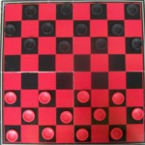
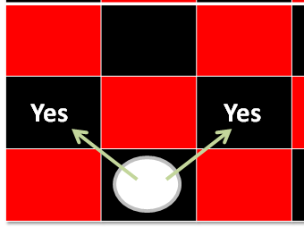
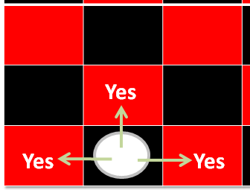
Interfaces: A Checkers Example
Regular rules²
Regular board¹
Variant rules²
1 From www.allaboutfungames.com)
2 Board images from “Tam”

Slide 6
Interface Board
public interface Board
{
public static final int SIZE = 8;
public void displayBoard();
public void initializeBoard();
public void movePiece();
boolean moveValid(int xSource,
int ySource,
int xDestination,
int yDestination);
...
}

Slide 7
Class RegularBoard
public class RegularBoard implements Board
{
public void displayBoard()
{
...
}
public void initializeBoard()
{
...
}

Slide 8
Class RegularBoard (2)
public void movePiece() {
//Get (x, y) coordinates for the source and destination
if (moveValid(xS, yS, xD, yD) == true)
//Actually move the piece
else
//Don’t move piece and display error message
}
public boolean moveValid(int xSource, int ySource,
int xDestination,
int yDestination)
{
if (moving forward diagonally)
return(true);
else
return(false);
}
} // End of class RegularBoard

Slide 9
Class VariantBoard
public class VariantBoard implements Board
{
public void displayBoard ()
{
...
}
public void initializeBoard ()
{
...
}

Slide 10
Class VariantBoard (2)
public void movePiece() {
//Get (x, y) coordinates for the source and destination
if (moveValid (xS, yS, xD, yD) == true)
// Actually move the piece
else
//Don’t move piece and display error message
}
public boolean moveValid(int xSource, int ySource,
int xDestination,
int yDestination)
{
if (moving straight-forward or straight side-ways)
return(true);
else
return(false);
}
} //End of class VariantBoard

Slide 11
Interfaces: Recapping The Example
Interface Board
  No state (variable data) or behavior (body of the method is empty)
  Specifies the behaviors that a board should exhibit e.g., clear screen
  This is done by listing the methods that must be implemented by classes that implement the interface.
Class RegularBoard and VariantBoard
  Can have state and methods
  They must implement all the methods specified by the interface ‘Board’ (but can also implement other methods too)

Slide 12
Specifying Interfaces In UML
<< interface >>
Interface name
method specification
Realization / Implements
Class name
method implementation

Slide 13
Alternate UML Representation (Lollipop Notation)
Interface name
Class name
method implementation

Slide 14
Implementing Multiple Interfaces
Java allows for this.
Interface1
Interface2
Interface3
Class

Slide 15
Implementing Multiple Interfaces
Format:
public class <class name> implements <interface name 1>,
<interface name 2>, <interface name 3>…
{
}

Slide 16
Multiple Implementations Vs. Multiple Inheritance
class <class name 1> extends <class name 2>, <class name 3>…
{
}
A class can implement multiple interfaces
Classes in Java cannot extend more than one class
Again: multiple inheritance is not possible in Java but is possible in other languages such as C++:
  Multiple inheritance (mock up code)

Slide 17
Multiple Implementations Vs.
Multiple Inheritance (2)
Parent class 1
Parent class 2
Parent class 3
Child class
Multiple inheritance: conceptual view representing using UML

Slide 18
Abstract Classes (Java)
Classes that cannot be instantiated.
A hybrid between regular classes and interfaces. Some methods may be implemented while others are only specified (no body).
Used when the parent class:
  specifies a default implementation of some methods,
  but cannot define a complete default implementation of other methods (implementation must be specified by the child class).
Format:
  public abstract class <class name>
  {
  <public/private/protected> abstract method ();
  }

Slide 19
Abstract Classes (Java): 2
1) From “Big Java” by C. Horstmann pp. 449 – 500.
Example¹:
  public abstract class BankAccount
  {
  protected float balance;
  public void displayBalance()
  {
  System.out.println("Balance $" + balance);
  }
  public abstract void deductFees();
  }

Slide 20
Another Example For Using An Abstract Class
RegularBoard
<< interface >>
Board
CheckerBoard
{abstract}
+moveValid()
+SIZE:int
+displayBoard()
+initializeBoard()
+movePiece()
+moveValid()
+displayBoard()
+initializeBoard()
+movePiece()
+moveValid()
VariantBoard
+moveValid()

Slide 21
You Should Now Know
What are interfaces/types
  How do types differ from classes
  How to implement and use interfaces in Java
  When interfaces should be employed
What are abstract classes in Java and how do they differ from non-abstract classes and interfaces.
  When to employ abstract classes vs. interfaces vs. ‘regular’ classes
How to read/write UML notations for abstract classes and interfaces.
What does multiple inheritance from multiple implementations

Slide 22
Copyright Notification
“Unless otherwise indicated, all images in this presentation are used with permission from Microsoft.”

