Slide 1
Code Reuse Through Hierarchies
Part 1: defining commonalities between classes in parent using inheritance.

Slide 2
Real Life Hierarchies
Base entity:
Attributes: age, height, weight
Actions: eat(), sleep(), excrete(), multiply()
Derived entity:”martial artist” has all attributes and actions of base entity plus
Attributes: belt/level
Actions: ironPalmStrike(),shadowlessKick()
Derived entity: ‘spy’ has all attributes and actions of base entity plus
Attributes: territory, code name e.g. 0-0TAM
Actions: stealth(), codebreaking(), lockPicking()

Slide 3
Review: Association Relation Between Classes
public class Car {
private Engine anEngine;
  private Lights carLights;
  public start() {
  anEngine.ignite();
  carLight.turnOn();
  }
}
public class Engine {
public boolean ignite() {
.. }
}
public class Lights {
private boolean isOn;
public void turnOn() {
isOn = true;}
}
One type of association relationship is a ‘has-a’ relation (also known as “aggregation”).
  E.g. 1, A car <has-a> engine.
  E.g. 2, A lecture <has-a> student.
Typically this type of relationship exists between classes when a class is an attribute of another class.

Slide 4
A New Type Of Association: Is-A (Inheritance)
An inheritance relation exists between two classes if one class is a more specific variant type of another class
Vehicle
Motorcycle
Car
Bus
SUV
Sports car
Mini
Full sized

Slide 5
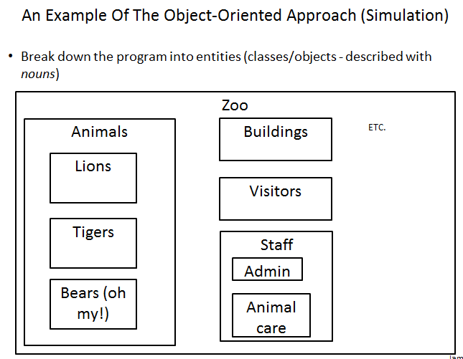
Recall O-O Approach: Finding Candidate Classes

Slide 6
What If There Are Commonalities Between Classes
Examples:
  All birds ‘fly’
  Some types of animals ‘swim’: fish, penguins, some snakes, crocodiles, some birds
  All animals ‘eat’, ‘drink’, ‘sleep’ etc.
  Under the current approach you would have the same behaviors repeated over and over!
Hawk
King Penguin
Lion
eat()
sleep()
drink()
eat()
sleep()
drink()
eat()
sleep()
drink()
Waste!
Waste!
Waste!

Slide 7
New Technique: Inheritance
When designing an Object-Oriented program, look for common behaviors and attributes
  E.g., color, species, eat(), drink(), sleep()
  These commonalities are defined in a ‘parent’ class
Animal
-color
-species
+eat()
+sleep()
+drink()

Slide 8
New Technique : Inheritance (2)
These commonalities are defined in a ‘parent’ class
  Classes that are derived from (are more specific versions) of the parent class are referred to a ‘child’ classes.
As appropriate other ‘child’ classes will directly include or ‘inherit’ all the non-private attributes and behaviors of the parent class.
  ‘Privates’ are still accessible through public methods.
Animal
-color
-species
+eat()
+sleep()
+drink()
Hawk
King Penguin
Lion

Slide 9
Defining A Class That Inherits From Another
This means that a Lion object AUTOMATICALLY has all the capabilities of an Animal object
The only attributes and methods that need to be specified are the ones unique to a lion
Format:
  public class <Name of child class> extends <Name of parent class>
  {
  // Definition of child class – only what is unique to
  // this class
  }
Example:
  public class Lion extends Animal
  {
  public void roar() {
  System.out.println("Rawr!");
  }
  }

Slide 10
First Inheritance Example
Name of the folder containing the complete example: 1basicExample

Slide 11

Class Person
public class Person
{
private int age;
public Person() {
age = 0;
}
public Person(int anAge) {
age = anAge;
}
public void doPersonStuff() {
System.out.println("Eat, sleep, drink, excrete, be" +
" fruitful");
}
}
Image of James Tam curtesy of James Tam

Slide 12
Class Hero: A Hero Is A Person
public class Hero extends Person {
}
This automatically gives instances of class Hero all the capabilities of an instance of class Person

Slide 13

Class Hero: A Person But A Whole Lot More
public class Hero extends Person
{
private int heroicCount;
public Hero()
{
heroicCount = 0;
}
public void doHeroStuff()
{
System.out.println("Saving the world for: truth!," +
" justice!, and all that good " +
" stuff!");
heroicCount++;
}
}
Image of super James Tam curtesy of James Tam

Slide 14

The Driver Class: Person Vs. Hero
public class Driver
{
public static void main(String [] args)
{
Person bob = new Person();
bob.doPersonStuff();
System.out.println();
Hero clark = new Hero();
clark.doPersonStuff();
clark.doHeroStuff();
}
}

Slide 15
Benefit Of Employing Inheritance
Code reuse:
  The common and accessible attributes and methods of the parent will automatically be available in all the children.
Person
+doPersonStuff()
Accountant
Hero
Teacher

Slide 16
New Terminology: Method Overriding
Overriding occurs when the parent class has a different version of a method than was implemented in the child class.
Person
+doPersonStuff()
Hero
+doPersonStuff()

Slide 17
Reminder: Method Overriding Vs. Method Overloading
Method overriding: different versions of a method in parent vs. child
Method overloading: different versions of a method in a single class definition
Person
+doPersonStuff()
Hero
+Hero()
+Hero(int)
+Hero(int,String)
+doPersonStuff()

Slide 18
Method Overriding Example
Name of the folder containing the complete example: 2overriding

Slide 19
Class Hero
public class Hero extends Person
{
//New method: the rest of the class is the same as the
//previous version
public void doPersonStuff()
{
System.out.println("Pffff I need not go about " +
"mundane niceties such as eating!");
}
}

Slide 20
The Driver Class (Included For Reference)
public class Driver
{
public static void main(String [] args)
{
Person bob = new Person();
bob.doPersonStuff();
System.out.println();
Hero clark = new Hero();
clark.doPersonStuff();
...
}
}

Slide 21
Overriding: Who Do We Call?
bob.doPersonStuff();
clark.doPersonStuff();

Slide 22
New Term: Binding
When a reference and a method are specified together, binding determines which version of the method is called.
If neither method overloading nor method overriding are employed then binding is very easy to determine.
public class Person {
private int age;
public Person() {
age = 0;
}
Person jim = new Person();
jim.setAge(27);
public setAge(int anAge) {
age = anAge;
}
}

Slide 23
New Term: Binding (2)
Early binding (overloading): determined at compile time (by ‘javac’)
  Parameter list determines
Late binding (overriding): determined at run time (by ‘java’)
  The type of the implicit parameter (“this” reference) determines

Slide 24
Method Overloading Vs. Method Overriding
Distinguishes overloaded methods
Method Overloading (what you should know)
  Multiple method implementations for the same class
  Each method has the same name but the type, number or order of the parameters is different (signatures are not the same)
  The method that is actually called is determined at program compile time (early binding).
  i.e., <reference name>.<method name>(parameter list);

Slide 25
Method Overloading Vs. Method Overriding (2)
Binding at compile time (early)
Examples of method overloading:
  public class Foo
  {
  public void display( ) { }
  public void display(int i) { }
  public void display(char ch) { }
  }
  Foo f = new Foo ();
  f.display( );
  f.display(10);
  f.display(‘c’);

Slide 26
Method Overloading Vs. Method Overriding (3)
The type of the reference (implicit parameter “this”) distinguishes overridden methods
Method Overriding
  The method is implemented differently between the parent and child classes.
  Each method has the same return value, name and parameter list (identical signatures).
  The method that is actually called is determined at program run time (late binding).
  i.e., <reference name>.<method name> (parameter list);

Slide 27
Example Overriding: The Type Of The Reference Determines The Method Called
public class Person {
public void doPersonStuff() {
...
}
}
public class Hero extends Person {
public void doPersonStuff() {
...
}
}
// Bob is a Person
bob.doPersonstuff();
// Clarke is a Hero
clark.doPersonStuff();

Slide 28
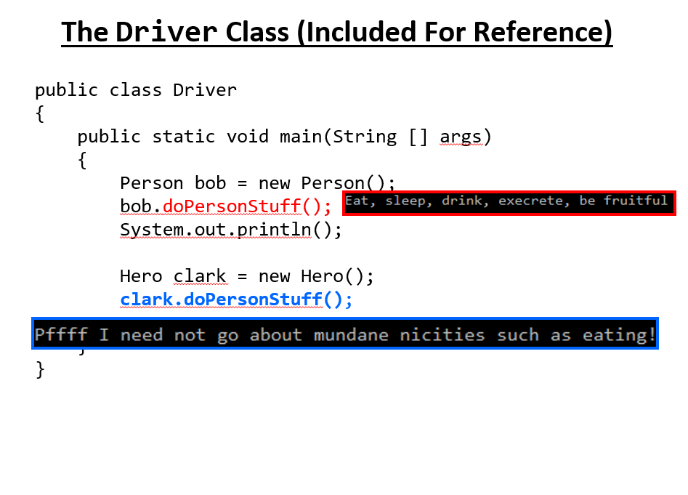
New Terminology: Polymorphism
Poly = many Morphic = forms
A polymorphic method has an implementation in the parent class and a different implementation the child class.
Polymorphism: the specific method called will be automatically be determined without any type checking needed (the type of reference determines which method is called)
Recall the example:

Slide 29
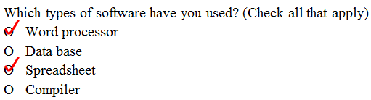
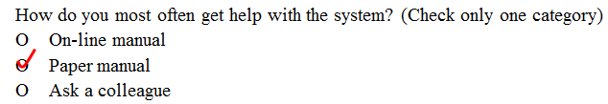
New Terminology: Super-class Vs. Sub-class
All people
on the earth
Superclass (Button)
(Superset –
Bigger)
All people
in Canada
Subclass (RadioButton)
(Subset - smaller)

Slide 30

The ‘Super’ Keyword
Used to access the parts of the super-class.
Format:
  <super>.<method or attribute>
Example:
  public void doPersonStuff()
  {
  System.out.println("Pffff I need not go about mundane"+
  " niceties such as eating!");
  super.doPersonStuff();
Parent’s version of method

Slide 31
Super Keyword: When It’s Needed
You only need this keyword when accessing non-unique methods or attributes (exist in both the super and sub-classes).
Without the super keyword then the sub-class will be accessed
Person
+doPersonStuff()
For a ‘Hero’ to access super class method (use ‘super’) super.doPersonStuff()
Hero
For a ‘Hero’ to access this classes version (no super keyword) doPersonStuff()
+doPersonStuff ()

Slide 32
Super Keyword: When It’s Not Needed
If that method or attribute exists in only one class definition then there is no ambiguity.
Person
For a ‘Hero’ doPersonStuff()
(No such method in class Hero to be confused with this method).
+doPersonStuff ()
Hero
For a ‘Hero’ doHeroStuff()
+doHeroStuff ()

Slide 33
Something Especially Good?
Note: There Is No Super.Super In Java

Slide 34
Using The Super Keyword
Name of the folder containing the complete example: 3super
  Note: this example illustrated the use of the super keyword in conjunction with a method “doPersonStuff”.
  As long as access permissions allow it, any attribute or method in the super class can be accessed in the same way using the ‘super’ keyword.

Slide 35
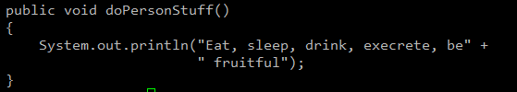
Class Hero: Using The Super Keyword
public class Hero extends Person
{
public void doPersonStuff()
{
System.out.println("Pffff I need not go about mundane" +
" niceties such as eating!");
timeDelay();
super.doPersonStuff();
timeDelay();
// Hero specific output
System.out.println("...well actually I do :$");
}
private void timeDelay()
{
final long DELAY_TIME = 1999999999;
for (long i = 0; i <= DELAY_TIME; i++);
}
}
For any Person

Slide 36
Using The Super Keyword Again
This fourth example illustrates the use of this keyword with the constructor and the (new to this example) toString() method
Note how the toString() method delegates some behavior to the parent class and implements some of the behaviors in the child class.
Name of the folder containing the complete example : 4superConstructors

Slide 37
Class Person
public class Person {
private int age;
public Person() {
age = 0;
}
public Person(int anAge) {
age = anAge;
}
public void doPersonStuff() {
System.out.println("Eat, sleep, drink, execrate, be" +
" fruitful");
}

Slide 38
Class Person (2)
//NEW
public String toString()
{
String s = "";
s = s + "Age of the person: " + age;
return(s);
}
}

Slide 39
Class Hero: Using Super()
public class Hero extends Person
{
private int heroicCount;
public Hero() {
super();
heroicCount = 0;
}
public Hero(int anAge) {
super(anAge);
heroicCount = 0;
}
public void doHeroStuff() {
...
heroicCount++;
}
public Person() {
age = 0;
}
public Person(int anAge) {
age = anAge;
}

Slide 40
Class Hero: Using Super(): 2
//NEW
public String toString()
{
String s = super.toString();
if (s != null)
s = s + "\n" + "Count of noble and heroic deeds " +
heroicCount;
return(s);
}
// Class Person
public String toString()
{
String s = "";
s = s + "Age of the person: " + age;
return(s);
}

Slide 41
The Driver Class
public Person(int anAge){
age = anAge;
}
public class Driver
{
public static void main(String [] args)
{
Person bob = new Person(55);
Hero clark = new Hero(25);
public Hero(int anAge){
super(anAge);
heroicCount = 0;
}
public Person(int anAge){
age = anAge;
}

Slide 42
The Driver Class: 2
System.out.println("Bob\n" + bob);
System.out.println("Clark\n" + clark);
}
}
public String toString()
{
String s = "";
s = s + "Age of the person: " + age;
return(s);
}
public String toString() // Hero
{
String s = super.toString();
if (s != null)
s = s + "\n" + "Count of noble and heroic deeds " +
heroicCount;
return(s);
}
public String toString() // Person
{
String s = "";
s = s + "Age of the person: " + age;
return(s);
}

Slide 43
Example 4 Synopsis
Using the super keyword to access the parent constructors
Uses the super keyword to access the parent implementation of toString()
Both method calls would delegate some of the required behaviors to the parent (access modify parent class attributes) and then the child implement the remaining behavior (access child class attributes)

Slide 44
Keep In Mind: Inheritance Is A One Way Relationship!
A Hero is a Person but a Person is not a Hero!
That means that while the sub-class can access the super-class parts but the super-class cannot access the sub-class parts.
New (sub) class
  New attributes
  New behaviors
Existing (super) class
  Attributes
  Behaviors

Slide 45
Access Modifiers And Inheritance
Private ‘-‘: still works as-is, private attributes and methods can only be accessed within that classes’ methods.
  Child classes, similar to other classes must access private attributes through public methods.
Public ‘+’: still works as-is, public attributes and methods can be accessed anywhere.
New level of access, Protected ‘#’: can access the method or attribute in the class or its sub-classes.

Slide 46
Summary: Levels Of Access Permissions
Access level | Accessible to
 | Same class | Subclass | Not a subclass
Public | Yes | Yes | Yes
Protected | Yes | Yes | No
Private | Yes | No | No

Slide 47
Levels Of Access Permission: An Example
public class P
{
private int num1;
protected int num2;
public int num3;
// Can access num1, num2 & num3 here.
}
public class C extends P
{
// Can’t access num1 here
// Can access num2, num3
}
public class Driver
{
// Can’t access num1 here and generally can’t access num2
// here
// Can access num3 here
}

Slide 48
General Rules Of Thumb
Variable attributes should not have protected access but instead should be private.
Most methods should be public.
Methods that are used only by the parent and child classes should be made protected.

Slide 49
Updated Scoping Rules
When referring to an identifier in a method of a class
  Look in the local memory space for that method
  Look in the definition of the class
  New: Look in the definition of the parent class

Slide 50
Updated Scoping Rules (2)
public class P
{
}
public class C extends P
{
public void method ()
{
}
}
<<< Third: Parent’s attribute >>>
Similar to how local variables can shadow attributes, the child attributes can shadow parent attributes.
<<< Second: Attribute>>>
<<< First: Local >>>
Reference to an identifier e.g., ‘num’

Slide 51
Updated Scoping Rules: A Trace
Name of the folder containing the complete example : 5scope

Slide 52

Scoping Rules: Review Code (1 Class)
public class Driver {
public static void main(String [] args) {
System.out.println("REVIEW");
System.out.println("------");
P = new P();
p.method1();
System.out.println();
public class P {
protected int x = 1;
private int y = 2;
public void method1() {
int x = 10;
int y = 20;
System.out.println("P.method1()");
System.out.println("Locals shadow attributes");
System.out.println("x/y: " + x + " " + y);
}

Slide 53
Scoping Rules: Review Code (1 Class): 2
p.method2();
System.out.println();
public void method2()
{
int x = 10;
int y = 20;
System.out.println("P.method2()");
System.out.println("Loc x/y: " + x + " " + y);
System.out.println("Attr x/y: " + this.x + " " +
this.y);
}

Slide 54
Updated Scoping Rules
System.out.println("NEW: INHERITANCE HIERARCHIES");
System.out.println("----------------------------");
C c = new C();
c.method1();
// Child
public class C extends P {
private int x = 3;
private int z = 4;
public void method1() {
System.out.println("C.method1()");
System.out.println("Child attributes");
System.out.println("x/z: " + this.x + " " +
this.z);
}

Slide 55
Updated Scoping Rules (2)
c.method2();
// Child
public void method2() {
int x = 100;
int y = 200;
int z = 300;
System.out.println("C.method2()");
System.out.println("Local shadows all");
System.out.println("x/y/z: " + x + " " + y + " " +
z);
}

Slide 56
Updated Scoping Rules (3)
c.method3();
public class P
{
protected int x = 1;
private int y = 2;
// Child
public void method3() {
int x = 100;
int y = 200;
int z = 300;
System.out.println("C.method3()");
System.out.println("Loc x/y/z: " + x + " " + y + " " + z);
System.out.println("P(x/y): " + super.x + " " + super.getY());
// super.y : syntax error, access permission violated
System.out.println("C(x/z): " + this.x + " " + this.z);
}

Slide 57
The Final Modifier (Inheritance)
What you know: the keyword final means unchanging (used in conjunction with the declaration of constants)
Methods preceded by the final modifier cannot be overridden
  e.g., public final void cannot_override()
Classes preceded by the final modifier cannot be extended
  e.g., final public class CANT_BE_EXTENDED

Slide 58
You Should Now Know
What is inheritance, when to employ it, how to employ it in Java
Defining parent classes by looking for a commonalities
What are the benefits of employing inheritance
  What is method overriding
    How does it differ from method overloading
    What is polymorphism
    The difference between early vs. late binding and the criteria used to determine the method ‘bound’ in each case
How does the ‘protected’ level of access permission work, how do private and public access permissions work with an inheritance hierarchy.
  Under what situations should each level of permission be employed

Slide 59
You Should Now Know (2)
Updated scoping rules (includes inheritance) and how shadowing works with an inheritance hierarchy
How the ‘super’ keyword works, when it is and is not needed
What is the effect of the keyword ‘final’ on inheritance relationships

Slide 60
Copyright Notification
“Unless otherwise indicated, all images in this presentation are used with permission from Microsoft.”

