Slide 1
Recursion
You will learn the definition of recursion as well as seeing how simple recursive programs work
Notes:
Recursion in Pascal
1
http://www.businessinsider.com/apple-interview-questions-2011-5#write-a-function-that-calculates-a-numbers-factorial-using-recursion-9

Slide 2
What Is Recursion?
“the determination of a succession of elements by operation on one or more preceding elements according to a rule or formula involving a finite number of steps” (Merriam-Webster online)
Notes:
Recursion in Pascal
2

Slide 3
What This Really Means
Breaking a problem down into a series of steps. The final step is reached when some basic condition is satisfied. The solution for each step is used to solve the previous step. The solution for all the steps together form the solution to the whole problem.
(The “Tam” translation)
Notes:
Recursion in Pascal
3

Slide 4
Definition Of Philosophy
1 The New Webster Encyclopedic Dictionary of the English Language
“…state of mind of the wise man; practical wisdom…” ¹
See Metaphysics
Notes:
Recursion in Pascal
4
Teaching tips (Insider’s true story)
I was learning about recursion in a first year CPSC course (I was a business major then)
I had trouble with the concept
So instead of taking the successor course I was thinking about taking a philosophy course instead
I didn’t know much about philosophy so I thought I would try to find out more information
I started by looking in the dictionary (the WWW was invented then…)

Slide 5
Metaphysics
2 The New Webster Encyclopedic Dictionary of the English Language
“…know the ultimate grounds of being or what it is that really exists, embracing both psychology and ontology.” ²
Notes:
Recursion in Pascal
5

Slide 6
Result Of Lookup , Possibility One: Success
I know what Ontology means!
Notes:
Recursion in Pascal
6

Slide 7
Result Of Lookup, Possibility One
Philosophy?
Metaphysics?
Success! I’ll take a Philosophy option.
Ontology!
Notes:
Recursion in Pascal
7

Slide 8
Result Of Lookup, Possibility Two: Failure
Lookup ‘loops’ back.
Notes:
Recursion in Pascal
8

Slide 9
Result Of Lookup, Possibility Two
Philosophy?
Metaphysics?
Rats!!!
See previous
Ontology?
Notes:
Recursion in Pascal
9

Slide 10
Ontology
“…equivalent to metaphysics.”³
3 The New Webster Encyclopedic Dictionary of the English Language
^{Audio curtesy of James Tam}
Notes:
Recursion in Pascal
10

Slide 11
Result Of Lookup, Possibility Three: Failure
You’ve looked up everything and still don’t know the definition!
Notes:
Recursion in Pascal
11
Gone thru every definition in the dictionary but there is a part in each definition that you don’t fully understand so you can never stop the lookup and figure out what philosophy means.

Slide 12
Looking Up A Word
if (you completely understand a definition) then
  return to previous definition (using the definition that’s understood)
else
lookup (unknown word(s))
Notes:
Recursion in Pascal
12

Slide 13
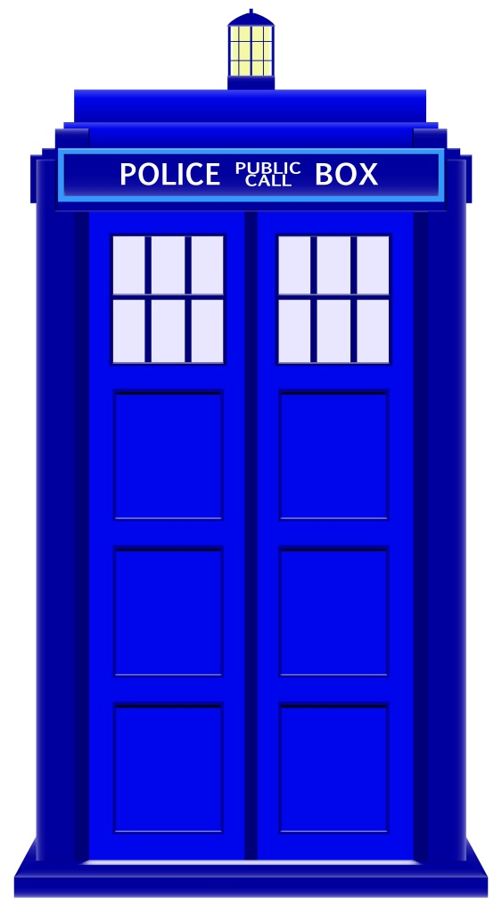
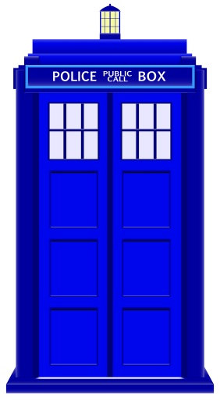
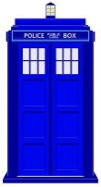

Related Material: Recursion
“A programming technique whereby a function or method calls itself either directly or indirectly.”
‘Tardis’ images: colourbox.com

Slide 14
Direct Call
void fun()
...
fun();
function

Slide 15
Indirect Call
f¹
f²

Slide 16
Indirect Call
f¹
f²
f³
…
f^{n}

Slide 17
Requirements For Sensible Recursion
1) Base case
2) Progress is made (towards the base case)
Notes:
Recursion in Pascal
17
e.g., sum of a series of numbers from 1 – n.
Sum(4) = 4 + 3 + 2 + 1 = 10
Recursively:
Sum(4) = 4 + sum(3)
Sum(3) = 3 + sum(2)
Sum(2) = 2 + sum(1)
Sum(1) = 1
General:
Sum(n) = n + sum(n-1)

Slide 18
Example Program: SumSeries.java
static int sum(int no) {
if (no == 1)
return(1);
else
return(no + sum(no-1));
}
main(String args []) {
...
System.out.print("Enter the last
number: ");
last = in.nextInt();
total = sum(last);
System.out.println("The sum of
the series from " +
"1 to " + last + " is " +
total);
}
sumSeries
total = sum(3)
6
sum (3)
if (3 == 1)
return(1);
F
else
return(3 + sum (3 – 1));
3
sum (2)
if (2 == 1)
return(1);
F
else
return(2 +sum (2 – 1));
1
sum (1)
if (1 == 1)
return 1
T
Notes:
Recursion in Pascal
18
Draw a memory map for each call to sum.

Slide 19
When To Use Recursion
When a problem can be divided into steps.
The result of one step can be used in a previous step.
There is a scenario when you can stop sub-dividing the problem into steps (step = recursive call) and return to a previous step.
  Algorithm goes back to previous step with a partial solution to the problem (back tracking)
All of the results together solve the problem.
Notes:
Recursion in Pascal
19
Show an example where information has to be reversed like a number conversion: display linked list in reverse order

Slide 20
When To Consider Alternatives To Recursion
When a loop will solve the problem just as well
Notes:
Recursion in Pascal
20

Slide 21
Types Of Recursion:
  Tail recursion:
    Aside from a return statement, the last instruction in the recursive function or method is another recursive call.
    tail(int x) {
    System.out.println(x);
    if (x < 10)
    tail(++x); // Last real instruction (implicit return)
    }
    This form of recursion can easily be replaced with a loop.
  Non-tail recursion:
    The last instruction in the recursive function or method is NOT another recursive call e.g., an output message
    nonTail(int x) {
    if (x < 10)
    nonTail(++x);
    System.out.println(x); // Last instruction
    }
    This form of recursion is difficult to replace with a loop (stopping condition occurs BEFORE the real work begins).

Slide 22
Simple Counting Example
Name of the example program: TailDriver.java
First example: can be directly implemented as a loop
  public class TailDriver
  {
  public static void tail (int no)
  {
  if (no <= 3)
  {
  System.out.println(no);
  tail(no+1);
  }
  return;
  }
  public static void main (String [] args)
  {
  tail(1);
  }
  }

Slide 23
‘Reversed’ Counting Example
  Name of the example program: NonTailDriver.java
  public class NonTailDriver
  {
  public static void nonTail(int no)
  {
  if (no < 3)
  nonTail(no+1);
  System.out.println(no);
  return;
  }
  public static void main (String [] args)
  {
  nonTail(1);
  }
  }

Slide 24
Error Handling Example Using Recursion (2)
Name of the example: ErrorCheckingDriver.java
  Iterative/looping solution (day must be between 1 – 31)
  public static int promptDay() {
  int day = -1;
  Scanner in = new Scanner(System.in);
  System.out.print("Enter day of birth (1-31): ");
  day = in.nextInt();
  if ((day < 1) || (day > 31)) {
  day = promptDay();
  }
  return(day);
  ...
  birthDay = promptDay()

Slide 25
Drawbacks Of Recursion
Function calls can be costly
  Uses up memory
  Uses up time
Notes:
Recursion in Pascal
25

Slide 26
Benefits Of Using Recursion
Simpler solution that’s more elegant (for some problems)
Easier to visualize solutions (for some people and certain classes of problems – typically require either: non-tail recursion to be implemented or some form of “backtracking”)
Notes:
Recursion in Pascal
26
Show minesweeper

Slide 27
Common Pitfalls When Using Recursion
These three pitfalls can result in a runtime error
  No base case
  No progress towards the base case
  Using up too many resources (e.g., variable declarations) for each function call
Notes:
Recursion in Pascal
27

Slide 28
No Base Case
int sum(int no) {
return(no + sum (no - 1));
}
Notes:
Recursion in Pascal
28

Slide 29
No Base Case
When does it stop???
int sum(int no) {
return(no + sum (no - 1));
}
Notes:
Recursion in Pascal
29

Slide 30
No Progress Towards The Base Case
int sum (int no) {
if (no == 1)
return(1);
else
return(no + sum (no));
}
Notes:
Recursion in Pascal
30

Slide 31
No Progress Towards The Base Case
The recursive case doesn’t make any progress towards the base (stopping) case
int sum (int no) {
if (no == 1)
return(1);
else
return(no + sum (no));
}
Notes:
Recursion in Pascal
31

Slide 32
Using Up Too Many Resources
Name of the example program: RecursiveBloat.java
  public static void fun(int no) {
  char [] array = new char [500000000]; // 1000 MB
  System.out.println(no);
  no = no + 1;
  if (no <= 888)
  fun(no);
  }
Notes:
Recursion in Pascal
32

Slide 33
Undergraduate Student Definition Of Recursion
Word: re·cur·sion
Pronunciation: ri-'k&r-zh&n
Definition: See recursion
^{Audio curtesy of James Tam}
”
Notes:
Recursion in Pascal
33
Teaching tip (finale to the true story)
I still couldn’t figure out how recursion worked
Gave on taking a philosophy course for now
Asked a higher level undergrad who was in lab what was recursion
Here’s his answer

Slide 34
Recursion: Job Interview Question
http://www.businessinsider.com/apple-interview-questions-2011-5#write-a-function-that-calculates-a-numbers-factorial-using-recursion-9

Slide 35
You Should Now Know
What is a recursive computer program
How to write and trace simple recursive programs
What are the requirements for recursion/What are the common pitfalls of recursion
Notes:
Recursion in Pascal
35

