Slide 1
Advanced Java Programming
Part 2: references and objects, shallow vs. deep copies, automatic garbage collection, parameter passing

Slide 2
Review: Previous Class
What you have learned in your prerequisite class: some variables directly contain data:
  num1 = 12
  num2 = 3.5
  ch = 'a'
What you may have learned your prerequisite class: some variables ‘refer’ to other variables.
  list = []
  list = [1,2,3]

Slide 3
Review: This Class
In Java when you use objects and arrays there are two things involved:
  Reference
  Object (or array)
Example with an object
  Person charlie; // Creates reference to object
  charlie = new Person("Sheen"); // Creates object
Example with an array
  double [] salaries; // Creates reference to array
  salaries = new double[100]; // Creates array
Normally a newly created reference contains a ‘null’ value (meaning it refers to ‘nothing’).
Roughly equivalent to:
  charlie = null;

Slide 4
Review: This Class
Why is it important to know that a reference and what the reference refers two are separate?
Name of the folder containing the online example: 4referencesVsObjects

Slide 5
Addresses And References
Real life metaphor: to determine the location that you need to reach the ‘address’ must be stored (electronic, paper, human memory)
Think of the delivery address as something that is a ‘reference’ to the location that you wish to reach.
  Lose the reference (electronic, paper, memory) and you can’t ‘access’ (go to) the desired location.
???
121
122
123
123
Reference =
123

Slide 6
Addresses And References
A reference to an array does not directly contain the contents of the array
  Instead the reference contains the address (“refers to”) of the array
Notes:
Draw out
int [] array;
Array = new int[2];

Slide 7
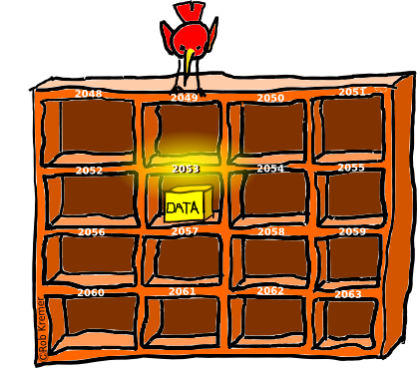
Recap: Variables
Variables are a ‘slot’ in memory that contains ‘one piece’ of information.
    num = 123
Normally a location is accessed via the name of the variable.
  Note however that each location is also numbered!
  This is the address of a memory location.
Image: Curtesy of Rob Kremer

Slide 8
References And Objects
    Name of the folder containing the complete example : 5referenceExamples
  public class Person
  {
  private String name;
  public Person() { name = "none"; }
  public Person(String newName) { setName(newName);
  }
  public String getName() { return(name); }
  public void setName(String newName) {
  name = newName;
  }
  }

Slide 9

References And Objects (2)
In main():
Person bart;
Person lisa;
bart = new Person("bart");
System.out.println("Bart object name: " + bart.getName());
lisa = bart;
bart = new Person("lisa");
System.out.println("Bart object name: " + bart.getName());
System.out.println("Lisa object name: " + lisa.getName());

Slide 10
References And Objects (3)
What happened?
Person bart;
Person lisa;
bart = new Person("bart");
lisa = bart;
bart = new Person("lisa");
Address = 200
(Person object)
“lisa”
Address = 100
(Person object)
“bart”
@ = 200
bart
@ = 100
lisa
@ = 100

Slide 11
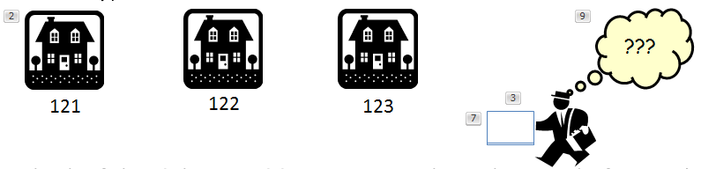
References And Objects (4)
Person bart;
Person lisa;
bart = new Person("bart");
lisa = bart;
bart = new Person("lisa");
Note:
The object and the reference to the object are separate e.g., ‘bart’ originally referenced the ‘bart object’ later it referenced the ‘lisa object’
The only way to access the object is through the reference.
These same points applies for all references (arrays included)
Objects that can be referenced
Reference

Slide 12

Shallow Copy Vs. Deep Copies
Shallow copy (new term, concept should be review)
  New term:
    Copy the address from one reference into another reference
    Both references point to the same location in memory
A shortcut (‘link’ or ‘ln’ in UNIX) is similar to a shallow copy. Multiple things that refer to the same item (document)

Slide 13

Shallow Copy Vs. Deep Copies (2)
Name of the folder containing the complete example:
  6shallowVsDeep
  Person mary = new Person(21);
  Person bob = new Person(12);
  System.out.println(mary.age + " " +
  bob.age);
  mary = bob; // Shallow;
  bob.age = 66;
  System.out.println(mary.age + " " +
  bob.age);
Memory leak!
mary
Age
21
bob
Age
66
12
Notes:
Memory leak is a part of memory used by a program that can no longer be accessed

Slide 14
New Term: Memory Leak
When memory that was used by a program is no longer needed but is not freed up for other programs.

Slide 15

Shallow Copy Vs. Deep Copies (3)
Deep copy (new term, concept should be review)
  New term, deep copy:
    It’s not the addresses stored in the references that’s copied
    Instead the data referred to by the references are copied
  After the copy each reference still refers to a different address (the address refers to a data variable)
Making an actual physical copy is similar to a deep copy.

Slide 16
Shallow Copy Vs. Deep Copies (4)
Name of the folder containing the complete example : 6shallowVsDeep
  // Mary still 66
  bob = new Person(77);
  mary.age = bob.age; // Deep
  bob.age = 144;
  System.out.println(mary.age + " " +
  bob.age);
mary
Age
77
66
bob
Age
144
77

Slide 17
Automatic Garbage Collection Of Java References
References
Dynamic memory
f1(Address of a “Foo”)
Object (Instance of a “Foo”)
f2 (Address of a “Foo”)
Object (Instance of a “Foo”)
Dynamically allocated memory is automatically freed up when it is no longer referenced (Foo = a class) e.g.,
  Foo f1 = new Foo();
  Foo f2 = new Foo();

Slide 18
Automatic Garbage Collection Of
Java References (2)
References
Dynamic memory
f1
Object (A “Foo”)
f2
Object (A “Foo”)
null
Dynamically allocated memory is automatically freed up when it is no longer referenced e.g.,
  f2 = null;

Slide 19

Automatic Garbage Collection Of
Java References (3)
Dynamically allocated memory is automatically freed up when it is no longer referenced e.g.,
  f2 = null;
  Recall that a null reference means that the reference refers to nothing, it doesn’t contain an address).
References
Dynamic memory
f1
Object (A “Foo”)
f2
Object (A “Foo”)
Image copyright unknown
null

Slide 20
Caution: Not All Languages Provide Automatic Garbage Collection!
Some languages do not provide automatic garbage collection (e.g., C, C++, Pascal).
In this case dynamically allocated memory must be manually freed up by the programmer.
New term: Memory leak: memory that has been dynamically allocated (such as via the Java ‘new’ keyword’) but has not been freed up after it’s no longer needed.
  Memory leaks are a sign of poor programming style and can result in significant slowdowns.

Slide 21
Methods Of Parameter Passing
New term: Pass by value
  The data stored (the “value” stored) in the parameter is copied
New term: Pass by reference
  Pass the address of the parameter
  This allows references to the parameter inside the method (the method has a “reference” to the original parameter).

Slide 22
Passing Parameters As Value Parameters
method (p1);
Pass a copy of the data
method (<parameter type> <p1>)
{
}
Notes:
We pass data from slot to slot

Slide 23
Passing Parameters As Reference Parameters
method (p1);
Pass the address of the parameter (refer to the original parameter in the method)
method (<parameter type> <p1>)
{
}
Notes:
We pass the address of a slot from one slot to another slot
Currently both slots refer to the same address but that can change

Slide 24
Which Parameter Passing Mechanism Is Used?
Passed by value
Pass by reference
All ‘simple’ built in types:
  Integers (byte, short, int, long)
  Floating point (float, double)
  Character (char)
  Boolean (boolean)
Objects
Arrays
(That is, anything that consists of a reference and the item referenced).

Slide 25
Parameter Passing Example
Name of the folder containing the complete example : 7parameters

Slide 26
Class Person
public class Person {
private int age;
private String name;
public Person() {
age = -1;
name = "none";
}
public int getAge() {
return(age);
}
public String getName() {
return(name);
}

Slide 27
Class Person (2)
public void setAge(int anAge) {
age = anAge;
}
public void setName(String aName) {
name = aName;
}
}

Slide 28
Class ParameterExample
public class ParameterExample
{
public void modify(Person aPerson, int aNum)
{
aPerson.setName("Eric Cartman");
aPerson.setAge(10);
aNum = 888;
System.out.println("Person inside modify()");
System.out.println(aPerson.getName() + " " +
aPerson.getAge());
System.out.println("Number inside modify()");
System.out.println(aNum);
}
}
Modifies parameters here

Slide 29

The Driver Class
public class Driver
{
public static void main(String [] args)
{
int num = 13;
Person aPerson = new Person();
ParameterExample pe = new ParameterExample();
System.out.println("Person in main() before edit");
System.out.println(aPerson.getName() + " " +
aPerson.getAge());
System.out.println("Number inside main() before edit");
System.out.println(num);
System.out.println("----------");

Slide 30
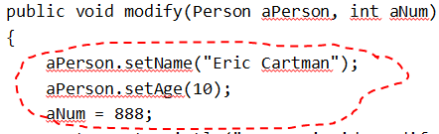
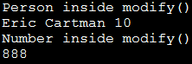

The Driver Class (2)
pe.modify(aPerson,num);
System.out.println("----------");
System.out.println("Person in main() after edit");
System.out.println(aPerson.getName() + " " +
aPerson.getAge());
System.out.println("Number inside main() after edit");
System.out.println(num);
}
}

Slide 31
Previous Example: Analysis
Why did the parameter that was passed by reference change and the simple type (passed by value) did not?

Slide 32
Pass By Reference In Java: Important Rules
To change the original object (do this all/most of the time): Use mutator methods when a reference is passed as a parameter.
public void modify(Person aPerson)
{
aPerson.setName("Eric Cartman");
aPerson.setAge(10);
aNum = 888;
}
Do not: Use an assignment statement when the reference is passed as a parameter.
public void modify(Person aPerson)
{
aPerson = new Person("Kenny"); //Creates a new object.
}

Slide 33
Benefits Of Employing References
References require a bit more complexity but provide several benefits over directly working with objects and arrays.
Benefit 1: Reference parameters allows changes to made inside of methods.
  As you have just seen a reference contains the address of ‘something’ (object, array).
  As long as the address of the object or array is retained changes made inside the method will persist after the method ends.
  Recall that functions or methods can only return zero or one things (passing out of a function after it ends).
  Passing by reference (passing into the function just as it starts executing) allows more than one change to persist after the function has ended:
  fun(reference1,reference2,reference3…etc.)

Slide 34
Benefits Of Employing References (2)
Benefit 2: If an array or object is large then it’s more memory efficient to pass a reference instead.
Example:
  References are typically 32 or 64 bits in size.
  An array or object will almost always be larger.
    char [] array1 = new char[1000000]; // 4 MB
    class SocialNetworkUser
    {
    // attribute for images
    // attribute for videos
    }

Slide 35
New Terminology/Definitions
Shallow and deep copy
Automatic garbage collection
Memory leak
Parameter passing: Pass by value, pass by reference

Slide 36
After This Section You Should Now Know
References
  How references and objects are related
  The difference between a deep vs. shallow copy
  What is the difference between comparing references vs. objects
  What is automatic garbage collection and how it’s related to the use of references
How the two methods of parameter passing work, what types are passed using each mechanism
What are the benefits of employing references

Slide 37
Copyright Notification
“Unless otherwise indicated, all images in this presentation are used with permission from Microsoft.”

