Slide 1
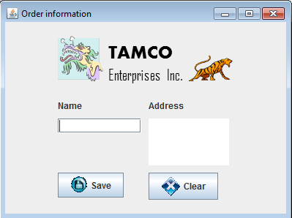
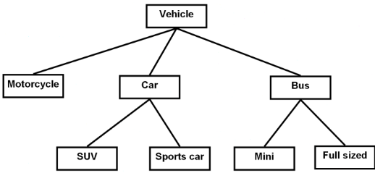
Introduction To CPSC 233
James Tam
Java
Object-Orientation
Graphical-user interfaces
Images courtesy of James Tam
These notes can be found on the course website: https://pages.cpsc.ucalgary.ca/~tamj/2021/233W/index.html
(There is a link to the website in D2L under ‘content’).

Slide 2

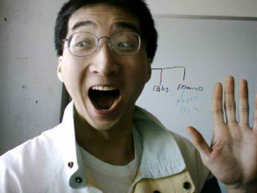
Then And Now…
CPSC 231: What was it like then
CPSC 233: What will it be like now
A Lot of work! (Image copyright unknown)
…but don’t forget how much smarter you’ve became!
Image of James Tam: courtesy of James Tam
Even more work!!!

Slide 3
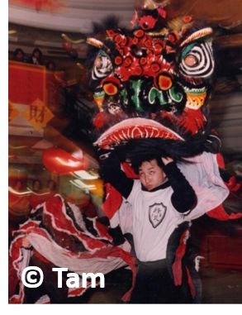
Contact Information (James Tam)
Contact Information (James Tam)
  Regular office: ICT 707 (Memory aid: “Just like the airplane”)
    My virtual office during the pandemic:
      https://ucalgary.zoom.us/j/91266944736
      Passcode: hope
      There is a virtual waiting room in Zoom:
        It helps ensure privacy (I may need to screen share actual code) and keep order When it gets busy you may have to sit there for a period of time while I am helping others.
    Email: tam@ucalgary.ca
  Make sure you specify the course name and number in the subject line of the email ‘CPSC 233’
Office hours (James Tam)
  Monday: & Tuesday 1:00 – 1:50 PM
  Reminder other sources of help for this course is available via the “Continuous Tutorial” – more on this later.
  Appointments possible at other days/times (subject to availability).
  Dropping by outside of office hours without prior notice is “hit and miss”
© Tam

Slide 4
Teaching Tutorials
As the name implies teaching will occur during this time.
  It may overlap with lecture but unique material will also be taught in tutorial.
Similar to lecture you can view the content in the form of pre-created videos.
  This can be found in D2l: Content-> Teaching tutorial links
  Contact information for the tutorial instructors:
    https://pages.cpsc.ucalgary.ca/~tamj/2021/233W/#Tutorial_information

Slide 5
Help Tutorials
Passcode for all Zoom meetings = hope
Also known as Continuous tutorials (or CT for short)/
A sort of “Help desk” specific to this course staffed by Teaching Assistants.
Location and access to the CT (first floor Math Sciences) https://pages.cpsc.ucalgary.ca/~tamj/2021/233W/CT_map.png
For the distance learning lectures look in D2L under: Content-> Help tutorial (CT) links and then under the specific week.
  In order to make the most efficient use of finite resources (Teaching Assistant work hours):
    more hours will be scheduled when there is higher anticipated demand,
    some weeks may have little or no CT times scheduled,
    whenever possible try to ask your questions in CT rather than via email (it’s more time efficient for the TA and you should get a faster response).
Similar to my office time there is a virtual waiting room for the CT.

Slide 6
Course Resources
Required resources:
  Course website (link can be found in D2L): http://pages.cpsc.ucalgary.ca/~tamj/2021/233W/index.html
  Get the notes off the course webpage before lecture)
Recommended but not required:
  "Absolute Java" Walter Savitch, (Pearson)
  Alternately you can pick out one of the ‘free’ online texts from the university library:
  http://proquest.safaribooksonline.com.ezproxy.lib.ucalgary.ca/

Slide 7
How To Use The Course Resources
They are provided to support and supplement this class.
  The notes outline the topics to be covered
  At a minimum look through the notes to see the important topics.
  However the notes are just an outline and just looking at them without coming to class isn’t sufficient to do well
  You will get the details (e.g., explanations) during lecture time
    Take notes!
    Remote learning version: Taking notes applies when you are viewing the recorded lectures.

Slide 8

Your Engagement Level ---> Your Learning
+
Learning
colourbox.com
Computer programs
Computer program

Slide 9
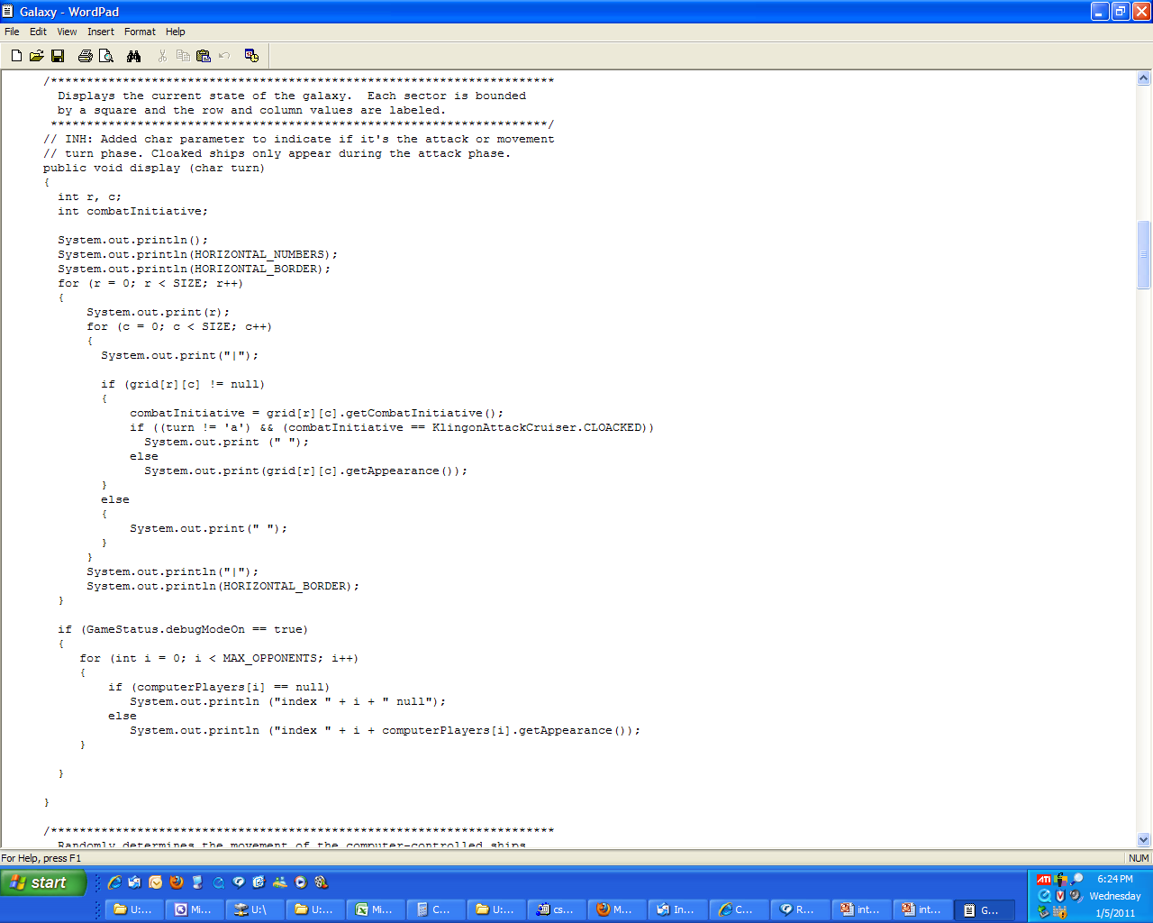
How To Use The Course Resources (2)
Notes:
9

Slide 10
How To Use The Course Resources (2)
If you miss a class make sure that you catch up on what you missed (get someone’s class notes)
...when you do make it to class make sure that you supplement the slides with your own notes (because you aren’t going to remember it in the exams if you don’t)
Notes:
10

Slide 11
How To Use The Course Resources (3)
What you are responsible for:
  Keeping up with the content in class which includes the topics covered but also announcements or assignment information whether you were present in the class or not.
  If you are absent, then you are responsible for getting the information from the other students in class.
  (I won’t be able to repeat the lecture content if you are absent…there’s just too many of you to make it practical and recall to get the most out of the class you need to be actively engaged)
However, after you’ve caught up by talking with a classmate:
  Ask for help if you need it
  There are no dumb questions
  …except for waiting until the exam

Slide 12
Tam’s “House Rules”
I will endeavor to keep the lecture within the prescribed time boundaries
You won’t pack up and end before time is up

Slide 13





Tam’s “House Rules”
No recordings/captures without permission during class please
(Recall that learning tends to increase with additional levels of engagement).
Colourbox.com

Slide 14
233 Students: Assumed Knowledge
You completed CPSC 231 (or the equivalent) with a grade of C- or higher.
You do not need to know Python programming for this class.
  However sometimes I will refer briefly to Python programs just to contrast what (most/all) students already know with what they need to learn.
You are proficient at using common procedural programming tools e.g., branching, loops, decomposition into functions etc.
(Non-distance learning version): If you are new to the CPSC network then you should (quickly) familiarize yourself.
  One starting point (Topic #0):
  https://pages.cpsc.ucalgary.ca/~tamj/2021/233W/starting/index.html

Slide 15
How To Succeed In This Course: A Summary
Practice things yourself
Make sure that you keep up with the material
Look at the material before coming to lecture
Start working on things early
If you only remember one tip then make it the first one: You get better by doing!

Slide 16
Evaluation This Term: Assignments
There will be two types of assignments
  Full (regular) assignments (Proportion of term grade 90%)
  Mini assignments (Proportion of term grade 10%)
There are 5 mini-assignments (Proportion of term grade = 2% each x 5 = 10%)
  The goal is to create a small and relatively simple program in order to learn basic programming concepts such as Java syntax
  Marking is focused on program functionality (does the program “do what it is supposed to do”).

Slide 17
Full Assignments
There are 5 full assignments
  Marking is based on a number of factors (such as program functionality, documentation, style)
Main focus of each assignment and it’s weighting:
  Assignment 1: Introduction to Object-Orientation (Proportion of term grade 15%)
  Assignment 2: 1D array of simple types (Proportion of term grade 15%)
  Assignment 3: 2D array of objects (Proportion of term grade 22%)
  Assignment 4: Inheritance and hierarchies (Proportion of term grade 23%)
  Assignment 5: Writing a program with a graphical user interface (Proportion of term grade 15%)

Slide 18
No Group Is Allowed For Assignments
Assignments and exercises must be individually completed and individually submitted using the D2L Dropbox.
  There is no group work allowed for this class.
  Students should not see the program code for graded components produced by other students.
  Violating these rules may result in an academic misconduct investigation being conducted by the office of the dean.
  More specific details will be provided later in the semester.

Slide 19
Grading
Both types of assignments will be marked by the tutorial instructor.
  Grades will be posted in D2L
  The TA is the person to contact if you have concerns or questions.
  If you still have questions or issues after contacting your TA then feel free to contact your course instructor.

Slide 20
Assignments: Late Submissions
Extensions require: 1) a reasonable cause (e.g. illness, death in the family) 2) documentation (e.g. a sworn declaration signed by a commissioner of oaths)
  https://live-ucalgary.ucalgary.ca/sites/default/files/teams/1/university-of-calgary-statutory-declaration-coursework-and-examinations.pdf
Cases where extensions will NOT be granted include situations that are typical of student life: having multiple due dates, work commitments etc.
Technical failures or forgetting to hand in or submitting an invalid file for part or all of your assignment is not a valid reason for an extension.

Slide 21
Assignments: Late Submissions (2)
Late assignment submissions without an extension will have the following penalties applied.
Submission received: | On time | Hours late : >0 and <=24 | Hours late: >24 and <=48 | Hours late: >48 and <= 72 | Hours late: >72
Penalty: | None | -1.0 GPA | -2.0 GPA | -3.0 GPA | No credit

Slide 22
Assignments: Minimizing Your Risk
Bad things sometimes happen!
  Sometimes it’s a technical failure (e.g., hardware failure, ransomware)
  Sometimes it’s human error (e.g., oops, accidentally deleted)
Rules of thumb for assignment submissions:
  Do it early! (Get familiar with the system)
  Do it often! (If somehow real disaster strikes and you lose everything at least you will have a partially completed version that your TA can mark).
  Check your work and don’t assume it was submitted okay.
    Don’t just check file names in D2L!
    Download and look through the file or files that you submitted (not only to check that the file wasn’t corrupted but also that you submitted the correct version).
These assignments constitute a significant portion of your grade and require an investment of time.
  Take a few seconds to mitigate your risk (e.g. submit early) otherwise you could lose out on hours/days of work (not to mention the assignment grade).

Slide 23
Backing Up And Submitting Your Work
Bottom line: it is up to you to make sure things are done correctly and on time.
We are happy to help if you have questions beforehand then do ask (make sure you ask your questions early enough so you can receive an answer before the due time).
But don’t wait until after the due date (it’s too late).

Slide 24
Examinations
No exams for the remote learning version of this course
There will be two exams: a midterm and final.
Midterm exam (worth 25%)
  It will occur during regular lecture on Friday Oct 23 (in class)
  (More information can be found on the course web site)
    Section title:
      “Course topics, lecture notes and assignment descriptions, exam information”
    Hyperlink (see this for information about preparing for the exam)
      http://pages.cpsc.ucalgary.ca/~tamj/2015/233F/#Midterm exam

Slide 25
Examinations (2)
No exams for the remote learning version of this course
Final exam (worth 40%)
  Date/time/location determined by the Office the Registrar.
  (That means I find out these details at the same time that you do).
  You can find information about your final exams online via the university PeopleSoft portal.
All will completed on paper (not in front of a computer).
Note: you need to pass the weighted average of the exam component in order to receive a grade of C- or higher in this class.

Slide 26
Estimating Your Term Grade (2)
To determine your weighted term grade point simply multiply each grade point by the weight of each component.
Sum the weighted grade points to determine the term grade.
Simple and short example (not exactly the same as this term but it should be enough to give you an idea of how to do the specific calculations required this semester):
  Assignment 1: weight = 15%, example score = A
  Assignment 2: weight = 15%, example score = A
  Midterm: weight = 30%, example score = B+
  Final: weight = 40%, example score = C-
  Weighted assignments: (0.15 * 4.0) + (0.15 * 4.0) = 0.6 + 0.6 = 1.2
  Weighted midterm: 0.3 * 3.3 = 0.99
  Weighted final: 0.4 * 1.7 = 0.68
  Total term grade point = 1.2 + 0.99 + 0.68 = 2.87
  (In this case the term letter is B using official university cutoffs)

Slide 27
Estimating Your Overall Term Grade Point
  Percentages won’t be used to determine the term grade/letter grade
  So don’t ask me: “What percent do I need to pass this class?”
  The official passing letter/grade point for this university is a ‘D’ or 1.0.
Use the spreadsheet on the course web page to estimate your term letter grade:
  https://pages.cpsc.ucalgary.ca/~tamj/2021/233W/grade_calculator.xlsx
1 Note: to keep things simple the formula in the spreadsheet does not check if the exam component was passed or not (you can do the check manually or add it in yourself)

Slide 28
Why Grade Points?
It’s the official university grading system
  Alternatives are possible but require faculty level approval
Approval of anything other than a grade point system requires predetermined cutoffs at the start of the term e.g., >= 90% equals ‘A’ etc.
  Doesn’t allow for consideration that individual components may be more challenging than others (lower cutoffs)
Grade points are more lenient for grades on the lower-middle end of the scale
  Grade points: Getting an “A”/4.0 on the assignment component worth 30% of the term grade yields a minimum term grade of 1.2 (4.0 * 0.3) which equates to a term grade of ‘D’ (possibly higher)
  Percentages: Getting an “A” may roughly work out to 90% or higher (depending on the scale) which works out to a minimum term percent of 27% = 90% score * 30% weight…almost certainly an “F” for the term grade.

Slide 29
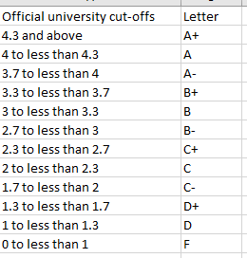
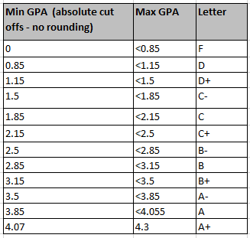
Contrast The Cut-Offs
Official UC cutoffs
The Tam cutoffs
Term GPA
4
4
3.7
3.3
3.0
2.7
2.3
2.0
1.7
1.3
1.0
0
    The cutoffs in the spreadsheet are significantly more lenient (almost everyone “gets a big break” e.g. instead of 3.7 for an A- it’s 3.5 (midpoint between A-/3.7 and B+/3.3 is the higher letter grade)
    Do not expect a further “rounding up” at the end of the term e.g.
    Q: 3.4999999999999999999999999999999999999999999999999 is soooooooooooooooooooooooooooooooooooooooooooooooo close to 3.5 can’t you get an “A-”
    A: ‘No’ or using an Internet lingo emphasis
      NOOOOOOOOOOOOOOOOOOOOOOOOOOOOOOOOOOOOOOOOOOOOOOOOOOOOOOOOOOOOOOOOOOOOOOOOOOOOOOOOOOOOOOOOOOOOOOOOO!!!!!!!!!!!!!!!!!!!!!!!!!!!!!!!!!!!!!!!!!!!!!!!!!!!!!!!!!!!!!!!!!!!!!!!!!!!!!!!!!!!!!!!!!!!!!!!!!!!!!!!!!!!!!!!!!!!!!!!!!!!!!

Slide 30
Examination Content
No exams for the remote learning version of this course
Multiple choice questions:
  Partial program traces e.g., what’s the program output
  Basic program structure e.g., find the errors, which function or operator is needed for a particular mathematical operation
  More examples and details coming during the semester
Written questions:
  Write a small/partial computer program.
  Trace the execution of a computer program e.g., what is the ‘output’.
  Conceptual (lower weight for this type of question) e.g., definition of a technical term.
  Likely there will be a smaller proportion of written questions on the midterm vs. the final.
I will be grading the exams.
  (I’ll do the best I can to get them done in a timely fashion but remember this is often a high enrollment class).

Slide 31
Examination Content (2)
No exams for the remote learning version of this course
More sample ‘exam type’ questions will be provided during the semester.
  Sometimes ‘on the fly’ in lecture so pay attention to these and take notes.

Slide 32
Copyright Notification
“Unless otherwise indicated, all images in this presentation are used with permission from Microsoft.”
Sound effects (due to budgetary constraints) were produced by James Tam

