Slide 1
An Introduction To Graphical User Interfaces
Part 4: You will be taught some usability heuristics in the design of more user friendly interfaces.

Slide 2
User-Friendly Software (If There Is Time)
In today’s world it’s not just sufficient to create software that has implemented a given set of operations.
If the person using the system cannot understand it or has troubles using common functions then the software or technology is useless.
Reference course: If you’re interested in more information:
  http://pages.cpsc.ucalgary.ca/~tamj/2008/481W/index.html

Slide 3
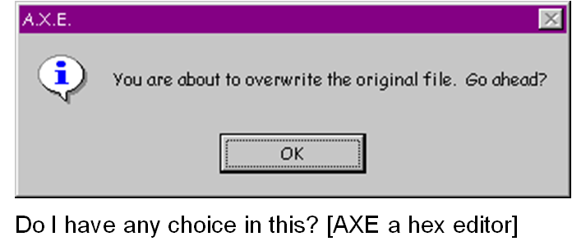
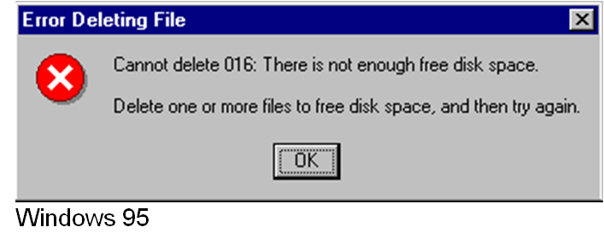
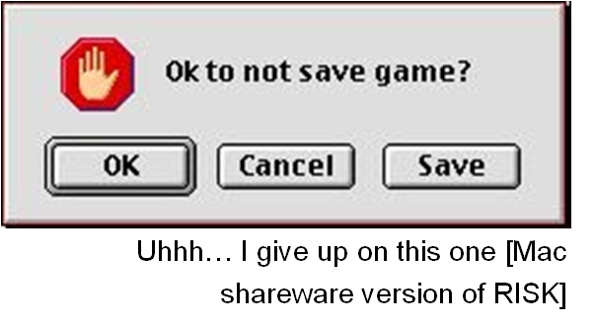
Not So Friendly Examples (If There Is Time)
Not So Friendly Examples (If There Is Time)

Slide 4
Some Rules (Of Thumb) For Designing Software (If There Is Time)
(The following list comes from Jakob Nielsen’s 10 usability heuristics from the book “Usability Engineering”
  Minimize the user’s memory load
  Be consistent
  Provide feedback
  Provide clearly marked exits
  Deal with errors in a helpful and
  positive manner

Slide 5
Minimize The User’s Memory Load (If There Is Time)
Computers are good at ‘remembering’ large amounts of information.
People are not so good remembering things.

Slide 6
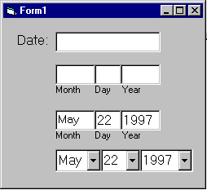
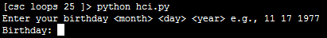
Minimize The User’s Memory Load (If There Is Time)
To reduce the memory load of the user:
  Describe required the input format, show examples of valid input, provide default inputs
Examples:
Example 1:
Example 2:

Slide 7
Be Consistent (If There Is Time)
Consistency of effects
  Same words, commands, actions will always have the same effect in equivalent situations
  Makes the system more predictable
  Reduces memory load
Consistency of layout
  Allows experienced users to predict where things should be (matches expectations)
Notes:
Same command (action) can be used the same way in different situations or on different objects
E.g., In the Interplay Productions game Starfleet command I
Pressing <esc> at the beginning will skip the intro videos
Later pressing <esc> boots you right out of the game (and you have to watch the intro videos again!)

Slide 8
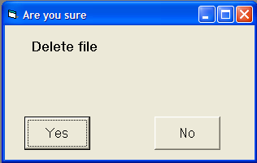
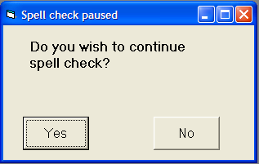
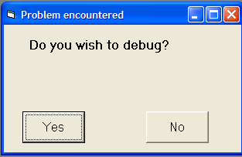
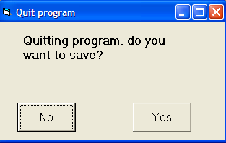
Be Consistent (If There Is Time)
Consistency of language and graphics
  Same information/controls in same location on all screens / dialog boxes forms follow boiler plate.
  Same visual appearance across the system (e.g. widgets).
Images courteously of James Tam
Notes:
Consistency
Includes the consistency of placement
Also includes being consistent in how the program behaves (e.g., one generic command should apply regardless of what object you are executing that command on). E.g. rm vs. rmdir

Slide 9
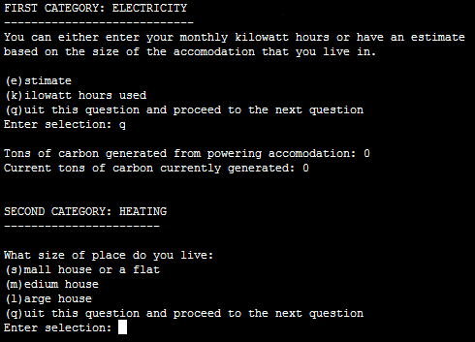
Be Consistent (If There Is Time)
This last option allows the user to proceed to the next question.

Slide 10
Provide Feedback (If There Is Time)
Letting the user know:
  What the program is currently doing: was the last command understood, has it finished with it’s current task, what task is it currently working on, how long will the current task take etc.

Slide 11
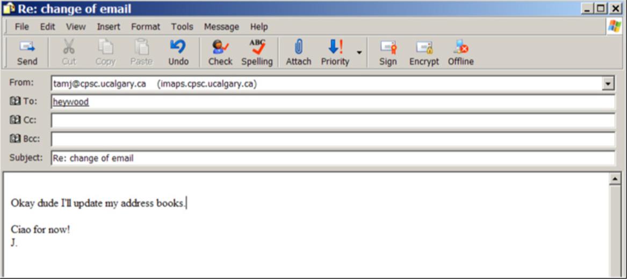
Provide Feedback (If There Is Time)
What is the program doing?
Outlook Express image courteously of James Tam
Notes:
Story:
I was unknowing in the middle of a large Internet transfer
I hit send but apparently nothing happened (but depressed and bounced back up but nothing else happened)
I pressed send a few times wondering what was going on

Slide 12
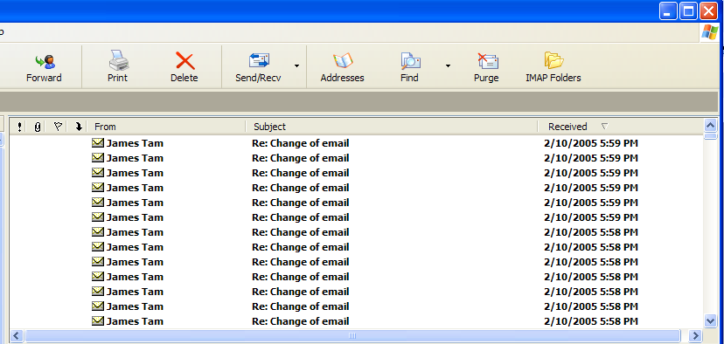
Provide Feedback (If There Is Time)
The rather unfortunate effect on the (poor) recipient.
Outlook Express image courteously of James Tam
Notes:
* Result: screenshot of the many emails I sent my annoyed cousin

Slide 13
Provide Feedback (If There Is Time)
In terms of this course, feedback is appropriate for instructions that may not successfully execute
  what the program is doing (e.g., opening a file),
  what errors may have occurred (e.g., could not open file),
  and why (e.g., file “input.txt” could not be found)
...it’s not hard to do and not only provides useful updates with the state of the program (“Is the program almost finished yet?”) but also some clues as to how to avoid the error (e.g., make sure that the input file is in the specified directory).
At this point your program should at least be able to provide some rudimentary feedback
  E.g., if a negative value is entered for age then the program can remind the user what is a valid value (the valid value should likely be shown to the user as he or she enters the value):
  age = int(input ("Enter age (0 – 114): "))

Slide 14
Provide Clearly Marked Exits (If There Is Time)
This should obviously mean that quitting the program should be self-evident (although this is not always the case with all programs!).
In a more subtle fashion it refers to providing the user the ability to reverse or take back past actions (e.g., the person was just experimenting with the program so it shouldn’t be ‘locked’ into mode that is difficult to exit).
Users should also be able to terminate lengthy operations as needed.

Slide 15
Provide Clearly Marked Exits (If There Is Time)
This doesn’t just mean providing an exit from the program but the ability to ‘exit’ (take back) the current action.
  Universal Undo/Redo
    e.g., <Ctrl>-<Z> and <Ctrl>-<Y>
  Progress indicator & Interrupt
  Length operations
Image: From the “HCI Hall of Shame”
Notes:
Universal Undo
MS-Office <CTRL>-<Z> undo, <CTRL>-<Y> redo
Interrupt
If you are in the middle of something that you don't have time for now
The system should let you stop that operation

Slide 16
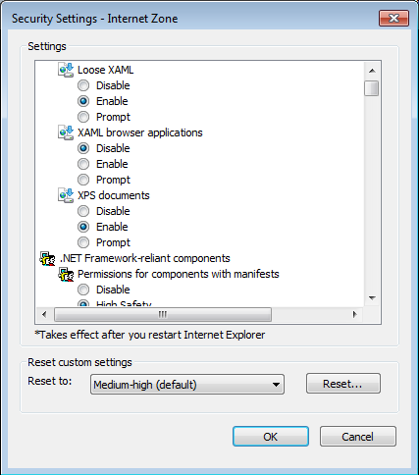
Provide Clearly Marked Exits (If There Is Time)
Restoring defaults
  Getting back original settings
What option did I change?
What was the original setting?
Allows for defaults to be quickly restored
Image: Internet Explorer security settings curtesy ofJames Tam
Notes:
Restoring defaults
If you change the settings of a program and you don't know to change it back
Or if changing it back will take too much work
E.g. MS-Word: File->Page set-up and getting back the default settings for margins

Slide 17
Provide Clearly Marked Exits (If There Is Time)
The user can skip or ‘exit’ any question
Image: An old CPSC 231 assignment curtesy of James Tam

Slide 18
Deal With Errors In A Helpful And
Positive Manner (If There Is Time)
(JT: with this the heuristic it states exactly what should be done).

Slide 19
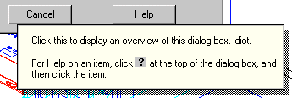
Rules Of Thumb For Error Messages (If There Is Time)
Polite and non-intimidating
  Don’t make people feel stupid
    Try again, bonehead!
Understandable
  Error 25
Specific
  Cannot open this document
  Cannot open “chapter 5” because the application “Microsoft Word”
  is not on your system
Helpful
  Cannot open “chapter 5” because the application “Microsoft Word”
  is not on your system. Open it with “WordPad” instead?
So obvious it could never happen?
No
Not
AutoCAD Mechanical
Why?
Better
Even better: A potentially helpful suggestion

Slide 20
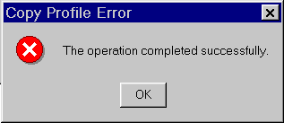
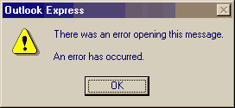
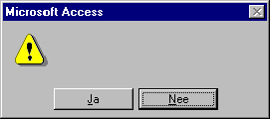
Examples Of Bad Error Messages (If There Is Time)
Images: From the “HCI Hall of Shame”

Slide 21
(If There Is Time)
“HIT ANY KEY TO CONTINUE”
“HIT ANY KEY TO CONTINUE”

Slide 22
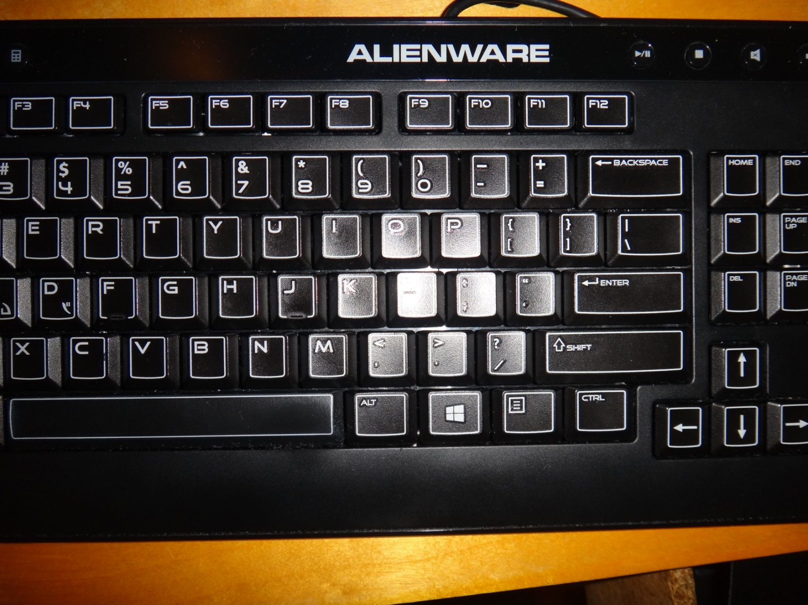
(If There Is Time)
THE “Any Key”
Image: Curtesy of James Tam

Slide 23
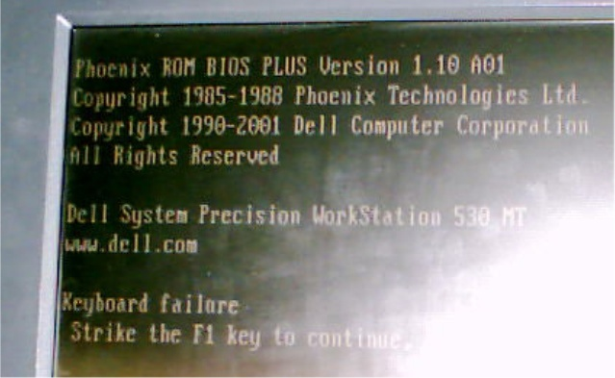
I’d Rather Deal With The ‘Any’ Key (If There Is Time)
Picture courtesy of James Tam: An error message from a Dell desktop computer
Notes:
Another true story
Using my computer one day and suddenly the machine reboot
During the BIO startup it said that there was a hardware failure: the keyboard
Then it told me to hit a key on the keyboard to continue
Nonsense instruction: hit a key when there is keyboard failure

Slide 24
After This Section You Should Now Know
When and why are loops used in computer programs
What is the difference between pre-test loops and post-test loops
How to trace the execution of pre-test loops
How to properly write the code for a loop in a program
What are nested loops and how do you trace their execution
How to test loops
Some rules of thumb for interaction design (if there is time)
  Minimize the user’s memory load
  Be consistent
  Provide feedback
  Provide clearly marked exits
  Deal with errors in a helpful and
  positive manner

Slide 25
You Should Now Know
The difference between traditional and event driven software
How event-driven software works (registering and notifying event listeners)
How some basic Swing controls work
  Capturing common events for the controls such as a button press
How to layout components using layout managers and laying them out manually using a coordinate system

Slide 26
You Should Now Know (2)
Some rules of thumb for interaction design (if there is time)
  Minimize the user’s memory load
  Be consistent
  Provide feedback
  Provide clearly marked exits
  Deal with errors in a helpful and
  positive manner

Slide 27
Copyright Notice
Unless otherwise specfied, all images were produced by the author (James Tam).

