Slide 1
An Introduction To Graphical User Interfaces
Part 3: You will learn different ways of having one control access other controls as well as learning the basics of some additional java components. In addition, important non-GUI concepts such anonymous classes/objects, inner classes, friend functions are introduced.

Slide 2
Components Effecting The State Of Other Components
Name of the folder containing the full example: 6controlAffectControls
  Access to other controls will occur via the existing Java clases and methods: getContentPane(), getComponent().

Slide 3
Components Effecting The State Of Other Components: The Driver Class
public class Driver
{
public static final int WIDTH = 800;
public static final int HEIGHT = 600;
public static void main(String [] args)
{
MyFrame aFrame = new MyFrame();
aFrame.setSize(WIDTH,HEIGHT);
aFrame.setVisible(true);
}
}

Slide 4
Components Effecting The State Of Other Components: Class MyFrame
public class MyFrame extends JFrame
{
private JLabel aLabel1;
private JLabel aLabel2;
private JButton aButton;
private MyButtonListener aButtonListener;

Slide 5
Components Effecting The State Of Other Components: Class MyFrame (2)
public MyFrame()
{
MyWindowListener aWindowListener =
new MyWindowListener();
addWindowListener(aWindowListener);
aLabel1 = new JLabel("Label 1");
aLabel2 = new JLabel("Label 2");
// Component.setBounds(x,y,w,h)
aLabel1.setBounds(100,100,100,30);
aLabel2.setBounds(300,100,100,30);

Slide 6
Components Effecting The State Of Other Components: Class MyFrame (3)
aLabel1 = new JLabel("Label 1");
aLabel2 = new JLabel("Label 2");
aLabel1.setBounds(100,100,100,30);
aLabel2.setBounds(300,100,100,30);
aButtonListener = new MyButtonListener();
aButton = new JButton("Press for multiple effects");
aButton.addActionListener(aButtonListener);
aButton.setBounds(150,300,200,50);
add(aLabel1);
add(aLabel2);
add(aButton);
setLayout(null);
}
public JLabel getLabel1() { return aLabel1; }
public JLabel getLabel2() { return aLabel2; }
}

Slide 7
Note: JFrame Containment
A JFrame actually contains just one GUI component, the content pane.
GUI widgets that appear to be added to the JFrame are actually added to the content pane (a container in and of itself). Get the components inside the content pane to actually get the widgets that appeared to be added to the JFrame.
myFrame.add(aButton)
JFrame
To access controls “added to the frame”
ContentPane
aContainer = aFrame.getContentPane()
Components
First
Second
Etc
component = aContainer.getComponent(0)

Slide 8
Components Effecting The State Of Other Components: Class MyButtonListener
public void actionPerformed(ActionEvent e)
{
JButton aButton = (JButton) e.getSource();
MyFrame aFrame = (MyFrame)
aButton.getRootPane().getParent();
JLabel aLabel1 = aFrame.getLabel1();
JLabel aLabel2 = aFrame.getLabel2();
Container aContainer = aFrame.getContentPane();
// First item added to list, first label
Component aComponent = aContainer.getComponent(0);
if (aComponent instanceof JLabel) {
aLabel1 = (JLabel) aComponent;
aLabel1.setText("Effect1");
}

Slide 9
Components Effecting The State Of Other Components: Class MyButtonListener (2)
// Second item added to list, second label
aComponent = aContainer.getComponent(1);
if (aComponent instanceof JLabel) {
aLabel2 = (JLabel) aComponent;
aLabel2.setText("Effect1");
}
}

Slide 10
Last Example: Critique
The implementation of the button listener class required knowledge of the implementation of the frame listener class.
  The order in which controls are added to the frame must be known!
  What if there are two different authors for these classes?
  This approach couples the implementation of two classes (changes can introduce errors)
// From class MyFrame
add(aLabel1); // Added first
add(aLabel2); // Added second
add(aButton);
// From class MyButtonListener
Component aComponent = aContainer.getComponent(0);
if (aComponent instanceof JLabel) {
aLabel1 = (JLabel) aComponent;
aLabel1.setText("Effect1");
}

Slide 11
Components Effecting The State Of Other Components: Alternate Approach
Name of the full online example: 7controlAffectControlsActionCommand
  Identifying controls via the: actionCommandAttribute

Slide 12
The Driver Class
public class Driver
{
public static final int WIDTH = 800;
public static final int HEIGHT = 600;
public static void main(String [] args)
{
MyFrame aFrame = new MyFrame ();
aFrame.setSize(WIDTH,HEIGHT);
aFrame.setVisible(true);
}
}

Slide 13
Class MyFrame
public class MyFrame extends JFrame {
public static final String B1IDENTIFIER = "1";
public static final String B2IDENTIFIER = "2";
private JButton button1;
private JButton button2;
private MyButtonListener aButtonListener;
public MyFrame() {
MyWindowListener aWindowListener = new
MyWindowListener();
addWindowListener(aWindowListener);
aButtonListener = new MyButtonListener();

Slide 14
Class MyFrame (2)
button1 = new JButton("Button1");
button1.setActionCommand(B1IDENTIFIER);
button1.setBounds(100,100,100,30);
button1.addActionListener(aButtonListener);
button2 = new JButton("Button2");
button2.setActionCommand(B2IDENTIFIER);
button2.setBounds(300,100,100,30);
button2.addActionListener(aButtonListener);
add(button1);
add(button2);
setLayout(null);
}
}

Slide 15
Class MyButtonListener
Identifying the buttons
public class MyButtonListener implements ActionListener
{
public void actionPerformed(ActionEvent e)
{
JButton aButton = (JButton) e.getSource();
MyFrame aFrame = (MyFrame)
aButton.getRootPane().getParent();
String temp = aButton.getActionCommand();
if(temp.equalsIgnoreCase(MyFrame.B1IDENTIFIER))
aFrame.setTitle("Button 1 pressed");
else if(temp.equalsIgnoreCase(MyFrame.B2IDENTIFIER))
aFrame.setTitle("Button 2 pressed");
}
}

Slide 16
This Version: Critique
There was one method handles events for all the buttons.
Inside that method there was a need to ‘identify’ the source of the event.
  The method could get very long even though there are few sources of events (buttons)
  What if the GUI has dozens of buttons or other controls
public void actionPerformed(ActionEvent e)
{
String s = e.getActionCommand();
}
if(temp.equalsIgnoreCase(MyFrame.B1IDENTIFIER))
aFrame.setTitle("Button 1 pressed");
else if(temp.equalsIgnoreCase(MyFrame.B2IDENTIFIER))
aFrame.setTitle("Button 2 pressed");

Slide 17
Anonymous Objects/Anonymous Class
If an object needs to be created but never directly referenced then it may be candidate for being created as an anonymous object.
An example of where an anonymous object may be created is an event listener.
Creating an anonymous object:
  JButton aButton = new JButton("Press me.");
  aButton.addActionListener(new ActionListener() {
  public void actionPerformed(ActionEvent e)
  {
  JButton aButton = (JButton)
  e.getSource();
  aButton.setText("Stop pressing me!");
  }
  });
One advantage: code for widget and event handler are in the same place.
No reference name
Awkward if complex programming is required.
Notes:
Do this so you can restrict access to the class and so you can see the code for the outer class and the inner class all in one place.

Slide 18
An Example Using Anonymous Class And Object
Name of the folder containing the complete example:
8controlAffectControlsAnonymousObjectClass
  Anonymous objects/classes are used for the listeners (nested inside the container).
  GUI component are then accessed via the containers accessor methods.

Slide 19
An Example Using Anonymous Class And Object (2)
WindowAdaptor
ActionListener
JFrame
JButton
MyWindowListener
??? (Anonymous)
MyFrame
Driver

Slide 20
Driver Class
public class Driver
{
public static final int WIDTH = 400;
public static final int HEIGHT = 300;
public static void main(String [] args)
{
MyFrame aFrame = new MyFrame ();
aFrame.setTitle("Original");
aFrame.setSize(WIDTH,HEIGHT);
aFrame.setVisible(true);
}
}

Slide 21
Class MyFrame
public class MyFrame extends JFrame
{
private JLabel aLabel;
private GridBagLayout aLayout;
private GridBagConstraints aConstraint;
private JButton left;
private JButton right;

Slide 22
Class MyFrame (2)
public MyFrame() {
MyWindowListener aWindowListener =
new MyWindowListener();
addWindowListener(aWindowListener);
aConstraint = new GridBagConstraints();
left = new JButton("LEFT: Press right button.");
left.setBackground(Color.lightGray);

Slide 23
Class MyFrame (3)
left.addActionListener(new ActionListener()
{ // class definition
public void actionPerformed(ActionEvent e) {
// method definition: left button
JButton left = (JButton) e.getSource();
MyFrame aFrame = (MyFrame)
left.getRootPane().getParent();
String title = aFrame.getTitle();
aFrame.setTitle("Left pressed");
right = aFrame.getRight();
right.setBackground(Color.green);
left.setBackground(Color.lightGray);
timeDelay();
aFrame.setTitle(title);
} // End method definition
} // End class definition
); // End of parameter list for addActionListener()

Slide 24
Class MyFrame (4)
right = new JButton("RIGHT: Press left button");
right.setBackground(Color.lightGray);
right.addActionListener(new ActionListener()
{ // Class definition
public void actionPerformed(ActionEvent e) {
// Method definition
JButton right = (JButton) e.getSource();
MyFrame aFrame = (MyFrame)
right.getRootPane().getParent();
String title = aFrame.getTitle();
JButton left = aFrame.getLeft();
aFrame.setTitle("Right pressed");
left.setBackground(Color.green);
right.setBackground(Color.lightGray);
timeDelay();
aFrame.setTitle(title);
}
});

Slide 25
Class MyFrame (5)
private void timeDelay()
{
try {
Thread.sleep(3000);
}
catch (InterruptedException e) {
System.out.println("Problem with pausing of the
program");
}
}
public JButton getLeft() {
return(left);
}
public JButton getRight() {
return(right);
}
}

Slide 26
‘Friend Functions’
Some programming languages allow classes to be ‘friendly’.
A method can be declared in class X so it’s accessible by another class Y even though the method is outside of the scope of class Y.
The ‘friendly’ method of class X allows access to all of the privates & protected parts of X to instances of Y.
It’s used when instances of classes X & Y operate closely.
Java does not directly allow for friend functions but other languages such as C++ do.
Does this violate encapsulation?
Notes:
Class X {
public :
// function headers
friend void m1();
}
// Not part of any class
Void m1()
{
}

Slide 27
Nested/Inner Classes
Inner class
Outer class
1 For more information (last accessed 2021): http://download.oracle.com/javase/tutorial/java/javaOO/nested.html
Occurs when one class (body) is defined inside of another class:
  public class X {
  private class Y {
  }
  }
Why nest class definitions¹:
  It is a way of logically grouping classes that are only used in one place.
  Nested classes can lead to more readable and maintainable code.
  It increases encapsulation (inner class hidden from all classes except the outer class).
Similar to declaring anonymous objects, nesting classes may be used when creating event listeners.
Notes:
Logical grouping of classes—If a class is useful to only one other class, then it is logical to embed it in that class and keep the two together. Nesting such "helper classes" makes their package more streamlined.
More readable, maintainable code—Nesting small classes within top-level classes places the code closer to where it is used.
Increased encapsulation—Consider two top-level classes, A and B, where B needs access to members of A that would otherwise be declared private. By hiding class B within class A, A's members can be declared private and B can access them. In addition, B itself can be hidden from the outside world.

Slide 28
Example: Inner Classes
Name of the folder containing the full online example:
9buttonAlternateInnerClasses
  The example again employs an anonymous object/class (not a new concept).
  What’s new is the use of a class definition nested within another class definition.

Slide 29
Example: Inner Classes (2)
WindowAdaptor
ActionListener
JFrame
JButton
MyWindowListener
??? (Anonymous)
MyFrame
Driver

Slide 30
The Driver Class
import javax.swing.JButton;
import java.awt.event.ActionEvent;
import java.awt.event.ActionListener;
public class Driver
{
public static final int WIDTH = 300;
public static final int HEIGHT = 200;
public static void main(String [] args)
{
MyFrame aFrame = new MyFrame();
aFrame.setSize(WIDTH,HEIGHT);
JButton aButton = new JButton("Press me.");

Slide 31
The Driver Class (2)
aButton.addActionListener(
new ActionListener() // Anonymous object/class
{
public void actionPerformed(ActionEvent e)
{
JButton aButton = (JButton) e.getSource();
aButton.setText("Stop pressing me!");
} // End: Defining method actionPerformed
} // End: Defining anonymous object/class
); // End: Parameter list for addActionListener
aFrame.add(aButton);
aFrame.setVisible(true);
}
}

Slide 32
Class MyFrame: Outline
Definition of class MyWindowListener entirely within definition of class MyFrame
Listens for events for that window
NOTE: The inner class can access the outer class’ privates! “Friend”
public class MyFrame extends JFrame
{
// MyFrame’s private parts
public MyFrame()
{
: :
}
// Inner class defined within the MyFrame class.
// Private because it's only used by the MyFrame class.
private class MyWindowListener extends WindowAdapter
{
public void windowClosing(WindowEvent e)
{
: :
}
}
}

Slide 33
Class MyFrame (2)
import javax.swing.JFrame;
import java.awt.event.WindowAdapter;
import java.awt.event.WindowEvent;
public class MyFrame extends JFrame
{
public MyFrame ()
{
MyWindowListener aWindowListener = new
MyWindowListener();
this.addWindowListener(aWindowListener);
}

Slide 34
Class MyFrame (3)
Proof that the inner class can access the outer class’ privates
// Inner class defined within the MyFrame class.
// Private because it's only used by the MyFrame class.
private class MyWindowListener extends WindowAdapter {
public void windowClosing (WindowEvent e) {
JFrame aFrame = (JFrame) e.getWindow();
aFrame.setTitle("Closing window...");
delay();
aFrame.setVisible(false);
aFrame.dispose();
}
} // End: Definition of class MyWindowListener
private void delay() {
try {
Thread.sleep(3000); }
catch (InterruptedException ex) {
System.out.println("Pausing of program was interrupted"); }
}
} // End: Definition of class MyFrame
Notes:
It could also be defined as an anonymous inner class if the code is small but I don’t know the syntax if it extends another class
public class MyFrame extends JFrame
{
this.addWindowListener (new MyWindowListener () extends WindowAdapter
{
}
}

Slide 35
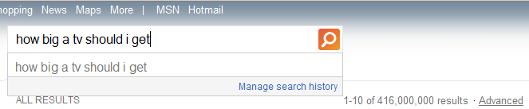
Types Of Input Text Fields: Short
JTextField: Used to get short user input
  e.g., entering login or personal information.
Name of the folder containing the full online example:
  10textFieldExample
Bing search query

Slide 36
Example: JTextField (2)
JTextField
JFrame
MyFrame
Driver

Slide 37
The Driver Class
public class Driver
{
public static void main(String [] args)
{
MyFrame aFrame = new MyFrame();
}
}

Slide 38
Class MyFrame
public class MyFrame extends JFrame implements ActionListener
{
private JTextField text; // New control
private GridBagLayout aLayout;
private GridBagConstraints aConstraint;

Slide 39
Class MyFrame: Using JTextField
public MyFrame()
{
setSize(300,200);
setDefaultCloseOperation
(JFrame.DISPOSE_ON_CLOSE);
aConstraint = new GridBagConstraints();
aLayout = new GridBagLayout();
setLayout(aLayout);
text = new JTextField("default");
text.addActionListener(this);
addWidget(text,0,0,1,1);
setVisible(true);
}

Slide 40
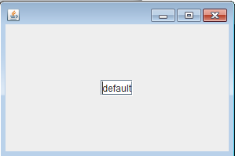
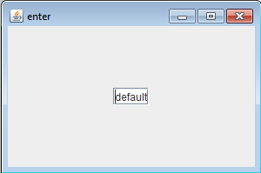
Class MyFrame: Reacting To The Event
public void actionPerformed(ActionEvent e)
{
setTitle("enter");
}
}

Slide 41
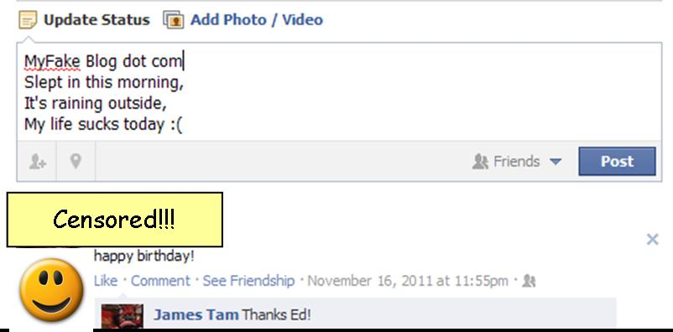
Types Of Input Text Fields: Long
Getting more extensive input
  e.g., feedback form, user review/comments on a website
  Requires the use of another control: JTextArea
Name of the folder containing the full online example:
  11textAreaExample
Facebook status update field

Slide 42
The Driver Class: Using JTextArea
public class Driver {
public static void main(String [] args) {
JFrame frame = new JFrame();
frame.setSize(400,250);
//New control
JTextArea text = new JTextArea();
JScrollPane scrollPane = new JScrollPane(text);
text.setFont(new Font("Times",Font.BOLD, 32));
for (int i = 0;i < 10; i++)
text.append("foo" + i + "\n");
frame.add(scrollPane);
MyDocumentListener listen = new MyDocumentListener();
(text.getDocument()).addDocumentListener(listen);
frame.setVisible(true);
frame.setLayout(null);
frame.setDefaultCloseOperation(JFrame.DISPOSE_ON_CLOSE);
}
}

Slide 43
The Text Listener: MyDocumentListener
public class MyDocumentListener implements DocumentListener {
public void changedUpdate(DocumentEvent e) {
System.out.println("updated");
displayChanges(e);
}
public void insertUpdate(DocumentEvent e) {
System.out.println("insert");
System.out.println(e.getLength());
displayChanges(e);
}
public void removeUpdate(DocumentEvent e) {
System.out.println("removed");
displayChanges(e);
}

Slide 44
The Text Listener: MyDocumentListener (2)
public void displayChanges(DocumentEvent e)
{
Document d = e.getDocument();
try
{
String s = d.getText(0,d.getLength());
System.out.println(s);
}
catch (BadLocationException ex)
{
System.out.println(ex);
}
}
}

Slide 45
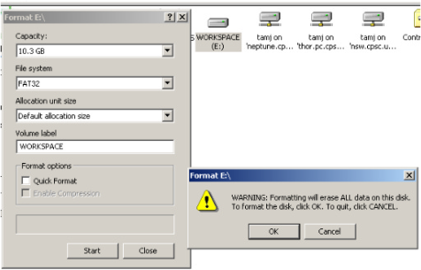
Dialog Boxes And “User-Friendly Design”
Note: used sparingly dialog boxes can communicate important information or to prevent unintentional and undesired actions.

Slide 46
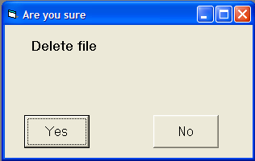
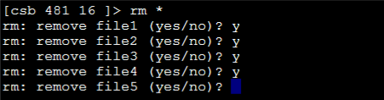
Dialog Boxes And “User-Friendly Design” (2)
They interupt the regular use of the program so make sure they are only used sparingly
  …they can easily be over/misused!)

Slide 47

Dialogs Are Frequently Used Online
Great! I’ve got the info that I need.

Slide 48
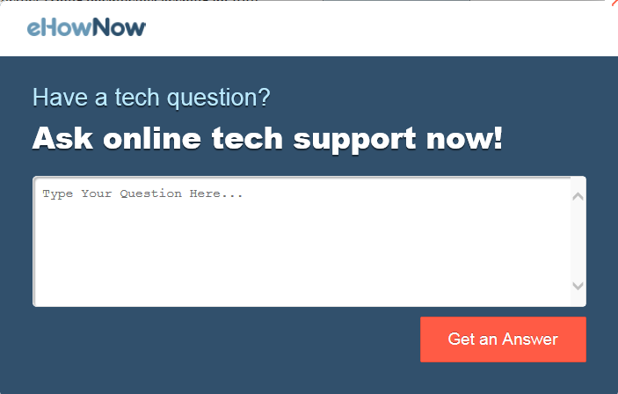
Dialogs Are Frequently Used Online
Hey I was reading that!

Slide 49
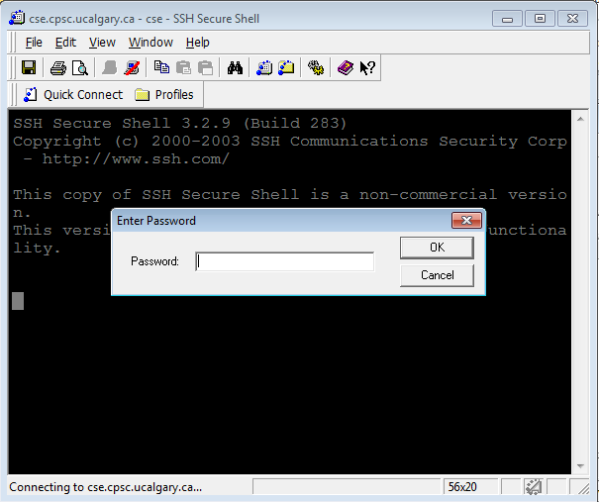
Dialog Boxes (If There Is Time)
Typically take the form of a small window that ‘pops up’ during program execution.
Part of the login ‘dialog’

Slide 50
JDialog Example
Name of the folder containing the full online example:
  12dialogExample

Slide 51
Example: JDialog (2)
JPasswordField
JDialog
JLabel
MyDialog
Driver

Slide 52
The Driver Class
public class Driver
{
public static void main(String [] args)
{
MyDialog aDialog = new MyDialog();
aDialog.setBounds(100,100,300,200);
aDialog.setVisible(true);
}
}

Slide 53
Class MyDialog
public class MyDialog extends JDialog implements ActionListener
{
private static final int MATCH = 0;
private static final String ACTUAL_PASSWORD = "123456";
private JPasswordField aPasswordField;
private JLabel aLabel;
public MyDialog() {
aLabel = new JLabel("Enter password");
aLabel.setBounds(50,20,120,20);
aPasswordField = new JPasswordField();
aPasswordField.setBounds(50,40,120,20);
aPasswordField.addActionListener(this); //Event handler
setLayout(null);
addControls(); // Slide #2
setDefaultCloseOperation(JDialog.DISPOSE_ON_CLOSE);
}

Slide 54
Class MyDialog (2)
public void addControls()
{
add(aLabel);
add(aPasswordField);
}

Slide 55
Class MyDialog (3)
public void actionPerformed(ActionEvent e) {
Component aComponent = (Component) e.getSource();
if (aComponent instanceof JPasswordField) {
JPasswordField aPasswordField =
(JPasswordField) aComponent;
String passWordEntered = new
String(aPasswordField.getPassword());
if (passWordEntered.compareTo(ACTUAL_PASSWORD)
== MATCH)
loginSuccess(); //Slide #4
else
loginFailed() //Slide #5
}
}

Slide 56
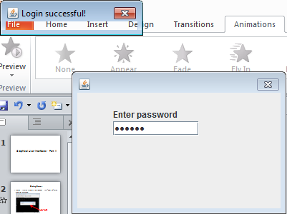
Class MyDialog (4)
public void loginSuccess() {
JDialog success = new JDialog();
success.setTitle("Login successful!");
success.setSize(200,50);
success.setVisible(true);
cleanUp(success);
}
public void cleanUp(JDialog popup) {
try
Thread.sleep(3000);
catch (InterruptedException ex)
System.out.println("Program interrupted");
this.setVisible(false);
this.dispose();
popup.setVisible(false);
popup.dispose();
System.exit(0); // Dialog cannot end whole program
}

Slide 57
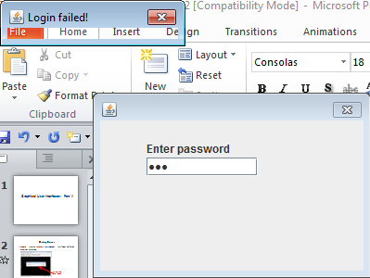
Class MyDialog (5)
public void loginFailed()
{
JDialog failed = new JDialog();
failed.setTitle("Login failed!");
failed.setSize(200,50);
failed.setVisible(true);
cleanUp(failed);
}
public void cleanUp(JDialog popup) {
try
Thread.sleep(3000);
catch (InterruptedException ex)
System.out.println("Program interrupted");
this.setVisible(false);
this.dispose();
popup.setVisible(false);
popup.dispose();
System.exit(0); // Dialog cannot end whole program
}

Slide 58


Controls Affecting Other Controls
As previously shown this is not an uncommon occurrence
The code to react to the event allows for easy access to the control that raised the event.

Slide 59
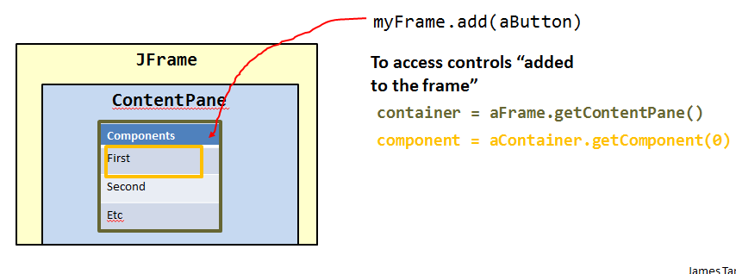
Ways Of Accessing Other Controls
Via Java Swing containment
  Example to illustrate with JButton control: 6controlAffectControls
  JT’s $0.02
    Stylistically acceptable (of course!)
    Can be challenging to track down specific container/method
Notes:
when you integrate the notes make sure that this is done at the right place

Slide 60
Ways Of Accessing Other Controls (2)
Implementing the listener class as a nested inner class.
  (Recall that if one class is defined inside the definition of another class that the inner class is within the scope of the outer class and as a consequence it can access private attributes or methods).
  JT’s $0.02: take care that you don’t employ this technique too often and/or to bypass encapsulation/information hiding.
    public class MyFrame extends JFrame {
    private JLabel a Label;
    ...
    private class MyWindowListener extends extends
    WindowAdapter {
  public void windowClosing (WindowEvent e) {
  aLabel.setText(“Shutting down”);
    }
    } // End definition for inner window listener class
    } // End definition for outer frame class

Slide 61
Ways Of Accessing Other Controls (3)
Adding the control as an attribute of the control that could raise the event.
  Once you have access to the container then you can use accessor methods to get a reference to all the GUI components contained within that container.
  The previously mentioned example (#6) illustrated this:
    public class MyFrame extends Jframe {
  private JLabel aLabel1;
  private JLabel aLabel2;
  ...
public JLabel getLabel1 () { return aLabel1; }
public JLabel getLabel2 () { return aLabel2; }
    }
  JT’s $0.02:
    Replaces Java’s containment with a simpler has-a relation that you created

Slide 62
Ways Of Accessing Other Controls (4)
  Note: adding one control as an attribute of another control need not be limited only to actual ‘containers’ such as JFrame or JDialog
  Example (button event changes a label)
    public class MyButton extends JButton {
    private JLabel aLabel;
    ...
    public Jlabel getLabel() { return(aLabel); }
    }
    public class MyButtonListener implements ActionListener {
    public void actionPerformed(ActionEvent e) {
    MyButton aButton = (MyButton) e.getSource();
    JLabel aLabel = aButton.getLabel();
    }
    }

Slide 63
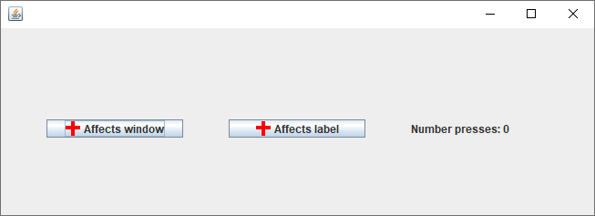
Adding Graphics To Java Controls
Name of the folder containing the full online example: 13addingPicturesToControlsTrackingState
This program allows the state of the GUI (number of button presses) to be tracked and displayed.

Slide 64
Example: Adding Pictures To Controls (2)
JButton
JFrame
MyButton
JLabel
MyFrame
Driver

Slide 65
The Driver Class
public class Driver
{
public static void main(String [] args)
{
MyFrame aFrame = new MyFrame();
aFrame.setVisible(true);
}
}

Slide 66
Class MyFrame
public class MyFrame extends JFrame
{
public static final String DEFAULT_LABEL_STRING = "Number
presses: ";
public static final int WIDTH = 700;
public static final int HEIGHT = 300;
private MyButton frameButton;
private MyButton labelButton;
private JLabel aLabel;
private int numPresses;
public MyFrame()
{
numPresses = 0;
initializeControls();
initializeFrame();
}

Slide 67
Class MyFrame (2)
public void addControls() {
add(frameButton); //Calls to super class method
add(labelButton);
add(aLabel);
}
public JLabel getLabel() {
return(aLabel);
}
public int getNumPresses() {
return(numPresses);
}
public void incrementPresses() {
numPresses++;
}

Slide 68
Class MyFrame (3)
public void initializeFrame()
{
setSize(WIDTH,HEIGHT);
setLayout(null);
addControls();
setDefaultCloseOperation(JFrame.EXIT_ON_CLOSE);
}

Slide 69
Class MyFrame (4)
No path provided: location is the same directory as the program
public void initializeControls() {
ImageIcon anIcon = new ImageIcon("IconPic.gif");
frameButton = new MyButton("Affects
window",anIcon,this);
frameButton.setBounds(50,100,150,20);
frameButton.addActionListener
(new FrameButtonListener()); // Frame events only
labelButton = new MyButton("Affects label",anIcon,this);
labelButton.setBounds(250,100,150,20);
labelButton.addActionListener
(new LabelButtonListener()); // Label events only
aLabel = new JLabel(DEFAULT_LABEL_STRING +
Integer.toString(numPresses));
aLabel.setBounds(450,100,150,20);
}
}

Slide 70
Class MyButton
Each instance will have a reference to a Java GUI widget (label, frame etc.)
public class MyButton extends JButton
{
private Component aComponent;
public MyButton(String s,
ImageIcon pic,
Component aComponent)
{
super(s,pic);
this.aComponent = aComponent;
}
public Component getComponent()
{
return(aComponent);
}
}
Image reference passed onto the appropriate super class constructor

Slide 71
Class To Change Label: LabelButtonListener
public class LabelButtonListener implements ActionListener
{
public void actionPerformed(ActionEvent anEvent)
{
MyButton aButton = (MyButton) anEvent.getSource();
MyFrame aFrame = (MyFrame) aButton.getComponent();
// Method of MyButton
aFrame.incrementPresses(); // Frame stores count
JLabel aLabel = aFrame.getLabel();
String s = MyFrame.DEFAULT_LABEL_STRING;
int currentPresses = aFrame.getNumPresses();
s = s + Integer.toString(currentPresses);
aLabel.setText(s); // Label displays current count
}
}
"Number presses: "
"Number presses: "<#>

Slide 72
Class To Update Frame: FrameButtonListener
public class FrameButtonListener implements ActionListener
{
// Assumes screen resolution is at least 1024 x 768
private final static int MAX_X = 1023;
private final static int MAX_Y = 767;
// Time in milliseconds
private final static int DELAY_TIME = 2500;

Slide 73
Class To Update Frame: FrameButtonListener (2)
public void actionPerformed(ActionEvent anEvent)
{
MyButton aButton = (MyButton) anEvent.getSource();
JFrame aFrame = (JFrame) aButton.getComponent();
aFrame.setTitle("Don't you click me! I'm in a bad
mood!!!");
Random aGenerator = new Random();
// Control randomly “runs away” based on screen size
int x = aGenerator.nextInt(MAX_X);
int y = aGenerator.nextInt(MAX_Y);
aFrame.setLocation(x,y); // Move control to new location
aButton.setBackground(Color.RED); // Control is angry
pause();
aFrame.setTitle(""); // Angry text is gone
}
This class
MAX_X = 1023;
MAX_Y = 767;

Slide 74
Class To Update Frame: FrameButtonListener (3)
private void pause() // Give user time to note GUI changes
{
try
{
Thread.sleep(DELAY_TIME);
}
catch (InterruptedException ex)
{
ex.printStackTrace();
}
}
}
This class
DELAY_TIME = 2500

Slide 75
After This Section You Should Now Know
Different ways of having events from one Java Component after other Component:
  Using Java’s built in containment classes and methods of access.
  Declaring the Component as an attribute of the container class (and then access the Component via an accessor method).
  Implementing the listener ability in the container class for the control.
  Declaring the container as an attribute of the component that is the source of the event.
Anonymous objects/classes as well as an inner class
  How to declare of define each one
  How they can be used in conjunction with event listeners.
  (Inner classes) how this approach for defining a class is similar to defining friend functions

Slide 76
After This Section You Should Now Know (2)
Methods of reacting to events from different controls
  Using the actionCommandAttribute to differentiate between controls that caused the event to be raised.
Basic method and attributes for setting the physical properties (e.g. size) and visual characteristics (e.g. color) of a Java Component.
The basic use of the following Java controls: JTextField, JTextArea, JScrollPane, Jdialog (along with cautions about their over use), JPasswordField.
How to augment a Java Component with an image (via the Java ImageIcon class).

Slide 77
References
Books:
  “Java Swing” by Robert Eckstein, Marc Loy and Dave Wood (O’Reilly)
  “Absolute Java” (4th Edition) by Walter Savitch (Pearson)
  “Java: How to Program” (6th Edition) by H.M. Deitel and P.J. Deitel (Pearson)
Websites:
  Java API specifications (last accessed 2021): https://docs.oracle.com/en/java/javase/11/docs/api/index.html
  Java tutorials (last accessed 2021): http://download.oracle.com/javase/tutorial/uiswing/
  Java tutorial, layout (last accessed 2021): http://docs.oracle.com/javase/tutorial/uiswing/layout/using.html

Slide 78
Copyright Notice
Unless otherwise specfied, all images were produced by the author (James Tam).

