Slide 1
An Introduction To Graphical User Interfaces
Part 2: You will learn how to arrange or organize graphical controls within a GUI manually and using a layout manager class.

Slide 2
How To Handle The Layout Of Components
Manually set the coordinates yourself
Use one of Java’s built-in layout manager classes

Slide 3
How To Handle The Layout Of Components
Manually set the coordinates yourself
Use one of Java’s built-in layout manager classes

Slide 4
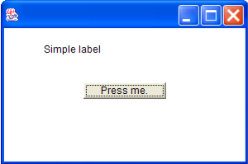
Layout Is Based On Spatial (X,Y) Coordinates
e.g. MyFrame my =new MyFrame();
my.setSize(300,200);
Width e.g., w = 300
Height e.g., h = 200

Slide 5
Layout Is Based On Spatial Coordinates
x = 0
x = 300
y = 0
y = 200
Notes:
The x,y coordinates of the components are relative a 0,0 origin of the container e.g., if the frame.setBounds(40,40,200,200) then button.setBounds(40,40,100,20) would be offset the frame’s 40,40 by an additional 40,40. The frames 40,40 would offset the monitor’s bounds.
“Invisible label”
JFrame aFrame = new JFrame ();
aFrame.setLayout(null);
aFrame.setSize(640,480);
JLabel aLabel = new JLabel("Some text");
aLabel.setLocation(0,0);
aFrame.add(aLabel);
aFrame.setVisible(true);

Slide 6
Coordinates Of Components: Relative To
The Container
x = 0
x = 50
x = 100
y = 0
y = 50
Width = 100, Height = 20
y = 100
Width = 100, Height = 20

Slide 7
Pitfall 2: Invisible Component
Don’t forget that coordinates (0,0) are covered by the title bar of the frame.
Components added at this location may be partially or totally hidden by the title bar.

Slide 8
A Example With Manual Layout
Name of the folder containing the complete example: 4manualLayout

Slide 9
An Example With Manual Layout:
The Driver Class
import javax.swing.JButton;
import javax.swing.JLabel;
import javax.swing.JFrame;
public class Driver {
public static final int WIDTH_FRAME = 300;
public static final int HEIGHT_FRAME = 300;
public static final int X_COORD_BUTTON = 100;
public static final int Y_COORD_BUTTON = 100;
public static final int WIDTH_BUTTON = 100;
public static final int HEIGHT_BUTTON = 20;
public static final int X_COORD_LABEL = 50;
public static final int Y_COORD_LABEL = 50;
public static final int WIDTH_LABEL = 100;
public static final int HEIGHT_LABEL = 20;

Slide 10
An Example With Manual Layout:
The Driver Class (2)
To manually set the layout you must make the layout manager (object) null
Don’t use an automatic layout manager (layout is manually specified)
public static void main(String [] args) {
JFrame aFrame = new JFrame();
aFrame.setLayout(null);
aFrame.setSize(WIDTH_FRAME,HEIGHT_FRAME);
JButton aButton = new JButton("Press me.");
aButton.setBounds(X_COORD_BUTTON,
Y_COORD_BUTTON,
WIDTH_BUTTON,
HEIGHT_BUTTON);
JLabel aLabel = new JLabel("Simple label");
aLabel.setBounds(X_COORD_LABEL,
Y_COORD_LABEL,
WIDTH_LABEL,
HEIGHT_LABEL);
aFrame.add(aButton);
aFrame.add(aLabel);
aFrame.setVisible(true);
}
}

Slide 11
How To Handle The Layout Of Components
Manually set the coordinates yourself
Use one of Java’s built-in layout manager classes

Slide 12
Java Layout Classes
LayoutManager
BorderLayout
CardLayout
FlowLayout
GridLayout
GridBagLayout
There are many implementations (this diagram only includes the original classes that were implemented by Sun).

Slide 13
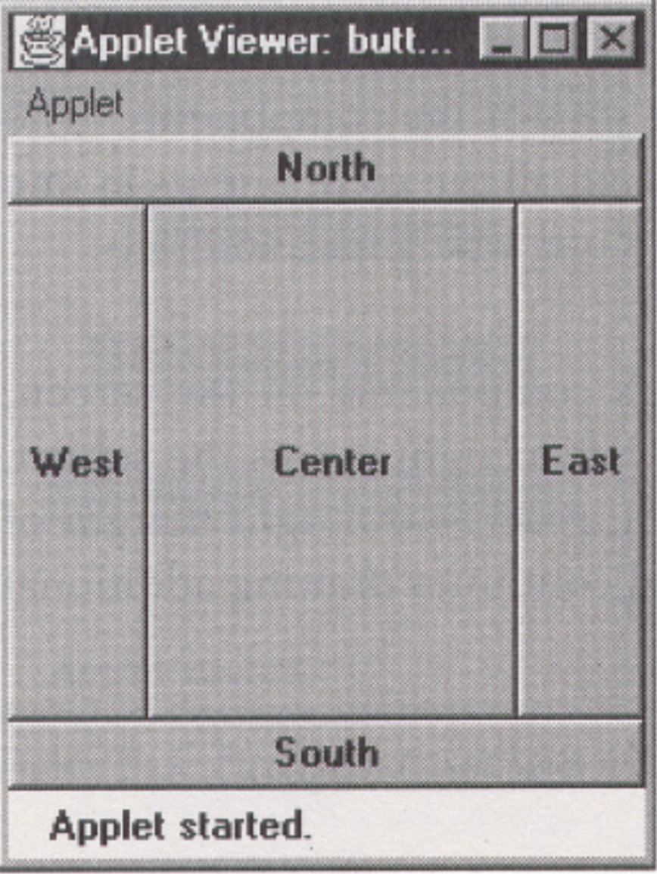
BorderLayout (“Compass Directions”)
From Java: AWT Reference p. 256

Slide 14
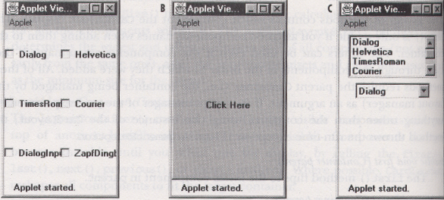
CardLayout (“Tab-Like”)
From Java: AWT Reference p. 264

Slide 15
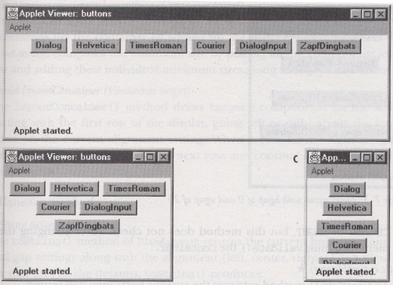
FlowLayout (Adapts To Resizing “Web-Like”)
From Java: AWT Reference p. 253

Slide 16
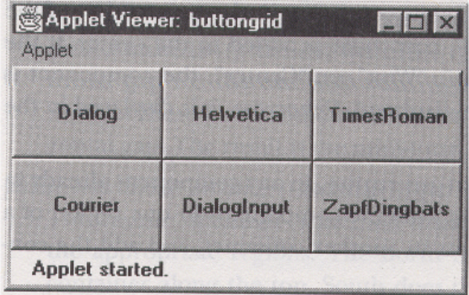
GridLayout
From Java: AWT Reference p. 260

Slide 17
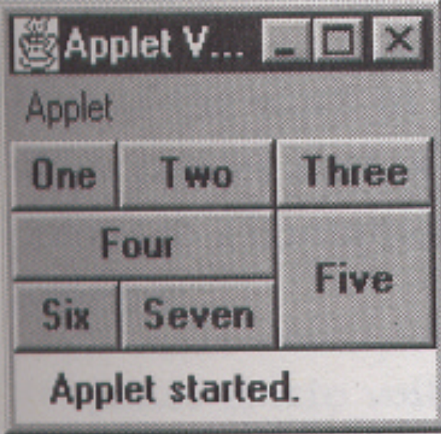
GridBagLayout
From Java: AWT Reference p. 269

Slide 18
Implementing A GUI When Using The GridBagLayout
Use graph paper or draw out a table.
x coordinates in the grid
0
1
2
0
Label1
y coordinates in the grid
1
Button1
2

Slide 19
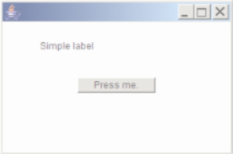
Implementing A GUI When Using The GridBagLayout
Use graph paper or draw out a table.
x coordinates in the grid
0
1
2
0
Label1
y coordinates in the grid
1
Button1
2

Slide 20
GridBagConstraints
Goes with the GridBagLayout class.
Because the GridBagLayout doesn’t know ‘how’ to display components you also need GridBagConstraints to constrain things (determine the layout).
GridBagConstraints indicates how components should be displayed for a particular GridBagLayout.
For more complete information see:
  https://docs.oracle.com/en/java/javase/16/docs/api/java.desktop/java/awt/class-use/GridBagConstraints.html

Slide 21
Some Important Parts Of The GridBagConstraints Class
public class GridBagConstraints
{
// Used in conjunction with the constants below to determine // the resize policy of the component
public int fill;
// Apply only if there is available space.
// Determine in which direction (if any) that the component
// expands to fill the space.
public final static int NONE;
public final static int BOTH;
public final static int HORIZONTAL;
public final static int VERTICAL;

Slide 22



GridBagContraints: Fill Values
Horizontal
Vertical
None

Slide 23
Some Important Parts Of The GridBagConstraints Class (2)
// Position within the grid
public int gridx;
public int gridy;
// Number of grid squares occupied by a component
public int gridwidth;
public int gridheight;

Slide 24
Some Important Parts Of The GridBagConstraints Class (3)
// Used in conjunction with the constants below to determine // that the component drift if the space available is larger // than the component.
public int anchor;
// Only if the component is smaller than the available space.
// Determine the anchor direction
public final static int CENTER;
public final static int EAST;
public final static int NORTH;
public final static int NORTHEAST;
public final static int NORTHWEST;
public final static int SOUTH;
public final static int SOUTHEAST;
public final static int SOUTHWEST;
public final static int WEST;

Slide 25
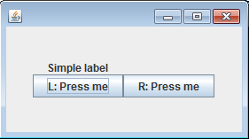
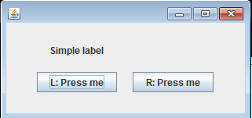
Some Important Parts Of The GridBagConstraints Class (4)
Insets = 0: no padding
Insets = 10: many spaces/padding
// With a particular ‘cell’ in the grid this attribute
// specifies the amount of padding around the component
// to separate it from other components.
// Usage:
// insets = new Insets(<top>,<left>,<bottom>,<right>);
// Example (Set top, left, bottom, and right)
// insets = new Insets(0, 0, 0, 0); // No padding (default)
public insets;

Slide 26
An Example Using The GridBagLayout
Name of the folder containing the complete example: :
5gridbaglayout

Slide 27
An Example Using The GridBagLayout:
The Driver Class
public class Driver
{
public static final int WIDTH = 400;
public static final int HEIGHT = 300;
public static void main(String [] args)
{
MyFrame aFrame = new MyFrame ();
aFrame.setSize(WIDTH,HEIGHT);
aFrame.setVisible(true);
}
}

Slide 28
An Example Using The GridBagLayout:
Class MyFrame
public class MyFrame extends JFrame {
private JButton left;
private JButton right;
private JLabel aLabel;
private GridBagLayout aLayout;
GridBagConstraints aConstraint;
public MyFrame() {
MyWindowListener aWindowListener = new MyWindowListener();
addWindowListener(aWindowListener);
aConstraint = new GridBagConstraints();
Scanner in = new Scanner(System.in);
System.out.print("Buffer size to pad the grid: ");
int padding = in.nextInt();

Slide 29
An Example Using The GridBagLayout:
Class MyFrame (2)
left = new JButton("L: Press me");
right = new JButton("R: Press me");
MyButtonListener aButtonListener = new MyButtonListener();
left.addActionListener (aButtonListener);
right.addActionListener (aButtonListener);
aLabel = new JLabel("Simple label");
aConstraint.insets = new
Insets(padding,padding,padding,padding);
aLayout = new GridBagLayout();
setLayout(aLayout); // Calling method of super class.
addWidget(aLabel, 0, 0, 1, 1);
addWidget(left, 0, 1, 1, 1);
addWidget(right, 1, 1, 1, 1);
}

Slide 30
An Example Using The GridBagLayout:
Class MyFrame (3)
public void addWidget(Component widget,
int x,
int y,
int w,
int h)
{ // aConstraint: refers to instance of
// GridBagConstraints
aConstraint.gridx = x;
aConstraint.gridy = y;
aConstraint.gridwidth = w;
aConstraint.gridheight = h;
aLayout.setConstraints(widget, aConstraint);
add(widget); // Calling method of super class.
}
} // End of definition for class MyFrame

Slide 31
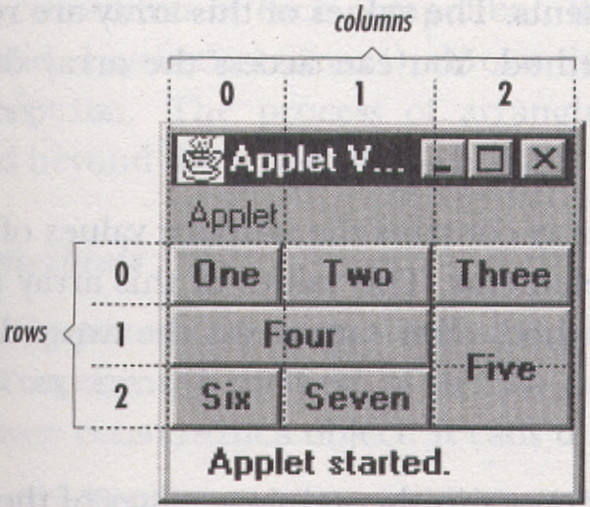
Advanced Uses Of GridBagLayout
Button | gridx (col) | gridy (row) | grid-width | grid-height
One | 0 | 0 | 1 | 1
Two | 1 | 0 | 1 | 1
Three | 2 | 0 | 1 | 1
Four | 0 | 1 | 2 | 1
Five | 2 | 1 | 1 | 2
Six | 0 | 2 | 1 | 1
Seven | 1 | 2 | 1 | 1
From Java: AWT Reference p. 269

Slide 32
Layout Of GUI Components
JT’s note (and opinion): learning how to layout GUI components manually will teach you “how things work”.
  That’s because you have to handle many details yourself (either manually or by using a layout class).
  Except when writing small programs with a simple GUI (assignment) doing things manually is just too much of a hassle.
    The programmer focuses on the wrong details (how do I get the programming language to ‘do stuff’ as opposed to how do I create a GUI that is ‘user-friendly’).
  In other cases (‘real life programs’) an IDE is used.
  Some examples:
    Sun’s NetBeans IDE: http://docs.oracle.com/javase/tutorial/uiswing/learn/index.html
    IBM’s Eclipse IDE:
    http://www.ibm.com/developerworks/opensource/library/os-ecvisual/

Slide 33
After This Section You Now Know
How to manually layout graphical components within a GUI (as specified by the (x, y) pixel coordinates.
How to use the layout manager class GridBagLayout in conjunction with GridBagConstraints to specify layout on a grid and to automated update layout when the container is resized.

Slide 34
Copyright Notice
Unless otherwise specfied, all images were produced by the author (James Tam).

