Slide 1
Technology Companies
Hardware houses of the microcomputer age (exert of the lectures from a computer history course).

Slide 2
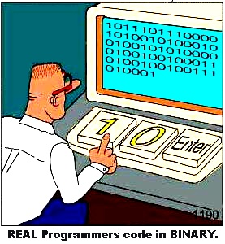
Microsoft: Beginnings
Microcomputer-software.
Because Gates completed most of the work on BASIC there was a 64/36 split in ownership of the new company.
Initial funds: royalties from the use of their version of BASIC (included with each Altair computer).
  $30/computer (4 KB)
  $35/computer (8 KB)
  $60/computer (extended version of BASIC, required external storage)
Also funds came from licensing of the BASIC source code.
  Developers could modify the translator as they saw fit (!!!)

Slide 3

Microsoft: Beginnings (2)
www.colourbox.com
The company had humble beginnings: a section of the office was given to Microsoft by MITS (manufacturer of the Altair).
  Gates still continued his workaholic coding schedule.

Slide 4
Microsoft: Beginnings (4)
To help promote the Altair (and the BASIC that came with it) Gates toured with MITS to meet with computer clubs which included: engineers, technicians, hobbyists, hackers, electronicphilles etc.
  Eventually BASIC became the standard for computers.

Slide 5
Microsoft: Beginnings (5)
One of these computer clubs (“Homebrew”) started in garage in Menlo Park (next to Palo Alto and Stanford university).
More than 30 people came out for the first meeting including Steve Wozniak (who was then working in the calculator division of Hewlett-Packard).
  Within a year of this first meeting: Wozniak along with Steve Jobs would build a personal computer of their own: Apple I.
Although Microsoft got its start through its relationship with MITS it eventually was hobbled by it.
  Microsoft could not license BASIC to MITS competitors.
  At first there were no competitors (no problem).
  In a few years dozens of other companies manufactured their own microcomputers: Commodore (PET), Radio Shack (TRS-80), Apple (Apple I).

Slide 6
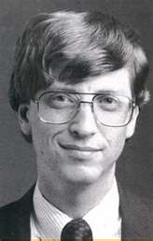
Microsoft: Beginnings (6)
After a long and complex legal proceedings Microsoft won the rights to sell BASIC as they saw fit.
BASIC was licensed to many other computer manufacturers: Radio Shack (TRS-80), Apple (Apple II)
But throughout the legal battle the company still worked on other programming languages: COBOL, FORTRAN as well as developing BASIC for chips other than the 8080.
Gates and Ballmer were frequently underestimated by their business rivals (“who are these kids?”)
  But they were more than able to hold their own.
http://www.syllablesoup.com/

Slide 7
Microsoft: Beginnings (7)
However Gates still made time for programming:
  Competitions were held with employees to see who write a program in the fewest lines of code.
  In the early years Gates himself indicates that he was heavily involved in all projects and there wasn’t a line of code that he didn’t personally look over (or even recode).
Notes:
Credit: DOS Encyclopedia, disk BASIC FAT (File Allocation Table).

Slide 8
Birth Of The Microsoft OS
IBM OS???
IBM OS???
Clipart: Microsoft

Slide 9
Birth Of The Microsoft OS (2)
IBM approached two companies as possible vendors of an operating system to run it’s computers:
  Digital Research (CP/M operating system was standard for Intel 8080 based systems)
    (There soon to be a 16 bit extension coming but not far enough in development).
  Microsoft (never wrote operating system software just a BASIC interpreter).
    Microsoft: 7 million in annual sales
    IBM: 30 billion in yearly revenues.
IBM and Microsoft worked out an arrangement to have a version of Microsoft’s DOS (Disk Operating System) run IBM computers: PC-DOS.
MS-DOS was based on 86-DOS an OS written by Tim Paterson of Seattle Computer products (later Q-DOS)

Slide 10
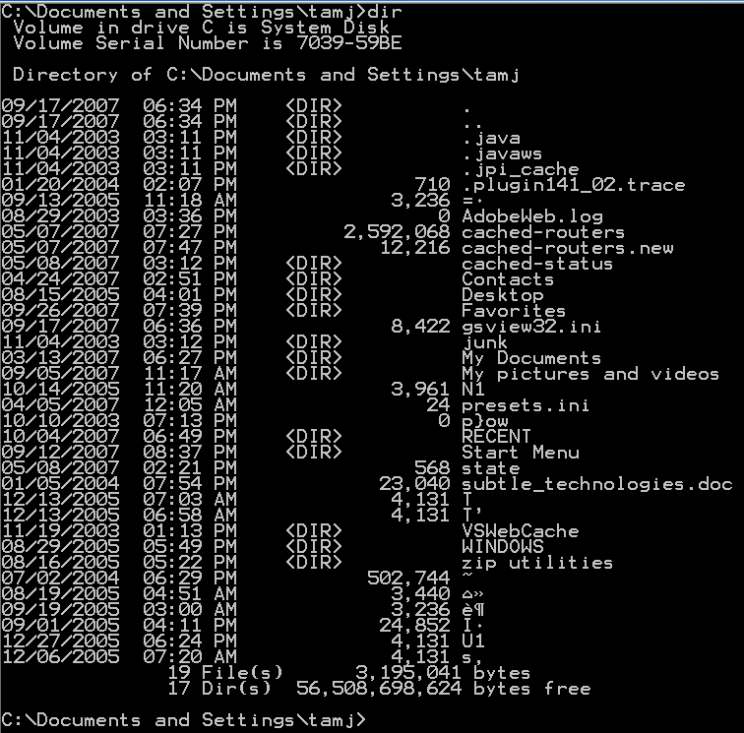
Birth Of The Microsoft OS (3)
The interface of PC/MS-DOS has been criticized as being user-unfriendly.
Command
Effect of the command

Slide 11
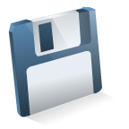
Birth Of The Microsoft OS (4)
However the interface of PC/MS-DOS was a significant improvement over other operating systems.
CP/M operating system
Reboot
computer
Wrong disk!!!
Clipart: Microsoft

Slide 12
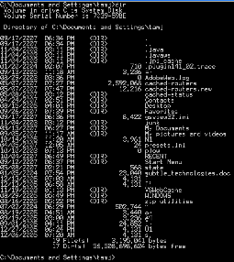
Birth Of The Microsoft OS (5)
However the interface of PC/MS-DOS was a significant improvement over other operating systems.
PC/MS-DOS operating system
Abort,
retry, fail?
Wrong disk!!!
Correct disk

Slide 13
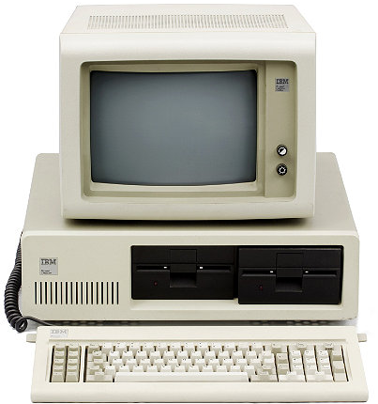
The IBM PC (Personal Computer: 1981)
IBM was a large company but a late comer into the microcomputer market.
As mentioned its machines used an operating system produced by Microsoft.
www.computerhistory.org

Slide 14
The IBM PC (Personal Computer: 1981): 2
With the entry of IBM in the microcomputer market, many developers produced a plethora of software.
IBM PC
Word processing
Accounting software
Games
Spreadsheets

Slide 15
The IBM PC (Personal Computer: 1981): 3
Apple entered the microcomputer market sooner and already had an established market when IBM began to first market the PC.
Because of the prevalence of so much software the IBM-PC soon overtook Apple (and other vendors) in sales.
Apple sales
IBM sales
Apple sales
IBM sales

Slide 16
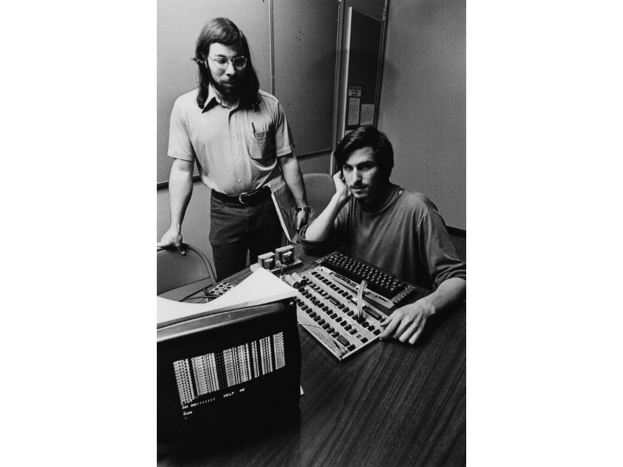
The History Of Apple Computers: Steve And Steve
Apple was founded by Steven Jobs and Steve Wozniac in a Silicon Valley garage.
Steven Jobs
Steve Wozniac
Images © Apple Computer, Inc. from www.computerhistory.org

Slide 17
Apple: Steve And Steve
1 “Corporations that changed the World: Apple Inc.” (Jason D. O’Grady: Greenwood Press 2009)
Bill Fernandez (Wozniak’s neighbour in Santa Clara California) introduced the ‘Steves’.¹
  Stephen Gary Wozniak (16)
  Steven Paul Jobs (21)
They built their first computer out of parts that were discarded (for ‘cosmetic’ reasons) by computer manufacturers.
  Named after their favourite drink: “The Cream Soda computer”.
  Jobs was marketing, Wozniak was the Engineer,

Slide 18
Steve Jobs
1”The little kingdom: The private story of Apple Computer” (Michael Moritz: William Morrow p. 38)
Born Feb 24, 1955 in San Francisco.
Age 23: Made his first million
Age 25 (1980): Worth approximately 100 million
2009: Worth approximately 6 billion
Even at an early age he showed an aptitude for business and people over engineering.
  “...he wasn't interested in getting his hands dirty”, “...he was more interested in wondering about the people that owned the cars.”¹

Slide 19
Steve Wozniak
1 “Corporations that changed the World: Apple Inc.” (Jason D. O’Grady: Greenwood Press 2009)
2 “iWoz: From Computer Geek to Cult Icon: How I Invented the personal computer, Co-founded Apple, and had Fun Doing It” (Steve Wozniak with G. Smith: W.W. Norton 2006)
Born August 11 1950
Commonly known by an abbreviation of his surname “The Woz”
“Prolific tinkerer”¹
“From a technical standpoint, Woz was literally Apple Computer”²

Slide 20
Apple I
1976: Wozniak completed a prototype and took it the Homebrew Computer club.
Jobs saw its immediate potential.
It used a standard TV as a monitor.
Due to Wozniak’s design genius it used a minimal number of chips (to keep costs and complexity down).
Boot code was in ROM.
Data was saved on cassette tapes.

Slide 21

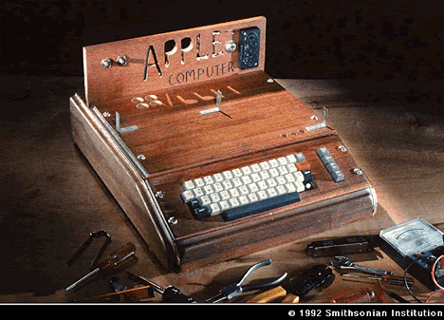
Apple I (2)
The first Apple computer: significantly different from it’s successors.
Extras
Clipart: Microsoft

Slide 22
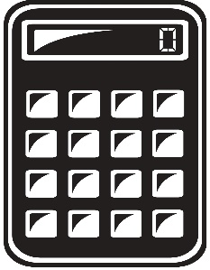

Apple I: Marketing
Clipart:www.colourbox.com
A local electronic shop owner immediately put in for an order of 50 computers.
Cash was so tight for `Apple` that payment for the parts had to made on credit.
  Even then personal sacrifices had to be made.
  Wozniak`s friend: Ronald Wayne helped him assemble the computers in Wozniak`s living room.
    Even this preassembly process the machine still required some assembly by the end customers.
Notes:
22

Slide 23
Apple II
1 “A History of Modern Computing” (Paul Ceruzzi: MIT Press 2003)
Proceeds from the sale of the predecessor machine financed the construction of its successor.
At this point Wayne sold his stake in company.
The ‘Steves’ had trouble raising money.
  Banks would not grant loans because they were skeptical of the marketability of a computer for the average person.
  Finally after another person agreed to co-sign the bank loan ($250,000) there was enough capital to fund production of the Apple II and Apple Computer was formed April 1, 1976.
Released in 1977.
Initially it ran a version of BASIC written by Wozniak.
Later it used a licensed version of Microsoft BASIC.
  The $10,000 fee was said to have saved Microsoft from insolvency.¹

Slide 24
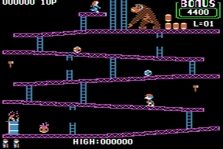
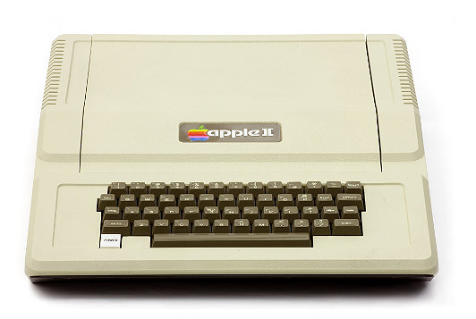
The Apple II (2)
It was a simpler and more powerful design than the Altair
The color graphics were superior to larger and more expensive computers
Strong selling points
  Name
  Appearance
Images
Apple II:
www.computerhistory.org
Donkey Kong: www.donkeykong.gamebub.com

Slide 25
Side Note: VisiCalc
Visible Calculator was the first electronic spreadsheet.
Dan Bricking conceived of the idea while he was a first year student at Harvard Business school.
Enlisted the aid of a Harvard graduate and using a borrowed Apple II computer a working version was produced in 1978.

Slide 26
The Apple II & VisiCalc
VisiCalc: “It was the software tail that wagged the hardware dog”

Slide 27
Apple Goes Public
IPO: December 12, 1980 (Open $22 per share, close at $29)
  Apple raised more money that day than any company except for Ford.

Slide 28
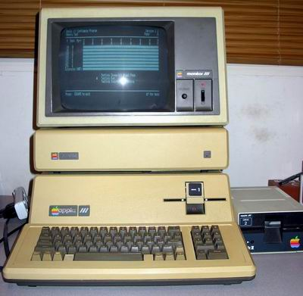
Apple III
Customers flocked to (the IBM PC):
  Apple became known for poor reliability.
The Apple III failed as a product:
  IBM ‘smelled blood’ and quickly released the IBM PC (Personal Computer).
  The PC design opened up the market for clones (more later).
Wozniak claimed it was a failure because marketing rather than engineering had designed it.
Image: www.vintage-computer.com

Slide 29
Jacky Scully
1 Triumph of the Nerds: The Transcripts, Part III
Recruited from Pepsi to work as CEO for Apple in 1983 by Steve Jobs.
  At Pepsi he spearheaded a successful marketing campaign to challenge Coke: the “Pepsi challenge”
    It was reputed however that Scully picked Coke over Pepsi in the challenge.
    What finally motivated the transfer was a plea by Jobs.
    "Do you want to sell sugared water for the rest of your life? Or do you want to come with me and change the world?¹
He was responsible for many changes:
  A decision to compete directly against IBM in the business computer market (Apple III)
  Removing Steve Jobs from development of an Apple microcomputer project.

Slide 30
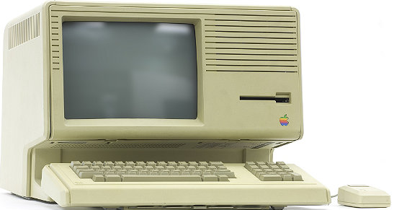
Lisa
Image © Mark Richards from www.computerhistory.org
(1983).
  5 MHz 68000 processor
  1 MB RAM
Unlike other Apple computers which were text-based, this one would employ a GUI.
  It was inspired by a tour of the Xerox PARC (Palo Alto Research Center) laboratories.
    It cost $1 million in Apple stock for a 3 day tour of Xerox.
    It was a failure but laid the ground work for the successful Macintosh.
      The Lisa (1983) incorporated many of the features of the Xerox Star.
      Like the Star it was expensive ($10K) and sales were weak

Slide 31
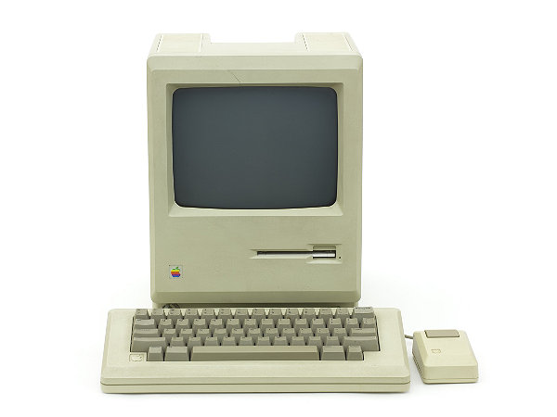
The Apple Macintosh (1984)
Apple’s next computer was the Macintosh
It incorporated many of the best features of the Lisa but was sold at a substantially lower price.
Also features not present in the Lisa were added to the Macintosh
Compared to the IBM-PC it was a speed vs. ease of use tradeoff
Image © Mark Richards from www.computerhistory.org

Slide 32
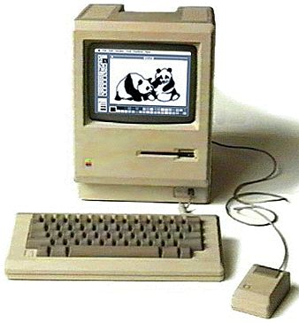
Macintosh
To prevent a repeat of the failures with the Apple III Jobs was diplomatically removed from this project.¹
  He eventually resigned and formed his own computer company NeXT
Goal: produce an easy to use, inexpensive computer with all the features could need all in one package.
Specifications:
  Processor: ~7 MHz 68000 Motorola
  Memory: 128 KB (upgradable – with some difficulty - to 512 KB)
1 “Corporations that changed the World: Apple Inc.” (Jason D. O’Grady: Greenwood Press 2009)

Slide 33
Macintosh (2)
It incorporated the best features of the Lisa but was sold at a substantially lower price.
Also features not present in the Lisa were added to the Macintosh
Compared to the IBM-PC it was a speed vs. ease of use tradeoff

Slide 34
The Attack Of The Clones
Although it was a late entry into the microcomputer market IBM eventually dominated.
Apple sales
IBM sales

Slide 35
The Attack Of The Clones (2)
Although the IBM-PC was marketed and sold under the IBM brand most of the parts were not manufactured in-house.
Processor: Company A
Clipart: Microsoft
Hard drive: Company B
Floppy drive: Company C
Expansion card: Company D
IBM-PC

Slide 36
The Attack Of The Clones (3)
The parts manufacturers were free to sell their components to other companies.
About the same time that the IBM-PC was sold, three ex-employees of Texas Instruments founded their own company: Compaq.
  They conceived of producing their own copy of the IBM-PC under their own brand name.
  It would run under MS-DOS and be 100% compatible with other software
  The first IBM-PC clone was delivered by Compaq in 1983.
IBM-PC
Compaq clone

Slide 37
The Attack Of The Clones (4)
This opened the flood gates for other computer manufacturers to produce their own clone computers.
Compaq clone
Mom and pop shop clone
IBM-PC
Dell clone

Slide 38
The Attack Of The Clones (5)
The result was that IBM eventually lost control over the computer architecture that it developed and marketed.
Apple sales
IBM sales
Microsoft operating system
Apple sales
IBM sales
Compaq sales
Dell sales
Mom & pop shop sales

Slide 39
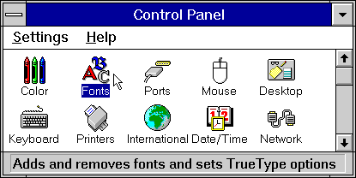
The Attack Of The Clones: The Rise Of Microsoft
The loser of the clone war was IBM.
The real winner of the clone war was Microsoft.
By the 1990s Microsoft developed an interface for MS-DOS that incorporated some of the features of the MAC GUI.
Windows 3 image from www.microsoft.com

Slide 40
References
The Intel website: http://www.intel.com
“A History of Modern Computing” (2nd Edition) Paul E. Ceruzzi
Hard Drive: Bill Gates and the making of the Microsoft Empire” (Jim Wallace & Jim Erickson: Harper Business 1993)
Corporations that changed the World: Apple Inc.” (Jason D. O’Grady: Greenwood Press 2009)
”The little kingdom: The private story of Apple Computer” (Michael Moritz: William Morrow p. 38)
“iWoz: From Computer Geek to Cult Icon: How I Invented the personal computer, Co-founded Apple, and had Fun Doing It” (Steve Wozniak with G. Smith: W.W. Norton 2006)

Slide 41
References (2)
Triumph of the Nerds: The Transcripts, Part III

Slide 42
After This Section You Should Now Know
General knowledge
  The general time that significant events (such as the creation of different computer models or technologies) occurred
  The people and organizations/companies behind these events/technologies and their background
  What companies produced which computers
  The names, general appearance and basic technical specifications of the computers of this time
  What were the specifications of the technologies of the day (such as the number of colors available with different graphical modes)
  What (if any) were the distinguishing feature or features of a computer
  How were these technologies or computers used

Slide 43
After This Section You Should Now Know (2)
How the invention of the microprocessor revolutionized computing
What was the first computer that was targeted specifically for the home user
What was the influence of Microsoft on microcomputers
The history of the IBM-PC
The foundation of Apple Computers
The history of some of Apple's early computers: Apple I, Apple II, Lisa, Macintosh
How IBM lost control over a computer architecture that it developed through the rise of clone computers

Slide 44
After This Section You Should Now Know (3)
How the rise of clone computers lead to the market dominance of Microsoft in the microcomputer market
When the Xerox Star was made available as well it’s influence on microcomputers

