Slide 1
Getting Started With Python Programming: Part 1
Tutorial: creating computer programs
Variables
Getting information from the user
Common mathematical operators

Slide 2
Reminder!
These course notes are mandatory
  Get them before class and go over them before attending
(If all else fails then look through them afterwards – at the very least to see what concepts/topics you are responsible for knowing).
  It’s the *first* step you should complete if you’ve missed lecture and need to catch up.
  (The second step is to get the in class notes of a classmate).
  After going through these notes the third step is to ask us for help in filling in any conceptual gaps.

Slide 3
Tips For Success: Programming Sections
(The previous 4 tips are still applicable but there’s some tips specific to programming):
  Take extensive notes: everything in class not just what the instructor “writes down” but also what he/she “says in class”.
    Some students may find when studying the lecture slides for the exam that they cannot understand concepts.
    The extra “filling of the blanks” occurs during lecture so you need to annotate the slides with your own notes
  After lectures have covered a particular concept/example
    If you have time try writing the program on your own (without looking at the online examples or notes) in order to create a program that fulfills the same task as the example program
    (It’s one thing to see the solution to a problem explained, your depth of understanding will be deeper if you have to re-create it from scratch yourself).
    JT’s note: you may find this unnecessary for the simple examples in this section but it will be beneficial to do this when more complex concepts are covered (e.g. nested loops onwards)

Slide 4
Python
This is the name of the programming language that will be used to illustrate different programming concepts this semester:
  My examples will be written in Python
  Your assignments will be written in Python
Some advantages (from Python dot org)
  Free
  Powerful
  Widely used (Google, NASA, Yahoo, Electronic Arts, some Linux operating system scripts etc.)
Named after a British comedy “Monty Python’s Flying Circus”
  Official website (Python the programming language, not the Monty Python comedy troop): http://www.python.org
  An overview of the web site: https://www.python.org/about/gettingstarted/

Slide 5
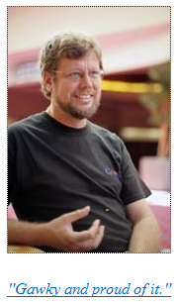
Python History
Developed in the early 1990s by Guido van Rossum.
Python was designed with a tradeoff in mind (from “Python for everyone” (Horstman and Necaise):
  Pro: Python programmers could quickly write programs (and not be burdened with an overly difficult language)
  Con: Python programs weren’t optimized to run as efficiently as programs written in some other languages.
From:
http://www.python.org/~guido/

Slide 6
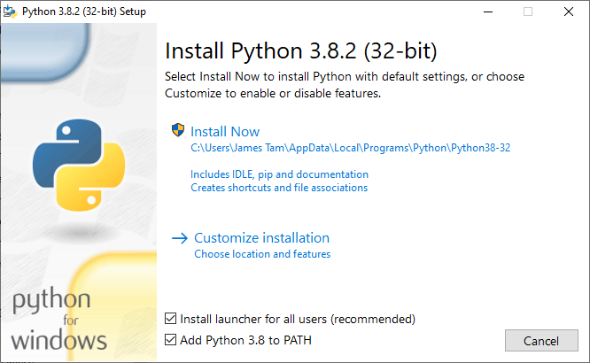
Working From Home (Installing Python)
Getting Python (get version 3.X and not version 2.X)
  http://www.python.org/download/
  Detailed information:
    https://pages.cpsc.ucalgary.ca/~tamj/2021/217P/notes/pdf/installing_accessing_python.pdf
Then click “Install Now”
Make sure you check this option!

Slide 7
Online Help: Official Python Site
Basic explanation of concepts (for beginners: along with examples to illustrate)
  http://docs.python.org/py3k/tutorial/index.html
  (Skip the notes on the interactive mode for now where you type but don’t save the program at the command line).
  For this course you need to create a python program in a file and then run python on that file.

Slide 8

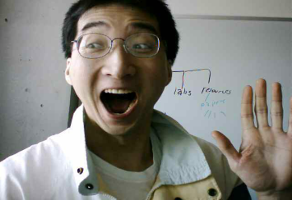
The Process Of Creating A Computer Program
‘Typical’ programmer
Translation
A special computer program (translator) translates the program written by the programmer into the only form that the computer can understand (machine language/binary)
Program Creation
A person (programmer) writes a computer program (series of instructions).
The program is written and saved using a text editor.
The instructions in the programming language (e.g., Python) are high level (look much like a human language).
Execution
The machine/binary language instructions can now be directly executed by the computer.
# Details in 2nd year
10000001
10010100 10000100
10000001 01010100
# Details later this term
list = [1,2,’a’]
for element in list
print(element)
(Images curtesy of James Tam)

Slide 9
Location Of My Online Examples
For this semester you can find them in D2L under ‘Content’.
Then look under the appropriately named folder which is listed by date and topic.
Alternatively you can find them by looking under the “main grid” of the course website (look for the ‘examples’ link):
  https://pages.cpsc.ucalgary.ca/~tamj/2021/217P/#Main_grid:_lecture_&_tutorial_schedule,_assignment_information

Slide 10
The First Python Program
Program name: small.py
Filename: 1small.py
print ("hello",end="")

Slide 11
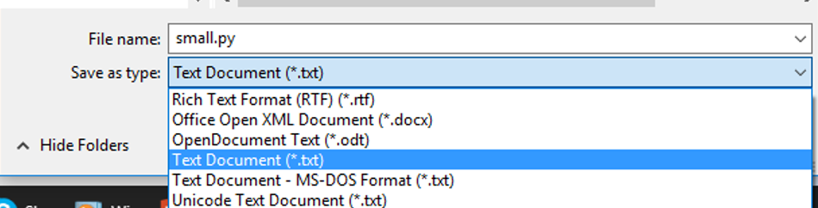
Creating/Running Programs: Windows
Step 1: Writing your program
  You need a text editor (e.g., WordPad, Notepad, Notepad++) to enter the program.
  It can be done using any editor that you want, but don’t use a word processor (e.g., MS-Word) and remember to save it as a text file ending with the suffix dot-py “.py”

Slide 12
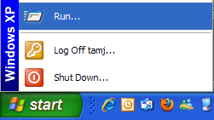
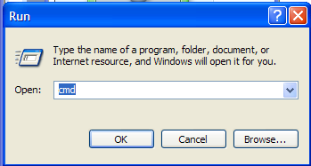

Creating/Running Programs: One Operating System (2)
  Step 2: Translating and running your program
  You need to open a command line to translate/run your Python program.
  The name of the Python translator is “Python”
  To translate/run your program type “python filename.py” at the command line.
    The first example program would be executed by typing “python 1small.py”
    For a program whose filename is called “output1.py” you would type “python output1.py”.
Running /translating the program
Output of program (result of running the program)

Slide 13
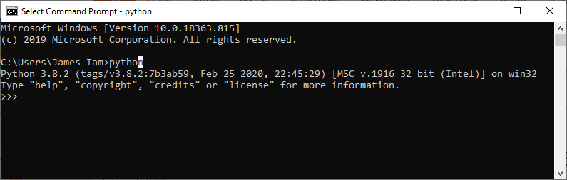
Python: Interactive Mode
If you just type ‘python’ without the name of a file containing a python program then you will enter the “interactive mode” of python.
  For now we won’t be covering this mode
To exit the mode either close the command line or at the command line type exit()

Slide 14
Important Reminders
Make sure you type the whole file name (including the part after the period) when you translate/run your program.
  E.g., “python small.py”
Unless you are very familiar with your operating system when you translate/run a program you should first navigate to the directory/folder where your Python program resides.
  JT: the ‘cd’ command changes your directory (Windows and UNIX although something different is needed when changing Windows drives)
  Suppose my program was under:
    C:\231 (Windows)
    OR
    /home/231 (UNIX)
  To reach this location you could (shortcuts excluded for now) then type:
    cd c:\231 (Windows)
    OR
    cd /home/231 (UNIX)

Slide 15
Section Summary: Writing A Small “Hello World” Program
You should know exactly what is required to create/run a simple, executable Python program.
  While you may not be able to create a new program from scratch at this point, you should be able to enter/run small.py yourself.

Slide 16
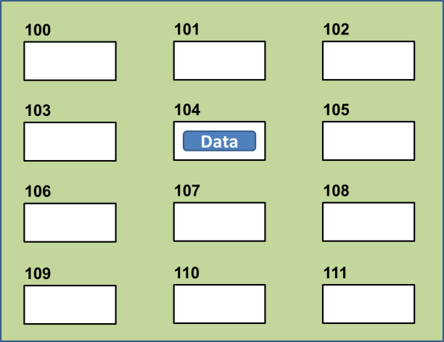
Variables
Set aside a location in memory.
Used to store information (temporary).
  This location can store one ‘piece’ of information.
    Putting another piece of information at an existing location overwrites previous information.
  At most the information will be accessible as long as the program runs i.e., it’s temporary
Some types of information which can be stored in variables include: integer (whole), floating point (fractional), strings (essentially any characters you can type and more)
  Format (creating):
  <name of variable> = <Information to be stored in the variable>
  Examples (creating):
  Integer (e.g., num1 = 10)
  Floating point (e.g., num2 = 10.0)
  Strings: alpha, numeric, other characters enclosed in quotes.
    e.g., name = "james"
    To be safe get in the habit of using double (and not single) quotes
Image curtesy of James Tam

Slide 17

The Assignment Operator: =
The assignment operator '=' used in writing computer programs does not have the same meaning as mathematics.
  Don’t mix them up!
Example:
  y = 3 (what is stored in ‘y’ at this point)
  x = y (what is stored in ‘x’,’y’ at this point)
  y = 6 (what is stored in ‘x’,’y’ at this point)
What is the end result? How was this derived (what are the intermediate
Name of the full example: 2assignment.py
  Quick tip: to show what a variable currently contains put the name of the variable without quotes inside the round brackets for the print function.

Slide 18
Variable Naming Conventions
Python requirements:
  Rules built into the Python language for writing a program.
  Somewhat analogous to the grammar of a ‘human’ language.
  If the rules are violated then the typical outcome is the program cannot be translated (nor run).
    A language such as Python may allow for a partial execution (it runs until the error is encountered).
Style requirements:
  Approaches for producing a well written program.
  (The real life analogy is that something written in a human language may follow the grammar but still be poorly written).
  If style requirements are not followed then the program can still be translated but there may be other problems (more on this during the term).

Slide 19
Variable Naming Conventions (2)
  Style requirement: The name should be meaningful.
  Style and Python requirement: Names must start with a letter (Python requirement) and should not begin with an underscore (style requirement).
  Style requirement: Names are case sensitive but avoid distinguishing variable names only by case.
Examples
#1:
age (yes) x, y (no)
#2
height (yes) 2x, _height (no)
#3
Name, name, nAme (no to this trio)

Slide 20
Variable Naming Conventions (2)
  Style requirement: Variable names should generally be all lower case (see next point for the exception).
  Style requirement: For names composed of multiple words separate each word by capitalizing the first letter of each word (save for the first word) or by using an underscore. (Either approach is acceptable but don’t mix and match.)
  Python requirement: Can't be a keyword (see next slide).
Examples
#4:
age, height, weight (yes)
Age, HEIGHT (no)
#5
firstName, last_name
(yes to either approach)

Slide 21
Key Words In Python¹
and del from not while
as elif global or with
assert else if pass yield
break except import print
class exec in raise
continue finally is return
def for lambda try
1 From “Starting out with Python” by Tony Gaddis

Slide 22
Variable Naming Conventions: Bottom Line
Both Python and style requirements should be followed when creating your variables.

Slide 23
Extra Practice
Come up with example names that violate and conform to the naming conventions.
  (You will have to go through this process as you write your programs anyhow so it’s a good idea to take about 5 – 10 minutes to make sure that you know the requirements).

Slide 24
Section Summary: Variables
What is a variable
What are some types of variables available in Python
How to create a variable in Python
What are naming conventions for variables

Slide 25

Displaying Output Using The Print() Function
This function takes zero or more arguments (inputs)
  Multiple arguments are separated with commas
  print() will display all the arguments followed by a blank line (move the cursor down a line).
    end="" isn’t mandatory but can be useful to prevent Python from adding the extra line (when precise formatting is needed)
  Zero arguments just displays a blank line
Name of the full example: 3output.py
  print("hi")
  print("hey",end="")
  print("-sup?")

Slide 26

Print("… ") Vs. Print(<name>)
Enclosing the value in brackets with quotes means the value in between the quotes will be literally displayed onscreen.
Excluding the quotes will display the contents of a memory location.
Name of the full example: 4output.py
  aString = "Some message"
  print(aString)
  print("aString")

Slide 27

Print("… ") Vs. Print(<name>): 2
Student exercise 1: remove these quotes and see if you can correctly predict the results.
Student exercise 2: remove parts: 1) end=“” 2) print() and see if you can correctly predict the results.
1 From what you’ve learned thus far each argument can be a constant string or name of a variable.
Format:
  print(arg1,arg2 … )¹
Name of the full example: 5output.py
  num = 10.0
  name = "james"
  print("Sup?")
  print("num=", end="")
  print(num)
  print()
  print("My name: ", name)

Slide 28
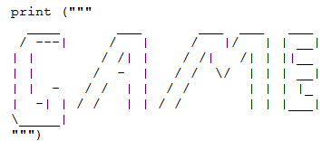
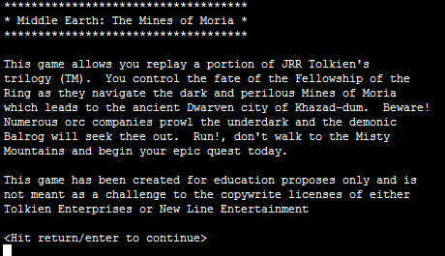
Triple Quoted Output
Used to format text output (free form and to reduce the number of calls to the print() function)
The way in which the text is typed into the program is exactly the way in which the text will appear onscreen.
Name of the full example: 6formatting.py
From Python Programming (2nd Edition) by Michael Dawson
From a CPSC 231 assignment courtesy of James Tam

Slide 29
Side Note, Output: Python 3 Vs. Python 2
Python 3: to be consistent all functions require brackets to enclose the arguments/function inputs
  E.g. print("Sup?")
Python 2 does not explicitly bracket all functions
  E.g. print "Sup?"
There are other differences so make sure you are writing programs that follow the Python 3 and not Python 2 syntax.

Slide 30
Arithmetic Operators
Name of the full example: 7operators.py
Operator | Description | Example
= | Assignment | num = 7
+ | Addition | num = 2 + 2
- | Subtraction | num = 6 - 4
* | Multiplication | num = 5 * 4
/ | Division | num = 9 / 2
// | Integer division | num = 9 // 2
% | Modulo | num = 9 % 2
** | Exponent | num = 9 ** 2
4.5
4
1
81

Slide 31
Order Of Operation
First level of precedence: top to bottom
Second level of precedence
  If there are multiple operations that are on the same level then precedence goes from left to right.
() | Brackets (inner before outer)
** | Exponent
*, /, //, % | Multiplication, division, modulo
+, - | Addition, subtraction
= | Assignment
Example
num = 3 * 2 ** 3
Vs.
num = (3 * 2) ** 3

Slide 32
Order Of Operation And Style
Even for languages where there are clear rules of precedence (e.g., Java, Python) it’s good style to explicitly bracket your operations and use blank spaces as separators.
  x = (a * b) + (c / d)
It not only makes it easier to read complex formulas but also a good habit for languages where precedence is not always clear (e.g., C++, C).

Slide 33
After This Section You Should Now Know
How to create, translate and run Python programs.
Variables:
  What they are used for
  How to access and change the value of a variable
  Conventions for naming variables
  How information is stored differently with different types of variables, converting between types
Output:
  How to display messages that are a constant string or the value stored in a memory location (variable or constant) onscreen with print()
How/why use triple quoted output
What are the Python operators for common mathematical operations
How do the precedence rules/order of operation work in Python

