Slide 1
What Is Needed
A computer:
  Running a newer version of MS-Windows (the newest version of Python won’t work for older versions of the operating system such as Windows XP).
  Mac OS X (be aware however that we don’t have access to Mac computers so we can try to help you but you might have to trouble shoot problems on your own).
    Example help link for getting set up:
      https://docs.python-guide.org/starting/install3/osx/
It’s not recommended that you write your program on a phone.

Slide 2
Official Download Site
A sub link of the official website for python: www.python.org
  https://www.python.org/download
  Version to get 3.X (as of spring 2021 it’s 3.9.4)
    Assignments and the project must be submitted using version 3.X
  DO NOT get python version 2.X for this course(the differences will result in problems in your marker running your program)
    These differences will result in your program not running (and you get no credit).
    Example (not the only one)
      Version 3.X: print("hello")
      Version 2.X: print "hello"

Slide 3
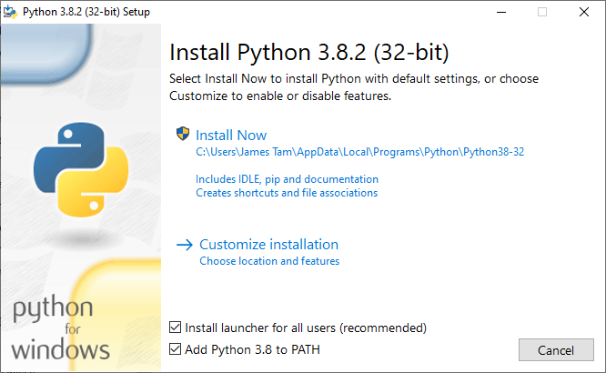
Installing Python
Getting Python (get version 3.X and not version 2.X)
  http://www.python.org/download/
Then click “Install Now”
Make sure you check this option!

Slide 4
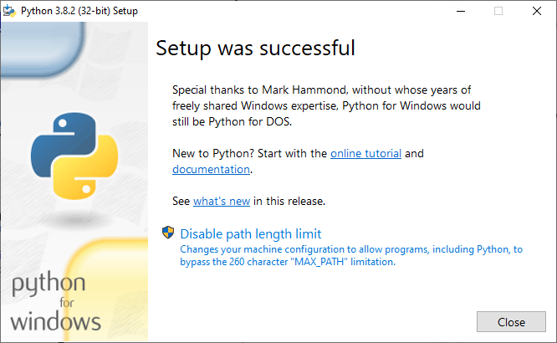
What To Do If You See This Popup During The Install
Select this option and be happy

Slide 5
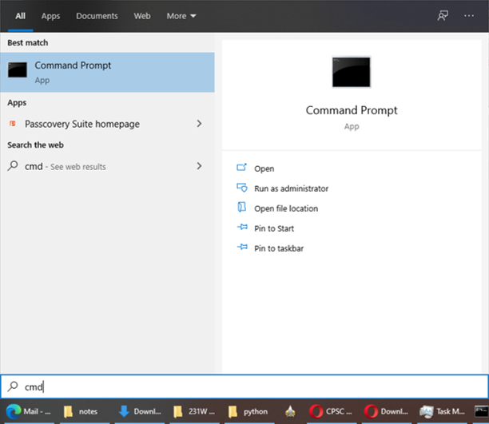
How To Access Python
Start up the command line (cmd in windows).
Press the start button and type ‘cmd’

Slide 6
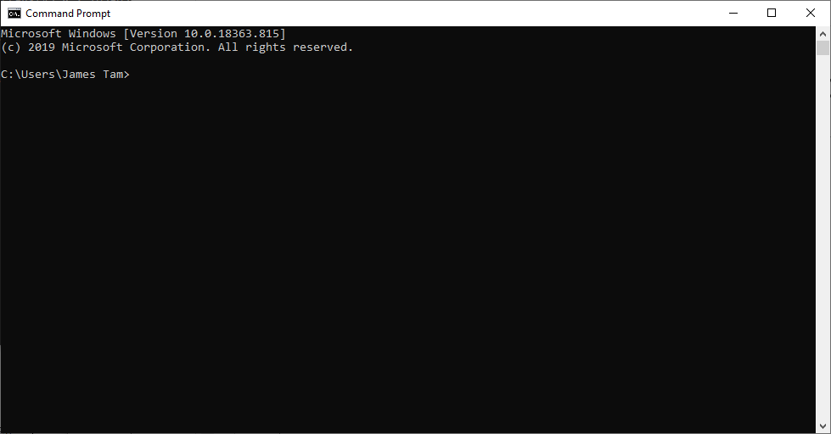
How To Access Python
Hit enter and you will see the “command line” (a line where you can type Windows commands).
  You can run python (as well as other Windows commands here).

Slide 7
What To Do After This…
The specific details of creating Python programs is quite involved and will constitute the bulk of this course so…
…for the exciting sequel you need to attend class ;-)

