Slide 1
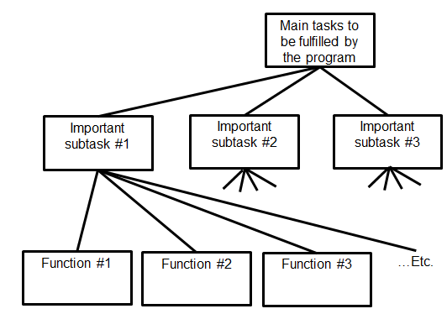

Introduction To CPSC 217
Python programming
Procedural programming
James Tam
Problem solving
Fun! Fun! Fun!

Slide 2

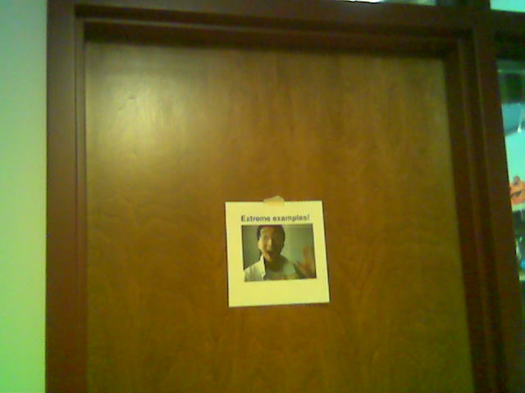

Administrative (James Tam)
Contact Information
  Email: tam@ucalgary.ca
  Make sure you specify the course name and number in the subject line of the email ‘CPSC 217’ (otherwise I might miss it).
Office time
  Monday and Tuesday from 1:00 – 1:50 PM
  https://ucalgary.zoom.us/j/91266944736
  (passcode = 'Hope')
  Other help resources are available (‘CT’ to be described later).
My regular office
My virtual office (=Zoom)
(This is the Tam humor BTW…)

Slide 3
Course Resources
Required resources:
  D2L site (You must get the notes from here before lecture)
    Course website can be reached via D2L (Content->Course Information) or https://pages.cpsc.ucalgary.ca/~tamj/2021/217P/
      The website includes everything but the lecture videos and may display better than viewing them from within the D2L frame.
    Recommended but not required textbook:
  "Starting Out with Python"(Gaddis T.) Addison-Wesley.
    5th edition via the campus bookstore
    4th or 3rd edition can be purchased in the “previously enjoyed” version
  Alternatively you can access any book licensed by the university (‘for free”) on the library web site:
    (One of many books available) “Visual QuickStart guide” http://proquest.safaribooksonline.com.ezproxy.lib.ucalgary.ca/

Slide 4
Your Engagement Level ---> Your Learning
+
Learning
Computer programs
Computer program

Slide 5
Lecture: How To Use The Course Resources
They are provided to support and supplement this class.
  The notes outline the topics to be covered
  At a minimum look through the notes to see the important topics.
  However the notes are just an outline and just looking at them without coming to class isn’t sufficient to do well
  You will get additional details (e.g., explanations) during lecture time
    Take notes!
    If you miss a lecture then get a copy of the in-class notes from another student (who takes detailed notes)

Slide 6
Lecture Content
You need to attend class (even if it’s virtual)
  Make sure you review the video if you miss class
New programming concepts
  E.g. repetition, functional decomposition…
Filtering concepts: programming languages are extensive, even professional software developers aren’t experts in all parts of a language.
  You will be informed as to what concepts are important for this course
  What parts of the language are important.
  How to do things with language e.g. how to use a random number function as computer simulation.
While “Googling it” can provide links to example programs Google won’t show you all the answers e.g. what’s important for this course.
Beyond this lecture will provide some opportunities to develop your skills e.g. we’ll go over practice problems

Slide 7
Tutorials
There’s two types: teaching and help tutorials
Teaching tutorials:
  Similar to lecture, again you should be attending when they run or at least reviewing the videos afterward.
    Reinforce concepts but the audience size is smaller (easier to ask questions about content) and hearing an alternative explanation for complex concepts can be beneficial.
    The teaching assistants will also go over assignments.
    Some hands on work will also occur.

Slide 8
Tutorials (2)
Help tutorials (CT/Continuous tutorial)
  Attendance is optional.
  It’s your opportunity to ask questions.
  Staffed by the teaching assistants (who teach the tutorials):
T01 | Amir Aminbeidokhti | amir.aminbeidokhti@ucalgary.ca
T02 | Amir Aminbeidokhti | amir.aminbeidokhti@ucalgary.ca
T03 | Yajurv Bhatia | yajurv.bhatia@ucalgary.ca
T04 | Yajurv Bhatia | yajurv.bhatia@ucalgary.ca
T05 | Sonali Keshava Murthy Naik | sonali.keshavamurthy@ucalgary.ca
T06 | Sonali Keshava Murthy Naik | sonali.keshavamurthy@ucalgary.ca
Plus the TA who answers email questions outside of CT times will staff most of the CT hours: Israa, email israa.farouk1@ucalgary.ca

Slide 9
Evaluation Components
Assignments:
  5 full assignments: 88% total
  6 mini assignments (2% each) = 12% total
Information about assignments will be made available here:
  https://pages.cpsc.ucalgary.ca/~tamj/2021/217P/#Main_grid:_lecture_&_tutorial_schedule,_assignment_information

Slide 10
Programming Language
All evaluation components must be completed by writing a program using Python version 3.x (not version 2.x) and submitting your work to the appropriate D2L Dropbox link.
You need a computer in order to install and run python.
Information about installing python and then accessing it on your computer.
  https://pages.cpsc.ucalgary.ca/~tamj/2021/217P/notes/pdf/installing_accessing_python.pdf
Note: A5 will include a short writing component (D2L quiz) related to the content of the lectures (more details provided later).

Slide 11
Mini Assignments
The focus is learning how to apply the technical concepts (e.g., branches, functions, loops etc.) by writing a small and relatively simple program.
Marking will focus on ‘functionality’: getting the program to work
Although you shouldn’t ignore other things such as style and documentation these things won’t be graded for the mini-assignments

Slide 12
Full Assignments
Similar to the mini assignments you will write a computer program
  The programs will be larger and more challenging than the mini-assignments (require a ‘tough’ problem to be solved).
Marking will not only be based on the functionality of your program (i.e. does it work) but other criteria such as programming style and documentation (additional details will be provided during the semester as each assignment is released).
Details
  Assignment 1: Basics of writing a python program
  Assignment 2: Using branches and repetition in a program
  Assignment 3: Decomposing a program into functions
  Assignment 4: A biological simulation using 2D lists
  Assignment 5: Part 1: files/exception handling, Part 2: a D2L quiz

Slide 13
Assignments
You will create a working and executable computer program.
Use a text editor (similar to a word processor minus the fancy formatting capabilities) to create it and you will electronically submit the text file (to D2L) for marking.
Although you may be given some time in tutorial to work on your assignments (during the “open tutorial”) mostly you will complete your work on your own time.
  Don’t underestimate the time/effort required.
  Creating a good working program is harder than it may first appear.

Slide 14
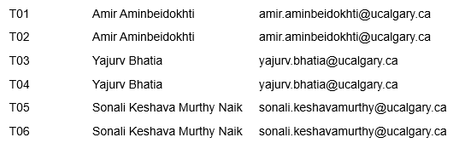
Assignments (2)
Assignments will be marked by the tutorial instructor who teaches your tutorial section.
  That person is the first person to go to if you want to determine your grade or have questions about grading.

Slide 15
Assignments (3)
Test your programs using Python 3.x (not 2.x)
  If your program doesn’t work under these conditions then it will not be marked.
Collaboration:
  Each student must work on his/her own assignment (no group work is allowed for this class)
  Each student must individually submit an assignment
  Students must not see each other’s assignment code
  Additional details will be provided later during the semester
You will electronically submit the file which contains your solution to the assignment via D2L:
  http://d2l.ucalgary.ca/
  (Find the appropriate course name/number and lecture section)

Slide 16
Submitting Assignments
Bottom line: it is each student’s responsibility to make sure that the correct version of the program was submitted on time.
  Alternate submission mechanisms e.g., email, uploads to cloud-based systems such as Google drive, time-stamps, TA memories cannot be used as alternatives if you have not properly submitted into D2L
  Only files submitted into D2L by the due date is what will be marked
Late assignments:
  Full assignments: they may be submitted for a progressive per day penalty (see the assignment description).
  Mini-assignments: late assignments will not be accepted.
If you are ill then a sworn declaration is required.
  Contact your course instructor and not your tutorial instructor to get permission for a late submission

Slide 17
JT’s Helpful Hint: Electronically Submitting Work
Bad things sometimes happen!
  A virus, hardware failure, you screwed up the submission.
Rules of thumb for assignment submissions:
  Do it early! (Get familiar with the system)
  Do it often! (If somehow real disaster strikes and you lose everything at least you will have a partially completed version that your TA can mark).
  Check your work.
    Don’t assume that everything was submitted OK.
    Don’t just check file names but at least take a look at the actual file contents (not only to check that the file wasn’t corrupted but also that you submitted the correct version).
    Assignment 0 ‘A0’:
      An exercise in tutorial where you practice submitting and checking your work
      Not directly graded but still important to complete

Slide 18
How To Verify Submissions In DropBox
There is a help link provided with each assignment description.
Teaching Assistants will cover in conjunction with Assignment zero.
  Not graded but important practice
  Learning objectives:
    How to submit assignments using D2L (most know this).
    How to properly check if a submission “went through” (main learning objective as most students do not do this).
Resource file
  http://pages.cpsc.ucalgary.ca/~tamj/resources/Verifying_D2L_Submissions.pdf

Slide 19
Backing Up And Submitting Your Work
Bottom line: it is up to you to make sure things are done correctly and on time.
If you have questions beforehand then do ask (make sure you ask your questions early enough so you can receive an answer before the due time).
But don’t wait until after the due date (it’s too late).
  If your work isn’t in D2L before the due date then you will be awarded no credit.

Slide 20
Assignments: Late Submissions
If you have a legitimate reason for an extension to get in touch with the course instructor (tam@ucalgary.ca) before the deadline (don’t wait until after the due time/day).
Full assignments: Late submissions without an instructor approved extension will have the following penalties applied.
Mini-assignments: cannot be submitted late:
  Please make sure you submitted it properly before the deadline (the onus is on you to do this).
  If you don’t do this:
    D2L will “cut you off” after the deadline.
    Don’t email it after the deadline because it won’t allow you to be awarded credit.
Submission received: | On time | Hours late : >0 and <=24 | Hours late: >24 and <=48 | Hours late: >48 and <=72 | Hours late: >72 and <=96 | Hours late: >96
Penalty: | None | -1 GPA | -2 GPA | -3 GPA | -4 GPA | No credit

Slide 21
Grades For Each Component
The official grading mechanism for this (and most) universities is a letter grade/grade point e.g. A/4.0, A-/3.7 etc.
Term grades must be stated as a letter grade.
Component grades (assignment, exam etc.) can either be a letter grade or a raw score (e.g. percentage)
For this class
  each major component will be awarded a grade point (and not a percentage) e.g. the 2.0 GPA and not 65% will be used to calculate your term grade.
  and this is the value used to determine the term grade.

Slide 22
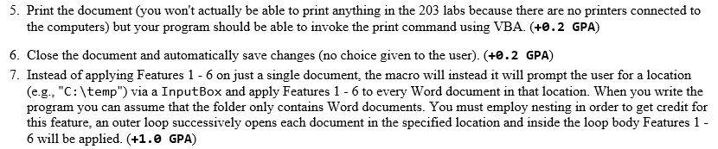
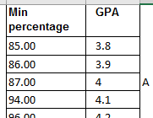
Grading: Course Components
Each course component will have a grading key
Sample from a past assignment (different course)
    A student who completes only Features #5 – 7 will be awarded an assignment grade point of 0.2 + 0.2 + 1.0 = 1.4 (just over a D+ grade)
Examinations will include a lookup table (raw percentage score to grade point). Sample from another course.

Slide 23
Why Grade Points?
It’s the official university grading system
  Alternatives are possible but require faculty level approval
Approval of anything other than a grade point system requires predetermined cutoffs at the start of the term e.g., >= 90% equals ‘A’ etc.
  Doesn’t allow for consideration that individual components may be more challenging than others (lower cutoffs)
Grade points are more lenient for grades on the lower-middle end of the scale
  Grade points: Getting an “A”/4.0 on the assignment component worth 30% of the term grade yields a minimum term grade of 1.2 (4.0 * 0.3) which equates to a term grade of ‘D’ (possibly higher)
  Percentages: Getting an “A” may roughly work out to 90% or higher (depending on the scale) which works out to a minimum term percent of 27% = 90% score * 30% weight…almost certainly an “F” for the term grade.

Slide 24
Grade Points Are Letter Grades Not Percentages
For examinations the mapping between a raw score and a grade point occurs one way (raw score mapped to grade point)
  Example (purely for illustration purposes) 65 – 69% = C/2.0, 70 – 74% = C+/2.3
  But grade points don’t correlate back to percentages
    e.g. I was awarded a 66% on midterm and then I see this is a 2.0 GPA (out of 4.0)
    Does this mean that my percentage ‘went’ from a 66% to a 50%!!!???
    No.
      A C/2.0 does not mean that 50% was awarded as a course grade.
      To put this in perspective a passing grade point in this university is a 1.0/D in a course. If a grade point mapped back to a percentage this would mean that anyone getting a 25% or higher would pass any course here.
  The mapping of the midterm to grade point will be posted sometime after the midterm grades have been released.
  The mapping of the final exam to grade point will be posted sometime after the final exam grades have been released.

Slide 25
Calculating Your Overall Term Grade Point
To determine your weighted term grade point simply multiply each grade point by the weight of each component.
  Percentages won’t be used to determine the term grade point/letter
Sum the weighted grade points to determine the term grade.
Simple and short example (not exactly the same as this term but it should be enough to give you an idea of how to do the specific calculations required this semester):
    Assignment 1: weight = 60/100, example score = A
    Assignment 2: weight = 40/100, example score = B+
    Weighted assignment 1: 0.6 * 4.0 = 2.4
    Weighted assignment 2: 0.4 * 3.3 = 1.32
    Total term grade point = 2.4 + 1.32 = 3.72
  (In this case the term letter is A- if the official university cutoffs were used – more on this shortly)
  (The number and weight of graded components will needed by adjusted to compute your actual term grade).

Slide 26
Calculating Your Overall Term Grade Point (2)
You can use the spreadsheet on the course web page to estimate your term letter grade:
  https://pages.cpsc.ucalgary.ca/~tamj/2021/217P/grade_calculator.xlsx

Slide 27
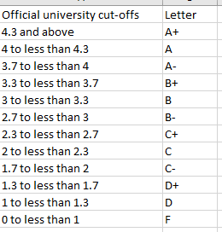
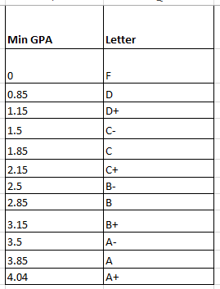
Contrast The Cut-Offs
Official UC cutoffs
The Tam cutoffs (spring 2021)
4
4
3.7
3.3
3.0
2.7
2.3
2.0
1.7
1.3
1.0
0
    The cutoffs in the spreadsheet are significantly more lenient (almost everyone “gets a big break” e.g. instead of 3.7 for an A- it’s 3.5 (midpoint between A-/3.7 and B+/3.3 is the higher letter grade)
    Do not expect a further “rounding up” at the end of the term e.g. 3.4999999999999999999999999999999999999999999999999 is soooooooooooooooooooooooooooooooooooooooooooooooo close to 3.5 can’t you get an “A-”
    No or using an Internet emphasis
    NOOOOOOOOOOOOOOOOOOOOOOOOOOOOOOOOOOOOOOOOOOOOOOOOOOOOOOOOOOOOOOOOOOOOOOOOOOOOOOOOOOOOOOOOOOOOOOOOO!!!!!!!!!!!!!!!!!!!!!!!!!!!!!!!!!!!!!!!!!!!!!!!!!!!!!!!!!!!!!!!!!!!!!!!!!!!!!!!!!!!!!!!!!!!!!!!!!!!!!!!!!!!!!!!!!!!!!!!!!!!!!

Slide 28
Common Computer Skills Assumed
You know what a computer is!
You’ve used a computer in some form (e.g., turn on, turn off, open a file, played a game, gone online etc.)
You have experience using common applications (specifically email, web browsers, text editing using a word processor).

Slide 29

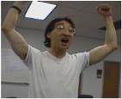
What This Course Is About
Writing/creating computer programs.
But it is not assumed that you have prior knowledge of Computer Science (or even experience writing programs)
It can be a lot of work.
  The course can be completed by students with a normal course load (many already have gotten through it!)
  But be cautious if you already have many other commitments
Late night ‘coding’
Satisfaction coming from solving that tough algorithm!
Wav file from “Tam”
Notes:
Just like getting a good cardio workout: you will have to puff and sweat
With writing computer programs: you will have to plug away and toil in front of a computer
Finding some problems hard and perhaps a little frustrating is normal
Working at these problems is how you get better

Slide 30

Actual Practice: Common Interview Questions
  Besides looking at degrees granted and grades received, some tech companies (e.g., Google) may ask you questions that appear non-technical:
  You’re asked to solve puzzles during the interview.
There is a relationship between skill at solving puzzles (“problem solving”) and success in a (technically oriented) industry.
  You will develop these skills writing programs for this class.
Example list of questions
http://www.businessinsider.com/15-google-interview-questions-that-will-make-you-feel-stupid-2009-11
Notes:
\

Slide 31
Course Goals
Know the basic structure of a computer program (rules for laying out a program and how the basic constructs such as repetition and branching work)
  If you don’t know and understand these concepts then your program won’t work at all and you can’t proceed to the next goals.
Develop basic problem solving and analysis skills.
  As mentioned this is a skill that you will need to develop for “the real world”
Learn good design principles.
  For example you may know how to get a program to run across the Internet but you may not know how to write a fun game that people will want to play on Facebook™.
  “This *%$#! App really sucks!”

Slide 32
How To Succeed
Successful people
Notes:
32

Slide 33
How To Succeed In This Course
Practice things yourself (not by getting the answer from someone/someplace else).
  How Computer Science works: You get better by doing things for yourself (this is a ‘hands-on’ field of study and work).
Providing solutions to assignments may be popular among students but useless for learning
What’s needed is for me to teach you the skills to solve any reasonable size problem
Similar to getting fit: you can’t just watch
You have to do it yourself
Notes:
\

Slide 34
How To Succeed In This Course (2)
  Write lots programs.
    At the very least attempt every assignment.
    Try to do some additional practice work (some examples will be given in class, some practice assignments will be available on the course web page).
    Write lots of little ‘test’ programs to help you understand and apply the concepts being taught.
  Trace lots of code (computer programs)
    Involves reading through programs that other people have written, and executing it ‘by hand’ in order to understand how and why it works
    This is an essential skill.
    Relying on just running the program and observing the results won’t always work (errors?)
  Extra practice problems for the course:
    https://pages.cpsc.ucalgary.ca/~tamj/2021/217P/assignments/practice/index.html

Slide 35
How To Succeed In This Course (3)
Make sure that you keep up with the material
  Many of the concepts taught later depend upon your knowledge of earlier concepts.
  Don’t let yourself fall behind!
  At least attempt all assignments!
Rule of thumb: don’t fall behind more than 1 week (1 lecture for spring)
:
Problem decomposition
Loops/repetition
Decisions/branching
Introduction to programming

Slide 36
How To Succeed In This Course (4)
If you find concepts unclear trying to research the answer on your own can be beneficial (because this is a ‘hands on’ field).
  Read alternate explanations of the concepts covered in class in the text book (or other textbooks: remember that electronic books accessible through the library-Safari are ‘free’).
  Looking at online resources:
    Remember academic resources online just like other online information may not always be a good source.
    Start with more reputable sources
      http://proquest.safaribooksonline.com.ezproxy.lib.ucalgary.ca/
      www.python.org
Addendum to the previous point #2 and a point raised earlier “ask questions”.
  If you are still unclear on concepts then make sure that you ask for help.
  Don’t wait too long (more than a few days) to do this because latter concepts may strongly depend on your understanding of earlier concepts..

Slide 37
How To Succeed In This Course (5)
Look at the material before coming to lecture so you have a rough idea of what I will be talking about that day:
  Read the slides
  Look through the textbook(s)
When we get to more complicated programs that appear to ‘jump around’ in how they execute (“section: problem decomposition/functions”) just having an idea of the scope and components of the program beforehand can be useful when I cover it in class.

Slide 38
How To Succeed In This Course (6)
Start working on things as early as possible:
  Don't cram the material just before the exam, instead you should be studying the concepts as you learn them throughout the term.
  It’s important to work through and understand concepts *before* you start (full) assignments.
  If you try to learn a new concept and work out a solution for the assignment at the same time then you may become overwhelmed.
  Don’t start assignments the night (or day!) that they are due, they may take more time than you first thought (start as soon as possible).
  Some assignments may require the application of multiple concepts, not all the concepts have to be completely covered before you start working on an assignment.
    Start working based on what’s currently been covered (this will teach you how to decompose a program and work on it a part at a time).

Slide 39
How To Succeed In This Course: A Summary
Practice things yourself
Make sure that you keep up with the material
Look at the material before coming to lecture
Start working on things early

