Slide 1
MS-Word
Week 2
Official resource for MS-Office products: https://support.office.com

Slide 2
Activities In Tutorial
TA demos:
  Used for more complex features (typically multiple steps are required).
  The tutorial instructor will show on the projector/instructor computer each step for running the feature in Word.
  Unless otherwise specified the tutorial material will take the form of a TA demonstrating the use of features in Word.
Student exercises:
  Used instead of TA demos for simpler features.
  You will have already been given a summary of how to invoke the feature and the purpose of the exercise is to give you a chance to try it out and get help if needed.

Slide 3
First Tutorial

Slide 4
Working With Tables
Creating a new table
  Insert->Tables group: Table
Converting existing text into a table
  Select text
  Insert->Tables group: Convert Text to a Table
Tables in Word allow for simple (as compared to a spreadsheet such as Excel) calculations to be performed
  Layout->Data group: Formula
  More on this feature later

Slide 5
Basic Table Operations
Merging cells
  Select the cells to merge
  Right click and select the “Merge Cells” option
Inserting new rows or columns
  Select a location in the table
  Right click and select either the “Insert rows above/below” or the “Insert columns to the left/right” option as appropriate
Deleting existing cell(s)
  Select cell or cells to delete
  Right click and select the “Delete cells” option

Slide 6
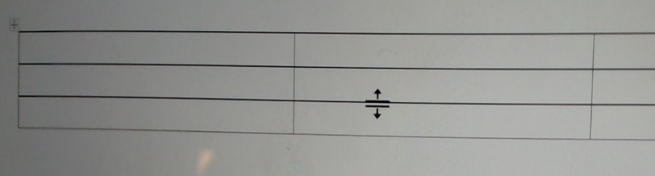

Basic Table Operations (2)
Changing the height/width of rows/columns
  Mouse over (move the mouse over) the boundary of the row or column to resize until the cursor appearance changes.
  (In the image above) the specified row may be thickened or narrowed using the modified cursor.

Slide 7
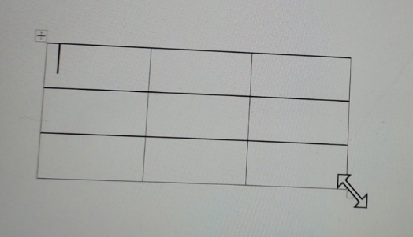

Basic Table Operations (3)
Resizing the entire table
  Mouse over the bottom right corner of the table until the cursor appearance changes (different appearance from resizing rows or columns).
  The table may now be shrunk or enlarged (the aspect ratio – height to width) will be maintained.

Slide 8
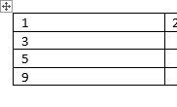
Table Formulas To Know For The Exam
Average(<direction>)
Max(<direction>)
Min(<direction>)
Sum(<direction>)
Directions: above, below, left, right
Example (created via: Layout->Data group: Formula & inserting into Row 4, Column 1):
Inserted formula
=sum(above)

Slide 9

Note: Inserting Formulas Via Running a Feature In The Ribbon Vs. Typing
With the previous example and the data in the first three rows:
Selecting the 4th row and directly typing in that row ‘=sum(above)’ will have the result be treated as text and yield:

Slide 10
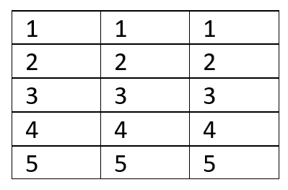
Tutorial Demo:
Start with the Word document: table_example
Enter new values (overwrite existing values) into the following locations:
  Enter a new value into Row 1, Column 3 via (Layout->Data group: Formula) =sum(left)
  Enter a new value into Row 5, Column 2 via (Layout->Data group: Formula) =average(above)
  Directly type int Row 3, Column 3: =sum(right)
Col 1 Col 2 Col 3
Row 1
Row 2
Row 3
Row 4
Row 5
Notes:
Answers:
2
2.5
=sum(right(

Slide 11
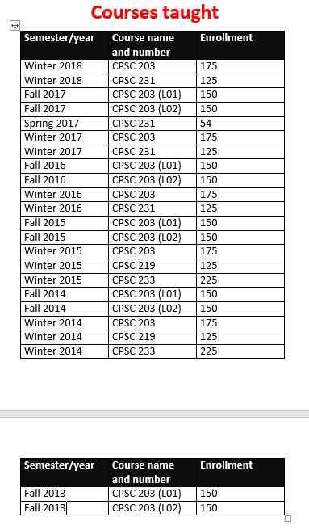
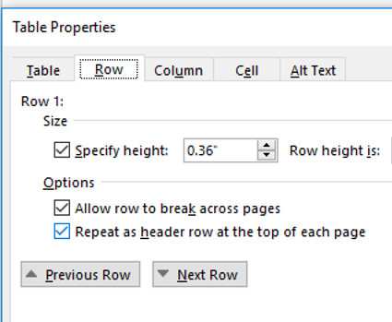
Repeating Table Headings
Always ensure that the headings appear at the top of each page even after the table is modified (deleted and added rows)
Steps:
  Right click on the table
  Select “Table properties”
  Select the ‘row’ tab
  Check the box “Repeat header at the top of each page”.
    By default the box is not checked

Slide 12
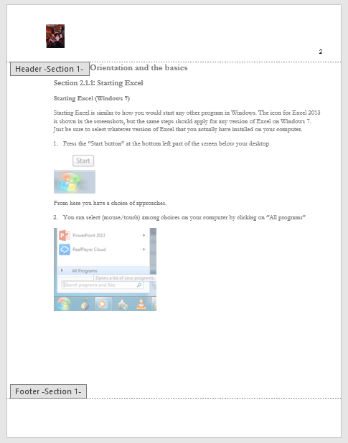
Headers / Footers
Items inserted in these locations can appear on each page
Example:
  Insert->(Header & Footer group: Page Number)
Header
Footer

Slide 13
Text Styles
Home tab->(‘Styles’ group)
Styles have pre-defined fonts, font sizes and font effects which can be applied with a single click.
Word comes with pre-defined styles that can be applied to text.
  Alternatively one can use the format painter (copy-paste formatting)
    Home->(Clipboard group)->Format painter
New styles can also be pre-defined
Some documents may be formatted (e.g. margins, spacing, fonts, font effects etc.) to conform to common writing styles:
  APA template:
    https://templates.office.com/en-US/APA-style-report-6th-edition-TM03982351

Slide 14
Text Styles: Demo #1
(There is no starting document needed for this demo as the tutorial instructor is creating a new style. The TA just has to create a new document add a little text and apply the newly created style to some of the text).
Tutorial instructor will demonstrate how to create a new style:
  Font style that the new style is based on: Normal
  Name: ‘Tut style’
  Font type: Arial
  Font size: 16
  Save the new style
Select some text and apply the style to it

Slide 15
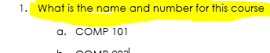
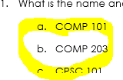
Text Styles: Demo #2
Starting document: Multiple_styles
It can be specified in Word where instances of one style will be followed by instances of another style e.g. each multiple choice question (#1, 2, 3…) includes and is immediately followed by a number of selections (typically 4 or 5).
  Font settings for both styles is: Garamond, 12 point based on the ‘Normal’ style
  First style name: Multiple choice question
  Second style name: Multiple choice selection

Slide 16
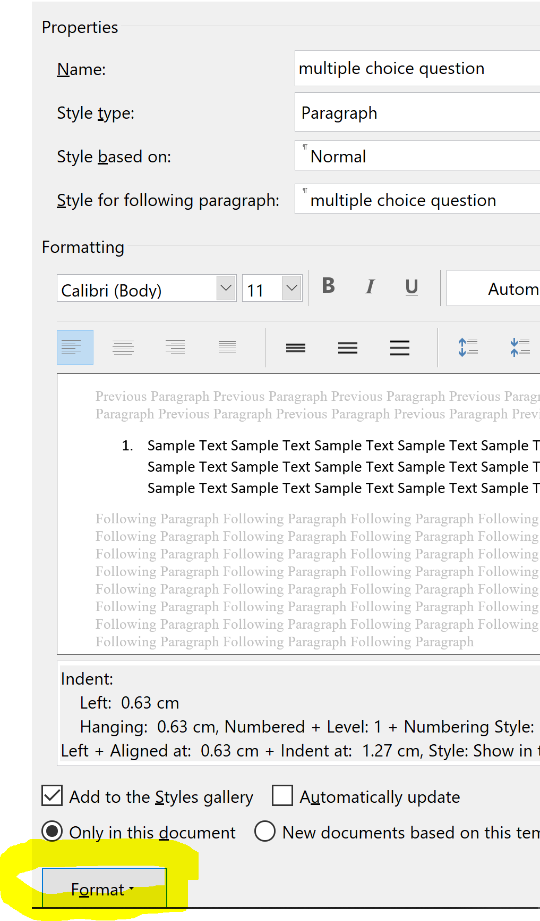
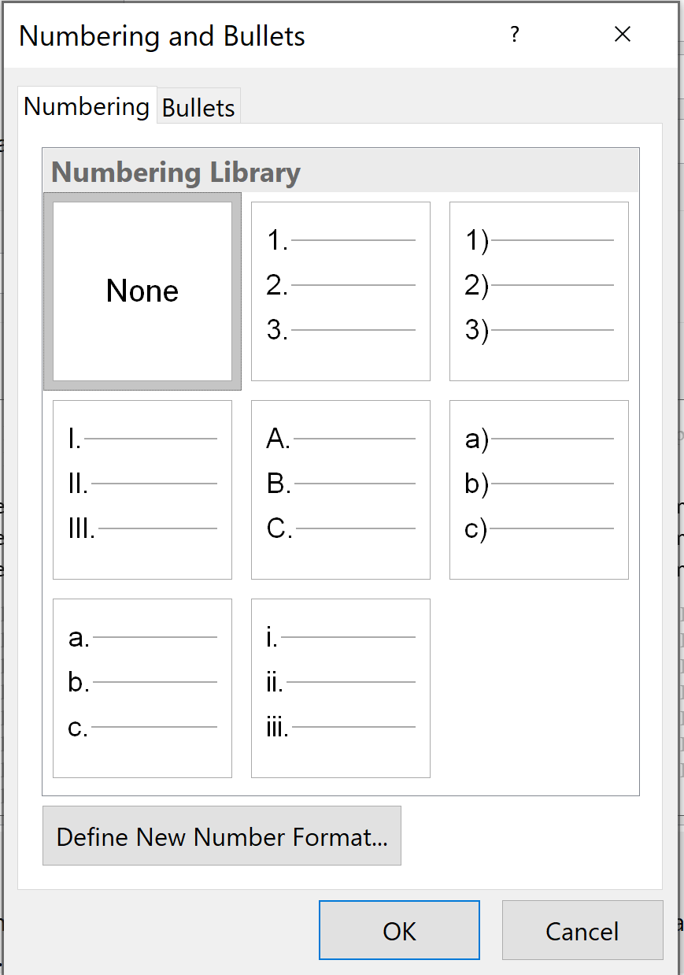
Text Styles: Demo #2
List numbering effects can be set via the ‘Format’ option of the ‘Properties’ of the new style and select the ‘Numbering’ option.
Types of lists to create for the demonstration:
  Multiple choice question: First option
  Multiple choice selection: Fifth option

Slide 17
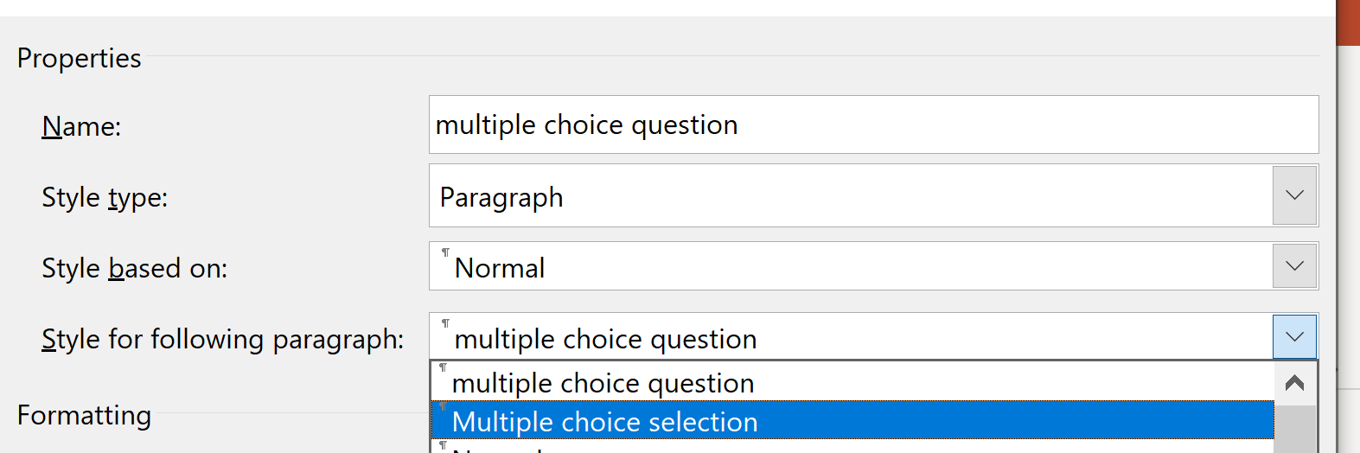
Text Styles: Demo #3
Ensuring an instance of one style is followed by an instance of another style.
  (In this demonstration each instance of “Multiple choice question” will be immediately followed by an instance of “Multiple choice selection”).

Slide 18
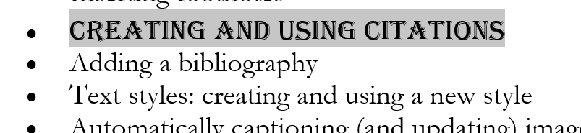
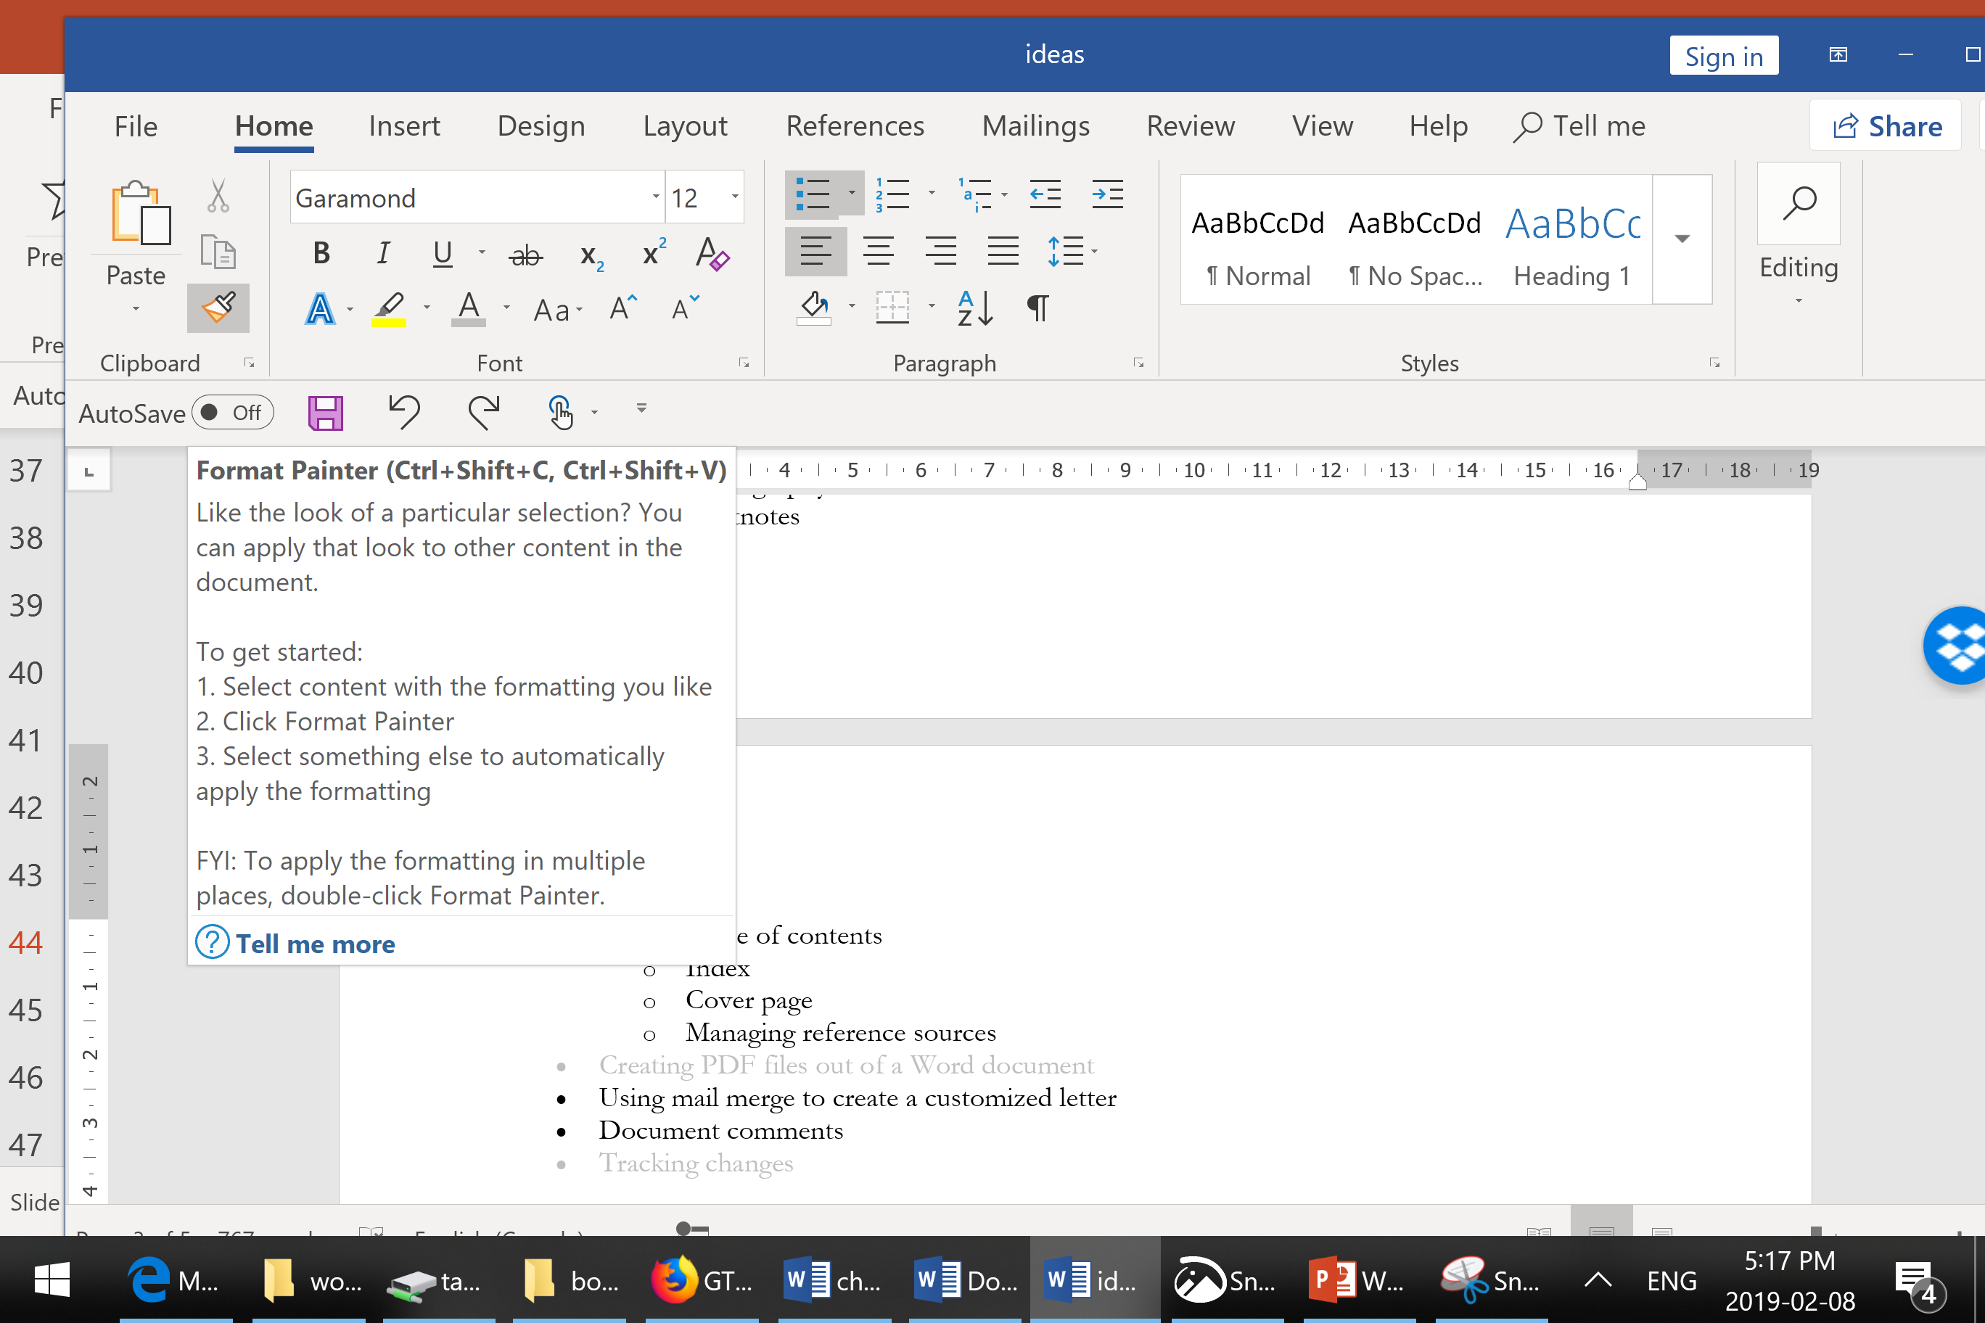
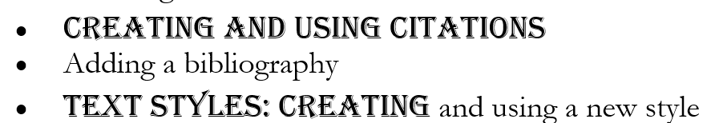

Format Painter
It can be used as quick way of applying the formatting effects (such as font type, size, color) from selected text to other text.
  Selected text
  Click on the “Format Painter’ (cursor changes to a paint brush)
  ‘Paint’ (apply) the formatting to other text (“Text Styles: Creating”)

Slide 19
Second Tutorial

Slide 20
Finding Text In A Document
This is one of the major advantage for having an electronic vs. paper version.
  Example: “Where in this giant section of notes did Tam talk about ‘inserting’ things into Word”
Shortcut:
  <Ctrl>-<f> Press both keys (same time or one after another without releasing the first)
  Home->(Under the ‘Editing group’)->Find (or Replace)
  Styles can even be ‘found’ and replaced

Slide 21
Document Views
Read mode:
  Approximates reading a book (or tablet, magazine). “An easy (JT?)
  to read view”
  Two-page representation allows easy flipping forward/backward
Print layout:
  Default view, onscreen appearance largely matches appearance when printed.
Web layout
  View the document as if it were posted as a web page (no page breaks because web documents are typically one continuous document).

Slide 22
Document Views (2)
Outline
  Outline shows the headings (sub-headings and sub-sub-heading) view of the document.
  Even text in paragraph form is formatted in list form (bulleted and numbered lists)
  Pro: allows faster access to specific list elements
  Use this view for creating master-sub documents
Draft
  Useful for slower computers: images and non-text objects are not shown, page breaks are shown with simple graphics (dotted lines)
An online resource for understanding the different views:
  http://www.peachpit.com/articles/article.aspx?p=2044335&seqNum=2

Slide 23
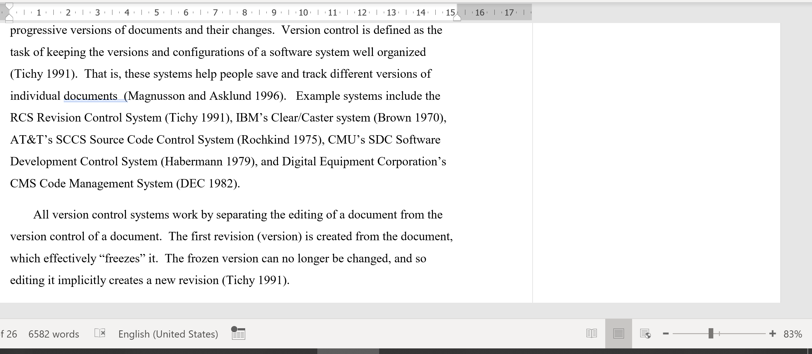

Zooming Into/Out Of A Document

Slide 24
Creating Master-Subdocuments
Important: a master document DOES NOT contain the sub documents.
  No text, images or other data from the subdocument(s) is contained within the master document.
Instead a master document contains links to the subdocument.
  Advantage: this allows multiple users to edit different subdocuments. (This is because each subdocument is a separate document rather than having one large master document – under normal circumstances only one person can edit a document).
  If you are required to implement a master-subdocument and you do things this correctly (as a real master-subdocument(s)) then you will be awarded no credit.

Slide 25
When Can You Use Master Documents
A document consists of several sections
  E.g. Chapters of a book, a report that contains different parts
Question: what is the advantage of creating a master document over alternatives such as creating one large document or several smaller documents (which aren’t linked with a master document)

Slide 26
Outlining The Process Of Creating Master Documents
Documents needed
  Each section or ‘sub-document’ (e.g. book chapter) is created as a normal Word document
    Don’t set up formatting and style yet.
  Then create an additional Word document is created that will become the master document
Process
  Links to the different ‘sections’ (Step #1) are added to the master document making the ‘section documents’ sub documents of the master document.
  The sub documents can be accessed via the master document.

Slide 27
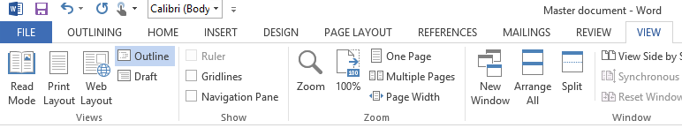
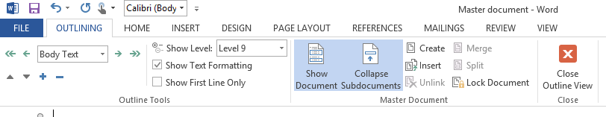
Linking Documents (As Master-Sub Documents)
(Information from the MS-Office help system)
  View->(Document Views group: click Outline)
  Outlining->(Master Document group: Show document) ->Insert

Slide 28
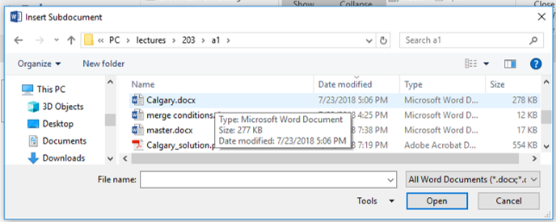
Linking Documents (As Master-Sub Documents)
(After clicking ‘insert’): select the sub-documents to link into the master document
Important! This step ‘links’ the master and sub-document but does not copy and paste the contents

Slide 29
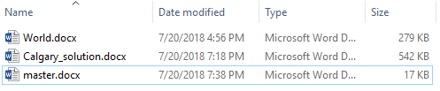

Note: The Master Document Does Not Contain The Sub-Document
Look at the file sizes! (Correct)
(Incorrect: copy-pasted smaller documents into big one)

Slide 30
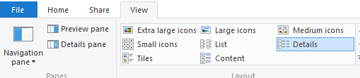
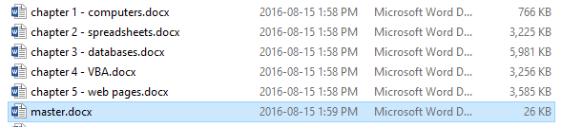
Determining File Sizes In Windows
(In Windows): View tab->details
(Another example of master-sub documents:
  ‘master.docx’ links to but doesn’t contain contents of the 5 chapters.

Slide 31
Multiple Programs: Linked Documents
Example files can be found in the tutorials link for this week under the subfolder ‘linked_documents_example’
Contents of this folder:
  Word document: linked_document (links income to the spreadsheet with the second but not the first example which is a simple copy-paste of the spreadsheet data)
  Excel spreadsheet: Income

Slide 32
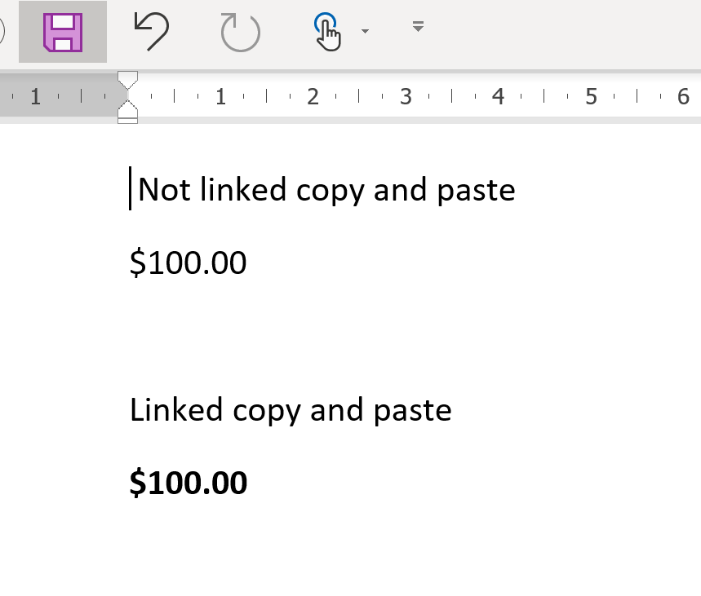
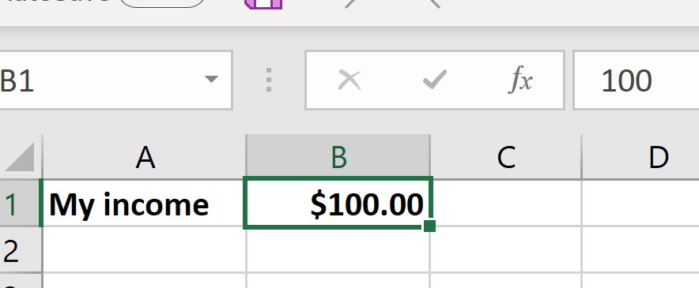
TA Demo: Original Income $100
TA opens both the Excel the spreadsheet and the Word document.
  In the Word document income is $100 for both examples.

Slide 33
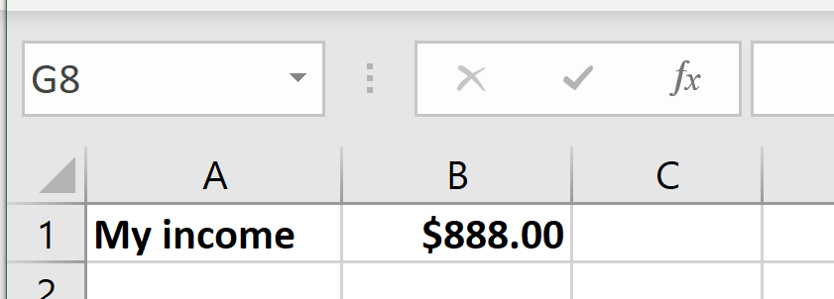
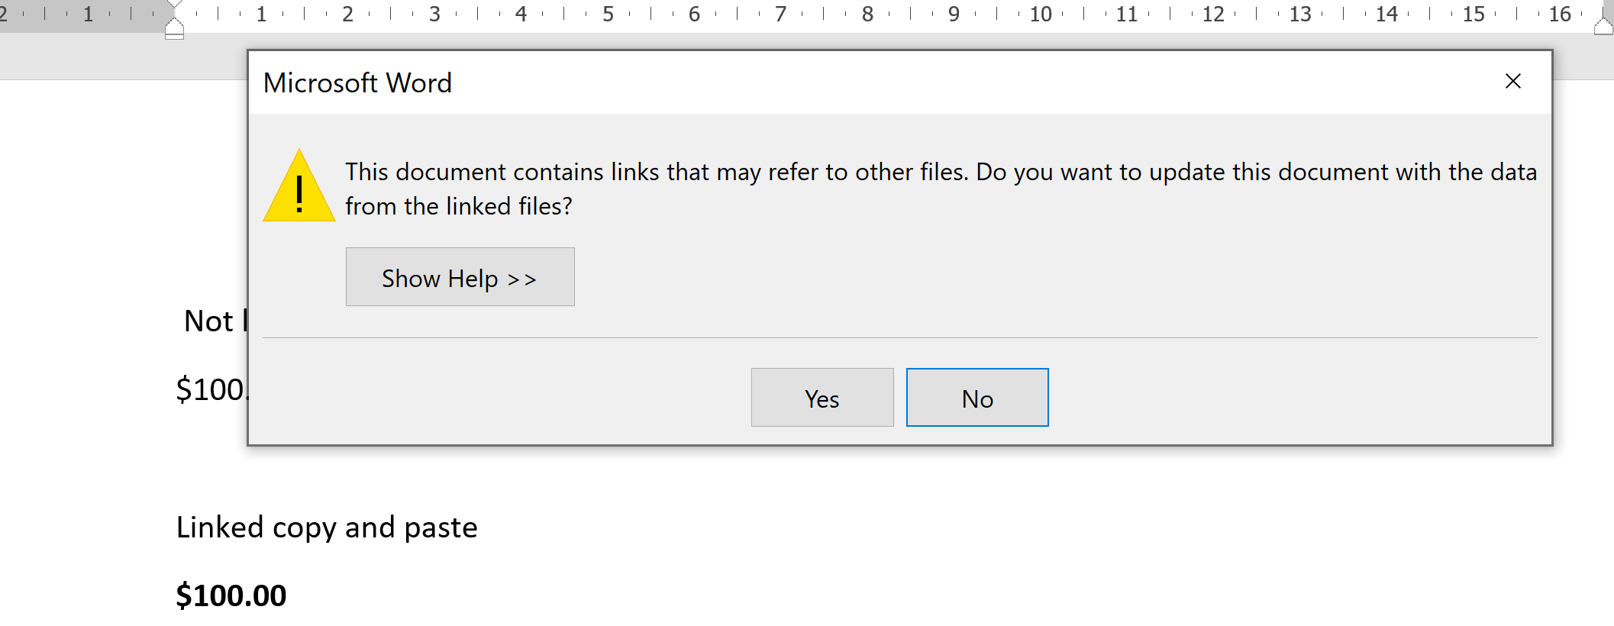
TA Demo: Change Income To $888
The Excel spreadsheet is edited and saved.
Close and reopen the Word document and prompt will appear to update the linked information.
  Select ‘Yes’

Slide 34
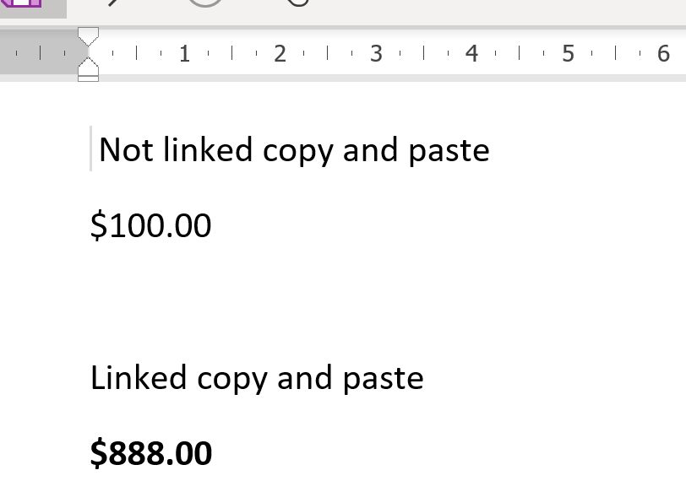
TA Demo: Change Income To $888 (2)
The income for the linked version (second) is updated to the new value.

Slide 35
Advantage Of Linking Documents
The calculating capabilities of the spreadsheet can be utilized by determining results in Excel.
Links will then allow the most recent version of those results to be displayed in Word (which has more options than Excel for formatting and laying out text).
A master-subdocument relationship is another example of linking documents (coming up).

