Slide 1
VBA: Tutorial Week 5
Formatting cells: setting the fill color, changing fonts and font effects
Accessing cell data
Inserting and simple configuring of chart properties
Accessing specific workbooks
Data analysis of a worksheet: counting occurrences, specifying search criteria
Sorting spreadsheets
Nested loops
Official resource for MS-Office products: https://support.office.com

Slide 2
Workbook Exercise #5
Counting the total number of town visitors (count is written to the spreadsheet).
Counting the number of visitors for each month (count appears in a popup MsgBox).

Slide 3
Example: Changing Fonts, Font Effects, Fill Color
Font changes can be made via the Cells or the Range object
Spreadsheet name: 1_formatting_cells
  Sub formattingEffects()
  Dim colorChoice As String
  Dim colorChoiceInvalid As Boolean
  Range("B2:D5").Font.Name = "Arial Black"
  Cells(1, 1).Font.Size = 24
  colorChoiceInvalid = True

Slide 4
Example: Changing Fonts, Font Effects, Fill Color (2)
  Do While (colorChoiceInvalid = True)
  colorChoiceInvalid = False
  colorChoice = InputBox("Color (red,blue,green): ")
  If ((colorChoice <> "red") And _
  (colorChoice <> "blue") And _
  (colorChoice <> "green")) Then
  colorChoiceInvalid = True
  ElseIf (colorChoice = "red") Then
  Range("C3:E7").Interior.Color = vbRed
  Range("C3:E7").Font.Color = vbWhite
  Range("C3:E7").Font.Bold = True
  ElseIf (colorChoice = "blue") Then
  Range("C3:E7").Interior.Color = vbBlue
  Range("C3:E7").Font.Color = vbYellow
  Range("C3:E7").Font.Bold = True

Slide 5
Example: Changing Fonts, Font Effects, Fill Color (3)
  ElseIf (colorChoice = "green") Then
  Range("C3:E7").Interior.Color = vbGreen
  Range("C3:E7").Font.Color = vbBlue
  End If
  Loop
  End Sub

Slide 6
Example: Accessing Specific Worksheets
Spreadsheet name: 2_accessing_worksheets_by_user_input
  Sub accessingWorksheets()
  Dim worksheetName As String
  Dim worksheetNumber As Long
  worksheetName = InputBox("Worksheet name to change (Grade
  data, Students, Sheet2): ")
  worksheetNumber = InputBox("Worksheet number to change (1-
  3): ")
  Worksheets(worksheetName).Range("A1") = "Made change to
  worksheet " & worksheetName
  Worksheets(worksheetNumber).Range("B1") = "Made change to
  worksheet #" & worksheetNumber
  End Sub

Slide 7

Accessing Worksheets
Much like with a VBA program where instructions typically affect the currently active document, programs written for Excel will affect the currently active worksheet.
Worksheets can either be accessed by the name or the order in which the sheet was added to the spreadsheet (not the left-right ordering).

Slide 8
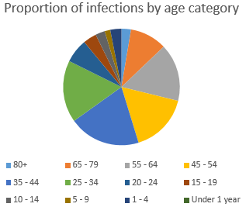
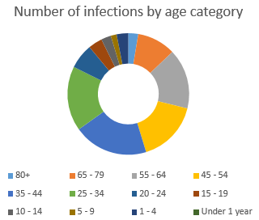
Commonly Used Charts To Represent Proportions
Pie chart
Donut chart

Slide 9
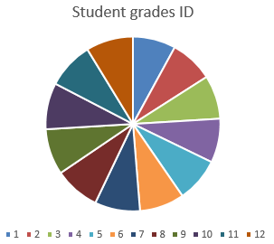
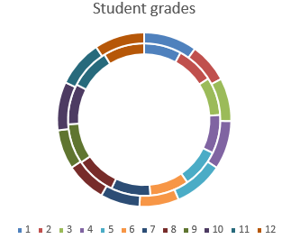
Pie And Donut Charts: When Not To Use
These types of representations are poor at representing exact numeric values (e.g. what was the grade for student #6?).
  Yet they are sometimes used this way in real life!

Slide 10
Example: Inserting Charts Representing Proportions
Spreadsheet name: 3_inserting_portional_charts
Sub insertPieChart()
  Range("A2:A14,C2:D14").Select
  ActiveSheet.Shapes.AddChart2(201, xlPie).Select
  ActiveChart.ChartTitle.Select
  ActiveChart.ChartTitle.Text = "Proportion of infections by age"
  End Sub
  Sub insertDonutChart()
  Range("A2:A14,C2:C14").Select
  ActiveSheet.Shapes.AddChart2(201, xlDoughnut).Select
  ActiveChart.ChartTitle.Select
  ActiveChart.ChartTitle.Text = "Number of infections by age"
  End Sub

Slide 11
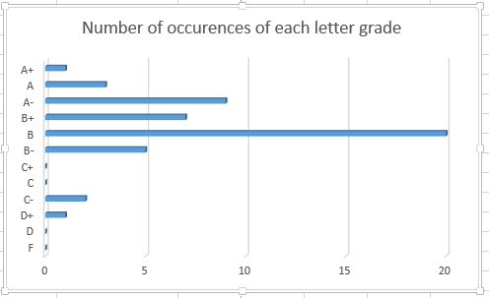
Example: Inserting Charts Representing Quantities
Some good choices include bar, column and line charts
Spreadsheet name: 4_inserting_quantitative_charts
  Bar chart
  Sub insertBarChart()
  Range("C2:D13").Select
  ActiveSheet.Shapes.AddChart2(201, xl3DBarClustered).Select
  ActiveChart.ChartTitle.Select
  ActiveChart.ChartTitle.Text = "Number of occurrences"
  End Sub

Slide 12
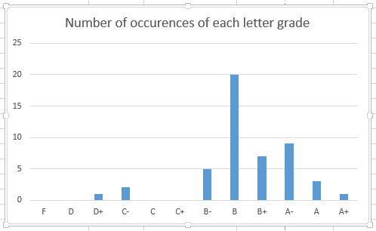
Example: Inserting Charts Representing Quantities (2)
  Sub insertColumnChart()
  Range("C2:D13").Select
  ActiveSheet.Shapes.AddChart2(201, xlColumnClustered).Select
  ActiveChart.ChartTitle.Select
  ActiveChart.ChartTitle.Text = "Number of occurrences"
  End Sub

Slide 13
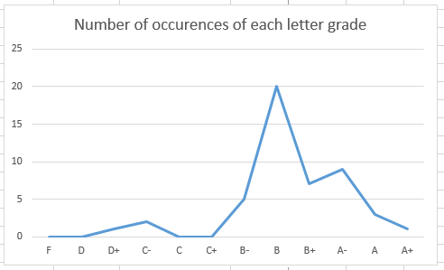
Example: Inserting Charts Representing Quantities (3)
  Sub insertLineChart()
  Range("C2:D13").Select
  ActiveSheet.Shapes.AddChart2(201, xlLine).Select
  ActiveChart.ChartTitle.Select
  ActiveChart.ChartTitle.Text = "Number of occurrences"
  End Sub

Slide 14
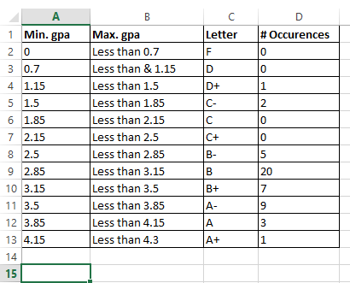
Counting The Number Of Rows In A Chart
With a small set of data you may be able to do this.
  What if you wanted to do this for many spreadsheets (instances of non-empty rows in 1000+ sheets).
A loop can be used to step through row by row until an empty row has been encountered.

Slide 15
Example: Counting Rows
Name of spreadsheet: 5_counting_rows_for_chart
  This program will only include in the chart the actual number of rows of data.
  Sub countingRowsToShart()
  Const LETTER_GRADE_COLUMN As Long = 3
  Const START_ROW As Long = 1
  Const EMPTY_ROW As String = ""
  Dim rowData As String
  Dim currentRow As Long
  Dim count As Long

Slide 16
Example: Counting Rows (2)
  'Counting number of rows
  currentRow = START_ROW
  count = 0
  rowData = Cells(currentRow, LETTER_GRADE_COLUMN)
  Do While (rowData <> EMPTY_ROW)
  count = count + 1
  currentRow = currentRow + 1
  rowData = Cells(currentRow, LETTER_GRADE_COLUMN)
  Loop
  'Insert chart based on range. Will always start at C1
  'but last row determined by number of rows
  Range("C1" & ":" & "D" & count).Select
  ActiveSheet.Shapes.AddChart2(201, xlLineMarkers).Select
  End Sub

Slide 17
Exercise 1
Program description:
  Counts the number of rows containing data (headings and student data).
  The count will be written to cell address that is specified by the user.
Spreadsheet containing the solution (don’t look at it until you have at least made an attempt): Exercise1_counting_rows_writing_user_specified_location

Slide 18
Example: Counting Instances Of User Specified Search Criteria
Spreadsheet name: 6_searching_spreadsheets_with_user_critiera_writing_results
  Sub searchV1()
  Const EMPTY_DATA As String = ""
  Const MEMBERS_ROW As Long = 2
  Const START_RESULTS_ROW As Long = 17
  Const SEARCH_CRITERIA_COLUMN = 2
  Const MEMBER_COLUMN As Long = 1
  Const ETHNICITY_COLUMN As Long = 2
  Const CITY_COLUMN As Long = 3
  Const AGE_COLUMN As Long = 4
  Const NUMBER_MATCHES_ROW As Long = 15
  Const NUMBER_MATCHES_COLUMN As Long = 2

Slide 19
Example: Counting Instances Of User Specified Search Criteria (2)
  Dim count As Long
  Dim searchRow As Long
  Dim currentResultsRow As Long
  Dim desiredCity As String
  Dim currentMemberName As String
  Dim minAge As Long
  Dim maxAge As Long
  Dim currentMemberCity As String
  Dim currentMemberAge As Long
  desiredCity = InputBox("City: ")
  minAge = InputBox("Youngest age for search: ")
  maxAge = InputBox("Oldest age for search: ")

Slide 20
Example: Counting Instances Of User Specified Search Criteria (3)
  Do While (currentMemberName <> EMPTY_DATA)
  currentMemberCity = Cells(searchRow, CITY_COLUMN)
  currentMemberAge = Cells(searchRow, AGE_COLUMN)
  If ((desiredCity = currentMemberCity) And _
  ((currentMemberAge >= minAge) And _
  (currentMemberAge <= maxAge))) Then
  count = count + 1
  Cells(currentResultsRow, MEMBER_COLUMN) = Cells(searchRow,
  MEMBER_COLUMN)
  Cells(currentResultsRow, SEARCH_CRITERIA_COLUMN) =
  desiredCity & ", " & currentMemberAge
  currentResultsRow = currentResultsRow + 1
  End If
  searchRow = searchRow + 1
  currentMemberName = Cells(searchRow, MEMBER_COLUMN)
  Loop

Slide 21
Example: Counting Instances Of User Specified Search Criteria (4)
  'Write out total number of matches
  Cells(NUMBER_MATCHES_ROW, NUMBER_MATCHES_COLUMN) = count
  End Sub

Slide 22
Exercise 2
Program description:
  Counts the number of occurrences of a Covid status (e.g. Recovered, Died) in the spreadsheet.
  The status is entered by the user.
  The count will be written to row 3, column 10 (Cell J3).
Spreadsheet containing the solution (don’t look at it until you have at least made an attempt): Exercise2_covid_data_counting_number_of_user_selected_occurance

Slide 23
Exercise 3
Program description:
  Starting with the solution to the previous exercise modify the program so the user can also select the location where results are written to the spreadsheet.
  It’s your choice if the destination is determined by a (row, column) integer pair or through a cell address.
Spreadsheet containing the solution (don’t look at it until you have at least made an attempt): Exercise3_covid_data_user_selects_start_and_end_count_range_and output location

Slide 24
Example: Error Checking Input, Sorting Based On User Criteria
Name of spreadsheet: 7_error_checking_input_sorting_by_user_criteria
  Sub errorCheckingSortingGrades()
  Dim sortCriteria As String
  Dim sortKey As String
  sortCriteria = InputBox("Sort criteria: ID', 'Last Name', 'GPA'")
  Do While ((sortCriteria <> "ID") And _
  (sortCriteria <> "Last Name") And _
  (sortCriteria <> "GPA"))
  sortCriteria = InputBox("Sort criteria: ID', 'Last name',
  'GPA'")
  Loop

Slide 25
Example: Error Checking Input, Sorting Based On User Criteria (2)
  If (sortCriteria = "ID") Then
  sortKey = "A1"
  ElseIf (sortCriteria = "Last Name") Then
  sortKey = "B1"
  ElseIf (sortCriteria = "GPA") Then
  sortKey = "E1"
  End If
  ActiveWorkbook.Worksheets(1).Sort.SortFields.Clear
  ActiveWorkbook.Worksheets(1).Sort.SortFields.Add Key:= _
  Range(sortKey), Order:=xlAscending
  With ActiveWorkbook.Worksheets(1).Sort
  .SetRange Range("A1:F12")
  .Header = xlYes 'Options: x1No, x1yes
  .Apply
  End With
  End Sub
Note: there is a recorded macro you can see in the VB editor that shows how to sort by multiple keys

Slide 26
Nesting
Two repeated processes.
  One is nested inside the other.
  That means that each time one process starts the nested/inner process starts from beginning to end.
Examples of nested (non-exhaustive list) from lecture.
  Washing Dishes
    While (there are dishes left unwashed)
    Get a dirty dish
    Apply soap to dish
    while (dish is still dirty)
    Rub dish with wet cleaning tool
    If (more soap needed)
    Apply soap to dish

Slide 27
Nesting (2)
Examples of nested (non-exhaustive list) from lecture (continued):
  Martial Arts
  While (there is still a compass point with opponent)
  Turn left to face opponent
  while (opponent is still standing)
  Throw right reverse punch
  Left rising block
  Throw right reverse punch
  Assume guard position

Slide 28
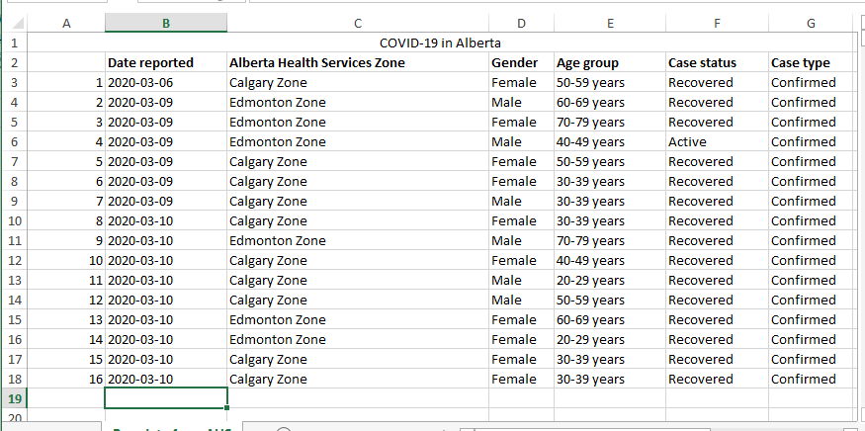
Nesting (3)
Examples of nested (non-exhaustive list) from lecture (continued):
  Counting Covid Alberta Cases

Slide 29
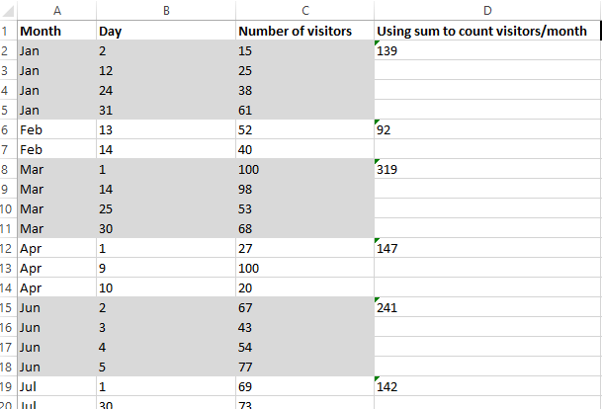
Nesting (4)
Another example: Workbook exercise

Slide 30
Example: Nesting
This program prompts the user for a North American country.
It will re-prompt so long as the country name isn’t one of three possibilities.
Each time the user enters a valid country the program will check if valid region has been entered (currently program only cross checks Canada with Canadian provinces).
Again the program re-prompts for a region until a valid one has been entered.
Spreadsheet name: 8_nested_loops_country_city_count

Slide 31
Example: Nesting (2)
  Sub countClients()
  Const COUNTRY_COLUMN As Long = 1
  Const REGION_COLUMN As Long = 2
  Const NO_VALUE As String = ""
  Const START_ROW As Long = 3
  Dim country As String
  Dim region As String
  Dim countryCount As Long
  Dim regionCount As Long
  Dim row As Long
  Dim countryFromSS As String
  Dim regionFromSS As String
  country = NO_VALUE
  region = NO_VALUE

Slide 32
Example: Nesting (3)
  Do While ((country <> "Canada") And _
  (country <> "USA") And _
  (country <> "Mexico"))
  country = InputBox("North American country: ")
  Do While ((region <> "British Columbia") And _
  (region <> "Alberta") And _
  (region <> "Saskatchewan") And _
  (region <> "Manitoba") And _
  (region <> "Ontario") And _
  (region <> "Quebec") And _
  (region <> "New burnswick") And _
  (region <> "Nova Scotia") And _
  (region <> "Prince Edward Island") And _
  (region <> "Newfoundland and Labrador"))
  region = InputBox("Province to count: ")
  Loop
  Loop

Slide 33
Example: Nesting (4)
  countryCount = 0
  regionCount = 0
  row = START_ROW
  countryFromSS = Cells(row, COUNTRY_COLUMN)
  Do While (countryFromSS <> NO_VALUE)
  regionFromSS = Cells(row, REGION_COLUMN)
  If (countryFromSS = country) Then
  countryCount = countryCount + 1
  End If
  If (regionFromSS = region) Then
  regionCount = regionCount + 1
  End If
  row = row + 1
  countryFromSS = Cells(row, COUNTRY_COLUMN)
  Loop

Slide 34
Example: Nesting (4)
  Range("F2") = "# clients from " & country
  Range("G2") = countryCount
  Range("F3") = "# in " & country & " who live in " & region
  Range("G3") = regionCount
  End Sub

Slide 35
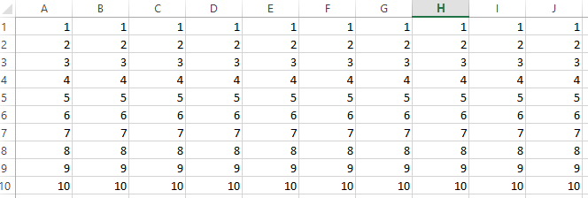
Exercise 4
Program description:
  Using nested loops the program will write the following information into the spreadsheet.
  JT’s comment: this one is substantially more challenging than the previous exercises but solving it will help you find a solution to the graded components.
  Along row 1 from column 1 – 10 write the number 1 into sheet.
  Along row 2 from column 1 – 10 write the number 2 into sheet.
  Along row 3 from column 1 – 10 write the number 3 into sheet.
  Continue along this pattern up to and including row 10 where the number 10 will be written.
Spreadsheet containing the solution (don’t look at it until you have at least made an attempt): Exercise4_nested_loops_numbering_cells

Slide 36
Exercise 5
Program description: get and display the month and year
  Prompt the user for a month as a numerical value from 1 – 12.
  As long as value outside this range is entered the program will repeat the prompt.
  After a valid value for the month has been entered the program will prompt for the day (again an integer value).
  The program will repeatedly prompt for the day as long as a value outside the valid range has been entered.
    The valid range depends upon the month:
      February: ignore leap year and assume the maximum number of days is 28.
      Month with 30 days: April, June, September, November
      Months with 31 days: all other months
Spreadsheet containing the solution (don’t look at it until you have at least made an attempt):Exercise5_nested_loops_entering_month_day

Slide 37
An Excellent Exercise To Help You Prepare For The Assignment: The Last Workbook Exercise
The last exercise is quite challenging (you already have 3 graded components assigned which included the basics of VBA programming).
Similar to the full assignment the exercise requires that you implement a solution using nested loops.
  Workbook Exercise:
    Outer loop to traverse from the start of the days where visitors came to town until the end.
    Inner (nested) loop runs from start to finish each time the outer loop runs: traverses all the visitor information for a particular month.
  Assignment:
    Outer loop to traverse from the start of the Covid cases until the end (empty row).
    Inner (nested) loop runs from start to finish each time the outer loop runs: traverses or steps through all the Covid cases for a particular day.

