Slide 1
VBA: Tutorial Week 4
Accessing document names (DIR) & opening documents (Documents collection)
Official resource for MS-Office products: https://support.office.com

Slide 2
Microsoft Introduction/Overview Of VBA
https://docs.microsoft.com/en-us/office/vba/library-reference/concepts/getting-started-with-vba-in-office

Slide 3
Reinforcing What You Have Been Told: Academic Misconduct
What’s allowed in terms of assignments and ‘help’.
There is no group work allowed for this class.
Students should not see the assignment solutions produced by other students.
If you include work completed by another person (lecture or tutorial examples, something found online – not from another student).
Clearly cite the source (distinguish your work from others) e.g.
Sub a3()
'<<< Begin: Word search from CPSC 203 lecture example >>>
'Extra_Loop_Search_4_Word
With ActiveDocument.Content.Find
Do While .Execute(FindText:=searchWord, _
Forward:=True, MatchWholeWord:=True) = True
occurrences = occurrences + 1
Loop
End With
'<<< End: code from lecture >>>
...

Slide 4
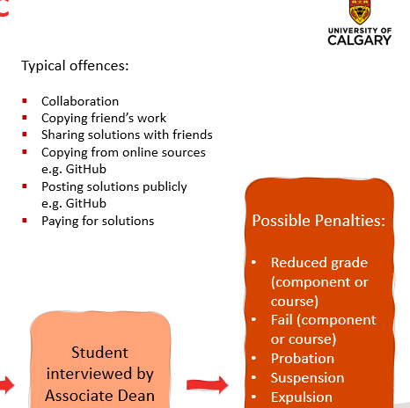
More On Academic Misconduct
Suspect misconduct cases must be handled by the assistant department head and the associate dean.
The Teaching Assistant nor the course instructor can discuss cases with students.
Possible Penalties (determined by the office of the dean, image from the associate head)
(This should convince students that it’s “not worth” taking the chance).

Slide 5
More On Academic Misconduct (2)
For more information (there is also a link to this website in every assignment and workbook exercise) under the heading “Important points to keep in mind”
https://pages.cpsc.ucalgary.ca/~tamj/2020/203F/assignments/misconduct.html
Further clarification needed?
Please contact your course instructor: tam@ucalgary.ca (so you get a consistency of answers received).

Slide 6
General Approach For Automatically Opening/Processing Word Documents In VBA
The DIR function will return the name of files (including Word documents) at a specified location.
Given the name of a Word document the methods of the Documents collection can open that document.
After a document has been opened it becomes the currently active document (when another document is opened then the second document becomes the currently active document).
Methods/attributes of the ActiveDocument collection can then be used to process the currently active document e.g. word count, find a word, get information about the collections in that document (such as tables, images etc.)
The document can also be modified (e.g. font effects, writing text to the document, modifying items in a collection etc.)

Slide 7
Document Processing Example
Prompts user for a path (location to folder containing the documents).
Repeatedly prompts so long as the path is empty.
If the path is not empty the program checks if the folder does not contain Word documents, if so an error message appears and program ends.
If folder does contain documents:
Display the current name of the document in a popup
Open the document
If the opened document contains no shapes then write an error message into the document with enhanced font effects
If the opened document does contain shapes the successive set the fill color of each shape to red (from first to last)

Slide 8
Document Processing Example (2)
(Folder does contain documents continued)
Automatically save and close the document.
Move onto the next document (get the name) and apply Steps 1 – 6 to it.
Name of the Word document containing the example program: 11set_fill_color_for_all_documents_in_a_folder

Slide 9
Document Processing Example
Sub setFillAllFolderDocuments()
Const ERROR_MESSAGE As String = "No shapes in document to fill"
Dim location As String
Dim currentDocumentName As String
Dim fullname As String
Dim currentShape As Long
Dim numShapes As Long
location = ""
currentDocumentName = ""
Do While (location = "")
location = InputBox("Enter path to Word documents " & _
"(e.g. C:\temp): ")
If (location = "") Then
MsgBox ("You entered '" & location & _
"', don't enter an empty location")
End If
Loop
Repeatedly prompt if the user didn't enter any location

Slide 10
Document Processing Example (2)
Separator between last containing folder and filename
location = location & "\"
currentDocumentName = Dir(location & "*.doc*")
If (currentDocumentName = "") Then
MsgBox ("Unable to retrieve any docs in the " & _
"specified location")
Only consider and open Word (2003 or 2007+) documents
Check if program is unable to find Word documents in location

Slide 11
Document Processing Example (3)
Loop executes so long as there is another Word document that hasn't already been accessed
Else
Do While (currentDocumentName <> "")
MsgBox (currentDocumentName)
fullname = location & currentDocumentName
Documents.Open (fullname)
numShapes = ActiveDocument.Shapes.Count
If (numShapes = 0) Then
Selection.Font.Bold = True
Selection.Font.ColorIndex = wdRed
Selection.Font.Size = 24
Selection.TypeText (ERROR_MESSAGE)
Need path and full name to open a document
If no shapes in doc write error message
Set fill color to red for all shapes,

Slide 12
Document Processing Example (4)
There’s 1+ shapes in doc
Else
currentShape = 1
Do While (currentShape <= numShapes)
ActiveDocument.Shapes(currentShape).Fill.ForeColor
= vbRed
currentShape = currentShape + 1
Loop 'Goes through each shape in current doc
End If 'Checks if any shapes in current doc
ActiveDocument.Close (wdSaveChanges)
currentDocumentName = Dir
Loop 'Goes through each Word doc
End If 'Checks if any Word docs in folder
End Sub
Starting with first shape so long as there's another shape in document repeat loop
Automatically save and close document, move onto next document

Slide 13
Student Exercise 4
The program will prompt the user for a path.
Displays an error message if the path is empty and the program ends.
If the path is not empty then it will successively open each Word document at that location and process it in the following fashion:
Font type will be changed to “Garamond”
The word count will be written to the top of the document using bolded text.
If there’s any tables in the document then they will be sorted (tables have headers).
Hint: it’s pretty extensive requiring several objects and methods (as well a collection to be accessed) so you might have to view previous examples.
Name of the document containing the solution: exericse4_process_all_documents_in_a_folder.docm

