Slide 1
VBA: Tutorial Week 3
Non-linear, non-sequential programming using branches and loop
Nesting: branches and loops
Branching, looping and the InlineShapes collection
Option Explicit
Using the VBA debugger
Official resource for MS-Office products: https://support.office.com

Slide 2
Microsoft Introduction/Overview Of VBA
https://docs.microsoft.com/en-us/office/vba/library-reference/concepts/getting-started-with-vba-in-office

Slide 3
First Tutorial (Monday or Tuesday)

Slide 4
Activities In Tutorial
TA demos:
  Used for more complex features (typically multiple steps are required).
  The tutorial instructor will show on the projector/instructor computer each step for running the feature in Excel.
  Unless otherwise specified the tutorial material will take the form of a TA demonstrating the use of features in Excel.
  Slides titled “Lecture Review” are covered for the second time and dealing with less complex material.
    For this reason they will only be covered briefly in tutorial.
Student exercises:
  Used instead of TA demos for simpler features.
  You will have already been given a summary of how to invoke the feature and the purpose of the exercise is to give you a chance to try it out and get help if needed.

Slide 5
Student Exercise #1
(You may need to review the lecture notes on collections before trying this exercise)
Using the starting document called “1sorting_table_starting” write a VBA program that will sort the first table (ascending order, assumes there is a header) if the document contains more than one table.
If the cut-off for the number of tables hasn’t been met then the program should display a popup message box with a brief description of why sorting didn’t occur as well as the number of tables in the document.
(JT’s comment: test your program by seeing what happens if it contains: no tables, 1 table, 2 or more tables).
Document containing the solution: 1sorting_table_solution

Slide 6
Branching: Alternate Courses Of Execution
What you will know from lecture:
  Branching allows for alternative courses of execution.
  Each alternative executes one or more VBA instructions.
  Branching can be implemented in different ways depending upon the programming language what you will have learned is variations of the IF structure.

Slide 7
IF-THEN ; IF-THEN, ELSE
A Boolean expression (results in either a true or false value) will determine the instruction or instructions that will execute.
IF-THEN executes an instruction or instructions (body of the IF) when the Boolean expression evaluates to true.
  E.g.
    If (true) Then
    The above examples always executes the body because the Boolean expression is always true (the expression is a constant value that is true).
IF-THEN, ELSE reacts for both the true and the false cases.
  E.g.
    If (num >= 0) Then
    Else
    Executes the IF-body when num is positive and the Else-body when num is not positive.

Slide 8
Branches: Depending Upon The # Of Images
Name of the document containing example: 1ifElse
Features: checks if the number of images (‘InlineShapes’ in VBA) is above the defined cut-off value).
  ifThenExample: The first program reacts (popup appears) if the cut-off has been met.
  ifThenElseExample: The second program reacts one way if the cut-off has been met (popup appears) and another way (different popup appears)
  After the branch has been completed both programs will then execute any remaining instructions after the branching structure (after the ‘End If’)
  Also:
    shows an example of defining a named constant (specifies the cut-off value),
    shows the use of the line continuation character (string argument for the MsgBox in the body of the ELSE-branch in the second program).

Slide 9
Branches: Depending Upon The # Of Images IF-Then Version
' First program (IF-THEN)
Sub ifThenExample()
Const CUT_OFF As Long = 2
Dim numShapes As Long
numShapes = ActiveDocument.InlineShapes.Count
If (numShapes > CUT_OFF) Then
MsgBox (">" & CUT_OFF & " pics in active Word doc")
End If
MsgBox ("Branching structure over: End program")
End Sub

Slide 10
Branches: Depending Upon The # Of Images IF-Then, Else Version
' Second program (IF-THEN, ELSE)
Sub ifThenElseExample()
Const CUT_OFF As Long = 2
Dim numShapes As Long
numShapes = ActiveDocument.InlineShapes.Count
If (numShapes > CUT_OFF) Then
MsgBox (">" & CUT_OFF & " pics in active Word doc")
Else
MsgBox ("# pics didn't meet the cutoff of " & CUT_OFF & _
" pics " & " required ")
End If
MsgBox ("Branching structure over: End program")
End Sub

Slide 11
Logic And Branching
Recall how the logical functions, AND() OR(), can be combined with an IF-function in Excel.
  E.g. (hires U of C graduates with a GPA of 3.3 or higher) IF(AND(A1>3.3,B1="UC", "Hire", "")
With programming languages the structure is slightly different, Boolean expressions are chained or connected with AND OR logical operators.
  Format:
    If ((Boolean expression 1) <Logical operator> (Boolean expression 2)…) then
  Example:
    If ((age < 0) Or (age > 114)) Then
  (More than 2 Boolean expressions can be evaluated by the use of additional logical operators):
    If ((age < 0) Or (age > 114) Or (hair = "mullet")) Then

Slide 12
Logic & Branching
Name of the document containing example: 2branchingLogic
Features: Error checks user input using branching (both branches produce similar results)
  First branch example: Employs logical OR (checks if it’s true age is outside the valid range).
    Shows an error message if it’s true that the age is outside the allowable range.
    Shows a confirmation message if it’s false that the age is outside the allowable range (i.e. the age is okay)
  Second branch example: Employs logical AND (checks if it’s true age is inside the valid range)
    Shows a confirmation message if it’s true that the age is inside the allowable range
    Shows an error message if it’s false that the age is inside the allowable range (i.e. the age is not okay)
  Both branches produce the same popup given the same user input (student: verify this for practice).

Slide 13
Logic & Branching: Error Checking Age
VBA instructions needed for both branches
Dim age As Long
age = InputBox("Age (0 - 114)?")

Slide 14
Error Checking A Value: IF With OR
If ((age < 0) Or (age > 114)) Then
MsgBox ("OR: Age is outside allowable range of 0 - 114")
Else
MsgBox ("OR: Age of " & age & " is OK")
End If

Slide 15
Error Checking A Value: IF With AND
If ((age >= 0) And (age <= 114)) Then
MsgBox ("AND: Age of " & age & " is OK")
Else
MsgBox ("AND: Age is outside allowable 0 - 114")
End If

Slide 16
Checking Multiple Conditions
There’s two general cases:
  Zero or one of the conditions is true (no more than one so having one true case excludes the possibility of any other cases being true).
    Example: getting a letter grade for a class during a particular semester, specifying the current city, town that you reside in.
    VBA structure to use: IF-ELSEIF
  Zero, one, two up to all of the cases can be true.
    Example: for each class taken checking if a perfect score was awarded (letter grade ‘A’), checking if a person has ever lived in each of the cities, towns in a particular country (Have you ever lived in Calgary? Have you ever lived in Edmonton? Etc.)
    VBA structure to use: Multiple and independent IFs

Slide 17
IF-ELSEIF, Multiple IFs
Name of the document containing example: 3multipleIfVSIFElseIF
Features:
  Part I: Check for birth city
    Prompts the user for the city that person was born in an reacts in different ways based on that information. One approach uses an IF-ELSEIF structure, the other employs multiple and separate IF structures.
    Note: the use of the multiple IFs is not an appropriate solution in cases such as this but is included for learning purposes (to show how difficult it can be to check for the ‘none of the above’ case).
  Part II: Check education level and if the person is a senior citizen
    These two checks are independent, education level and the senior check are unrelated.
    (Alternatively phrased): regardless of what the user enters for the years of education, the program will always check if the person is or is not a senior.

Slide 18
Multiple Conditions: Checking City Of Birth
Solution using multiple IFs
Dim birthCity As String
birthCity = InputBox("City of birth")
If (birthCity = "Calgary") Then
MsgBox ("You are 'Part of the Energy'")
End If
If (birthCity = "Edmonton") Then
MsgBox ("From the City of Champions")
End If
If (birthCity = "Dubai") Then
MsgBox ("Definitely Dubai!")
End If
If (birthCity = "Fargo") Then
MsgBox ("You're always warm")
End If

Slide 19
Multiple Conditions: Checking City Of Birth (2)
' When none of the cases in any of the previous IFs apply
' requires a very awkward solution
If ((birthCity <> "Calgary") And _
(birthCity <> "Edmonton") And _
(birthCity <> "Dubai") And _
(birthCity <> "Fargo")) Then
MsgBox ("Multiple-IFs: Miscellaneous place")
End If

Slide 20
Multiple Conditions: Checking City Of Birth (3)
Solution using IF-ELSEIF (better approach)
  If (birthCity = "Calgary") Then
  MsgBox ("You are 'Part of the Energy'")
  ElseIf (birthCity = "Edmonton") Then
  MsgBox ("From the City of Champions")
  ElseIf (birthCity = "Dubai") Then
  MsgBox ("Definitely Dubai!")
  ElseIf (birthCity = "Fargo") Then
  MsgBox ("You're always warm")
  Else
  MsgBox ("IF-ELSEIFs: Miscellaneous place")
  End If

Slide 21
Multiple Conditions: Education Level, Senior Citizen
' Check for grade level and if senior have nothing to do
' with each other, both checks must always occur so using multiple
' Ifs is appropriate.
Dim gradeLevel As Long
  Dim age As Long
  gradeLevel = InputBox("What is your highest grade level: ")
  age = InputBox("What is your age: ")
  If (gradeLevel >= 13) Then
  MsgBox ("College person!")
  End If
  If (age >= 65) Then
  MsgBox ("Senior citizen")
  End If

Slide 22
Multiple Conditions: Education Level, Senior Citizen (Solution With Bug)
Student exercise: find the bug in the following program.
Dim gradeLevel As Long
  Dim age As Long
  gradeLevel = InputBox("What is your highest grade level: ")
  age = InputBox("What is your age: ")
  If (gradeLevel >= 13) Then
  MsgBox ("College person!")
  ElseIf (age >= 65) Then
  MsgBox ("Senior citizen")
  End If

Slide 23
Looping/Repetition
Used when a part (or the entire) program needs to repeat as long a condition has been met.
The condition is a Boolean expression.
START
Do while (Condition)
Instruction(s)
Loop
Run game
Y
Play again?
N
END GAME

Slide 24
Example: Counting Program (Up/Increases)
Name of the document containing example: 4loopV1Up
Features:
  The program will iterate (count) through the sequence of numbers 1 – 11 in increments of 2 (1, 3, 5, 7, 9, 11)
  Sub countingLoopV1Up()
  Dim i As Long
  i = 1
  Do While (i <= 11)
  MsgBox ("i=" & i)
  i = i + 2
  Loop
  End Sub
  Student exercise: what if the Boolean expression was changed to (i <= 10)?

Slide 25
Example: Counting Program (Down/Decreases)
Name of the document containing example: 5countingloopV2Down
Features:
  The program will iterate (count) through the sequence of numbers 10 – 1 in decrements of 3 (10, 7, 4, 1)
  Sub nineLoopV2()
  Dim i As Long
  i = 10
  Do While (i >= 1)
  MsgBox ("i=" & i)
  i = i - 3
  Loop
  End Sub
  Student exercise: what if the Boolean expression was changed to (i >= 0)?

Slide 26
Student Exercise
Write a program that will, using a loop, display all the multiples of 5 in the range from 5 – 15,625.
The program will display each multiple of 5 within this range in a MsgBox one-at-a-time.
Document containing the solution: 2multiples_of_five_solution

Slide 27
Nesting: Branches And Loop
Branches and loops can be nested within each other
  Scenario 1
  If (Boolean) then
  If (Boolean) then
  ...
  End if
  End if
  Scenario 2 Scenario 3
  Do while (Boolean) If (Boolean) then
  If (Boolean) then Do while (Boolean)
  ... ...
  End if Loop
  Loop End if

Slide 28
Recognizing When Nesting Is Needed
Scenario 1: Only if a question answers true then check if another question answers true or false.
  Example: If the user entered Canada as country of residence then ask if the user’s province of residence is Alberta.
  Type of nesting: a IF-branch
  nested inside of an IF-branch
    If (Boolean) then
    If (Boolean)
    ...
    End If
    End If
Q:Canadian?
F
T
Residence is CA
Q: Albertan?
F
T
Residence also AB
Done

Slide 29
(Key Part: IF) Nested Inside An IF
Nesting: a structure (e.g. IF) is nested inside of another structure (e.g. IF) when the second structure is part of the body of the first structure.
Word document containing the example: 6nesting_branch_within_branch
  'Some parts excluded for brevity.
  country = InputBox("Current country of residence: ")
  If (country = "Canada") Then
  message = message & "Great country, "
  province = InputBox("Current province of residence: ")
  If (province = "AB") Then
  message = message & " Greatest place on earth ^-*"
  End If 'Checking province
  End If 'Checking country
Recall: the check for the Boolean expression for the second IF does not occur unless the first Boolean expression is true. (Don’t bother checking if province is AB if country isn’t Canada).

Slide 30
Second Tutorial (Wednesday or Thursday)

Slide 31
Recognizing When Nesting Is Needed
F
Scenario 2: If a question answers true then check if a process should be repeated.
  Example: If the user entered an odd number then count through a sequence 1 to this number and display each odd number in this sequence.
  Type of nesting: a Do-While loop nested inside of an IF-branch
    If (Boolean) then
    Do While (Boolean)
    ...
    Loop
    End If
Q:Odd #?
T
Q: Not yet exceeded last #?
F
T
Display current #
Increment to next odd #
Done

Slide 32
(Key Part: Do-While) Nested Inside An IF
Word document containing the example: 7nesting_loop_in_branch
'Variable & constant declaration excluded for brevity
lastOdd = InputBox("Enter last odd number in sequence: ")
remainder = lastOdd Mod 2
If (remainder = 0) Then
MsgBox (lastOdd & " is even not odd.")
Else
If (lastOdd <= MAX_ODD) Then
count = 1
Do While (count <= lastOdd)
MsgBox ("Current number = " & count)
count = count + 2
Loop
End If 'End: checks size of last #
End If 'End: checks if # is odd or even

Slide 33
Recognizing When Nesting Is Needed
Q: As last # not exceeded?
Scenario 3: As long some condition is met a question will be asked. As long as some condition is met a popup will be displayed.
  Example: While the last number in a sequence hasn’t been exceeded if the current number is even it will be displayed.
  Type of nesting: an IF-branch nested inside of a Do-While loop
  Do While (Boolean)
    If (Boolean) then
    ...
    End If
    Loop
F
T
Q: Even?
F
T
Display #
Increment to next #
Done

Slide 34
(Key Part: IF Nested) Inside A Do-While
Word document containing the example: 8nesting_branch_in_loop
  Const MAX_NUMBER As Long = 20
  Dim lastNumber As Long
  Dim count As Long
  Dim remainder As Long
  lastNumber = InputBox("Enter last number in a sequence: ")
  If (lastNumber <= MAX_NUMBER) Then
  count = 1
  Do While (count <= lastNumber)
  remainder = count Mod 2
  If (remainder = 0) Then
  MsgBox ("Current even #: " & count)
  End If
  count = count + 1
  Loop
  End If

Slide 35
Return To Collections
Recall with the collections you have seen: Documents, InlineShapes, Shapes, Tables you can access a particular element or item in the collection by that item’s index.
  Example (accesses the first InlineShape): ActiveDocument.InlineShapes(1)
Also the number of items in the collection can be accessed through the collection’s count attribute.
  Example (the variable numTables will contain the current number of tables in the currently active Word document):
  numTables = ActiveDocument.Tables.count

Slide 36
Return To Collections (2)
Now that you have learned how to use looping and branching structures, you can:
  Access each item in a collection (using a loop).
  Check if the number of items in the collection is the desired amount (using a branch).

Slide 37
Collections: Inline Shapes
Example program: 3_loop_branch_inline_shapes
  For documents containing 2 - 4 InlineShapes (images) the program will halve the size of odd numbered images.
  Sub reduceOddInlineShapes()
  Const MIN_SHAPES As Long = 2
  Const MAX_SHAPES As Long = 4
  Dim count As Long
  Dim numShapes As Long
  Dim tempWidth As Long
  numShapes = ActiveDocument.InlineShapes.count
  If ((numShapes < MIN_SHAPES) Or (numShapes > MAX_SHAPES)) Then
  MsgBox ("Number of Inline Shapes not " & MIN_SHAPES & _
  "-" & MAX_SHAPES)

Slide 38
Collections: Inline Shapes (2)
  Else
  count = 1
  Do While (count <= numShapes)
  If ((count Mod 2) = 0) Then
  tempWidth = ActiveDocument.InlineShapes(count).Width / 2
  ActiveDocument.InlineShapes(count).Width = tempWidth
  End If
  count = count + 1
  Loop
  End If
  End Sub

Slide 39
Student Exercise 3
Write a program that will prompt the user for a positive integer value (1 or greater).
The program will then double the size of the item # of the Inline Shape in the currently active document.
Name of the document containing the solution: 3enlarge_A_pic_solution

Slide 40
Student Exercise 4
Modify the solution to the previous exercise so that the program error checks the user’s input.
If the value enter by the user is less than 1 or it exceeds the current number of In line shapes in the document:
  The program will display an error message specifying the correct range of values that can be entered (it needs to be based on the actual number of shapes in the currently active document).
  The program will repeat the prompt until a value within the correct range has been entered.
Name of the document containing the solution: 4enlarge_A_pic_solutionV2

Slide 41
Counting Occurrences Of A Word
It’s an application of the ‘Find’ method of the ActiveDocument object combined with looping.
Why count occurrences:
  Evaluating resumes by matching skills sought vs. skills listed by the applicant.
  Ranking the relevance of a paper vs. a search topic by the number of times that the topic is mentioned.
    Word frequency may be one criteria employed when websites rank search results according to relevance

Slide 42
Checking Occurrences
Word document containing the macro (actually it checks if word is or isn’t found rather than doing an actual count but a small modification will allow a count to be performed):
10determine_if_word_occurs
  Sub checkingOccurence()
  Dim occurs As Boolean
  Dim searchWord As String
  searchWord = InputBox("Word to search for")
  occurs = False
  With ActiveDocument.Content.Find
  Do While .Execute(FindText:=searchWord, Forward:=True, _
  MatchWholeWord:=True) = True
  occurs = True 'Word was found change state
  Loop
  End With

Slide 43
Checking Occurrences
  True: search for exact word
  False: partial match counted e.g. when looking for ‘the’ words like ‘there’ are counted
  Search not started, assume Word not in document
Word document containing the macro (actually it checks if word is or isn’t found rather than doing an actual count but a small modification will allow a count to be performed):
10determine_if_word_occurs
  Sub checkingOccurence()
  Dim occurs As Boolean
  Dim searchWord As String
  searchWord = InputBox("Word to search for")
  occurs = False
  With ActiveDocument.Content.Find
  Do While .Execute(FindText:=searchWord, Forward:=True, _
  MatchWholeWord:=True) = True
  occurs = True
  Loop
  End With
  Word to find in document
Body of Do-While entered when a match occurs (in this case can set variable to indicate that it’s true that word was found)

Slide 44
Checking Occurrences
Once the search is complete display the results of the search
  If (occurs = True) Then
  MsgBox ("'" & searchWord & "'" & " was found")
  Else
  MsgBox ("'" & searchWord & "'" & " could not be found")
  End If
  End Sub

Slide 45
Student Exercise 3
Modify the previous program. Instead of determining if the search word was or was not found have your program count the number of occurrences.
  A word should be counted if it’s a partial match e.g. when search for ‘the’ the words ‘the’, ‘their’, ‘they’re’ and ‘there’ should all be counted.
After the search is complete the number of occurrences should be displayed in a popup
Name of the document containing the solution: exercise3
  Example data used to test the correctness of your solution.
  Search for ‘the’, count should be 2
  Search for ‘at’, count should be 2
  Search for ‘t’, count should be 4

Slide 46

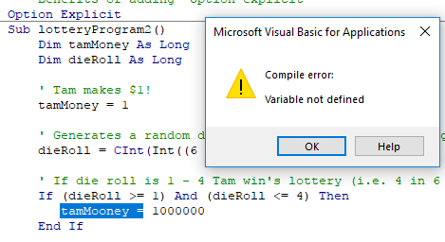
Option Explicit Used
Including ‘Option Explicit’ requires that variables must be created via ‘Dim’ variable declaration
  E.g. Dim tamMoney As Long
After creating/declaring the variable the memory location can be used by assigning a value into that location.
  E.g. tamMoney = 1
Advantage: helps catch bugs
  If you type in the wrong variable name if you use Option Explicit then VBA may tell you exactly where the error lies.
tamMoney
1

Slide 47
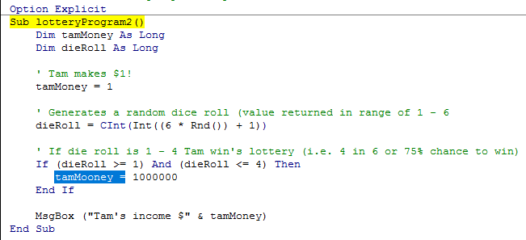
Example: Option Explicit Used
VBA will automatically catch the error and point out the location
Example: 6A_optionExplicitUsed.docm

Slide 48
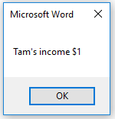
Example: Option Explicit Not Used
Example: 6B_optionExplicitNotUsed.docm
  Sub lotteryProgram2()
  Dim tamMoney As Long
  Dim dieRoll As Long
  tamMoney = 1
  dieRoll = CInt(Int((6 * Rnd()) + 1))
  If (dieRoll >= 1) And (dieRoll <= 4) Then
  tamMooney = 1000000
  End If
  MsgBox ("Tam's income $" & tamMoney)
  End Sub
The program erroneously set the wrong variable!
Tam didn’t get the “big bucks” ☹
Errors like this can be hard to catch/fix in all but smallest programs

Slide 49
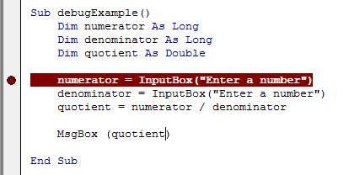
The VBA Debugger
Debuggers can be used to help find errors in your program
Setting up breakpoints
  Points in the program that will ‘pause’ until you proceed to the next step
  Useful in different situations
    The program ‘crashes’ but you don’t know where it is occurring
      Pause before the crash
    An incorrect result is produced but where is the calculation wrong
Set up breakpoints
  Click in the left margin

Slide 50
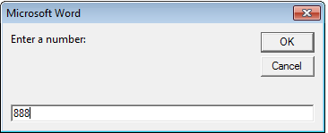
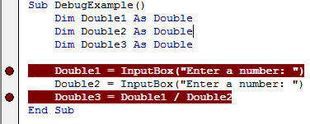
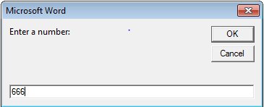
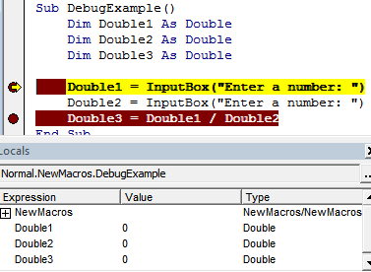
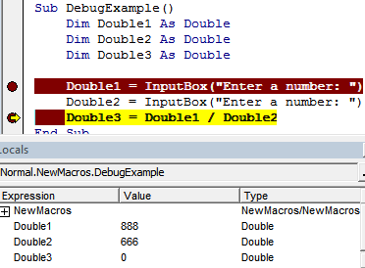
The VBA Debugger (2)
Multiple breakpoints
Program pauses when breakpoints are reached
  The contents of variables can be displayed at that point in the program

Slide 51
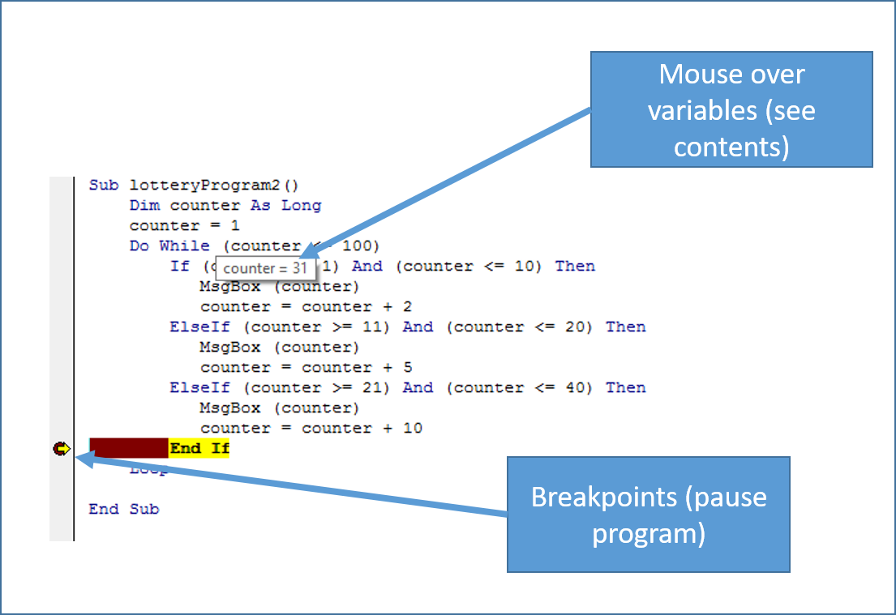
The VBA Debugger (3)
Combining breakpoints and viewing variables.

Slide 52
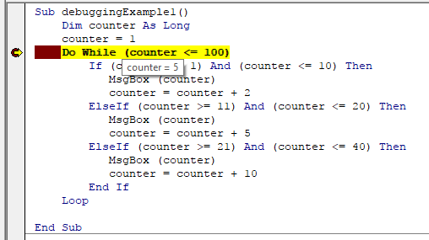
An Example To Run With The Debugger
Set up a breakpoint and trace through the program step-by-step while viewing the contents of the loop control during each iteration of the loop
Example: 7debuggerExample.docm
  Sub: DebuggingExample1

Slide 53
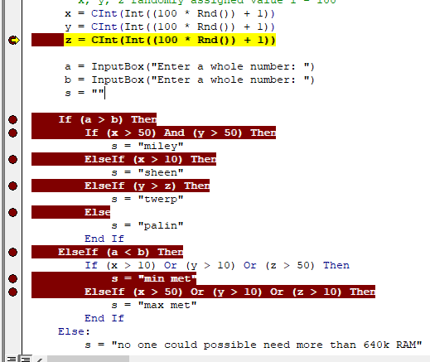
An Example To Run With The Debugger (2)
Program randomly assigns value into x, y, z (1 – 100)
Set up multiple breakpoints and mouse over variables at the breakpoints to view their contents.
This time x = 71, y = 54, z = 1
Which branches execute
What values will be assigned to the string ‘s’
Example (cont’): 7debuggerExample.docm
  Sub: DebuggingExample2

