Slide 1
VBA: Tutorial Week 1
Recording a macro
Documenting a program
Getting user input via a MsgBox
Display output using an InputBox
Storing information with common types of variables in VBA
Common VBA operators
Official resource for MS-Office products: https://support.office.com

Slide 2
Activities In Tutorial
TA demos:
  Used for more complex features (typically multiple steps are required).
  The tutorial instructor will show on the projector/instructor computer each step for running the feature in Excel.
  Unless otherwise specified the tutorial material will take the form of a TA demonstrating the use of features in Excel.
  Slides titled “Lecture Review” are covered for the second time and dealing with less complex material.
    For this reason they will only be covered briefly in tutorial.
Student exercises:
  Used instead of TA demos for simpler features.
  You will have already been given a summary of how to invoke the feature and the purpose of the exercise is to give you a chance to try it out and get help if needed.

Slide 3
How To Create VBA Programs
This topic: Shifted from the lecture material.
Method 1: Record the macro automatically: keystrokes and mouse selections will be stored as part of the program
Method 2: Manually enter the program (type it in yourself into the VBA editor)

Slide 4
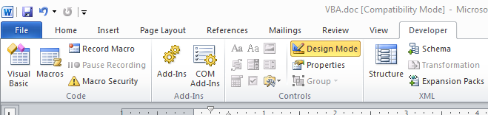
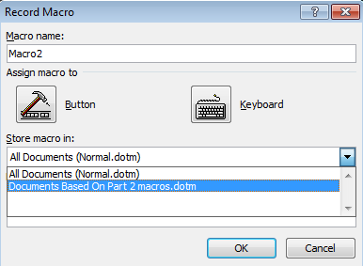
Method 1: Recording A Macro
Developer ribbon
  Click on “Record Macro”
  Recording details
What to name the macro (next slide for more info)
Document to store the macro (select the current Word document)

Slide 5
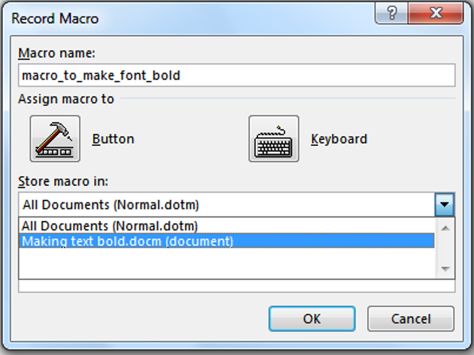
Recording A Macro (2)
    Give the macro a self explanatory name and press ‘OK’ (recording begins).
    Important reminder: record the macro in the current document and not “All documents” (Important!)

Slide 6
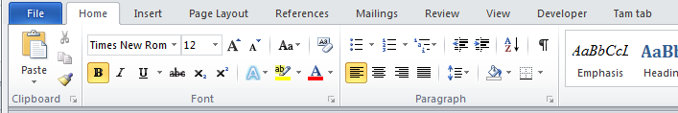
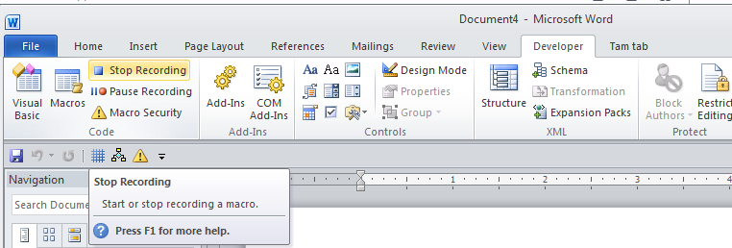
Recording A Macro (3)
While recording you can run whatever Word features you want to add to the recording of the macro
  In this case you would select bold font
  For this simple example all commands have been entered so you can stop the recording (click “Stop recording”)

Slide 7
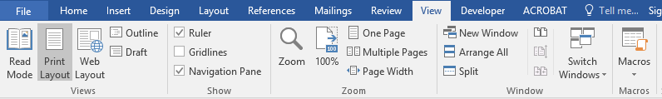
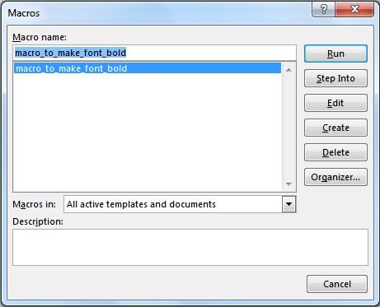
Running A Recorded Macro
Under the ‘View’ ribbon select ‘Macros’
Select the macro (Under “Macro name”) and then click ‘Run’

Slide 8
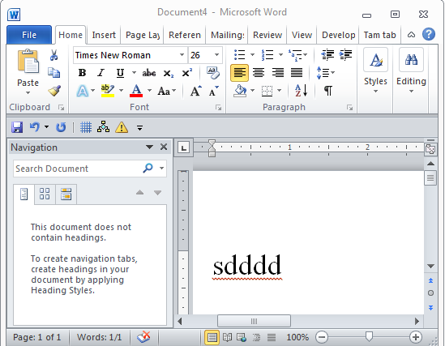
Running A Recorded Macro (2)
In this case nothing happened?
  This macro changes selected/highlighted text to bold
  You need to select some text before running the macro

Slide 9
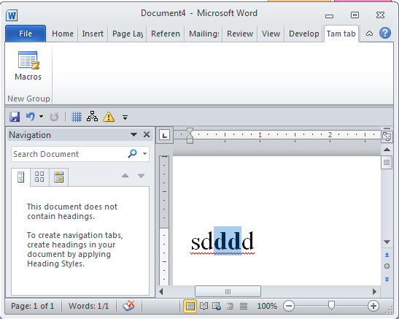
Running A Recorded Macro (3)
After selecting the text and running the macro again, whatever text was highlighted now becomes bold.

Slide 10
Other Examples Of Useful (?) Recorded Macros
Printing: selecting a printer and setting print options can be tedious if your print driver application does not save your previous selections.
  Even if previous selections are saved recording a macro may be useful if you have multiple printing profiles e.g. I print low quality black and white double sided documents stapled on the top left for staff and high quality color single sided with multiple staples with glossy paper for clients.
Entering hard to spell words (especially if they are new)
  Example: “Gotterdammerung” is hard enough to spell but this word is supposed to have the “umlaut” for the ‘o’ (actually ö) and ‘a’ (actually ä).
  JT: shifting to German keyboard in Word can be done via: <Ctrl>-<shift>-<;> (this key combination must be entered prior to typing each alternate character).

Slide 11
Method 1: Recording Macros (Comments)
It’s a good and simple way for anyone to automate a tedious series of commands in Word.
This approach is quite limited.
  E.g. how would you record a macro to automatically open, edit and print all the documents in a folder? (You can’t).
  The main goal in introducing the recording approach is to make you aware of this capability for your future use. (Automating tedious tasks).
For the assignment this approach will not work.
Also on the exam you must manually write macros (on paper) or trace a macro (figure out what happens when it runs).
  “Recording” is not feasible for the exam

Slide 12
How To Create VBA Programs For This Course
Method 1: Record the macro automatically: keystrokes and mouse selections will be stored as part of the program
Method 2: Manually enter the program (type it in yourself into the VBA editor)
  This is how you are to complete your assignment and is how many VBA programs are created.
  Consequently the remainder of the course notes will focus on Method 2

Slide 13
Microsoft Introduction/Overview Of VBA
https://docs.microsoft.com/en-us/office/vba/library-reference/concepts/getting-started-with-vba-in-office

Slide 14
Creating Macros
The focus on this course will be creating macros by typing them into the VBA editor (not recording them)

Slide 15
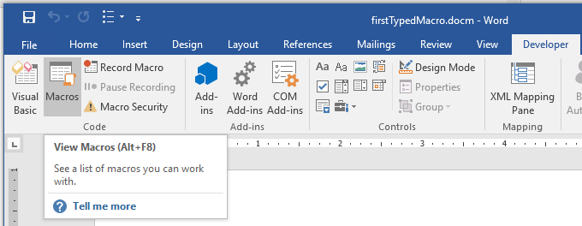
Step 1: Finding The Macro Feature
To enter a new macro/view previously created macros it’s the same as viewing a recorded macro: “Developer->Macro”

Slide 16
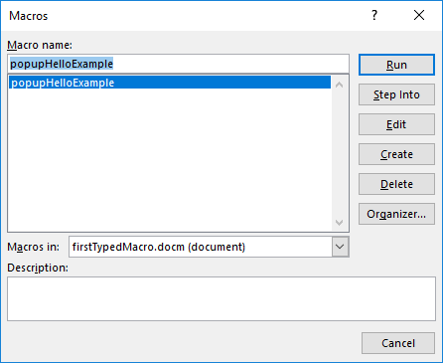
Step 2: Naming And Saving The Macro
Enter the name “Macro name” using a good self-descriptive name (small examples that don’t carry out a useful function such as this example are more challenging to name).
Important! Make sure you save the macro in the current document and not all documents (“Normal.dotm”)

Slide 17
Step 3: Select The Edit Option

Slide 18
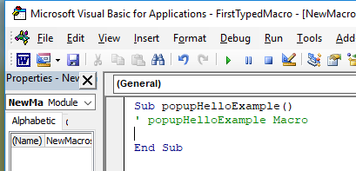
Step 4: Enter the Macro In The VBA Editor
The VBA editor is not the same as the Word editor
Enter text here (indent 4 spaces)
MsgBox("Hello")

Slide 19
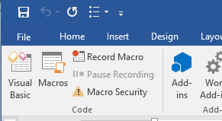
Step 5: Saving The Macro
Typically if you either save via the VBA editor…
…or the Word editor then the macro will be saved.

Slide 20
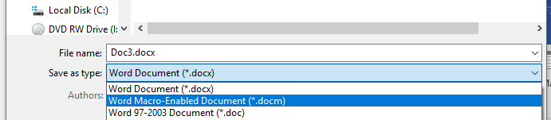
Step 5: Saving The Macro
To be safe you can save using both editors but in any case make sure you save the Word document as a “Word Macro-Enabled Document” (*.docm)

Slide 21
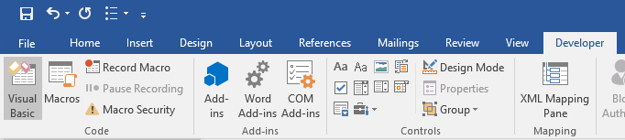
Running The Macro
Regardless of how a macro has been created:
  Automatically recorded
  Manually entered
A macro will be run using the same series of steps.
Developer->Macros
The single macro should be highlighted, then click ‘run’

Slide 22
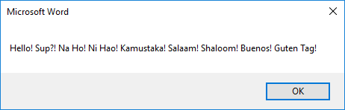
Result Of Running The Example Macro
JT: if you need to see the solution to the exercise look at the document: 1firstTypedMacro.docm

Slide 23
Student Exercise #1
Writing and running a macro that displays your name
Name to give your macro: ‘firstMyName’
Name of macro-enabled Word document ‘exercise1_first_typed_macro_student_exercise.docm’

Slide 24
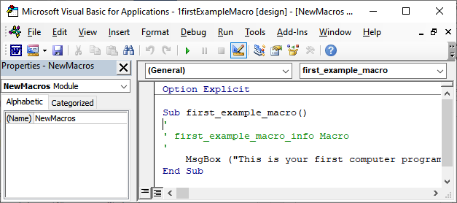
Solution #1
(This is what you would type into the VBA editor).
MsgBox("James Tam")

Slide 25
Program Documentation
Doesn’t contain executable instructions.
Created for the reader of the program (other programmers, in this class it’s for your assignment marker)
Format:
  ' <Documentation>
Example:
  ' Author: James Tam
No error: Everything after the quote until the end of the line will not be translated into machine language/binary
That means documentation doesn’t have to be a valid and executable instruction

Slide 26
Program Documentation: Assignments (A3)
These requirements also apply to any other full assignments that involve program writing (if applicable).
Your VBA assignment submission must include identification about you and information the features of your program
  Full name
  Student identification number
  Tutorial number
  List the program features (from the assignment description) and clearly indicate if the feature was completed or not completed.
  Program version

Slide 27
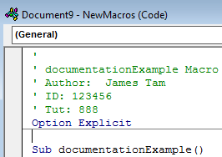
Location Of Program Documentation
Contact information should be located before your program
Before the ‘sub’ keyword
  Before ‘Option explicit’ if included (more details on this later for now just take it as a given that including this is a good idea).
Documentation: marked in red

Slide 28
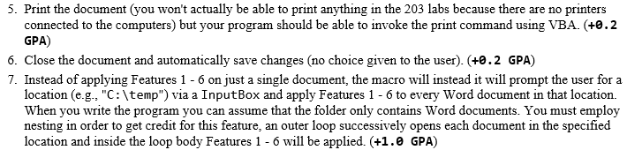
Program Documentation: A3 Documenting Program Features
Program features (this will be worth many marks)
Example assignment description
Program documentation
  ' Author: James Tam ID: 123456
  ' Version: Nov 2, 2015
  ' Tutorial: 99
  ' PROGRAM FEATURES
  ' #5: Printing: completed
  ' #6: Close and save: not completed
  etc
Notes:
To TA: Students literally list assignment features and signify yea or nay if feature was completed

Slide 29
Program Versioning: What Students Need To Document In Order To Be Awarded Credit
Shows:
Versioning system employed
Versioning tied to a list of which features completed for that version.
A3.docm
' Version: Sept 20, 2012
' Program features completed:
' (5) Print
' (6) Save & close

Slide 30

Variables
A location in memory used to store information temporarily.
At most a variable can store a single piece of information.
num
num = 1
1
num = 17

Slide 31
Creating/Declaring Variables
Creating and naming memory locations
  Dim anInt As Long
  Dim aReal As Double
  Dim aString As String
Assigning values to those locations
  anInt = 2000
  aReal = 3.14
  aString = "Peter Griffin"

Slide 32
Displaying The Contents Of Variables
Format:
  MsgBox (<Name of the variable>)
Example (assumes a variable called ‘age’ has already been created and a value has been assigned to it)
  MsgBox (age)
Question for students: What’s the output of the MsgBox
  Dim name As String
  name = "Smith"
  MsgBox (name)

Slide 33
Explanation Of Output
When a message box can display a constant string the string must be enclosed in double quotes
  E.g. MsgBox("hello")
When a message box displays the contents of a variable then the name of the variable is not enclosed in quotes
  E.g. MsgBox (age)

Slide 34
Mixed Output: Strings And Variables
Each field must be separated with and connected with an ampersand ‘&’
Format:
  MsgBox ("<string>" & variable & "<string>"….)
Example:
  MsgBox ("Age=" & age)

Slide 35
Mixed Output Example
2variablesMixedOutput.docm
  Sub variablesMixedOutput()
  Dim age As Long
  Dim name As String
  age = 37
  name = "Homer J. Simpson"
  MsgBox ("Name: " & name & ", " & "Age: " & age)
  End Sub

Slide 36
Getting Input
Getting information from the user as the program runs via an InputBox
Format:
  InputBox ("<Prompting message>")
Example:
  InputBox ("Tell me your name")

Slide 37
Input Example
3inputExample.docm
  Sub inputExample()
  Dim age As Long
  Dim name As String
  age = InputBox("Tell me your age: ")
  name = InputBox("What is your name: ")
  MsgBox ("Name: " & name & ", " & "Age: " & age)
  End Sub
Notice how the values displayed in the MsgBox will vary in this example according to user input

Slide 38
Student Exercise #2
Write a new VBA program in a new Word document
Declare a String variable called ‘name’
Write a program that will ask the user for their name using an InputBox and store the input in the variable called ‘name’
The program will then display the value entered by the user using a MsgBox

Slide 39
Solution #2
Dim name As String
Name = InputBox("Name: ")
MsgBox(Name)
Complete solution: exercise2_get_display_name

Slide 40
Microsoft Introduction/Overview Of VBA
https://docs.microsoft.com/en-us/office/vba/library-reference/concepts/getting-started-with-vba-in-office

Slide 41
Basic VBA Operators
Operation | Symbol used in VBA | Example
(Same as Excel)
Addition | + | 2 + 2
Subtraction | - | 3 – 2
Multiplication | * | 10 * 10
Division | / | 81 / 9
Exponent | ^ | 2 ^ 3
(Different operator)
Concatenation | & | “hi” & “there”

Slide 42
Common VBA Operators
4operators.docm
Sub operators
  ' Part I
  doubleNum1 = 2 + 2
  MsgBox (doubleNum1)
  doubleNum1 = 7 * 13
  MsgBox (doubleNum1)
  doubleNum1 = 15 / 2
  MsgBox (doubleNum1)
  doubleNum1 = 2 ^ 4
  MsgBox (doubleNum1)
  aString = "the" & "cat" + " in" & "- hat"
  MsgBox (aString)

Slide 43
Common VBA Operators (2)
' Part II
doubleNum1 = 2
doubleNum2 = 3
doubleNum3 = doubleNum1 ^ 3
doubleNum1 = doubleNum1 * doubleNum2
doubleNum2 = doubleNum1 + doubleNum3
MsgBox ("doubleNum1=" & doubleNum1 & "-" &
"doubleNum2=" & doubleNum2 & "-" & "doubleNum3=" &
doubleNum3)
End Sub

Slide 44
Student Exercise #2
Write a new VBA program in a new Word document
Declare a String variable called ‘name’
Write a program that will ask the user for their name using an InputBox and store the input in the variable called ‘name’
The program will then display the value entered by the user using a MsgBox

