Slide 1
Excel: Tutorial Week 2
Multiple worksheets
Named constants
Using pre-created functions
Setting the format of data in a cell
Highlighting important information via conditional formatting
Official resource for MS-Office products: https://support.office.com

Slide 2
First Tutorial

Slide 3
Thanksgiving Monday: October 12
No tutorial on Monday
Tuesday tutorials are designated as Open Tutorials.
TA is available for help but no new material will be taught.

Slide 4
Second Tutorial

Slide 5
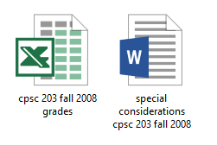
Terminology
Spreadsheet (referred to as a “workbook” by Microsoft)
A Microsoft Excel file
Worksheet
A part of a spreadsheet

Slide 6
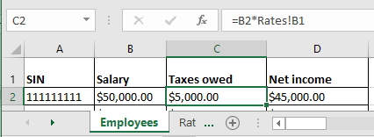
Formula References To Other Worksheets
Example spreadsheet: “references_V1_10%tax”
“Employees” worksheet
“Rates” worksheet
References to same worksheet
Reference to another worksheet

Slide 7
Named Constant
The same value is referenced many times in sheet so it is defined once as a “named constant” – a constant given a name
Named constants: Tax Rate = 10%, PI = 3.14
Unnamed constant: =B2 * 0.1
Named constants are typically defined and grouped in a lookup table
This is an example of how your assignment style marks could be affected i.e. retyping the 0.1 (poor approach, what if the weighting changes then the unnamed constant must be retyped many times)
= B2 * 0.1
= B3 * 0.1

Slide 8
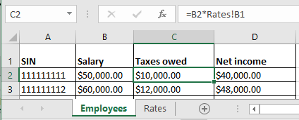
Advantages Of Using Unnamed Constants
Taxes change, example spreadsheet: references_V1_20%tax
One change updates everything that refers to !RatesB1
(More on this later)

Slide 9
Using Pre-Created Formulas
Entering pre-created formulas, refer again to a previous example: functions

Slide 10
Sample Data

Slide 11
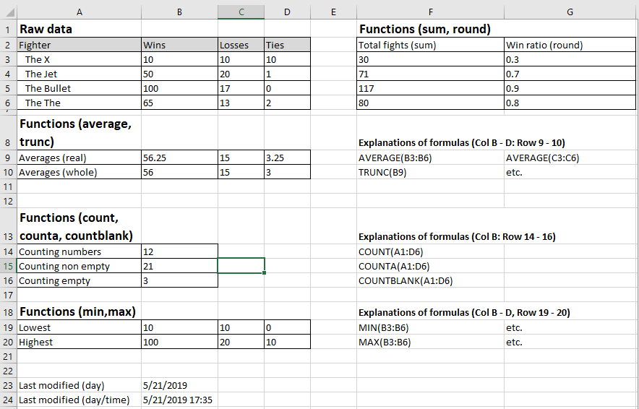
SUM (Col F), ROUND (Col G)
Notes:
e.g. 1 Cell F3: =SUM(B3:D3),
e.g. 2 Cell G3 =ROUND(B3/F3,1) The last argument is the number of places of precision

Slide 12
AVERAGE, TRUNC
(Average: Row 9, Trunc: Row 10 – Truncates the averages from Row 9)
Notes:
Everything on Row 9 (Col B – D) employs the AVERAGE function e.g. Cell B9: =AVERAGE(B3:B6)
Everything on Row 9 (Col B – D) employs the TRUNC function e.g. Cell B10: =TRUNC(B9)

Slide 13
Counting functions (Col B, Rows 14 - 16)
(Count: Row 14, CountA: Row 15, CountBlank: Row 16)
Notes:
Col B: Counts from Cell A1 to Cell D6
B14: =COUNT(A1:D6) ANSWER = 12 (3 x 4 of B3 to D6)
B15: =COUNTA(A1:D6) ANSWER = 21 (everything in the range is included in the
count). Only B1 – D1 are empty (not text or numbers)
B16: =COUNTBLANK(A1:D6) ANSWER = 3 (B1 to D1) Returns non-blank cell count, 3
blank cells = B1 – D1

Slide 14
MIN, MAX (Row 19 – 20, Col B - D)
Notes:
All of Row 19 (Col B – D) are the lowest values for Wins, losses, ties e.g. B19: =MIN(B3:B6)
All of Row 20 (Col B – D) are the highest values for Wins, losses, ties e.g. B20: =MAX(B3:B6)

Slide 15
Time Information: TODAY (B23), NOW (B24)
Notes:
B23: =TODAY()
B24: =DATE()

Slide 16
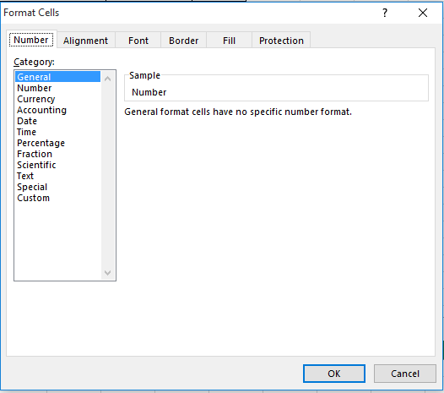
Setting The Format Of Cell Data
Example spreadsheet: data_types
Setting the data type (again right click and select ‘Format Cells’)
Reminder: The ‘Number’ tab is the default selection

Slide 17
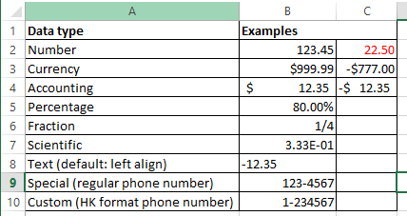
Examples Of Different Types
Notes:
Data in cells
B5: 0.8 is the actual data but displayed as 80% because the percent format is selected
B6: =0.25 (but displays as ¼ because fractional type selected)
B7: =1/3 (displays in scientific format)
B9 & B10: original data typed in as 1234567 by selecting a format Excel takes cares of putting the dash in the correct place

Slide 18
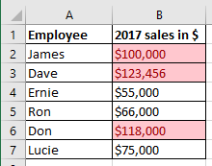
Conditional Formatting
Example spreadsheet: conditional_formatting
It can be used to visually highlight data which has met a certain condition (e.g. 6 figure sales volume or higher in 2017).
Can either be used to:
Assign specific colors when a condition is met (e.g. red for all finance employees and blue for marketing)
Assign a range or gradient of colors depending upon to what degree that a condition is met (e.g. red for high income, darker for higher values)

Slide 19
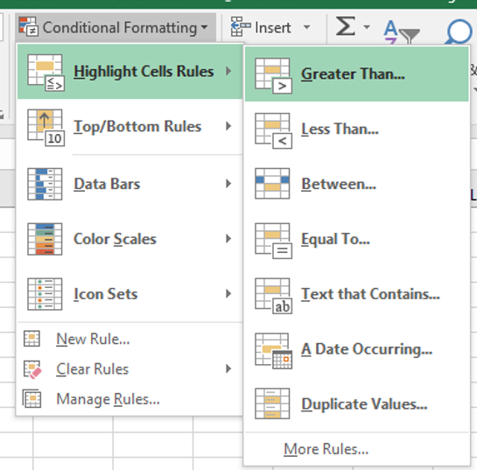
Setting Conditional Formatting
Home -> Styles: Conditional formatting
If you don’t know much about visual design then keep it simple, stick to the basics (highlighting only if a condition is met rather than setting gradients for the degree to which a condition is met)

Slide 20
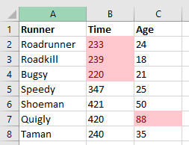
Conditional Formatting Exercise
Student exercise: modify spreadsheet “conditional_formatting_exercise” so that the cells are colored under the following conditions:
Time is less than 240 seconds
Age is greater than 50 years
One example solution

Slide 21
Other Excel Resources
Online training resources created by Microsoft:
Tutorials
https://support.office.com/en-us/article/excel-for-windows-training-9bc05390-e94c-46af-a5b3-d7c22f6990bb
A MAC specific resource
https://support.office.com/en-us/article/excel-2016-for-mac-help-2010f16b-aec0-4da7-b381-9cc1b9b47745

