Slide 1
VBA Programming: Part II
How to win friends using functions and influence people using methods (not really but it sounds catchier than how to use pre-created functions and methods to do neat stuff)
Online support: https://support.office.com/en-US/article/create-or-run-a-macro-c6b99036-905c-49a6-818a-dfb98b7c3c9c
Notes:
https://support.microsoft.com/en-us/office/enable-or-disable-macros-in-office-files-12b036fd-d140-4e74-b45e-16fed1a7e5c6

Slide 2
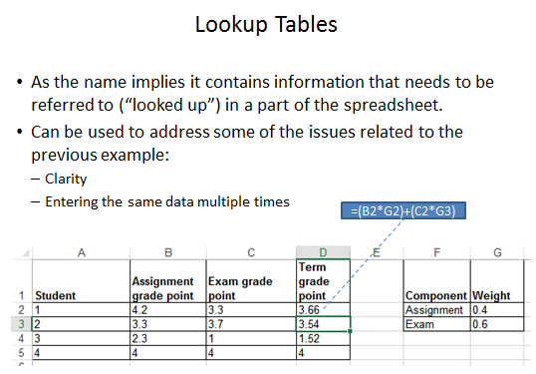
Review: Lookup Tables (For Constants)
Excel: Lookup tables are used to define values that do not typically change but are referred to in multiple parts of a spreadsheet.

Slide 3
Named Constants
They are similar to variables: a memory location that’s been given a name.
Unlike variables constants cannot change.
  VBA makes a memory location unchanging when the Const keyword is used
The naming conventions for choosing variable names generally apply to constants but constants should be all UPPER CASE. (You can separate multiple words with an underscore).
  This isn’t a usual Visual Basic convention but since it’s very common with most other languages, you will be required to follow it for this class.
Example Const PI = 3.14
  PI = Named constant, 3.14 = Unnamed constant
They are capitalized so the reader of the program can quickly distinguish them from variables.

Slide 4
Declaring Named Constants
1 The expression can be any mathematical operation but can’t be the result of a function call
Learning objective: how to declare constant.
Format:
  const <Name of constant> as <Data type> = <Expression>¹
  JT: it’s preceded by the keyword ‘const’ to indicate that it is a constant/unchanging.
Example:
  const PI As Double = 3.14
Notes:
Stress how 3.14 is substituted for PI

Slide 5
Why Use Named Constants
No ☹
Yes ☺
They can make your programs easier to read and understand
Example:
  Income = 315 * 80
Vs.
  Income = WORKING_DAYS_PER_YEAR * DAILY_PAY

Slide 6
Why Use Named Constants
Updating the initial value for a named constant will update it throughout the program wherever the constant is referred to.
Learning objective: Shows you how/why use named constants
Name of the Word document containing the program: 1Constants.docm
Const TAX_RATE As Double = 0.2
Dim grossIncome As Long
Dim taxOwed As Long
Dim incomeAfterTax As Long
grossIncome = 100
taxOwed = grossIncome * TAX_RATE
incomeAfterTax = grossIncome - taxOwed
MsgBox (grossIncome & " " & taxOwed & " " & _
incomeAfterTax & " " & TAX_RATE)

Slide 7
Example: A Person
Example properties (information in VBA known as attributes):
Age
Height
Name
Hair color
…
Example actions (actions in VBA known as ‘methods’):
Walk
Talk
Eat
Sleep
Drink
Excrete
…

Slide 8
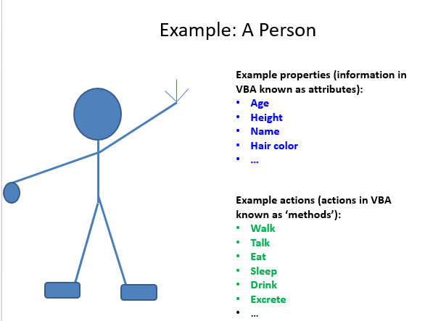
VBA Object
Similar to everyday objects VBA-Objects have attributes and actions
  Attributes: information that describe the object.
    E.g., the name of a document, size of the document, date modified, number of words etc.
  Methods: actions that can be performed (sometimes referred to as ‘functions’ or ‘procedures’ or ‘subroutines’ depending upon the language).
    E.g., save, print, spell check etc.

Slide 9
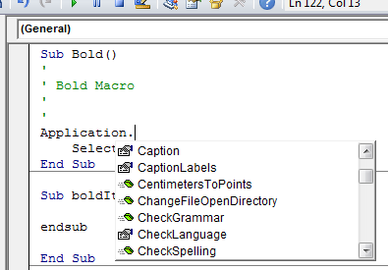
Common VBA Objects
Application: the MS-Office program running (for CPSC 203 it will always be MS-Word)
ActiveDocument
Selection
When enter one of these keywords in the editor followed by the ‘dot’ you can see more information.
Take advantage of the benefits of VBA:
The list of properties and methods is a useful reminder if you can’t remember the name
If you don’t see the pull down then this is clue that you entered the wrong name for the object

Slide 10
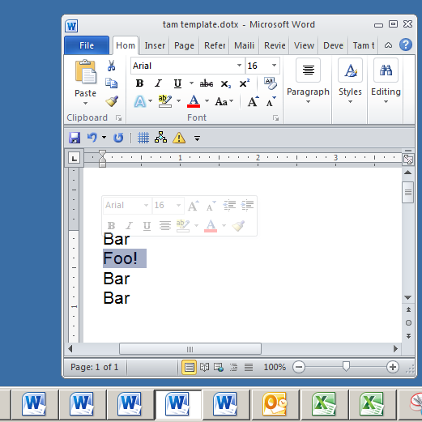
Example: What Are The Three Objects
Application:
  MS-Word
Active/current Document:
  “tam template”
Selection
  “Foo!”

Slide 11
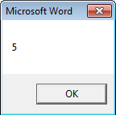
Using Pre-Built Capabilities/Properties Of Objects
Format:
  <Object name>.<method or attribute name>
Example:
  Sub ApplicationTest()
  MsgBox (Application.Windows.Count)
  End Sub
Application.Windows.Count
Property of Window:
Number
Accessing the Windows property of Word (the application)
Info about the windows currently opened
Object referred to: ‘Application’

Slide 12
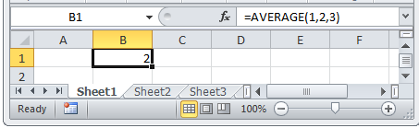
Attributes Vs. Methods/Functions
Recall
  Property: information about an object
  Method: capabilities of an object (possible actions)
Property: current cell
Using the ‘average()’ function

Slide 13
The Application Object
As mentioned this object is the VBA application running e.g. MS-Word
Learning objective: accessing a part (attribute) of an object
Program illustrating an example usage: 2applicationObject.docm
  Sub ApplicationTest()
  MsgBox (Application.Windows.Count)
  End Sub
Application.Windows.Count
Property of Window:
Number
Accessing the Windows property of Word (the application)
Info about the windows currently opened
Object referred to: ‘Application’

Slide 14
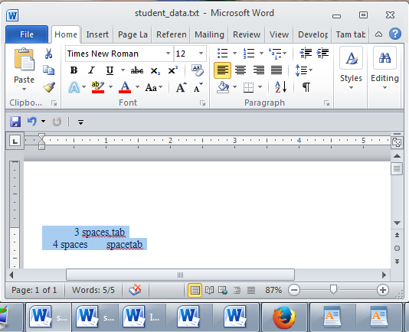
Introduction To The ActiveDocument Object
Quick recap: although you may have many documents open, the ‘active document’ is the document that you are currently working with:
  Because it may be easy to confuse documents it’s best to only have a single Word document open when writing a VBA program.
The active document

Slide 15
Attributes Of The ActiveDocument Object
Application: the application/program associated with the document (useful if a VBA macro is linking several applications):details on next slide
Content: the data (text) of the currently active document (needed if you want to perform a text search ‘Find’ in a VBA program):details later in these notes
Name: the (file) name of the current document (useful for determining the active document if multiple documents are currently open): next slide
Path: the save location of the active document e.g. C:\Temp\ :details on next slide
FullName: the name and save location of the current document :details on next slide
HasPassword: true/false that document is password protected: details on next slide
SpellingChecked: true/false document has been spell checked since document was last edited: :next slide
SpellingErrors.Count: the number of typographical errors
Note: Information for these attributes/properties can be viewed by passing the information as a parameter to a message box
Format: MsgBox (ActiveDocument.<Attribute Name>)
Example: MsgBox (ActiveDocument.SpellingErrors.Count)

Slide 16
Example Of Accessing Attributes
Learning objective: accessing some common attributes of the ActiveDocument object (e.g. accessing document name, path).
Program illustrating an example usage: 3activeDocumentAttributes.docm
  Sub activeDocumentAttributes()
  MsgBox (ActiveDocument.Application)
  MsgBox (ActiveDocument.Name)
  MsgBox (ActiveDocument.Path)
  MsgBox (ActiveDocument.FullName)
  MsgBox ("Spell checked? " & _
  ActiveDocument.SpellingChecked)
  MsgBox ("Password protected? " & _
  ActiveDocument.HasPassword)
  MsgBox ("# typos=" & ActiveDocument.SpellingErrors.Count)
  End Sub

Slide 17
Some Methods Of The ActiveDocument Object
Checkspelling(): exactly as it sounds: next slide
Close(): closes the active document (different options available)
CountNumberedItems(): number of bulleted and numbered elements: next slide
DeleteAllComments(): removes comments from the current document: next slide
Printout(): prints current active document on the default printer : next slide
Save(): saves the current document under the same name: next slide
SaveAs2(): saves the current document under a different name: : next slide
Select(): select all text in the active document
SendMail(): sends an email using MS-Outlook, the currently active document becomes a file attachment
ComputeStatistics(wdStatisticWords): counts the number of words in a document.
Notes:
Count numbered items = 4 (includes bullets)

Slide 18
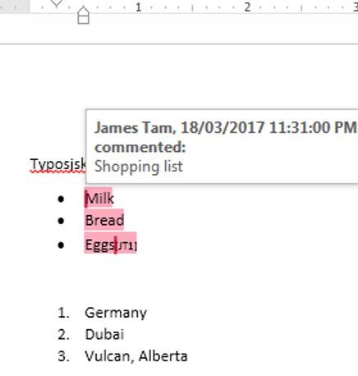
Example Of Using Methods
Learning objective: accessing some common methods of the ActiveDocument object.
Program illustrating an example usage: 4activeDocumentMethods.docm
  Sub activeDocumentAttributes()
  ActiveDocument.CheckSpelling
  MsgBox (ActiveDocument.CountNumberedItems)
  ActiveDocument.DeleteAllComments
  ActiveDocument.PrintOut
  ActiveDocument.Save
  ActiveDocument.SaveAs2 ("Copy")
  ActiveDocument.Range.ComputeStatistics(wdStatisticWords)
  End Sub

Slide 19
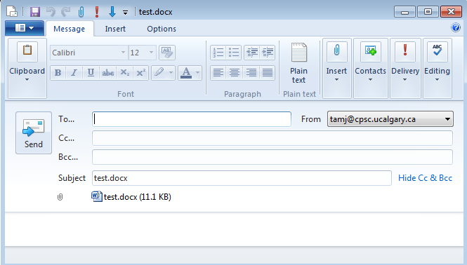
ActiveDocument.SendMail()
Runs the default email program
The active document automatically becomes an attachment
Subject line = name of document
(For anything more ‘fancy’ you should use VBA to create and access an MS-Outlook object)

Slide 20
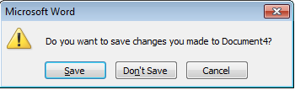
Closing The Active Document
Default action when closing a MS-Word document that has been modified (prompt)
VBA code to close a document in this fashion:
  ActiveDocument.Close (wdPromptToSaveChanges)
One closing option: Allow the user to save

Slide 21
Reinforcing Example: Using Pre-Defined Constants (Closing Documents)
Learning objectives: writing a VBA instruction to close the currently active Word document, reinforcing the value of named constants (in this case the constants have been predefined by Microsoft).
Word document containing the macro: “5closingActions.docm”
  Sub ClosingActions()
  ActiveDocument.Close (<Selected option for closing action>)
  End Sub
'Choose one action
wdPromptToSaveChanges
wdDoNotSaveChanges
wdSaveChanges

Slide 22
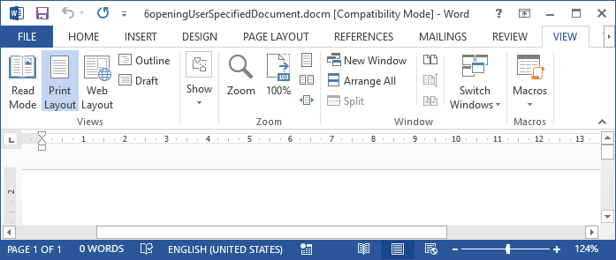
Opening A Document
Given the name of a document a VBA program can be used to open that document in Word.
Learning objective: opening a user specified Word document in the same folder that the currently active document resides.
  To avoid confusion make sure that the currently active document is the one containing this VBA program.
  Click on the window for this Word document prior to running this program.
Click

Slide 23
Opening A Document (2)
Word document containing the macro: 6openingUserSpecifiedDocument
    Sub findHighLight()
    Dim documentName As String
    Dim path As String
    path = ActiveDocument.path
    documentName = InputBox("Name of Word document: ")
    Documents.Open (path & "\" & documentName & ".docx")
    End Sub

Slide 24
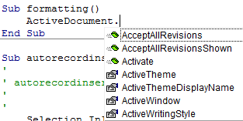
Formatting A Document
Selected text:
  Only format the currently selected text via the ‘Selection’ object).
Entire document:
  You first need to specify the document or part of a document to be formatted
  One way is through the ‘ActiveDocument’ object
  Then choose the ‘Select’ method of that document.
    Review: it’s a method and not a property because it applies an action: select = selecting the text of the entire document

Slide 25
Introduction To The Selection Object
This is the currently selected text in a document.
  It may be empty (nothing selected)

Slide 26
Basic Attributes Of The Selection Object
Font.Name: specifies the type (name) of font
Font.Size: specifies the font size
Font.ColorIndex: specifies the color of the font
Font.UnderLine: specifies the type of underlining to be applied (or to remove underlining)
Font.Bold: allows bolding to change (toggle or set)
Similar to how the Attributes/Properties of ActiveDocument Object affect only the currently active document these Attributes/Properties only take effect on the currently selected text (if there’s any).
Notes:
Font.Color = Works but doesn’t show up under pull down and requires different named constants

Slide 27
Using The Selection Object Attributes
Learning objective: changing the properties of fonts in Word
Name of the Word document containing the program: 7selectionAttributes.docm
  Sub selectionObjectAttributes()
  ' Selection.Font.Underline = <Selection for underlining>
  ' wdUnderlineNone, wdUnderlineSingle
  ' e.g. Selection.Font = wdUnderlineSingle
  Selection.Font.Name = "Wingdings" 'Must be in quotes
  Selection.Font.Size = 36
  Selection.Font.ColorIndex = wdBlue
  ' Bolding options
  Selection.Font.Bold = wdToggle ' On/off
  Selection.Font.Bold = True ' Turn on (false = off)
  End Sub

Slide 28
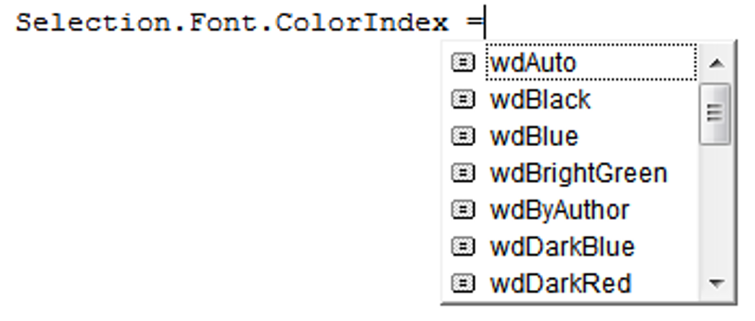
Seeing Color (And Under Line Options)
Use the ‘auto complete’ feature of VBA to view the options

Slide 29
Some Methods Of The Selection Object
ClearFormatting: removes all formatting effects (e.g. bold, italics)
TypeText: insert the text specified in the VBA program
Delete: deletes any selected text
EndKey: move the cursor to the end of the document (covered in a later and in a large example)
HomeKey: move the cursor to the start of the document (covered in a later and in a large example)
InsertFile: replace selection with text from the specified file (covered in a later example)
Similar to how the method of ActiveDocument Object affect only the currently active document these Attributes/Properties only take effect on the currently selected text (if there’s any).

Slide 30
Using Simple Methods Of The Selection Object
Learning objective: writing text into the active Word document.
Name of the Word document containing the program: 8selectionMethods.docm
Try running it with and without some text selected
  Sub selectionObjectMethod()
  Selection.ClearFormatting
  Selection.TypeText ("My new replacement text")
  End Sub

Slide 31
Formatting Text (Entire Active Document): An Example
Objective:
  Suppose you want to format a document in the following way
  Entire document
    Font = Calibri

Slide 32
Formatting: Entire Document
As mentioned the entire document can be selected.
Now for the ‘selected text’ (in this case it’s the whole document) access the ‘Font’ property and the ‘Name’ property of that font and give it the desired name.
Learning objective: on the previous page.
Word document containing the macro: 9formattingEntireDocument.docm
    Sub formattingEntireDocument()
    ActiveDocument.Select
    Selection.Font.Name = "Calibri"
    ' The previously covered ways of formatting selected text
    ' can then be run.
ActiveDocument.Select
Selection.Font.Name = "Calibri"

Slide 33

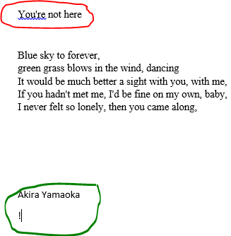
Writing Text To Start/End
Learning objective: moving the selection (cursor) to the start or end of the currently active document.
Name of the Word document containing the program: 10selectionHomeEndKey.docm
  HomeKey docs: https://msdn.microsoft.com/en-us/library/office/ff192384.aspx
  EndKey docs: https://msdn.microsoft.com/en-us/library/office/ff195593.aspx
  Sub selectionHomeEndKey()
  Const SONG_TITLE = "You're not here"
  Const SONG_LYRICIST = "Akira Yamaoka"
  Selection.HomeKey Unit:=wdStory
  Selection.TypeText (SONG_TITLE)
  Selection.EndKey Unit:=wdStory
  Selection.TypeText (SONG_LYRICIST & vbCr & "!")
  End Sub
vbCr (line break) = hitting enter

Slide 34
Automatically Inserting Text Into A Word Document
Learning objective: inserting the text containing in different types of files (Word document, rich text file, plain text file) into the currently active Word document.
Name of the Word document containing the program: 11selectionInsertingText.docm

Slide 35
Inserting Text Into One Document From Other Documents
Example files (must all be in the same folder)
11input1.docx
11input2.rtf
11input3.txt
Text input1
Text input2
Text input3
Types of files used as input for the program in this example:
11input1.docx = Word 2007 document
11input2.rtf = Rich text file
11input3.txt – Text document (no formatting).
Word docm document (VBA program: 11selectionInsertingText)

Slide 36
“Finding” Things In A Document
Example: ‘find’ can also be performed by using the Selection object but I prefer this approach.
Find by using the ActiveDocument object
  ‘Find’ is an object that is part of the ‘Content’ object of the ‘ActiveDocument’
  ActiveDocument.Content.Find
One source of information:
http://msdn.microsoft.com/en-us/library/office/aa211953(v=office.11).aspx

Slide 37
Find: Single Replacement
Background for example:
My old email address (still works): tamj@cpsc.ucalgary.ca
My new email address: tam@ucalgary.ca
Incorrect variant: tamj@ucalgary.ca
Learning objective: finding & replacing an instance of text, splitting long instructions onto multiple lines.
Word document containing the macro: 12simpleFind.docm
sub simpleFind()
  ActiveDocument.Content.Find.Execute _
  FindText:="tamj",ReplaceWith:="tam"
  end Sub
  'The instruction can be broken into two lines without causing
  'An error by using an underscore as a connector
  ActiveDocument.Content.Find.Execute _
  FindText:="tamj", ReplaceWith:="tam"

Slide 38
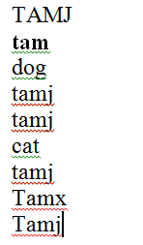
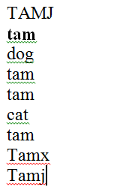
More Complex Find And Replace: Case Sensitive
Learning objective: a case sensitive find-replace.
Word document containing the macro: 13findReplaceAllCaseSensitive.docm
  Sub findReplaceAllCaseSensitive()
  ActiveDocument.Content.Find.Execute FindText:="tamj", _
  ReplaceWith:="tam", Replace:=wdReplaceAll, _
  MatchCase:=True
  End Sub
Before
After

Slide 39
With, End With
Complete original command
ActiveDocument.Content.Find.Execute
For ‘deep’ commands that require many levels of ‘dots’, the ‘With’, ‘End With’ can be a useful abbreviation.
Example
  With ActiveDocument.Content.Find
  .Text = "tamj"
  Equivalent to (if between the ‘with’ and the ‘end with’:
  ActiveDocument.Content.Find.Text = "tamj"
Previous example, the ‘Find’ employing ‘With’, ‘End With’:
Also the search and replacement text are specified separately to shorten the ‘execute’ (the “ActiveDocument.Content.Find” listed once)
  With ActiveDocument.Content.Find
  .Text = "tamj"
  .Replacement.Text = "tam"
  .Execute MatchCase:=True, Replace:=wdReplaceAll
  End With
‘Find text’ and ‘replacement text’ moved here to simplify the ‘.execute’

Slide 40
Find And Replace
It’s not just limited to looking up text.
Font effects e.g., bold, italic etc. can also be ‘found’ and changed.

Slide 41
Finding And Replacing Bold Font
Learning Objective: find/replace font effects (e.g. bolding).
Word document containing the macro: 14findBold.docm
  'Removes all bold text
  Sub findBold()
  With ActiveDocument.Content.Find
  .Font.Bold = True
  With .Replacement
  .Font.Bold = False
  End With
  .Execute Replace:=wdReplaceAll
  End With
  End Sub

Slide 42
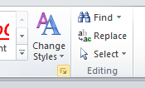
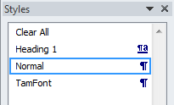
Finding/Replacing Formatting Styles
You already have a set of pre-created formatting styles defined in MS-Word.
You can redefine the characteristic of a style if you wish.
Assume for this example that you wish to retain all existing styles and not change their characteristics.
But you want to replace all instances of one style with another style e.g., all text that is ‘normal’ is to become ‘TamFont’
‘Find’ can be used to search (and replace) instances of a formatting style.

Slide 43
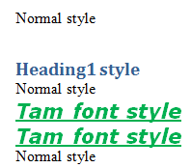
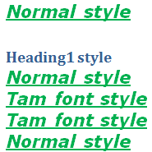
Finding/Replacing Formatting Styles (2)
Learning objective: finding & replacing instances of a text style.
Word document containing the macro: 15findReplaceStyle.docm
  Sub findReplaceStyle()
  With ActiveDocument.Content.Find
  .Style = "Normal"
  With .Replacement
  .Style = "TamFont"
  End With
  .Execute Replace:=wdReplaceAll
  End With
  End Sub
BEFORE
AFTER
‘Normal’ style becomes ‘TamFont’

Slide 44
Highlighting ‘Found’ Text
Learning objective: finding text and visually highlighting the text to make it stand out.
Word document containing the macro: 16findReplaceStyle.docm
  Sub findHighLight()
  Dim searchWord As String
  Dim fontSize As Long
  searchWord = InputBox("Enter word to emphasize: ")

Slide 45
Highlighting ‘Found’ Text (2)
  With ActiveDocument.Content.Find
  .Text = searchWord
  .Replacement.Font.Bold = True
  .Replacement.Font.ColorIndex = wdBlue
  fontSize = Selection.Font.Size
  .Replacement.Font.Size = fontSize + 4
  .Forward = True
  .MatchCase = False
  .MatchWholeWord = True
  .Execute Replace:=wdReplaceAll
  End With
  End Sub

Slide 46
Collections
An object that consists of other objects
  Real World example: a book consists of pages, a library consists of books
Example: The Documents collection will allow access to the documents that have been opened in Word.
Access to a collection rather than the individual objects may be time-saving shortcut.
  Instead of manually closing all open documents this can be done in one instruction:
  Documents.close
You have actually seen an example using the Documents collection ‘open’ method:
  Documents.open<“Document name>”)

Slide 47
Types Of Collections
Some Attributes/Properties of a document that return a collection.
    Documents: access to all the currently open documents
    Shapes: access to MS-Word shapes in a document (rectangles, circles etc.): If there is time
    InlineShapes: access to images inserted into a Word document
    Tables: access to all tables in a document: If there is time
    E.g., ActiveDocument.Tables –accesses all the tables in your document
    ActiveDocument.Tables(1) –access to the first table in a document.
    Windows: briefly introduced at the start of this section of notes (as part of the Applications object)

Slide 48
Documents Collection For Printing: Multiple Documents
Printing all the documents currently open in MS-Word.
  Take care that you don’t run this macro if you have many documents open and/or they are very large!
  Also the program requires that you have at least 3 Word documents open when you run it.
    Otherwise it will crash.
  Learning objective: printing open documents (first three).
  Word document containing the macro example: “17printThreeDocuments.docm”
  Sub PrintDocumentsCollection()
  Documents.Item(1).PrintOut
  Documents.Item(2).PrintOut
  Documents.Item(3).PrintOut
  End Sub

Slide 49
Accessing Shapes And Images (For Fun And Profit)
(VBA specific)
  Shapes (basic shapes that are drawn by Word)
  InlineShapes (images that are created externally and inserted into Word)
Both collections accessed via the ActiveDocument object:
  ActiveDocument.Shapes: access to all the shapes in the currently active Word document
    ActiveDocument.Shapes(<index>): access to shape #i in the document
  ActiveDocument.InlineShapes: access to all the images in the currently active Word document
    ActiveDocument.InlineShapes(<index>): access to image #i in the document

Slide 50
Some Attributes/Properties InlineShapes & Shapes
Common to Both:
  Height
  Width
  Example usage: ActiveDocument.InlineShapes(1).Height
  Count
  Example usage: ActiveDocument.Shapes.Count
Shapes
  .Fill.ForeColor
  Example usage: ActiveDocument.Shapes(6).Fill.ForeColor = vbRed

Slide 51
Example: Accessing Shapes And Images
  Learning objective: accessing and modifying the images (InlineShapes) and simple geometric shapes built into Word (Shapes).
  Word document containing the complete macro: “18accessingImagesFigures.docm”
  Sub accessImagesShapes()
  Dim numImages As Integer
  Dim numShapes As Integer
  numImages = ActiveDocument.InlineShapes.Count
  numShapes = ActiveDocument.Shapes.Count
  MsgBox ("Images=" & numImages)
  MsgBox ("Simple shapes=" & numShapes)

Slide 52
Example: Accessing Shapes And Images
  ' Double the height of the first and third image
  ActiveDocument.InlineShapes(1).Height = _
  ActiveDocument.InlineShapes(1).Height * 2
  ActiveDocument.InlineShapes(3).Height = _
  ActiveDocument.InlineShapes(3).Height * 2
  ' Modify the MS-Word 'Shapes
  ' Second shape increases in size by a factor of 4
  ActiveDocument.Shapes(2).Width = _
  ActiveDocument.Shapes(2).Width * 4
  ' Sixth shape colored red
  ActiveDocument.Shapes(6).Fill.ForeColor = vbRed
  End Sub

Slide 53
Accessing Tables (If There Is Time)
The tables in the currently active Word document can be made through the ActiveDocument object:
  ActiveDocument.Tables: accesses the ‘tables’ collection (all the tables in the document).
  ActiveDocument.Tables(<integer ‘i’>): accesses table # i in the document
    i = 1 accesses the first table
    i = 2 accesses the second table
  ActiveDocument.Tables(1).Sort: sorts the first table in the document (default is ascending order)
Some attributes & methods of the Table collection
  Count (attribute) : the current number of tables in the collection
  Sort (method) : will arrange the tables in order (default is ascending order)

Slide 54
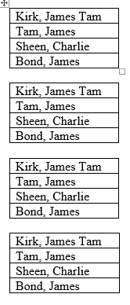
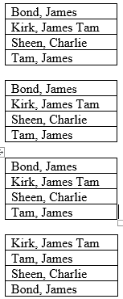
Simple Example: Sorting Three Tables (If There Is Time)
Instructions needed for sorting 3 tables
  ActiveDocument.Tables(1).Sort
  ActiveDocument.Tables(2).Sort
  ActiveDocument.Tables(3).Sort
Before
After

Slide 55
Full Example: Table (If There Is Time)
Learning objective: sorting tables using the Tables collection.
Word document containing the complete macro: “19sortingTables.docm”
Dim numTables As Long
numTables = ActiveDocument.Tables.Count
MsgBox ("# tables to sort " & numTables)
MsgBox ("Sorting Table #1")
ActiveDocument.Tables(1).Sort
MsgBox ("Sorting Table #2")
ActiveDocument.Tables(2).Sort
MsgBox ("Sorting Table #3")
ActiveDocument.Tables(3).Sort

Slide 56
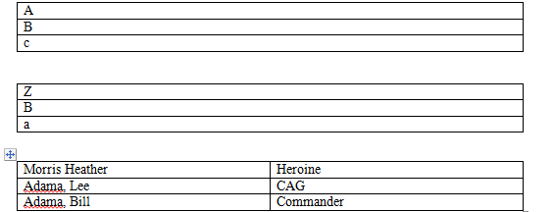
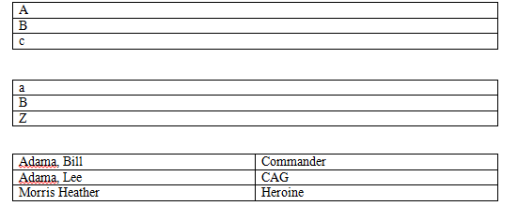
Result: Sorting Tables (If There Is Time)
Before
After

Slide 57
After This Section You Should Now Know
How to copy and run the pre-created lecture examples
How the VB editor identifies programming errors
How to create and execute simple VBA macros
  You should know that macros can be automatically recorded but specifics will be covered in tutorial
  Manually entering programs into the VB editor yourself
How to create/use a Message Box “MsgBox”
How to use basic mathematical operators in VB expressions
How to create and use variables
Naming conventions for variables

Slide 58
After This Section You Should Now Know
Objects
  Properties/attributes vs. methods
Using common properties/attributes and methods of the following objects
  Application
  ActiveDocument
  Selection
Collections
  What are they
  What is the advantage in using them
  Common examples found in Word documents

Slide 59
After This Section You Should Now Know (2)
Using common collections in VBA
  Documents
  Shapes
  InLineShapes
  Tables
  Windows

Slide 60
Images
“Unless otherwise indicated, all images were produced by James Tam

