Slide 1
Computer Security
A brief and practical guide to computer and Internet security

Slide 2
Why Security Is Important: News Stories & Media Links
https://www.theregister.co.uk/security/
https://catless.ncl.ac.uk/Risks/
https://krebsonsecurity.com/
https://www.ctvnews.ca/canada/credit-card-skimmers-found-at-vancouver-transit-stations-1.4010396
https://calgary.ctvnews.ca/video?playlistId=1.4070367
https://www.ctvnews.ca/canada/three-digital-scams-to-watch-out-for-1.3916802
https://globalnews.ca/news/4110785/facebook-data-scandal-payments-industry-retailers-canada/
https://globalnews.ca/news/3984952/peterborough-police-warn-of-death-threat-email-scam/
https://globalnews.ca/news/4353447/dont-be-fooled-by-the-password-email-scam/
https://www.consumer.equifax.ca/personal/education/identity/5-traveling-habits-that-put-you-at-risk-for-identity-theft?CTID=suitcase&utm_source=360i_facebook&utm_medium=social_article
https://globalnews.ca/news/4353684/alberta-health-services-phishing-scam/

Slide 3
Why Security Is Important: News Stories & Media Links (2)
https://www.ctvnews.ca/business/crtc-levies-fines-against-two-companies-under-canada-s-anti-spam-law-1.4010248
https://globalnews.ca/news/4369709/cryptojacking-computer-malware-threat-cryptocurrency
https://www.ctvnews.ca/canada/three-digital-scams-to-watch-out-for-1.3916802
https://globalnews.ca/news/4369709/cryptojacking-computer-malware-threat-cryptocurrency
https://globalnews.ca/news/4238897/bmo-simplii-customers-information/
https://www.gamespot.com/gallery/how-to-protect-your-gaming-pc-from-malware/2900-1599/?utm_source=weekly_newsletter&utm_medium=email&utm_campaign=20160510&bt_ee=1HOaudAeIVvqLqdRV+YG8yBcNiqpZ2stzvnbzhg4JEjMjkKyTeVZI95SsS7Y6fO3&bt_ts=1518127522278

Slide 4


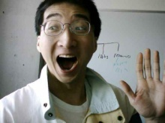
Test
You get a file attachment in a message, from which of the following people would should you open it without precautions and why?
???
A total stranger
Someone you’ve only met on the Internet
Colourbox.com
Your best friend
Colourbox.com
This guy!!!

Slide 5
Bottom Line
Don’t automatically trust any suspicious emails with links or attachments regardless of who the source may appear to be

Slide 6
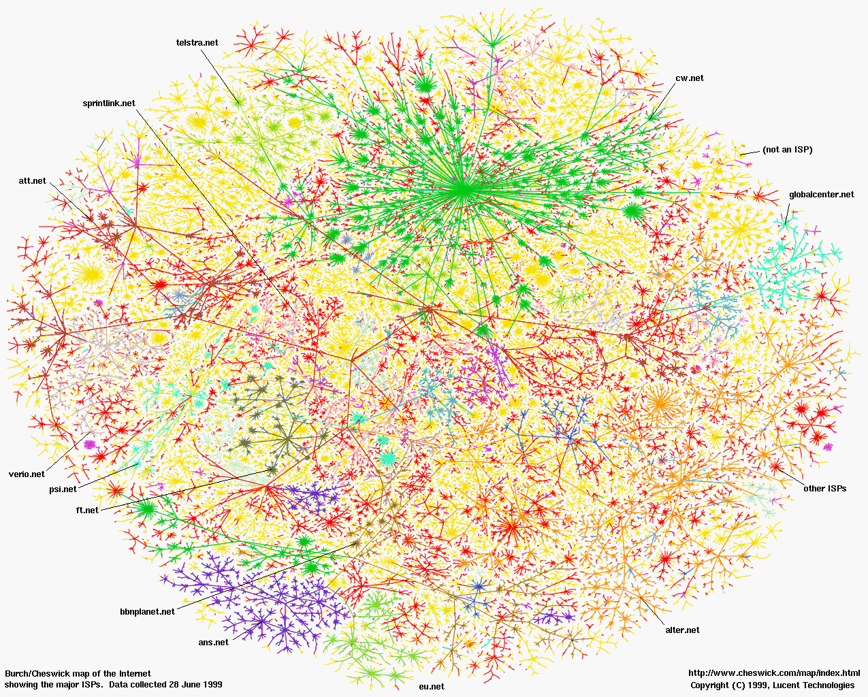

Guaranteed Electronic Security
Disconnect your computer/device from the Internet
Leave your computer/devices off all the time
Put your them all in a vault (never use
From: www.colourbox.com

Slide 7
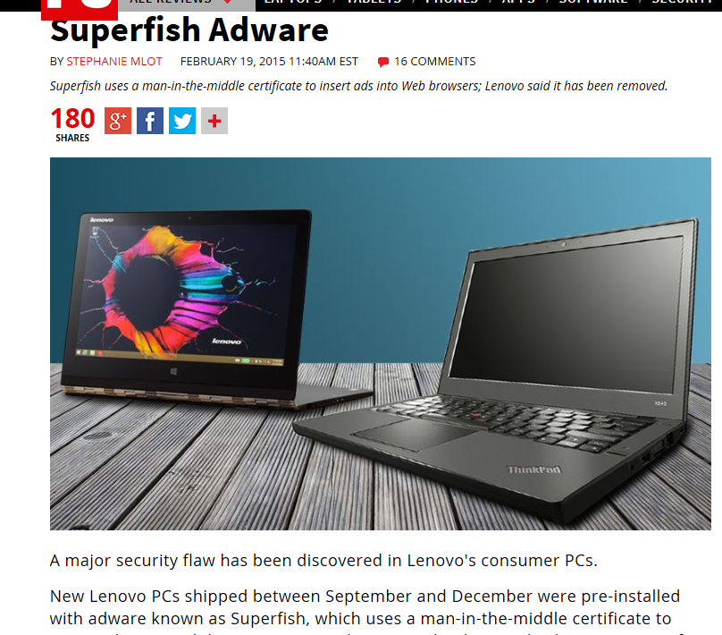
Guaranteed Electronic Security (2)
“Simple”: just buy a brand new computer!
  Think again!
From PC mag (2015): http://www.pcmag.com/article2/0,2817,2477006,00.asp

Slide 8
How To Guarantee Security Against Threats Such As Viruses (3)
“Simple”:
  “Simple solution #1”: Just ‘nuke’ my computer (wipe all the drives and reinstall everything)
  “Simple solution #2”: Use a computer with an operating system other than MS-Windows like MAC-OS or Linux.
  Problems with simple solution #1:
    Computer hardware (i.e. not MS-Windows specific) can be infected with malicious software)
      This ‘infection’ cannot be removed by formatting the hard drive
      From
      http://www.forbes.com/sites/thomasbrewster/2015/03/18/hacking-tails-with-rootkits/
    For more information on ‘infecting’ computer hardware with malicious software (CanWest security conference 2015): https://cansecwest.com/agenda.html

Slide 9
Guaranteed Electronic Security (4)
  Problems with simple solution #2:
    Viruses (and other malicious problems) DO exist for operating systems other than Windows
    Examples of Mac viruses & security issues:
      https://www.macworld.co.uk/feature/mac-software/mac-viruses-list-3668354/
    Examples of Linux viruses & security issues:
      https://www.techrepublic.com/article/linux-unix-viruses-and-worms-demand-special-attention/

Slide 10
Guaranteed Electronic Security (5)
Lesson:
  You are never guaranteed to have 100% protection.
  Taking precautions (e.g., getting anti-virus software) provide a reduced chance of an infection or other security-related problem.

Slide 11
(New?) Terms Commonly Used In Conjunction With Security
Hacker
Hacked computers (or other device)
Phishing (and the related term Spearing Phishing)

Slide 12
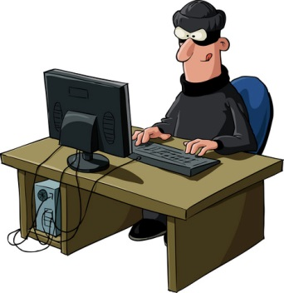
New Term: Hacker
A generic term for a person that writes malicious software (e.g., a virus that damages your computer) or tries to break into a computer system.
From: www.colourbox.com
One of many examples today: “Hacker attack leaves women angry, worried”
A security breach that exposed such personal information as the addresses and birth dates of more than 160,000 women enrolled in a mammography registry is raising questions about protecting people's privacy while at the same time making information available for much-needed research, an expert on bioethics said….
…from the Winston Salem Journal

Slide 13
New Term: “Hacked” Computer System / Device
Refers to a computer system in which the security system has been compromised.
  “…to gain access to a computer illegally” (www.m-w.com)
  “To use one's skill in computer programming to gain illegal or unauthorized access to a file or network” (http://www.thefreedictionary.com)
  Allow access to the data on the computer(s)
It can be done in many ways:
  Sometimes it’s as simple as getting an administrator password
Keep in mind this term is used in popular culture (even by news media outlets) for less serious security issues.

Slide 14
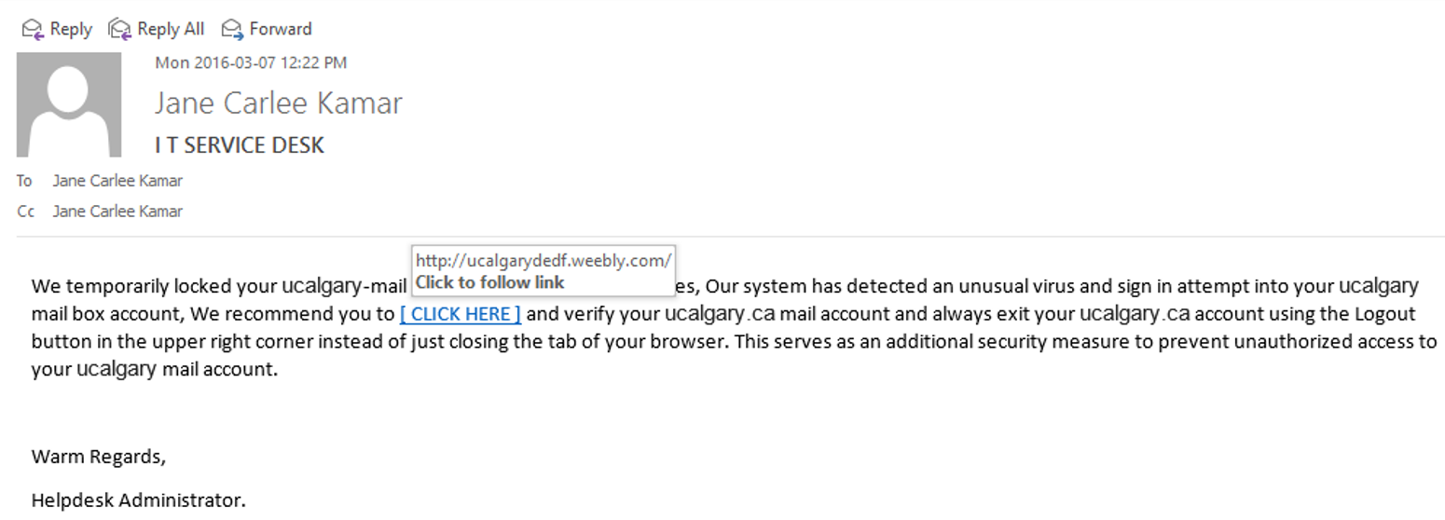
New Term: Phishing
An attempt to get another person to reveal personal or confidential information (such as passwords) through trickery.

Slide 15
How Many “Fall For” Phishing?
Too many
  Gartner estimates that 57 million U.S. Internet users have received fraudulent e-mail linked to phishing scams, and that 3% of them, or 1.7 million people, may have been tricked into divulging personal information.¹
  (In contrast the “click through” rate of general spam junk email is just one half of a percent).²
  Other sources provide a far gloomier picture (statistics sent to me via an university email from UC-IT)
    “On average, 12-30 per cent of users open malicious emails and then click on a link in the email. Companies that provide training programs notice improvements of between 26 and 99 per cent in their phishing email click rates.”³
  It’s serious enough at this university such that ALL U of C faculty and staff will be tested!
1https://www.computerworld.com/securitytopics/security/cybercrime/story/0,10801,92948,00.html (Last accessed Nov 20, 2017)
2 https://www.computerworld.com/article/2564850/cybercrime-hacking/surge-in-phishing-attacks-prompts-calls-for-change.html s(Last accessed Nov 20, 2017)
3 (Ponemon 2016 report, https://securityintelligence.com/cost-of-a-data-breach-2016/)

Slide 16
Basic/Simple Phishing Example
You have a problem with unauthorized access and you need to login to confirm access.
Apply a common sense filter to this:
  Would one good login negates several ‘bad’ logins?
  Why would your ‘login to confirm your account’ make any difference if there were several suspicious or invalid attempts.
A slightly better scam would at least ask you to login and change your password

Slide 17
Slightly Better Phishing Attack
New term: “Spear phishing” ¹: make the message more convincing by:
  Targeting the members of a particular organization (e.g. U of C staff and faculty, customers of an online business etc.)
  The email appears to originate from this organization.
    (In some cases the actual mail server of the organization may have been previously compromised and used to send these emails).
Using these above two techniques the email then provides urgent and apparently legitimately sounding reasons why personal data must be provided by going to a website (with a link in the email) where there is a request or requests for private information: passwords, pins, login names etc.
1 FBI (US Federal Bureau of Investigations: https://archives.fbi.gov/archives/news/stories/2009/april/spearphishing_040109)

Slide 18
How You Can Get Stung With A Phishing Email?
Obvious level: you gave given away private information
Less obvious: you go to the website just to “check it out” but you don’t give any private information.
  No problem?
  Think again!
  Your computer/phone can be infected by simply visiting a website.
  Going to a website downloads the ‘content’ (text, images, videos etc.) but may also download programs (in the form of ‘scripts’ or ‘web scripts’).
  New term: Drive by download (getting an electronic infection from just visiting a website).
  Skeptical? Try going to this web address (don’t worry it’s not a real virus infection)
    https://pages.cpsc.ucalgary.ca/~tamj/2017/203F/autorun.html

Slide 19
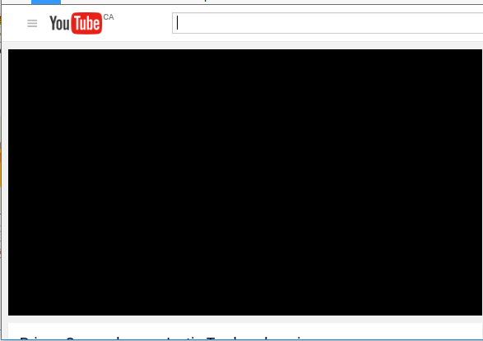
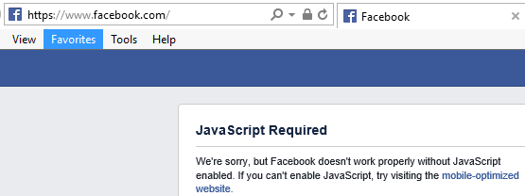
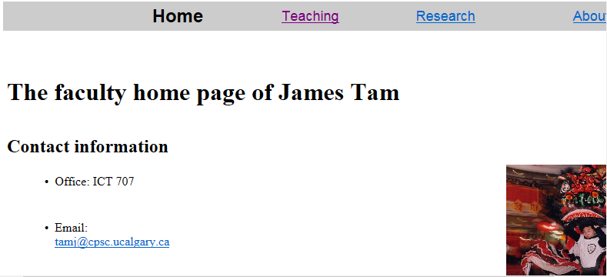
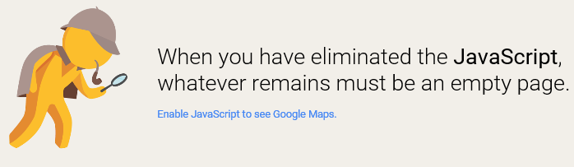
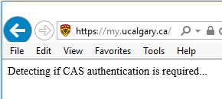
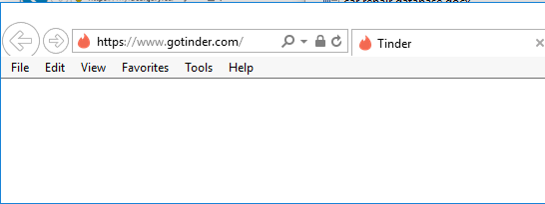
Scripts? Who Needs Them!
…Likely You Do
A-OK!

Slide 20
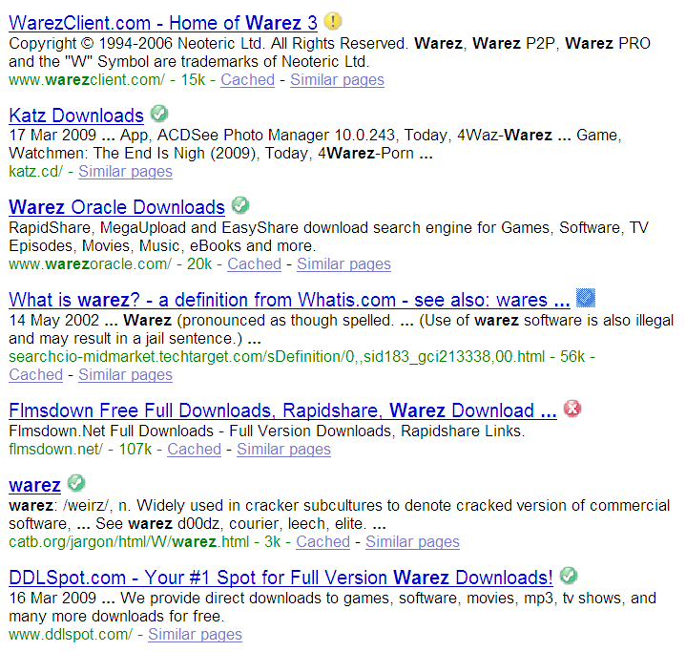
Preventative Measures Against Drive By Downloads
(Note this list is far from comprehensive).
Be cautious going to unfamiliar websites.
  Some security programs (e.g., McAfee) and search sites evaluate the safety of other websites.

Slide 21
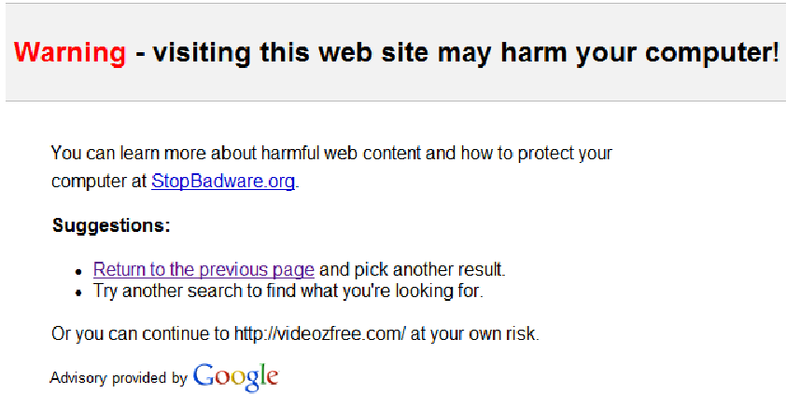
Preventative Measures Against Drive By Downloads (2)
  Some search engines (e.g., Google) may block access to sites that may infect or otherwise harm your computer.
From www.codinghorror.com

Slide 22
Malware (“Malicious Software”)
A program designed to infiltrate or damage a computer.
Most references to computer viruses are actually references to malware.
  The distinction is important because programs written to protect you from a virus may not offer you full protection against other forms of malware (you need a specialized program)
Categories of Malware:
  Computer viruses
  Worms
  Macro Viruses
  Trojans / Trojan Horses
  Spyware
  Note: there is much overlap between these categories e.g., a Trojan may also include spyware.

Slide 23
New Term: Denial Of Service Attack
An attempt to make a service unavailable
  Repeatedly sending requests for information to the computer system
  “Crashing” the computer system that is under attack
The ‘attackers’ (owners of the computer(s) from which the attack has been launched) may be unaware of their involvement
  “Mydoom/MyDoom” infected computers
Symptoms
  Computer running more slowly
  Some processes taking up resources (processor time, memory – check is with the Task manager)
  Increase in network usage (Your ISP may provide ways of letting you know your data usage rate)

Slide 24
New Term: Botnets
Paraphrased definition from (Norton: an established anti-virus software manufacturer): https://us.norton.com/internetsecurity-malware-what-is-a-botnet.html
A collection of connected computers (‘zombie’) which together can complete various tasks some of which may be for malicious purposes:
    A distributed-denial-of-service (DDoS) attack when prevents access to targeted websites
    Sending spam mail
    Replacing generic Internet banner ads with ones specifically targeted towards you
    Generating popups that urge you pay for software to remove your computer from the botnet
    In general using your computer as part of a network to carry out various nefarious tasks

Slide 25
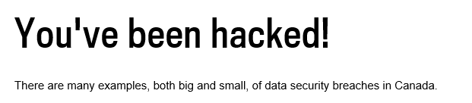
Why Terminology Is Important: News Media And Security
My financial institution/workplace/university computer system has been:
  Hacked?
  Suffered from a Denial of service attack?
    http://montrealgazette.com/news/local-news/youve-been-hacked
How do the following affect you.
My financial institution/workplace/university computer system user’s have fallen for a phishing scam?
(Exert)
“Hacktivists temporarily overwhelmed a number of federal websites with denial-of-service attacks to oppose the government’s anti-terrorism bill, C-51.”

Slide 26
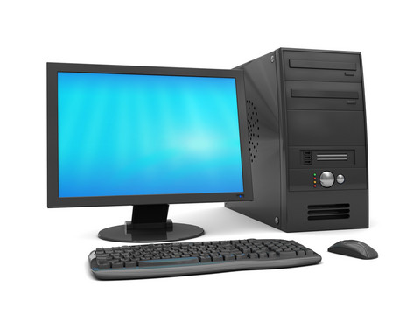
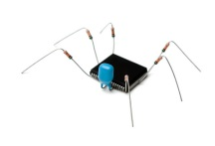


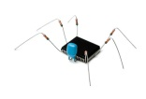
Computer Virus
Similar to a biological virus
The Internet
The infection and the replication process may or may not produce noticeable symptoms
Images from: www.colourbox.com

Slide 27
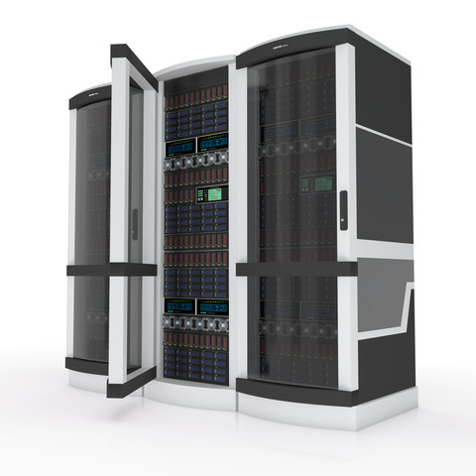

Computer Virus: Objective
For early virus writers the goal was simply infiltration of a computer or network.
At most the virus would result in some minor mischief
Department of National Defense
Woohoo I made it in!
Your PC is stoned!
Images from www.colourbox.com

Slide 28
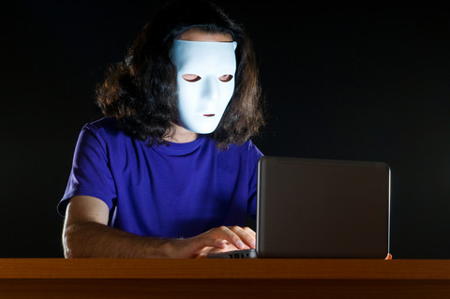
Computer Virus: Objective (2)
Some viruses were designed to be malicious or were ‘mutated’ into a malicious version (steals data, damages/deletes files, causes the computer to malfunction etc.)
Department of National Defense
Woohoo I made it in!
Your PC is stoned!
…and your hard drives are erased too!
Images from www.colourbox.com

Slide 29


Computer Virus: Objective (4)
Now a virus infection may be related to business or national espionage.
  This means that ‘serious’ resources can be put into ‘hacking’.
Woohoo I made it in! (rival company)
Department of National Defense
$$$
Woohoo I made it in! (Foreign intelligence agency)
National secrets
Images from www.colourbox.com

Slide 30
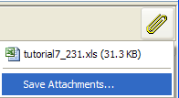
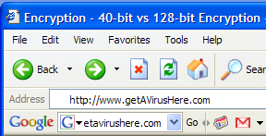
Computer Virus: Spread
Require human-intervention to spread:
  Opening email attachments
  Web-based: just going to a website can result in a infection (as mentioned a “drive-by download”).

Slide 31
“Top 10 Celebs [JT: Searching For Info. About Them] Most Likely To Give You A Computer Virus”¹
2011
1) Heidi Klum
2) Cameron Diaz
3) Piers Morgan
4) Jessica Biel
5) Katherine Heigl
6) Mila Kunis
7) Anna Paquin
8) Adriana Lima
9) Scarlett Johansson
10) Tie! Emma Stone, Brad Pitt and Rachel McAdams
2012
1) Emma Watson
2) Jessica Biel
3) Eva Mendes
4) Selena Gomez
5) Halle Berry
6) Megan Fox (up from #15!)
7) Shakira
8) Cameron Diaz
9) Salma Hayek
10) Sofia Vergara
2013
1) Lily Collins
2) Avril Lavigne
3) Sandra Bullock
4) Kathy Griffin
5) Zoe Saldana
6) Katy Perry
7) Britney Spears
8) Jon Hamm
9) Adriana Lima
10) Emma Roberts
1 Source: http://www.mcafee.com/us/microsites/most-dangerous-celebrities/index.html

Slide 32
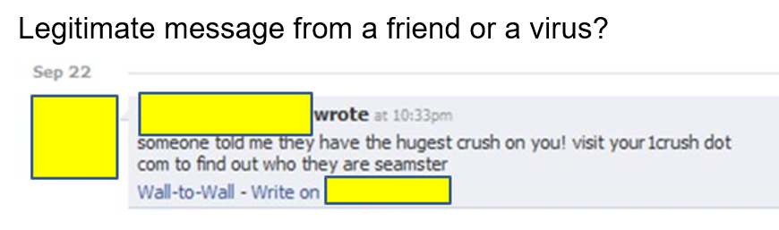
Computer Virus (And Other Malicious Programs): Avoiding?
“Solution”: Just don’t go to *bad* websites
  “Trusted websites may inadvertently be used as part of a virus attack.
Examples:
  Facebook Virus Infecting 'Friends' List: Prompts Users to Download Video
    http://www.canada.com/globaltv/ontario/story.html?id=48291ac4-f3c5-465c-b172-80299e4ca5dc
  Provocative messages from your contacts that tempts viewers to follow a link:

Slide 33
Computer Virus: Avoiding?
  Also it’s not just personal accounts that can be hacked but also the entire website itself or the company’s computers/database.
    http://www.ibtimes.com/hacks-cost-sony-pictures-entertainment-15-million-investigation-cleanup-costs-1850048
    http://money.cnn.com/2014/01/10/technology/security/target-hack-tips/index.html
  The means you can get infected by just visiting one of your favorite websites (without clicking on potentially malicious links)

Slide 34
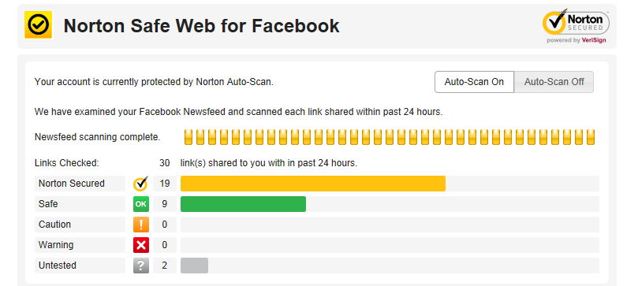
Useful Side Note: Evaluating Security Of Facebook Links
A Facebook security app

Slide 35
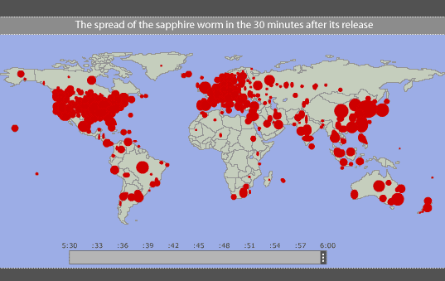
Worms
Unlike a virus a Worm can spread without human intervention.
  Many worms have automatically infected computers e.g., ‘Slammer’ (2003)
For detailed information (Symantec anti-virus)
  http://www.symantec.com/security_response/writeup.jsp?docid=2003-012502-3306-99
Image and facts from www.pbs.org (Accessed in 2015)
At it’s peak Slammer doubled in size every 8.5 seconds
Within 10 minutes it infected 90% of the worlds vulnerable host computers

Slide 36
Worm: Consequences Of An Infection
Worms are designed to automatically spread themselves (ties up computer resources trying to infect other computers ).
They may have other negative effects similar to a virus.
  “My computer is so slow”
  My computer is acting ‘funny’

Slide 37
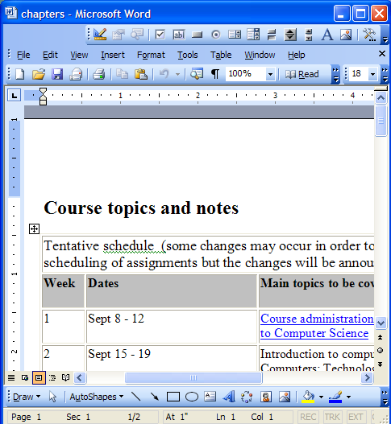
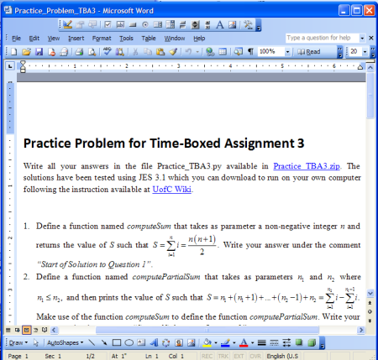

Macro Viruses
Macros can be added to many types of documents.
  They provide useful functions e.g., allow for some tedious tasks to be automated.
A macro virus is a malicious program that’s imbedded as a macro in a file.
Macro viruses replicate through the application that’s associated with the file (e.g., an MS-Word document).
Documents made with that application contain the infection
Original document: infected

Slide 38
Consequences Of Getting A Macro Virus Infection
Not only the original infected document spawns infections but ANY document created with that application is infected if the ‘template’ document e.g., ‘Normal.dot’ has been compromised
  (An example from VBA programming)
    Word macro that adds the Normal template to the collection of currently opened documents (where it may be edited by the macro).
    Set wordDocument = Documents.Add("Normal.dot")

Slide 39
Macros Viruses
“Melissa”: Information about an old but ‘successful’ Macro Virus
  http://www.cnn.com/TECH/computing/9903/29/melissa.02.idg/index.html?_s=PM:TECH
  http://www.symantec.com/press/1999/n990329.html
  http://support.microsoft.com/kb/224567
Macro viruses aren’t just “ancient history”, take the potential threat seriously!
  http://www.symantec.com/avcenter/macro.html
  http://www.microsoft.com/security/portal/threat/encyclopedia/search.aspx?query=Virus
  http://ca.norton.com/search?site=nrtn_en_CA&client=norton&q=macro+virus

Slide 40
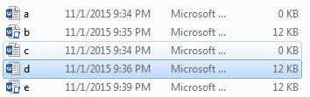
Which Document Contains A Macro?

Slide 41
Question: What Is The Security Difference?
Opening the following documents:
  Document.docm
  Document.docx
  Document.doc

Slide 42
Types Of Documents That Can Contain Macros
(Type ‘M’)
You can store the macros that you write for this class this way
  In a single document ‘doc-m’ document
You can also store macros in these documents (not for this class but important to be aware in terms of computer security).
  Normal ‘dot-m’ template i.e. “Normal.dotm”
    Default template used to produce all Word documents (formatting, layout etc.)
  Custom ‘dot-m’ template e.g. “histPaper.dotm”, “psychPaper.dotm”…
    You can override the default by creating your own template documents

Slide 43
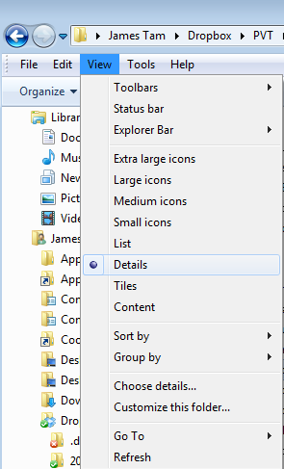
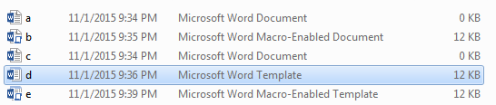
Viewing File Information: Learning What Type Of File Is That Word Document
View details: select ‘view’ in a folder

Slide 44
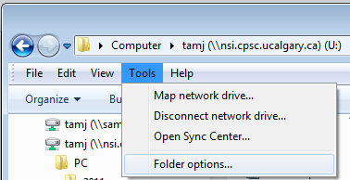
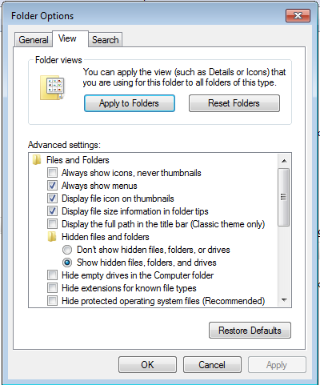

Viewing File Suffixes
In a folder select: Tools->Folder options
Under the ‘view’ tab uncheck ‘Hide extensions for known file types’

Slide 45
.DOCX (And .XLSX, .PPTX)
These types of files cannot have macros attached to them.
  Reduced capabilities (no macros) but increased security (no macros)
Question: Are these files with these extensions 100% safe?
File name extensions hidden
Enabling the display of file name extensions

Slide 46
Macros And Security
Cannot contain macros
  MS-Office files that really end in ‘x’ e.g. “docx”, “xlsx”, “pptx” etc.
  When you save a document in Office 2007 (or newer) it will in one of these file types.
May contain macros
  Template documents, end in dot-m e.g. Normal.dotm
  Older (Office 97 to 2003) Office documents e.g. “doc”, “xls”, “ppt” etc.
  Macro-enabled documents, end in m e.g. “docm”, “xlsm”, “pptm”

Slide 47
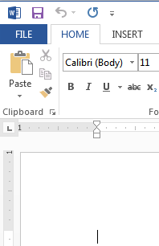
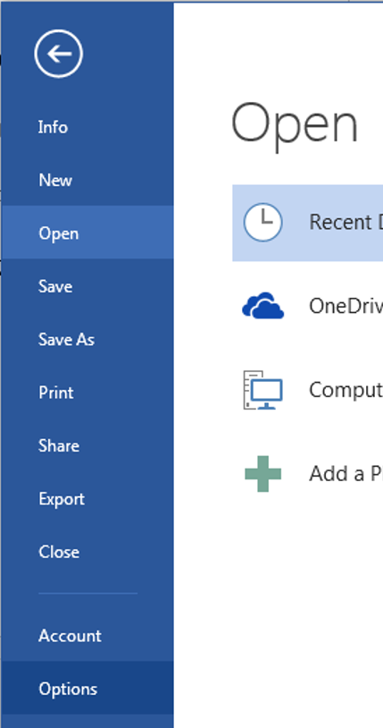
Enabling Macros To Run
If you can' t run macros in MS-office (you see odd error messages) then examine the "Trust Center“ settings in Word
  Select the ‘File’ ribbon
  Select ‘options’

Slide 48
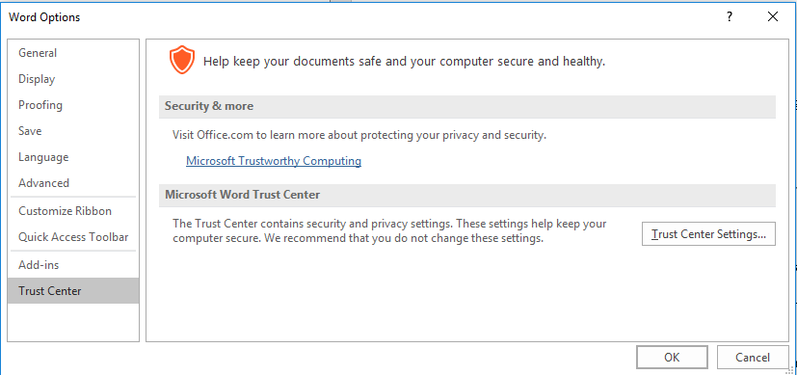
Enabling Macros To Run (2)
3A) Select “Trust Center”
3B) Select “Trust Center Settings”

Slide 49
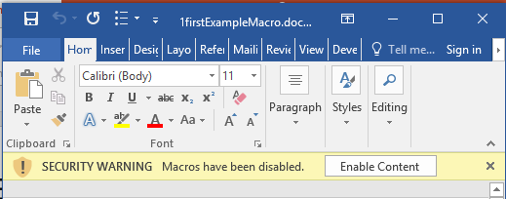
Effect: Opening Word Documents
Using the default setting will disable all macros by default (safer approach) but you can still enable the macros as the document is opened.
JT’s caution
You should NOT casually select this option for all MS-Word documents
It’s recommended that you ONLY enable macros you have created (or the lecture examples)

Slide 50
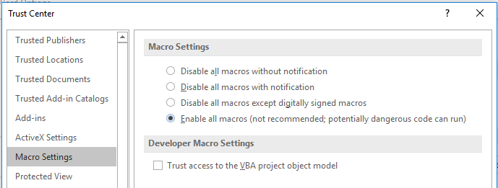
Macro Security
DO NOT take the ‘easy’ way out
More secure
NO!
Less
secure
For more information:
http://www.office.microsoft.com/en-us/help/enable-or-disable-macros-in-office-documents-HA010031071.aspx

Slide 51


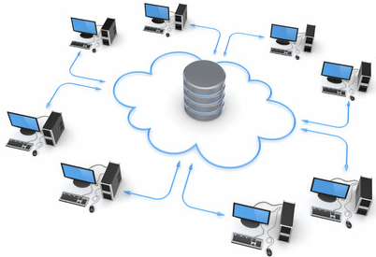
Trojans / Trojan Horse
They are imbedded in a program or file that looks useful or interesting.
Adding ‘useful’ phone apps outside of the sanctioned App-store
Some new application that allows you save videos from YouTube_{TM}!
Get a cheap hacked version of some commercial software (e.g., via ‘torrent’, ‘warez’ sites)
Download a special viewer to see “astonishing” pictures/videos of your favorite celebrity.
Images from www.colourbox.com

Slide 52
Consequences Of A Trojan Infection
A Trojan tricks users into infecting their computer by “letting in” the malicious program
  E.g., you install what you think is a useful program only to have a malicious program bundled in
The backdoor program can have negative effects similar to a virus infection.

Slide 53
Protection Against These Forms Of Malware
Malware discussed so far
  Viruses
  Worms
  Macro Viruses
  Trojans / Trojan Horses

Slide 54
Protection Against These Forms Of Malware
Use an anti-virus program:
  It’s included in Windows ‘for free’:
    Windows (Windows security essentials is available for free download while Windows defender is built into Windows 8+): http://windows.microsoft.com/en-CA/windows/security-essentials-download
  If your operating system doesn’t include security software
    Something is better than nothing (some are free!)
      Many Internet providers give something out for free if you’re a subscriber
    But try to get a program from an established company (better than a free version or a version produced by a smaller or less experienced company).
      McAfee: http://www.mcafee.com
      Norton: http://www.norton.com
      Kaspersky: www.kaspersky.com
    But make sure that you update your program and the virus definitions on a regular basis.

Slide 55

Spyware
From www.colourbox.com
Secretly gathers information about your computer and computer usage and transmits this information back to the author.
In some cases the process may be fairly legitimate in other cases it may be more nefarious.
Spyware may also take the form of a program that is installed with another (potentially useful) program making it similar to a Trojan.
From the software usage agreement from some company ‘X’:
(From Internet Privacy for Dummies “The first spyware?”
“You hereby grant company X [JT: actual name removed] the right to access and use the used computing power and storage space on your computer/s and/or Internet access or bandwidth for the aggregation of content and use in distributed computing.”

Slide 56

Spyware (2)
Some forms of spyware are relatively benign and record generic information about your computer.
However some forms of spyware record and transmit highly confidential information.
  Some do this by recording and sending all the text that you enter with the infected computer.
  Others may be more selective (e.g., it recognizes when you’re about enter information into a password field and only send passwords and other login information).
  A few may even transmit as a live video your computer desktop and send the video to the creator of the spyware.
From www.colourbox.com

Slide 57
What Does Spyware Information Look Like?
A program that records to a file what you are currently doing on your computer.
(This is not meant as ‘spyware’ but instead is used to help troubleshoot technical problems.
  “What did the user do?”
  (Windows 7: Problem Steps Recorder)
  (Windows 10: Steps Recorder or PSR)

Slide 58
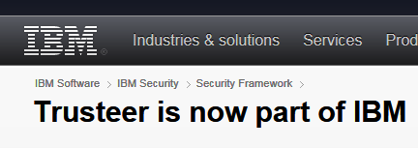
Banking Anti-Spyware Software
When you login to some banking sites they offer the ability to download additional free software to reduce the effectiveness of spyware.
  Example: Trusteer is used by a number of Canadian banks.
  (Among other things) this software can prevent spyware from making screen grabs of sensitive banking information when you are at an affiliated financial institution.

Slide 59
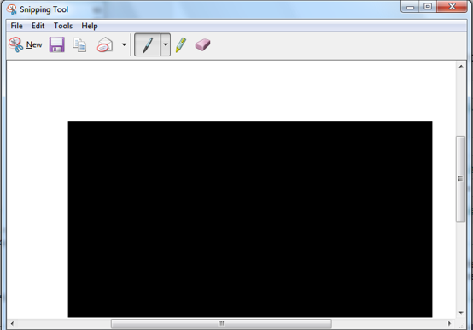
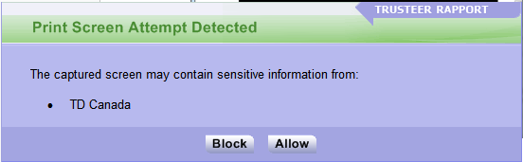
Using Anti-Spyware Software: Attempted Automatic Screen Grab Attempts

Slide 60
Protecting Against Spyware
Some anti-virus programs have begun to expand their services to protect against spyware.
However there are programs that are dedicated solely to protecting against spyware.
Some examples:
  Ad Aware: www.lavasoft.com
  Spy Sweeper: www.webroot.com
  Spybot: www.spybot.com
Similar to an anti-virus program you should update your anti-spyware program and the spyware definitions on a regular basis.

Slide 61
Keystroke Loggers
A specialized form of spyware
Record some or all of the information entered on a keyboard.
They may be used for fairly legitimate purposes:
  Trouble shooting errors
  Monitoring and evaluating employee performance
  Crime prevention
A keystroke logger can be hardware or software based.
Keystroke loggers can also be a form of spyware that was unknowingly installed.

Slide 62
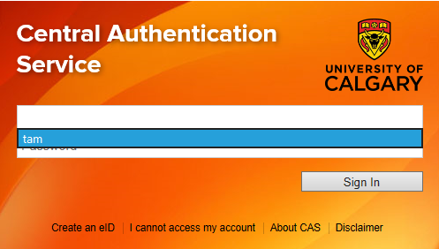
Preventing/Mitigating The Effect Of Keystroke Loggers
Install an anti-spyware program.
Get a sophisticated firewall: monitors and controls traffic coming into or out of your network (more on these later).
Minimize the typing of sensitive information with automatic form fillers:

Slide 63
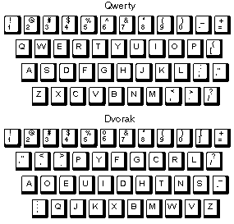
Preventing/Mitigating The Effect Of Keystroke Loggers (2)
Use an alternative keyboard layout:
Fully custom keyboard layouts can be created using tools like the Microsoft Keyboard Layout Creator (a bit extreme however).

Slide 64
Preventing/Mitigating The Effect Of Keystroke Loggers (3)
Using low tech methods can also be fairly effective for some keystroke loggers by ‘scrambling’ the text entered or by minimizing (or avoiding altogether) the amount of text actually typed in.

Slide 65
Preventing/Mitigating The Effect Of Keystroke Loggers (4)
Two step authentication
  Password
  One time code

Slide 66
Cryptocurrency ‘Mining’
(A greatly simplified explanation):
  It uses the computing power of a computer to solve complex problems to produce data.
  The data can be transferred as a currency.
  Complex verification (is supposed to) make avoid problems of ‘faking’ the currency.
    The verification process is also very “processor intensive”
  Additional details (targeted towards a general audience and generally uses lay terms):
    https://www.economist.com/the-economist-explains/2015/01/20/how-bitcoin-mining-works
    https://nationalpost.com/pmn/news-pmn/canada-news-pmn/what-is-a-digital-currency-and-how-does-cryptocurrency-mining-work

Slide 67
Cryptocurrency ‘Mining’ And Security
On the web
  Websites may use your computer to mine cryptocurrency when the site is visited.
  Some websites pay their costs and generate revenue by using visitor’s computers during the mining process instead of placing advertisements on their site.
  Other websites may mine visitor’s computers without notice.
Malware
  Malicious programs that are installed on your computer may use your computer to mine currency.
  After the computer is infected the mining may occur independent of what websites are visited or even if a web browser is not running at all.
Blocking Crypto mining software:
  https://www.cnet.com/news/scam-websites-are-using-that-green-https-padlock-to-fool-you/

Slide 68
Other Electronic Counter-Measures Against Malware
Defensive measures discussed thus far:
  Getting a good anti-virus program
  Getting a good anti-spyware program
Update your operating system (not only for Windows) and key software (e.g., web browsers and programs that run into conjunction with them such as programs that play videos, email readers, MS-Office).
  Some forms of Malware take advantage of vulnerabilities in the operating system and anti-virus programs and anti-spyware programs are ineffective against them e.g., the Sasser Worm (2004).
  Updates for Windows and other programs may not only fix bugs and add new features but can also patch these security vulnerabilities.
Get a firewall (and turn it on/configure the security settings).
  Software firewalls may get turned off (consider a hardware firewall)

Slide 69
Firewalls
It can come in hardware (e.g. router-firewall combination)
  This form covers your whole network
Windows (and MacOS) includes a software firewall
  This form of firewall can be customized for a particular device (e.g. content filters)
Many focus on preventing suspicious information (e.g. malware) from downloading into a network or computer
More advanced features:
  Examining outgoing information uploaded from a local network or computer to the general Internet
  Disabling Internet connections (known as ‘ports’) with known problems (e.g. certain email ports are frequently used by malware that generates spam)

Slide 70
Configuring Your Firewall
Firewalls may help to secure your computer by blocking ports with security problems.
  General rule of thumb: if you don’t use a port then don’t open it for access with your firewall (otherwise it may be used by malicious programs).
  E.g. Port 25 was used as the default way of sending email, now it is frequently used to send spam mail
If you are unsure of how to configure your firewall:
  Use the default or recommended configuration
  Some firewalls do all or most of the configuration of the ports for you (e.g., Norton).

Slide 71
Downloading And Installing Software
Only download software from sites that you are familiar with or ones that have a reasonably good reputation e.g. Microsoft.com, apple.com
Go to the ‘App’ stores for the company that developing the operating system software:
  The Microsoft store
  Apple App store
  Google play
Alternatively look for software reviewed from reputable sites
  e.g., www.tomshardware.com, www.pcmag.com
  These sites may or may not provide direct downloads but at least you will have the names of programs that you can then search for.

Slide 72
Where To Get Your Software?
Direct from the vendor (make sure you go to the right website or even use physical media – yes there is an advantage to getting CD/DVD)
Getting software from an official ‘app-type store’ (some stores are safer than others)
Go to sites recommended by reputable sources e.g. computer magazines (PCMag)
The general Internet (e.g. you find via a search website)
‘Pirate’ websites: ‘torrents’, ‘warez’ (offer ‘cracked’ commercial software)
More safe
Less safe

Slide 73
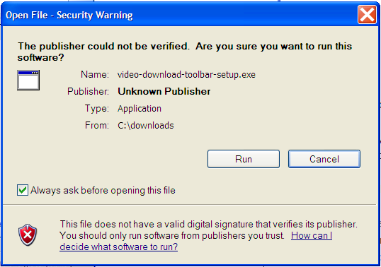
Check When Installing Software
When you install the program check the publisher information.
  Installing software from unknown publishers increases your risk.
  The identity of ‘known’ publishers is electronically certified¹ by companies such as VeriSign (digital proof that the software actually comes from a particular company).
Example software with an ‘unknown’ publisher (but this particular example isn’t necessarily malware).
1 For more information on digital signatures: https://acrobat.adobe.com/in/en/sign/capabilities/digital-signatures-faq.html

Slide 74
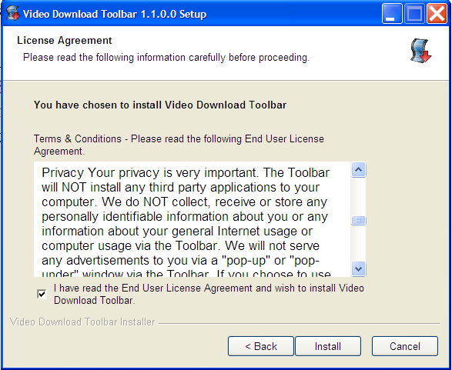
Check When Installing Software (2)
When you install the program at least skim the Terms of Use.
  Sometimes buried in the text is an implicit agreement to include additional programs or features along with the program that you are installing.
  Some of these ‘extras’ may be regarded as Spyware.
An example license agreement for the “terms of use” for the software. (This example isn’t necessarily malware).

Slide 75
Check When Installing Software (3)
When you install the program pay attention to the extra ‘add-ons’.
  This is a program that tries to install itself when you are installing another program.
  Some may be legitimate programs.
  Others may be more sketchy, installs (new term) Adware: software that automatically delivers advertising to your computer) or worse!
Some newer browsers may block third party add-on software

Slide 76
Ransomware
This form of attack makes files on your computer inaccessible via encryption until a fee (“ransom”) is paid.
The files can inaccessible indefinitely although some forms of ransomware may employ additional pressure tactics
  e.g. “every hour ‘x’ number of files will be deleted until the ransom is paid”.
The ransomware may be introduced to the system via a Trojan e.g. file attachment, clicking on a link in an email.
Some ransomware may encrypt a system without a specific action on the part of the user e.g. “Wanna crypt worm”
  However a security update for Windows did address the security vulnerability
  https://blogs.technet.microsoft.com/msrc/2017/05/12/customer-guidance-for-wannacrypt-attacks/

Slide 77
Protecting Against/Mitigating The Effects Of Ransomware
Ransomware may enter a computer system using stolen login credentials and drive by downloads:
  The same actions taken to avoid falling for phishing scams can help (e.g. be cautious of ‘verifying’ login and other personal information).
  Avoid suspicious emails links and be cautious of going to unknown websites.
Backup important files as often as possible (on a device that’s only connected to your computer during the backup).
Regularly update your operating system (don’t put off those Windows (and other) updates).
Consider the use of ‘imaging’ software so you can copy the state of your hard drive at a particular point in time (includes configurations and installations that may have been made).
An article by Forbes written for general audiences for dealing with malware: https://www.forbes.com/sites/waynerash/2020/01/29/how-to-reduce-your-chances-of-getting-hit-with-ransomware/#d4c20dc18754

Slide 78
Protecting Against/Mitigating The Effects Of Ransomware (2)
While installing an anti-malware program may sometimes help consider installing a specialized program that is specifically written to detect and counter the behavior of ransomware.
  These behaviors may range from programs that encrypt or delete files to ones that change the master boot record of the hard drive (where the operating system has been installed)

Slide 79
Portable USB Flash Drives
Similar to physical health good hygiene practices must be followed.
  Careless connection of flash drives means that you aren’t just vulnerable to malware on that person’s computer but any other computers that the flash drive has been connected to.

Slide 80
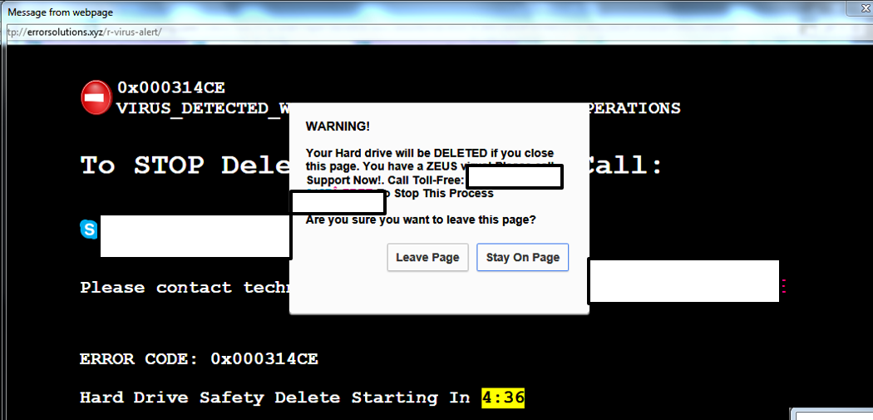
Is This A Trap? How To Avoid?
A popup comes up looking like something legitimate from Windows. How do avoid installing malware when you see this window?
From: James (credit for the image not for the scareware popup)

Slide 81
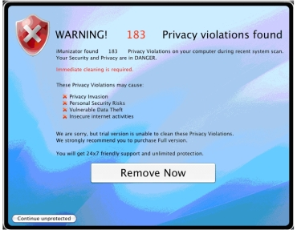
Scareware
In-and-of itself this is not necessarily a malicious program.
It’s an authentic looking message giving you a fake warning about problems with your computer.
  Virus infection
  Damaged operating system files slowing down your computer
From: http://www.symantec.com

Slide 82
Scareware (2)
Typically pops up while browsing a web site.
It may simply be an elaborate ruse to get people to try their product.
In other cases trying to remove a problem that doesn’t exist may actually create new problems:
  Malware infection
  Credit card theft
Try closing your browser or even rebooting your computer and see if the messages persist.
Examine the messages carefully, are they originating from a security program currently installed on your computer?
  E.g., “Tam secureguard sez’ u r infected”
  Try running your own anti-virus software and see if the “security software” shows up as an infection.

Slide 83
Information On Avoiding Scareware Pitfalls
Example tips (From Microsoft):
  Promises of money for little or no effort.
  Deals that sound too good to be true.
  Alarmist messages and threats of account closures.
    Check the return email address
    Don’t click on the links provided to ‘fix’ the problem
    Use common sense e.g., would a computer tech administrator require personal information to ‘verify your email account information’
  Requests to donate to a charitable organization after a disaster that has been in the news.
    Just donate directly via the website rather than using the email.
  Bad grammar and misspelled words.
For more information:
  http://www.microsoft.com/security/pc-security/antivirus-rogue.aspx

Slide 84
Side Note: Scammers Are Annoying But…
…it’s probably best to avoid confrontations:
  http://globalnews.ca/news/1444283/calgary-couple-harassed-over-phoney-lottery-scam/

Slide 85


New Term: Encryption
Unencrypted data (text, images, videos, etc.) can be viewed.
Encryption processes data so it cannot be viewed until the data is decrypted.
Many methods (protocols) of transmitting information on the Internet do not encrypt data by default:
  Email
  Http (used to be the default for websites)
Signs that a website uses encrypted connections:
  https in the web address:
  A lock icon appears in the browser

Slide 86
HTTPS
Browser to browser traffic to a particular website encrypted .
Potential issues:
  Other Internet transmissions may not necessarily be encrypted e.g. a separate chat program like Skype (unless the chat program uses it’s own encryption).
  Even though the visual indicators for encryption appear (e.g. lock icon) it’s possible that the web traffic is being intercepted and decrypted without any indication to the website visitor:
    Recall this example: a well known brand of laptops included in their factory software build software that would do this (it was supposed to allowed advertising to be inserted but it could result in other security issues without the laptop user being aware of it).
    “Man-in-the-middle” attacks. For more information (reputable information source but the link includes a plug for their security software): https://us.norton.com/internetsecurity-wifi-what-is-a-man-in-the-middle-attack.html

Slide 87
Not Every Site Employs HTTPS
Recap of https: an encrypted connection between your computer and the website that employs the https protocol.
  My connection to a bank https://www.bankoftam.com is encrypted.
  During that same Internet session I check my email on a dating website that uses regular http e.g. http://www.somdatingwebsite.com (not a real website) and the information can be viewed by third parties (personal information, contact details, payment information if the site charges).

Slide 88
VPN (Virtual Private Network)
Encrypts all Internet transmissions (not just your browser).
  (It can be used with https connections e.g. if you are using a free public hotspot you may be subject to security problems such as Man-in-the-middle type of attacks.
    Other devices connected to that Wi-Fi hotspot can view (‘sniff’) information that you have sent out.
    Even if your information is routed to third party it may not be readable due to the VPN encryption.
  Keep in mind! VPNs only encrypt information from your computer to the VPN server.
    After that information may be viewable so it is not a substitute for https.
Your computer
ISP
VPN server
Rest of the Internet
Rest of the Internet
Destination

Slide 89
VPN: More Information
Explanation:
  https://headvpn.com/Which_is_better_-_HTTPS_vs_VPN/
  https://computer.howstuffworks.com/vpn.htm
  https://www.pcmag.com/article/364072/do-i-need-a-vpn-at-home
Review of VPN software:
  https://www.pcmag.com/article2/0,2817,2403388,00.asp
U of C VPN software: Forte (licensed for student use): see the extra video for getting set up (and it’s not just for laptops but licensed for the iPhone and Android).
  https://ucalgary.service-now.com/it?id=kb_article&sys_id=f7ca400d139962406f3afbb2e144b05f

Slide 90
‘Full’ End-To-End Encryption
Although sites such as Facebook only provide https connections you can have chat information fully encrypted from “end-to-end” (only sender and receiver) if you use tools such as “secret conversations” (Facebook tool available only via mobile).
  One difference between full end-to-end security and https:
    https: browser to Facebook server encryption (assuming no Man-the-middle attacks computers on the Internet between your computer and the Facebook servers cannot read your information).
    That means Facebook staff (or others such as: 1) governments that subpoenas Facebook for your information 2) hackers break into Facebook and steal your information) can view transmissions
    Example article:
      https://time.com/4944373/are-your-facebook-messages-private/

Slide 91
‘Full’ End-To-End Encryption (2)
  There exist other end-to-end encryption chat programs as well e.g. WhatsApp (owned by Facebook), Telegram, Wickr Me, Signal.
  Of course since the recipient can view messages if you are truly concerned about privacy and security (e.g. “Something coming back to haunt you” in the future) keep in mind that recipient may capture information locally and storage of that information may not be secure e.g. pictures of secure text and files send via secure chat.

Slide 92
Basic Wi-Fi Security: Logging Onto Another Network
Be cautious when accessing the Internet via free Wi-Fi hotspots!
First question: is the hotspot actually available in your location (look for physical signage, ask staff).
Second question: are you actually accessing the free Wi-Fi network or a fake that appears like the actual Wi-Fi connection that you want to access.
  Similar to fake websites the name of fake Wi-Fi hotspot is spelled very close to the name of the real Wi-Fi hotspot
Third: avoid logging onto websites where you need to enter or access private information (e.g. bank)

Slide 93
Basic Wi-Fi Security: Logging Onto Another Network (2)
Fourth: employing a VPN can help prevent others on the network from accessing your information sent to/from your Internet connection.
  If encryption isn’t properly set up on the network then hackers can employ ‘packet sniffers’ to view the contents of transmissions so the VPN provides encryption.
Fifth: although convenient don’t select an option to connect automatically to the network.

Slide 94
Basic Wi-Fi Security: Configuring Your Home Network
First: Change the defaults for the administrator login name, password and even the name of the Wi-Fi network immediately.
  Looking at the default Wi-Fi name online may yield the default login information.
Second: pick a secure password (guidelines to follow).
Third: apply updates to your router (‘flash’ the storage device) as they become available.

Slide 95
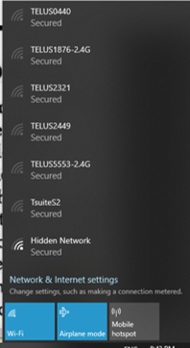
Basic Wi-Fi Security: Configuring Your Home Network (2)
Fourth: adds more security but it might be adding unnecessary inconvenience.
  You can ‘disable’ the broadcasting of the SSID i.e. your router is set up such that the wireless network won’t appear as login option to others.
    The average person won’t know how to find your wireless network although a more sophisticated user may do so.
This requires that turn it back when someone with a new device needs to connect to your Wi-Fi network
Fifth: makes it less convenient to access your home Wi-Fi but makes it harder for someone to find your network.
  If you do broadcast your SSID you can turn the strength of the Wi-Fi signal to reduce the range of coverage.

Slide 96
Choosing A Good Password
Even with the best encryption, if the password is weak a brute force approach (brute force = try all combinations) can ‘crack’ your security.
  Because computers of today perform math quickly and a brute force approach is just mathematically going through possible combinations a poorly chosen password can eventually be determined.
  E.g. creating a 2 digit password = 100 combinations (more digits used in the password the more difficult it is to guess the actual password)
    00
    01
    02
    09
    …
    99

Slide 97
Choosing A Good Password (2)
  E.g. 3 binary digit password and a brute force hack
    000
    001
    010
    011
    100
    101
    110
    111
  2 raised to the number of bits = number of combinations

Slide 98
Choosing A Good Password (3)
The more bits used, the harder it is to guess (‘crack’) the password
2¹ = 2 combinations
2² = 4 combinations
2³ = 8 combinations
…
2²⁴ ~ 16 million combinations
2³² ~ 4 billion combinations
This is why, say, 256 bit encryption is better than encryption that uses fewer bits (more combinations)

Slide 99
Choosing A Good Password (4)
Using different characters makes it even harder to guess a password
  E.g. Using only digits
    a single digit password =10 combinations (0- 9)
    Two digit password = 100 combinations (0-99)
  E.g. same case alpha
    Using a single alpha character (lower case) = 26 combinations
    Using two alpha characters (lower case) = 26 x 26 combinations
  E.g. mixed case alpha
    Using a single alpha (upper and lower case) = 52 combinations
  E.g. mixed case alpha and digits
    Using a single alpha (52 mixed alpha plus 10 digits) = 62 combinations

Slide 100
Guides For Password Security
Things to avoid in passwords
  Never choose something of direct personal meaning to yourself that someone can guess
    Name, birthdate, address, pet’s name etc.
Things to guide your choice of a password
  Avoid using only a dictionary word as a password e.g. ‘Sesquipedalianism’
  Use a mix of alpha (mix case), numeric, “special characters”
  E.g. My1Bae20Iz300-ZeLdA

Slide 101
Guides For Password Security (2)
But you may have heard that the password creation rule of thumb (e.g. using special characters) is ‘bad’ – not in and of itself
  Compare: ‘Ab&9’ (128x128x128x128 = 128⁴ ~ 268 million combinations) vs. ‘’kieiekieie” (26¹⁰ ~141 trillion combinations)
    Short passwords using special characters can be worse than longer passwords that are drawn from one type of character.
  Better: ‘Akieiek_9’ = 1,180,591,620,717,411,303,424 or ~1 Sextillion combinations

Slide 102
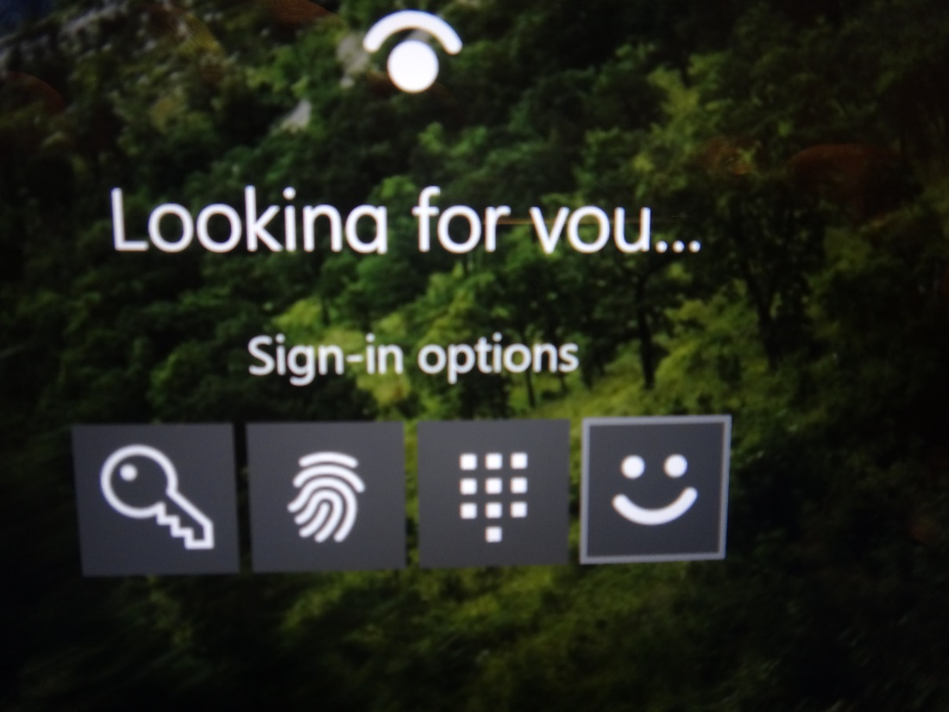
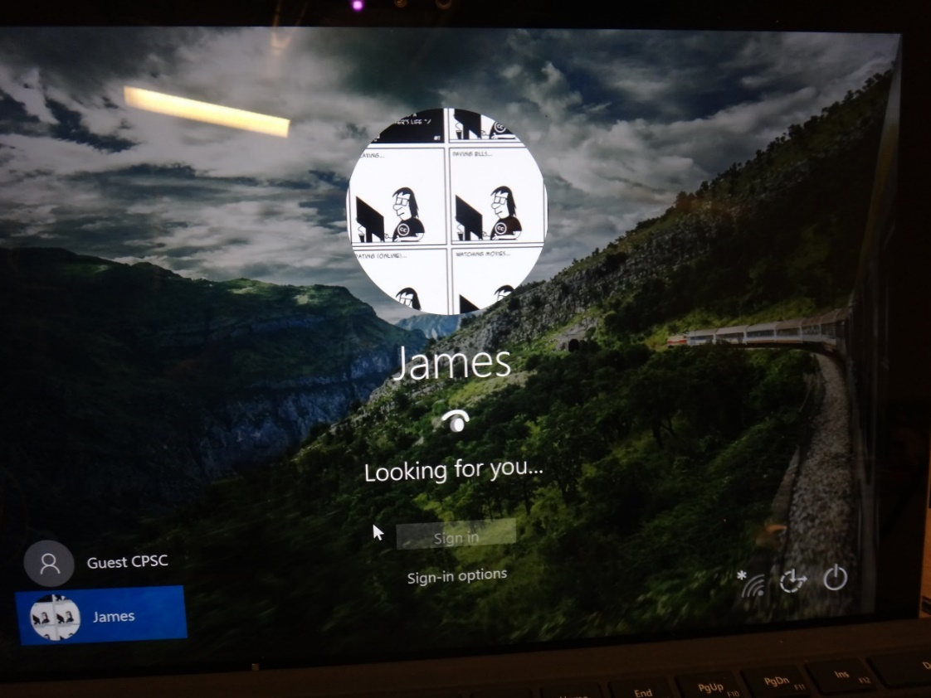
Password Alternatives
Finger print and facial recognition
More information on Windows ‘Hello’
https://privacy.microsoft.com/en-US/windows-10-windows-hello-and-privacy
Images: Curtesy of James Tams

Slide 103
Password Alternatives
Class discussion: what are some of the potential security issues.

Slide 104
Some Symptoms Of A Malware Infection
Hardware/software changes (note these symptoms may arise by factors other than malware)
  Computer runs slower (processor, memory, disk usage increase dramatically)
  Computer malfunctioning (e.g. unexpected crashes)
  Files are altered (e.g. different default ‘open with’ program, files have been corrupted)
The web browser has been altered.
  Different home/start page
  The browser is redirected to the different pages
  New tool bars/adds have appeared
  Popups unexpectedly appear, sounds play for no apparent reason

Slide 105
Some Symptoms Of A Malware Infection (2)
An infection may have occurred even if no symptoms are apparent e.g. spyware (if properly written) should “keep a low profile”

Slide 106
Security: Proactive Measures
Install an anti-virus program from a reputable company.
  Update the definitions on a regular basis.
Install an anti-spyware program from a reputable company (if the previous doesn’t protect or protect well from spyware).
  Update the definitions on a regular basis.
Add a firewall.
  Make sure that it’s properly configured.
  (Change the default login and password information)
Update your operating system and programs on a regular basis.
  The updates not only provide bug/error fixes but may also patch security flaws.

Slide 107
After An ‘Infection’: Your Computer Appears To Be Running ‘Funny’
Update security software
Update virus definitions
Run security (e.g. anti-virus) software (Complete steps 1 & 2) before #3
Start up the Task manager and look for unusual processes running and/or ones that are taking up many system resources
Look at installed programs on control panel, sort by date and look at programs installed around or after you noticed things going weird
Look at browser “extensions” (Microsoft)/”add-ons” (Firefox)/”plug-ins” (Chrome)
(Of course your problem could be caused by faulty hardware or software).

Slide 108
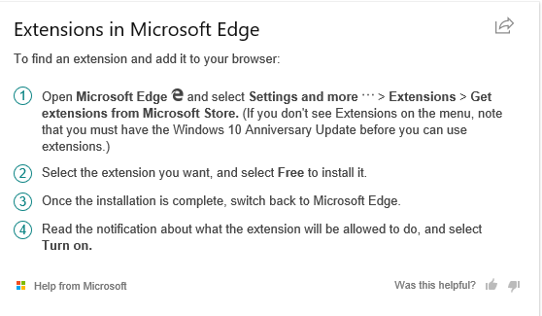
Microsoft Browser ‘Extensions’ (For Your Own Use)

Slide 109

Firefox Plugins (For Your Own Use)
From:
  https://support.mozilla.org/en-US/kb/disable-or-remove-add-ons#w_how-to-disable-plugins

Slide 110
After This Section You Should Now Know
In terms of computer security, what is meant by the terms ‘hacker’ and a ‘hacked system’ vs a denial of service attack
How do phishing and spear fishing scams work
What is malware
  What are some common categories of malware
  How do the different forms of malware get onto your computer
  What are the consequences of having a malware infection on your computer
  How to protect against malware
How do the newer security related threats and issues work: ransomware, cryptocurrency mining
Electronic and non-electronic defensive measures against malware

Slide 111
After This Section You Should Now Know (2)
What is scareware and how it can be a security threat
The different levels of safety/danger when finding software
What is a logical port and how do firewalls increase security by closing ports
Security issues related to portable flash drives
What is encryption and how does it tie into security
The difference between encrypted and unencrypted information.
  How different approaches to encryption can reduce security risks
Examples of Wi-Fi security issues

Slide 112
After This Section You Should Now Know (3)
Guidelines for choosing a good password
  How different choices in password can affect computer security (number of combinations)
How to recognize symptoms of a malware infection and ways of reacting as well as proactively preventing problems

Slide 113
Images
“Unless otherwise indicated, all images were produced by James Tam

