Slide 1
Spreadsheets
You will learn about some important features of Excel.
Online MS-Office information source: https://support.office.com/

Slide 2
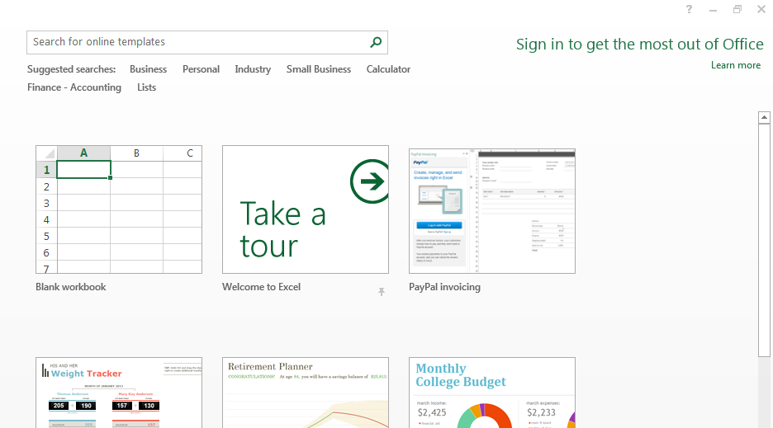
Getting Started: Creating A New Blank SpreadSheet (Excel: “Workbook”)
Once Excel has started, select the option for creating a new sheet:
Select this for CPSC 203

Slide 3
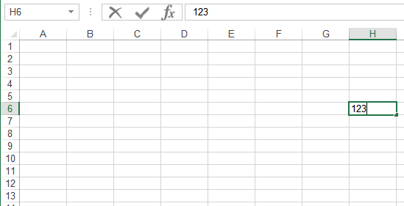
Spreadsheets 101 (Basics)
Column headings
Coordinates of current cell
Row numbers
Current cell
Contents of current cell

Slide 4
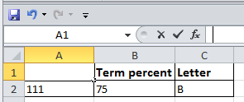
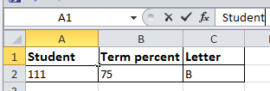
Entering Data
Click on cell to enter the data (in the example: selected cell A1)
Type in cell contents (data entered in the example: ‘Student’)

Slide 5
Contents Of A Cell: Types
Raw data: also referred to as ‘constants’
Labels: describe the contents of another cell
Formula: values derived from the raw data (e.g., calculations: =2+2, lookup values: =D2*2, functions: =sum(B2,B9))

Slide 6
Distinguishing Formulas From Text
In Excel all formulas must be preceded by the ‘=‘ symbol (“assignment operator”) to distinguish it from text.
Example spreadsheet: 1_formulas
Label
2 + 2
Formula
= 2 + 2
For the sake of brevity, you can assume that all formulas in this section will be preceded by the assignment operator ‘=‘

Slide 7
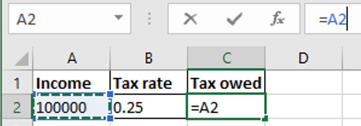
Entering A Formula That Refers To Another Cell Or Cells
Approach 1: type it all in all
Click on a cell where you want to enter the formula e.g. click on C2
Type in the formula manually e.g. type =A2*B2
Approach 2: type and click
Click on a cell where you want to enter the formula e.g. click on C2
When you get to the part of the formula that refers to another cell then just click on the cell (being referred to) rather than typing in the cell address e.g. click on A2 after typing the ‘=‘ in C2
1) Click here
2) Reference to Cell A2 appears here

Slide 8
Formatting Cells
For other information for the other tabs (right clicking on a cell to ‘format cells’)
Similar to the basic features of Word these features will be assumed prior knowledge or knowledge that students can pick up on their own.
These features won’t be covered in lecture nor will they be covered in tutorial.
For more information please refer to the tutorial notes: “excel_basic_features”.

Slide 9
Basic Mathematical Operators
Example spreadsheet: 2_operators
Mathematical operation | Excel operator | Example
Assignment | = | = 888
Addition | + | = 2 + 2
Subtraction | - | = 7 – 2
Multiplication | * | = 3 * 3
Division | / | = 3 / 4
Exponent | ^ | = 3 ^ 2

Slide 10
Order Of Operation
Operations on a higher level are evaluated first
8 / 2 ^ 3 Equals 8 / 8 or 1
When a sequence of operators from same level (e.g. addition, subtraction) are encountered in a cell the expression is evaluated from in order in which they appear (left to right).
2 + 2 - 1 Equals 4 – 1 or 3
Level | Operation | Symbol
1 | Brackets (inner before outer) | ()
2 | Exponent | ^
3 | Division, Multiplication, | / *
4 | Addition, Subtraction | + -

Slide 11
Designing Spreadsheets: Rules Of Thumb
Do not directly enter values as data that can be derived from other values (this is a numerical calculation example)
Example
Assignment grade (assume one assignment worth 40%) = 4.2 (data in cell A2)
Exam grade (assume only one exam worth 60%) = 3.3 (data in cell B2)
Calculate term grade point =(A2*0.4)+(B2*0.6) OR directly enter 3.66?
4.2
3.3
=(A2*0.4)+(B2*0.6)
A2
B2

Slide 12
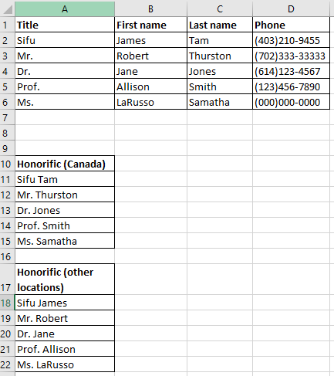
Designing Spreadsheets: Rules Of Thumb (2)
Do not directly enter values as data that can be derived from other values (the ‘&’ operator connects text)
Example: 3_generating_honorifics
Manually entered data
=A2 & " " & C2
Generated (and updated) according to the data
=A2 & " " & B2
In Excel the ampersand ‘&’ connects text strings

Slide 13
Designing Spreadsheets: Rules Of Thumb (3)
Label information so it can be clearly understood

Slide 14
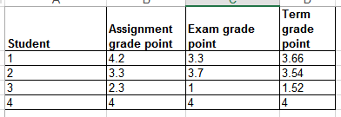
Designing Spreadsheets: Rules Of Thumb (4)
Never enter the same information more than once
Example spreadsheet: 4grades_formulas
Advantages: reduces size and complexity of the sheet, making changes can be easier.
Seems obvious? Not always
Example: What if the previous spreadsheet were used to calculate the grades for a class full of students?
Some would create the sheet this way:
=(B2*0.4)+(C2*0.6)
=(B3*0.4)+(C3*0.6)
Etc.

Slide 15
Designing Spreadsheets: Rules Of Thumb (5)
=(B2*0.4)+(C2*0.6)
Issues:
Making changes: What if the value of each component (40% assignments, 60% exams) changed?
Retyping/modifying all formulas is inefficient (at least a copy-paste is needed)
Clarity: What does the 0.4 & 0.6 refer to (sometimes it’s not so obvious)? It violates the “label information” rule of thumb.
=(B3*0.4)+(C3*0.6)
Etc.

Slide 16
Lookup Tables
Example spreadsheet: 5_grades_lookup
As the name implies it contains information that needs to be referred to (“looked up”) in a part of the spreadsheet.
Can be used to address some of the issues related to the previous example:
Clarity
Entering the same data multiple times
=(B2*$G$2)+(C2*$G$3)

Slide 17
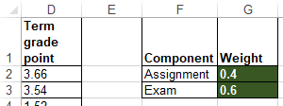
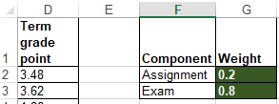
Quick Hint #1: When To Use the $ Sign (Absolute Cell Reference)
If a formula always refers to the same location in the spreadsheet (e.g. lookup table or lookup cell)
Always precede references to cells being looked up with a dollar sign
Values in G2 and G3 are needed in calculations for all students so the row and column are preceded by a dollar sign: (B2*$G$2)*(C2*$G$3)
The dollar signs ensure that when the formula is copy-pasted, other student’s term grade points always refers to grade weightings specified in the lookup table defined in Cell G2 and Cell G3.
=(B2*$G$2)+(C2*$G$3)
Changing the lookup table values automatically changes all cells that refer to the table (i.e. term GPAs update)

Slide 18
Quick Hint #2: When NOT To Use the $ Sign (Relative Cell Reference)
If a formula will refer to different cells if it is copy-pasted (or moved) to another part of the spreadsheet.
E.g. assignment and exam GPA used to calculate term grade.
Original formula
=(B2*$G$2)+(C2*$G$3)
Formula copied down 1 row (row +1)
=(B3*$G$2)+(C3*$G$3)

Slide 19
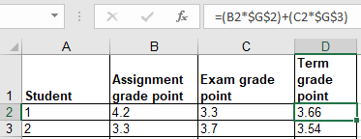
Relative Cell Reference: No $ Sign
General rule:
If the formula is moved/copied ‘down’ by ‘a’ rows then the relative row references increases by ‘a’ amount.
Previous example: formula is copied down by 1 row so the cell references increased by 1: from B2 to B3 (+1) for the assignment component and from C2 to C3 (+1) for the exam component.
Thus the formula changed:
From: =(B2*$G$2)+(C2*$G$3)
To: =(B3*$G$2)+(C3*$G$3)
If the formula is moved/copied ‘up’ by ‘a’ rows then the relative row references decreases by ‘a’ amount.
If the formula is moved/copied ‘left’ by ‘c’ rows then the relative cell references decreases by ‘c’ amount.
If the formula is moved/copied ‘right’ by ‘d’ rows then the relative cell references increases by ‘d’ amount.

Slide 20
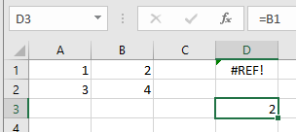
Relative Cell Reference: Errors
If a relative cell reference produces a row or column reference outside the valid range (e.g. below ‘A’ or ‘1’) an error message will appear.
Example: copy the relative cell reference from D3 to D1.
The new formula would refer to Cell =B1 minus two rows (not possible).
Maximum number of cells in an Excel spreadsheet¹
1,048,576 rows by 16,384 columns
(This information is included for your own reference rather than something you should know as a requirement for the exam).
1 Source: https://support.office.com/en-us/article/excel-specifications-and-limits-1672b34d-7043-467e-8e27-269d656771c3

Slide 21
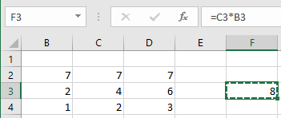
Cell References: Example Exam Question
What’s the result of copying the expression from F3 to G4?
Note: References to empty cells (e.g. B1) that are used in a mathematical expression return 0.
Example B1 + C1 = 0

Slide 22
Data Too Big For Your View
Covered in this section of lectures notes
Freezing panes
Simple merging of cells (merging cells on a single row).
Covered in the introductory tutorial notes
Resizing rows or columns
Wrap the data
Merge data (merging multiple rows as well as multiple columns)

Slide 23
“Freezing” Panes: How/Why
Often used to lock the view so labels always stay onscreen regardless of which part of the sheet you are viewing.
Obviously this is useful for cases that contain column (or row) headings.
Running the Freeze Panes feature: View -> Window: Freeze Panes

Slide 24
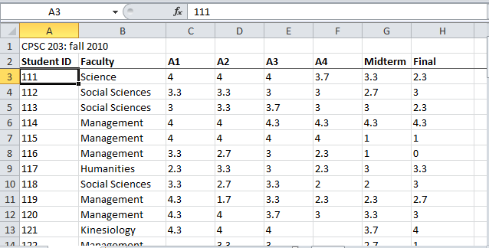
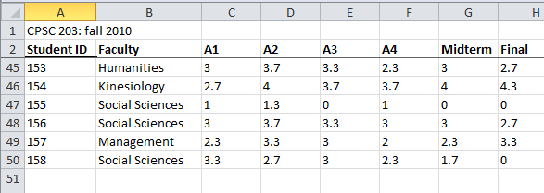
Freezing Panes: Effect On Example Spreadsheet

Slide 25
Freeze Panes: Procedure
Move to the row below the row to be ‘frozen’.
In the previous example with student grades it would be Row 3.
Select:
View -> Window : Freeze Panes and then select the “Freeze Pane” option among the options.

Slide 26
Merging The Columns Along A Single Row
Combines the columns into one wider column.
Before the merge
(Merging Row 1: Col A – E)
After “Merge & Center” (merge and center align)
After the Merge Across, Merge Cells (merge and retain previous alignment settings)

Slide 27
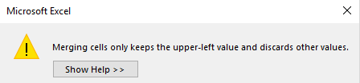
Merge Columns (Each Containing Data)
Only the data in the top left-most cell of the merged range is retained.
Before the merge.
After the merge: Merge and center (“L01” is lost)
After the merge: Merge across, Merge cells (data “L01” is lost)

Slide 28
Copy-Paste: Explanation
A single cell or a range of cells can be copied (or cut) and pasted.
There are a number of options for how the originating cell or cell is pasted into the new location.
We will cover a few of the options for this class
“Paste”: copies the formula (which may be modified if the cell references are relative)
May update final values if the data changes (relative references used).
“Paste values”: includes only data or the final result of a formula.
If the formula changes then the pasted data won’t be updated.
“Paste link”(always updates to the current value in the source cell)

Slide 29
Copy-Paste: Example
Example spreadsheet: 6_copy_paste
Copy paste from A3 into C3 (paste current formula), D3 (paste current data), D3 (paste link)
Changes in data in the source cell: if the values in A5 & B5 change to 9 and 6 respectively what will the values be in C3, D3, E3 and why.
Changes in the formula in the source cell: Contents of A3 was changed to =9*3
=$A$5*$B$5
56
=$A$3
=$A$5*$B$5

Slide 30
Copy-Paste
For your information: Multiple cells (an entire row, column or even a range of cells e.g. A1:C10 can by copied-pasted)

Slide 31
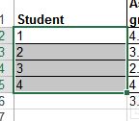
Autofill
Allows for a sequence (constant or addition by a constant amount) to be extended
E.g., The sequence “1, 2, 3” (can be extended to include “…4, 5, 6”)
Steps:
Highlight the cells containing the sequence to extend (selecting one cell just repeats the contents of that one cell).
Move the mouse pointer to the ‘handle’ at the bottom right

Slide 32
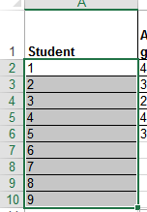
Autofill (2)
Drag the mouse as far down as you wish the sequence to be extended to.

Slide 33
Autofill (3)
It’s best to only extend a sequence that only employs addition (e.g. +1, +3, -1, -10) or a constant sequence using autofill handles.
To extrapolate other sequences (e.g. multiplication) don’t use autofill:
https://support.office.com/en-us/article/project-values-in-a-series-5311f5cf-149e-4d06-81dd-5aaad87e5400

Slide 34
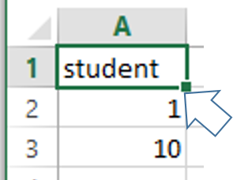
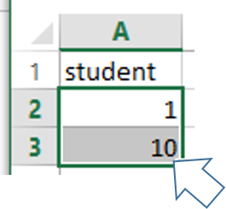
Autofill: Practice
What would be the autofill result of the following.
E.g.1
E.g. 2

Slide 35
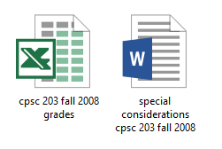
Terminology
Spreadsheet (referred to as a “workbook” by Microsoft)
A Microsoft Excel file
Worksheet
A part of a spreadsheet

Slide 36
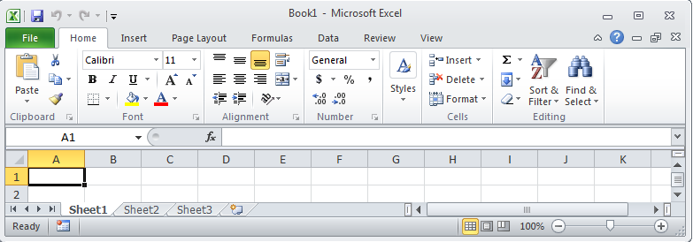
Worksheets
Each spreadsheet can consist of multiple worksheets.
Example:
Spreadsheet: all my CPSC 203 grades for the CPSC 203 fall 2008 term.
Worksheets for each of the two lectures taught by this instructor that term.
Worksheet
Create new worksheet
Spreadsheet

Slide 37
When To Use Multiple Worksheets
Rules of thumb:
When there are multiple sheets of related information, each group of information can be stored in it’s own worksheet (self contained)
Grades for lecture 01
(worksheet)
Grades for lecture 02
(worksheet)
Grades for lecture 03
(worksheet)
Grades for all sections(spreadsheet)
Budget for dad (worksheet)
Budget for mom
(worksheet)
Budget for sunny-boy
(worksheet)
Family budget (spreadsheet)

Slide 38
When Not To Use Multiple Worksheets
If the information consists of groups of unrelated information then the information about each group should be stored in a separate spreadsheet/workbook rather than implementing it a spreadsheet with multiple worksheets.
Grades for mom (spreadsheet)
Expenses for the family business (spreadsheet)
Daily calorie intake for dad (spreadsheet)

Slide 39
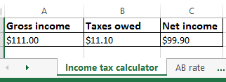
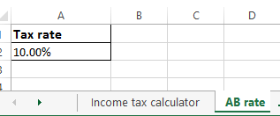
Referring To Other Worksheets
One worksheet can refer to information stored in another worksheet.
Example spreadsheet:
7_multiple_worksheet_example
JT’s tip:
For more complex examples you might want to take extra “in-class” notes.
(It could be hard to understand the concepts at a level sufficient for the exam or remember notation/symbols if you just look at the slides).

Slide 40
References Between Spreadsheets
In a fashion similar to using multiple worksheets, one spreadsheet can refer to information stored in another spreadsheet.
Example spreadsheets:
8A_multiple_spreadsheet_example
8B_multiple_spreadsheet_example

Slide 41
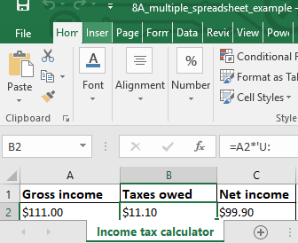
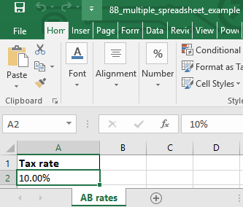
8A
8B
=A2*'[8B_multiple_spreadsheet_example.xlsx]AB rates'!$A$2

Slide 42
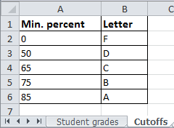
Why Use Cross References?
Cross references:
a worksheet refers to another worksheet,
a spreadsheet refers to another spreadsheet,
…may be used when:
the second worksheet or spreadsheet contains data that needs to be “looked up” (e.g., a lookup table)
Some examples where cross reference lookups may be needed:
Grade cutoffs
Tax brackets
Product numbers (lookup a product number to get more information about the product)

Slide 43
Data Validation
Ensures that the data falls within a valid range (e.g. Age must be 0 – 116) or that a specific type of data is entered (e.g. whole number only).
Invoking:
Data->Data Tools: Data Validation
Example spreadsheet: 9_data_validation
Name: no restrictions e.g. “James Tam”, “James Tam 2”, “James Goldstein-Chan” “James.org”
Age: number years (whole number) from 1 – 116
Income: can include any value from $0.00 - $1,000,000.00 (cents can be entered)
Make sure you include good error messages when setting up data validation rules..
Tell the user what range of values and/or the type of values that can be entered.

Slide 44
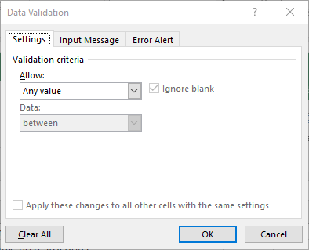
Data Validation Example: Name
No restrictions on input (this is the default in Excel)

Slide 45
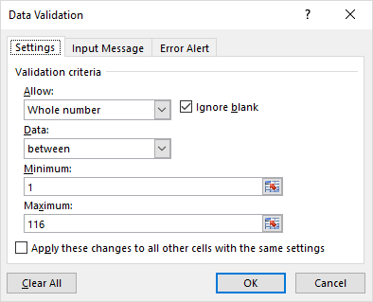
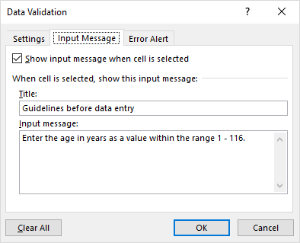
Data Validation Example: Age
Age must be a whole number from 1 – 116.
Tools to prevent errors in input
Restricting the input
Tooltip help before data entry

Slide 46
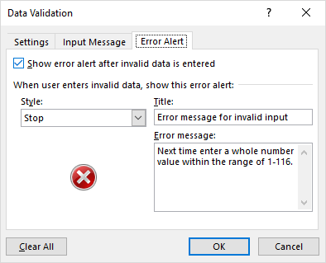
Data Validation Example: Age
A tool to react after bad data has been entered.
Popup error message appears after the input restrictions have not been met.

Slide 47
Data Validation Example: Income
Income allow for any value from $0.00 - $1,000,000.00 (cents may be entered – this is a clue that the input should not be restricted only to whole numbers).

Slide 48
Pre-Created Excel Formulas

Slide 49
What Function Is Right For Your Situation?
Excel provides reminders.
Built in functions are grouped into the ‘formulas’ tab on the ribbon
Also Excel provides “name completion” and “tool tips”

Slide 50
Input Format For Excel Functions
Required input is typically a range of cells
Format: =FUNCTION(<start cell> : <end cell>)
Example:
=AVERAGE(A1:A3)
Alternatively input may be fixed inputs (type data directly into the brackets)
=AVERAGE(20,30,10)
Optional function inputs (“arguments”)
Distinguished by the use of square brackets [optional argument]
=IF (<condition to check>,
<return value: condition true>,
[<return value: condition false>])
For the exam you can see either form

Slide 51
Basic Statistics
Example spreadsheet:
10_basic_statistics
Example formulas: SUM(), AVERAGE(), MIN(), MAX()
General usage:
Each formula requires as input a sequence of numbers
E.g., formula(1,2,3):
Sum = 6 , =SUM(1,2,3)
Average = 2 , =AVERAGE(1,2,3)
Min = 1 , =MIN(1,2,3)
Max = 3 , =MAX(1,2,3)

Slide 52
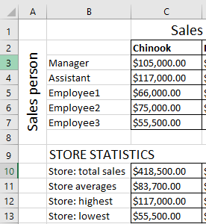
Basic Statistics (2)
Referring to a range of cells
=SUM(C3:C7)
=AVERAGE(C3:C7)
=MAX(C3:C7)
=MIN(C3:C7)

Slide 53
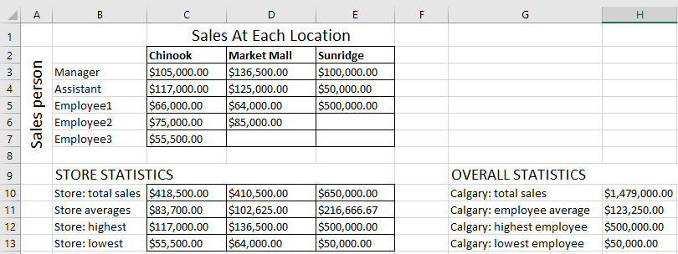
Basic Statistics (3)
FYI: Ranges can span multiple rows and columns
=SUM(C3:E7)

Slide 54
Counting Functions
All of these functions tally up the number of cells that do or do not contain a certain type of data e.g., numbers, blank cells…
General usage:
FUNCTION(<start cell range> : <end cell range>)
An array (list) of inputs can be the function argument but this is rare except for illustration or examination purposes e.g., =COUNT(1,"A",2)

Slide 55
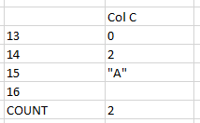
Counting Functions: COUNT()
Counts the number of cells within the specified range that contain a numeric value.
https://support.office.com/en-US/article/COUNT-function-A59CD7FC-B623-4D93-87A4-D23BF411294C
=COUNT(C13:C16)
Q: What is the result?

Slide 56
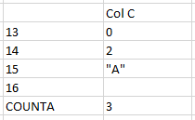
Counting Functions: COUNTA()
Counts the number of cells within the specified range that aren’t empty
https://support.office.com/en-US/article/COUNTA-function-7DC98875-D5C1-46F1-9A82-53F3219E2509
=COUNTA(C13:C16)
Q: What is the result?

Slide 57
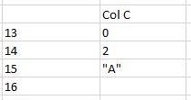
Counting Functions: COUNTBLANK()
Counts the number of empty cells within the specified range
https://support.office.com/en-US/article/COUNTBLANK-function-6A92D772-675C-4BEE-B346-24AF6BD3AC22
=COUNTBLANK(C13:C16)

Slide 58
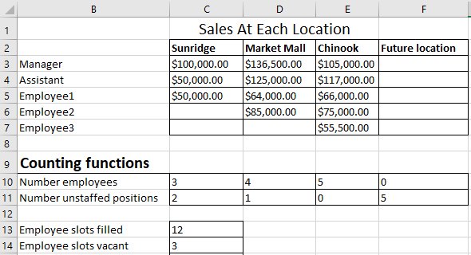
Counting Functions: Spreadsheet Example
Example spreadsheet: 11_counting_functions
COUNT(): Also used in Row 10
COUNTBLANK(): Also used in Row 11
=COUNT(C3:E7)
=COUNTBLANK(C3:E7)

Slide 59
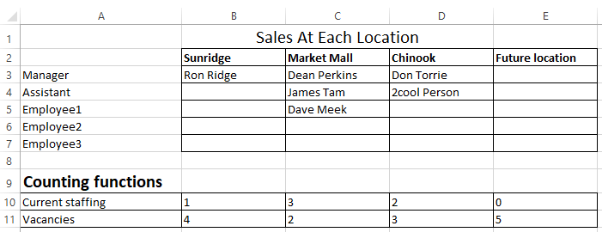
Counting Functions: Spreadsheet Example (2)
COUNTA(): Number of cases where the employee name has been entered into the system.
That is, blank cells can be either for unstaffed positions or cases where the name of the staff member has not yet been entered.
=COUNTA(B3:B7)

Slide 60
Lookup Functions
One common use of a lookup function is to determine which category that some numeric value resides.
Membership in a category is often determined by ranges:
Mapping raw scores to a letter grade.
Determining your ‘tax bracket’.
Evaluating your “FICO” credit score.

Slide 61
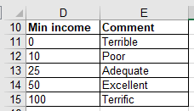
Lookup Tables
Lookup functions require a ‘lookup table’ that specifies the ranges.
Example: for your given grade in a course, a lookup table specifies the various cutoffs for the different letter grades.
Similar to a lookup table containing constants but these examples are for a range of values (there are strict requirements in the format) rather than a single value.
Important format requirements for the first column of the lookup table examples covered this term:
table values must be in ascending order,
column values can only be numeric.
In the example the data in cells D11 – D15 follow these requirements.

Slide 62
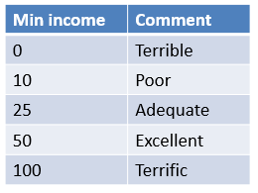
Example: Specifying Conditions
income>=0 and <10?
True
“Terrible”
False
income>=10 and <25?
True
“Poor”
False
income>=25 and <50?
True
“Adequate”
According to the values in this table: a numeric value<0 is an error condition
False
income>=50 and <100?
True
“Excellent”
False
income>=100?
True
“Terrific”

Slide 63
VLOOKUP
Official link for help
https://support.office.com/en-US/article/VLOOKUP-function-0BBC8083-26FE-4963-8AB8-93A18AD188A1
Format:
VLOOKUP(<Lookup value>,
<Lookup table Start : End>,
<Lookup table Column specifying the return value>)
Example:
=VLOOKUP(B2, D11:E15, 2)
Cell:
Contains value to find in table e.g., a grade point
Lookup table:
Start : End
cell coordinates
Lookup table:
Column value to return, for this example:
(1 = first col. = ‘D’,
2 = second col. = ‘E’)

Slide 64
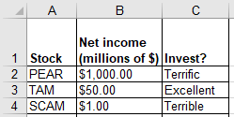
VLOOKUP: Investments
Example spreadsheet: 12_vlookup
=VLOOKUP(B2,D11:E15,2)
Col D (1st)
Col E (2nd)
Min income | Comment
0 | Terrible
10 | Poor
25 | Adequate
50 | Excellent
100 | Terrific
11
12
13
14
15

Slide 65
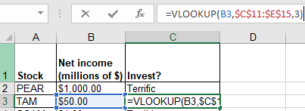
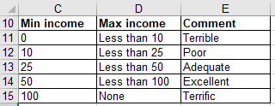
VLOOKUP: Multi-Column (3+) Lookup Table
Name of example spreadsheet: 13_vlookup_multiple_columns
Lookup function
Excellent
Lookup table
Col 1
Col 2
Col 3

Slide 66
Conditional Counting Function
Increases a tally count if one or conditions have been met
COUNTIF()

Slide 67
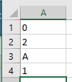
Conditional Counting Function: COUNTIF()
Counts the number of cells that meets a particular requirement
How many employees of a multi-national corporation are Canadian?
How many students in a class were awarded an “A+” grade?
Example below: Count the number of cells within the range that contain a positive numeric value.
https://support.office.com/en-US/article/COUNTIF-function-E0DE10C6-F885-4E71-ABB4-1F464816DF34
=COUNTIF(A1:A3,">0")

Slide 68
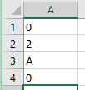
Conditional Counting Function: COUNTIF(), 2
=COUNTIF(A1:A3,"B")

Slide 69
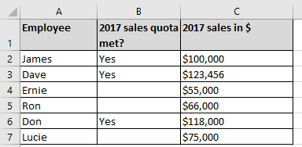
COUNTIF(): Full Example
Example spreadsheet: 14_countif
Conditions tallied
Which employees met quota? (If the cell contains “Yes”)
Which employees had sales that were deemed as high (above $100,000)
=COUNTIF(B2:B7,"YES")
=COUNTIF(C3:C8,">100000")

Slide 70
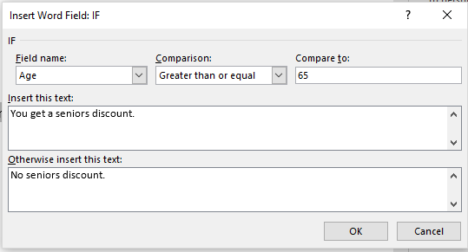
Recall: From Word Mail Merge Filters
Example Mail merge filters covered previously
Filter rule based on age:
65 and over: “You get a seniors discount.”
Under 65: “No seniors discount.”
The If-Then-Else filter checks if a condition has been met e.g. a field in the spreadsheet data source was equal to some value.
If the condition has been met (condition = true) then display a message.
If the condition has not been met (condition = false) then display another message.

Slide 71
New Terminology
A Boolean expression takes a condition (a comparison such as degree being equal to ‘B.Sc.’’) as input and returns a Boolean value.
The conditions must be specified to yield either a Boolean result.
Boolean / Boolean value: must be either true or false
Examples of statements that must be true or false:
A job applicant has been awarded a B.A. degree.
The customer is a senior citizen.
It is below freezing [freezing point of water] today.
The result of this comparison is Boolean (the condition can only be met or not met).

Slide 72
Format: IF-ELSE
Format:
=if (<Boolean expression>,
<Boolean return value: condition true>,
[<Boolean return value: condition false>])
Reminder: square brackets [] is the notation used by Microsoft for optional arguments
Example:
=IF (B2>=100,"GO!","Don’t’ waste your $")
Official help link
https://support.office.com/en-US/article/IF-function-69aed7c9-4e8a-4755-a9bc-aa8bbff73be2?CorrelationId=6aeb3056-a94b-47ac-af6e-90dff250a029

Slide 73
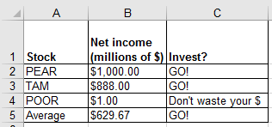
Excel IF-Function: Investing Example
In column ‘C’ the sheet will display “GO!” if net income is 100 (millions of $) or greater “Don’t waste your $” otherwise.
Example spreadsheet: 15_if_invest_or_not
Boolean expression
=IF (B2>=100, "GO!", "Don’t’ waste your $")
Return: condition true
Return: condition false - “else case”

Slide 74
Comparators
Mathematical representation | Excel representation | Meaning
< | < | Less than
> | > | Greater than
= | = | Equal to
≤ | <= | Less than, equal to
≥ | >= | Greater than, equal to
≠ | <> | Not equal to

Slide 75
Example Return Values
Type of return value | Example return value | Example use
Text | “GO” | =IF (B2>=100,"GO!", "No go")
Numeric | 4, 4.0 | =IF (C3="A+",4.3, -1)
Cell reference | A2, A3 | =IF(A1>0,A2,A3)
Boolean | True, False | =IF(1>2,True,False)
)

Slide 76
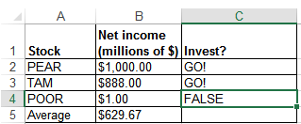
IF: Specifying Only The True Case (Poor Approach)
Example spreadsheet: 16_if_else_invest_or_not_NO_FALSE_return
If only a return value for the true case has been specified:
When the condition has not been met (False result from the Boolean expression)…literally the text “FALSE” will be displayed.
=IF(B4>=100,"GO!")

Slide 77
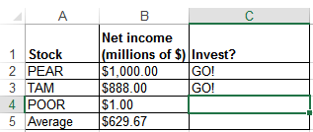
IF: Specifying Only The True Case (Better Approach)
Example spreadsheet: 17_if_else_invest_or_not_ammended
Consequently:
When a message is desired only when the ‘if condition case’ is true then something, even an empty message, should be specified for the ‘else return case’ (false that the condition has been met).
=IF(B4>=100,"GO!","")

Slide 78
Logic: What You Learned
You were informally taught the AND as well as the OR logical operations in the section covering Internet searches.
Example:
“James Tam” Calgary Logical AND (default)
Vs.
“James Tam” OR Calgary Logical OR
More formally: AND, OR are logical operators
Mathematical operators take numbers as input and return a number
New term: Logical operators take a Boolean as input and return a Boolean value.
Logical operators can connect compound (2+) Boolean expressions.
(Boolean expression) Logical operator (Boolean expression) etc.

Slide 79
Logical AND: All Restrictions
Used when all conditions / Boolean expressions (BE) must be true
Example:
Prerequisites for CPSC 233: Introductory programming course as well as discrete math (“as well as” = AND in this case).
Intro programming grade >= C- AND Math grade >= C-
If either course grade is not satisfactory it’s false that the requirement is met.
With Logical-AND if any Boolean Expression is false then the entire compound condition is made false.
Only if all course grades satisfactory will it be true that the pre-requisites have been met.
With Logical-AND only if all conditions are true will the entire compound condition be true.
Condition 1 / BE 1
Condition II / BE 2

Slide 80
Logical AND: Many Conditions
To evaluate the result just extend the general rule:
Multiple AND-expressions must all be true for the overall result to be true.
If at least one expression is false then the overall result is false.
Example:
Internet search: “James Tam” CPSC Calgary
Before a webpage appears as a search result, all three conditions must be met (the three text phrases must appear in that page).
The more search phrases that you include, the more narrow will be your results (fewer).
A course with 3 or more prerequisites.
Job applicants must meet 3 or more requirements e.g. Applicant must be an adult, awarded a university undergraduate degree (or a superior degree), overall grade point from that degree must be at least 3.0.

Slide 81
Logical OR: At least One Restriction
Used when at least one condition / Boolean expression (BE) must be met (true).
Example:
Prerequisites for CPSC 233: One of CPSC 217 or 231
CPSC 231 GPA >= C- OR CPSC 217 GPA >= A-
If at least one of: CPSC 217, 231 was completed satisfactorily, then the intro programming requirement was met.
With Logical-OR if any condition / Boolean Expression is true then the entire compound condition is made true.
Only if no courses were completed satisfactorily then the programming requirement has not been met.
With Logical-OR only if all conditions are false will the entire compound condition be false.
Condition 1 / BE 1
Condition 2 / BE 2

Slide 82
Logical OR: Many Conditions
As was the case with Logical-AND to evaluate the result just extend the general rule:
If at least one expression is true then the overall result is true.
Multiple OR-expressions must all be false for the overall result to be false.
Example:
Internet search: “Wayne Gretzky” OR “The Great One” OR “Number 99” OR “Number ninety nine”
A website that includes at least one of the text phrases will be shown as a search result.
Increasing the number of OR-expressions will broaden (increase) the number of search results.
A course with a choice of prerequisites.
Job applicants can be awarded one of a number of degrees e.g. B.A., B.Comm, B.Sc. etc.

Slide 83
Mixed Logical Expressions
AND, OR conditions can be combined in actual usage.
Example:
Internet search: “Wayne Gretzky” OR “The Great One” OR “Number 99” OR “Number ninety nine” AND “Edmonton Oilers”
A website will show as a search result if it contains at least one of the three ‘names’ as well as containing the text “Edmonton Oilers”.
Course prerequisites: CPSC 233 requires one of: CPSC 217, 231 as well as Math 271
In actual usage logical operators may be implicit so you should be able to interpret plain English descriptions in an assignment or during an examination.
CPSC 217 OR CPSC 231 AND MATH 271
With logic and software ‘AND’ is a higher order precedence than OR so the above is not evaluated left-right, the above is the same as:
CPSC 217 OR (CPSC 231 AND MATH 271)
(CPSC 217 OR CPSC 231) AND MATH 271 (To avoid confusion bracket expressions to make things explicit).

Slide 84
Logical Functions In Excel
The basic logical operations: AND, OR can be invoked as functions in Excel
Similar to evaluating logical expressions on paper, all Excel logical function inputs can only be a True or False value.
Function inputs can be:
Boolean constant e.g. AND(True,False,False)
Boolean expression e.g. OR(A1>0,A2>0,3>2)
A cell that contains a Boolean value e.g. AND(A1,A2), OR(B1,Z2)
Format:
AND(<True or False>,<True or False>...)
OR(<True or False>,<True or False>...)

Slide 85
Types Of Inputs: Logic Functions
Examples (spreadsheet name: 18_logic)
AND(C1>=45,D1="John Smith")
OR(C1>=0,D2>=0)

Slide 86
New Terminology: Nested Calculation
Nested calculation: one calculation is nested within another second calculation when the result of the first calculation is used to determine the result of the second calculation.
Simple example:
Calories expended = (height + 7) * 100
More complex example:
First calculation: determine the total cost of salaries and other expenditures for each Canadian province.
Second calculation: determine total for all sources of revenue for each province.
Third calculation: calculate the surplus (of deficit) for each province
= (sum all provincial revenues) – (total provincial expenditures)
The calculations for revenues and expenditures are nested within (part of) the calculation for the surplus (or deficit)

Slide 87
Nested Functions
The return result of one function is used as an argument for another function.
Example:
Find the maximum grade for each lecture section.
Example:
Lecture 01: =MAX(A2:A101)
Lecture 02: =MAX(B2:B101)
Calculate the average of the lecture maximums
Average of the maximum scores: = AVERAGE(MAX(A2:A101), MAX(B2:B101))
=MAX(A2:A101)
MAX(B2:B101)
=AVERAGE( , )

Slide 88
Using One Function’s Return Value As Input For Another Function (Nesting Functions: Logic, IF)
Breaking down the process into parts
Call a function and that function returns a value e.g. B4 = 3.7, C4 = 4
Use the return value of the first function as part/all of the input of a second function
The first function is nested within the second function.
AND(B4>=3.7,C4>=5)
Returns False
=IF( , "H","")
Actual formulation of the function
IF(AND(B4>=3.7,C4>=5), "H","")

Slide 89
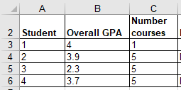
Logic And IF’s: Example
Being on the Dean’s list requires: a grade point of 3.7 or higher and a full load 5 or more courses.
AND Excel example: Dean’s list
Signify when a student has made the Dean’s list requirements with an “D”, blank cell otherwise.
Example spreadsheet: 19_if_with_logic
=IF(AND(B4>=3.7,C4>=5),"D","")

Slide 90
Logic And IF’s: Example (2)
OR Example: Hired if at least one requirement has been met:
work experience of 5+ years,
grade 3.7 or higher
(Same spreadsheet as previous example)
E12
=IF(OR(E12>=5,G16>=3.7),"1+ requirement met","")
G16

Slide 91
Conditional Formatting
Example spreadsheet: 21_conditional_formatting
It can be used to visually highlight data which has met a certain condition.

Slide 92
Setting Conditional Formatting
Home Tab-> (Styles group: Conditional formatting)
With the previous example select:
“Greater Than”
Enter 99999.99 with “Light Red Fill with Dark Red Text”
If you don’t know much about visual design then keep it simple, stick to the basics!

Slide 93
Ways Of Graphically Representing Information
Pie chart
Bar graph
Excel: Column (vertical),
bar (horizontal)
Line graph

Slide 94
Pie Charts
Good for showing proportions, how much of the whole does each item contribute.
It’s poor for showing exact numeric values.

Slide 95
Bar And Line Graphs
For showing trends
Comparing functions

Slide 96
Creating Graphs Using Excel: Specifying Data
Select the range of cells

Slide 97
Creating Graphs Using Excel: Inserting Graph
Insert-> (Charts Group: Type of graph e.g. 2D Column)

Slide 98
Creating Graphs Using Excel: Choosing Specific Data
To select non-adjacent columns select the first column, press and don’t release control and then select the next column.

Slide 99
Editing The Graph Title (And Other Parts)

Slide 100
Rules Of Thumb For Graphs
What type of graph to use:
Bar graphs are used to plot non-continuous data e.g., the number of patients that go to different hospitals.
Line graphs are used to plot continuous data e.g., mortality trends over time.
JT: Avoid or minimize the use 3D graphics! Keep things simple.

Slide 101
After This Section You Should Now Know
The benefit of electronic over paper spreadsheets
Spreadsheets 101: The basic layout and components of a spreadsheet
Entering data: manually and via autofill
Raw data vs. labels vs. formulas
How formulas are distinguished from text
Entering formulas that refer to other cells
Common mathematical operators and the order of operation
The three rules of thumb for designing spreadsheets
Don’t make something data if it can be derived
Label everything so it can be understood
Don’t duplicate data

Slide 102
After This Section You Should Now Know (2)
Lookup tables
How to create and use a lookup table
Includes lookup tables with constant values and lookup tables to be used in conjunction with lookup function
When to use absolute vs. relative cell references in formulas
How do formulas using absolute vs. cell references change when copied elsewhere
Ways of changing views when the data is too large for the display
Freezing panes
Merging cells

Slide 103
After This Section You Should Now Know (3)
Different forms of copy paste:
Paste
Paste values
Paste link
What is a worksheet
When to use multiple spreadsheets vs. multiple worksheets
How to reference data in other spreadsheets or worksheets (cross references)
How to prevent errors using data validation

Slide 104
After This Section You Should Now Know (4)
How to use basic statistical formulas: sum(), average(), min(), max()
How to use counting functions: count(), counta(), countblank(),countif()
A lookup function: vlookup()
A conditional counting function: countif()
The ‘if-else’ function
Logic functions: and, or
Using the output of one function become the input of another function, example: and, or in conjunction with if-else
How to use basic statistical formulas: SUM(), AVERAGE(), MIN(), MAX()

Slide 105
After This Section You Should Now Know (5)
How to use counting functions: COUNT(), COUNTA(), COUNTBLANK()
A lookup function: VLOOKUP()
A conditional counting function: COUNTIF()
The ‘IF-ELSE’ function
Logic functions: AND, OR
Using the output of one function become the input of another function, example: and, or in conjunction with IF-ELSE
How to apply conditional formatting to a spreadsheet
When to use pie charts vs. bar graphs vs. line graphs
How to use graphs in Excel

Slide 106
Images
“Unless otherwise indicated, all images were produced by James Tam
Notes:
http://office.microsoft.com/en-ca/images/nature-CM079001922.aspx

