Slide 1
Computers
A basic introduction into computer hardware and a practical guide to using computers

Slide 2
Technical Specifications
Hardware: the physical ‘touchable/hard’ components of a computer
Software (many are often referred to as “Apps”) : the programs that control or run the hardware
Rather than presenting a long list of hardware specifications and how things work for it’s own sake, the focus will be on providing some of the information you will see when actually buying a machine.
However due to brevity - a complete computer buyer’s guide would constitute a complete (continuing education) lecture only a subset of some of the more pertinent/common specifications will be covered.
(This is very basic material to bring everyone up to a basic level)
Later sections can be more challenging (e.g. VBA programming)

Slide 3
A Sample Of Online Buying Guides
There’s many sources available but here is a small sample:
Laptops
General purpose:
https://www.digitaltrends.com/computing/laptop-buying-guide/
Gaming
https://www.pcgamer.com/best-gaming-laptop/
Desktop computers
Best general purpose:
https://www.pcmag.com/picks/the-best-desktop-computers
https://www.digitaltrends.com/computing/best-desktop-computers/
Inexpensive:
https://www.digitaltrends.com/dtdeals/best-cheap-desktop-computer-deals/
Gaming
https://www.pcgamer.com/best-gaming-pc/
https://www.cnet.com/news/best-gaming-laptop-for-2020/ (Desk and laptop)

Slide 4
Example Technical Specifications
Paraphrased from an online electronics retailer:
P330 30CY0017US Workstation - 1 x Core i7 i7-9700 - 16 GB RAM - 512 GB SSD - Raven Black - Windows 10 Pro 64-bit (“Equipped with an Intel Core i7 processor, 12GB RAM, and NVIDIA GeForce GTX 1050 graphics...”)
Intel Core i7-9700 [JT, information not available by default: 3.0/4.7 GHz] (3.6GHz Intel Core i7-7700 processor)
16 GB of RAM (12 GB of RAM)
512 GB SSD (1 TB hard drive)
9 USB ports [JT, information not available by default: 6 USB 3.1, 2 USB 2.0], 3 video ports [JT, information not available by default: Display port x2, HDMI] (“6 USB ports, including 2 USB 3.0 ports, let you plug in peripherals, while an HDMI output… delivers crisp high-quality visuals and high-fidelity audio to a home theatre ”)
FYI: $1,482.99 ($1139.99 in 2018 $)
Last accessed from www.bestbuy.ca August 2020 (August 2018)

Slide 5
Which Type Of Computer Is Best For You?
No single category, model (let alone manufacturer ) is best for everyone
Ask yourself how you will use your machine, what things are the most important to you:
Portability?
Touch screen capability?
Will you run programs that will ‘push’ your system e.g., video editing, 3D gaming, image and 3D graphic editing or will you use your computer mainly for common tasks (e.g., word processing, spreadsheets).
Web browsing: may require more memory (RAM).
Do you buy new computers often or do you prefer spending more but buying less frequently?

Slide 6
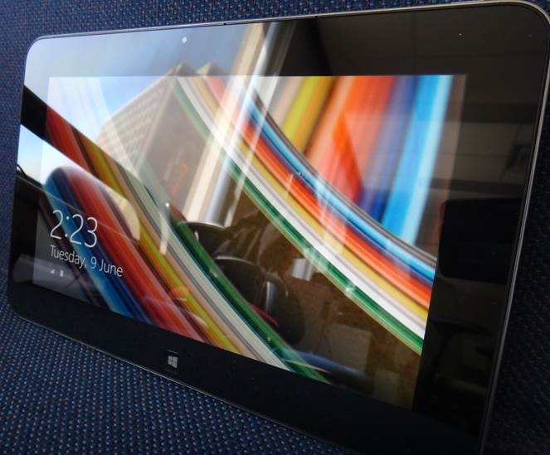
Tablets
Examples: iPad, there are several Android models, many of the Windows versions tend to be tablet-laptop variants.
The lightest and most portable multi-touch computer
Touch interface:
Good/bad issues
“Oops!”
Better for ‘light’ work
Price : performance ratio not the best among the categories

Slide 7
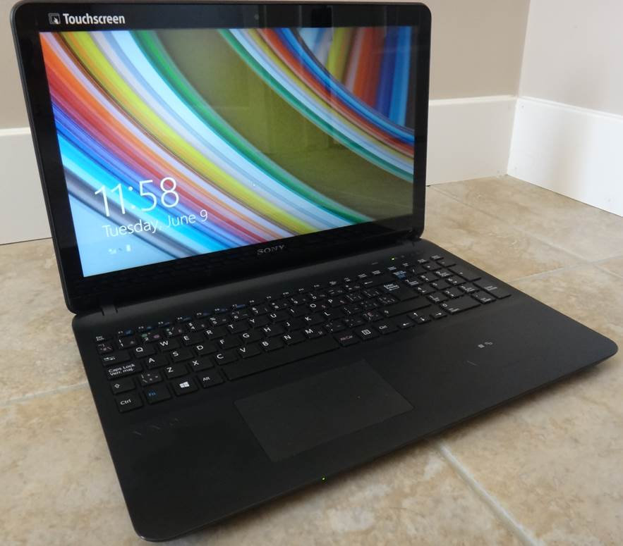
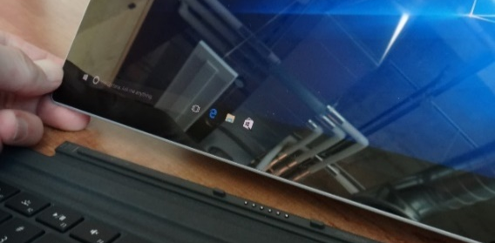
Laptops/Notebooks
Compared to tablets:
Larger display area, bigger and heavier
Adds a CD or DVD as well as a physical keyboard but may include touch capability as well
“2 in 1” laptops: combine power of laptop and portability of tablet e.g. Microsoft Surface
Compared to desktops:
Portability (obviously better)
Not as good price/performance,
Future expandability, choice of hardware more limited (the hardware you start off with is largely what you will end up with).

Slide 8
“Specialized/Variant Laptops”
Ultrabooks e.g. Asus Zenbook, Microsoft Surface
Ultra = thinner and lighter (increased portability) but exclude some hardware e.g., Ethernet (physical network connection), CD/DVD
All things being equal Ultrabooks tend to cost more than a regular laptop (manufacturing in exact, smaller, detail)
Netbooks e.g. Acer Travelmate
A cheaper but more portable form of a laptop (smaller and lower quality display, overall less powerful hardware) with a built in physical keyboard but no CD/DVD.
Much less common with the rise of tablets.
Unlike Chromebooks (next page) most/all typical desktop programs (e.g. Office, games, Photoshop) can be run on a netbook (some may be slow).
Now in 2020 many but not all netbooks run Chrome (cheaper)
Comparison of netbooks vs. tablets
http://www.ehow.com/info_8721028_difference-between-tablet-pc-netbook.html
http://www.pcadvisor.co.uk/buying-advice/tablets/3450587/netbook-vs-tablet/
http://blogs.canoe.ca/canoetech/signs-of-the-times/netbooks-vs-tablets/

Slide 9
“Specialized/Variant Laptops” (2)
Chromebook¹
Runs via Google Chrome OS (operating system)
Designed for users with a constant Internet connection
Documents and programs are stored online rather than on the computer
Local storage is limited e.g. flash drive
Requires a less powerful portable computer (often much less expensive), it’s for users who primarily use a computer browser (Chrome) and online applications (e.g. Google docs) rather than commonly used programs (e.g., MS-Office)
References:
https://www.digitaltrends.com/computing/chromebook-vs-laptop/
Technology in Action (15 e): Evans, Martin, Poatsy

Slide 10
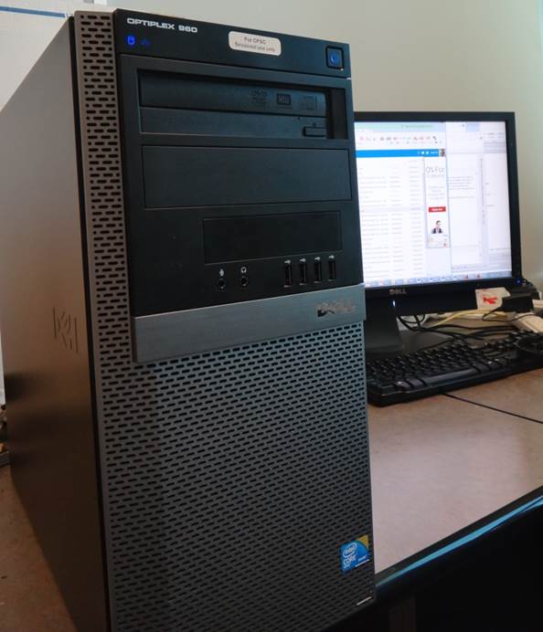
Desktop Computers
Everything is separate (monitor, computer, keyboard and parts like memory and drives may be swapped/upgraded more easily)
Allows for mixing and matching but more complex connections and it’s not portable).
Faulty components can be more easily replaced.
E.g. spilling liquid on a laptop may be a drastic mistake, not so much with a separate desktop keyboard
Larger ‘foot print’ (size):
Drawback: More space required
One benefit: greater expandability
Compared to portable laptops and tablets: Reduced cost to get more options

Slide 11
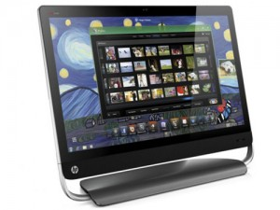
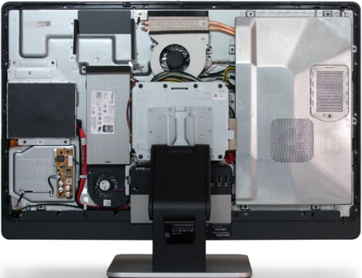
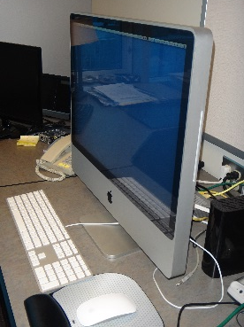
“All-In-One-Computers”
Examples: Apple iMac, Premium 2020 Dell Inspiron, MS Surface Studio
As the name implies everything is included together (computer and monitor)
Laptops and tablets aren’t classified as “All-In-One” because they don’t have a monitor casing that looks like desktop setup
Many employ touchscreen technology
Commonly chosen when:
A desktop is desired but space is tight
Some portability is desired (rule of thumb: can move within your a house rather movable outside).
With few exceptions they’re not expandable (https://bestreviews.com/best-all-in-one-computers), largely just drives and memory can change (pro: no hardware conflicts that you may get by mixing and matching with desktops).
Visually appealing
Images (all accessed or produced in 2015, credits going left to right)
Apple computer: Courtesy of James Tam
HP computer: http://gadgetynews.com/hp-omni-hd-allinone-pc-beats-audio-quadcore-power
Inside the case: http://www.tomshardware.co.uk/xps-one-27-touchscreen-all-in-one,review-32666-3.html

Slide 12
Units Of Measurement
Kilo: One thousand 1,000 (e.g. kilogram, kilometer etc.)
Mega: One million 1,000,000
Giga: One billion 1,000,000,000
Tera: One trillion 1,000,000,000,000
Example usage (from advertisements specifying computer speed): 3.6 GHz processor (G = Giga, Hz = processor oscillation speed)
Large units of measurement will be discussed again when processors and storage devices are covered

Slide 13
Basic Units Of Storage
On the computer all information is stored in binary (2 states e.g., on/off, pitted surface/smooth surface on a CD/DVD, connected/disconnected electrical connection on a flash drive)
A single off/on combination is referred to as a ‘bit’ (binary digit)
8 bits grouped together is referred to as a ‘byte’
off
on

Slide 14
Large Units Of Measurement And Storage
The amount of information that can be stored and transferred is typically measured in bytes rather than bits.
Kilobyte (KB) ~ a thousand bytes (1,024 = 2¹⁰)
Low quality preview ‘thumbnail’ images or shorter Word documents with no images may range from a few thousand to tens of thousands of bytes in size.
Megabyte (MB) ~ a million bytes (1,048,576 = 2²⁰)
Typical phone pictures are single digit MB in size.
Audio files (e.g., MP3) are several Megabytes in size.
Streaming Internet video (compressed, standard definition) ~several hundred Megabytes perhaps one thousand Megabytes for a full movie.
X 1,000
X 1,000,000

Slide 15
Large Units Of Measurement And Storage (2)
Gigabyte ~a billion bytes (1,073,741,824 = 2³⁰)
(Several hundred to one thousand: camera images or audio files
~ 30 minutes of DVD quality video (~1/4 of the information stored on a standard DVD)
Terabyte (TB) ~ a trillion bytes (1,099,511,627,776 = 2⁴⁰)
Several hundred thousand to one million: images or audio files
~ 200 regular DVD’s (~32 Blu-ray) of information
X 1,000,000,000
X 1,000,000,000,000

Slide 16
File Sizes: Example Images

Slide 17
File Sizes: Audio Files

Slide 18
File Sizes: Videos
Lengths of the videos range from ~20 seconds to 15 minutes
22s, 320x240 resolution (1 hour = 880 MB)
15m 29s, 1920x1080 resolution (1 hour ~2.7 GB)

Slide 19
Most Important Hardware (When Choosing A Computer)
(This refers to hardware that distinguishes one computer from another computer, other pieces such as hardware such as some sort of network connection are also crucial but not significantly different from computer-to-computer).
Processor (CPU – or the APU for some AMD models)
Memory (RAM)
Storage (hard drive)
‘Hardware intensive’: software may fully/mostly utilize the computer hardware e.g. 3D graphical editors, video editing software, some games etc.

Slide 20
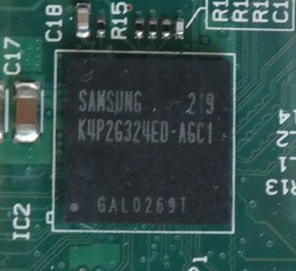
Main Processor (CPU: Central Processing Unit)
ARM processor
The ‘brains’ of the computer:
Determines program execution speed (not just calculation speed)
Benefits of a faster CPU
Programs are loaded faster (includes computer startup time)
Editing/viewing videos and ripping music/videos to your computer may be faster and more free of ‘glitches’
(Of course!) Calculations are completed more quickly (e.g., evaluating the results of a spreadsheet)

Slide 21
CPU Clock speed
Aside from the processor model it’s the most common technical specification
It’s the speed at which the processor operates (oscillation rate)
Typical home-type computers (e.g., laptops, desktops) operate at low single digit unit Giga-clock speeds ~1 to 4 GHz
Note: Other than clock speeds there’s other factors that determines how fast a processor will run a program but all other things being equal a processor with a higher clock speed will run faster.
Computer from advertisement (2020 Ad)
Processor: Intel Core i7-9700 (default clock speed = 3.0 GHz)
Computer from advertisement (2020 Ad)
Processor: Intel Core i7-9700 (clock speed not provided an approach not unique to Best Buy):
Costco: Intel® Core™ i5-9400
Some other retailers still provide clock speed: The Source, Staples, London Drugs etc.

Slide 22
Processor Manufacturers
Intel
For more information (last accessed August 2018): https://www.intel.com/content/www/us/en/processors/processor-numbers.html
AMD
For more information (last accessed August 2018):
https://www.amd.com/en/products/processors-desktop
AMD vs. Intel: look at the speed tests performed with different software running (benchmarks).
E.g., http://www.tomshardware.com/t/cpus/
The links are available for your reference if you want more information.
However brand definitely does matter in that you can’t freely mix and match between Intel and AMD.

Slide 23
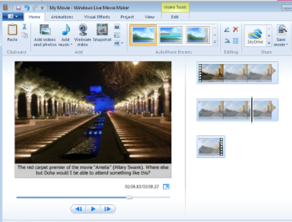
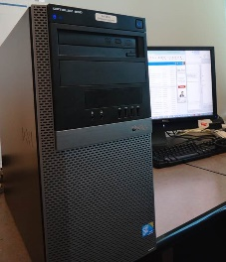
Multi-Core Processors
A processor’s ‘core’ is the part that allows computations and instructions to be executed
(Don’t confuse the processor part with the model name of some Intel processors e.g., Intel: Core i3, Core i5, Core i7 etc.)
AMD manufacturers multi-core processors as well
The number of cores determines how many tasks that a computer can execute at the same time.
Single core computer:
Only appears to work on multiple tasks simultaneously.
Computer from advertisement (2020 Ad)
Processor: Intel Core i7-9700
Video editing
Playing a video game
Pause

Slide 24
Processors: Multi-Core (2)
Dual-core processors: can work on two tasks simultaneously
First processing core: Video editing
Second processing core: Playing a video game

Slide 25
Processors: Multi-Core (3)
Other multi-core processors:
Quad core : 4 processing cores
6 core
8 core
Extreme machines (expensive)
12 core (e.g., MacBook pro)
18 core (e.g. Intel Xeon processor)
https://money.cnn.com/2017/12/14/technology/imac-pro-on-sale/index.html
For more information: comparing dual vs. quad core processors (i.e. in general what’s the benefit of more vs. fewer cores)
http://www.pcmag.com/article2/0,2817,2406293,00.asp

Slide 26
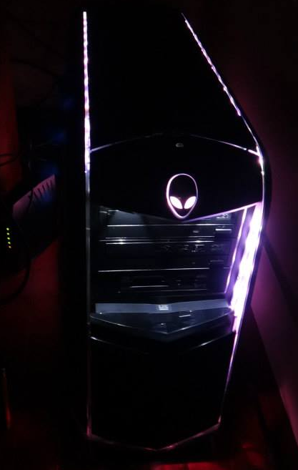
Processors: Multi-Core (4)
Having a processor with multiple cores can speed up execution even if only a single hardware intensive program is running.
The program is written specifically to take advantage of multi-core technology.
Check the ‘system requirements’ or ‘technical requirements’ on the packaging or website e.g., Photoshop, Excel, Crysis: www.ea.com/games/crysis/crysis
First core: runs one part of game
Second core: runs another part of the same game

Slide 27
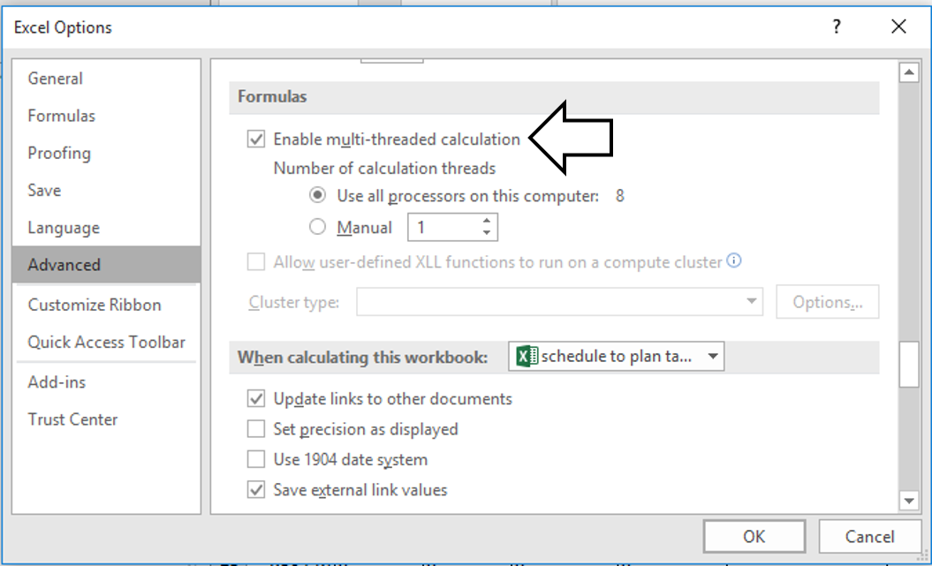
Example Program, MS-Excel: Optimal Performance With Multiple Cores
Multi-threaded program:
Specifically written so it can work on two tasks at the same time.
Almost all programs are not multi-threaded.

Slide 28
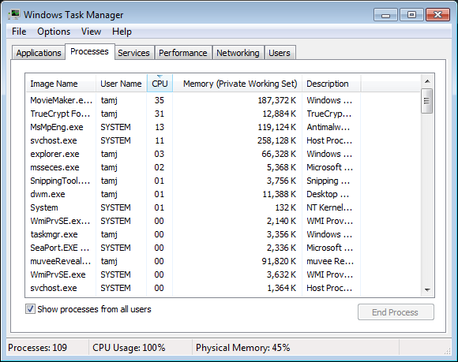
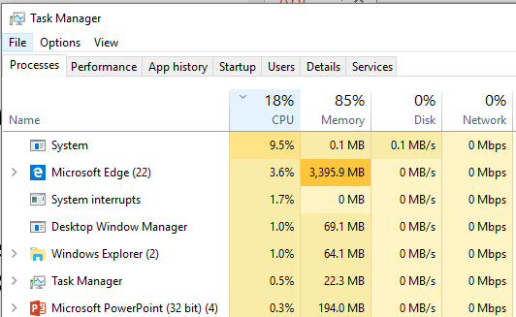
Will Multiple Cores Always Be Faster?
Simple answer: it depends
Advanced answer: look at actual computer usage e.g., Task manager (Windows), Activity Monitor (MAC OS-X)
Multiple cores: probably will help
Multiple cores: little or no effect

Slide 29
Intel Processor ‘Models’ (Brand Modifier)¹
Another important factor determining execution speed
Intel processor models:
Pentium and Celeron (netbooks):
Very old low end chips
Unless you’re cash strapped avoid computers with these processors
(JT: until part way through 2013 I was running a ~12-15 year old version of a old Celeron for my main computer tasks…painfully!)
Netbooks may use them
Core i3 (used/refurbished computers):
Dual core processors
For budget computers, good for basic every day computer use (word processing, browsing the web – you might want to avoid viewing videos extensively especially HD video)
Sources:
http://www.cnet.com/topics/desktops/buying-guide/
http://ark.intel.com/
http://www.intel.com/content/www/us/en/processors/processor-numbers.html

Slide 30
Intel Processor ‘Models’ (Brand Modifier) (2)
Tam min (2015)
Core i5 (more expensive used computers, new computers on clearance, online only)
Mainstream quad core processor line (a handful of lower end ones are dual core)
Core i7 (entry for most new desktops)
For more information about Intel processor models:
http://ark.intel.com/
http://www.intel.com/content/www/us/en/processors/processor-numbers.html
⬅Tam min (2018)
Computer from advertisement:
Processor: 3 GHz Intel Core i7-9700 processor
There’s many versions of the i7 model
Computer processor from 2018 Ad:
3.6GHz Intel Core i7-7700 processor
With the brand modifier (e.g. i5 vs. i7) and the numbers that follow it, larger numbers are better.
Deciphering the Intel numbers:
https://www.intel.com/content/www/us/en/processors/processor-numbers.html?wapkw=what%20do%20the%20numbers%20mean%20for%20i7%20processors

Slide 31
Memory (RAM)
When a computer program is executing the instructions as well as any data currently needed (e.g., images, videos) is loaded into RAM from the storage device (usually the hard drive).
RAM is temporary storage (gone when you shut off or restart your computer).
“Volatile storage” requires continuous power to store information.
Significantly faster than any storage device.
More expensive on a per unit basis than a storage device such as a hard drive.
The memory capacity of today’s computers are typically specified in single or low double digit Gigabytes (recall that’s billions of bytes) .

Slide 32
How Much RAM?
Amount of RAM | Primary computer usage
< 4 GB | Basic: web browsing, email, word processing
4 – 8 GB | Multitasking: running a few applications simultaneously, playing simple/lower end games, watching regular (lower definition) movies, simple photo editing.
10 GB and above | Multitasking with regular applications or even with hardware-intensive applications such as games with higher resolution graphics (rules of thumb: “first person shooter” and/or 3D games rather than simpler adventure, role-playing, strategy games), video editing, 3D or extensive image editing (e.g., Photoshop), HD (high definition) entertainment
Tam absolute
Min. (>8) less can even affect web browsing →
Computer from the advertisement:
Memory: 16 GB of RAM
Computer from 2018:
Memory 12 GB

Slide 33
How Much RAM? (2)
If you do browse the web extensively then consider getting more memory (RAM) especially if the pages include multi-media, many advertisements.
Sometimes it may not be obvious that a web page is running other programs (which may be quite hardware intensive tasks).
This may lead to questions such as “Why is my web browser so slow?” when the problem may be due to an add-on/plug-in to the browser.
Use tools such as the Task Manager and Activity monitor to evaluate how much memory that your browser (or other programs) uses.
Do this more than once while going online (memory usage can vary greatly).

Slide 34
Storage (Hard Drive)
All data that’s needed in the long term must be kept in some form of storage device.
Storage (hard drive): stores data or programs that aren’t currently needed but needed at some point in the future.
Memory (RAM): stores data and programs currently being used.
Types of hard drives (storage devices):
Magnetic hard drives (common abbreviation as ‘HDD’)
Stores information via magnetism
Solid state hard drives (common abbreviation as ‘SSD’)
Stores information without moving parts (i.e. solid)
The typical storage capacity of hard drives is measured in hundreds of Gigabytes or single digit Terabytes

Slide 35
Comparison Of Hard Drive Types
Magnetic hard drive (HDD)
Solid state hard drive (SSD)
Slower
Less expensive
Hard drives with the highest capacities are only magnetic
Less ‘durable’ (may be affected by magnetic fields, physical jarring, temperature extremes)
Faster (roughly double)
More expensive
Lower maximum storage capacity
More durable (no moving parts)
Smaller and lighter (an issue with portables such as tablets and laptops)

Slide 36
Just How Sturdy Are Solid State Drives?
(Do not try this at home)
My dog ate my homework, or in this case seal.
https://www.ctvnews.ca/world/working-usb-stick-found-in-frozen-seal-scat-1.4287192
FYI: This is not a sufficiently good cause for an extension of a graded component.
(Remember extensions require a good reason which can be verified under reasonable conditions). >-<

Slide 37
Typical SSD capacity ~256 – 2 TB (2020: 4 TB possible)
Typical HDD capacity ~ 1 – 16 TB (2020: 32 TB possible)
Computer from advertisements:
2020: Storage: 512 GB SSD
2018: 1 TB HDD)
Capacity | Images (number): assume 2 MB per image | Music (hours): assumes 2 MB per minute | Movies (hours): assumes 70 MB/hour | HD Movies (hours): assumes 2.4 GB/hour
256 GB | 128,000 | 2,133 | 3657 | 107
512 GB | 256,000 | 4,267 | 7314 | 213
1 TB | 500,000 | 8,333 | 14,286 | 417
2 TB | 1,000,000 | 16,667 | 28,571 | 833
4 TB | 2,000,000 | 33,333 | 57,143 | 1667
8 TB | 4,000,000 | 66,667 | 114,286 | 3,333
12 TB (down to 32) | 6,000,000 | 100,000 | 171,429 | 5,000
(SSD) Tam
range
(HDD) Tam range

Slide 38
How Much Can You Actually Store?
Assume that an image or audio file is 2 MB in size
1 TB drive ~ 1,000,000,000,000 bytes
2 MB file 2,000,000
Number of files (1st work out the simple case 1 MB file, 1,000,000 bytes)
1,000,000,000,000 (drive capacity)
Divide by file size 1,000,000 bytes (average size will do)
= 1,000,000 files each 1 MB in size (for simplicity so we just cancel out zeros)
Number of 2 MB files (divide by 2, above was for 1 MB files)
1,000,000 / 2 = 500,000 images or music files

Slide 39
Don’t Forgot: Space Is Not All Free
Formatting a hard drive uses up some of it’s capacity
E.g. 1 TB drive becomes 930 GB (70 GB not free)
The operating system takes up space
Example: Windows 7 or 8.1 (source: http://windows.microsoft.com)
16 GB (32 bit), 20 GB (64 bit)
Windows 10 (Home version)
20 GB
Productivity (work) application (source: https://products.office.com)
Example: MS-Office Professional Plus 2013 = 3 GB
A game (source: http://elderscrollsonline.info/system-requirements)
Elder Scrolls = 60 GB
With just Windows and 2 programs installed 153 GB has been used up (~15.3% of a 1 TB drive)

Slide 40
Hard Drive Tips
Bigger is often better: even higher capacity drives have come down significantly in price.
But for magnetic drives balance: storage capacity vs. speed (higher capacity drives tend to have lower rpm – slower revolution speed)
7,200 to 10,000 RPM
Or combine an SSD for speed with a magnetic drive for its high storage capacity (store smaller files than are less frequently accessed here).

Slide 41
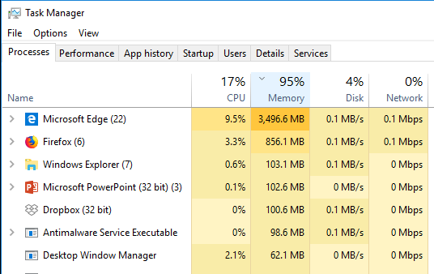
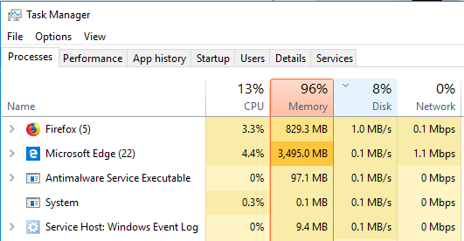
Amount Of Memory Affecting Computer Performance
Sometimes a computer may be slow because of an older/cheaper processor.
The amount of RAM/memory can also drastically affect speed.
Class discussion: How?

Slide 42
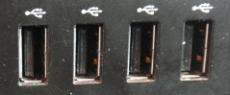
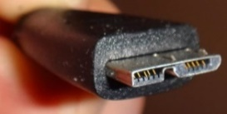
Ports
2020: 9 USB ports, display port x2, HDMI
2018: 6 USB ports, HDMI video
External connections.
USB (standard): get as many ports as possible, ‘hub’ devices don’t always work as well as advertised.
USB 3.0 (3.1): useful to have when backing of large amounts of data.
Roughly x10 speed: in theory it’s 480 Mbps vs. 5 Gbps vs. 10 Gbps)
HDMI: allow display on a TV monitor or connections to some peripherals (cable box, game consoles)
Display port: another popular form of video output
SD: can be useful for connecting to some peripherals (devices that use SD cards such as cameras, e-readers, tablets) or as extra storage space (Chromebooks, netbooks).
(Other important ports e.g., audio, network (or wireless connection which doesn’t require a physical port) are standard in computers of today).

Slide 43
Recap Of This Section: Things You Should Now Know
The different category of computers and computing devices: tablets, notebooks/laptops, ultrabooks, netbook, desktop all-in-ones as well as some of their strengths
The large units of measurement and how they apply to computer specifications
The basic units of storage: bits and bytes and how the groupings of bytes applies to hardware
Processor clock speed and reasonable values for computers of today
The effect of multiple processing cores on speed

Slide 44
Recap Of This Section: Things You Should Now Know (2)
What is the function of RAM, how does it work, how it related to storage, what are reasonable amounts for computers of today
What the two main types of storage technology (magnetic and solid state) and how they compare, what is a reasonable amount for today’s computer usage
Characteristics of memory vs. storage
Common computer ports

