Slide 1
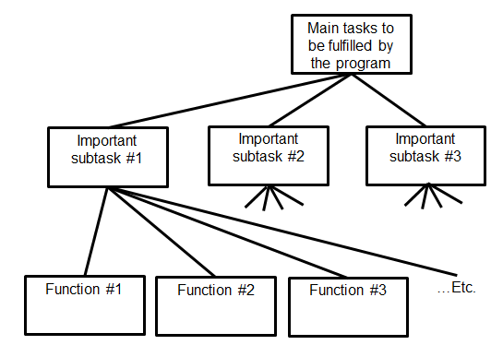

Introduction To CPSC 231
Python programming
Procedural programming
James Tam
Problem solving
Fun! Fun! Fun!

Slide 2


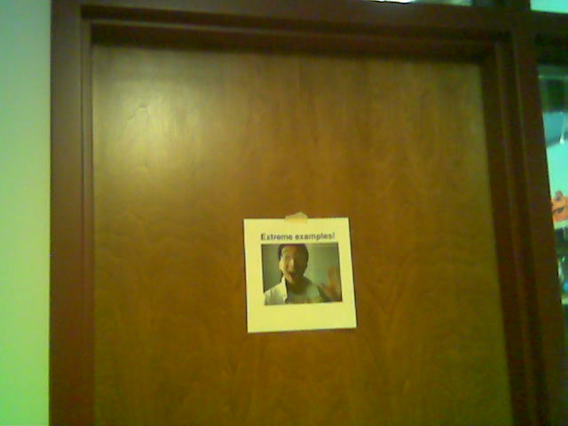
Administrative (James Tam)
Contact Information
  Office: ICT 707
  Email: tam@ucalgary.ca
  Make sure you specify the course name and number in the subject line of the email ‘CPSC 231’
Office hours
  Office hours: Monday & Tuesday 14:00 – 14:50
  Appointments possible at other days/times (subject to availability).
  Dropping by outside of office hours without prior notice is “hit and miss”
ICT 7th
Yes
E
My Office
No
x

Slide 3
Course Resources
Required resources:
  Course website: http://pages.cpsc.ucalgary.ca/~tamj/2018/231F/index.html (You must get the notes off the course webpage before lecture)
Recommended but not required:
  "Starting Out with Python"(Gaddis T.) Addison-Wesley.
    4th edition new in the campus bookstore
    3rd edition can be purchased in the “previously enjoyed” version
  Alternatively you can access any book licensed by the university (‘for free”) on the library web site:
  (One of many books available) “Visual QuickStart guide” http://proquest.safaribooksonline.com.ezproxy.lib.ucalgary.ca/

Slide 4
How To Use The Course Resources
They are provided to support and supplement this class.
  The notes outline the topics to be covered
  At a minimum look through the notes to see the important topics.
  However the notes are just an outline and just looking at them without coming to class isn’t sufficient to do well
  You will get additional details (e.g., explanations) during lecture time
    Take notes!
    If you miss a lecture then get a copy of the in-class notes from another student (who takes detailed notes)

Slide 5
Your Engagement Level ---> Your Learning
+
Learning
Computer programs
Computer program
Notes:
The more someone ‘does’ the higher their engagement and the deeper their learning
Levels
Sleeping
Just listening during class
Taking notes/actively asking questions
Above two levels plus writing a few or many programs

Slide 6
How To Use The Course Resources (2)
What you are responsible for:
  Keeping up with the content in class which includes the topics covered but also announcements or assignment information whether you were present in the class or not.
  If you are absent, then you are responsible for getting the information from the other students in class.
    Make sure your UC registered email is correct and one you actually read (some course announcements will be sent to these emails)
  (I won’t be able to repeat the lecture content if you are absent…there’s just too many of you to make it practical and recall to get the most out of the class you need to be actively engaged)
However, after you’ve caught up by talking with a classmate:
  Ask for help if you need it
  There are no dumb questions
  …except for waiting until the exam
Notes:
They won’t be babied, make it clear that they need to meet me halfway
E.g. if they miss a week of lecture they shouldn’t expect for me to lecture them privately for 3 hours so they can catch up when they have made no effort to catch up on their own
We are university instructors for the whole class not private tutors
Ending with a positive: if they are making an effort then they shouldn’t be afraid to ask for help!

Slide 7

Tam’s “House Rules”
I will endeavor to keep the lecture within the prescribed time boundaries
You won’t pack up and end before time is up

Slide 8




Tam’s “House Rules”
No recordings/captures without permission during class please
(Recall that learning tends to increase with additional levels of engagement).

Slide 9
Yes: “This Stuff Will Be On The Exam”
The administrative notes contains important information e.g. how your grades are calculated, course policies etc.
To encourage students to pay attention to details (and to reward those who do so):
  Some of your midterm multiple questions will come from this section.
  You may see a question or two from this section on the final exam as well.

Slide 10
Evaluation Components
Four mini assignments (2/100 of term grade)
Five full assignments (28/100 of term grade)
Two examinations (60/100 of term grade)
Notes:
I tend to focus on the proportion of the term grade that a particular component contributes
Because grade points are used, sometimes they are confused if percentages instead of proportions are used

Slide 11
Assignments
You will create a working and executable computer program.
Use a text editor (similar to a word processor minus the fancy formatting capabilities) to create it and you will electronically submit the text file (to D2L) for marking.
Although you may be given some time in tutorial to work on your assignments (during the “open tutorial”) mostly you will complete your work on your own time.
  Don’t underestimate the time/effort required.
  Creating a good working program is harder than it may first appear.
Assignments will be marked by the tutorial instructor.
  He/she is the first person to go to if you want to determine your grade or have questions about grading.
Notes:
Sounds obvious but some students ask if they will be able to fully complete their assignments during tutorial like they do in Chem or Bio

Slide 12
Assignments (2)
Test your programs using the Linux lab computers (203 lab rooms) running Python 3.x (not 2.x)
  If your program doesn’t work under these conditions then it will not be marked.
Collaboration:
  Each student must work on his/her own assignment (no group work is allowed for this class)
  Each student must individually submit an assignment
  Students must not see each other’s assignment code
  Additional details will be provided later during the semester
You will electronically submit the file which contains your solution to the assignment via D2L:
  http://d2l.ucalgary.ca/
  (Find the appropriate course name/number and lecture section)
Notes:
I would go through this clearly
Leaving ambiguity now may provide a loophole if they are caught for misconduct
Also they might rightfully complain that they can’t be prosecuted for violating rules if the rules weren’t clearly stated

Slide 13
Submitting Assignments
Bottom line: it is each student’s responsibility to make sure that the correct version of the program was submitted on time.
  Alternate submission mechanisms e.g., email, uploads to cloud-based systems such as Google drive, time-stamps, TA memories cannot be used as alternatives if you have not properly submitted into D2L
  Only files submitted into D2L by the due date is what will be marked
Late assignments will not be accepted.
If you are ill then medical documentation is required.
  Contact your course instructor and not your tutorial instructor to get permission for a late submission
Notes:
I would make it very clear that late assignments won’t be accepted
If they screw up for one reason or another (e.g. forgot a file, upload corrupted, submitted the wrong version etc.) then the fault is theirs and whatever is submitted in D2L as of the due time is what will be marked
Also clearly indicate to them that Tas don’t have discretion for late submissions not even in the case of illness and they need to talk to the course instructor

Slide 14
JT’s Helpful Hint: Electronically Submitting Work
Bad things sometimes happen!
  A virus, hardware failure, you screwed up the submission.
Rules of thumb for assignment submissions:
  Do it early! (Get familiar with the system)
  Do it often! (If somehow real disaster strikes and you lose everything at least you will have a partially completed version that your TA can mark).
  Check your work.
    Don’t assume that everything was submitted OK.
    Don’t just check file names but at least take a look at the actual file contents (not only to check that the file wasn’t corrupted but also that you submitted the correct version).
    Assignment 0 ‘A0’:
      An exercise in tutorial where you practice submitting and checking your work
      Not directly graded but still important to complete
Notes:
Again this may seem obvious but a surprising number don’t back up their work and they only submit for the first time just a few minutes before the due date

Slide 15
How To Verify Submissions In DropBox
There is a help link provided with each assignment description.
Teaching Assistants will cover in conjunction with Assignment zero.
  Not graded but important practice
Resource file
  http://pages.cpsc.ucalgary.ca/~tamj/resources/Verifying_D2L_Submissions.pdf

Slide 16
Backing Up And Submitting Your Work
Bottom line: it is up to you to make sure things are done correctly and on time.
If you have questions beforehand then do ask (make sure you ask your questions early enough so you can receive an answer before the due time).
But don’t wait until after the due date (it’s too late).
  If your work isn’t in D2L before the due date then you will be awarded no credit.

Slide 17
Mini Assignments
There will be four mini assignments worth 0.5/100 of the term grade for a total of 2/100 of term grade.
The focus is learning how to apply the technical concepts (e.g., branches, functions, loops etc.) by writing a small and relatively simple program.
Marking will focus on ‘functionality’: getting the program to work
Although you shouldn’t ignore other things such as style and documentation these things won’t be graded for the mini-assignments
Notes:
Example mini:
Write a program that will prompt the user for a base and power and calculate an exponent using a loop
(Typically students find it pretty easy and the learning objective is for them to learn the structure and syntax of programming concepts before they have to apply those concepts in a big assignment)

Slide 18
Full Assignments
Similar to the mini assignments you will write a computer program
  The programs will be larger and more challenging than the mini-assignments (require a ‘tough’ problem to be solved).
Marking will not only be based on the functionality of your program but other criteria such as programming style and documentation (additional details will be provided during the semester as each assignment is released).
Total weight of the full assignments 28/100 of term grade
  Assignment 1: worth 2/100 (introduction to UNIX and writing programs)
  Assignment 2: worth 5/100 (introduction to simple programming concepts)
  Assignment 3: worth 5/100 (moderately challenging)
  Assignment 4: worth 8/100 (quite challenging)
  Assignment 5: worth 8/100 (quite challenging but in a different way than the previous assignment)
Notes:
These are the traditional programming assignments
Bigger and more complex
Students not only apply programming concepts but must also do so in the context of a tough (for them) programming problem

Slide 19
Mini And Full Assignments
The mini-assignments will tie into and help you start early on the ‘tougher’ full assignments
Full Assignment | Mini-Assignment
A1: Introduction to UNIX and writing Python programs
A2: Getting programs to automatically repeat and allow for alternatives (looping and branching) | Mini-A2: branching and looping
A3: Decomposing a program into functions | Mini-A3: writing a program that includes functions
A4: Problem solving, lists, file input and output | Mini-A4: Lists
A5: Classes and objects | Mini-A5: Defining a class and working with objects

Slide 20
Examinations
There will be two examinations: midterm and final exam.
Midterm exam
  Proportion of the term grade: 30/100
  In class midterm Friday March 2
Final exam (again for multi-section: common to all lectures, out of class)
  Proportion of the term grade: 40/100
  Date/time/location determined by the Office the Registrar.
  You can find information about your final exams online via the university PeopleSoft portal.
Both exams will completed on paper (not in front of a computer).
You must pass the weighted average of the exam component to be awarded a grade of C- or higher in the class.
Notes:
Stress the out of class midterm a few times so they don’t miss it (some do)
I would do this in writing (course website, email) AND verbally a few times
That way if something goes wrong (they misread, misunderstand, forget) then you have taken reasonable measures to inform them
Also mention the special requirements: passing (GPA = 1.0) weighted average of midterm and final to get C- (regardless of what their raw grade point may work out to)

Slide 21
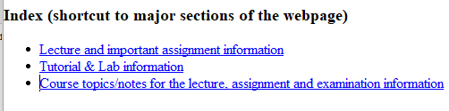
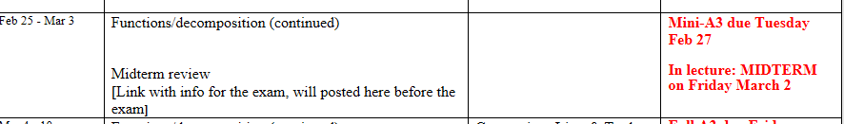
Examinations (2)
Information about the examinations will be available on the main grid before the respective test:
  Under the main index:
    Main grid: Course topics, lecture notes, assignment descriptions, exam information

Slide 22
Examination Content
Multiple choice questions:
  Partial program traces e.g., what’s the program output
  Basic program structure e.g., find the errors, which function or operator is needed for a particular mathematical operation
  More examples and details coming during the semester
Written questions:
  Write a small/partial computer program.
  Trace the execution of a computer program e.g., what is the ‘output’.
  Conceptual (lower weight for this type of question) e.g., definition of a technical term.
  Likely there will be a smaller proportion of written questions on the midterm vs. the final.
I will be grading the exams.
  (I’ll do the best I can to get them done in a timely fashion but remember there’s a fair number of you in the class).

Slide 23
Examination Content (2)
More sample ‘exam type’ questions will be provided during the semester.
  Sometimes ‘on the fly’ in lecture so pay attention to these and take notes.
Notes:
More incentive for them to come to class and take notes
Sometimes after teaching a concept e.g. recursion I might go over a sample exam question e.g. error changing an integer to ensure that it is within some range using recursion
If there’s time I may have them try it in class before I give the solution

Slide 24
Grades For Each Component
The official grading mechanism for this (and most) universities is a letter grade/grade point e.g. A/4.0, A-/3.7 etc.
Term grades must be stated as a letter grade.
Component grades (assignment, exam etc.) can either be a letter grade or a raw score (e.g. percentage)
For this class
  each major component will be awarded a grade point (and not a percentage)…e.g. the 2.0 GPA and not 65% will be used to calculate your term grade.
  and this is the value used to determine the term grade.

Slide 25
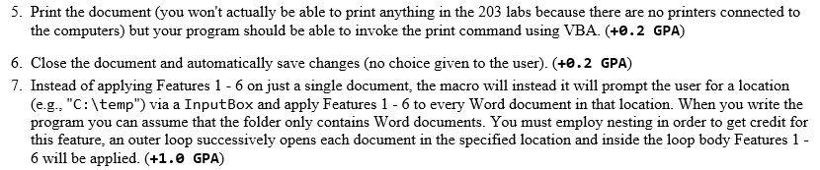
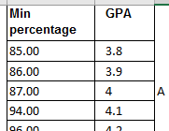
Grading: Course Components
Each course component will have a grading key
Sample from a past assignment (different course)
    A student who completes only Features #5 – 7 will be awarded an assignment grade point of 0.2 + 0.2 + 1.0 = 1.4 (just over a D+ grade)
Examinations will include a lookup table (raw percentage score to grade point). Sample from another course.

Slide 26
Why Grade Points?
It’s the official university grading system
  Alternatives are possible but require faculty level approval
Approval of anything other than a grade point system requires predetermined cutoffs at the start of the term e.g., >= 90% equals ‘A’ etc.
  Doesn’t allow for consideration that individual components may be more challenging than others (lower cutoffs)
Grade points are more lenient for grades on the lower-middle end of the scale
  Grade points: Getting an “A”/4.0 on the assignment component worth 30% of the term grade yields a minimum term grade of 1.2 (4.0 * 0.3) which equates to a term grade of ‘D’ (possibly higher)
  Percentages: Getting an “A” may roughly work out to 90% or higher (depending on the scale) which works out to a minimum term percent of 27% = 90% score * 30% weight…almost certainly an “F” for the term grade.

Slide 27
Grade Points Are Letter Grades Not Percentages
For examinations the mapping between a raw score and a grade point occurs one way (raw score mapped to grade point)
  Example (purely for illustration purposes) 65 – 69% = C/2.0, 70 – 74% = C+/2.3
  But grade points don’t correlate back to percentages
    e.g. I was awarded a 66% on midterm and then I see this is a 2.0 GPA (out of 4.0)
    Does this mean that my percentage ‘went’ from a 66% to a 50%!!!???
    No.
      A C/2.0 does not mean that 50% was awarded as a course grade.
      To put this in perspective a passing grade point in this university is a 1.0/D in a course. If a grade point mapped back to a percentage this would mean that anyone getting a 25% or higher would pass any course here.
  The mapping of the midterm to grade point will be posted sometime after the midterm grades have been released.
  The mapping of the final exam to grade point will be posted sometime after the final exam grades have been released.

Slide 28
Estimating Your Overall Term Grade Point
To determine your weighted term grade point simply multiply each grade point by the weight of each component.
  Percentages won’t be used to determine the term grade point/letter
Sum the weighted grade points to determine the term grade.
Simple and short example (not exactly the same as this term but it should be enough to give you an idea of how to do the specific calculations required this semester):
    Assignments: weight = 30/100, example score = A
    Midterm: weight = 30/100, example score = B+
    Final: weight = 40/100, example score = C-
    Weighted assignments: 0.3 * 4.0 = 1.2
    Weighted midterm: 0.3 * 3.3 = 0.99
    Weighted final: 0.4 * 1.7 = 0.68
    Total term grade point = 1.2 + 0.99 + 0.68 = 2.87
  (In this case the term letter is B-)

Slide 29
Estimating Your Overall Term Grade Point (2)
Use the spreadsheet on the course web page to estimate your term letter grade:
  http://pages.cpsc.ucalgary.ca/~tamj/2018/203W/grade_calculator.xlsx
The grade point to letter grade mapping employs the official university cutoffs:
  http://www.ucalgary.ca/pubs/calendar/current/f-2.html
  (I may employ a more lenient set of cutoffs at the end of term but the official cutoffs will provide you with a ‘worse case’ estimate of your grade).
  Also an “A+” doesn’t have a specified letter grade that is different from an “A” for term letter grades.
    I’ll likely extrapolate the pattern e.g. C+ = 2.3, B+ = 3.3 so an A+ will be higher than a 4.0 and a bit lower than 4.3 (because not all course components allow for an A+ to be awarded)
1 Note: to keep things simple the formula in the spreadsheet does not check if the exam component was passed or not (you can do the check manually or add it in yourself)

Slide 30
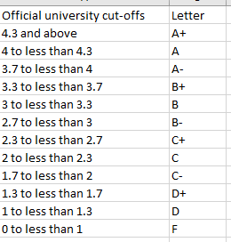
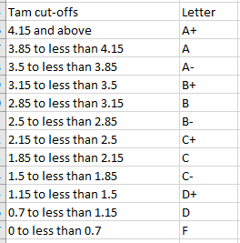
Contrast The CutOffs
Official UC cutoffs
The Tam cutoffs
4
4
3.7
3.3
3.0
2.7
2.3
2.0
1.7
1.3
1.0
0
    The cutoffs in the spreadsheet are significantly more lenient (almost everyone “gets a big break” e.g. instead of 3.7 for an A- it’s 3.5 (midpoint between A-/3.7 and B+/3.3 is the higher letter grade)
    Do not expect a further “rounding up” at the end of the term e.g. 3.4999999999999999999999999999999999999999999999999 is soooooooooooooooooooooooooooooooooooooooooooooooo close to 3.5 can’t you get an “A-”
    No or using an Internet emphasis
    NOOOOOOOOOOOOOOOOOOOOOOOOOOOOOOOOOOOOOOOOOOOOOOOOOOOOOOOOOOOOOOOOOOOOOOOOOOOOOOOOOOOOOOOOOOOOOOOOO!!!!!!!!!!!!!!!!!!!!!!!!!!!!!!!!!!!!!!!!!!!!!!!!!!!!!!!!!!!!!!!!!!!!!!!!!!!!!!!!!!!!!!!!!!!!!!!!!!!!!!!!!!!!!!!!!!!!!!!!!!!!!

Slide 31
Common Computer Skills Assumed
You know what a computer is!
You’ve used a computer in some form (e.g., turn on, turn off, open a file, played a game, gone online etc.)
You have experience using common applications (specifically email, web browsers, text editing using a word processor).
Notes:
When I poll the class and ask how many ever wrote a program the proportion is usually low (maybe 5 – 25%)
Out of that proportion some may think that simple html tags or writing a hello world is sufficient for them to be deemed as programmers
Point: teach them as if they have no prior knowledge

Slide 32

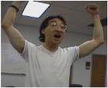
What This Course (CPSC 231) Is About
Writing/creating computer programs.
But it is not assumed that you have prior knowledge of Computer Science (or even experience writing programs)
It can be a lot of work.
  The course can be completed by students with a normal course load (many already have gotten through it!)
  But be cautious if you already have many other commitments
Late night ‘coding’
Satisfaction coming from solving that tough algorithm!
Wav file from “Tam”
Notes:
Just like getting a good cardio workout: you will have to puff and sweat
With writing computer programs: you will have to plug away and toil in front of a computer
Finding some problems hard and perhaps a little frustrating is normal
Working at these problems is how you get better

Slide 33

Actual Practice: Common Interview Questions
  Besides looking at degrees granted and grades received, some tech companies (e.g., Google) may ask you questions that appear non-technical:
  You’re asked to solve puzzles during the interview.
There is a relationship between skill at solving puzzles (“problem solving”) and success in a (technically oriented) industry.
  You will develop these skills writing programs for this class.
Example list of questions
http://www.businessinsider.com/15-google-interview-questions-that-will-make-you-feel-stupid-2009-11
Notes:
http://www.businessinsider.com/15-google-interview-questions-that-will-make-you-feel-stupid-2009-11
Pick an alternative problem solving exercise if desired – keep in mind most have never written a program so it has to be something that they are all capable of completing).s
http://www.businessinsider.com/apple-interview-questions-2011-5#how-do-you-test-the-prototype-of-the-vending-machine-5

Slide 34
Course Goals
Know the basic structure of a computer program (rules for laying out a program and how the basic constructs such as repetition and branching work)
  If you don’t know and understand these concepts then your program won’t work at all and you can’t proceed to the next goals.
Develop basic problem solving and analysis skills.
  As mentioned this is a skill that you will need to develop for “the real world”
Learn good design principles.
  For example you may know how to get a program to run across the Internet but you may not know how to write a fun game that people will want to play on Facebook™.
  “This *%$#! App really sucks!”

Slide 35
How To Succeed
Successful people
Notes:
35
Stress: these people got good at their field by ‘doing’
Painters painted
Composers composed

Slide 36
How To Succeed In This Course
Practice things yourself (not by getting the answer from someone/someplace else).
  How Computer Science works: You get better by doing things for yourself (this is a ‘hands-on’ field of study and work).
Providing solutions to assignments may be popular among students but useless for learning
What’s needed is for me to teach you the skills to solve any reasonable size problem
Similar to getting fit: you can’t just watch
You have to do it yourself
Notes:
You don’t get in shape by watching someone else work out
Similarly they won’t become good programmers by just going to lecture, they have work at problems themselves
That’s why Tas and the course instructors will not and cannot provide answers, students will get more out of the process if they try to work it out for themselves
Long term problem: But if they don’t know how to solve problems on their own there’s no way some one will hire them as a programmer
Short term problem: even if they never plan to take another CPSC course they still need to get through this one, solving assignment problems will help them solve problems on the exam
Giving them the answer provides the short term satisfaction of getting ‘a good grade on the assignment

Slide 37
How To Succeed In This Course (2)
  Write lots programs.
    At the very least attempt every assignment.
    Try to do some additional practice work (some examples will be given in class, some practice assignments will be available on the course web page).
    Write lots of little ‘test’ programs to help you understand and apply the concepts being taught.
  Trace lots of code (computer programs)
    Involves reading through programs that other people have written, and executing it ‘by hand’ in order to understand how and why it works
    This is an essential skill.
    Relying on just running the program and observing the results won’t always work (errors?)
Notes:
There will be some practice problems on the course webpage
Encourage them to try solving the problems in the recommended textbook and even the books on the Safari website if they are really keen

Slide 38
How To Succeed In This Course (3)
Make sure that you keep up with the material
  Many of the concepts taught later depend upon your knowledge of earlier concepts.
  Don’t let yourself fall behind!
  At least attempt all assignments!
Rule of thumb: don’t fall behind more than 1 week
:
Problem decomposition
Loops/repetition
Decisions/branching
Introduction to programming
Notes:
* If they fall behind more than a week, maybe two then they probably won’t be able to catch up

Slide 39
How To Succeed In This Course (4)
If you find concepts unclear trying to research the answer on your own can be beneficial (because this is a ‘hands on’ field).
  Read alternate explanations of the concepts covered in class in the text book (or other textbooks: remember that electronic books accessible through the library-Safari are ‘free’).
  Looking at online resources:
    Remember academic resources online just like other online information may not always be a good source.
    Start with more reputable sources
      http://proquest.safaribooksonline.com.ezproxy.lib.ucalgary.ca/
      www.python.org
Addendum to the previous point #2 and a point raised earlier “ask questions”.
  If you are still unclear on concepts then make sure that you ask for help.
  Don’t wait too long (more than a few days) to do this because latter concepts may strongly depend on your understanding of earlier concepts..
Notes:
They should try to figure out things themselves but don’t fall into the extreme case of waiting too long (some students show up only at the very end of term to ask for help with earlier concepts).
Rule of thumb: try it out for a few days, no more than a week before asking for help (don’t fall behind more than a week)

Slide 40
How To Succeed In This Course (5)
Look at the material before coming to lecture so you have a rough idea of what I will be talking about that day:
  Read the slides
  Look through the textbook(s)
When we get to more complicated programs that appear to ‘jump around’ in how they execute (“section: problem decomposition/functions”) just having an idea of the scope and components of the program beforehand can be useful when I cover it in class.
Notes:
They may not be able to trace it on their own but at least getting an overview can help
Some programs will be “big”
They MUST develop the skill of tracing a program that won’t all fit on one slide/screen (students complain that instructors jump around if the program spans multiple screens)

Slide 41
How To Succeed In This Course (6)
Start working on things as early as possible:
  Don't cram the material just before the exam, instead you should be studying the concepts as you learn them throughout the term.
  It’s important to work through and understand concepts *before* you start (full) assignments.
  If you try to learn a new concept and work out a solution for the assignment at the same time then you may become overwhelmed.
  Don’t start assignments the night (or day!) that they are due, they may take more time than you first thought (start as soon as possible).
  Some assignments may require the application of multiple concepts, not all the concepts have to be completely covered before you start working on an assignment.
    Start working based on what’s currently been covered (this will teach you how to decompose a program and work on it a part at a time).
Notes:
Starting early:
Sometimes small syntax or logic errors can hold you up (waiting too long may stress you out so much that you can’t spot an easy error)
Sometimes programming is harder than it looks: There’s a difference between listening to someone talking about a concept and you doing it yourself.

Slide 42
How To Succeed In This Course: A Summary
Practice things yourself
Make sure that you keep up with the material
Look at the material before coming to lecture
Start working on things early

Slide 43
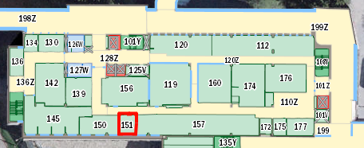
Computer Science: Help And Teaching Tutorials
Help tutorials (“Continuous Tutorial/CT”):
  Attendance is not required (no official registration)
  Q & A session: it will be used as an additional place where you can get help.
  Located near the technical “Help Desk”
  The CT schedule will be posted early in the semester.
Math Sciences
CPSC tech help
CT for CPSC 231

Slide 44
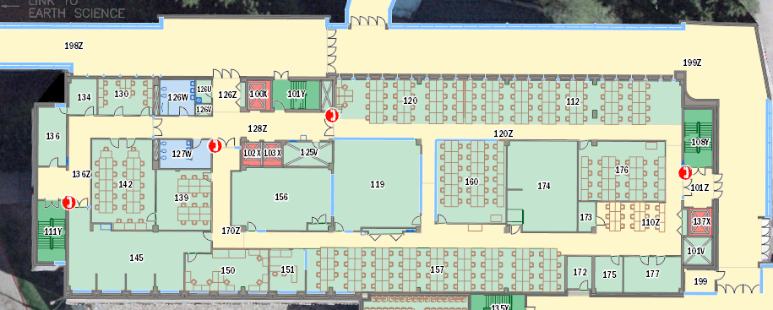
Computer Science: Help And Teaching Tutorials
Teaching tutorials:
  They will be conducted by the Teaching Assistants (TA).
  A mandatory component of the course (registration in a specific section is required).
  Review of concepts covered in lecture (especially the more challenging ones).
  Discussion of assignment requirements.
  Assignment and exam feedback/return after grading is complete.
MS 160
MS176

Slide 45
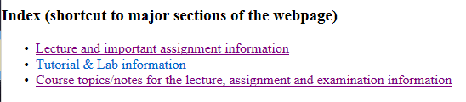
Computer Science: Labs And Tutorials (Reminder: 2)
(Teaching tutorial information continued):
  Practice exercises.
  ‘Open tutorials’ will sometimes be held (extra CT/help time where TA’s will be available to help students).
More information about tutorials and labs is available on the course web site:
  http://pages.cpsc.ucalgary.ca/~tamj/2018/231/index.html#Tutorial_information

