Slide 1
Creating And Publishing A Webpage
You will learn the basic html ‘tags’ for formatting a webpage as well including internal and external content

Slide 2
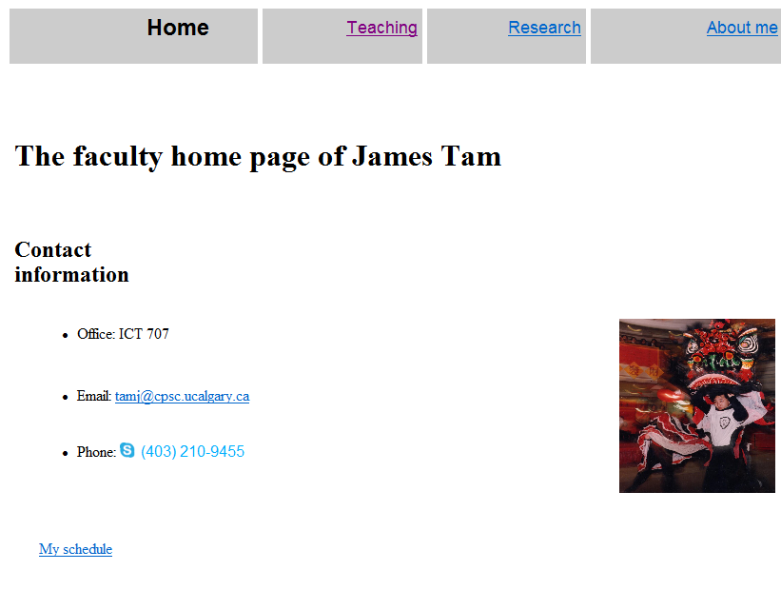
Web Page
A document that can be seen “online” via the World-Wide-Web
Going to the web address:
  www.cpsc.ucalgary.ca/~tamj (or pages.cpsc.ucalgary.ca/~tamj)
  Retrieves a document called “index.html” from the computer science web server to load into your web browser.

Slide 3
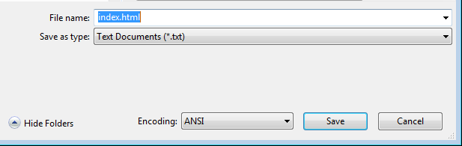
Making A University Webpage
Use a simple editor WordPad (don’t use MS-Word because it will generate a great deal of extra unnecessary information for a simple webpage).
Save it as a text file
Make sure you manually add the .htm or .html suffix to the end of the file otherwise it will be text .txt file and not display properly (uses a text editor such as Notepad instead of web browser to view).

Slide 4
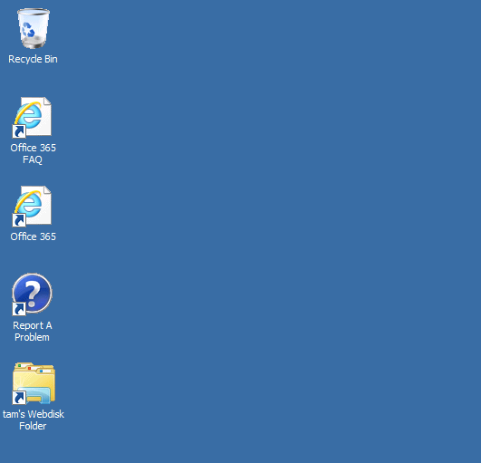
Saving The Webpage
In the “Webdisk” folder on the 203 lab computers should contain a “public_html” folder
  For students the Web disk folder name may be different slightly different from my ‘Prof’ account.
  (The Webdisk is where you save documents on the UC-IT server and not on a local drive)
My account in the CPSC 203 computer lab

Slide 5
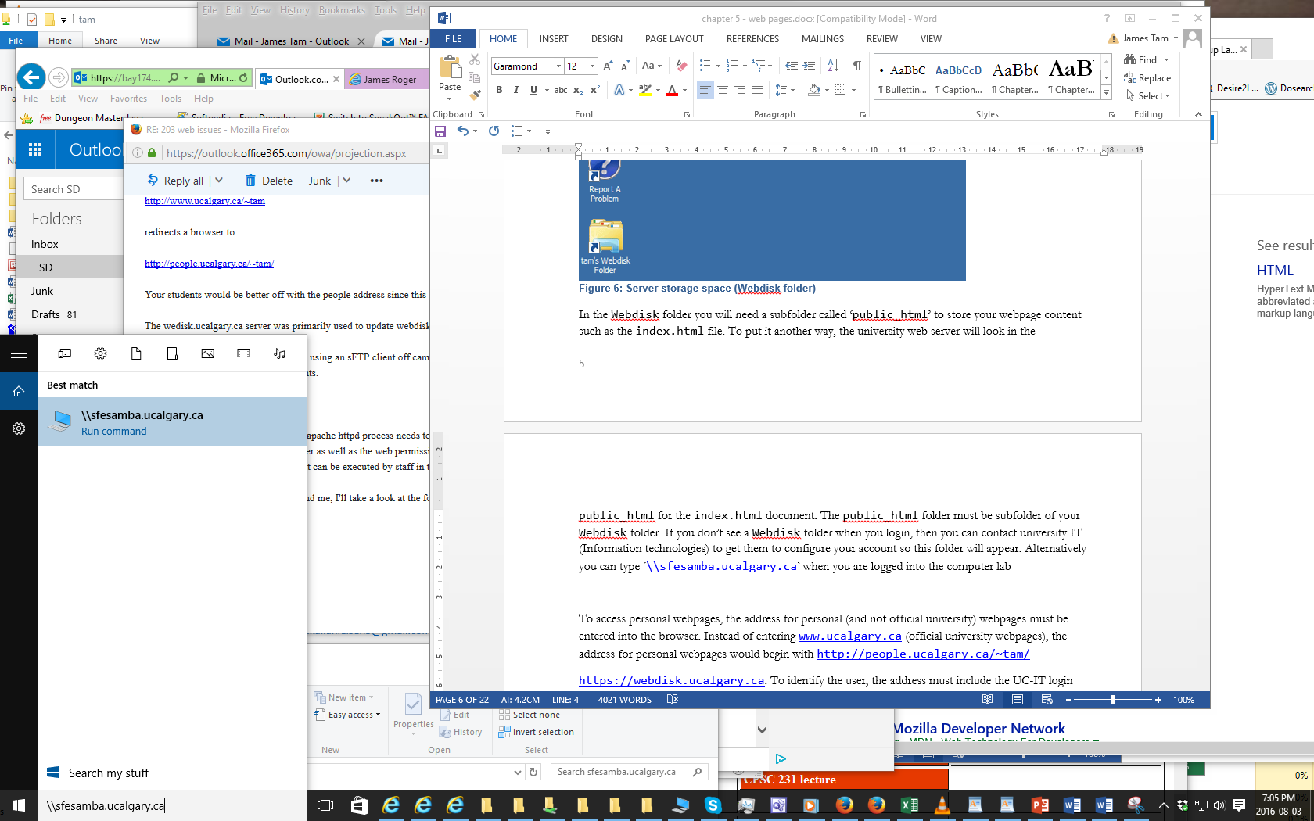
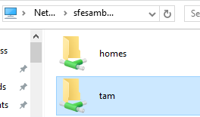
If WebDisk Doesn’t Exist: Address It Yourself
When you are logged into a computer in the 203 computer lab type (under ‘Start’): \\sfesamba.ucalgary.ca
If you successfully login then you should see something similar to this (WebDisk will be a sub-folder)

Slide 6
If WebDisk Doesn’t Exist: Get UC-IT To Fix It
Contact university IT (Information technologies) to get them to configure your account so this folder will appear.
  Go to 7th floor Math Sciences (not ICT – that’s the Computer Science department which is not the same).
  Submit an online ticket (bug report): http://www.ucalgary.ca/it/
  Call: 403-220-5555
  Email: itsupport@ucalgary.ca.

Slide 7
Web Address Of Your Page
The first part is the general University of Calgary web address for personal web pages:
  https://people.ucalgary.ca/
The final part after the “.ca/” identifies you:
Format:
  <tilde><your U of C login name>
Example:
  ~tam/
  (The web server will look in your public_html folder and try to load the ‘index.html’ file into the browser when the above web address is entered).
Web address of my U of C web page (not Computer Science)
  https://people.ucalgary.ca/~tam/index.html

Slide 8
Viewing Website: Reminder
To “publish the website” (make it viewable on the web).
  Put the ‘.html’ document in your folder “public_html”
  The web address is:
  http://people.ucalgary.ca/~<username>/<filename>
  Example if the file were called ‘index.html’ my web address would be:
  https://people.ucalgary.ca/~tam/index.html
If you want to see what your website would look like with a browser when working from home:
  Start up a web browser (e.g., IE, Firefox) and ‘drag’ the webpage document into the browser
  OR
  Just double click on the document (your computer should pull up a web browser unless you reconfigured the default setup).

Slide 9
Transferring Your Work To/From UC/Home
You can use a flash memory device
(Just make sure that you don’t just transport your web document ‘htm’ file back and forth but ALSO all images and video that you have embedded into your web page (links to external pages don’t apply).

Slide 10
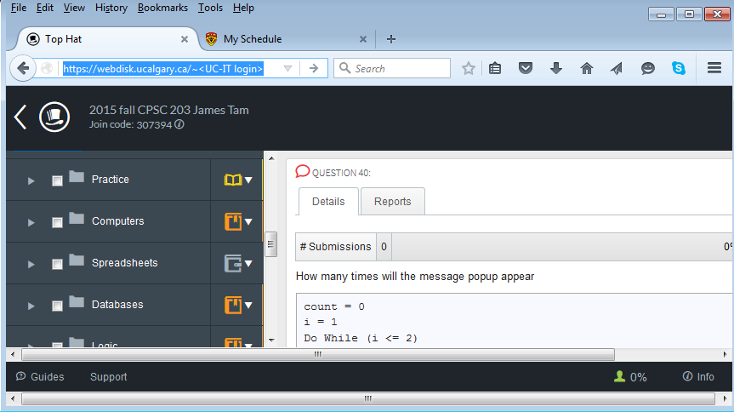
Recap
Setup: folder structure
<Your Webdisk folder>
Accessing your page through the web
<public_html>
  https://people.ucalgary.ca/~<UC-IT login>
<Contents of your webpage>
index.html
<Contents of your webpage>

Slide 11
More Information: University Online Storage / Webpage
http://www.ucalgary.ca/it/services/webdisk-file-storage#quickset-field_collection_quicktabs_1

Slide 12
Alternative Methods Of Creating A Website (If There Is Time)
(The ‘content’ e.g., index.html and other documents must still be created).
Your website must be ‘hosted’
Minimum requirements for the host
  Stores the content of your website (index.html and other files)
  It has the ability to register your custom website (give it a name)
    E.g., www.tamj.com
  OR
  Your website will be a sub-address of their main web address
    E.g.. www.somewebsitehost/com/tam

Slide 13
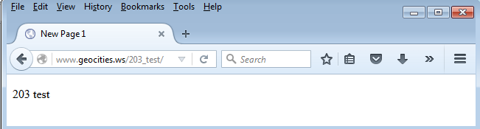
Website Hosts (If There Is Time)
Many Internet service providers automatically (without additional cost) provide hosting services for subscribers
Some Internet companies provide webhosting services to anyone without charge
  http://www.geocities.ws

Slide 14
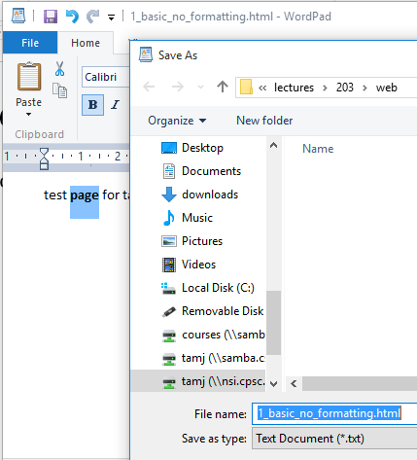
Creating A Simple Page
Creating the document in WordPad and saving it as an ‘.html’ document.
Name of example web page: 1_basic_no_formatting.htm
Save it as a text document but add in the suffix ‘.html’

Slide 15
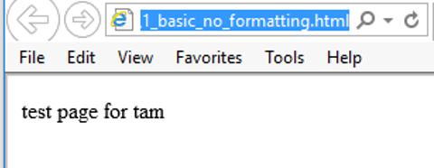
Viewing The Page In A Web Browser
The text appears but is not formatted

Slide 16
HTML
HTML (Hypertext Markup language): used to specify the format and content of a web page.
  An Internet protocol (rules) that was developed in the early 1990’s decades after the creation of the original Internet.
  The purpose of the protocol was to allow documents to be linked (sharing information by linking related documents).
    “Rules for how documents would be linked together”
  Mechanisms for formatting the webpage were also built into the protocol.
Examples of specifying formatting used in web page text: font effects (bold, italics, underline), font sizes, font types
Examples of specifying the content of a web page:
  Multi-media such images and videos can be imbedded into a web page.
  Links to other documents (or even external web sites)

Slide 17
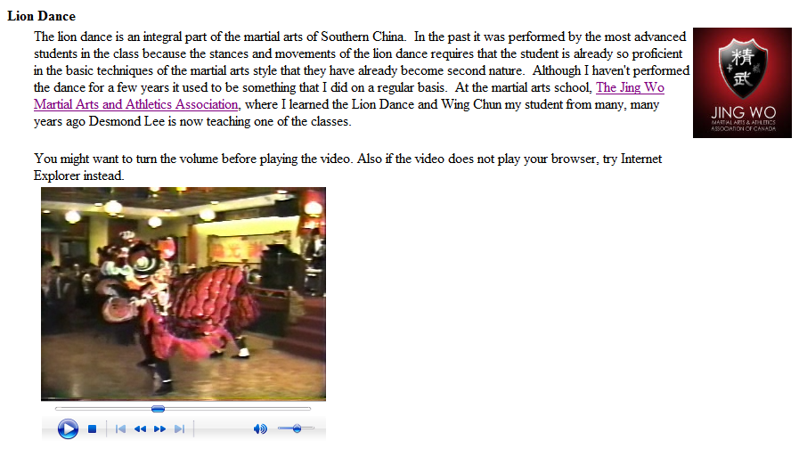
Example Uses Of HTML
Font effects
External website
Image
Video

Slide 18
Formatting Your Webpage
You must use ‘tags’.
Formatting tags specify:
  Exactly what part of the web page will be formatted e.g., a paragraph, line, word, single character etc.
  How that section will be formatted e.g., bold, italics etc.
Many tags come in pairs.
  ‘Opening tag’ (e.g., indicates the beginning of the formatting)
  ‘Closing tag’ (indicates the end of the formatting)
Other tags don’t require a closing tag
  Example a tag to insert a ‘break’ just places a carriage return at the specified location

Slide 19
Common Formatting Tags
The text between the opening tag <tag name> and the closing tag </tag name> will be formatted in the manner specified by the tag.
Extra thing to keep in mind!
  The formatting effect on appears when you view the webpage through a browser not when you are editing the page using the WordPad editor
View from WordPad
  Bold
    <b> this text is bolded </b> this text will not be bolded
  Italics
    <i>this text is italicized</i> this text is non-italicized
  Underline
    <u>underlined text</u> non-underline text
  Strikethrough (alternative tag <strike></strike>)
    <s>strike-through text</s>text with no strike

Slide 20

Tags Appear In The Editor (WordPad) But Not In The Browser (IE)
Name of example web page: 2formatting_tags.htm
Viewed with WordPad (shows the formatting tags)
Viewed through a web browser (shows the effect of the tags in IE, Firefox etc.)

Slide 21
Moving Text To A New Line
Notice in the last example that the carriage returns (‘enter’ key) typed into WordPad did not separate lines when viewed through the browser (no ‘new lines’ to break up the text).
The tag to separate lines is <br>
  There is no closing tag needed because the break-tag just moves the text after the tag to the next line (again when viewed through the browser)

Slide 22


New Version Of The Webpage
(The previous web page with line separators)
Name of the web page: 3formatting_tags_line_breaks.htm
Viewed with WordPad (shows the formatting tags)
Viewed through a web browser (shows the effect of the tags)

Slide 23
Headings
Recall the ‘CRAP’ design principles (spreadsheet design section)
  Contrast: making different things really stand out
Heading?
CPSC 203: Assignment 4 (Creating web pages and writing Java Scripts for the web)
Due Tuesday March 24 at 4 PM
Creating a web page
You are to build a web page. Sample themes include a personal page, a page your favorite organization or group (team, charity etc.) Generally you are pretty free in your choice of website theme - it should be something that is appropriate for a university assignment submission.
Heading!
CPSC 203: Assignment 4 (Creating web pages and writing Java Scripts for the web)
Due Tuesday March 24 at 4 PM
Creating a web page
You are to build a web page. Sample themes include a personal page, a page your favorite organization or group (team, charity etc.) Generally you are pretty free in your choice of website theme - it should be something that is appropriate for a university assignment submission.

Slide 24
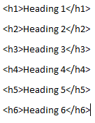
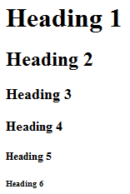
The Headings Tag
Each headings tag has an associated number
  1 is first level (largest and most prominent)
  2 is second level (not as large, less prominent)
  Etc.
Example webpage: 4headings.htm
Notice how the ‘break’ tag isn’t needed when the heading tag is used

Slide 25
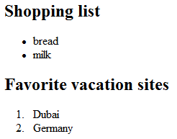
The List Tags
Lists can be:
  unordered (bullet points) <ul>list</ul>
  ordered (numbered in ascending order) <ol>list</ol>
  The entire list (ordered or unordered must be enclosed in one of the above opening/closing tag pairs)
  The above two tags determine whether an entire list consists EITHER ordered or unordered elements.
    This is why the above <opening>-<closing> tag pair must enclose the entire list
  In both of the above cases each list element must be enclosed in a list-tag <li><element></li>
<ol>
<li>
</li>
<li>
</li>
</ol>

Slide 26
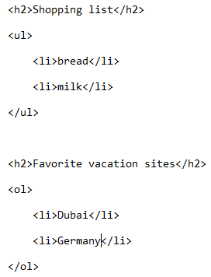
The List Tags (2)
Name of example web page: 5lists.htm
Notes:
Removing ul or ol removes indenting
Removing the li tag removes numbering or bulletting

Slide 27
Embedding “Content”
(Note: there are different ways of embedding content, this is one of the easier ways).
Like text, multi-media such as images and videos can be embedded into a website.
The multi-media can either be local (on the same computer as your web page document) or external (an external website such as: Vimeo, Bing video, Yahoo video, YouTube etc.
Video:
  <embed src="<Video name>" autostart="false">
Images:
  <img src="lion.jpg">

Slide 28
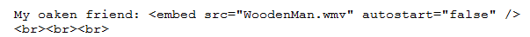
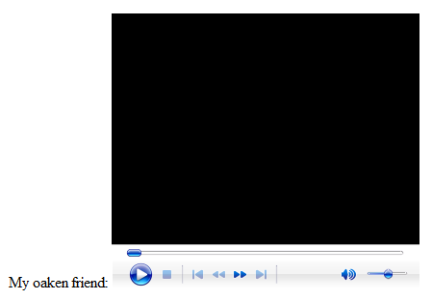
Embedding Local Multimedia
Name of the web document: 6content.htm
(Assumes that the image ‘lion.jpg’ and the video “WoodenMan.wmv” are in the same folder as this web document).
Video example

Slide 29
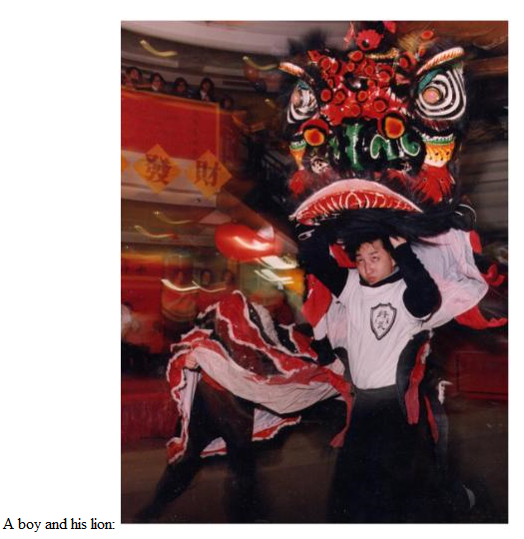
Embedding Local Multimedia (2)
Image example
How to handle cases where the image doesn’t load properly:
  Format:
    <img src="<Image name>" alt="<Alternate text>">
    Example:
    <img src="lion.jpg" alt= "No lion loaded">

Slide 30

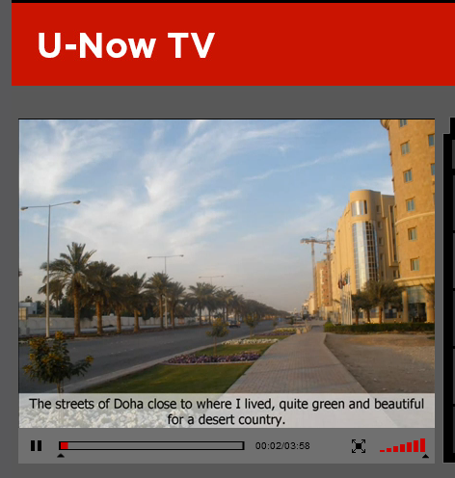

Links To Other (External) Webpages
Suppose you want your web page to link to a YouTube video or to an image located on another website.
You can use the ‘href’ tag for external links
  <a href="<web address"</a>
Name of web document: 7links_external.htm
Video example
WordPad
Hosted/Stored on www.jetvisiion.tv
Web browser

Slide 31
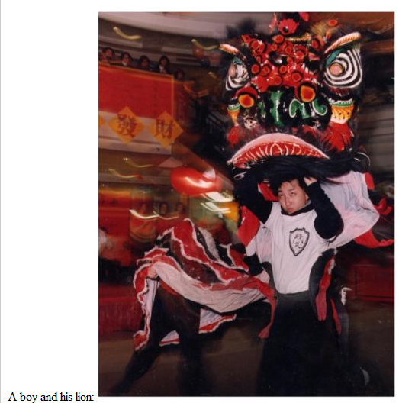
Links To Other (External) Webpages (2)
Image example:
WordPad
Web browser
Previous example (image stored on my university website “Embedding Local Multimedia (2)”): <img src="lion.jpg">
This example (image is stored on an external website) <img src="<web address for another website including location of image and name of image">

Slide 32
Advantages To External Links “HREF”
Less disk space used
May allow content that you don’t ‘own’ to appear on your page

Slide 33
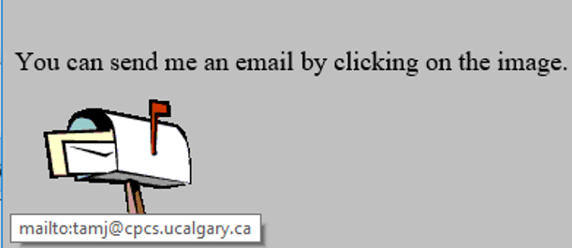
A HREF: Contact Information
You can use the ‘mailto’ in conjunction with “A href”
General format
  <a href="mailto:<Email address>"> <Instructions> </a>
Example
  <a href="mailto:tam@ucalgary.ca">Email</a>

Slide 34
After This Section You Should Now Know
How to create a web document (‘htm’ or ‘html’ document) and have it published (viewable) on the web via the university web server
The web address for your university web page
Common html tags
  Font effects: bold, italics, underline, strike out/strike through
  Headings
  Ordered and unordered lists
  Embedding multi-media images and text within a web page
  Creating external links via the “A href”

