Slide 1
VBA (Visual Basic For Applications) Programming Part II
Objects
Named constants
Collections
Nesting
Useful VBA functions
Linking Office applications

Slide 2



Real-World Objects
You are of course familiar with objects in the everyday world.
  These are physical entities
Each object is described by its properties (information)
Each object can have a set of operations associated with it (actions)

Slide 3
Example: A Person
Example properties (physical and other attributes): information
Age
Height
Name
Hair color
…
Example operations (actions, in VBA they are called ‘methods’): capabilities
Walk
Talk
Eat
Sleep
Drink
Excrete
…

Slide 4
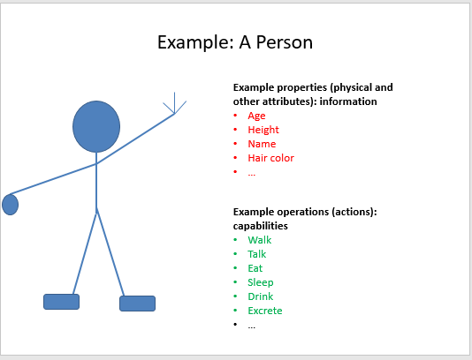
VBA Object
Similar to everyday objects VBA-Objects have properties and actions
  Properties: information that describe the object
    E.g., the name of a document, size of the document, date modified, number of words etc.
  Capabilities: actions that can be performed (sometimes referred to as ‘methods’ or ‘functions’)
    E.g., save, print, spell check etc.

Slide 5
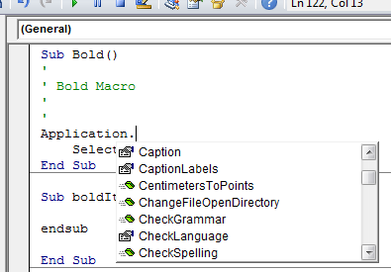
Common VBA Objects
Application: the MS-Office program running (for the programs you see in CPSC 203 it will always be MS-Word)
ActiveDocument
Selection
When enter one of these keywords in the editor followed by the ‘dot’ you can see more information.
Take advantage of the benefits of VBA:
The list of properties and methods is a useful reminder if you can’t remember the name
If you don’t see the pull down then this is clue that you entered the wrong name for the object

Slide 6
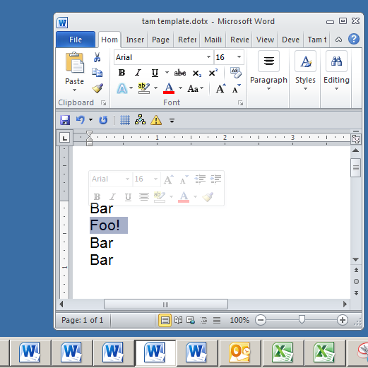
Example: What Are The Three Objects
Application:
  MS-Word
Active/current Document:
  “tam template”
Selection
  “Foo!”

Slide 7
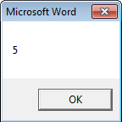
Using Pre-Built Capabilities/Properties Of Objects
Format:
  <Object name>.<method or attribute name>
Example:
  Sub ApplicationTest()
  MsgBox (Application.Windows.Count)
  End Sub
Application.Windows.Count
Property of Window:
Number
Accessing the Windows property of Word (the application)
Info about the windows currently opened
Object referred to: ‘Application’

Slide 8
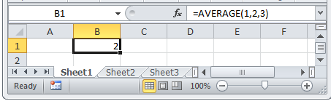
Properties Vs. Methods/Functions
Recall
  Property: information about an object
  Method: capabilities of an object (possible actions)
Property: current cell
Using the ‘average()’ function

Slide 9
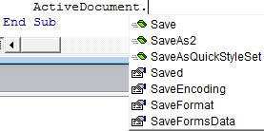
Properties Vs. Methods: Appearance
Methods
Property
Similar to functions in MS-Excel some object’s methods may require an argument or arguments
Examples
  ActiveDocument.CountNumberedItems
  ActiveDocument.Save
  ActiveDocument.SaveAs2("<name>")
No argument required
Argument: New name of document needed

Slide 10
The Application Object
As mentioned this object is the VBA application running e.g. MS-Word
Program illustrating an example usage: 1applicationObject.docm
  Sub ApplicationTest()
  MsgBox (Application.Windows.Count)
  End Sub
Application.Windows.Count
Property of Window:
Number
Accessing the Windows property of Word (the application)
Info about the windows currently opened
Object referred to: ‘Application’

Slide 11
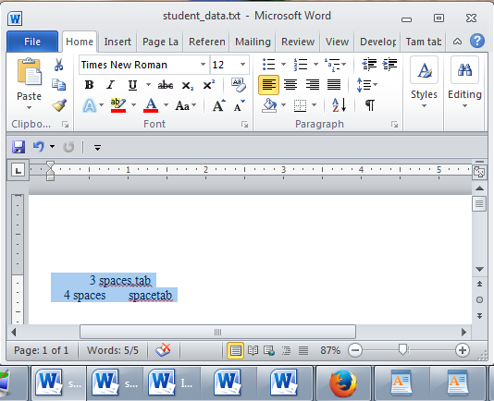
The ActiveDocument Object
Quick recap: although you may have many documents open, the ‘active document’ is the document that you are currently working with:
  Because it may be easy to confuse documents it’s best to only have a single Word document open when writing a VBA program.
The active document

Slide 12
Some Attributes Of The ActiveDocument Object
Application: the application/program associated with the document (useful if a VBA macro is linking several applications):details on next slide
Content: the data (text) of the currently active document (needed if you want to perform a text search ‘Find’ in a VBA program):details later in these notes
Name: the (file) name of the current document (useful for determining the active document if multiple documents are currently open): next slide
Path: the save location of the active document e.g. C:\Temp\ :details on next slide
FullName: the name and save location of the current document :details on next slide
HasPassword: true/false that document is password protected: details on next slide
Selection: the currently select text in the active document (may be empty) :details later in these notes
SpellingChecked: true/false document has been spell checked since document was last edited: :next slide
SpellingErrors.Count: the number of typographical errors
Note: Information for these attributes/properties can be viewed by passing the information as a parameter to a message box
Format: MsgBox (ActiveDocument.<Attribute Name>)
Example: MsgBox (ActiveDocument.SpellingErrors.Count)

Slide 13
Example Of Accessing Attributes/Properties
Program illustrating an example usage: 2activeDocumentAttributes.docm
  Sub activeDocumentAttributes()
  MsgBox (ActiveDocument.Application)
  MsgBox (ActiveDocument.Name)
  MsgBox (ActiveDocument.Path)
  MsgBox (ActiveDocument.FullName)
  MsgBox ("Spell checked? " & _
  ActiveDocument.SpellingChecked)
  MsgBox ("Password protected? " & _
  ActiveDocument.HasPassword)
  MsgBox ("# typos=" & ActiveDocument.SpellingErrors.Count)
  End Sub

Slide 14
Some Methods Of The ActiveDocument Object
Checkspelling: exactly as it sounds: next slide
Close: closes the active document (different options available)
CountNumberedItems: number of bulleted and numbered elements: next slide
DeleteAllComments: removes comments from the current document: next slide
Printout: prints current active document on the default printer : next slide
Save: saves the current document under the same name: next slide
SaveAs2: saves the current document under a different name: : next slide
Select: select some text in the active document
SendMail(): sends an email using MS-Outlook, the currently active document becomes a file attachment

Slide 15
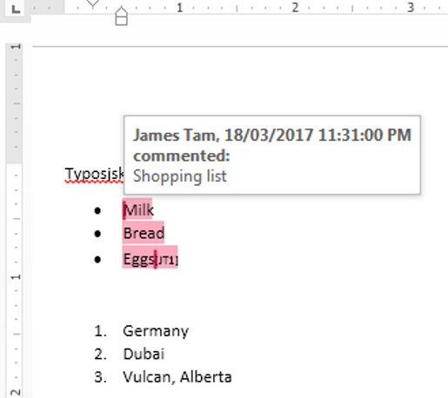
Example Of Using Methods
Program illustrating an example usage: 3activeDocumentMethods.docm
  Sub activeDocumentAttributes()
  ActiveDocument.CheckSpelling
  MsgBox (ActiveDocument.CountNumberedItems)
  ActiveDocument.DeleteAllComments
  ActiveDocument.PrintOut
  ActiveDocument.Save
  ActiveDocument.SaveAs2 ("Copy")
  End Sub

Slide 16
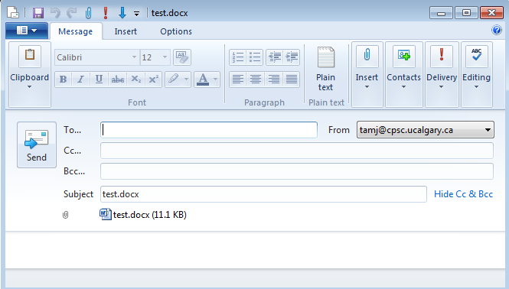
ActiveDocument.SendMail()
Runs the default email program
The active document automatically becomes an attachment
Subject line = name of document
(For anything more ‘fancy’ you should use VBA to create and access an MS-Outlook object)

Slide 17
“Finding” Things In A Document
It can be done in different ways:
Example (common) ‘Find’ is an object that is part of the ‘Selection’ object in a document.
  JT’s note: although it may appear to be confusing at first it doesn’t mean that the find (or find and replace) requires text to be selected.
  Making ‘Find’ a part of ‘Selection’ was merely a design decision on the part of Microsoft.
Example (alternative is JT’s preferred approach) ‘Find’ is an object that is part of the ‘Content’ object of the ‘ActiveDocument’
  ActiveDocument.Content.Find
  More details coming up...
One source of information:
http://msdn.microsoft.com/en-us/library/office/aa211953(v=office.11).aspx

Slide 18
Find: Single Replacement
Word document containing the macro: 4simpleFind.docm
sub simpleFind()
  ActiveDocument.Content.Find.Execute FindText:="tamj",ReplaceWith:="tam"
  end Sub
  ‘Reminder: The instruction can be broken into two lines without
  ‘an error by using the “line continuation” as a connector
  ActiveDocument.Content.Find.Execute FindText:="tamj", _
  ReplaceWith:="tam"
Background for example:
My old email address (still works): tamj@cpsc.ucalgary.ca
My new email address: tam@ucalgary.ca
Incorrect variant: tamj@ucalgary.ca

Slide 19
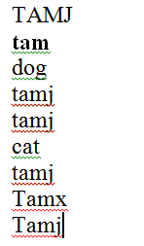
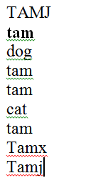
More Complex Find And Replace
Word document containing the macro: findReplaceAllCaseSensitive.docm
  Sub findReplaceAllCaseSensitive()
  ActiveDocument.Content.Find.Execute FindText:="tamj", _
  ReplaceWith:="tam", Replace:=wdReplaceAll, _
  MatchCase:=True
  End Sub
Before
After

Slide 20
With, End With
ActiveDocument.Content.Find.Execute
For ‘deep’ commands that require many levels of ‘dots’, the ‘With’, ‘End With’ can be a useful abbreviation.
Example
  With ActiveDocument.Content.Find
  .Text = "tamj"
  Equivalent to (if between the ‘with’ and the ‘end with’:
  ActiveDocument.Content.Find.Text = "tamj"
Previous example, the ‘Find’ employing ‘With’, ‘End With’:
Also the search and replacement text are specified separately to shorten the ‘execute’ (the “ActiveDocument.Content.Find” listed once)
  With ActiveDocument.Content.Find
  .Text = "tamj"
  .Replacement.Text = "tam"
  .Execute MatchCase:=True, Replace:=wdReplaceAll
  End With
Anything between the ‘find’ and ‘with’ will be preceded in this example with ActiveDocument.Content.Find:
‘Find text’ and ‘replacement text’ moved here to simplify the ‘.execute’

Slide 21
Find And Replace
It’s not just limited to looking up text.
Font effects e.g., bold, italic etc. can also be ‘found’ and changed.

Slide 22
Finding And Replacing Bold Font
Word document containing the macro: 5findBold.docm
  'Removes all bold text
  Sub findBold()
  With ActiveDocument.Content.Find
  .Font.Bold = True
  With .Replacement
  .Font.Bold = False
  End With
  .Execute Replace:=wdReplaceAll
  End With
  End Sub

Slide 23
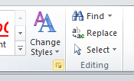
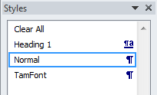
Finding/Replacing Formatting Styles
You already have a set of pre-created formatting styles defined in MS-Word.
You can redefine the characteristic of a style if you wish.
Assume for this example that you wish to retain all existing styles and not change their characteristics.
But you want to replace all instances of one style with another style e.g., all text that is formatted as ‘normal’ is to become formatted as ‘TamFont’
‘Find’ can be used to search (and replace) instances of a formatting style.

Slide 24
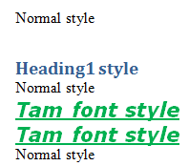
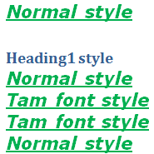
Finding/Replacing Formatting Styles (2)
Word document containing the macro: 6findReplaceStyle.docm
  Sub findReplaceStyle()
  With ActiveDocument.Content.Find
  .Style = "Normal"
  With .Replacement
  .Style = "TamFont"
  End With
  .Execute Replace:=wdReplaceAll
  End With
  End Sub
BEFORE
AFTER
‘Normal’ style becomes ‘TamFont’

Slide 25
Counting The Number Of Occurrences Of A Word
Example applications:
  Evaluating resumes by matching skills sought vs. skills listed by the applicant.
  Ranking the relevance of a paper vs. a search topic by the number of times that the topic is mentioned.
    Word frequency may be one criteria employed when websites rank search results according to relevance
Complete Word document containing the macro: 7counting occurences.docm

Slide 26
Example: Counting Occurrences
  Sub countingOccurences()
  Dim count As Long
  Dim searchWord As String
  count = 0
  searchWord = InputBox("Word to search for")
  ' Exact match (assignment)
  With ActiveDocument.Content.Find
  Do While .Execute(FindText:=searchWord, Forward:=True, _
  MatchWholeWord:=True) = True
  count = count + 1
  Loop
  End With
  MsgBox ("Exact matches " & count)
  End Sub

Slide 27
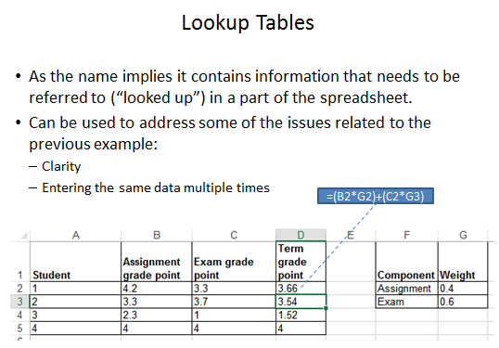
Review: Lookup Tables (For Constants)
Excel: Lookup tables are used to define values that do not typically change but are referred to in multiple parts of a spreadsheet.

Slide 28
Named Constants
They are similar to variables: a memory location that’s been given a name.
Unlike variables their contents cannot change.
The naming conventions for choosing variable names generally apply to constants but constants should be all UPPER CASE. (You can separate multiple words with an underscore).
  This isn’t a usual Visual Basic convention but since it’s very common with most other languages, you will be required to follow it for this class.
Example CONST PI = 3.14
  PI = Named constant, 3.14 = Unnamed constant
They are capitalized so the reader of the program can quickly distinguish them from variables.

Slide 29
Declaring Named Constants
1 The expression can be any mathematical operation but can’t be the result of a function call
Format:
  Const <Name of constant> = <Expression>¹
  JT: it’s preceded by the keyword ‘const’ to indicate that it is a constant/unchanging.
Example:
  Sub ConstantExample()
  Dim area as Double
  Dim radius as Double
  Const PI = 3.14
  radius = InputBox("Radius")
  area = PI * (radius * radius)
  End Sub

Slide 30
Why Use Named Constants
No ☹
Yes ☺
They can make your programs easier to read and understand
Example:
  Income = 315 * 80
Vs.
  Income = WORKING_DAYS_PER_YEAR * DAILY_PAY

Slide 31
Predefined Constants: MS-Word Constants
Microsoft uses their owning naming convention for predefined named constants.
Example:
  wdPromptToSaveChanges
Usage:
  ActiveDocument.Close(wdPromptToSaveChanges)

Slide 32
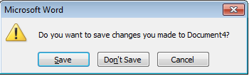
Closing Documents
Default action when closing a MS-Word document that has been modified (prompt)
VBA code to close a document in this fashion:
  ActiveDocument.Close (wdPromptToSaveChanges)
Pre-defined constant

Slide 33
More Pre-Defined Constants: Closing Documents
ActiveDocument.Close method
Word document containing the macro: “8closingActions.docm”
  Sub ClosingActions()
  ActiveDocument.Close (<Constant for closing action>)
  End Sub
'Choose one constant
wdPromptToSaveChanges
wdDoNotSaveChanges
wdSaveChanges

Slide 34
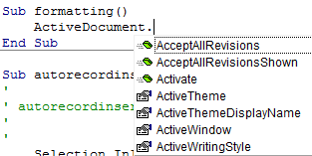
Formatting A Document
Entire document:
  You first need to specify the document or part of a document to be formatted
  One way is through the ‘ActiveDocument’ object
  Then choose the ‘Select’ method of that document.
    Review: it’s a method and not a property because it applies an action: select = selecting the text of the entire document
Selected text:
  Only format the currently selected text via the ‘Selection’ object).

Slide 35
Formatting Text (Entire Active Document): An Example
Suppose you want to format a document in the following way
Entire document
  Font = Calibri

Slide 36
Formatting: Entire Document
As mentioned the entire document can be selected.
Now for the ‘selected text’ (in this case it’s the whole document) access the ‘Font’ property and the ‘Name’ property of that font and give it the desired name.
Word document containing the macro: 9formattingEntireDocument.docm
  Sub formattingEntireDocument()
  ActiveDocument.Select
  Selection.Font.Name = "Calibri"
  End Sub
ActiveDocument.Select
Selection.Font.Name = "Calibri"

Slide 37
The Selection Object
This is the currently selected text in a document.
  It may be empty (nothing selected)

Slide 38
Some Attributes/Properties Of The Selection Object
Font.Name: specify the type (name) of font
Font.Size: specify how big is the font
Font.ColorIndex: specify the color of the font
Font.UnderLine: specify the type of underlining to be applied (or to remove underlining)
Font.Bold: allows bolding to change (toggle or set)
Similar to how the Attributes/Properties of ActiveDocument Object affect only the currently active document these Attributes/Properties only take effect on the currently selected text (if there’s any).

Slide 39
Using The Selection Object Attributes/Properties
Name of the Word document containing the program: 10selectionAttributes.docm
  Sub selectionObjectAttributes()
  Selection.Font.Name = "Wingdings" 'Must be in quotes
  Selection.Font.Size = 36
  Selection.Font.ColorIndex = wdBlue
  ' Selection.Font.Underline = <Constant for underlining>
  ' wdUnderlineNone, wdUnderlineSingle
  ' e.g. Selection.Font = wdUnderlineSingle
  ' Bolding options
  Selection.Font.Bold = wdToggle ' On/off
  Selection.Font.Bold = True ' Turn on (false = off)
  End Sub

Slide 40
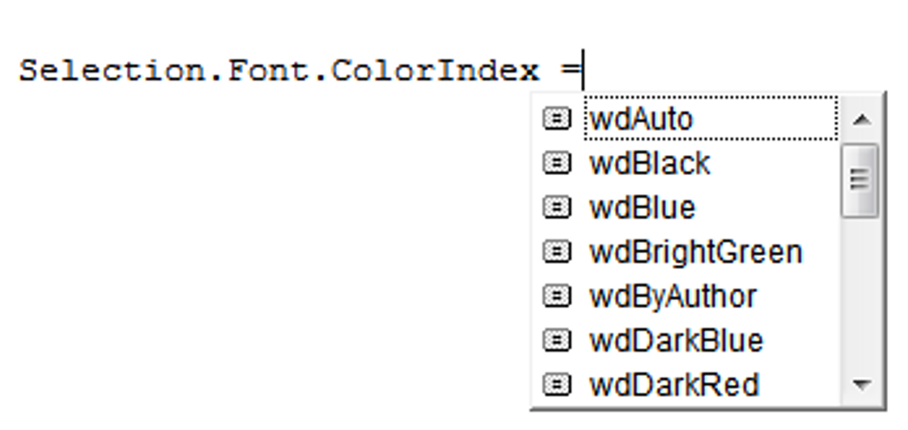
Seeing Color (And Under Line Options)
Use the ‘auto complete’ feature of VBA to view the options

Slide 41
Some Methods Of The Selection Object
ClearFormatting: removes all formatting effects (e.g. bold, italics)
TypeText: insert the specified text in the VBA program
Delete: deletes any selected text
EndKey: move the cursor to the end of the document (covered later in a large example)
HomeKey: move the cursor to the start of the document (covered later in a large example)
InsertFile: replace selection with text from the specified file
(covered in a later example)
Similar to how the method of ActiveDocument Object only affect the currently active document these Attributes/Properties may only take effect on the currently selected text (if there’s any).
Affects selected text: ClearFormatting, Delete
Does not require text to be selected: TypeText, EndKwy, HomeKey, InsertFile

Slide 42
Using Simple Methods Of The Selection Object
Name of the Word document containing the program: 11selectionMethod.docm
Try running it with and without some text selected
  Sub selectionObjectMethod()
  Selection.ClearFormatting
  Selection.TypeText ("My new replacement text")
  End Sub

Slide 43
Writing Text To Start/End
Name of the Word document containing the program: 12selectionHomeEndKey.docm
  HomeKey docs: https://msdn.microsoft.com/en-us/library/office/ff192384.aspx
  EndKey docs: https://msdn.microsoft.com/en-us/library/office/ff195593.aspx
  Sub selectionHomeEndKey()
  Const SONG_TITLE = "You're not here"
  Const SONG_LYRICIST = "Akira Yamaoka"
  Selection.HomeKey Unit:=wdStory
  Selection.TypeText (SONG_TITLE)
  Selection.EndKey Unit:=wdStory
  Selection.TypeText (SONG_LYRICIST)
  End Sub

Slide 44
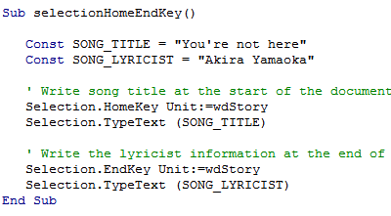
The Previous VBA Program: Application Of ‘Proximity’ (Spreadsheet section: C.R.A.P.)
Related parts of the program are grouped together
Each part is separated with whitespace

Slide 45
Inserting Text
Example files (must all be in the same folder)
13input1.docx
13input2.rtf
13input3.txt
Text input1
Text input2
Text input3
Word docm document (VBA program)

Slide 46
Automatically Inserting Text Into A Word Document
Name of the Word document containing the program: 13selectionInsertingText.docm
  Sub insertingText()
  Selection.InsertFile ("13input1.docx")
  Selection.InsertFile ("13input2.docx")
  Selection.InsertFile ("13input3.docx")
  End Sub

Slide 47
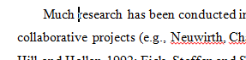

The Selection Object again
With a approaches if no text was selected then the program would produce no visible effect.
  Sub SelectedFontChange()
  Selection.Font.Bold = wdToggle
  End
The program could automatically select text for you “expanding” the selection.
  Sub AutoSelectedFontChange()
  Selection.Expand
  Selection.Font.Bold = wdToggle
  End Sub
Before
After

Slide 48
Constants For The Selection Object
Name of constant | Meaning of constant
wdSelectionIP | No text selected
wdSelectionNormal | Text (e.g., word, sentence) has been selected
wdSelectionShape | A graphical shape (e.g., circle, text book) has been selected
Application of these constants coming up on the next slide

Slide 49
The Selection Object And A Practical Application Of Branching
An example application of branching: check if a selection has been made and only apply the selection if that is the case.
  Checking if a condition is true
Word document containing the macro: “14selectionExample.docm”
  Sub checkSelection()
  If Selection.Type = wdSelectionIP Then
  MsgBox ("No text selected, nothing to change")
  Else
  Selection.Font.Bold = wdToggle 'wdToggle, constant
  End If
  End Sub

Slide 50
Applications Of Branching
Checking state
  IF(program is in some state) then
  Program reacts
  End
Example 1:
  If (Application.CapsLock = True) Then
  MsgBox ("Caution: Caps Lock is On!“)
  End If
Example 2:
  age = InputBox("Age: ")
  If (age < 0) Then
  MsgBox ("Age cannot be negative")
  End If

Slide 51
Applications Of Branching
Recall this example from earlier (tutorial)
Selection.Font.Bold = wdToggle
If no text is selected nothing happens but the user is not informed.
Modification of the program using IF-branches:
  Checking if text has been selected and if not displaying an error popup message.
Example 3:
If (Selection.Type = wdSelectionIP) Then
MsgBox ("No text selected, nothing to change")
Else
Selection.Font.Bold = wdToggle 'wdToggle, constant
End If
Constants for the Selection object
wdSelectionIP No text selected
wdSelectionNormal Text selected

Slide 52
Application Branching: Marking Program (If There Is Time)
Word document containing the macro: “15Marking program.docm”
Synopsis:
  The program spells checks the document
    Assume each document includes the name of the person in the file name
  If the number of errors meets a cut-off value then it’s a ‘fail’
  Otherwise it’s a pass
  The feedback is ‘written’ to the beginning of the document using a specific font and several font effects in order to stand out
    The message is customized with the person’s name at the beginning of the feedback

Slide 53
Marking Program
Sub MarkingForSpelling()
Dim totalTypos As Integer
Const MAX_TYPOS = 1
Dim currentDocument As String
Dim feedback As String
'Get Name of current document
currentDocument = ActiveDocument.Name
'Tally the number of typos
totalTypos = ActiveDocument.SpellingErrors.Count
'Feedback is prefaced by student(document) name
feedback = currentDocument & " marking feedback..."

Slide 54
Marking Program (2)
' HomeKey move to the home position (start of document)
Selection.HomeKey Unit:=wdStory
'Recall: before this feedback just = document name and
'an indication that feedback is coming
If (totalTypos > MAX_TYPOS) Then
feedback = feedback & ": Too many typographical errors:
Fail"
Else
feedback = feedback & ": Pass"
End If
' Chr(11) adds a newline (enter) to the end of feedback
feedback = feedback & Chr(11) & Chr(11)
' Alternative use the constant vbCr (VB cursor return)

Slide 55
Marking Program (3)
' Font effects to make the feedback stand out
Selection.Font.ColorIndex = wdRed
Selection.Font.Size = 16
Selection.Font.Name = "Times New Roman"
' Write feedback into the document
Selection.TypeText (feedback)
End Sub

Slide 56
Collection
An object that consists of other objects
  Real World example: a book consists of pages, a library consists of books
Example: The Documents collection will allow access to the documents that have been opened.
Access to a collection rather than the individual objects may be time-saving shortcut.
  Instead of manually closing all open documents this can be done in one instruction:
  Documents.close

Slide 57
Types Of Collections
Some Attributes/Properties of a document that return a collection.
    Documents: currently open documents
    Shapes: MS-Word shapes in a document (rectangles, circles etc.)
    InlineShapes: images (pictures inserted) into a Word document
    Tables: tables in a document
    E.g., ActiveDocument.Tables –accesses all the tables in your document
    ActiveDocument.Tables(1) –access to the first table in a document.
    Windows: briefly introduced at the start of this section of notes

Slide 58
Documents Collection For Printing: Multiple Documents
Printing all the documents currently open in MS-Word.
  Take care that you don’t run this macro if you have many documents open and/or they are very large!
  Word document containing the macro example: “16printMultipleDocumentst.docm”
  Sub PrintDocumentsCollection()
  Dim numDocuments As Integer
  Dim count As Integer
  numDocuments = Documents.count
  count = 1
  Do While (count <= numDocuments)
  Documents.Item(count).PrintOut
  count = count + 1
  Loop
  End Sub
Learning: another practical application of looping e.g., automatically open multiple documents, make changes, print and save them without user action needed

Slide 59
Accessing Shapes And Images (If There Is Time)
(VBA specific)
  Shapes (basic shapes that are drawn by Word)
  InlineShapes (images that are created externally and inserted into Word)
Both collections accessed via the ActiveDocument object:
  ActiveDocument.Shapes: access to all the shapes in the currently active Word document
    ActiveDocument.Shapes(<index>): access to shape #i in the document
  ActiveDocument.InlineShapes: access to all the images in the currently active Word document
    ActiveDocument.InlineShapes(<index>): access to image #i in the document

Slide 60
Example: Accessing Shapes And Images
  Word document containing the complete macro: “17accessingImagesFigures.docm”
  Dim numImages As Integer
  Dim numShapes As Integer
  numImages = ActiveDocument.InlineShapes.Count
  numShapes = ActiveDocument.Shapes.Count
  MsgBox ("Images=" & numImages)
  MsgBox ("Simple shapes=" & numShapes)

Slide 61
Example: Accessing Shapes And Images (2)
  ' Checks expected # images and alters first & third
  If (numImages = 4) Then
  ActiveDocument.InlineShapes(1).Height = _
  ActiveDocument.InlineShapes(1).Height * 2
  ActiveDocument.InlineShapes(3).Height = _
  ActiveDocument.InlineShapes(3).Height * 2
  End If
  ' Checks expected # shapes, alters 2nd & 6th
  ' Deletes the first shape
  If (numShapes = 6) Then
  ActiveDocument.Shapes(2).Width = _
  ActiveDocument.Shapes(2).Width * 4
  ActiveDocument.Shapes(6).Fill.ForeColor = vbRed
  ActiveDocument.Shapes(1).Delete
  End If

Slide 62
Nesting
Nesting refers to an item that is “inside of” (or “nested in”) some other item.
Recall from ‘spreadsheets’ nesting refers to an ‘IF-function’ that is inside of another ‘IF-function’
  Example (assume that the respondent previously indicated that his or her birthplace was an Alberta city)
  Select the AB city in which you were born
      Airdrie
      Calgary
      Edmonton
    …
    Selecting Airdrie excludes the possibility of selecting Calgary
    Cities listed later are ‘nested’ in earlier selections)
Nesting in programming (VBA) refers to IF-branches and Do-While loops that are inside of each other

Slide 63
Nesting
Nesting: one structure is contained within another
  Nested branches:
  If (Boolean) then
  If (Boolean) then
  ...
  End If
  End if
Branches and loops can be nested within each other
  Do while (Boolean) If (Boolean) then
  If (Boolean) then Do while (Boolean)
  ... ...
  End if Loop
  Loop
  Do while (Boolean)
  Do while (Boolean)
  ...
  Loop
  Loop

Slide 64
Recognizing When Nesting Is Needed
Scenario 1: A second question is asked if a first question answers true:
  Example: If it’s true the applicant is a Canadian citizen, then ask for the person’s income (checking if eligible for social assistance).
  Type of nesting: an IF-branch nested inside of another IF-branch
  If (Boolean) then
    If (Boolean) then
    ...
    End If
    End if
Q: Citizen?
F
T
Q: Low income?
F
T
Nested branch/IF
Can receive assistance
No assistance

Slide 65
Example #1: Nested IFs
Word document containing the example: 18nestingIFinsideIF.docm
  Sub nestedCase1()
  Dim country As String
  Dim income As Long
  Const INCOME_CUTOFF = 24000
  country = InputBox("What is your country of citizenship?")
  If (country = "Canada") Then
  income = InputBox("What is your income $")
  If (income <= INCOME_CUTOFF) Then
  MsgBox ("Citizenship: " & country & "; " & _
  "Income $" & income & _
  ": eligible for assistance")
  End If
  End If
  End Sub

Slide 66
Recognizing When Nesting Is Needed
F
Scenario 2A: As long some condition is met a question will be asked. As the question is asked if the answer is invalid then an error message will be displayed.
  Example: While the user entered an invalid value for age (too high or too low) then if the age is too low an error message will be displayed.
  Type of nesting: an IF-branch nested inside of a Do-While loop
  Do While (Boolean)
    If (Boolean) then
    ...
    End If
    Loop
Q: As long invalid value?
T
Q: Invalid?
F
T
Display error
Prompt for value
Done

Slide 67
Example 2A: IF Nested Inside A Do-While
Word document containing the example: 19nestingIFinsideWHILE.docm
  Sub nestedCase2A()
  Dim age As Long
  Const MIN_AGE = 1
  Const MAX_AGE = 118
  age = InputBox("How old are you (1-118)?")
  Do While ((age < MIN_AGE) Or (age > MAX_AGE))
  If (age < MIN_AGE) Then
  MsgBox ("Age cannot be lower than " & _
  MIN_AGE & " years")
  End If
  age = InputBox("How old are you (1-118)?")
  Loop
  MsgBox ("Age=" & age & " is age-okay")
  End Sub

Slide 68
Recognizing When Nesting Is Needed
F
Scenario 2B: If a question answers true then check if a process should be repeated.
  Example: If the user specified the country of residence as Canada then repeatedly prompt for the province of residence as long as the province is not valid.
  Type of nesting: a Do-While loop nested inside of an IF-branch
    If (Boolean) then
    Do While (Boolean)
    ...
    Loop
    End If
Q:Canada?
T
Prompt for province
Q: Province Invalid?
F
T
Prompt for province
Done

Slide 69
Example 2B: Do-While Nested Inside An IF
Word document containing the example: 20nestingWHILEinsideIF.docm
  Dim country As String
  Dim province As String
  country = InputBox("What is your country of citizenship?")
  If (country = "Canada") Then
  province = InputBox("What is your province of " & _
  "citizenship?")
  Do While ((province <> "AB") And (province <> "BC"))
  MsgBox ("Valid provinces: AB, BC")
  province = InputBox("What is your province of" & _
  " citizenship?")
  Loop
  End If
  MsgBox ("Country: " & country & ", " & "Province: " & _
  " province)

Slide 70
Recognizing When Nesting Is Needed
F
Scenario 3: While one process is repeated, repeat another process.
  More specifically: for each step in the first process repeat the second process from start to end
  Example: While the user indicates that he/she wants to calculate another tax return prompt the user for income, while the income is invalid repeatedly prompt for income.
  Type of nesting: a Do-While loop nested inside of an another Do-While loop
    Do While (Boolean)
    Do While (Boolean)
    ...
    Loop
    Loop
Q:Another tax return?
T
Prompt for Income
Q: Income Invalid?
F
T
Prompt for Income
Done

Slide 71
Example #3: Do-While Nested Inside Another Do-While
Word document containing the example: 21nestingWHILEinsideWHILE.docm
  Dim runAgain As String
  Dim income As Long
  Const MIN_INCOME = 0
  runAgain = "yes"
  Do While (runAgain = "yes")
  MsgBox ("CALCULATING A TAX RETURN")
  income = -1
  Do While (income < MIN_INCOME)
  income = InputBox("Income $")
  Loop
  runAgain = InputBox("To calculate another return" & _
  " enter yes")
  Loop
  a

Slide 72
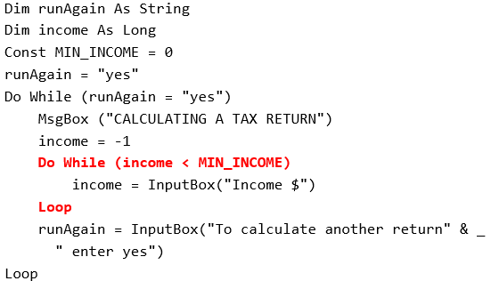
Application Of Alignment (C.R.A.P.): Nesting
Allows program structure (nesting levels) to be easily determined:
  What statements execute as which body

Slide 73
Example: Nesting
Write a program that will count out all the numbers from one to six.
For each of the numbers in this sequence the program will determine if the current count (1 – 6) is odd or even.
  The program display the value of the current count as well an indication whether it is odd or even.
Which Step (#1 or #2) should be completed first?

Slide 74
Step #1 Solution
  Sub nesting()
  Dim counter As Long
  counter = 1
  Do While (counter <= 6)
  counter = counter + 1
  Loop
  End Sub

Slide 75
Step #1 Completed: Now What?
For each number in the sequence determine if it is odd or even.
This can be done with the modulo (remainder) operator: MOD
  An even number modulo 2 equals zero (2, 4, 6 etc. even divide into 2 and yield a remainder or modulo of zero).
  If (counter MOD 2 = 0) then 'Even
  An odd number modulo 2 does not equal zero (1, 3, 5, etc.)
Pseudo code visualization of the problem
  Loop to count from 1 to 6
  Determine if number is odd/even and display message
  End Loop
  Determining whether a number is odd/even is a part of counting through the sequence from 1 – 6, checking odd/even is nested within the loop

Slide 76
Step #2 Solution
  Sub nesting()
  Dim counter As Long
  counter = 1
  Do While (counter <= 6)
  If (counter Mod 2 = 0) Then
  MsgBox ("Even: " & counter)
  Else
  MsgBox ("Odd: " & counter)
  End If
  counter = counter + 1
  Loop
  End Sub

Slide 77
Accessing Tables (If There Is Time)
The tables in the currently active Word document can be made through the ActiveDocument object:
  ActiveDocument.Tables: accesses the ‘tables’ collection (all the tables in the document).
  ActiveDocument.Tables(<integer ‘i’>): accesses table # i in the document
  ActiveDocument.Tables(1).Sort: sorts the first table in the document (default is ascending order)

Slide 78
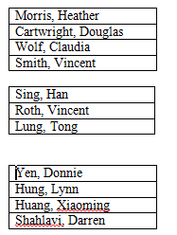
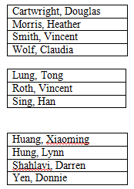
Simple Example: Sorting Three Tables
Instructions needed for sorting 3 tables
  ActiveDocument.Tables(1).Sort
  ActiveDocument.Tables(2).Sort
  ActiveDocument.Tables(3).Sort
Before
After

Slide 79
Previous Example
Critique of the previous approach: the program ‘worked’ for the one document with3 tables but:
  What if there were more tables (cut and paste of the sort instruction is wasteful)?
  What if the number of tables can change (i.e., user edits the document)
Notice: The process of sorting just repeats the same action but on a different table.
  ActiveDocument.Tables(1).Sort
  ActiveDocument.Tables(2).Sort
  ActiveDocument.Tables(3).Sort
Looping/repetition can be applied reduce the duplicated statements

Slide 80
Revised Example: Sorting Tables With A Loop
  Word document containing the complete macro: “22sortingTables.docm”
  Dim CurrentTable As Integer
  Dim NumTables As Integer
  NumTables = ActiveDocument.Tables.Count
  If NumTables = 0 Then
  MsgBox ("No tables to sort")
  Else
  CurrentTable = 1
  Do While (CurrentTable <= NumTables)
  MsgBox ("Sorting Table # " & CurrentTable)
  ActiveDocument.Tables(CurrentTable).Sort
  CurrentTable = CurrentTable + 1
  Loop
  End If

Slide 81
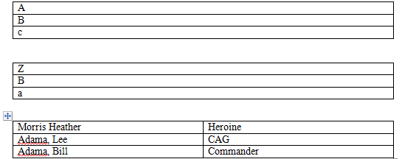
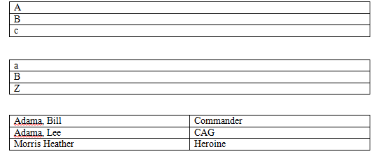
Result: Sorting Tables
Before
After

Slide 82


More On Sort
A handy parameter that can be used to configure how it runs.
Format
  Sort (<Boolean to Exclude header – True or False>)
Example
  ActiveDocument.Tables(CurrentTable).Sort(True)
  Before
  After

Slide 83
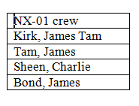
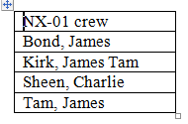
Second Sorting Example: Exclude Headers
Before
Document containing the macro: “23sortingTablesExcludeHeader.docm”
  Dim CurrentTable As Integer
  Dim NumTables As Integer
  NumTables = ActiveDocument.Tables.Count
  If NumTables = 0 Then
  ' Don't bother sorting
  MsgBox ("No tables to sort")
  Else
  CurrentTable = 1
  Do While (CurrentTable <= NumTables)
  MsgBox ("Sorting Table # " & CurrentTable)
  ActiveDocument.Tables(CurrentTable).Sort (True)
  CurrentTable = CurrentTable + 1
  Loop
  End If
After

Slide 84
The DIR Function
It can be used to go through all the documents in a folder (this will be illustrated gradually in advanced examples but the first one will be rudimentary and only access single documents)
It can access sub-folders and sub-sub folders of a folder (very advanced use: well beyond the scope of the this course)
Basic use: this function takes as inpu a location (e.g., C:\temp\) and a filename as an argument and it determines if the file exists at the specified location.
  If the file is found at this location then the function returns the name of the file.
  If the file is not found at this location then the function returns an empty string (zero length)
  Getting the file name can then allow that document to be opened

Slide 85
Simple Use Of The DIR Function
Contents of folder “dirExample1”
  Word document containing the macro example: 24DIRFunctionSimple.docm
Dim location As String
Dim filename As String
Dim result As String
location = "C:\temp\203\dirExample1\"
result = Dir(location)
MsgBox (result)
filename = "Doc1.docx"
result = Dir(location & filename)
MsgBox (result)
result = Dir(location & "*.xls*")
MsgBox (result)
a.xlsx
b.Xls
Doc1.docx
Output of the message boxes:
a.xlsx
Doc1.docx
a.xlsx

Slide 86
Example: Using Dir To Check If File Exists (2)
  Word document containing the macro example: 25DIRFunctionIntermediate.docm
    Sub openExistingDocument()
    Dim filename As String
    Dim checkIfExists As String
    Dim last As Integer
    filename = InputBox ("Enter the path and name of file to
    open e.g., 'C:\temp\tam.docx'")
    ' Error case: nothing to open, user entered no info
    If (filename = "") Then
    MsgBox ("You entered a blank file name")

Slide 87
Example: Using Dir To Check If File Exists (3)
    ' No error: non-empty info entered
    Else
    checkIfExists = Dir(filename)
    If (Len(checkIfExists) = 0) Then
    MsgBox ("File does not exist the specified
    location" & filename)
    Else
    MsgBox ("File exists opening")
    Documents.Open (filename)
    End If
    End If
    End Sub

Slide 88
Practical Use Of Dir: Access Each File In A Directory
  Word document containing the macro example: 26loopFolder.docm
      Dim directoryPath As String
      Dim currentFile As String
      directoryPath = "C:\temp\203\dirExample2\"
      currentFile = Dir(directoryPath)
      If (currentFile = "") Then
      MsgBox ("No files in directory: " & directoryPath)
      End If
      Do While (currentFile <> "")
      MsgBox (currentFile) ' Display file name in popup
      currentFile = Dir ' Move onto next document in folder
      Loop

Slide 89
Alternate Version: Access Only Word Documents
  Word document containing the macro example: 27loopWordFolder.docm
    Sub openAllWordDocumentsInFolder()
    Dim directoryPath As String
    Dim currentFile As String
    directoryPath = "C:\temp\203\dirExample3\"
    currentFile = Dir(directoryPath & "*.doc*")
    If (currentFile = "") Then
    MsgBox ("No Word documents in location " &
    directoryPath)
    End If
    Do While (currentFile <> "")
    MsgBox ("Opening " & currentFile)
    Documents.Open (directoryPath & currentFile)
    currentFile = Dir
    Loop
    End Sub

Slide 90
Applying Many Of The Previous Concepts In A Practical Example & Linking Documents And (If There’s Time)
As you are aware different programs serve different purposes:
  Database: storing and retrieving information
  Spreadsheet: performing calculations, displaying graphical views of results
  Word processor: creating text documents with many features for formatting and laying out text
VBA allows the output of one program to become the input of another program.
  Although this can be done ‘manually’ (reading the documents and typing in changes) if the dataset is large this can be a tedious and error-prone process
  VBA can be used to automate the process

Slide 91
Processing All Documents In A Folder: Overview
Overview of the process (may be very helpful for the assignment)
    While (There are unprocessed documents in folder)
    Open next unprocessed document
    ‘ (This opened document becomes the active document)
    Process the active document
    Move onto the next document

Slide 92
Processing All Documents In A Folder: VBA Program
JT’s note: this is one of the more complete examples to use as a guide for your solution to the final feature of A3
Word document containing the macro: “28processAllFolderWordDocuments.docm”
  Sub processFolderDocuments()
  Const FOLDER_PATH As String = "C:\temp\203\dirExample3"
  Dim currentFile As String
  Dim wordCount As Long
  currentFile = Dir(FOLDER_PATH & "*.doc*")
  Do While (currentFile <> "")
  Documents.Open (FOLDER_PATH & currentFile)
  wordCount = ActiveDocument.Words.count
  MsgBox (currentFile & "# words in doc " & wordCount)
  currentFile = Dir
  Loop
  End Sub

Slide 93
Processing All Documents In A Folder: VBA Program
1) Get’s name of 1st document, specifies that only Word2003- (doc) or Word 2007+ (docx) will be opened
Word document containing the macro: “28processAllFolderWordDocuments.docm”
  Sub processFolderDocuments()
  Const FOLDER_PATH As String = "C:\temp\203\dirExample3"
  Dim currentFile As String
  Dim wordCount As Long
  currentFile = Dir(FOLDER_PATH & "*.doc*")
  Do While (currentFile <> "")
  Documents.Open (FOLDER_PATH & currentFile)
  wordCount = ActiveDocument.Words.count
  MsgBox (currentFile & "# words in doc " & wordCount)
  currentFile = Dir
  Loop
  End Sub
2) Using the name of the Word document open it (add to the Documents collection)
3) The newly opened Word document becomes the currently active document
4) Get the name of the next document (Word because #1 specified only Word documents)

Slide 94
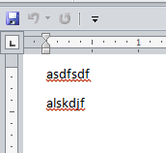
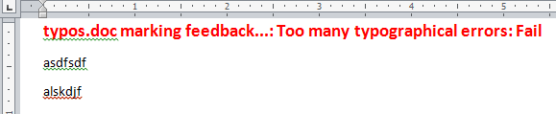
Revised Marking Program (If There Is Time)
Word document containing the macro: “29markAllFolderDocuments.docm”
  Sub markAllFolderDocuments()
  Const MAX_TYPOS = 1
  Const LARGER_FONT = 14
  Dim directoryPath As String
  Dim currentFile As String
  Dim totalTypos As Integer
  Dim feedback As String

Slide 95
Revised Marking Program (2)
  directoryPath = InputBox("Location and name of folder
  containing assignments (e.g., C:\grades\")
  currentFile = Dir(directoryPath & "*.doc*")
  If (directoryPath = "") Then
  MsgBox ("No Word documents in specified folder,
  looking in default location C:\Temp\")
  directoryPath = "C:\Temp\"
  End If

Slide 96
Revised Marking Program (3)
e.g. Feedback for “Typos.docx” = “Typos marking feedback…”
  Do While (currentFile <> "")
  Documents.Open (directoryPath & currentFile)
  currentDocument = ActiveDocument.Name
  totalTypos = ActiveDocument.SpellingErrors.Count
  feedback = currentDocument & " marking feedback..."
  Selection.HomeKey Unit:=wdStory
  If (totalTypos > MAX_TYPOS) Then
  feedback = feedback & ": Too many typographical
  errors: Fail"
  Else
  feedback = feedback & ": Pass"
  End If
  feedback = feedback & vbCr
  Selection.Text = feedback
  ' Loop body continued on next page
e.g. Feedback for “Typos.docx” = “typos.doc marking feedback...: Too many typographical errors: Fail”

Slide 97
Revised Marking Program (4)
  ' Loop body continued from previous page
  With Selection.Font
  .Bold = True
  .Size = LARGER_FONT
  .ColorIndex = wdRed
  End With
  ActiveDocument.Close (wdSaveChanges)
  currentFile = Dir
  Loop
  End Sub

Slide 98
Example Problem
Financial statements (monetary data) about many companies can be stored in a spreadsheet where an analysis can be performed e.g. does the company have enough $$$ on hand to meet its financial commitments.
This information can be read into a VBA program which can further evaluate the data.
The results can be presented in Word using the numerous text formatting features to highlight pertinent financial information.
Names of the documents used in this example:
  FNCE.xlsx (contains the financial data: program input)
  30spreadSheetAnalyzer.docm (contains the VBA program as well as the presentation of results: program output)

Slide 99
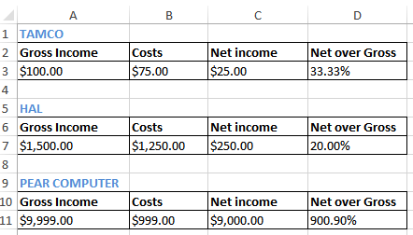
Spread Sheet Analyzer
  Sub spreadsheetAnalyzer()
  Const MIN_INCOME = 250
  Const MIN_RATIO = 25
  Const PERCENT = 100
  Dim company1 As String
  Dim income1 As Long
  Dim ratio1 As Long
  Dim company2 As String
  Dim income2 As Long
  Dim ratio2 As Long
  Dim company3 As String
  Dim income3 As Long
  Dim ratio3 As Long
  Dim comment1 As String
  Dim comment2 As String
  Dim comment3 As String
TAMCO: 33%
HAL: Net income $250
PEAR COMPUTER: Net income $9000, 901% <== BUY THIS!

Slide 100
Spread Sheet Analyzer (2)
Object =
Type for any MS-Office variable
https://msdn.microsoft.com/
Dim excel As Object
Set excel = CreateObject("excel.application")
excel.Visible = True
Dim workbook
Dim location As String
location = InputBox("Path and name of spreadsheet e.g.
C:\Temp\FNCE.xlsx")
Set workbook = excel.workbooks.Open(location)

Slide 101
Spread Sheet Analyzer (2)
Object =
Type for any MS-Office variable
https://msdn.microsoft.com/
Dim excel As Object
Set excel = CreateObject("excel.application")
excel.Visible = True
Dim workbook
Dim location As String
location = InputBox("Path and name of spreadsheet e.g.
C:\Temp\FNCE.xlsx")
Set workbook = excel.workbooks.Open(location)

Slide 102
Spread Sheet Analyzer (3)
' Get company names
company1 = excel.Range("A1").Value
company2 = excel.Range("A5").Value
company3 = excel.Range("A9").Value
' Get net income and ratio
income1 = excel.Range("C3").Value
ratio1 = excel.Range("D3").Value * PERCENT
income2 = excel.Range("C7").Value
ratio2 = excel.Range("D7").Value * PERCENT
income3 = excel.Range("C11").Value
ratio3 = excel.Range("D11").Value * PERCENT
' Move the selection to the top of the Word document
Selection.HomeKey Unit:=wdStory

Slide 103
Spread Sheet Analyzer (4): First Company
TAMCO: 33%
comment1 = company1 & ": "
If (income1 >= MIN_INCOME) Then
comment1 = comment1 & "Net income $" & income1
Selection.Font.Color = wdColorRed
Selection.TypeText (comment1)
If (ratio1 >= MIN_RATIO) Then
comment1 = ", " & ratio1 & "% <== BUY THIS!"
Selection.Font.Color = wdColorBlue
Selection.TypeText (comment1)
End If
Selection.TypeText (vbCr)
Else
If (ratio1 >= MIN_RATIO) Then
comment1 = comment1 & ratio1 & "%" & vbCr
Selection.Font.Color = wdColorBlue
Selection.TypeText (comment1)
End If
End If

Slide 104
Spread Sheet Analyzer (5): Second Company
HAL: Net income $250
comment2 = company2 & ": "
If (income2 >= MIN_INCOME) Then
comment2 = comment2 & "Net income $" & income2
Selection.Font.Color = wdColorRed
Selection.TypeText (comment2)
If (ratio2 >= MIN_RATIO) Then
comment2 = ", " & ratio2 & "% <== BUY THIS!"
Selection.Font.Color = wdColorBlue
Selection.TypeText (comment2)
End If
Selection.TypeText (vbCr)
Else
If (ratio2 >= MIN_RATIO) Then
comment2 = comment2 & ratio2 & "%" & vbCr
Selection.Font.Color = wdColorBlue
Selection.TypeText (comment2)
End If
End If

Slide 105
Spread Sheet Analyzer (6): Third Company
PEAR COMPUTER: Net income $9000, 901% <== BUY THIS!
comment3 = company3 & ": "
If (income3 >= MIN_INCOME) Then
comment3 = comment3 & "Net income $" & income3
Selection.Font.Color = wdColorRed
Selection.TypeText (comment3)
If (ratio3 >= MIN_RATIO) Then
comment3 = ", " & ratio3 & "% <== BUY THIS!"
Selection.Font.Color = wdColorBlue
Selection.TypeText (comment3)
End If
Selection.TypeText (vbCr)
Else
If (ratio3 >= MIN_RATIO) Then
comment3 = comment3 & ratio3 & "%" & vbCr
Selection.Font.Color = wdColorBlue
Selection.TypeText (comment3)
End If
End If

Slide 106
After This Section You Should Now Know
Objects
  Properties/attributes vs. methods
Using common properties/attributes and methods of the following objects
  Application
  ActiveDocument
  Selection
What is a named constant, why use them (benefits)
What is a predefined named constant and what are some useful, commonly used predefined constants
Naming conventions for constants

Slide 107
After This Section You Should Now Know (2)
Collections
  What are they
  What is the advantage in using them
  Common examples found in Word documents
Using common collections in VBA
  Documents
  Shapes
  InLineShapes
  Tables
  Windows

Slide 108
After This Section You Should Now Know (3)
Nesting:
  IF within an IF
  Do-While within an IF, IF within a Do-While
  A Do-While within a Do-While
  Writing and tracing/nested structures
  When to apply nesting

Slide 109
After This Section You Should Now Know (4)
How to use the ‘Dir’ function to access a folder
  Using this function to step through all the documents or specific types of documents in a folder
  Also includes using the ‘Len’ function to check the length of filename and location path (String)
Accessing other types of MS-Office programs with an VBA program written for Word

Slide 110
Copyright Notice
Unless otherwise specified, all images were produced by the author (James Tam).

