Slide 1
Databases, Part II: Retrieving Information
In this section you will learn about how information can be retrieved via queries.
  Online MS-Office information source: https://support.office.com/

Slide 2
Reminder: Purpose Of A Database
To retrieve information information
Sale $$$
Sale $$$
Database: Customer information

Slide 3

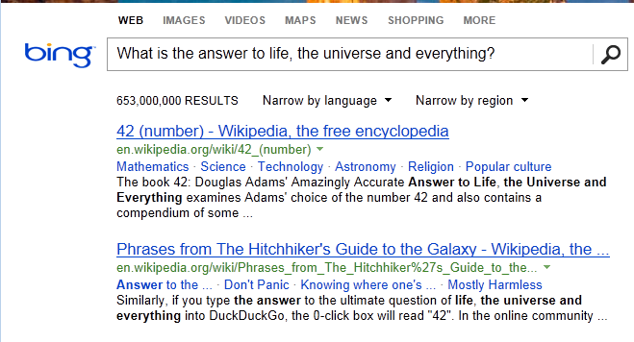
Database Queries
Queries are questions ‘asked’ of/to the database in order to retrieve information.
“What is the answer to life, the universe and everything”
– The Hitchhiker's Guide to the Galaxy (Del Rey 1979)
– The Hitchhiker’s Guide to the Galaxy (BBC 1981)

Slide 4
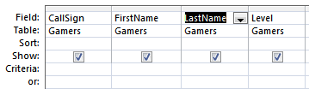
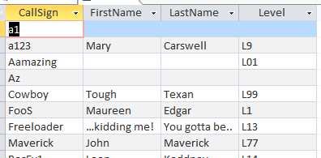
Retrieving Data Via Queries
Data retrieval occurs through the use of ‘queries’:
  As mentioned: A query is a question asked of the data in the database.
  May be worded to show only the parts of the database for which the answer to the question is true OR it be worded to just show the values of the attributes specified in the query
  Example: What is the CallSign, FirstName, LastName and Level of gamers in the Gamers Table:
Query (this graphical form is an Access specific)
Result of the query

Slide 5
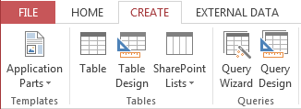
Forming Queries Graphically In Access
Create->Query Design

Slide 6
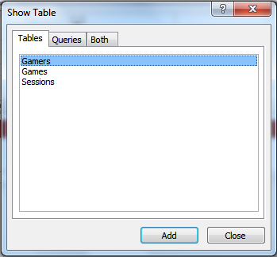
Forming Queries Graphically In Access (2)
Select a table or tables (whose attributes will be displayed in the query)

Slide 7
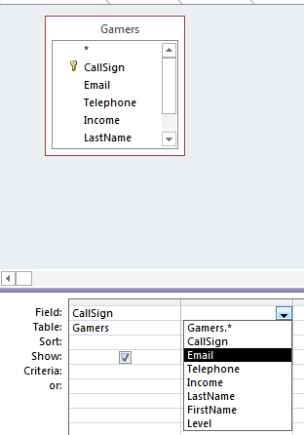
Forming Queries Graphically In Access (3)
Select the attributes of the table

Slide 8
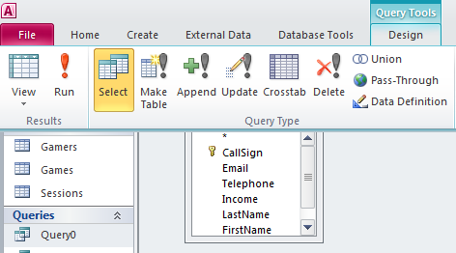
Forming Queries Graphically In Access (4)
Run the query to view the results: Design->Run

Slide 9
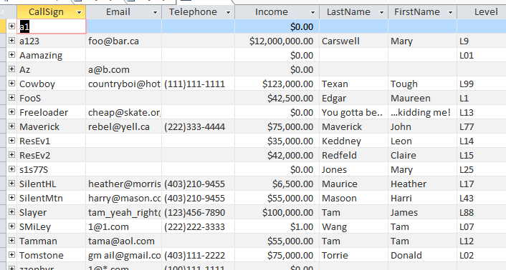

Query #1: Specifying Query Criteria
  What is the CallSign & Email & and FirstName, LastName of all gamers with the last name of Tam?
{
}
{
}

Slide 10
SQL (Structured Query Language)
It’s the universal language for querying a database (very widely used!)
Unlike graphical queries the statements can be used in different database programs (not just Access)
Queries are formed using text descriptions (can be more powerful but more complex than graphical queries):
  SELECT: Specifies the relevant attributes of which tables are involved in the query e.g., CallSign attribute of the Gamers table
  FROM: Lists the tables from which the data is to be selected
  WHERE: Provides the conditions to determine if a particular row shows or doesn’t show as a query result
  ORDER BY: Specifies the order in which rows are to be returned;
Note: Capitalizing of the above four words is a standard SQL convention.

Slide 11
Simple SQL Queries: Generic Format
SELECT: <Table name¹>.<Attribute name¹>, <Table name¹>.<Attribute name¹>….
FROM: <Table name¹>, <Table name¹>… <Table name¹>
1 Only include the tables and attributes that will actually be displayed in the query results

Slide 12
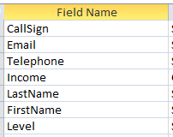
Example SQL Query
  Example: What is the CallSign, FirstName, LastName and Level of every gamer in the Gamers Table:
  Graphical Access query:
  SQL:
    SELECT Gamers.CallSign, Gamers.FirstName,
    Gamers.LastName, Gamers.Level
    FROM Gamers;
Note: not all attributes specified in the query

Slide 13
CPSC 203: What You Need To Know About Forming Queries
You need to know how to form and evaluate/trace queries (determine what will appear when the query is run) graphically (“Query Design”) or using SQL for both the assignment and for the examination component.

Slide 14


Query #1B: Using An Attribute In Query Condition But Not Displayed As A Result
Previous Example:
  What is the CallSign & Email & and FirstName, LastName of all gamers with last name of Tam?
  I know all gamers displayed in the results will have ‘Tam’ for a last name (why display obvious information)

Slide 15
Calculated Values
In Access they are attributes /columns of the query that are derived from one or more attributes/columns of the tables used in the query
GAMES Table
Title | RatePerMinute
TheTams | $0.33
(In the query this value is derived from the hourly rate)
RatePerMinute = HourlyRate / 60

Slide 16

Specifying Calculated Values (Access Specific)
Graphically (MS-Access via DesignView)
  Format:
  <Query column name>:
  <[Attribute name] or constant> <expression>
  <[Attribute name] or constant> <expression>...
  <[Attribute name] or constant>
  Example:
  RatePerMinute: [HourlyRate] / 60

Slide 17
Specifying Calculated Values (SQL)
  Format:
  SELECT <Table name.Attribute name¹>,
  <Table name.Attribute name²>, ...
  <[Attribute name] or constant> <expression>
  <[Attribute name] or constant> <expression> ...
  <[Attribute name] or constant> AS <Query column name>
  <Table name.Attribute name^{n}>
  Example:
SELECT Games.Title, Games.HourlyRate, [HourlyRate]/60 AS RatePerMinute

Slide 18
Query #2: Calculated Values
Show the Title, HourlyRate, RatePerMinute of the games in our system.
  Note:
    A more useful and realistic query would calculate the cost of each gaming session as a gamer plays a game.
    That would involve querying multiple tables (Games and Sessions) which is more complex so that query will be formed later in this section of notes.
Back to the basic query: A conversion is needed
  Cost for playing a game is cost/hour
  Calculation needed for the missing information:
    CostPerMinute = CostPerHour / 60

Slide 19

Query # 2: Graphical Access Query (DesignView)
“Calculated Values” were used: The results of some columns were not stored in tables but derived only as the query is run from the values in other columns.
RatePerMinute:
[HourlyRate] / 60

Slide 20

Query #2: SQL Form And The Graphical DesignView
SELECT Games.Title, Games.HourlyRate, [HourlyRate]/60 AS RatePerMinute
FROM Gamers;

Slide 21
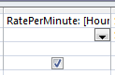
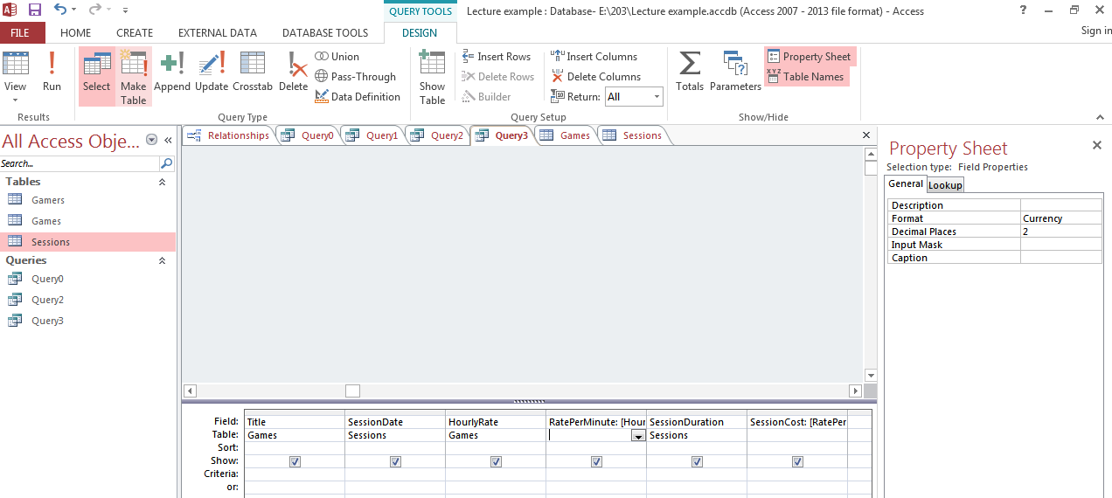
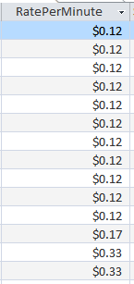
Access: Cleaning Up The Results
Select the attribute
Ribbon: Select the design tab,
  Select the property sheet option

Slide 22
Logical Operators
Operation | Description | MS-Access operator
AND | All conditions must be true for the result to be true. If any condition is false then the entire result is false. | And
OR | All conditions must be false for the result to be false. If any condition is true then the entire result is true. | Or

Slide 23

Relational Operators
Operator | Description
< | Less than
<= | Less than , equal to
> | Greater than
>= | Greater than, equal to
= | Equal to
<> | Not equal to

Slide 24
SQL: The ‘Where’ Clause
SELECT: Specifies the relevant attributes of which tables are involved in the query e.g., CallSign attribute of the Gamers table
FROM: Lists the tables from which the data is to be selected
WHERE: Provides the conditions to determine if a particular row appears in the query results
Format
  WHERE: <Boolean expression> <logic operator>
  <Boolean expression>
Examples:
  WHERE: Client.Age >= 0 AND Client.Age <= 114
  WHERE: Client.LastName = "Tam"

Slide 25

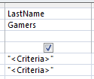
Query #3: Logical-OR
Show the CallSign, LastName & FirstName of all employees whose last name is “Maurice” or “Masoon”.
Note that query criteria specified within a column will have the logical OR operation applied.

Slide 26
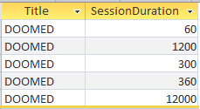
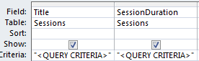
Query #4: Logical-AND
Show all online sessions of the game title “DOOMED” which had a session lasting an hour or more.
Note that query criteria specified between columns will have the logical AND operation applied to them.

Slide 27
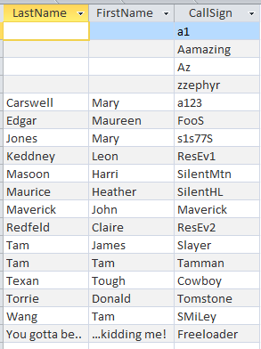
Ordering Queries
Query results can be ranked according to the attributes of a table.

Slide 28

Query #5: Ordering Queries
Show the CallSign, LastName and FirstName of all the gamers in ascending order sorted first by last name, then by first name and finally by call sign.
Use the “SORT” property (MS-Access) “ORDER BY” property (SQL example is on the next slide)

Slide 29
Ordering Queries: SQL Format
Generic format:
  ORDER BY <Table name¹>.<Attribute name¹>, <Table name¹>.<Attribute name¹>... <Table name¹>.<Attribute name¹>
Example:
  ORDER BY Students.LastName, Students.FirstName, Students.MiddleName
1 Only include attributes under the ‘ORDER BY’ clause that are involved in the ranking or ordering of query results
Example (rank only according by last name in this example)
SELECT Students.LastName, Students.FirstName, Students.MiddleName
From Students
ORDER BY: Students.LastName;

Slide 30
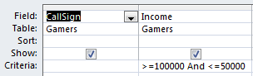

Query #6A: Contradictory Conditions
Take care not to specify queries that can never be true!
Example:
  Show the CallSign and Income of all gamers with an income $50,000 or lower AND $100,000 or higher.
SELECT Gamers.CallSign, Gamers.Income
FROM Gamers
WHERE (Gamers.Income >=100000 And
Gamers.Income
<=50000);

Slide 31
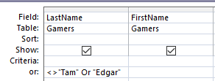
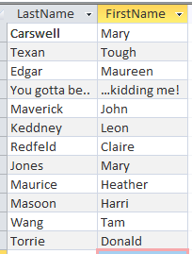
Query 6B: Queries That Are Always True
Example:
  What if the previous example to exclude gamers with a last name of “Tam” as well as “Edgar” used the logical-OR operator instead of the logical-AND operator.
Results:
SELECT Gamers.LastName, Gamers.FirstName
FROM Gamers
WHERE ((Gamers.LastName<>"Tam") Or (Gamers.LastName<>"Edgar");

Slide 32
Queries 7{A-D}: Using The Wildcard In Queries
Similar to validation rules, the wild card can be used in queries when only partial information is known.
Example: last name schwar*
Use the wildcard in conjunction with the ‘Like’ operator under ‘Criteria’ (MS-Access) or ‘Where’ & Like (SQL)

Slide 33
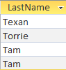



Wild Card: Example Queries
Show last name when LastName begins with ‘t’
Show first and last name when FirstName ends with ‘m’
SELECT Gamers.LastName
FROM Gamers
WHERE
(Gamers.LastName Like "t*");
SELECT Gamers.FirstName, Gamers.LastName
FROM Gamers
WHERE
(Gamers.FirstName Like "*m");

Slide 34
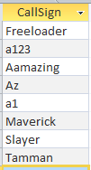

Wild Card: Example Queries (2)
Show the call sign when there’s an ‘a’ anywhere (call sign).
SELECT Gamers.CallSign
FROM Gamers
WHERE
(Gamers.CallSign Like "*a*");

Slide 35

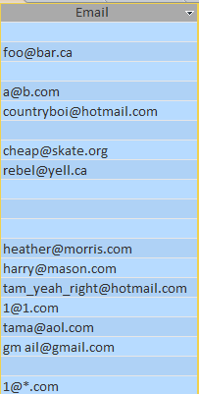

Single Character Wildcard ‘?’
Show .com emails with only a single character between the ‘@’ and the ‘.com’
(Any number of characters before the at-sign)
Query design
Table to query:
SELECT Gamers.Email
FROM Gamers
WHERE
(Gamers.Email Like
"*@?.com");
Query results:

Slide 36
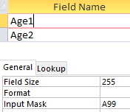
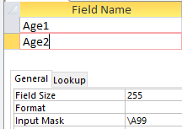

Input Masks: The Slash And The Query
There’s a separate database example to illustrate: “Extra database - input mask and queries”
Recall: input mask in the design view
In the Datasheet (data entry) view the ‘A’ character is displayed with the rest of the attribute data

Slide 37

Exported Table: Excel Spreadsheet
As can be seen the actual data (easiest to see when the database is exported to Excel) the ‘A’ following the slash is not actually stored (“Age2” attribute)

Slide 38


Query Results: age1
The data in ‘age1’ can be queried with ‘a’ is part of the attribute
DesignView of query
Query results: filtering to show values in attribute ‘Age1’ that start with ‘A’

Slide 39


Query Results: age2
The data in ‘age2’ DOES NOT include ‘a’ as part of the attribute.
Querying for this data ‘a’ will produce no results (i.e. proof that no values in attribute ‘Age2’ contain a leading ‘A’)
DesignView of query
Query results

Slide 40
Queries Can Span Multiple Tables
This is referred to as a ‘join’ because the results join data from multiple tables
Generic format of multi-table queries
  SELECT: <Table name>.<Attribute name>, <Table name>.<Attribute name>….
  FROM: <Table name> INNER JOIN <Table name>…INNER JOIN <Table name> ON <Table name>.<Primary key> = <Table name>.<Foreign key>... <Table name>.<Primary key> = <Table name>.<Foreign key>

Slide 41
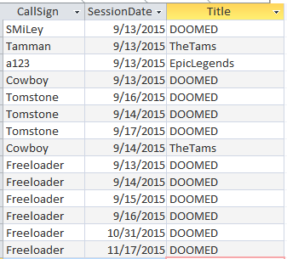
Query #8: Simple Multi-Table Query
What is the: Title (Games), HourlyRate (Games) and Date (Sessions) of games that were actually played.
  A gamer must have played at least one game (created a game session)

Slide 42
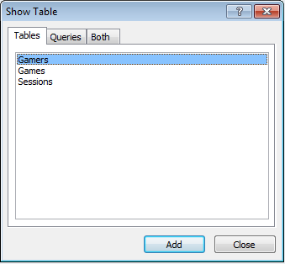

Query #8: Simple Multi-Table Query In Access
Add the desired tables to the query
Select the attributes of these tables relevant to the query

Slide 43
Query #8: SQL
We will create it ‘live’ in lecture to show you how to form a multi-table query.
  That is: take notes so you are more likely to learn and remember how to form a multiple table query for the exam.

Slide 44

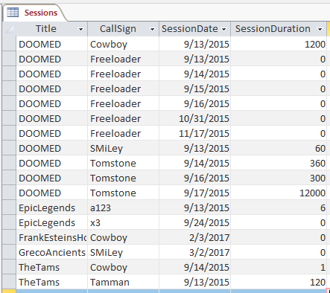
Query #9: Complex Multi-Table Queries
What is the: CallSign (Gamers), Income (Gamers), Title (Games) and Date (Sessions) of games that were played by gamers whose income was $100,000 or greater .
  First restriction: gamers with 6 figure incomes
‘Big money’ gamers that have actually played a game: a123, Cowboy
Note: ‘Slayer’ has never played a game

Slide 45

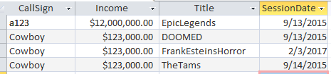
Query #9: Complex Multi-Table Queries (Access)
Forming the query (graphically in Access)
Query results

Slide 46
Query #9: Complex Multi-Table Queries (Building SQL With Reduced Bracketing)
SELECT Gamers.CallSign, Gamers.Income, Games.Title, Sessions.SessionDate
FROM: <Table name> INNER JOIN <Table name>…
FROM Games INNER JOIN Gamers INNER JOIN Sessions
  …ON Table name>.<Primary key> = <Table name>.<Foreign key>... <Table name>.<Primary key> = <Table name>.<Foreign key>
ON Gamers.CallSign = Sessions.CallSign)
ON Games.Title = Sessions.Title
WHERE Gamers.Income >=100000;

Slide 47
Query #10: Putting Multiple Things Together (Multi-Table Query Using Calculated Values)
Remember an earlier query that introduced calculated values (simple but not very practical)
  SELECT Games.Title, sGames.HourlyRate, [HourlyRate]/60 AS RatePerMinute
The new query illustrates the following concepts: calculated values, multi-table queries.
  Show the Title (Games), SessionDate (Sessions), HourlyRate (Games), RatePerMinute, SessionDuration (Sessions) and the SessionCost of games that were played.

Slide 48
Again Recall Query # 2: Graphical Access Query
“Calculated Values”: The results of some columns were not stored in tables but derived from the values in other columns
RatePerMinute:
[HourlyRate] / 60
Making This query more useful/realistic (multiple tables required)
SessionCost:
[RatePerMinute] * [SessionDuration]

Slide 49
Query 10: Multi-Table Query With Calculated Values
SELECT Games.Title, Sessions.SessionDate, Games.HourlyRate, [HourlyRate]/60 AS RatePerMinute, Sessions.SessionDuration, [RatePerMinute]*[SessionDuration] AS SessionCost
FROM Games INNER JOIN (Gamers INNER JOIN Sessions ON Gamers.CallSign = Sessions.CallSign) ON Games.Title = Sessions.Title;

Slide 50
Calculated Values: Result Is Always Stored In Column Of A Table (Attribute)
Deriving values only as a query is run vs. deriving a value and storing the value in a column of a table.
  Deriving a value as a column value:
    The result of the calculation applies to every instance/row in the table
    General example: Employees table, the amount that the worker pays into the company pension plan depends upon how much the employee earns and is generally applicable.
    Example from the database: RatePerMinute = HourlyRate / 60
      RatePerMinute is an attribute of every game
      RatePerMinute And HourlyRate are both attributes from the same table.

Slide 51
Calculated Values: Result Is Calculated Only When A Query Runs
  Deriving a value only as a query is run:
    The information should not be stored in the table: the result only applies to some instances/rows only and/or it would be a waste of space to store it in the table.
    General example: Employees table, cost of paying the worker an early retirement buyout is often offered only to older employees who are already close to retirement.
    Example from the database:
    SessionCost = RatePerMinute * SessionDuration
      Is SessionCost a logical attribute of a game?
      Is SessionCost a logical attribute of a session?
      MS-Access won’t allow SessionCost as a table attribute because it involves attributes from multiple tables: RatePerMinute is an attribute of the Games table while SessionDuration is an attribute of the Sessions table.
      For this reason SessionCost cannot be a calculated value of a table and can only be a calculated value derived during a query.
  NOTE: Look carefully at your assignment requirements in order to determine if any calculated values must be derived only during the query. You get few (if any) marks by storing a value in a table that is to be derived only during the query

Slide 52
Query #10: Forming The Queries
SELECT Games.Title, Sessions.SessionDate, Games.HourlyRate, [HourlyRate]/60 AS RatePerMinute, Sessions.SessionDuration, [RatePerMinute]*[SessionDuration] AS SessionCost
FROM Games INNER JOIN Sessions ON Games.Title = Sessions.Title;

Slide 53
After This Section You Should Now Know
How to form different queries in order to retrieve data from a database
  Specifying which attributes will appear
  Specifying which tables to include
  Specify query conditions (Boolean expressions often using logical-AND, logical-OR and sometimes logical-NOT or inequality)
  Ordering queries
  Specifying query results from multiple tables
How to derive values: calculated values either stored as an attribute (column of a table) or derived only during a query
How malformed queries can either take the form of:
  Contradictions (always false) result in no query results
  Always true queries results in every instance displayed as a query result

Slide 54
After This Section You Should Now Know (2)
How wildcards (single and multi-character) can be used in queries
How to form and trace (predict the result of) queries specified graphically (“Query Design” method of MS-Access) or the more general use SQL format.

