Slide 1
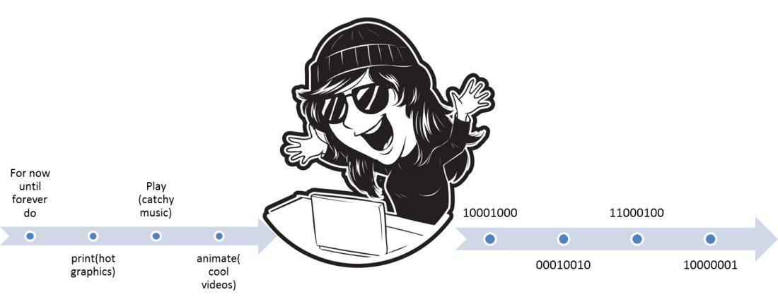


CPSC 203
Computer programming
Spreadsheet
Database
Introduction to practical problem solving
(James Tam)
Images: Colourbox.com

Slide 2


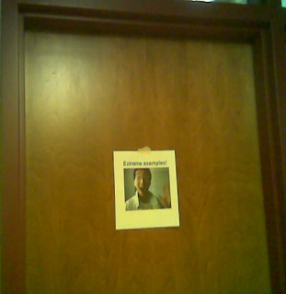
Administrative (James Tam)
Contact Information
  Office: ICT 707
  Email: tam@ucalgary.ca
  Make sure you specify the course name and number in the subject line of the email ‘CPSC 203’
Office hours
  Office hours:
    M&T: 14:00 - 14:50 (If I’m not in my office give me a few minutes or check the lecture room).
    Appointments possible at other days/times (subject to availability).
    Dropping by outside of office hours without prior notice is “hit and miss”
My Office
Images: courtesy of James Tam

Slide 3
Course Resources
Required resources:
  Course website: http://www.cpsc.ucalgary.ca/~tamj/2018/203W
  (You must get the slides off the course webpage before lecture so you don’t have to copy them down during class)
Course textbooks (recommended but not a mandatory purchases).
  #1: For all assignments but especially helpful for the tougher ones (Assignment 2 & 3)
    “Computer Science Chop Suey! Computer & software fundamentals, practical problem solving” by James Tam (Published by Wiley)
  #2: Just for the VBA programming part of the course (Assignment 3)
  “Mastering VBA for Microsoft Office 2013” by Richard Mansfield (Published by Wiley)

Slide 4
How To Use The Course Resources
They are provided to support and supplement this class.
  The notes outline the topics to be covered
  At a minimum look through the notes to see the important topics.
  However the notes are just an outline and just looking at them without coming to class isn’t sufficient to do well
  You will get additional details (e.g., explanations) during lecture time
    Take notes!
    If you miss a lecture then get a copy of the in-class notes from another student (who takes detailed notes)

Slide 5

Your Engagement Level ---> Your Learning
+
Learning
colourbox.com
Create: spreadsheets, databases
Write:
Computer programs

Slide 6
Tam’s “House Rules”
I always endeavor to keep the lecture within the prescribed time boundaries
You won’t pack up and leave before time is up

Slide 7





Tam’s “House Rules”
No recordings/captures without permission during class please
(Recall that learning tends to increase with additional levels of engagement).
Colourbox.com

Slide 8


Tam’s “House Rules”
Quiet whispering is OK…
…but make sure if it is *quiet*. If it’s loud enough for me to hear then it’s likely that others are being disturbed by the noise as well.
Images from colourbox.com

Slide 9
Windows Operating System: This Section
Although assignments mostly on MS-Office, this course will teach concepts using a version of MS-Windows.
  (The MAC-specific lecture is no longer timetabled).
You might be able to implement your work on a MAC (some of these students have completed 203 in the past) but keep in mind available resources are for Windows.
  That means if you have an odd technical glitch you might be on your own.
You can not only work on assignments in the CPSC 203 computer labs but many of the labs on campus.
  Keep in mind some features of MS-Office may (for some reason) be disabled if you use a computer lab other than the 203 lab
Notes:
https://support.office.com/en-us/article/Check-a-document-for-compatibility-C5AA52E0-15C8-4DA7-9942-379552795D90

Slide 10

Practical Course Outcomes
You get to learn 3! Count ‘em 3 commonly used software packages!
But wait-there’s more!!!
Data-base!!!
Advanced word processing!!!
Spread-sheet!!!
SALE!!!

Slide 11

Practical Course Outcomes (2)
  Employer XYZ wants to hire an Access © database developer or someone familiar with SQL queries now.
  This is what’s hot, hot, hot
  But what’s hot today may not look so good tomorrow
  Technology changes: get used to it

Slide 12
Practical Course Outcomes (3)
You will not only learn how to use existing technologies (spreadsheet, database, word processor) but also how to problem solve and even create your own new software.
  Developing your thinking and problem solving skills will improve your ability to adapt to changes in the future
Problem solving is required in the programming component: writing VBA Word macros (Assignment 3)
Some corporations have recognized the relationship between problem solving skills and success in the work world:
  E.g., “Killer” interview questions
    Google
    http://www.businessinsider.com/15-google-interview-questions-that-will-make-you-feel-stupid-2009-11?op=1
    Apple
    http://www.businessinsider.com/apple-interview-questions-2011-5#how-do-you-test-the-prototype-of-the-vending-machine-5

Slide 13
Yes: “This Stuff Will Be On The Exam”
The administrative notes contains important information e.g. how your grades are calculated, course policies etc.
To encourage students to pay attention to details (and to reward those who do so):
  Some of your midterm multiple questions will come from this section from this slide to the end
  You may see a question or two from this section on the final exam as well.

Slide 14
Evaluation Components
Assignments
Examinations

Slide 15
Assignments (Proportion Of Term Grade 30/100)
A1: Spreadsheet (Excel): 10% proportion of term grade
A2: Database (Access): 10% proportion of term grade
A3: Program writing (VBA): 10% proportion of term grade

Slide 16
Assignments
Assignments must be individually completed and individually submitted.
  There is no group work allowed for this class.
  Students should not see the assignment solutions produced by other students.
Assignments will be marked by the tutorial instructor.
  Grades will be posted in D2L
  You can contact him/her for the grade and/or the completed marking sheet.
  If you still have questions or issues after contacting your TA then feel free to contact your course instructor.

Slide 17
Submitting Assignments
Bottom line: it is each student’s responsibility to make sure that the correct version of the program/document was submitted on time.
  Alternate submission mechanisms e.g., email, uploads to cloud-based systems such as Google drive, time-stamps, TA memories cannot be used as alternatives if you have not properly submitted into D2L
  Only files submitted into D2L by the due date is what will be marked
Late assignments will not be accepted.
If you are ill then medical documentation is required.
  Contact your course instructor and not your tutorial instructor to get permission for a late submission
Notes:
I would make it very clear that late assignments won’t be accepted
If they screw up for one reason or another (e.g. forgot a file, upload corrupted, submitted the wrong version etc.) then the fault is theirs and whatever is submitted in D2L as of the due time is what will be marked
Also clearly indicate to them that Tas don’t have discretion for late submissions not even in the case of illness and they need to talk to the course instructor

Slide 18
JT’s On Electronically Submitting Work
Bad things sometimes happen!
  A virus, hardware failure, you screwed up the submission.
  Backup your work (not on the same storage device)
Rules of thumb for assignment submissions:
  Do it early! (Get familiar with the system)
  Do it often! (If somehow real disaster strikes and you lose everything at least you will have a partially completed version that your TA can mark).
  Check your D2L Dropbox submission.
    Don’t assume that everything was submitted OK.
    Don’t just check file names but at least take a look at the actual file contents (not only to check that the file wasn’t corrupted but also that you submitted the correct version).
    Assignment 0: ‘A0’:
      An exercise in tutorial where you practice submitting and checking your work
      Not directly graded but still important to complete
Notes:
Again this may seem obvious but a surprising number don’t back up their work and they only submit for the first time just a few minutes before the due date

Slide 19
How To Check Your Submission In DropBox
There is a help link provided with each assignment description.
Teaching Assistants will cover this topic in conjunction with Assignment zero.
  Not graded but important practice
Resource file
  http://pages.cpsc.ucalgary.ca/~tamj/resources/Verifying%20D2L%20Submissions.pdf

Slide 20
Assignments: Software Version¹
It is your responsibility to ensure compatibility
  A1 – A2 (MS-Office 2016 assignments)
    TAs will use the 203 lab computers (Windows) to mark whatever you submit
    U of C students should be able to access Office 365 “for free” (while they are current students)
      Info: http://www.ucalgary.ca/it/office365/faqs
      Accessing (need a UC account):
        http://www.ucalgary.ca/it/services/office-365 (click on the link “Access 0365 online”)
        http://office365.ucalgary.ca/
        If have trouble accessing: contact university UC-IT
        A2 (Access) isn’t part of Office 365 but you should be able to run it from most campus labs (including the 203 lab)
  A3: The VBA program you write must be executable (you write a computer program) on the lab computers using MS-Word

Slide 21
Examinations (Proportion Of Term Grade: 70%)
A mix of short answer and multiple choice questions
Closed book (don’t bring anything into the exam: just yourself and writing implements: at least one pen and at least one pencil
Midterm examination (30% of term grade)
  Scheduled by your course instructor and will occur during the semester
    Thursday Feb 15 from 4:30 - 5:45 PM (Outside of normal lecture time)
  Final examination (40% of term grade)
  Cumulative but with a focus on topics covered after the midterm
  The exam occurs during the regular end of term examination period so it will be scheduled by the Office of the Registrar
If you are awarded a higher grade on the final exam vs. the midterm exam then: your midterm grade = final exam grade

Slide 22
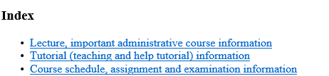
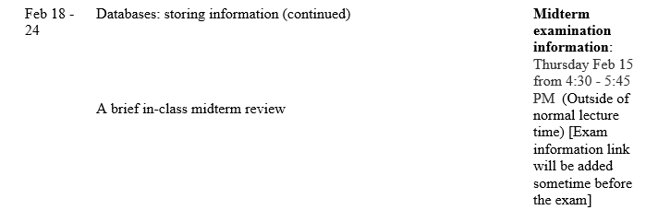
Examinations (2)
Information about the examinations will be available on the main grid before the respective test:
  Under the main index:
    Main grid: Course topics, lecture notes, assignment descriptions, exam information

Slide 23
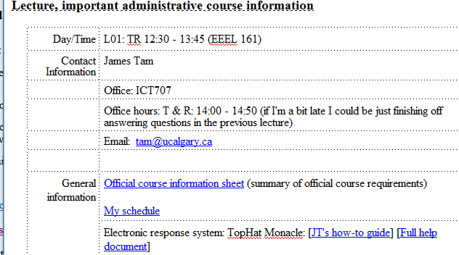
Sample Exam Questions
In class (ungraded) quiz questions:
  TopHat Monacle: information link
More sample ‘exam type’ questions will be provided during the semester.
  Sometimes ‘on the fly’ in lecture so pay attention to these and take notes.
Notes:
More incentive for them to come to class and take notes
Sometimes after teaching a concept e.g. recursion I might go over a sample exam question e.g. error changing an integer to ensure that it is within some range using recursion
If there’s time I may have them try it in class before I give the solution

Slide 24
Grades For Each Component
The official grading mechanism for this (and most) universities is a letter grade/grade point e.g. A/4.0, A-/3.7 etc.
Term grades must be stated as a letter grade.
Component grades (assignment, exam etc.) can either be a letter grade or a raw score (e.g. percentage)
For this class each major component will be awarded a grade point (and not a percentage) and this is the value used to determine the term grade.

Slide 25
Mapping Raw Scores To Grade Points: Assignments
For simplicity assignment marking keys will specify grade points only
  Example (purely for illustration purposes): spreadsheet computes average sales = 0.3 grade points, spreadsheet graphs results = 0.1 grade points etc., a macro allows the user to re-run calculations with different data = 1.0 grade points.
  Sum the grade points for each feature in order to yield the grade point awarded for the assignment e.g., 0.3 + 0.1 + 1.0 = 1.4 GPA earned if only the above features were implemented.

Slide 26
Mapping Raw Scores To Grade Points: Exams
For examinations the mapping between a raw score and a grade point occurs one way (raw score mapped to grade point)
  Example (purely for illustration purposes) 65 – 69% = C/2.0, 70 – 74% = C+/2.3
  But grade points don’t correlate back to percentages
    e.g. I was awarded a 66% on midterm and then I see this is a 2.0 GPA (out of 4.0)
    Does this mean that my percentage ‘went’ from a 66% to a 50%!!!???
    No.
      A C/2.0 does not mean that 50% was awarded as a course grade.
      To put this in perspective a passing grade point in this university is a 1.0/D in a course. If a grade point mapped back to a percentage this would mean that anyone getting a 25% or higher would pass any course here.
  The mapping of the midterm to grade point will be posted sometime after the midterm grades have been released.
  The mapping of the final exam to grade point will be posted sometime after the final exam grades have been released.

Slide 27
Estimating Your Overall Term Grade Point
To determine your weighted term grade point simply multiply each grade point by the weight of each component = weighted component
  Percentages won’t be used to determine the term grade/letter grade
Sum the weighted grade points to determine the term grade.
Simple and short example (not exactly the same as this term but it should be enough to give you an idea of how to do the specific calculations required this semester):
    Assignments: weight = 30%, example score = A/4.0
    Midterm: weight = 30%, example score = B+/3.3
    Final: weight = 40%, example score = C-/1.7
    Weighted assignments: 0.3 * 4.0 = 1.2
    Weighted midterm: 0.3 * 3.3 = 0.99
    Weighted final: 0.4 * 1.7 = 0.68
    Total term grade point = 1.2 + 0.99 + 0.68 = 2.87
  (In this case the term letter is B)

Slide 28
Estimating Your Overall Term Grade Point (2)
Use the spreadsheet on the course web page to estimate your term letter grade:
  http://pages.cpsc.ucalgary.ca/~tamj/2018/203W/grade_calculator.xlsx

Slide 29
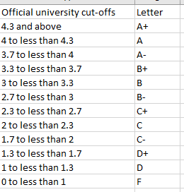
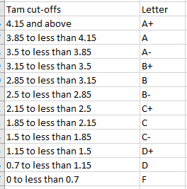
Contrast The Cut-Offs
Official UC cutoffs
The Tam cutoffs
4
4
3.7
3.3
3.0
2.7
2.3
2.0
1.7
1.3
1.0
0
    The cutoffs in the spreadsheet are significantly more lenient (almost everyone “gets a big break” e.g. instead of 3.7 for an A- it’s 3.5 (midpoint between A-/3.7 and B+/3.3 is the higher letter grade)
    Do not expect a further “rounding up” at the end of the term e.g. 3.4999999999999999999999999999999999999999999999999 is soooooooooooooooooooooooooooooooooooooooooooooooo close to 3.5 can’t you get an “A-”
    No or using an Internet emphasis
    NOOOOOOOOOOOOOOOOOOOOOOOOOOOOOOOOOOOOOOOOOOOOOOOOOOOOOOOOOOOOOOOOOOOOOOOOOOOOOOOOOOOOOOOOOOOOOOOOO!!!!!!!!!!!!!!!!!!!!!!!!!!!!!!!!!!!!!!!!!!!!!!!!!!!!!!!!!!!!!!!!!!!!!!!!!!!!!!!!!!!!!!!!!!!!!!!!!!!!!!!!!!!!!!!!!!!!!!!!!!!!!

Slide 30
Why Grade Points?
It’s the official university grading system
  Alternatives are possible but require faculty level approval
Approval of anything other than a grade point system requires predetermined cutoffs at the start of the term e.g., >= 90% equals ‘A’ etc.
  Doesn’t allow for consideration that individual components may be more challenging than others (lower cutoffs)
Grade points are more lenient for grades on the lower-middle end of the scale
  Grade points: Getting an “A”/4.0 on the assignment component worth 30% of the term grade yields a minimum term grade of 1.2 (4.0 * 0.3) which equates to a term grade of ‘D’
  Percentages: Getting an “A” may roughly work out to 90% or higher (depending on the scale) which works out to a minimum term percent of 27% = 90% score * 30% weight…almost certainly an “F” for the term grade.

Slide 31
How To Succeed In This Course: A Summary
Practice things yourself
(Programming section): Make sure that you keep up with the material
Start assignments early
Take good in-class notes, not just what I write but also what I say.

Slide 32
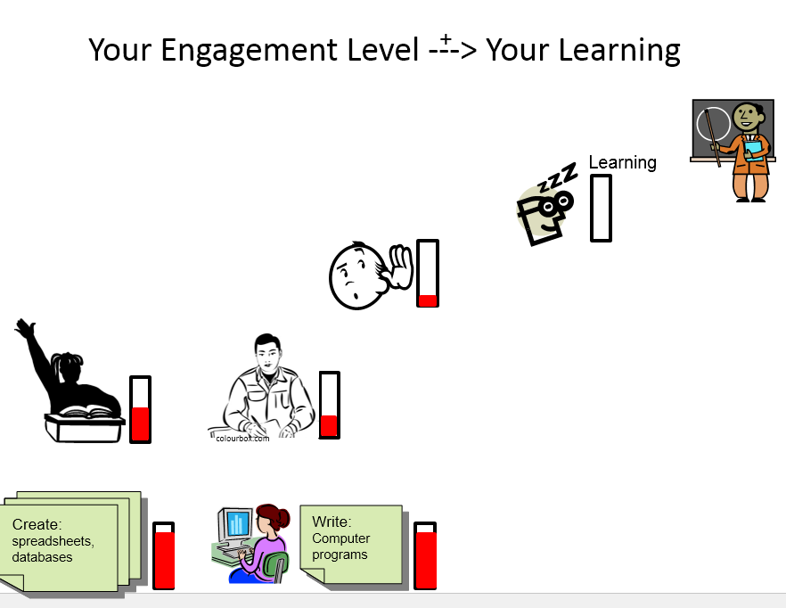
#1 Practice Things Yourself
Recall

Slide 33
#2 (Programming): Keep Up With The Material
(This applies to all topics but is especially pertinent to the VBA program writing section – A3 material - of the course).
Concepts are cumulative and progressively more challenging
  Many of the concepts taught later depend upon your knowledge of earlier concepts.
  Don’t let yourself fall behind!
  At least attempt the assignment.
Rule of thumb: don’t fall behind more than 1 week
Libraries
Loops
Branching
Logic
Introduction to programming

Slide 34
#3 Start Assignments Early
Don't look at the material just before the due date
  Studying the concepts as you learn them throughout the term.
  Programming section (A3) & to a large extent the database section (A2): It’s important to work through and understand concepts *before* you start work on the assignment.
  If you try to learn a new concept and work out a solution for the assignment at the same time then you may become overwhelmed.
Don’t start assignments the night (or day!) that they are due, they may take more time than you first thought
  Assignments start getting much challenging later in the course (A2 & A3)

Slide 35
#3 Start Assignments Early (2)
Some assignments may require the application of multiple concepts, not all the concepts have to be completely covered before you start working on an assignment.
  Start working based on what’s currently been covered
  A good work habit in real life (work on only a part of a problem at a time)

Slide 36
#4 Take Good In-Class Notes
Hierarchy of note taking
  None: just memorize course slides/notes.
  Moderate: write notes when the instructor writes things out (“must be important”).
  Extensive: write notes when the instruction writes things out but also when that person verbally describes things.
  When making notes, paraphrase concepts rewording things using your own terminology and phrases
This is essential when complex technical concepts (e.g. A2 & A3 material) are covered.
Worse
Better

Slide 37
How To Succeed In This Course: A Summary
Practice things yourself
(Programming section): Make sure that you keep up with the material
Start assignments early
Take good in-class notes, not just what I write but also what I say writing things in your own words

Slide 38
Copyright Notification
“Unless otherwise indicated, all images in this presentation are used with permission from Microsoft.”

