Slide 1
Introduction To Computer Hardware
You will learn common technical specifications

Slide 2
Technical Specifications
As mentioned, this version of this course will focus on more practical benefits than previous versions.
Rather than presenting a long list of hardware specifications and how things work for it’s own sake, the focus will be on providing some of the information you will see when actually buying a machine.
  However due to brevity - a complete computer buyer’s guide would constitute a complete (continuing education) lecture only a subset of some of the more pertinent/common specifications will be covered.

Slide 3
Example Technical Specifications
Paraphrased from an online electronics retailer:
  “3.6 GHz Intel Core i7-7700 processor and 12GB RAM offers powerful performance for multimedia projects, smooth multitasking, and effortless everyday computing.” (3.6 GHz 4th generation Intel Core i7-4790, 8 GB RAM)
  “1TB hard drive large digital warehouse to store all your files, photos, videos, music, and much more” (1 TB hard drive)
  6 USB ports, including 2 USB 3.0 ports (USB 3.0 ports)
  “HDMI output delivers crisp high-quality visuals and high-fidelity audio to a home theatre or monitor through a single cable connection”
  FYI: $1,099.99 ($949 in 2015 $)
  Last accessed from www.bestbuy.ca July 2017 (June 2015)

Slide 4
Which Type Of Computer Is Best For You?
(This is very basic material to bring everyone up to a basic level)
  Later sections can be more challenging (e.g. using databases)
No single model (let alone manufacturer ) is best for everyone
Ask yourself how you will use your machine, what things are the most important to you:
  Portability?
  Touch screen capability?
  Will you run programs that will ‘push’ your system, e.g., video editing, gaming, image and 3D graphic editing or will you use your computer mainly for common tasks (e.g., word processing, online browsing)

Slide 5
Which Type Of Computer Is Best For You? (2)
  Is gaming in general (even ones that don’t ‘push’ your system) important?
    If so consider a computer that is more commonly used.
  Future expandability and upgrade capability of your machine?

Slide 6
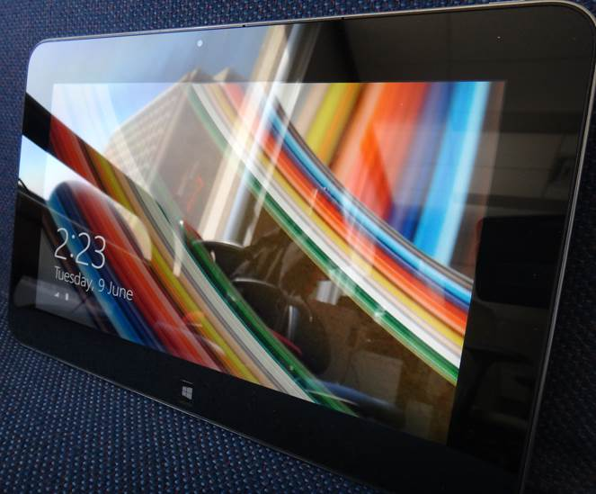
Tablets
The lightest and most portable
Touch interface:
  Good/bad issues
    “Oops!”
Good for ‘light’ work
  Price : performance not the best among the categories
Notes:
Touch interface:
Good/bad issues
Some love/hate it
Depends on the person and the task (e.g., browsing images allows for organizing, pinch and zoom Vs. typing in a lot of text)
Double tap by default is zoom rather than opening
BEST BUY.ca
Microsoft Surface Pro 3: $1000
Intel Core i5 -4300U HTT 1.6 GHz
4 GB RAM
128 GB Flash drive
HP $700
I5 3.3 GHz
1 TB HDD $70 – 100
8 GB RAm
SSD = 100 – 150
Monitor 23” about $150

Slide 7
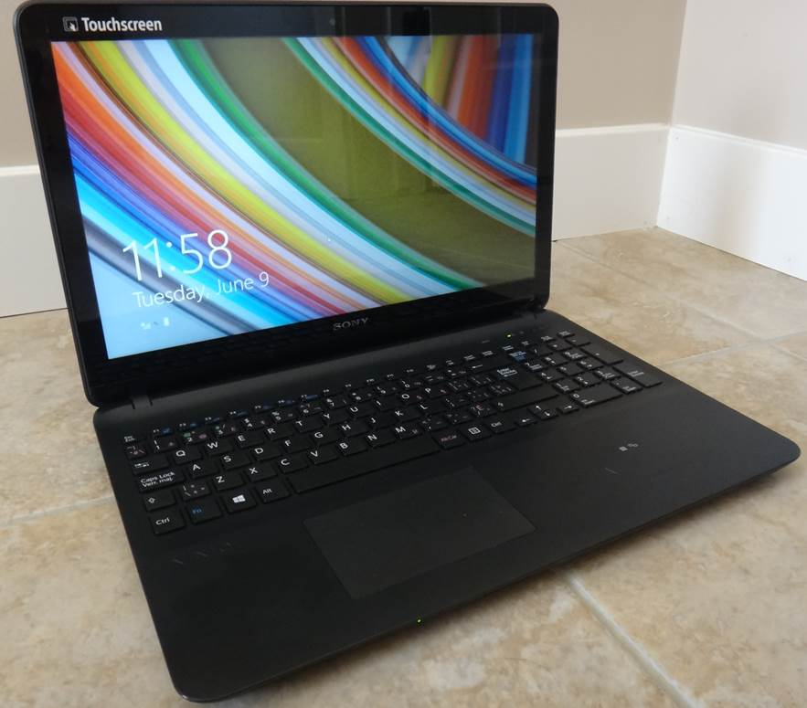
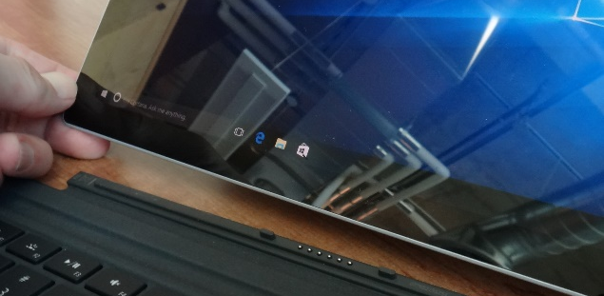
Laptops/Notebooks
Compared to tablets:
  Larger display area
  Adds CD or DVD as well as a physical keyboard but may include touch capability as well
  “2 in 1” laptops: combine power of laptop and portability of tablet
Compared to desktops:
  Portability (better)
  Price/performance, future expandability, choice of hardware not as good
Notes:
2 in 1:
Built in keyboard but detachable screen acts as a tablet

Slide 8
“Specialized/Variant Laptops”
Ultrabooks
  Ultra = thinner and lighter (increased portability)
  All things being equal cost tends to be higher than a laptop (manufacturing in exact detail)
Netbooks
  A cheaper but more portable form of a laptop (smaller and lower quality display, overall less powerful hardware).
  Much less common with the rise of tablets but still the cheapest option if a built in physical keyboard is desired
  Some common features on regular laptops are excluded (internal CD/DVD drive)
Comparison of netbooks vs. tablets (general technical and interaction issues over a model vs. model comparison)
http://www.ehow.com/info_8721028_difference-between-tablet-pc-netbook.html
http://www.pcadvisor.co.uk/buying-advice/tablets/3450587/netbook-vs-tablet/
http://blogs.canoe.ca/canoetech/signs-of-the-times/netbooks-vs-tablets/
Notes:
Ultrabooks
Often marketed as a cross between a laptop and a tablet (power of former) and portability and fun factor of the latter. (Trivia: Term originally coined by Intel, processor manufacturer but many manufacturers now
http://www.intel.com/content/www/us/en/trademarks/ultrabook.html
http://www.ultrabookreview.com/154-ultrabooks-versus-regular-laptops/
http://www.lenovo.com/us/en/faqs/what-is-an-ultrabook/
Netbook
Lenova focus on Internet for netbooks
http://www.lenovo.com/us/en/faqs/what-is-a-netbook/

Slide 9
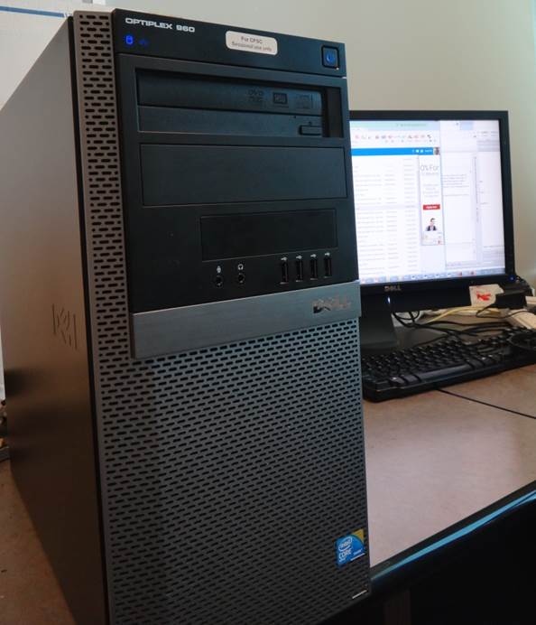
Desktop Computers
Everything is separate (monitor, computer etc.)
  Allows for mixing and matching but more complex connections and it’s not portable).
  Faulty components can be more easily replaced.
Larger ‘foot print’:
  More space required
  One benefit: greater expandability
  Compared to portable laptops and tablets: Reduced costs/more options

Slide 10
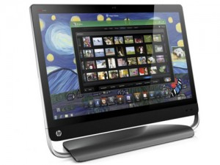
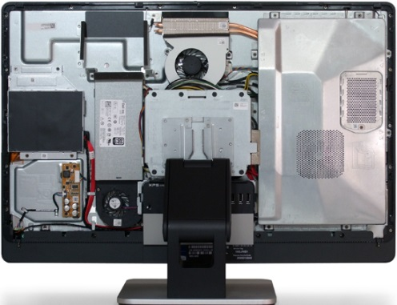
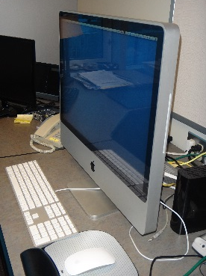
“All-In-One-Computers”
Although technically this includes tablets and laptops this is a unique actual category (commonly used term).
  As the name implies everything is included together: monitor, computer, memory, storage
Commonly chosen when:
  A desktop is desired but space is tight
  Some portability is desired (better than a desktop but not as good as a laptop)
  With few exceptions not expandable (plus: no hardware conflicts)
Somewhere in the middle between desktops and laptops in the balance between portability and hardware capabilities/power
Images (all accessed or produced in 2015)
Apple computer: James Tam
HP computer: http://gadgetynews.com/hp-omni-hd-allinone-pc-beats-audio-quadcore-power
Inside the case: http://www.tomshardware.co.uk/xps-one-27-touchscreen-all-in-one,review-32666-3.html
Notes:
Can include CD and Hard drives: http://h10025.www1.hp.com/ewfrf/wc/document?cc=us&lc=en&dlc=en&docname=c02162108 (pop CD in side or top)
Not good for gaming (integrated graphics, cheaper processors)

Slide 11
The Operating System (O/S): Purpose (If There Is Time)
Runs the computer
  Intermediary between the physical hardware and the software
Determines factors such as:
  The interface: familiarity, ease of use
  Configurability of the computer “tweakability”
  Security

Slide 12
The Operating System (O/S): MS-Windows “PC” (If There Is Time)
Most popular operating system for ‘traditional’ computers (desktop, laptops)
  You have the greatest chance of finding a rare program or hardware on this operating system
Provides a high degree of flexibility ‘tweaking’ (customizable)
The popularity of Windows combined with how it allows programmers increased ability to tweak (configure/customize/add features) things can increase the probability of a security-issue (e.g., virus)

Slide 13
The Operating System (O/S): MAC (If There Is Time)
Some find it’s interface more “User friendly”
Some also find it more challenging to tweak/customize
  “Focus on consistency”: The operating system presents you with what the designers think you need to see (must sometimes dig) to find the rest or to change defaults
The fact that the operating system is less commonly used and software programmers are more constrained (e.g., a fairly stringent approval mechanism by Apple before an app may be posted in the “App store”) makes it less likely (but not impossible) to encounter security-related issues:
  https://developer.apple.com/app-store/review/guidelines/
Notes:
https://developer.apple.com/app-store/review/guidelines/

Slide 14
The Operating System (O/S): MAC (2, If There Is Time)
Also note that similar to other operating systems, security-related problems can occur because of the operating system itself (unaffected by the vetting of the App store)
  http://www.forbes.com/sites/amitchowdhry/2014/12/26/why-apple-pushed-its-first-automatic-mac-os-x-security-update-this-week/

Slide 15
Large Units Of Measurement
Example usage (from the technical specifications shown earlier): 3.6 GHz processor (G = Giga, Hz = processor oscillation speed)
  Kilo: One thousand 1,000
  Mega: One million 1,000,000
  Giga: One billion 1,000,000,000
  Tera: One trillion 1,000,000,000,000
Large units of measurement will be discussed again when processors and storage devices are covered

Slide 16



Basic Units Of Storage
On the computer all information is stored in binary (2 states e.g., on/off, pitted surface/smooth surface, connected/disconnected circuit)
A single off/on combination is referred to as a ‘bit’ (binary digit)
8 bits grouped together is referred to as a ‘byte’
off
on

Slide 17

Large Units Of Measurement And Storage
The amount of information that can be stored and transferred is typically measured in bytes rather than bits.
Kilobyte (KB) ~ a thousand bytes (1,024 = 2¹⁰)
  Low quality preview ‘thumbnail’ images may range from a few thousand to tens of thousands of bytes in size.
Megabyte (MB) ~ a million bytes (1,048,576 = 2²⁰)
X 1,000
X 1,000,000
A typical image may range from ~20,000 Bytes / 20 KB to several million bytes (MB).
Audio files (e.g., MP3) are several Megabytes in size.
Streaming Internet video (compressed) ~several hundred Megabytes for a full movie.

Slide 18
Large Units Of Measurement And Storage (2)
Gigabyte (GB) ~ a billion bytes (1,073,741,824 = 2³⁰)
Terabyte (TB) ~ a trillion bytes (1,099,511,627,776 = 2⁴⁰)
X 1,000,000,000
  Several hundred camera images or audio files
  ~ 30 minutes of DVD quality video (~1/4 of the information stored on a typical DVD)
X 1,000,000,000,000
  Several hundred thousand images or audio files
  ~ 200 regular DVD’s (~32 Blu-ray) of information

Slide 19
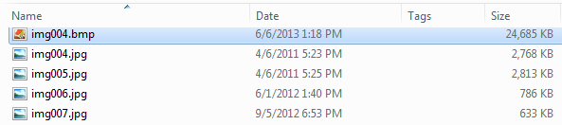
File Sizes: Example Images

Slide 20
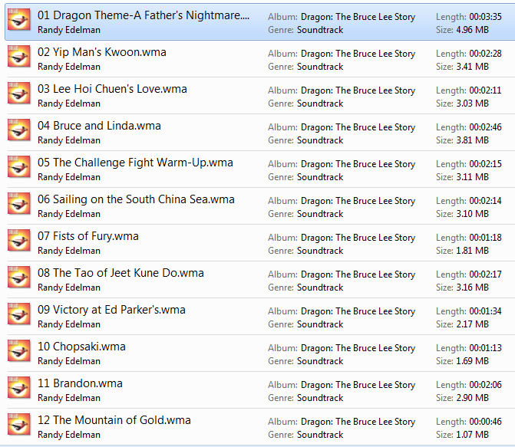
File Sizes: Audio Files

Slide 21
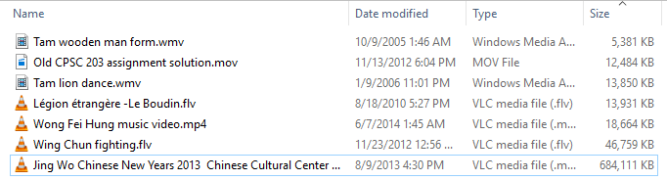
File Sizes: Videos
Lengths of the videos range from ~20 seconds to 15 minutes
22s, 320x240 resolution (1 hr. = 880 MB)
15m 29s, 1920x1080 resolution (1 hr ~2.7 GB)
Notes:
Calm: 30 seconds and 4.7 MB
Star Trek fan show: 45 minutes and 134 MB
Besides length of the video, the quality also effects the size

Slide 22
Most Important Hardware (When Choosing A Computer)
(This refers to hardware that distinguishes one computer from another computer, other pieces such as hardware such as some sort of network connection is also crucial but not significantly different from computer-to-computer).
Processor (CPU – or the APU for some AMD models)
Memory (RAM)
Storage (hard drive)
Notes:
Accelerated Processing Unit:
combines CPU and GPU elements into a single architecture. The first APU products being shipped by AMD and Intel do this without much fuss by adding graphics processing cores into the processor architecture and letting them share a cache with the CPU.

Slide 23
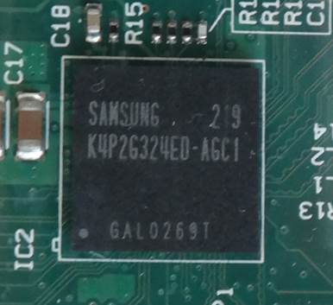
Main Processor (CPU: Central Processing Unit)
The ‘brains’ of the computer:
  Determines program execution speed (not just calculation speed)
Benefits of a faster CPU
  Programs are loaded faster (includes computer startup time)
  Editing/viewing videos and ripping music/videos to your computer may be faster and more free of ‘glitches’
  (Of course!) Calculations are completed more quickly (e.g., evaluating the results of a spreadsheet)
ARM processor

Slide 24
CPU Clock speed
Aside from the processor model it’s the most common technical specification
It’s the speed at which the processor operates (oscillation rate)
Typical home-type computers (e.g., laptops, desktops) operate at low single digit unit Giga-clock speeds ~1 to 4 GHz
  Note: Other than clock speeds there’s other factors that determines how fast a processor will run a program but all other things being equal a processor with a higher clock speed will run faster.
Computer from advertisement (2015 Ad)
Processor: 3.6 GHz Intel Core processor
Notes:
The clock distribution network inside the CPU carries that clock signal to all the parts that need it.

Slide 25
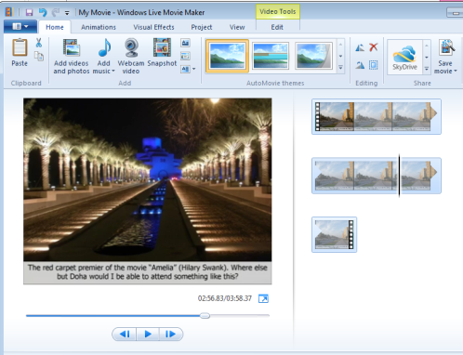
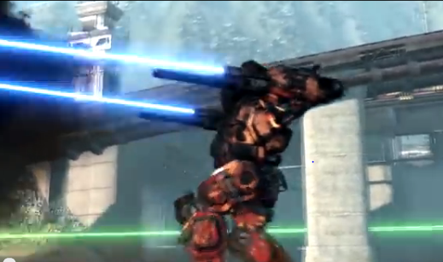
Multi-Core Processors
(Not to be confused with the model name of some Intel processors e.g., Core i3, Core i5, Core i7 etc.)
  AMD manufacturers multi-core processors as well
The number of cores determines how many tasks that a computer can execute at the same time.
Single core computer:
  Only appears to work on multiple tasks simultaneously.
Video editing
Playing a video game
Pause
Notes:
http://www.intel.com/pressroom/kits/pentiumee/

Slide 26
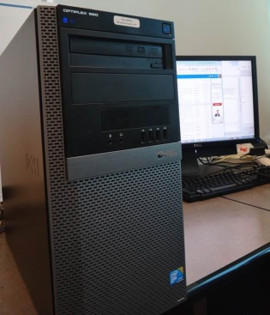
Processors: Multi-Core (2)
Dual-core processors: can work on two tasks simultaneously
First processing core: Video editing
Second processing core: Playing a video game

Slide 27
Processors: Multi-Core (3)
Other multi-core processors:
  Quad core : 4 processing cores
  6 core
  8 core
  12 core (e.g. MacBook pro)
  For more information: comparing dual vs. quad core processors (i.e. in general what’s the benefit of more vs. fewer cores)
    http://www.pcmag.com/article2/0,2817,2406293,00.asp
Notes:
8 core: AMD has some for sure
Dec 2018 Apple has up to 18 cores for ~13K
http://money.cnn.com/2017/12/14/technology/imac-pro-on-sale/index.html

Slide 28
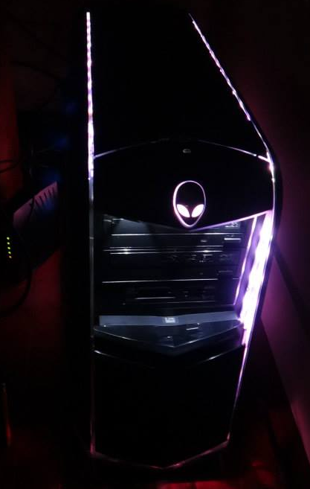

Processors: Multi-Core (4)
Having a processor with multiple cores can speed up execution even if only a single hardware intensive program (pushes the hardware of the computer) is running.
  The program is written specifically to take advantage of multi-core technology.
  Check the ‘system requirements’ or ‘technical requirements’ on the packaging or website e.g., Photoshop, Excel, Crysis: www.ea.com/games/crysis/crysis
First core: runs one part of game
Second core: runs another part of the same game

Slide 29
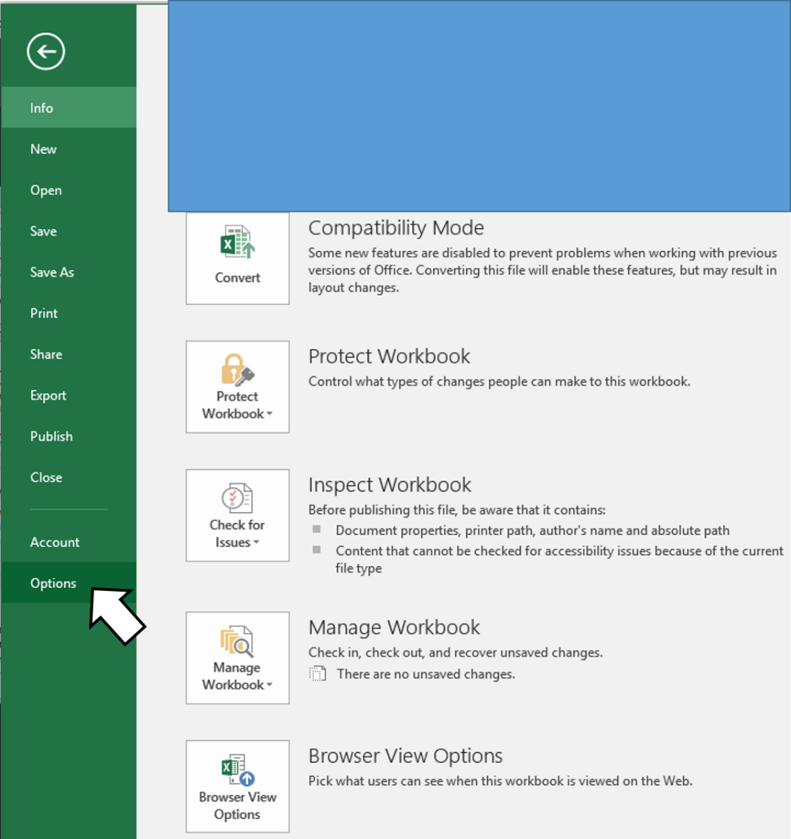
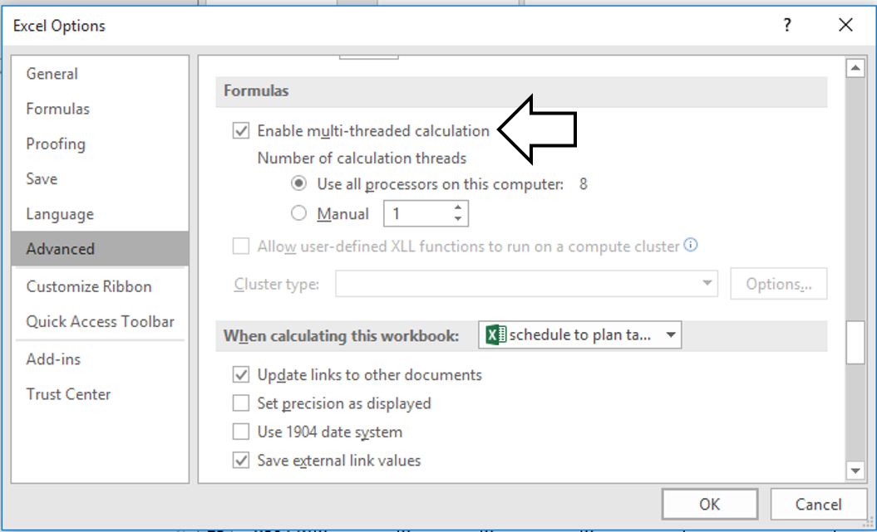
Example Program, MS-Excel: Optimal Performance With Multiple Cores

Slide 30
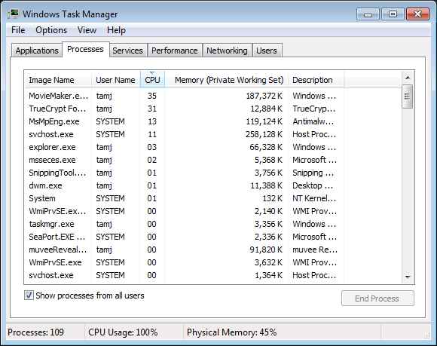
Will Multiple Cores Always Be Faster?
Simple answer: it depends
Advanced answer: look at actual computer usage e.g., Task manager (Windows), Activity Monitor (MAC OS-X)
Notes:
SVHost: I was deleting many files and total amount of disk space large, running the operating system for deleting took up processor time

Slide 31
Intel Processor Models¹
Another important factor determining execution speed
Intel processor models:
  Pentium and Celeron (bargain basement entry level or for portables):
    Very old low end chips
    Unless you’re cash strapped avoid computers with these processors
      (JT: until part way through 2013 I was running a very old version of a Celeron for my main computer tasks…painfully!)
  Core i3 (sensible entry level):
    Dual core processors
    For budget computers, good for basic every day computer use (word processing, browsing the web – you might want to avoid viewing videos extensively especially HD video)
Sources:
http://www.cnet.com/topics/desktops/buying-guide/
http://ark.intel.com/
http://www.intel.com/content/www/us/en/processors/processor-numbers.html

Slide 32
Intel Processor Models (2)
  Core i5 (good for most tasks/most users)
  Mainstream quad core processor line (a handful of lower end ones are dual core)
    Common in many desktop models and all-in-one computers
  Core i7 (for high end, powerful computer)
    Higher end processor for hardware-intensive tasks (e.g., games, video and image editing)
  For more information:
    http://ark.intel.com/
    http://www.intel.com/content/www/us/en/processors/processor-numbers.html
⬅Tam min
Computer from advertisement:
Processor: 3.6GHz Intel Core i7-7700 processor
There’s different versions of the i7 model
Computer processor from 2015 ad:
3.6GHz Intel Core i7-4790 processor
Notes:
http://cpu.userbenchmark.com/Compare/Intel-Core-i7-7700-vs-Intel-Core-i7-4790/3887vs2293
3.6 GHz 4 cores
Processor rank speed: 20th vs. 50th

Slide 33
AMD Processor Models (If There Is Time)
We won’t spend time on these lines but reference links are available for more information.
AMD processors:
  http://www.amd.com/en-us/products/processors/desktop
AMD vs. Intel: look at the speed tests performed with different software running (benchmarks).
  E.g., http://www.tomshardware.com/t/cpus/
However brand definitely does matter in that you can’t freely mix and match between Intel and AMD.

Slide 34
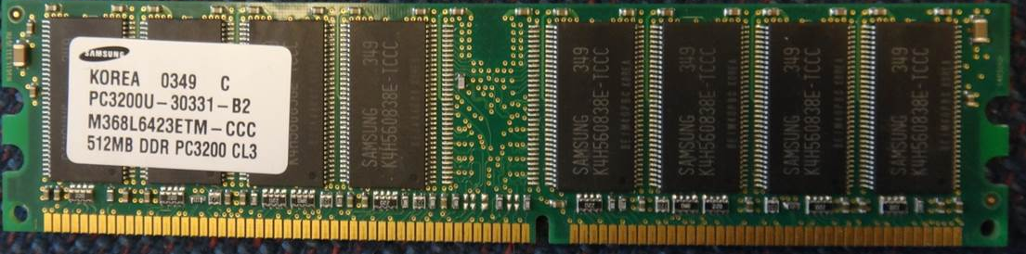
Memory (RAM)
When a computer program is executed the instructions as well as any data currently needed (e.g., images, videos) is loaded into RAM from the storage device (usually the hard drive).
RAM is temporary storage (gone when you shut off or restart your computer).
Significantly faster than any storage device.
More expensive on a per unit basis than a storage device such as a hard drive.
The memory capacity of today’s computers are typically specified in single or low double digit Gigabytes (recall that’s billions of bytes) .

Slide 35
How Much RAM?
Amount of RAM | Primary computer usage
< 4 GB | Basic: web browsing, email, word processing
4 – 8 GB | Multitasking: running a few applications simultaneously, playing simple/lower end games, watching regular (lower definition) movies, simple photo editing.
10 GB and above | Multitasking with regular applications or even with hardware-intensive applications such as games with higher resolution graphics (rules of thumb: “first person shooter” and/or 3D games rather than simpler adventure, role-playing, strategy games), video editing, 3D or extensive image editing (e.g., Photoshop), HD (high definition) entertainment
Tam
Min (8)→
Computer from advertisement:
Memory: 12 GB of RAM
Computer from 2015:
Memory 8 GB

Slide 36
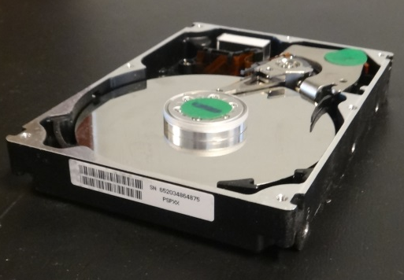
Storage (Hard Drive)
All data that’s needed in the long term must be kept in some form of storage device.
  Storage (hard drive): something that may not currently be needed but needed at some point in the future.
  Memory (RAM): something that is currently used must be stored here.
  Types of hard drives:
    Magnetic hard drives
      Stores information via magnetism
    Solid state hard drives
      Stores information without moving parts
    The typical storage capacity of hard drives is measured in hundreds of Gigabytes or single digit Terabytes

Slide 37
Comparison Of Hard Drive Types
Magnetic hard drive (HDD)
Solid state hard drive (SSD)
Slower
Less expensive
Hard drives with the highest capacities are only magnetic
Less ‘durable’ (may be affected by magnetic fields, physical jarring, temperature extremes)
Faster (roughly double)
More expensive
Lower maximum storage capacity
More durable (no moving parts)

Slide 38
Capacity | Images (number): assume 1 MB per image | Songs (number): assumes 10 MB per song | Movies (hours): assumes 70 MB/hour | HD Movies (hours): assumes 2.4 GB/hour
256 GB | 256,000 | 25,600 | 3657 | 107
320 GB | 320,000 | 32,000 | 4571 | 133
500 GB | 500,000 | 50,000 | 7143 | 208
640 GB | 640,000 | 64,000 | 9143 | 267
750 GB | 750,000 | 75,000 | 10714 | 313
1 TB | 1,000,000 | 100,000 | 14286 | 417
2 TB | 2,000,000 | 200,000 | 28571 | 833
3 TB | 3,000,000 | 300,000 | 42857 | 1250
4 TB | 4,000,000 | 400,000 | 57143 | 1667
Computer from advertisement/2015:
Storage: 1TB 7200 RPM hard drive
(SSD) Tam
range
(Magnetic) Tam
Range up to 32 TB (external)
Notes:
In computing, a hybrid drive is a logical or physical storage device that combines a fast storage medium such as NAND flash solid-state drive (SSD) with a hard disk drive (HDD), with the intent of adding some of the speed of flash storage to the cost-effective storage capacity of traditional HDDs. The purpose of the SSD in a hybrid drive is to act as a cache for the data stored on the HDD, improving the overall performance by keeping copies of the most frequently used data on the faster SSD.
Memory express has 32 TB drive for $5800
Computer in ad 7200 rpm so it’s an HDD
500 GB $250, 480 GB $219
960 GG $460
HDD
8 TB External 3.0 for $379, $329 Internal
Larger or even at 8 TB it’s server drives for several thousand

Slide 39
How Much Can You Actually Store?
Assume that your typical image or audio file is 2 MB apiece
  1 TB drive ~ 1,000,000,000,000 bytes
  2 MB file 2,000,000
Number of files (simple case 1 MB file, 1,000,000 bytes)
  1,000,000,000,000 (drive capacity)
  Divide by file size 1,000,000 bytes (average size will do)
  = 1,000,000 files each 1 MB in size (for simplicity so we just cancel out zeros)
Number of files 2 MB file size
  1,000,000 / 2 = 500,000 images or music files

Slide 40
Don’t Forgot: It’s Not All Free
Formatting a hard drive uses up some of it’s capacity
The operating system takes up space
  Example: Windows 7 or 8.1 (source: http://windows.microsoft.com)
  16 GB (32 bit), 20 GB (64 bit)
  Productivity (work) application (source: https://products.office.com)
  Example: MS-Office Professional Plus 2013 = 3 GB
  A game (source: http://elderscrollsonline.info/system-requirements)
  Elder Scrolls = 60 GB
With just Windows and 2 programs installed 83 GB has been used up (~8.3% of a 1 TB drive)
Notes:
Formatting may take up several percent of the hard drive
Down to about 400000 something thousand from a half a million

Slide 41
Hard Drive Tips
Bigger is often better: even higher capacity drives have come down significantly in price.
But for magnetic drives balance: storage capacity vs. speed (higher capacity drives tend to have lower rpm – slower revolution speed)
  7,200 to 10,000 RPM
Or combine an SSD for speed with a magnetic drive for its high storage capacity (store smaller files than are less frequently accessed here).
Notes:
Speed: 1 TB and 500 GB only are 10,000 rpm
Many are 7200 rpm but I saw some Alienware machines with 5400 rpm (spring 2015)

Slide 42
Optical Drives
CD/DVD?
  Do you play or rip music/videos?
  If the answer is no then you might settle with a single inexpensive DVD drive
    (Although many programs allow for Internet download some require an optical drive to install)

Slide 43
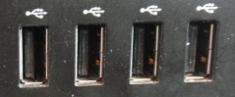
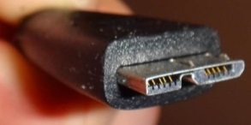
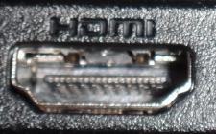



Ports (If There Is Time)
  USB 3.0 ports
  HDMI output crisp high-quality visuals and high-fidelity audio to a home theatre or monitor
Connections to external devices.
USB (standard): get as many ports as possible, ‘hub’ devices don’t always work as well as advertised.
USB 3.0: need a few of these for USB 3.0 compatible external hard drives (backup of large amounts of data).
HDMI: allow display on a TV monitor or connections to some peripherals (cable box, game consoles)
SD: can be useful for connecting to some peripherals (devices that use SD cards such as cameras, e-readers, tablets)
  But many use USB
(Other important ports e.g., video, audio, network are given in computers today)
Notes:
USB 3.0 vs. 2.0 about 10 times faster data transfer (idea conditions – other factors inside the drive e.g., rotational speed may slow down) 5 Gbps vs. 480 Mbps
Supposed to be coloured blue to distinguish from 2 but not all manufacturer’s do this e.g. Dell doesn’t always
http://en.community.dell.com/support-forums/laptop/f/3518/t/19444957
My Alienware is blue but not visible by looking (needed flash and camera to see)
USB Type-C twice the speed of 3.0
HDMI High-Definition Multimedia Interface: used by most TV’s, digital so it may be higher quality (no conversion), can transmits sounds on the cable
VGA: old, resolution can be higher but pixel quality may not be good because of conversion from analog to digital
USB3.0: the end that plugs into your computer looks the same as older USB, the other end that plugs into the device is different here is a micro USB 3.0 for a hard drive
USB-C: twice as fast as USB3 (USB 3.1) and interface benefits (no up-down, both ends the same: easier to plug in)
Spring 2015: some but not all manufacturers include it in on their machines (Dell and Chrome yet, Alienware no)

Slide 44
Graphics (If There Is Time)
Computers need specialized hardware to ‘draw’
  Goes back to computers even with primitive ‘graphics’ (colored formatted text)
Minimum: integrated graphics
  Drawing is built into the basic hardware (CPU’s with this capability are referred to as the APU) or the hardware where the CPU is slotted (motherboard)
Higher quality: dedicated graphics
  The computer includes additional hardware ‘dedicated’ to producing graphics “graphics card”:
    Graphics processor (GPU)
    Memory
    Etc.
Notes:
http://www.pcmag.com/encyclopedia/term/45075/integrated-graphics
http://www.tomshardware.com/reviews/graphics-card-myths,3694-5.html
VRAM up to 12 GB
GeForce® GTX 980 graphics with 12GB total (3x 4GB) GDDR5

Slide 45
Integrated Graphics: Benefits And Drawbacks (If There Is Time)
Sufficient for most users tasks e.g., word processing, spreadsheets, 2D gaming
Benefits:
  Reduced cost (hardware and power consumption)
Drawbacks:
  Reduced speed: Tasks that involve graphics are handled by the existing hardware (CPU and memory)
    May be especially noticeable if RAM is limited
  Reduced graphics (of course!): you may be able to run programs employing 3D graphics but with limitations e.g., game runs at lower graphical quality (resolution), game runs slower (or both)
Notes:
http://computers.toptenreviews.com/gaming-laptops/graphics-cards-integrated-vs.-dedicated.html
http://superuser.com/questions/420925/what-happens-when-you-add-a-graphics-card-to-a-i7-with-built-in-graphics-e-g-h

Slide 46
Dedicated Graphics (If There Is Time)
For serious 3D gaming , graphic design (e.g., editing 3D images)
Benefits:
  Speed (graphic-related processes are handled by the GPU and graphics memory rather than the CPU and main memory)
  Quality: higher quality graphics (of course!)
Drawbacks:
  Cost (initial hardware and power consumption)

Slide 47
After This Section You Should Now Know
The different category of computers and computing devices: tablets, notebooks/laptops, ultrabooks, netbook, desktop all-in-ones as well as some of their strengths
What is an operating system, what is its purpose
The large units of measurement and how they apply to computer specifications
The basic units of storage: bits and bytes and how the groupings of bytes applies to hardware
Processor clock speed and reasonable values for computers of today
The effect of multiple processing cores on speed

Slide 48
After This Section You Should Now Know (2)
What is the function of RAM, how does it work, how it related to storage, what are reasonable amounts for computers of today
What the two main types of storage technology (magnetic and SSD) and how they compare, what is a reasonable amount for today’s computer usage
Common computer ports

Slide 49
Gaming Or Multi-Media Computers (Extra Optional Topic)
Games and video/image editing software requires powerful hardware with large storage capacities:
Rules of thumb:
  Processor: multicores such as Intel Core i5/i7, and AMD's A6/A8/A10 and FX-series chips get a 6 core processor if you can afford it.
  RAM: > 8 GB
  Ports: USB 3.0 can be handy (increased data transfer rates to external devices).
  A dedicated graphics card is a must (and not one that is just built-in)
    http://www.tomshardware.com/reviews/gaming-graphics-card-review,3107.html
    http://gamingpchardware.hubpages.com/hub/best-new-graphics-cards

Slide 50
The Machines Of Tam (Extra Optional Topic)
Pre 2013
2013+
2.66 GHz Celeron
1 GB RAM
512 GB (originally ~80 GB)
Integrated graphics and sound (built into the motherboard and not separate cards)
i7-3960x (6 cores, 3.3 GHz)
32 GB RAM
512 GB SSD
1 TB HDD (but with several high capacity external USB drives)
Graphics: NVIDIA GeForce GTX 690
Sound: SB Recon 3D PCIe
2016: NVIDIA 1080 TI!
P.S. for most of my CPSC undergraduate days I used an old Amiga2000HD: 7.14 MHz CPU, 1 MB chip RAM, 4 MB fast RAM (5 MB RAM total) 1 GB hard drive, 32 kilobit modem
Notes:
NVIDIA GeForce GTX 690: 2 x 2 GB VRAM
Spring 2015: GTX960 4 GB VRAM

Slide 51
Additional Sources Of Information
Online buying guides:
  http://www.pcmag.com/article2/0,2817,2357400,00.asp
  http://www.bestbuy.ca/en-CA/research/desktop-computer-buying-guide/rc8771.aspx
  http://www.amazon.com/gp/feature.html?ie=UTF8&docId=1000863131
Detailed technical specifications:
(Processors)
  http://www.intel.com/content/www/us/en/processors/processor-numbers.html
  http://products.amd.com/en-us/DesktopCPUResult.aspx

Slide 52
Images
“Unless otherwise indicated, all images were produced by James Tam
Notes:
http://office.microsoft.com/en-ca/images/nature-CM079001922.aspx

