Slide 1
Getting Started With Python Programming
Tutorial: creating computer programs
Variables and constants
Input and output
Operators
Common programming errors
Formatted output
Programming style

Slide 2
Reminder!
These course notes are mandatory
  http://pages.cpsc.ucalgary.ca/~tamj/2017/231P/index.html#Course_topics/notes,_assignment/exam_information
  Get them before class and go over them before attending
(If all else fails then look through them afterwards – at the very least to see what concepts/topics you are responsible for knowing).
  It’s the *first* step you should complete if you’ve missed lecture and need to catch up.
  (The second step is to get the in class notes of a classmate).
  After going through these notes the third step is to ask us for help in filling in any conceptual gaps.

Slide 3
Tips For Success: Programming Sections
(The previous 4 tips are still applicable but there’s some tips specific to programming):
  Take extensive notes: everything in class not just what the instructor “writes down” but also what he/she “says in class”.
    Some students may find when studying the lecture slides for the exam that they cannot understand concepts.
    The extra “filling of the blanks” occurs during lecture so you need to annotate the slides with your own notes
  After lectures have covered a particular concept/example
    If you have time try writing the program on your own (without looking at the online examples or notes) in order to create a program that fulfills the same task as the example program
    (It’s one thing to see the solution to a problem explained, your depth of understanding will be deeper if you have to re-create it from scratch yourself).
    JT’s note: you may find this unnecessary for the simple examples in this section but it will be beneficial to do this when more complex concepts are covered (e.g. nested loops onwards)

Slide 4
Python
This is the name of the programming language that will be used to illustrate different programming concepts this semester:
  My examples will be written in Python
  Your assignments will be written in Python
Some advantages (from Python dot org)
  Free
  Powerful
  Widely used (Google, NASA, Yahoo, Electronic Arts, some Linux operating system scripts etc.)
Named after a British comedy “Monty Python’s Flying Circus”
  Official website (Python the programming language, not the Monty Python comedy troop): http://www.python.org
  An overview of the web site: https://www.python.org/about/gettingstarted/

Slide 5
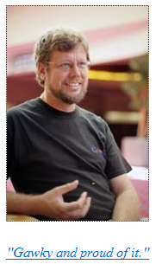
Python History
Developed in the early 1990s by Guido van Rossum.
Python was designed with a tradeoff in mind (from “Python for everyone” (Horstman and Necaise):
  Pro: Python programmers could quickly write programs (and not be burdened with an overly difficult language)
  Con: Python programs weren’t optimized to run as efficiently as programs written in some other languages.
From:
http://www.python.org/~guido/

Slide 6
Working From Home
Remotely login to the Computer Science network
    Advantage:
      The interface will be the same in the CPSC lab vs. working at home.
      If you login to the correct machine then your program is guaranteed to work in the lab (pick a “Linux” based machine).
      No need to transfer files because you are directly editing them on your CPSC account when you are at home
    Drawback:
      There is a fair learning curve at first
  Example: Connect using a remote login program such as SSH or Putty
    Info: http://pages.cpsc.ucalgary.ca/~tamj/resources/new_CPSC_student/working_at_home.html
    Downloads:
      Working from home, use Putty: http://www.ucalgary.ca/cpsc/files/cpsc/putty.zip
      Transferring files to/from home, use Filezilla: https://filezilla-project.org/
      (The remote login software SSH comes with MacOS so no download is needed).
    Sometime later in the semester, in tutorial, the Teaching Assistants will show you how to use these programs.

Slide 7
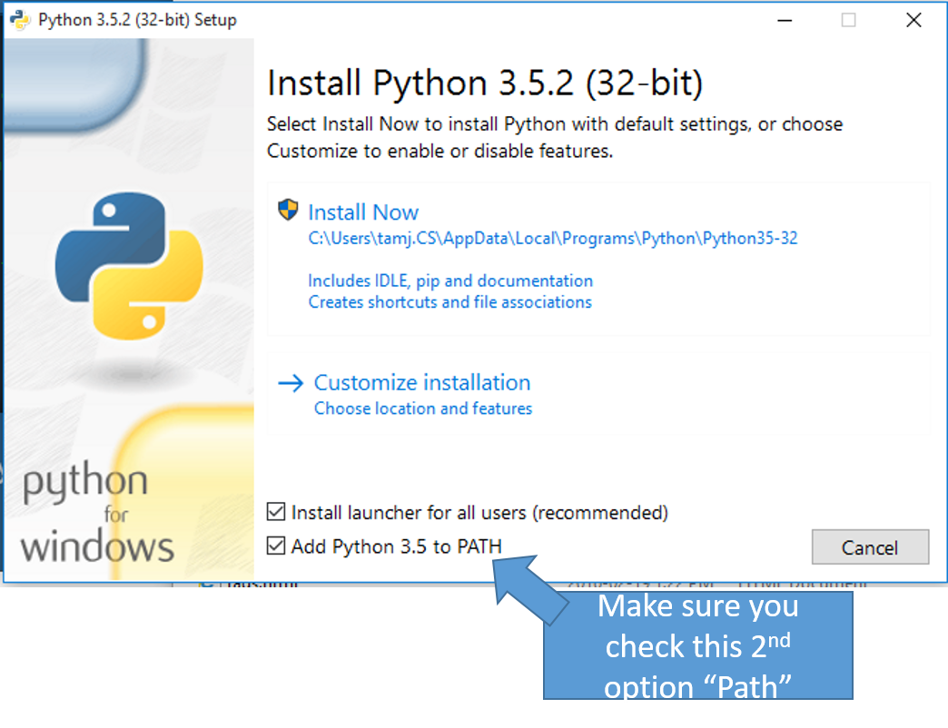
Working From Home (Installing Python)
Alternative (OK for 217/231 but not recommended for 219/233): Getting Python (get version 3.X and not version 2.X)
  http://www.python.org/download/

Slide 8
Online Help: Official Python Site
Basic explanation of concepts (for beginners: along with examples to illustrate)
  http://docs.python.org/py3k/tutorial/index.html
  (You may want to skip Step #1 and proceed immediately onto Step 2.1 and continue onto Step #3)

Slide 9

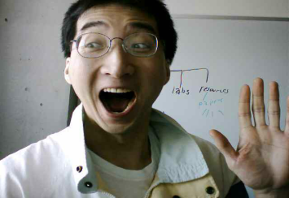
The Process Of Creating A Computer Program
‘Typical’ programmer
Translation
A special computer program (translator) translates the program written by the programmer into the only form that the computer can understand (machine language/binary)
Program Creation
A person (programmer) writes a computer program (series of instructions).
The program is written and saved using a text editor.
The instructions in the programming language (e.g., Python) are high level (look much like a human language).
Execution
The machine/binary language instructions can now be directly executed by the computer.
# Details in 2nd year
10000001
10010100 10000100
10000001 01010100
# Details later this term
list = [1,2,’a’]
for element in list
print(element)
(Images curtesy of James Tam)

Slide 10
Types Of Translators
  Interpreters (e.g., Python is an interpreted language)
    Each time the program is run the interpreter translates the program (translating a part at a time).
    If there are any translation errors during the process of interpreting the program, the program will stop execution right when the error is encountered.
  Compilers (e.g., ‘C’, C++ are compiled languages)
    Before the program is run the compiler translates the program all at once.
    If there are any translation errors during the compilation process, no machine language executable will be produced (nothing to execute)
    If there are no translation errors during compilation then a machine language program is created which can then be executed .

Slide 11
Location Of My Online Examples
Finding them via the WWW:
  URL: http://pages.cpsc.ucalgary.ca/~tamj/2017/231P/examples
Finding them in UNIX when you are logged onto a computer in the lab (or remotely logged in using Putty)
  Directory: /home/231/examples
The locations of the example programs that are specific to this section of notes (each section will have be located in a sub-directory/sub-link):
  http://pages.cpsc.ucalgary.ca/~tamj/2017/231P/examples/intro
  /home/231/examples/intro
FYI: examples I give TA’s for tutorials will be in a different location:
  http://pages.cpsc.ucalgary.ca/~tamj/2017/231P/tutorialSchedule.html
  /home/231/tutorials

Slide 12
The First Python Program
Program name: small.py
Filename: small.py
print ("hello",end="")

Slide 13
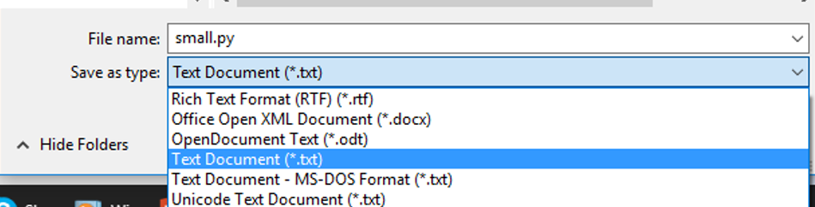
Creating/Running Programs: One Operating System
The process is similar on other platforms/OS’s (the TA’s will show you how to do it on the lab computers (Linux) during tutorials).
  Step 1: Writing your program
  You need a text editor (e.g., WordPad, Notepad, Notepad++) to enter the program.
  It can be done using any editor that you want, but don’t use a word processor (e.g., MS-Word) and remember to save it as a text file ending with the suffix dot-py “.py”

Slide 14
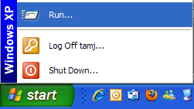
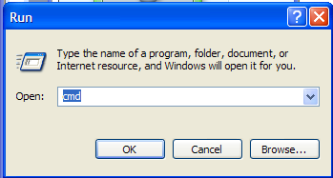

Creating/Running Programs: One Operating System (2)
  Step 2: Translating and running your program
  You need to open a command line to translate/run your Python program.
  The name of the Python translator is “Python”
  To translate/run your program type “python filename.py” at the command line.
    The first example program would be executed by typing “python small.py”
    For a program whose filename is called “output1.py” you would type “python output1.py”.
Running /translating the program
Output of program (result of running the program)

Slide 15
Important Reminders
Make sure you type the whole file name (including the part after the period) when you translate/run your program.
  E.g., “python small.py”
Unless you are very familiar with your operating system when you translate/run a program you should first navigate to the directory/folder where your Python program resides.
  JT: the ‘cd’ command changes your directory (Windows and UNIX although something different is needed when changing Windows drives)
  Suppose my program was under:
    C:\231 (Windows)
    OR
    /home/231 (UNIX)
  To reach this location you could (shortcuts excluded for now) then type:
    c:\231 (Windows)
    OR
    cd /home/231 (UNIX)

Slide 16
Section Summary: Writing A Small “Hello World” Program
You should know exactly what is required to create/run a simple, executable Python program.
  While you may not be able to create a new program from scratch at this point, you should be able to enter/run small.py yourself.

Slide 17
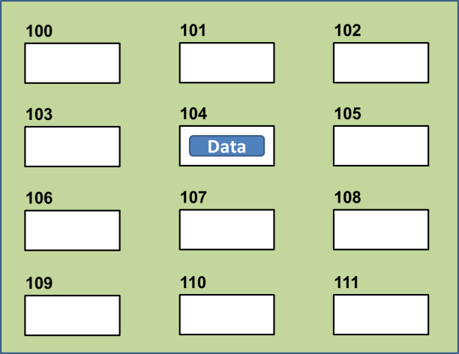
Variables
Set aside a location in memory.
Used to store information (temporary).
  This location can store one ‘piece’ of information.
    Putting another piece of information at an existing location overwrites previous information.
  At most the information will be accessible as long as the program runs i.e., it’s temporary
Some types of information which can be stored in variables include: integer (whole), floating point (fractional), strings (essentially any characters you can type and more)
  Format (creating):
  <name of variable> = <Information to be stored in the variable>
  Examples (creating):
  Integer (e.g., num1 = 10)
  Floating point (e.g., num2 = 10.0)
  Strings: alpha, numeric, other characters enclosed in quotes.
    e.g., name = "james"
    To be safe get in the habit of using double (and not single) quotes
Image curtesy of James Tam

Slide 18

The Assignment Operator: =
The assignment operator '=' used in writing computer programs does not have the same meaning as mathematics.
  Don’t mix them up!
Example:
  y = 3
  x = y
  x = 6
  y = 13
What is the end result? How was this derived (what are the intermediate results from each assignment/line above)?
See the program ‘assignment.py’
Notes:
[csc intro 11 ]> python3 assignment.py
3
3 3
6 3
6 13
Stress to students that unlike Math: x & y are separate memory locations and while they CAN contain the same information they do not have because they are SEPARATE

Slide 19
Variable Naming Conventions
Python requirements:
  Rules built into the Python language for writing a program.
  Somewhat analogous to the grammar of a ‘human’ language.
  If the rules are violated then the typical outcome is the program cannot be translated (nor run).
    A language such as Python may allow for a partial execution (it runs until the error is encountered).
Style requirements:
  Approaches for producing a well written program.
  (The real life analogy is that something written in a human language may follow the grammar but still be poorly written).
  If style requirements are not followed then the program can still be translated but there may be other problems (more on this during the term).

Slide 20
Variable Naming Conventions (2)
  Style requirement: The name should be meaningful.
  Style and Python requirement: Names must start with a letter (Python requirement) and should not begin with an underscore (style requirement).
  Style requirement: Names are case sensitive but avoid distinguishing variable names only by case.
Examples
#1:
age (yes) x, y (no)
#2
height (yes) 2x, _height (no)
#3
Name, name, nAme (no to this trio)

Slide 21
Variable Naming Conventions (2)
  Style requirement: Variable names should generally be all lower case (see next point for the exception).
  Style requirement: For names composed of multiple words separate each word by capitalizing the first letter of each word (save for the first word) or by using an underscore. (Either approach is acceptable but don’t mix and match.)
  Python requirement: Can't be a keyword (see next slide).
Examples
#4:
age, height, weight (yes)
Age, HEIGHT (no)
#5
firstName, last_name
(yes to either approach)

Slide 22
Key Words In Python¹
and del from not while
as elif global or with
assert else if pass yield
break except import print
class exec in raise
continue finally is return
def for lambda try
1 From “Starting out with Python” by Tony Gaddis

Slide 23
Variable Naming Conventions: Bottom Line
Both Python and style requirements should be followed when creating your variables.

Slide 24
Extra Practice
Come up with example names that violate and conform to the naming conventions.
  (You will have to go through this process as you write your programs anyhow so it’s a good idea to take about 5 – 10 minutes to make sure that you know the requirements).

Slide 25
Section Summary: Variables
What is a variable
What are some types of variables available in Python
How to create a variable in Python
What are naming conventions for variables

Slide 26

Displaying Output Using The Print() Function
This function takes zero or more arguments (inputs)
  Multiple arguments are separated with commas
  print() will display all the arguments followed by a blank line (move the cursor down a line).
    end="" isn’t mandatory but can be useful to prevent Python from adding the extra line (when precise formatting is needed)
  Zero arguments just displays a blank line
Simple Examples (output1.py)
  print("hi")
  print("hey",end="")
  print("-sup?")

Slide 27

Print("… ") Vs. Print(<name>)
Enclosing the value in brackets with quotes means the value in between the quotes will be literally displayed onscreen.
Excluding the quotes will display the contents of a memory location.
Example: output3.py
  aString = "Some message"
  print(aString)
  print("aString")

Slide 28

Print("… ") Vs. Print(<name>): 2
Exercise 1: remove these quotes and see if you can correctly predict the results.
Exercise 2: remove parts: 1) end=“” 2) print() and see if you can correctly predict the results.
1 From what you’ve learned thus far each argument can be a constant string or name of a variable.
Format:
  print(arg1,arg2 … )¹
Example: output2.py
  num = 10.0
  name = "james"
  print("Sup?")
  print("num=", end="")
  print(num)
  print()
  print("My name: ", name)

Slide 29
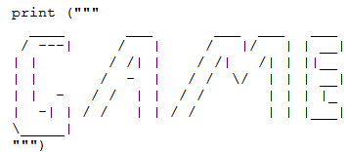
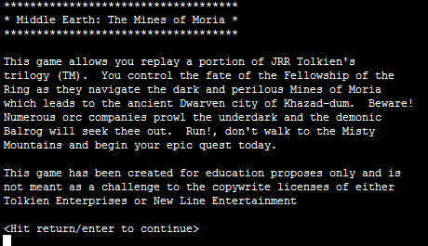
Triple Quoted Output
Used to format text output (free form and to reduce the number of calls to the print() function)
The way in which the text is typed into the program is exactly the way in which the text will appear onscreen.
Program name: formatting1.py
From Python Programming (2nd Edition) by Michael Dawson
From a CPSC 231 assignment courtesy of James Tam

Slide 30
By Default Output Is Unformatted
Example:
  num = 1/3
  print("num=",num)
Sometimes you get extra spaces (or blank lines)
The number of places of precision is determined by the language not the programmer
There may be other issues e.g., you want to display output in columns of fixed width, or right/left aligned output
There may be times that specific precision is needed in the displaying of floating point values

Slide 31
Formatting Output
Output can be formatted in Python through the use of format specifiers and escape codes

Slide 32

Format Specifiers (If There Is Time)
Format:
  print ("%<type of info to display/code>" %<source of the info to display>)
Example (starting with simple cases):
  Program name: formatting2.py
  num = 123
  st = "cpsc 231"
  print("num=%d" %num)
  print("course: %s" %st)
  num = 12.5
  print("%f %d" %(num,num))
Doesn’t literally display this: Placeholder (for information to be displayed)

Slide 33
Types Of Information That Can Be Formatted Via Format Specifiers (Placeholder) (If There Is Time)
Specifier | Type of Information to display
%s | String
%d | Integer (d = decimal / base 10)
%f | Floating point

Slide 34

Formatting Effects Using Format Specifiers (If There Is Time)
Format:
  %<width>¹.<precision>²<type of information>
Examples (format specifiers to format output):
  Program name: formatting3.p
  num = 12.55
  print ("%4.1f" %num)
  print ("%5.1f" %num)
  print ("%3.1f" %num)
  print ("%3s%-3s" %("ab", "ab"))
  print ("%-3s%3s" %("ab", "ab"))
1 A positive integer will add leading spaces (right align), negatives will add trailing spaces (left align). Excluding a value will set the field width to a value large enough to display the output
2 For floating point data only.

Slide 35
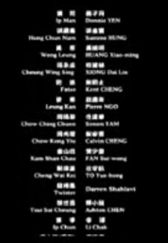
One Application Of Format Specifiers (If There Is Time)
It can be used to align columns of text.
Example (movie credits, tabular or financial information)

Slide 36
Section Summary: Formatting Output (If There Is Time)
How to use format specifiers (field width, precision) to format output

Slide 37
Escape Codes/Characters
The back-slash character enclosed within quotes won’t be displayed but instead indicates that a formatting (escape) code will follow the slash:
Escape sequence | Description
\a | Alarm: Causes the program to beep.
\n | Newline: Moves the cursor to beginning of the next line.
\t | Tab: Moves the cursor forward one tab stop.
\' | Single quote: Prints a single quote.
\" | Double quote: Prints a double quote.
\\ | Backslash: Prints one backslash.

Slide 38
Percent Sign¹ (If There Is Time)
If no format specifiers are used then simply enclose the ‘%’ within the quotes of a print() statement
  print("12%") → 12%
If format specifiers are used within a call to print() then use one percent sign to act as an escape code for another percent sign to follow
    print("%f%%", %(100)) → 100.000000%
1 Since the question inevitably comes up each term I’m answering it here

Slide 39

Escape Codes (2)
Program name: formatting4.py
  print ("\a*Beep!*")
  print ("hi\nthere")
  print ('it\'s')
  print ("he\\y \"you\"")

Slide 40
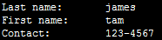
Escape Codes: Application
It can be used to nicely format text output (alignment output, provide separators within and between lines)
Program example: formatting5.py
  firstName = "James"
  lastName = "Tam"
  mobile = "123-4567"
  print("Last name:\t", lastName)
  print("First name:\t", firstName)
  print("Contact:\t", mobile)
Escape codes for aligning text is even more valuable if the width of a field (data to be displayed) is variable e.g., comes from user input or a text file.

Slide 41
Section Summary: Escape Codes
How to use escape codes to format output

Slide 42
Extra Practice
Traces:
  Modify the examples (output using format specifiers and escape codes) so that they are still valid Python statements.
    Alternatively you can try finding some simple ones online or from a textbook.
  Hand trace the code (execute on paper) without running the program.
  Then run the program and compare the actual vs. expected result.
Program writing:
  Write a program the will right-align text into 3 columns of data.
  Write a program the will left-align text into 3 columns of data.

Slide 43
Reminder: Variables
By convention variable names are all lower case
The exception is long (multi-word) names
As the name implies their contents can change as a program runs e.g.,
  income = 300000
  income = income + interest
  Income = income + bonuses

Slide 44
Named Constants
They are similar to variables: a memory location that’s been given a name.
Unlike variables their contents shouldn’t change.
The naming conventions for choosing variable names generally apply to constants but the name of constants should be all UPPER CASE. (You can separate multiple words with an underscore).
Example PI = 3.14
  PI = Named constant, 3.14 = Unnamed constant
They are capitalized so the reader of the program can distinguish them from variables.
  For some programming languages the translator will enforce the unchanging nature of the constant.
  For languages such as Python it is up to the programmer to recognize a named constant and not to change it.

Slide 45
Why Use Named Constants
They make your program easier to read and understand
  # NO
  populationChange = (0.1758 – 0.1257) * currentPopulation
Vs.
    #YES
    BIRTH_RATE = 17.58
    MORTALITY_RATE = 0.1257
    currentPopulation = 1000000
    populationChange = (BIRTH_RATE - MORTALITY_RATE) * currentPopulation
Avoid unnamed constants whenever possible!

Slide 46
Why Use Named Constants (2)
2) Makes the program easier to maintain
  If the constant is referred to several times throughout the program, changing the value of the constant once will change it throughout the program.
  Using named constants is regarded as “good style” when writing a computer program.

Slide 47
Purpose Of Named Constants (3)
BIRTH_RATE = 0.998
MORTALITY_RATE = 0.1257
populationChange = 0
currentPopulation = 1000000
populationChange = (BIRTH_RATE - MORTALITY_RATE) * currentPopulation
if (populationChange > 0):
print("Increase")
print("Birth rate:", BIRTH_RATE, " Mortality rate:", MORTALITY_RATE, " Population change:", populationChange)
elif (populationChange < 0):
print("Decrease")
print("Birth rate:", BIRTH_RATE, " Mortality rate:", MORTALITY_RATE, "Population change:", populationChange)
else:
print("No change")
print("Birth rate:", BIRTH_RATE, " Mortality rate:", MORTALITY_RATE, "Population change:", populationChange)

Slide 48
Purpose Of Named Constants (4)
One change in the initialization of the constant changes every reference to that constant
BIRTH_RATE = 0.998
MORTALITY_RATE = 0.1257
populationChange = 0
currentPopulation = 1000000
populationChange = (BIRTH_RATE - MORTALITY_RATE) * currentPopulation
if (populationChange > 0):
print("Increase")
print("Birth rate:", BIRTH_RATE, " Mortality rate:", MORTALITY_RATE, " Population change:", populationChange)
elif (populationChange < 0):
print("Decrease")
print("Birth rate:", BIRTH_RATE, " Mortality rate:", MORTALITY_RATE, "Population change:", populationChange)
else:
print("No change")
print("Birth rate:", BIRTH_RATE, " Mortality rate:", MORTALITY_RATE, "Population change:", populationChange)

Slide 49
Purpose Of Named Constants (5)
BIRTH_RATE = 0.1758
MORTALITY_RATE = 0.0001
populationChange = 0
currentPopulation = 1000000
populationChange = (BIRTH_RATE - MORTALITY_RATE) * currentPopulation
if (populationChange > 0):
print("Increase")
print("Birth rate:", BIRTH_RATE, " Mortality rate:", MORTALITY_RATE, " Population change:", populationChange)
elif (populationChange < 0):
print("Decrease")
print("Birth rate:", BIRTH_RATE, " Mortality rate:", MORTALITY_RATE, "Population change:", populationChange)
else:
print("No change")
print("Birth rate:", BIRTH_RATE, " Mortality rate:", MORTALITY_RATE, "Population change:", populationChange)
One change in the initialization of the constant changes every reference to that constant

Slide 50
When To Use A Named Constant?
(Rule of thumb): If you can assign a descriptive, useful, self-explanatory name to a constant then you probably should.
Example 1 (easy to provide self explanatory constant name)
  INCH_CM_RATIO = 2.54
  height = height * INCH_CM_RATIO
Example 2 (providing self explanatory names for the constants is difficult)
  calories used = (10 x weight) + (6.25 x height) - [(5 x age) - 161]

Slide 51
Extra Practice
Provide a formula where it would be appropriate to use named constants (should be easy).
Provide a formula where unnamed constants may be acceptable (may be trickier).
Search for formulas in science articles online if you can’t think of any.

Slide 52
Section Summary: Named Constants
What is a named constant
  How does it differ from a variable
  How does it differ from an unnamed constant
  What are some reasons for using named constants
Naming conventions for named constants

Slide 53
Arithmetic Operators
Operator | Description | Example
= | Assignment | num = 7
+ | Addition | num = 2 + 2
- | Subtraction | num = 6 - 4
* | Multiplication | num = 5 * 4
/ | Division | num = 9 / 2
// | Integer division | num = 9 // 2
% | Modulo | num = 9 % 2
** | Exponent | num = 9 ** 2
4.5
4
1
81

Slide 54
Order Of Operation
First level of precedence: top to bottom
Second level of precedence
  If there are multiple operations that are on the same level then precedence goes from left to right.
() | Brackets (inner before outer)
** | Exponent
*, /, //, % | Multiplication, division, modulo
+, - | Addition, subtraction
= | Assignment
Example
x = 3 * 2 ** 3
Vs.
x = (3 * 2) ** 3

Slide 55
Order Of Operation And Style
Even for languages where there are clear rules of precedence (e.g., Java, Python) it’s good style to explicitly bracket your operations and use blank spaces as separators.
  x = (a * b) + (c / d)
It not only makes it easier to read complex formulas but also a good habit for languages where precedence is not always clear (e.g., C++, C).

Slide 56

Input
The computer program getting string information from the user.
Strings cannot be used for calculations (information for getting numeric input will provided shortly).
Format:
  <variable name> = input()
  OR
  <variable name> = input("<Prompting message>")
Example: Program name: input1.py
  print("What is your name: ")
  name = input()
OR
  name = input("What is your name: ")
  OR
  print("What is your name: ", end="")
  name = input()
Avoid alignment issues such as this

Slide 57


Variables: Storing Information (If There Is Time)
On the computer all information is stored in binary (2 states)
  Example: RAM/memory stores information in a series of on-off combinations
  A single off/off combination is referred to as a ‘bit’
Bit
on
OR
off
Byte
8 bits

Slide 58
Variables: Storing Information (If There Is Time)
Information must be converted into binary to be stored on a computer.
User enters
Can be stored as
13

Slide 59
Storing Integer Information (If There Is Time)
1 bit is used to represent the sign, the rest is used to store the size of the number
  Sign bit: 1/on = negative, 0/off = positive
Format:
Previous example
Positive number
1 bit
Digits representing the size of the number (all the remaining bits)
Negative number
Size of number, in this case = 13
Positive number

Slide 60
Storing Real Numbers In The Form Of Floating Point (If There Is Time)
  Mantissa: digits of the number being stored
  Exponent: the direction (negative = left, positive=right) and the number of places the decimal point must move (‘float’) when storing the real number as a floating point value.
Examples with 5 digits used to represent the mantissa:
  e.g. One: 123.45 is represented as 12345 * 10⁻²
  e.g. Two: 0.12 is represented as 12000 * 10⁻⁵
  e.g. Three: 123456 is represented as 12345 * 10¹
Remember: Using floating point numbers may result in a loss of accuracy (the float is an approximation of the real value to be stored).
Sign
Mantissa
Exponent
1 bit
Several bits
Several bits

Slide 61
Storing Character Information (If There Is Time)
Typically characters are encoded using ASCII
Each character is mapped to a numeric value
  E.g., ‘A’ = 65, ‘B’ = 66, ‘a’ = 97, ‘2’ = 50
These numeric values are stored in the computer using binary
Character | ASCII numeric code | Binary code
‘A’ | 65 | 01000001
‘B’ | 66 | 01000010
‘a’ | 97 | 01100001
‘2’ | 50 | 00110010

Slide 62
Storing Information: Bottom Line
Why it important to know that different types of information is stored differently?
  One motivation: sometimes students don’t why it’s significant that “123” is not the same as the number 123.
  Certain operations only apply to certain types of information and can produce errors or unexpected results when applied to other types of information.
Example
  num = input("Enter a number")
  numHalved = num / 2

Slide 63
Converting Between Different Types Of Information
Example motivation: you may want numerical information to be stored as a string (for built in string functions e.g., check if a string consists only of numbers) but also you want to perform calculations).
Some of the conversion mechanisms (functions) available in Python:
  Format:
    int(<value to convert>)
    float(<value to convert>)
    str(<value to convert>)
  Examples:
  Program name: convert1.py
  x = 10.9
  y = int(x)
  print(x,y)
Value to convert
( )
Conversion function
Converted result

Slide 64

Converting Between Different Types Of Information (2)
Examples:
Program name: convert2.py
x = "100"
y = "-10.5"
print(x + y)
print(int(x) + float(y))

Slide 65
Converting Types: Extra Practice
Determine the output of the following program:
  print(12+33)
  print('12'+'33')
  x = 12
  y = 21
  print(x+y)
  print(str(x)+str(y))

Slide 66

Converting Between Different Types Of Information: Getting Numeric Input
The ‘input()’ function only returns string information so the value returned must be converted to the appropriate type as needed.
  Example
  Program name: convert3.py
  # No conversion performed: problem!
  HUMAN_CAT_AGE_RATIO = 7
  age = input("What is your age in years: ")
  catAge = age * HUMAN_CAT_AGE_RATIO
  print ("Age in cat years: ", catAge)
‘Age’ refers to a string not a number.
The ‘*’ is not mathematical multiplication

Slide 67

Converting Between Different Types Of Information: Getting Numeric Input (2)
  # Input converted: Problem solved!
  HUMAN_CAT_AGE_RATIO = 7
  age = int(input("What is your age in years: "))
  catAge = age * HUMAN_CAT_AGE_RATIO
  print("Age in cat years: ", catAge)
‘Age’ converted to an integer.
The ‘*’ now multiplies a numeric value.

Slide 68
Section Summary: Input, Representations
How to get user input in Python
How do the different types of variables store/represent information (optional/extra for now)
How/why to convert between different types

Slide 69
Program Documentation
Program documentation: Used to provide information about a computer program to another programmer (writes or modifies the program).
This is different from a user manual which is written for people who will use the program.
Documentation is written inside the same file as the computer program (when you see the computer program you can see the documentation).
The purpose is to help other programmers understand the program: what the different parts of the program do, what are some of it’s limitations etc.

Slide 70
Program Documentation (2)
Doesn’t contain instructions for the computer to execute.
Not translated into machine language.
Consists of information for the reader of the program:
  What does the program as a while do e.g., calculate taxes.
  What are the specific features of the program e.g., it calculates personal or small business tax.
  What are it’s limitations e.g., it only follows Canadian tax laws and cannot be used in the US. In Canada it doesn’t calculate taxes for organizations with yearly gross earnings over $1 billion.
  What is the version of the program
    If you don’t use numbers for the different versions of your program then simply use dates (tie versions with program features – more on this in a moment “Program versioning and backups”).

Slide 71
Program Documentation (3)
Format (single line documentation):
# <Documentation>
Examples:
    # Tax-It v1.0: This program will electronically calculate
    # your tax return. This program will only allow you to complete
    # a Canadian tax return.
The number sign ‘#” flags the translator that the remainder of the line is documentation.

Slide 72
Program Documentation (4)
Format (multiline documentation):
""" <Start of documentation>
  ...
  <End of documentation> """
Examples:
    """
    Tax-It v1.0: This program will electronically calculate
    # your tax return. This program will only allow you to complete
    # a Canadian tax return.
    """

Slide 73
Program Versioning And Back Ups
As significant program features have been completed (tested and the errors removed/debugged) a new version should be saved in a separate file.
Game.py
Game.Sept20
# Version: Sept 20, 2012
# Program features:
# (1) Load game
# (2) Show game world
Make backup file
# Version: Sept 20, 2012
# Program features:
# (1) Load game
# (2) Show game world

Slide 74
Program Versioning And Back Ups
As significant program features have been completed (tested and the errors removed/debugged) a new version should be saved in a separate file.
Game.Oct2
# Version: Oct 2, 2012
# Program features:
# (1) Save game
# Version: Sept 20, 2012
# Program features:
# (1) Load game
# (2) Show game world
Game.py
# Version: Oct 2, 2012
# Program features:
# (1) Save game
# Version: Sept 20, 2012
# Program features:
# (1) Load game
# (2) Show game world
Make new backup file
Game.Sept20
# Version: Sept 20, 2012
# Program features:
# (1) Load game
# (2) Show game world
Notes:
s

Slide 75
Backing Up Your Work
Do this every time that you have completed a significant milestone in your program.
  What is ‘significant’ will vary between people but make sure you do this periodically.
Ideally the backup file should be stored in a separate directory/folder (better yet on a separate device and/or using an online method such as an email attachment or ‘cloud’ storage).
Common student reason for not making copies: “Backing up files takes time!”
Compare:
  Time to copy a file: ~10 seconds (generous in some cases).
  Time to re-write your program to implement the feature again: 10 minutes (might be overly conservative in some cases).
Failing to backup your work is not a sufficient reason for receiving an extension.

Slide 76
Types Of Documentation
Header documentation
Inline documentation

Slide 77
Header Documentation
Provided at the beginning of the program.
It describes in a high-level fashion the features of the program as a whole (major features without a great deal of detail).
# HEADER DOCUMENTATION
# Word Processor features: print, save, spell check, insert images etc.
<program statement>
<program statement>

Slide 78
Inline Documentation
Provided throughout the program.
It describes in greater detail the specific features of a part of the program (function, loop, branch, group of related statements).
# Documentation: Saving documents
# ‘save’: save document under the current name
# ‘save as’ rename the document to a new name
<program statement>
<program statement>
# Documentation: Spell checking
# The program can spell check documents using the following English variants:
# English (British), English (American), English (Canadian)
<program statement>
<program statement>

Slide 79
Over-Documenting A Program
Except for very small programs documentation should be included
However it is possible to over-document a program
(Stating the obvious)
  num = num + 1 # Variable num increased by one
(Documentation can be useful in this case)
  lastRow = SIZE – 1 # Row numbering begins at zero
  Example: there are 3 rows in a list (size = 3)
  First row = 0
  Second row = 1
  Third (and last) row = 2 (equals 3-1 = 2)

Slide 80
Section Summary: Documentation
What is program documentation
What sort of documentation should be written for your programs
How program documentation ties into program versioning and backups

Slide 81
Prewritten Python Functions
Python comes with many functions that are a built in part of the language e.g., ‘print()’, ‘input()’
(If a program needs to perform a common task e.g., finding the absolute value of a number, then you should first check if the function has already been implemented).
For a list of all prewritten Python functions.
  https://docs.python.org/3/library/functions.html
  Note: some assignments may have specific instructions which list functions you are allowed to use (assume that you cannot use a function unless: (1) it’s extremely common e.g., input and output (2) it’s explicitly allowed )
  Read the requirements specific to each assignment
  When in doubt don’t use the pre-created code either ask or don’t use it and write the code yourself. (If you end up using a pre-created function rather than writing the code yourself you could receive no credit).

Slide 82
Types Of Programming Errors
Syntax/translation errors
Runtime errors
Logic errors

Slide 83
Syntax/ Translation Errors
Each language has rules about how statements are to be structured.
An English sentence is structured by the grammar of the English language:
  My cat sleeps the sofa.
Python statements are structured by the syntax of Python:
  5 = num
Grammatically incorrect (FYI: missing the preposition to introduce the prepositional phrase ‘the sofa’)
Syntactically incorrect: the left hand side of an assignment statement cannot be a literal (unnamed) constant (or variable names cannot begin with a number)

Slide 84
Syntax/ Translation Errors (2)
The translator checks for these errors when a computer program is translated to machine language.

Slide 85

Some Common Syntax Errors
Miss-spelling names of keywords
  e.g., ‘primt()’ instead of ‘print()’
Forgetting to match closing quotes or brackets to opening quotes or brackets e.g., print("hello)
Using variables before they’ve been named (allocated in memory).
Program name: error_syntax.py
print(num)
num = 123

Slide 86
Runtime Errors
Occur as a program is executing (running).
The syntax of the language has not been violated (each statement follows the rules/syntax).
During execution a serious error is encountered that causes the execution (running) of the program to cease.
With a language like Python where translation occurs just before execution (interpreted) the timing of when runtime errors appear won’t seem different from a syntax error.
But for languages where translation occurs well before execution (compiled) the difference will be quite noticeable.
A common example of a runtime error is a division by zero error.
  We will talk about other run time errors later.

Slide 87

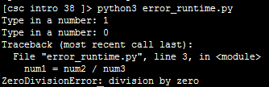
Runtime Error¹: An Example
Program name: error_runtime.py
  num2 = int(input("Type in a number: "))
  num3 = int(input("Type in a number: "))
  num1 = num2 / num3 # When zero is entered
  print(num1)
1 When ‘num3’ contains zero

Slide 88

Logic Errors
The program has no syntax errors.
The program runs from beginning to end with no runtime errors.
But the logic of the program is incorrect (it doesn’t do what it’s supposed to and may produce an incorrect result).
Program name: error_logic.py
  print ("This program will calculate the area of a rectangle")
  length = int(input("Enter the length: "))
  width = int(input("Enter the width: "))
  area = length + width
  print("Area: ", area)

Slide 89
Some Additional Examples Of Errors
All external links (not produced by your instructor):
  http://level1wiki.wikidot.com/syntax-error
  http://www.cs.bu.edu/courses/cs108/guides/debug.html
  http://cscircles.cemc.uwaterloo.ca/1e-errors/
  http://www.greenteapress.com/thinkpython/thinkCSpy/html/app01.html

Slide 90
Practice Exercise
(This one will be an ongoing task).
As you write you programs, classify the type of errors that you encounter as: syntax/translation, runtime or logical.

Slide 91
Section Summary: The 3 Error Types
What are different categories of errors
What is the difference between the categories of errors and being able to identify examples of each

Slide 92
Layout And Formatting
Similar to written text: all computers programs (except for the smallest ones) should use white space to group related instructions and to separate different groups.
  # These are output statements to prompt for user information
  Instruction1
  Instruction2
  Instruction3
  Instruction4
  # These are instructions to perform calculations on the user
  # input and display the results
  Instruction5
  Instruction6

Slide 93
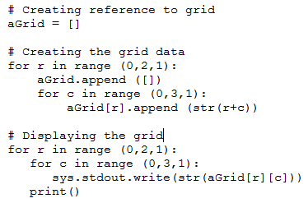
Layout And Formatting: Example

Slide 94
Section Summary: Layout And Formatting
Why is layout and formatting of programs important, how to do it

Slide 95
Extra: In Case You’re Interested
Different languages may have unique style guides
Here is the style guide for Python:
  http://legacy.python.org/dev/peps/pep-0008/

Slide 96
After This Section You Should Now Know
How to create, translate and run Python programs.
Variables:
  What they are used for
  How to access and change the value of a variable
  Conventions for naming variables
  How information is stored differently with different types of variables, converting between types
Output:
  How to display messages that are a constant string or the value stored in a memory location (variable or constant) onscreen with print()
How/why use triple quoted output
How to format output through:
  The use of format specifiers
  Escape codes

Slide 97
After This Section You Should Now Know (2)
Named constants:
  What are named constants and how they differ from regular variables
  What are the benefits of using a named constant vs. unnamed constant
What are the Python operators for common mathematical operations
How do the precedence rules/order of operation work in Python
Input:
  How to get a program to acquire and store information from the user of the program
What is program documentation and what are some common things that are included in program documentation
The existence of prewritten Python functions and how to find descriptions of them

Slide 98
After This Section You Should Now Know (3)
What are the three programming errors, when do they occur and what is the difference between each one
How to use formatting to improve the readability of your program

