Slide 1
Introduction To Computer Science
In this section you will get an overview of some research areas and higher level courses in Computer Science.

Slide 2
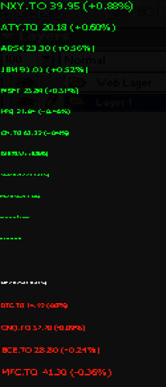
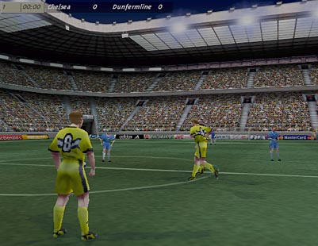
Introduction To Computer Science
Computer Science is about problem solving
Graphics:
Image curtesy of Xin Liu
Representing large sets of data
Image from:
Lau, E. (2003) Stocks.
Artificial Intelligence FIFA © Electronic Arts.
Notes:
Problem solving need not be simplistic code examples that first year students have seen thus far
Graphics: creating algorithms for producing realistic images (e.g. shown is the work of a former grad student here)
InfoViz: how to represent large sets of data so users can find and make sense of the information (e.g. shown is the visualization of stock market information and the actual work of a former undergrad student)
AI (multi-agent) Jorg’s work with EA: his agents would ‘play’ the FIFA soccer game and try to find bugs

Slide 3
Some Areas Of Study And Research In Computer Science
Human-Computer Interaction
Computer Graphics
Information Visualization
Databases
Computer theory
Computer networking and distributed systems
Artificial Intelligence
Computer Vision
Software Engineering
Computer Security
Games programming
This list provides only a brief introduction to the different areas of Computer Science and is far from comprehensive: For a more updated list of research areas: http://www.cpsc.ucalgary.ca/Research/
Calendar (courses):
http://www.ucalgary.ca/pubs/calendar/current/computer-science.html
http://www.ucalgary.ca/pubs/calendar/current/software-engineering.html

Slide 4
Human-Computer Interaction (HCI)
Most of Computer Science deals with the ‘technical’ side of computers such as:
Run computers faster!
Make computers store more information!!
Increase the networking capabilities of computers!!!
These technical issues (and others) are all very important but something is still missing...
For more information: http://ilab.cpsc.ucalgary.ca/

Slide 5
Human-Computer Interaction (HCI)
Most of Computer Science deals with the ‘technical’ side of computers such as:
Run computers faster!
Make computers store more information!!
Increase the networking capabilities of computers!!!
Increase the networking capabilities of computers!!!
These technical issues (and others) are all very important but something is still missing...
For more information: http://ilab.cpsc.ucalgary.ca/
Notes:
* These are technical issues

Slide 6
Human-Computer Interaction
...but don’t forget about the other side of the relationship.
No matter how powerful the computer and how well written is the software, if the user can’t figure out how it works then the system is useless.
Software should be written to make it as easy as possible for the user to complete their task. (Don’t make it any harder than it has to be).
This is just common sense and should/is always taken into account when writing software?
Common sense?...come on!

Slide 7
Previous Examples
Cases where designing “user-friendly” technology was not just a matter of commonsense.
Notes:
* Ask students to solicit their own examples and experiences

Slide 8
What Is Human-Computer Interaction?
Difficult to use
Easy to use
Or at least easier to use
Notes:
It may be idea to say you will make easy to use software and technology
In some complex task domains making ‘easy to use’ software may not be possible (leaves out important aspects of the task e.g., 3D drawing tools)
So in those cases the goal is to make the software ‘as easy to use’ as possible or at least not develop technology that gets in the way of the task

Slide 9
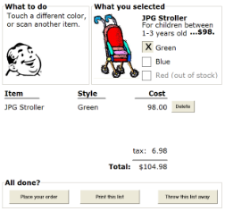
How Can This Be Done?
Many techniques have been developed.
Some may have already been covered (Usability heuristics from ‘Repetition’)
One other technique: simple but effective (user-centered design)
Basic principle: getting users involved in the design process from the beginning (rather than building the system and then getting feedback afterwards which is the traditional approach).
Many benefits:
Cost reduction: The further along the software development process the harder it is to make changes.
Users may also provide many unexpected insights
Paper sketches
Complete software (from Saul Greenberg mockup)
Notes:
Even rough paper sketches can elicit useful user feedback
Getting feedback early (sketches) rather than later (code) makes it more likely that changes can be made

Slide 10
HCI: Higher-Level Courses
CPSC 481: Human-Computer Interaction I
CPSC 581: Human-Computer Interaction II
(Related: Human-Robot Interaction)
CPSC 599.65—Robot head-based interaction
CPSC 599.62—Advanced topics in human-computer and human-robot interaction
CPSC 599.17—Human-robot interaction

Slide 11
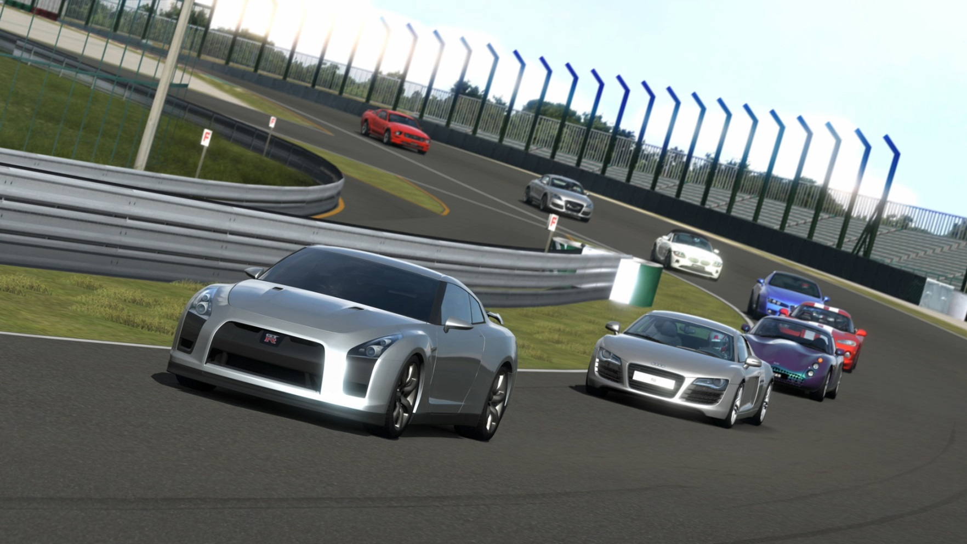
Computer Graphics
Concerned with producing and manipulating images on the computer.
Gran Turismo © Sony
For more information: http://jungle.cpsc.ucalgary.ca/
Notes:
Some even go so far as to describe graphics as everything on the computer excluding sound or text

Slide 12
Computer Graphics: Issues
How to make the images look “real”?
From http://klamath.stanford.edu/~aaa/
Notes:
Issue: How do you make the image look realistic: textures, colors, lighting effects etc.

Slide 13
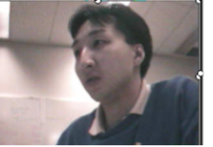
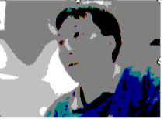
Computer Graphics: Common Misconception
It’s about creating the programs that produce the realistic images and animations (not using existing programs like Photo shop ©).

Slide 14
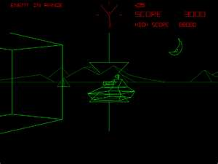
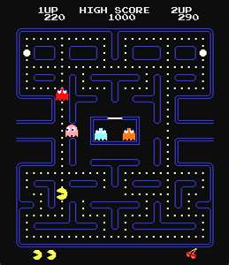
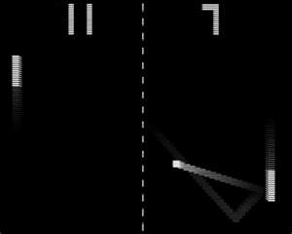
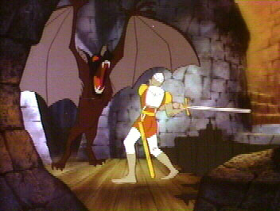
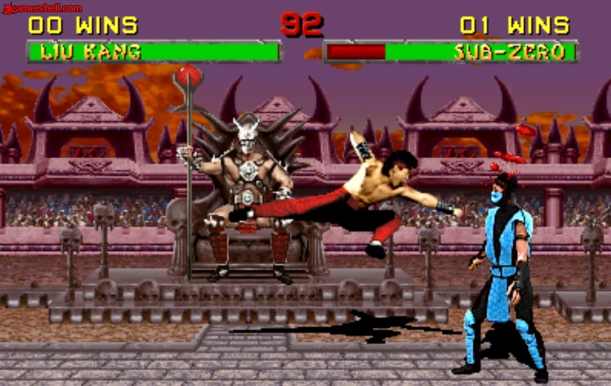
Computer ‘Graphics’ Have Come A Long Way!
“ASCII games”
‘Pacman’ http://ostatic.com
‘Battlezone’ www.sretroist.com
‘Pong’ www.world-of-games.co.uk
“Dragon’s lair” www.dragons-lair-project.com
“Mortal Kombat” www.gnomeslair.com
Notes:
ASCII graphics: graphics weren’t really ‘graphics’
Pong: early games that had actual graphics in the modern sense (albeit in a primitive form)
Battlezone and games like it employed ‘high quality’ vector graphics
Pacman: color graphics
Dragon’s lair: graphics taking a leap forward, almost as good as a cartoon
Mortal Kombat: digitized graphics (and gore) was highly contraversial

Slide 15
Computer Graphics: Still A Long Way To Go
“Even though modeling and rendering in computer graphics have been improved tremendously in the past 35 years, we are still not at the point where we can model automatically, a tiger swimming in the river in all it’s glorious details.” ¹
¹ From “The Tiger Experience” by Alain Fournier at the University of British Columbia
Notes:
* (Author): By automatically I mean in a way that does not need careful manual tweaking by an artist/expert.

Slide 16
Graphics: Some Areas
Animations
Modeling
Rendering
Image processing
Xin Liu
Xin Liu
James Tam
James Tam
Notes:
Animation: studies with ways to represent and manipulate motion
Modeling: creating the basic structure
Rendering: given a model, produce a realistic image or appearance from it
Imaging: image editing e.g., Chromakeying, reversing/mirror images

Slide 17
Graphics: Higher-Level Courses
CPSC 453: Introduction to computer graphics
CPSC 587: Fundamentals of computer animation
CPSC 589: Modeling for computer graphics
CPSC 591: Rendering

Slide 18
Artificial Intelligence
Trying to build technology that appears to be ‘intelligent’
Intelligence: What makes a person smart?
Fact retrieval?
Creativity?
Solving problems?
For more information:
http://pages.cpsc.ucalgary.ca/~jacob/AI/ http://pages.cpsc.ucalgary.ca/~denzinge/
http://pages.cpsc.ucalgary.ca/~kremer (retired)
Notes:
Intelligence often shown in movies as ability to recall facts
Better representation would be able to come up with something completely new
Or come up with an answer to a problem that doesn’t just involve brute calculations e.g., devising a manned probe to Mars given resource constraints and current technology

Slide 19
Artificial Intelligence: Some Areas
Expert systems
Neural networks

Slide 20
Expert Systems
The focus is on capturing the knowledge of a human expert as a set of rules stored in a database.
The expert system can then answer questions, diagnose problems and guide decision making.
Example applications: medicine, computer repair

Slide 21
Neural Networks
The focus is on building structures that function the way that neurons (and their connections in the brain) function.
(Simplified overview):
Neurons take electrical pulses as input and send electrical pulses as output.
A required level of input is required before the output is ‘fired’.
This approach has been applied to problems which involve pattern recognition ( e.g., visual, voice).
Notes:
Example like A5: the defender learns from the attacker’s past attacks
Neural networks imitate the brain's ability to sort out patterns and learn from trial and error, discerning and extracting the relationships that underlie the data with which it is presented.

Slide 22
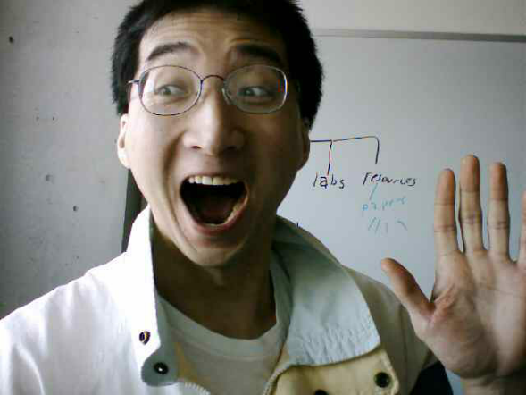
Artificial Intelligence: Mission Accomplished?
How do we know we have a "smart machine"?
The Turing test
???
?
?
Notes:
Turing test
Have a test participant interrogate a computer and a person via teletype.
If the participant can't tell the difference between the two then you have successfully created an artificial intelligence

Slide 23
Artificial Intelligence: Higher-Level Courses
CPSC 433: Artificial Intelligence
CPSC 565: Emergent computing
CPSC 567: Foundations of multi-agent systems
CPSC 568: Agent communications

Slide 24
Computer Vision
The focus is on interpreting and understanding visual information.
?
No
?
No
?
No
No
For more information: http://pages.cpsc.ucalgary.ca/~boyd/pmwiki/pmwiki.php?n=Main.Research
http://people.ucalgary.ca/~jparker/ (Transferred to Arts)
Notes:
Picture:
Which face would be recognized as a face using face-recognizing technology?
http://money.cnn.com/2014/09/16/technology/security/fbi-facial-recognition/index.html?iid=SF_T_Lead&hpt=hp_bn5
Determining what defines based on it's appearance Capture of video
Capture video of a runner who wears reflective balls.
The reflective areas highlight key parts of the person’s body.
Computerized data
The images are shown to expert running experts who analyze the person’s running style (what’s good, what’s bad and can be improved).
Based on the experts opinions on what is good and bad running form program the computer so it can analyze someone’s running style
The computer analysis was as good or better than the coaches opinions that the program’s information was based on.

Slide 25
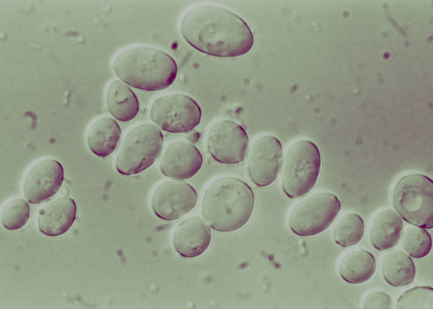
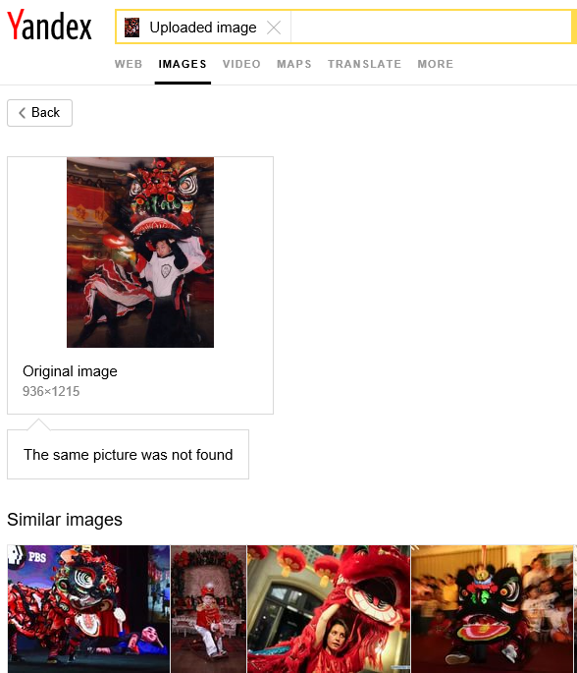
Computer Vision: Some Areas
Recognition
Identification of malignant cells: Stanford (Durmus et. al 2015)
Restoration
Image-based search engines
Removing imperfections such as blurring
Notes:
Recognition:
e.g., Image-based searches: TinEye and Google goggles – rather than type search string submit an image and it searches for information for that image
e.g., Identification – it recognizes a particular image (security process)
Restoration:
Needs to distinguish garbage from data

Slide 26
Computer Vision: Higher-Level Courses
CPSC 535: Introduction to image analysis and computer vision

Slide 27
Software Engineering
Concerned with employing systematic ways of producing good software on time and within budget.
A typical person can only hold ~7 concepts in their mind at a time.
A typical computer program consists of more than 7 ‘parts’.
Consequently mechanisms for dealing with this complexity are needed.
Top down approach is one way: break a large (hard to conceive) problem into smaller more manageable parts.
For more information: http://www.cpsc.ucalgary.ca/cpsc_research/areas/evolutionary
Notes:
Indicate that some of the coding conventions we’ve talked about employ principles of software engineering e.g., avoiding the use of the global variables, using named constants so that the program is easier to maintain.
Pair programming:
Driver: who actively types at the computer or records a design
Navigator: who watches the work of the driver and attentively identifies problems, asks clarifying questions, and makes suggestions.
Between the two students, they can generally figure out most problems and can avoid pesky syntax and semantic errors that can cost many hours to debug.

Slide 28
Software Engineering (2): Techniques
Agile development
Design patterns

Slide 29
Agile Programming
The focus is on reducing risk by producing a new iteration/version of the software in a short period of time (~1 – 4 weeks).
The project is then evaluated.
The emphasis is on real time and face-to-face communication between developers over written documentation.
Everyone associated with the project is brought together: developers, software testers, project managers and end users.
Benefit: reduced development time with fewer misunderstandings.
Contrast with traditional development: formal processes are followed such as heavily documenting program code.
Versions are produced less frequently than with the agile approach.
Documentation is the way that others understand how the code works.
The client may be periodically be asked to “sign-off” on the software.

Slide 30
Agile Programming (2)
Traditional approaches work well for extremely large projects that require a high degree of reliability.
Agile programming works well for smaller (although still large) projects where having a shorter development time is crucial.

Slide 31
Design Patterns
A design pattern: a way of creating software that has been shown to be been sound under a number of different contexts.
Design patterns are a way of documenting successful past approaches
Top down design: although not one of the formally recognized designed patterns it shares some similarities to those approaches.
Notes:
* Object-Oriented and the Top down approach can be viewed as a form of design pattern.

Slide 32
Software Engineering: Higher-Level Courses
Software Engineering 301 Analysis and Design of Large-Scale Software I (required for all CPSC majors)
Software Engineering 401 Analysis and Design of Large-Scale Software II
Software Engineering 403 Software Development in Teams and Organizations
Software Engineering 437 Software Testing
Software Engineering 471 Software Requirements Engineering
Software Engineering 511 Software Process and Project Management
Software Engineering 513 Web-Based Systems
Software Engineering 515 Agile Software Engineering

Slide 33
Software Engineering: Higher-Level Courses (2)
Software Engineering 521 Software Reliability and Software Quality
Software Engineering 523 Formal Methods
Software Engineering 533 Software Performance Evaluation
Software Engineering 541 Fundamentals of Software Evolution and Reuse

Slide 34
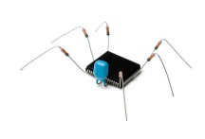
Computer Security
It can involve the creation of malicious software (‘malware’)
XXX
Cheap Viagra!
Buy more! Pay less!
Become rich overnight!
Spam generators
Purpose: learn about how malicious software is created and distributed.
Goal: develop countermeasures to protect computer systems
Colourbox
Virus software
Colourbox
For more information:
http://icis.cpsc.ucalgary.ca/
Spyware

Slide 35
Some Approaches To Computer Security
As just demonstrated, understanding ‘how things work’ is one key component to designing more secure systems.
e.g., Creating viruses and other malware in order to create better defenses against them.
But also the ‘human’ factor must be considered: some security experts think that many security breaches are due to user actions not technical flaws.
But this may require more than just standard ‘security workshops’.
Notes:
Human factor:
Most people know enough not to believe junk mail that says they need to verify account information especially when the recipient is blocked out
Some more sophisticated letters have links that mimic the appearance of the actual source (e.g., corporate images, actual links to company website but the login one is fake)
Talk about Google and how they integrate everything: email, social networking and other websites. May allow for better spoofing (e.g., get relationship info from Google+ and then when they send emails to your contacts they can also add in relationship info to make it more likely for you to believe that the letter is real, if you write them back asking for a confirmation question, their/your social networking information may provide some answers). This in contrast to keeping email and personal relationship info separate.

Slide 36
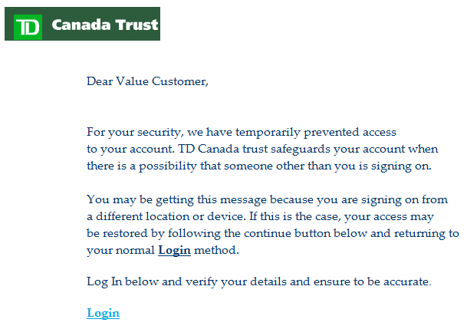
Which Is/Are Fake? Which Is/Are Real?
Notes:
Some say that educating the person behind all the security (user) is an even bigger issue than securing the technology
Which one of the emails is ‘fake’?
Mutual funds email real, rest are are fAke

Slide 37
Cryptography
As may have already been described earlier in the semester (depends on the particular assignments), cryptography can play an important role in security.
Transmitting and storing sensitive information.
Cryptography involves the development of new and better approaches for encoding sensitive data (to make unauthorized access harder).

Slide 38
Computer Security: Higher-Level Courses
CPSC 329: Explorations in information security and privacy
CPSC 418: Introduction to Cryptography
CPSC 525: Principles of computer security
CPSC 527: Computer viruses and malware
CPSC 528: Spam and spyware
CPSC 530: Information theoretic security

Slide 39
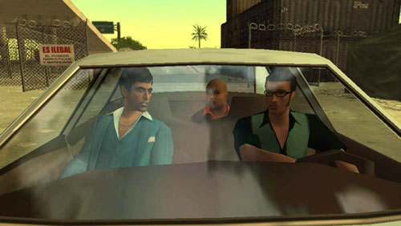
Games Development
Pulls together many areas of Computer Science
The University of Calgary was the first Canadian university to offer this area of study.
<< Warning!!! >>
Blatant advertisement
<< Warning!!! >>
“Scarface: The World is Yours“ © Radical Entertainment
For more information: http://www.cpsc.ucalgary.ca/undergrad/courses_progression/concentration?conc=game
Notes:
Do a discussion, ask them to list areas of CPSC that they think can apply to games programming and why
Show a good games video e.g., nintendogs
Show student game: Aeon clash

Slide 40
Computer Games: Higher-Level Courses
CPSC 585: Games programming
Actual ‘industry practices’ are taught and applied during the semester
Sound routines, graphics and more
(Lectures have been taught by actual game developers)

Slide 41
After This Section You Should Know
What are some areas of Computer Science
What does each area entail
Some of the sub-areas, techniques employed or issues associated with each area of computer science

Slide 42
Copyright Notification
“Unless otherwise indicated, all images in this presentation are used with permission from Microsoft.”

Slide 43
Sound And Other Special Effects
Unless otherwise indicated they were produced and edited by James Tam :$

