Slide 1
Programming Fundamentals In VBA (Visual Basic For Applications)
You will learn about basic program writing tools such as input-output, variables, branching and looping mechanisms.
Online support: https://support.office.com/en-US/article/create-or-run-a-macro-c6b99036-905c-49a6-818a-dfb98b7c3c9c

Slide 2
B.A.S.I.C.
Beginner’s All-Purpose Symbolic Instruction Code (BASIC)
  From: www.acm.org (original full article: http://time.com/69316/basic/)
A widely used programming language
It was relatively simple to learn (statements were “English-like” e.g., “if-then”)
Widely popular and it was commonly packaged with new computers in the 1970’s and 1980’s
(A then relatively unknown company: Microsoft got it’s initial cash inflows and reputation producing several versions of the language)

Slide 3
Visual Basic
A newer programming language developed by Microsoft
It was designed to make it easy to add practical and useful features to computer programs e.g., programmers could add a graphic user interface, database storage of information etc.
Also it can take advantage of the built in capabilities of the various versions of the Windows operating system
  Why write a feature of a program yourself when it already “comes with the computer”
For more information:
  http://msdn.microsoft.com/en-us/library/2x7h1hfk.aspx

Slide 4
Visual Basic For Applications (VBA)
Shares a common core with Visual Basic.
  Statements ‘look’ similar
Unlike Visual Basic, VBA programs aren’t written in isolation (creating a program just for it’s own sake).
  Most programs are written to be standalone: a computer game can be run without (say) running a web browser or MS-Office.
VB = Visual Basic, VBA = Visual Basic for Applications
Each VBA program must be associated with a ‘host’ application (usually it’s Microsoft office document such as MS-Word but other applications can also be augmented by VBA programs).
  The host application is enhanced or supplemented by the VBA program
  “Why doesn’t this stupid word processor have this feature??!!”
    - Now you can add that feature yourself using VBA

Slide 5
Visual Basic For Applications (VBA): 2
Important! Because every VBA program must be run within the context of host application when you are learning to write your programs do not open up an important MS-Word document and run your programs.
  The host program often needs an Word document in order to run certain capabilities.
  VBA programs often change documents (formatting, style, text).
  Therefore use only small ‘test’ MS-Word documents when running your VBA programs otherwise your information may be lost or corrupted.

Slide 6
Macros
Macro: a sequence of keystrokes or mouse selections (instructions to the computer) that can be repeated over and over
  MS-Office can be augmented by writing Macros (essentially computer programs) that will run either for multiple documents or only for a particular document.
  In this class we will focus solely on MS-Word macro programming
VBA (as guessed) is an example of a macro programming language e.g., you can write a program that includes a series of formatting and other commands that you frequently carry out in Word documents
Write the commands once in the form of a program and just re-run this program instead of re-entering each command

Slide 7
Macros And The Web-Based Office
According to Microsoft macros are not accessible via their online Office products:
      https://support.office.com/en-us/article/Differences-between-using-a-workbook-in-the-browser-and-in-Excel-f0dc28ed-b85d-4e1d-be6d-5878005db3b6?CorrelationId=917b1609-97e9-4cc7-9eeb-d188939ad740&ui=en-US&rs=en-US&ad=US
Result: use a computer with the desktop version of Office installed.
  203 lab
  Other campus computers
    Some ‘labs’ may have open access hours
  It is CRUICIAL that you test your program on the computers in the 203 lab because your assignment must work on the lab machines in order to receive credit.

Slide 8
Writing Macros
It is not assumed that you have any prior experience writing computer programs (macro language or something else).
Consequently early examples and concepts will be quite rudimentary i.e., “we will go slow”
  The effect is that you may find that the capabilities of the early examples will duplicate familiar capabilities already built into MS-Word
    Why are we writing a macro program for this feature?
    Makes it easier to understand (you know the expected result).
    Keeps the example simpler.
Later examples will eventually demonstrate the ‘power’ of macros
  You can do things that would be impossible (or at least difficult) with the default capabilities built into MS-Word

Slide 9
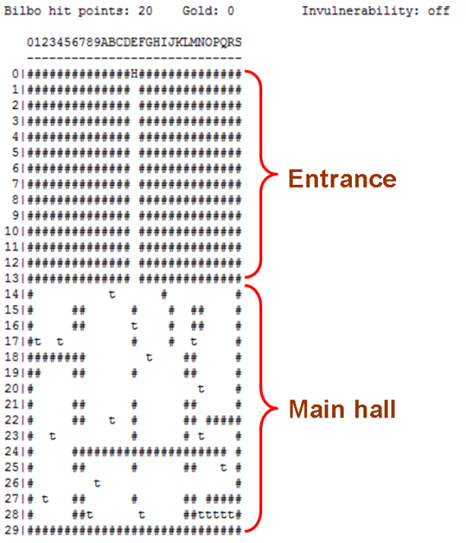
Assignments: 203 vs. 217
Program size (CPSC 217 non-majors programming class):
  A text-based computer game “The hobbit”: 677 line program
Program size (this class):
  VBA (changing the capabilities of MS-Word): 60 line program
  JavaScript (running a program through a web page): 70 line program

Slide 10
Final Exam: Programming Questions
Average grades (programming questions, final exam):
  The values indicate that the typical student shows a reasonable grasp of the material (i.e., they did “get through it”)
  In order to do well you need to be coming to class and doing extra work:
    The absolute minimum workload is to complete the assignment
    Write and trace as many programs as you have time for
    The more practice you get, the more skilled and knowledgeable you will become

Slide 11
Can You Complete The Following Tasks?
Open a MS-Word document and replace every instance of one phrase e.g., tamj@ucalgary.ca with another tamj@cpsc.ucalgary.ca
Open every document in a folder and perform the same search and replace operation:
  2 documents?
  10 documents?
  100 documents?
  All the documents in a particular folder?
  What if you just wanted to open the word documents with a particular word or phrase in the name e.g., “assignments_2014”?
This is an example where writing a macro once is a more efficient approach
  One answer to the question: “Why are we learning this???”

Slide 12
Advanced Use Of Macros
Although it’s beyond the scope of this class the following example is introduced now to make you aware of the power of VBA and macro languages.
  It can actually be used to perform real tasks.
You can use a macro to take advantage of the capabilities of each MS-Office application:
  Establishing references to applications to ‘link’ them
  Take the output from one application and making it the input of another.

Slide 13
Advanced Use Of Macros (2)
Example: macros can automate the following task
  Store data in MS-Access
  Store the query results in MS-Excel and perform calculations on the data
  Use the formatting capabilities of MS-Word to produce reports
  MS-Outlook can email the final documents

Slide 14
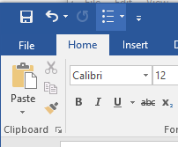
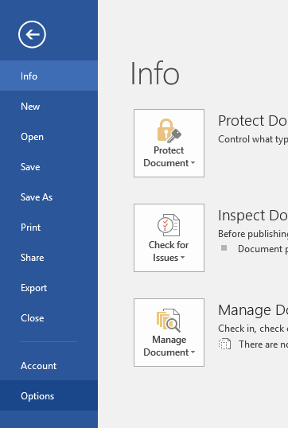
Viewing The ‘Developer’ Ribbon (MS-Word)
The macro programming capability comes built-in to the MS-Office suite.
  You simply have to enable that functionality
Steps
  Select the ‘File’ ribbon
  Select ‘options’

Slide 15
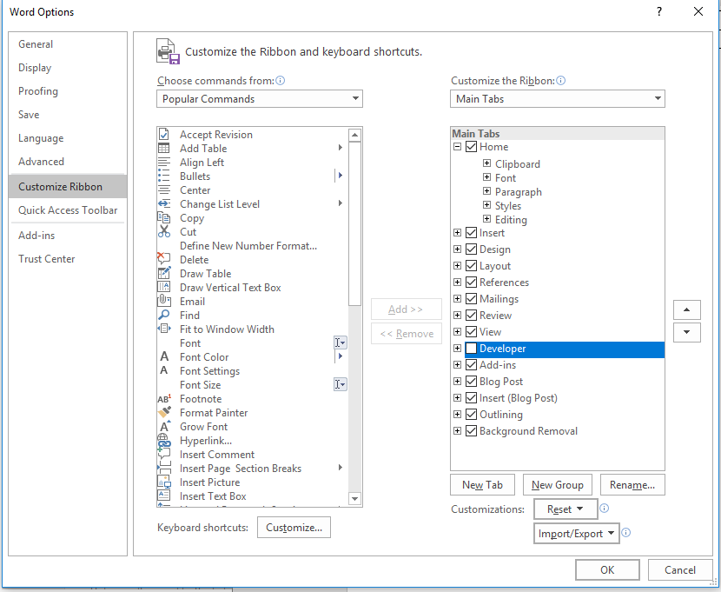
Viewing The ‘Developer’ Ribbon (MS-Word): 2
3A) Select “customize the ribbon”
3B) Check the ‘Developers’ box

Slide 16

Viewing The ‘Developer’ Ribbon (MS-Word): 3
This should add a new ribbon “Developer”

Slide 17
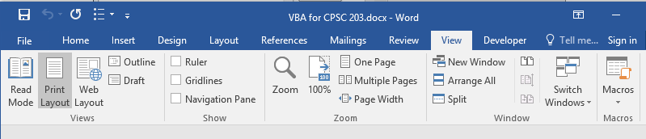
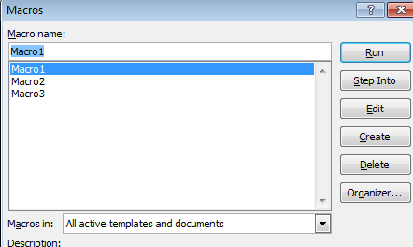
Alternate: View And Run Macros
You may or may not be able to edit the MS-Word ribbon with some computer labs.
You can see view macros via the ‘view’ tab on the ribbon (albeit with fewer options)

Slide 18
Macros And Computer Security
Computer viruses are simply malicious computer programs.
Macros can be a useful mechanism for reducing repetition or adding new capabilities to MS-Office.
But as is the case when writing a computer program malicious code can also be written with a macro and the virus can be activated by just opening the MS-office document that contains the macro.
Just because you are writing macro programs does not mean that you shouldn’t take macro security seriously!

Slide 19
Examples Macros Viruses
“Melissa”: Information about an old but ‘successful’ Macro Virus
  http://www.cnn.com/TECH/computing/9903/29/melissa.02.idg/index.html?_s=PM:TECH
  http://www.symantec.com/press/1999/n990329.html
  http://support.microsoft.com/kb/224567
Macro viruses aren’t just “ancient history”, take the potential threat seriously!
  http://www.symantec.com/avcenter/macro.html
  http://www.microsoft.com/security/portal/threat/encyclopedia/search.aspx?query=Virus
  http://ca.norton.com/search?site=nrtn_en_CA&client=norton&q=macro+virus

Slide 20
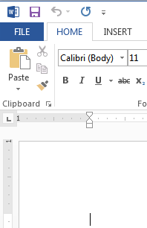
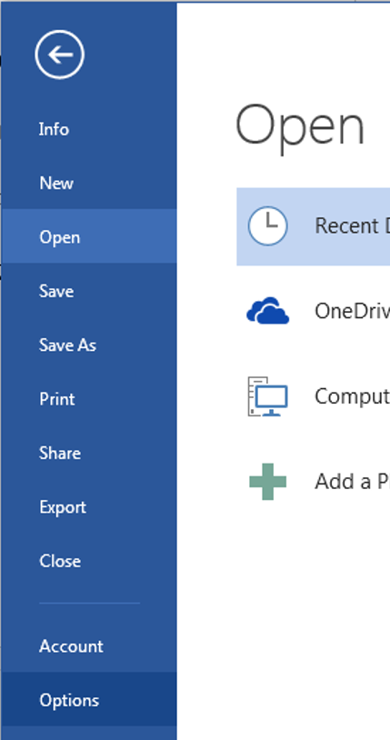
Enabling Macros To Run
If you can' t run macros in MS-office (you see odd error messages) then examine the "Trust Center“ settings in Word
  Select the ‘File’ ribbon
  Select ‘options’

Slide 21
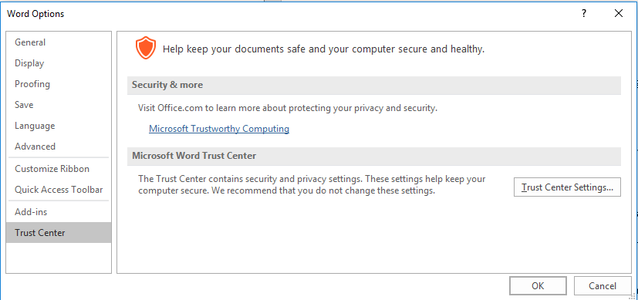
Enabling Macros To Run (2)
3A) Select “Trust Center”
3B) Select “Trust Center Settings”

Slide 22
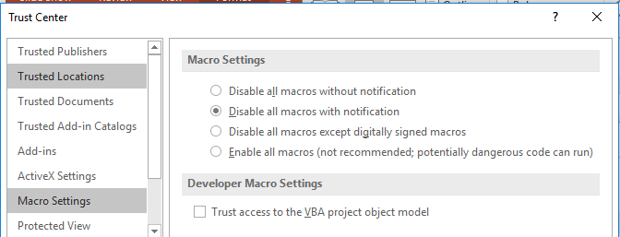
Enabling Macros To Run (3)
4A) Select “Macro Settings”
4B) Select “Disable all macros with notification”
More secure
Less
secure
5) Exit MS-Word (close ALL documents)

Slide 23
Enabling Macros To Run (4)
The default setting for MS-Word should already be set to “disable macros with notification” but these steps will allow you to use machines that aren’t set to default values.

Slide 24
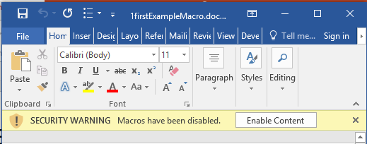
Effect: Opening Word Documents
Using the default setting will disable all macros by default (safer approach) but you can still enable the macros as the document is opened.
JT’s caution
You should NOT casually select this option for all MS-Word documents
It’s recommended that you ONLY enable macros you have created (or the lecture examples)

Slide 25
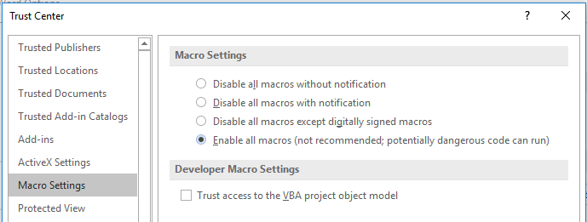
Macro Security
DO NOT take the ‘easy’ way out
More secure
NO!
Less
secure
For more information:
http://www.office.microsoft.com/en-us/help/enable-or-disable-macros-in-office-documents-HA010031071.aspx

Slide 26
Creating Macros
Record the macro automatically: keystrokes and mouse selections will be stored as part of the macro (you will be briefly shown how to do this in tutorial)
Manually enter the Macro (type it in yourself into the VBA editor)
  This is how you are to complete your assignment and is how many VBA programs are created.

Slide 27
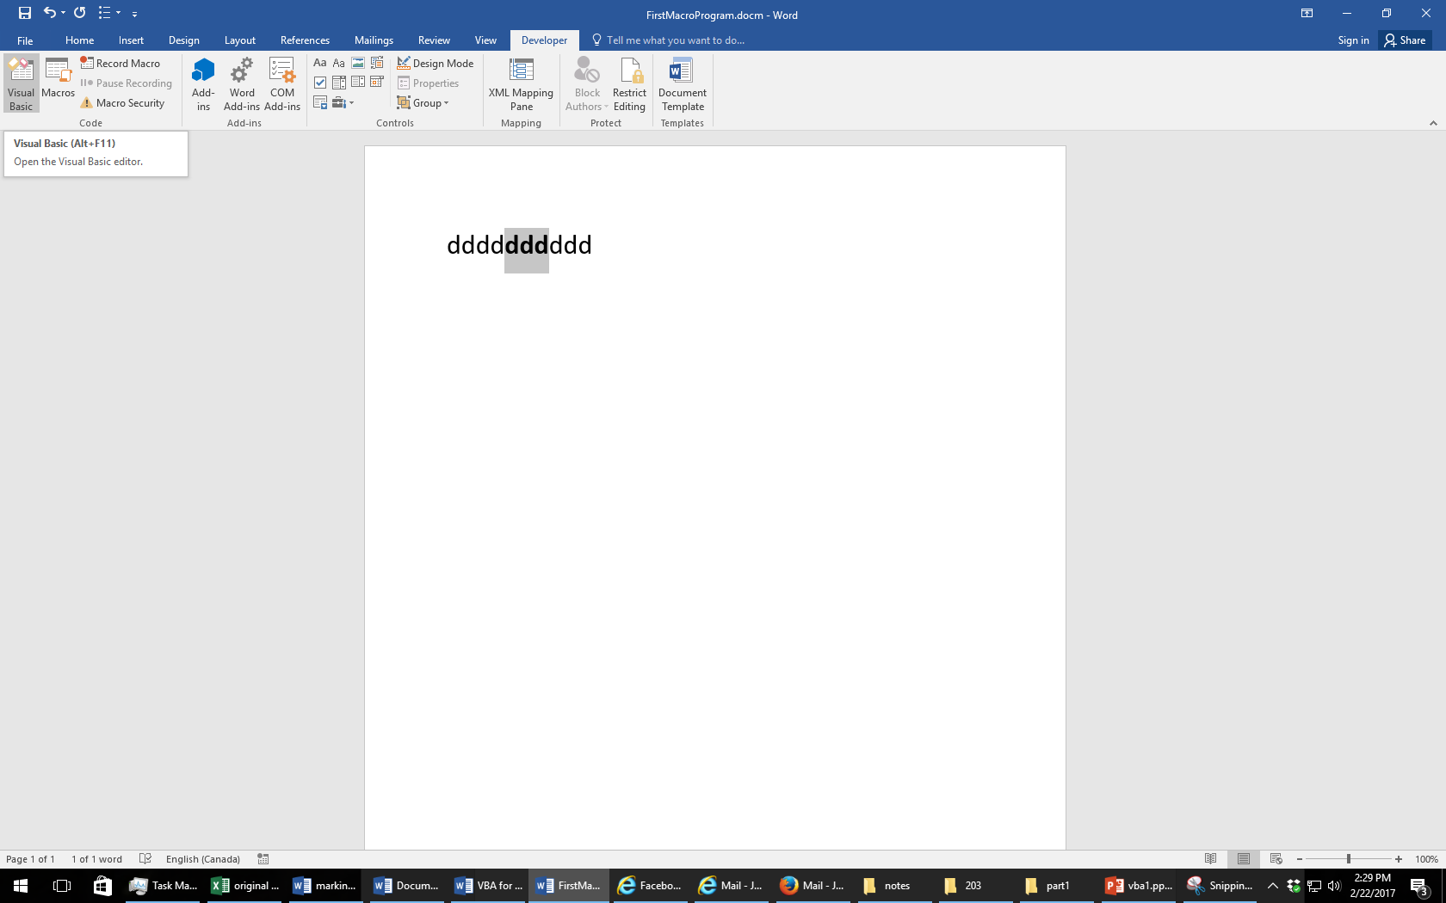
The Visual Basic Editor
You don’t need to familiarize yourself with every detail of the editor in order to create VBA programs.
Just a few key features should be sufficient
Starting the editor:
  Because VBA programs are associated with an office application open the editor from MS-Word
  Click the “Visual Basic” icon under “Developer”

Slide 28
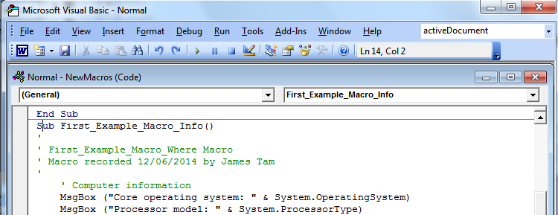
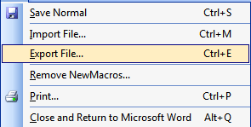
Overview Of The Important Parts Of The VBA Editor
Cut, copy, paste
Find, replace
Help lookup
Save
Program editor
Undo, redo
Export:
Useful for transferring or backing up your work
Run, pause, stop (VBA subroutine program)
Current location

Slide 29
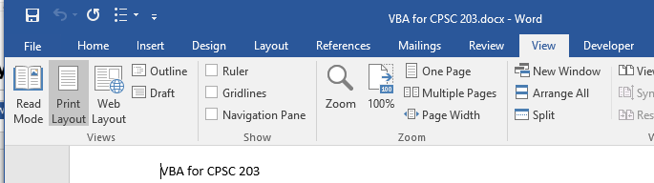
VBA Editor: Don’t Mix It Up With The Word Editor

Slide 30
Writing A Program In The VBA Editor
Format:
  ' Program documentation goes here (more on this later)
  sub <sub-program name>()
  End Sub
Example:
  ' Author, version, features etc.
  Sub first_example_macro_info()
  MsgBox ("Congratulations! This your first computer
  program")
  End Sub
Note: large VBA programs have multiple (sub) parts but for this class you only need to define a single ‘sub’.
Instructions in the body of program (indent 4 spaces)

Slide 31
The ‘Sub’ Keyword
Sub stands for ‘subroutine’ or a portion of a VBA program Format:
  Sub <subroutine name>()
  <Instructions in the subroutine>
  End Sub
Example:
  Sub First_Example_Macro_Info()
  End Sub
Unless otherwise told all VBA program statements must be inside the subroutine
Header, start of subroutine:
Has word ‘Sub’
Name of subroutine
Set of brackets
Note: all lines in between are indented (4 spaces)
End of subroutine:
Has ‘End Sub’

Slide 32
The ‘Sub’ Keyword: 2
Real world VBA programs will be broken down into multiple ‘subs’ (subroutines or program parts)
Again: Because this is only brief introduction into writing VBA programs you will only have to define one subroutine for your assignment.

Slide 33
Naming The Subroutine
This is what follows the ‘sub’ keyword.
Example
  Sub formattingResume
  End Sub
Naming standards:
  The name chosen should summarize what the program is supposed to do.
  It will play a role in determining your assignment grade.

Slide 34
Choosing A Name: Technical Requirements
Must start with an alphabetic letter, after than any combination of letters and numbers may be used
  OK: “assigment1”, “a2939” Not OK: “1assignment”, “*assignment”
Maximum length of 80 characters
It cannot contain spaces, punctuation or special characters such as # or !
  ‘resume headings’ (Not Allowed: space character)
  ‘macros!’ (Not Allowed: special character)
Can contain underscores (separate long names)

Slide 35

VBA Programming: How To Study
At the very least: try typing the programs into the VBA editor or cutting and pasting them yourself (watch for altered characters such as quotes)
For the more complex programs (end of this section as well as the next section) try re-creating the programs on your own:
  Think about what tasks are accomplished by my solution program
  Without looking at my solution try entering into the program into the VBA editor to accomplish these same tasks
With programming you learn by “doing yourself” rather than by watching someone else ‘do’
Sub first_example
MsgBox(“This

Slide 36
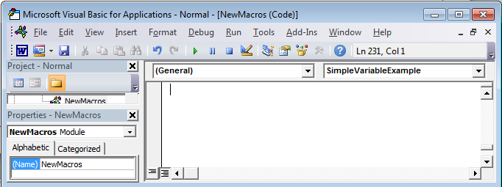
First VBA Example
Learning Objectives:
  Creating/running a VBA program
  Creating a Message Box “MsgBox”
Reminder steps (since this is your first example)
  Start up the application (MS-Word)
  Invoke the VBA editor: Developer->Visual Basic
  If successful you should see something similar to the image
Enter your program instructions here (program editor)

Slide 37
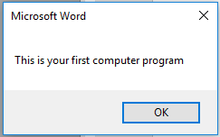
First VBA Example (2)
Type in or cut-and-paste the following example into the VBA editor (see last image for location of the editor, previous slide)
  This is NOT the same as pasting it directly into MS-Word.
  Word document containing the macro (empty document see the macro editor for the important details): 1firstExampleMacro.docm
  Sub first_example_macro_info()
  MsgBox ("This is your first computer program")
  End Sub

Slide 38
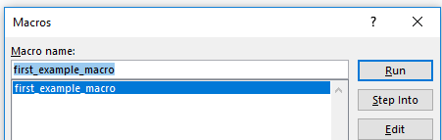
Reminder: Running Macros
(You must first have the ‘developer’ tab visible).
Developer->Macros
The single macro should be highlighted, then click ‘run’

Slide 39
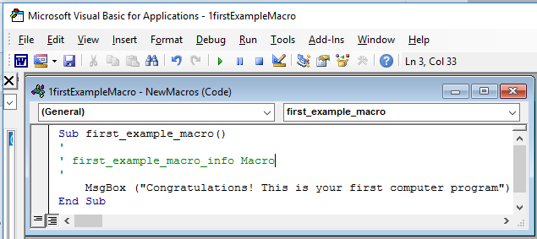
Running VBA Programs You Have Entered (2)
Or you can run the program right after you have entered it (in the editor).
Ensure correct program “sub” is to be executed (click there)
Press the ‘play/run’ button or “F5”

Slide 40
Structure Of VBA Programs: Reminder Of Important Points
As you just saw a program must begin with the “sub” keyword followed by the name of the “subroutine” (sub-part of the program).
It also ends with end “end sub”
Important style requirement: The part between the ‘sub’ and ‘end sub’ must be indented by 4 spaces (8 spaces if sub-indenting is used – next set of notes).
sub first_example_macro()
end Sub
MsgBox("Congrats!")

Slide 41
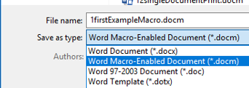
Saving Your Macro
You can save your macro into a Word document:
Create a new Word document
Save the document as a macro-enable document (Word document that has a macro computer program embedded within it).

Slide 42
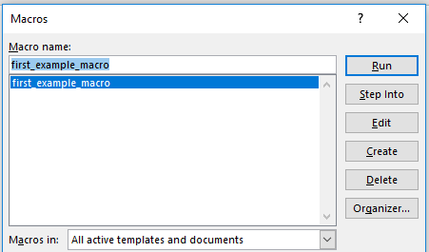
Saving Your Macro (2)
Next you have tell Word that you want to save your macro program inside this macro-enabled document.
  By default when you save your macros Word will select “Normal.dotm” (All documents) as the location.
    DO NOT save your macro in this document:
      You will have trouble transferring your macro to other computers
      Because “Normal.dotm” is the default template used to create some Word documents it may result in security warnings.

Slide 43
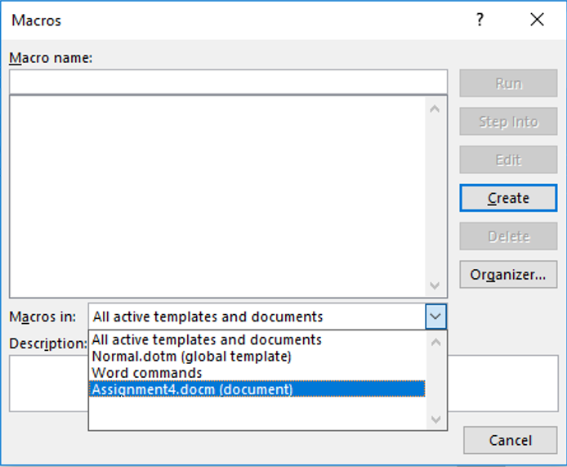
Saving Your Macro (3)
  Instead: Save your macro in your current document (in the example below it’s “Assignment4.docm”.
    Transferring this document will allow the macros to be transferred as well.

Slide 44
Viewing Macros
All macros that you have created can be viewed in the VBA macro editor:
  Macros manually entered in the editor (Message Box example)
  Macros automatically recorded (not covered in lecture but in tutorial)

Slide 45
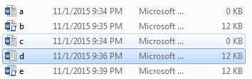
Which Document Contains A Macro?

Slide 46
Question: What Is The Security Difference?
Opening the following documents:
  Document.docm
  Document.docx
  Document.doc

Slide 47
Types Of Documents That Can Contain Macros
You store the macros that you write for this class this way
  In a single document ‘doc-m’ document
You can also store macros in these documents (not for this class but important to be aware in terms of computer security).
  Normal ‘dot-m’ template
    Default template used to produce all Word documents (formatting, layout etc.)
  Custom ‘dot-m’ template
    You can override the default by creating your own template documents

Slide 48
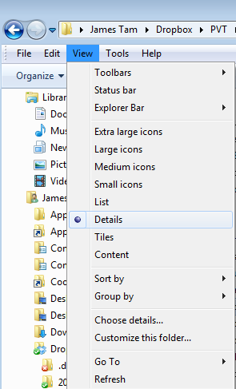
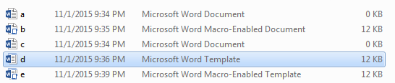
Viewing File Information: Learning What Type Of File Is That Word Document
View details: select ‘view’ in a folder

Slide 49
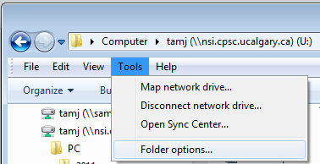
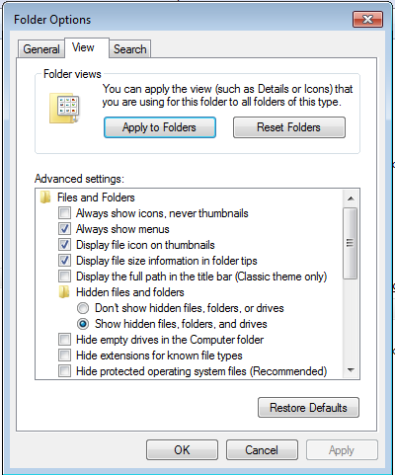

Viewing File Suffixes
In a folder select: Tools->Folder options
Under the ‘view’ tab uncheck ‘Hide extensions for known file types’

Slide 50
Reminder About Macro Security
A macro is a computer program that is attached to another program’s documents (e.g., MS-Word documents)
It can supplement the program’s features by automating repetitive tasks
But like another computer program the instructions can either be useful or malicious
  Do not forget the security setting are specified in the MS-Office “Trust Centre”

Slide 51
.DOCX (And .XLSX, .PPTX)
As mentioned these types of files cannot have macros attached to them.
  Reduced capabilities (no macros) but increased security (no macros)
Question: Are these files with these extensions 100% safe?
File name extensions hidden
Enabling the display of file name extensions

Slide 52
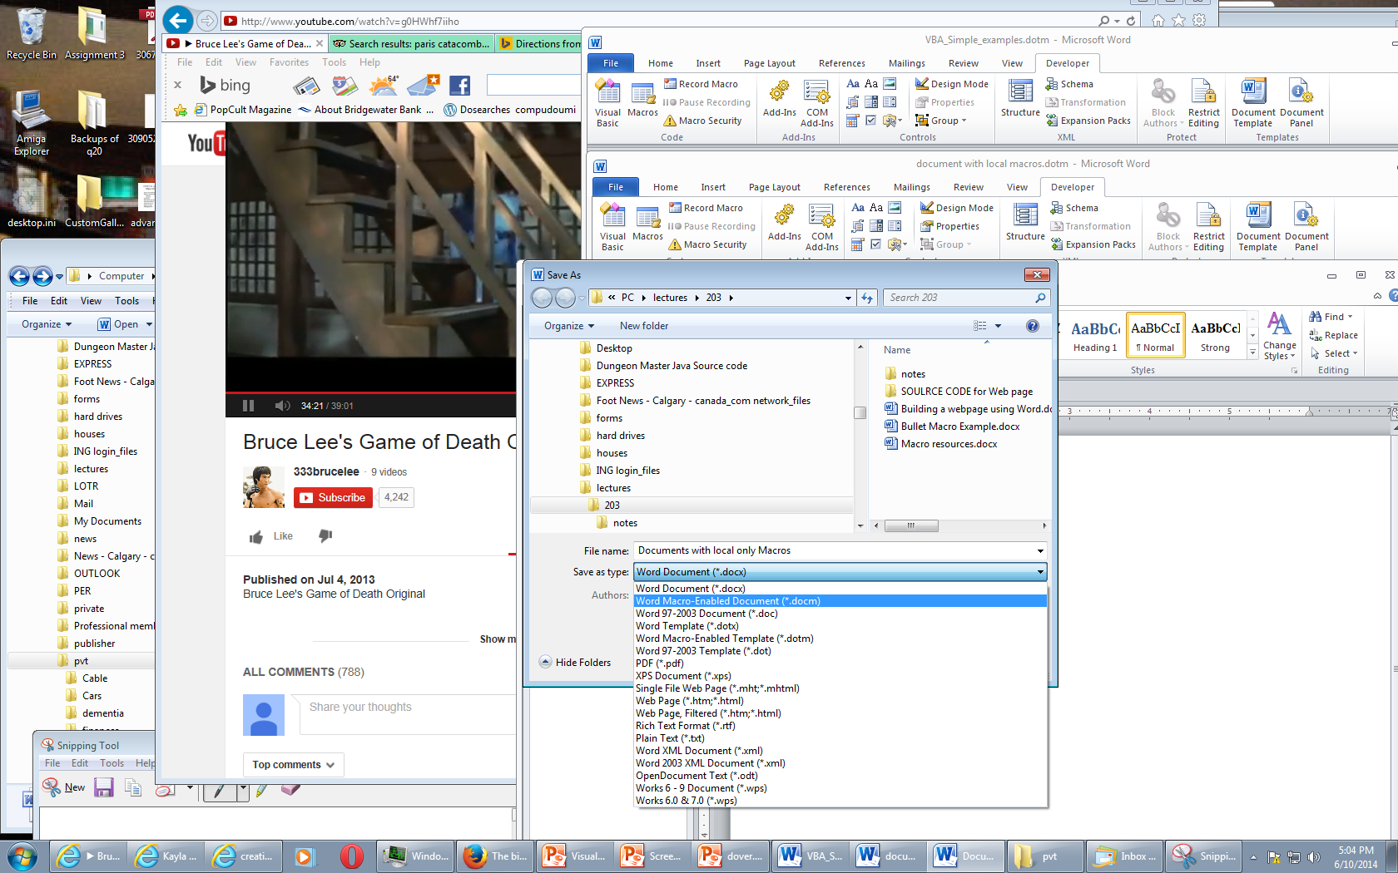
Transferring Your Macros (This Class)
If you create a macro-enabled MS-Word document (file name suffix “.docm”) then transfer the Word document itself.
Save the macro enabled word document to your portable USB flash drive
OR
Save the template document on your web disk drive (or any other ‘cloud’ storage system such as Dropbox.com)
  To download files stored on web disk onto another computer: https://webdisk.ucalgary.ca/

Slide 53
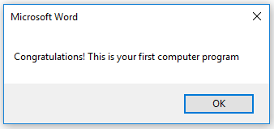
Message Box
(Details of the previous example)
Creates a popup window to output information from your program
Useful for testing
  Is my program working?
  Which part is running?
Also useful for displaying status messages about the current state of the program

Slide 54
Creating A Message Box
Format:
  MsgBox ("<Message to appear>")
Example:
  MsgBox ("This your first computer program")
Notes on ‘Format’:
Italicized: you have a choice for this part
Non-italicized: mandatory (enter it as-is)
Don’t type in the angled brackets (used to help you visually group)

Slide 55
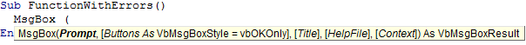
VBA Visual Aids: Function Arguments
As you type in the name of VB functions you will see visual hints about the arguments/inputs for the function.
  Enter the function name and then a space
Function arguments
(Bold): mandatory arguments

Slide 56
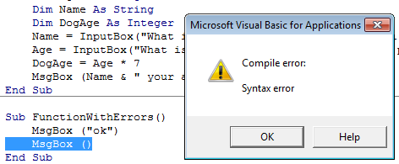

VBA Visual Aids: Error Information
The requirements for forming VBA programming instructions are referred to as the ‘syntax’ (grammar/rules) of the language.
Syntax violations are visually highlighted in VBA:
Required argument missing
Part of program that contains errors (yellow highlight)
Specific statement/instruction causing the error (red font)

Slide 57
Basic Mathematical Operators
Operation | Symbol used in VBA | Example
Addition | + | 2 + 2
Subtraction | - | 3 – 2
Multiplication | * | 10 * 10
Division | / | 81 / 9
Exponent | ^ | 2 ^ 3

Slide 58
Variables
Used to temporarily store information at location in memory
Variables must be declared (created) before they can be used.
Format for declaration:
  Dim <Variable name> as <Type of variable>
Example declaration:
  Dim BirthYear as Long
CPSC mail
TAM

Slide 59
Common Types Of Variables
Type of information stored | VBA Name | Example variable declaration | Default Value
Whole numbers | Long | Dim LuckyNumber as Long | 0
Real numbers | Double | Dim MyWeight As Double | 0
Chararacters¹ | String² | Dim Name As String | Empty string
Date³ | Date | Dim BirthDate As Date | 00:00:00
1) Any visible character you can type and more e.g., ‘Enter’ key
2) Each string can contain up to a maximum of 2 billion characters
3) Format: Day/month/year

Slide 60
Examples Of Assigning Values To Variables
CPSC mail
TAM
mail
Note: some types of variables requires some mechanism to specify the type of information to be stored:
Strings: the start and end of the string must be marked with double quotes "
Date: the start and end of the string must be marked with the number sign #
Dim LuckyNumber As Long
LuckyNumber = 888
Dim BirthDay As Date
BirthDay = #11/01/1977#
Dim MyName As String
MyName = "James"

Slide 61
Common Mistake #1
A variable is just that – it can change as a program runs.
Approach #1: variable not used (lacks flexibility)
  MsgBox ("My age is...")
  MsgBox ("...37")
Approach #2: variable employed (age can be changed with any mathematical expression)
  Dim age As Long
  age = 37
  MsgBox ("My age is...")
  MsgBox (age)
  age = 38
  MsgBox ("My age is...")
  MsgBox (age)

Slide 62


Variables: Metaphor To Use
www.colourbox.com
Think of VBA variables like a “mailslot in memory”
Unlike an actual mailslot computer variables can only hold one piece of information
  Adding new information results in the old information being replaced by the new information
Dim num as Long
num
num
num = 1
1
17
num = 17

Slide 63
Common Mistake #2
Assigning values from one variable does not ‘link’ them
  num1 = 1
  num2 = num1
  num1 = 2

Slide 64
Variables: Metaphor To Use (2)
  Also each computer variable is separate location in memory.
  Each location can hold information independently of other locations.
    Note: This works differently than mathematical variables!
    What is the result?
Dim num1 as Long
Dim num2 as Long
num1 = 1
num2 = num1
num1 = 2

Slide 65
MsgBox: Dislaying Mixes Of Strings And Variables
Format:
  MsgBox ("<Message1>" & <variable name>)
Name of the online example: 2variablesMixedOutput.docm
  Dim num as Long
  num = 7
  MsgBox ("num=" & num)
"num=" : A literal string
num: : contents of a variable (slot in memory)

Slide 66
Why Mix The Display Of Strings & Variables
Labeling variables as they appear makes your program easier to understand
4.3
3.3
3.7
2.0
4.0
4.0
3.9
1.0
Student 1: 4.3
Student 2: 3.3
Student 3: 3.7
Student 4: 2.0
Student 5: 4.0
Student 6: 4.0
Student 7: 3.9
Student 8: 1.0
Vs.

Slide 67
Student Exercise 1: Mixed Output
What is the output of the following MsgBox:
Sub exercise1()
Dim num As Long
num = 12
MsgBox ("num=" & num)
End Sub

Slide 68
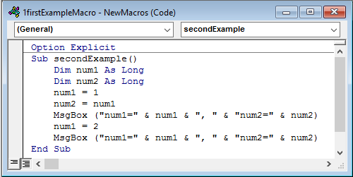
Option Explicit
It’s not mandatory to include for your program “to work”.
But including it at the very start of your program before the ‘sub’ and subroutine name will save you many headaches!
More details will be provided in tutorial.

Slide 69
Third VBA Example
Learning Objectives:
  Using variables
  Using mathematical operators

Slide 70
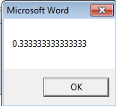
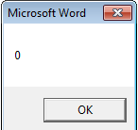
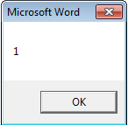
Third VBA Example (2)
  Word document containing the macro: 3types.docm
  Sub thirdExample()
  Dim RealNumber As Double
  Dim WholeNumber As Long
  RealNumber = 1 / 3
  MsgBox (RealNumber)
  WholeNumber = 5 / 10
  MsgBox (WholeNumber)
  WholeNumber = 6 / 10
  MsgBox (WholeNumber)
  End Sub
JT’s note: Anything over 0.5 is rounded up

Slide 71
Student Exercise #2
What would appear as output (MsgBox) when the following VBA macro program was executed
Sub exercise2()
Dim num1 As Long
num1 = 1
MsgBox (num1)
num1 = num1 + 1
MsgBox (num1)
End Sub

Slide 72
Variable Naming Conventions
Language requirements:
  Rules built into the Visual Basic (recall VBA is essentially Visual Basic tied to an MS-Office Application) language.
  Somewhat analogous to the grammar of a ‘human’ language.
  If the rules are violated then the typical outcome is the program cannot execute.
Style requirements:
  Approaches for producing a well written program.
  (The real life analogy is that something written in a human language may follow the grammar but still be poorly written).
  If style requirements are not followed then the program can execute but there may be other problems (e.g., it is difficult to understand because it’s overly long and complex - more on this during the term).

Slide 73
Naming Variables: VBA Language Requirements
Names must begin with an alphabetic character
  OK: name1 Not OK: 1name
Names cannot contain a space
  OK: firstName Not OK: first name
Names cannot use special characters anywhere in the name
  Punctuation: ! ? .
  Mathematical operators: + - * / ^
  Comparison operators: < <= > >= <> =

Slide 74
Naming Variables: Style Conventions
Style requirement (all languages): The name should be meaningful.
Style requirement (from the Microsoft Developer Network¹):
  Choose easily readable identifier names
  Favor readability over brevity.
Examples
#1:
age (yes)
x, y (no)
HorizontalAlignment (yes)
AlignmentHorizontal (no)
CanScrollHorizontally (yes)
ScrollableX (no)
1 http://msdn.microsoft.com/en-us/library/ms229045.aspx

Slide 75
Naming Variables: Style Conventions (2)
Style requirement: Variable names should generally be all lower case except perhaps for the first letter (see next point for the exception).
Style requirement: For names composed of multiple words separate each word by capitalizing the first letter of each word (save for the first word) or by using an underscore. (Either approach is acceptable but don’t mix and match.)
Avoid using keywords as names (next slide)
Examples
#3:
age, height, weight (yes)
HEIGHT (no)
#4
firstName, last_name
(yes to either approach)

Slide 76
Some Common Visual Basic Keywords¹
And Boolean Call Case Catch Continue
Date Decimal Default Dim Do Double
Each Else End Erase Error Event
Exit False Finally For Friend Function
Get Global Handles If In Inherits
Integer Interface Is Let Lib Like
Long Loop Me Mod Module Next
Not Nothing Of On Operator Option
Optional Or Out Overrides Partial Private
Property Protected Public Resume Return Select
Set Shadows Short Single Static Step
Stop String Sub Then Throw To
True Try Using Variant When While
Widening With
1 The full list can be found on the MSDN http://msdn.microsoft.com/en-us/library/dd409611.aspx
Notes:
76

Slide 77
Variable Naming Conventions: Bottom Line
Both the language and style requirements should be followed when declaring your variables.

Slide 78
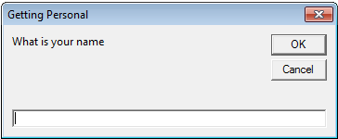
Getting User Input
A simple approach is to use an Input Box
Format:
  <Variable name> = InputBox(<"Prompt">, <"Title bar">)
Example:
  Name = InputBox("What is your name"), "Getting Personal")
Note: only the string for the prompt (first) is mandatory.
If the title bar information is omitted then the default is the application name (“Microsoft Word”)

Slide 79
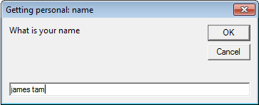
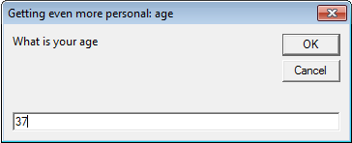
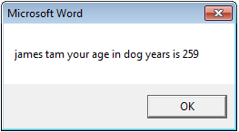
Example: InputBox
Learning: getting user input with an InputBox
Word document containing the macro: 4inputBox.docm
  Sub InputExample()
  Dim Age As Long
  Dim Name As String
  Dim DogAge As Long
  Name = InputBox("What is your name", "Getting personal: name")
  Age = InputBox("What is your age", "Getting even more personal: age")
  DogAge = Age * 7
  MsgBox (Name & " your age in dog years is " & DogAge)
  End Sub
  Note: there are two input boxes, one that prompts for the name and the other for the age. Each is given a self-descriptive name to distinguish them (an example of good programming style – more on this shortly)

Slide 80
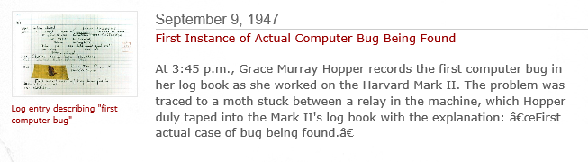
The VBA Debugger
‘Bug’:
  An error in the logic of your program.
  The program “doesn’t do what it is supposed to do”
  Example: an erroneous formula for calculating an area of a rectangle
  area = length + width
  Bugs will seldom be this obvious
Debuggers can be used to help find errors in your program
More information on using the VBA debugger will be provided in tutorial
Screenshot: www.computerhistory.org

Slide 81

Program Documentation
Instructions for the computer
(Computer): problem, I don’t know how to “James Tam”
Your VBA assignment submission must include identification about you and information the features of your program
  Full name
  Student identification number
  Tutorial number
  List the program features (from the assignment description) and clearly indicate if the feature was completed or not completed.
DON’T just enter this information into your program instructions

Slide 82
Program Documentation (2)
You must ‘mark’ this information so it doesn’t cause an error
  The marking will indicate to the VBA translation mechanism that the line is for the reader of the program and not to be translated and executed
  The marking is done with the single quote '
Format:
  ' <Documentation>
Example:
  ' Author: James Tam
No error: Everything after the quote until the end of the line will not be translated into machine language/binary
That means documentation doesn’t have to be a valid and executable instruction

Slide 83
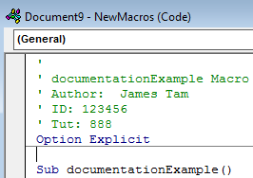
Program Documentation (3)
Contact information should be located before your program
Before the ‘sub’ keyword
  Before ‘Option explicit’ if included
Documentation: marked in red
Notes:
indicate the full details to follow on next slide if you can't fit it here

Slide 84
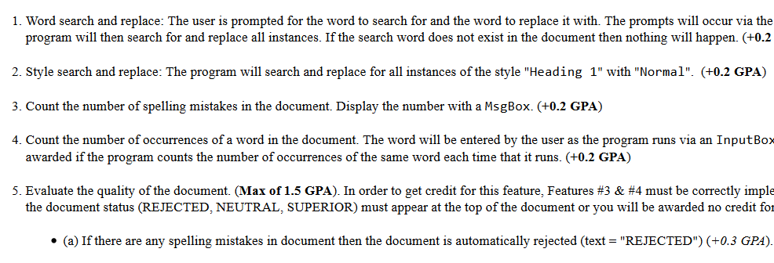
Program Documentation (4)
Program features (this will be worth many marks)
Example assignment description
Program documentation
  ' Author: James Tam ID: 123456
  ' Version: Nov 2, 2015
  ' Tutorial: 99
  ' PROGRAM FEATURES
  ' Word search and replace: completed
  ' Style search and replace: not completed
  etc

Slide 85
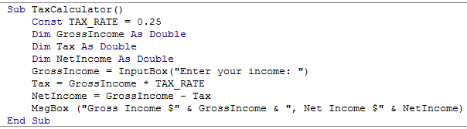
Recap: Programs You’ve Seen So Far Produces Sequential Execution
Each instruction executes from beginning to end, one after the other
When the last instruction is reached then the program ends
Start
End

Slide 86
New Program Writing Concepts (Non-Sequential)
Making decisions (branching)
Looping (repetition)
Grade point >= 1.0
True
False
MsgBox(“Passed”)
MsgBox(“Failed”)
START
Run game
Y
Play again?
N
END GAME

Slide 87
New Terminology
What you know; Boolean expression: An expression that must work out (evaluate to) to either a true or false value.
  e.g., it is over 45 Celsius today
  e.g., the user correctly entered the password
New term, body: A block of program instructions that will execute under a specified condition (for branches the body executes when a Boolean is true)
  Style requirement
    The ‘body’ is indented (4 spaces)
    A “sub-body” (IF-branch) is indented by an additional 4 spaces (8 or more spaces)
Sub Document_Open()
MsgBox ("Fake virus!")
End Sub
This/these instruction/instructions run when you tell VBA to run the macro, the ‘body’ of the macro program

Slide 88
Branching: Making Decisions In A Program
Similar to the Excel (IF-Function): Check if some condition has been met (e.g., password for the document correctly entered): Boolean expression
But the IF-Construct employed with programming languages is not just a function that returns a value for the true or false cases.
  For each IF: a statement or a collection of statements can be executed (this is referred to as “the body” of the if or else case.
  Example: entering a password
    Boolean expression true, password matches:
      True case body: display confirmation message and run program
    Boolean expression false, password doesn’t match:
      False case body: display error message

Slide 89
Branching/Decision Making Mechanisms
If-Then
If-Then, Else Similar to Excel if-then
If-Then, ElseIf, Else Similar to Excel nested ifs

Slide 90
Allowable Operators For Boolean Expressions
if (value operator value) then
VBA Mathematical
operator equivalent Meaning Example
< < Less than 5 < 3
> > Greater than 5 > 3
= = Equal to 5 = 3
<= ≤ Less than or equal to 5 <= 5
>= ≥ Greater than or equal to 5 >= 4
<> ≠ Not equal to x <> 5

Slide 91
Decision Making With ‘If-Then’
Boolean
True
Then execute an
instruction or instructions
False
Remainder of
the program

Slide 92
If-Then
Format:
  If (Boolean expression) Then
  If-Body
  End if
Example:
  If (totalWords < MIN_SIZE) Then
  MsgBox ("Document too short, total words " & totalWords)
  End If

Slide 93
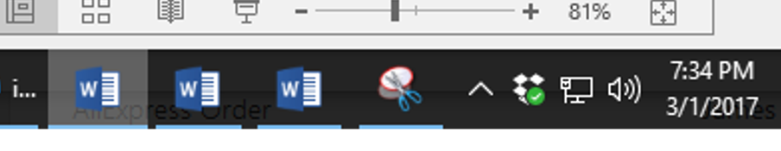
If-Then: Complete Example
Word document containing the macro: 5wordCount.docm
  ' Try deleting all the words in the Word doc and run the
  ' macro again
  Sub wordCount()
  Dim totalWords As Integer
  Const MIN_SIZE = 100
  totalWords = ActiveDocument.Words.Count
  If (totalWords < MIN_SIZE) Then
  MsgBox ("Document too short, total words " &
  totalWords)
  End If
  End Sub

Slide 94
Decision Making With An ‘If, Else’
Used when different Actions (separate bodies) are required for the true result (IF-case) vs. the false result (ELSE-case)

Slide 95
Decision Making With An ‘If, Else’
Boolean
True
Execute an instruction
or instructions (if-body)
False
Execute an instruction
or instructions (else-body)
Remainder of
the program

Slide 96
If-Then (True), Else (False)
Format:
  If (Boolean expression) Then
  If-Body
  Else
  Else-Body
  End if
Example:
  If (totalWords < MIN_SIZE) Then
  MsgBox ("Document too short, total words " & totalWords)
  Else
  MsgBox ("Document meets min. length requirements")
  End If

Slide 97
If-Then, Else: Complete Example
Word document containing the macro: 6wordCountV2.docm
  ' Try deleting words or changing the minimum size and observe ' the effect on the program.
  Sub wordCountV2()
  Dim totalWords As Integer
  MIN_SIZE = 1000
  totalWords = ActiveDocument.Words.Count
  If (totalWords < MIN_SIZE) Then
  MsgBox ("Document too short, total words " &
  totalWords)
  Else
  MsgBox ("Document meets min. length requirements")
  End If
  End Sub

Slide 98
Logic Can Be Used In Conjunction With Branching
Typically the logical operators AND, OR are used with multiple conditions/Boolean expressions:
  If multiple conditions must all be met before the body will execute. (And)
  If at least one condition must be met before the body will execute. (Or)
The logical NOT operator can be used to check if something has ‘not’ occurred yet
  E.g., If it’s true that the user did not enter the correct password then the program will end.

Slide 99
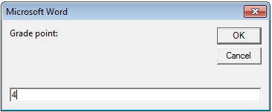
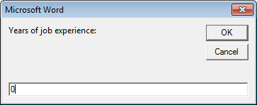
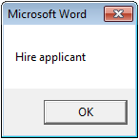
Logic: The “OR” Operator
Format:
If (Boolean expression) OR (Boolean expression) then
body
End if
Word document containing the macro (empty document, see macro editor for the important details): 7if_or_hiring.docm
  gpa = InputBox("Grade point: ")
  experience = InputBox("Years of job experience: ")
  If (gpa > 3.7) Or (experience > 5) Then
  result = "Hire applicant"
  Else
  result = "Insufficient qualifications"

Slide 100
Hiring Example: Example Inputs & Results
If (gpa > 3.7) Or (experience > 5) then
GPA | Years job experience | Result
2 | 0 | Insufficient qualifications
1 | 10 | Hire
4 | 1 | Hire
4 | 7 | Hire

Slide 101
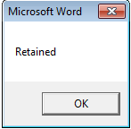
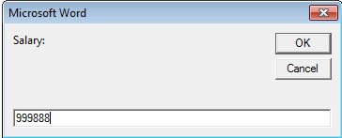

Logic: The “AND” Operator
Format:
If (Boolean expression) And (Boolean expression) then
body
End if
Word document containing the macro (empty document, see macro editor for the important details): 8if_and_firing.docm
  salary = InputBox("Salary: ")
  years = InputBox("Years of employment: ")
  If (salary >= 100000) And (years < 2) Then
  result = "Fired!"
  Else
  result = "Retained"

Slide 102
Firing Example: Example Inputs & Results
If (salary >= 100000) And (years < 2) Then
Salary | Years on job | Result
1 | 100 | Retained
50000 | 1 | Retained
123456 | 20 | Retained
1000000 | 0 | Fired!

Slide 103
Logic: The “NOT” Operator
Format:
  If Not (Boolean Expression) then
  body
  End if
Word document containing the macro example: 9checkSave.docm
  If Not (ActiveDocument.Saved) Then
  MsgBox ("You haven't saved " & ActiveDocument.Name
  & " yet")
  End If

Slide 104
Line Continuation Character
To increase readability long statements can be split over multiple lines.
  If (income > 99999) And _
  (experience <= 2) And _
  (numRepramands > 0) Then
  MsgBox ("You're fired!")
  End If
To split the line the line continuation character (underscore) must be preceded by a space.
Keywords cannot be split between lines e.g.
    Msg _
    Box
For more details see: http://support.microsoft.com/kb/141513

Slide 105
Line Continuation Character (2)
Strings split over multiple lines require a combination of the proper use of the line continuation character '_' and the concatenation operator '&‘:
  MsgBox ("Your " _
  & "name")

Slide 106
What To Do When Multiple Conditions Must Be Checked
Case 1: If each condition is independent of other questions
  Multiple if-then expressions can be used
  Example:
  Q1: Are you an adult?
  Q2: Are you a Canadian citizen?
  Q3: Are you currently employed?

Slide 107
What To Do When Multiple Conditions Must Be Checked (2)
Case 2 (mutually exclusive): If the result of one condition affects other conditions (when one condition is true then the other conditions cannot be true)
  If-then, elseif, else should be used
  Which of the following is your place of birth? (Answering true to one option makes the options false)
    Calgary
    Edmonton
    Lethbridge
    Red Deer
    None of the above

Slide 108
Decision Making With Multiple If-Then’s
Q1: Boolean 1
False
  Each question is independent (previous answers have no effect on later questions because all questions will be asked).
  Q1: Are you an adult?
  Q2: Are you a Canadian citizen?
  Q3: Are you currently employed?
True
Instruction or
instructions
Q2: Boolean 2
False
True
Instruction or
instructions
Remainder of
the program

Slide 109
Multiple If-Then's
Any, all or none of the conditions may be true
Employ when a series of independent questions will be asked
Format:
if (Boolean expression 1) then
body 1
end if
if (Boolean expression 2) then
body 2
end if
...
statements after the conditions

Slide 110

Multiple If-Then's (2)
Word document containing the macro: 10multipleIfs.docm
  Sub multipleIf()
  ' Check if there were any 'comments' added to the document.
  If (ActiveDocument.Comments.Count > 0) Then
  MsgBox ("Annotations were made in this document")
  End If
  ' A numbered item includes numbered and bulleted lists.
  If (ActiveDocument.CountNumberedItems() > 0) Then
  MsgBox ("Bullet points or numbered lists used")
  End If
  End Sub

Slide 111
Multiple If's: Mutually Exclusive Conditions
At most only one of many conditions can be true
Can be implemented through multiple if's
Word document containing the macro: “11gradesInefficient.docm”
Inefficient combination!
If (letter = "A") Then
grade = 4
End If
If (letter = "B") Then
grade = 3
End If
If (letter = "C") Then
grade = 2
End If
If (letter = "D") Then
grade = 1
End If
If (letter = "F") Then
grade = 0
End If

Slide 112
Decision Making With If-Then, Elseif, Else
Boolean
True
Instruction or
instructions
False
Boolean
True
Instruction or
instructions
False
JT’s note: once the first ‘true’ case is encountered all remaining and related Boolean expressions (using ‘Elseif’) are skipped
Instruction or
instructions
Remainder of
the program

Slide 113
Multiple If-Elif-Else: Use With Mutually Exclusive Conditions
Mutually exclusive
One condition evaluating to true excludes other conditions from being true
Example: having your current location as ‘Calgary’ excludes the possibility of the current location as ‘Edmonton’, ‘Toronto’, ‘Medicine Hat’
Format:
if (Boolean expression 1) then:
body 1
elseif (Boolean expression 2) then
body 2
...
else
body n
' Only one ‘end-if’ at very end
end if
statements after the conditions

Slide 114
If-Elseif-Else: Mutually Exclusive Conditions (Example)
Word document containing the macro (empty document, see macro editor for the important details): “12gradesEfficient.docm”
  If (letter = "A") Then
  grade = 4
  ElseIf (letter = "B") Then
  grade = 3
  ElseIf (letter = "C") Then
  grade = 2
  ElseIf (letter = "D") Then
  grade = 1
  ElseIf (letter = "F") Then
  grade = 0
  Else
  grade = -1 'A signal that letter was invalid
  End If
This approach is more efficient when at most only one condition can be true.
Extra benefit:
The body of the else executes only when all the Boolean expressions are false. (Useful for error checking/handling).

Slide 115

Location Of The “End If”: Multiple If’s
Independent If-then’s:
  Since each ‘if’ is independent each body must be followed by it’s own separate ‘end if’

Slide 116

Location Of The “End If”: If-then, Else
If-then, Else:
  Since the ‘if-then’ and the ‘else’ are dependent (either one body or the other must execute) the ‘end if’ must follow the body of the ‘else- body’ (last dependent “if-branch”)
Document either does or does not have enough words (one option IF or the other option ELSE must be applied)

Slide 117

Location Of The “End If”: If-Then, ElseIf
Dependent If-then, Else-If:
  Since the results of earlier Boolean expressions determine whether later ones can be true (reminder: because at most only one can be true) all of the if-then and Elseif expressions are dependent (one related block).
  The “end if” belongs at the very end of the block

Slide 118
VBA: If, Else-If And Excel: Nested-Ifs
These two concepts are comparable:
VBA:
  If (letter = "A") Then
  grade = 4
  ElseIf (letter = "B") Then
  grade = 3
  ElseIf (letter = "C") Then
  grade = 2
  ElseIf (letter = "D") Then
  grade = 1
  ElseIf (letter = "F") Then
  grade = 0
  Else
  grade = -1
  End If
  Excel (display different messages for different grade points e.g. Display “Perfect” if grade point is 4.0 or greater):
=IF(D2="A",4,
IF(D2="B",3,
IF(D2="C",2,
IF(D2="D",1,
IF(D2="F",0,
-1)))))

Slide 119
Looping/Repetition
How to get the program or portions of the program to automatically re-run
  Without duplicating the instructions
  Example: you need to calculate tax for multiple people
Ask for income
Loop: allows you to repeat the same tasks over and over again
Calculate deductions
Display amounts

Slide 120

Looping/Repetition (2)
The entire program repeats
START
Play game again?
Run game
Y
Play again?
N
www.colourbox.com
END GAME

Slide 121

Looping/Repetition (3)
Only a specific part of the program repeats
Re-running specific parts of the program
Flowchart
Invalid input?
N
Y
Ask for input again
…rest of program

Slide 122
Characteristics Of Do-While Loops
Described as variable repetition loops: runs as long as some condition holds true (number of times that the loop repeats is variable)
  e.g., while the user doesn’t quit the program re-run the program
  e.g., while the user enters an erroneous value ask the user for input.

Slide 123




Do-While Loop
Start
Condition?
F
T
Format:
  Do While <Condition>
  <Statement(s)>
  Loop
Example: “13whileUpOne.docm”
  Dim i As Integer
  i = 1
  Do While (i <= 4)
  MsgBox ("i=" & i)
  i = i + 1
  Loop
Statements
Loop
End
Any valid mathematical expression here

Slide 124
Programming Style: Variable Names
In general variable names should be self-descriptive e.g., ‘age’, ‘height’ etc.
Loop control variables are an exception e.g., ‘i’ is an acceptable variable name
  It’s sometimes difficult to come up with a decent loop control name
  Loop control variables are given shorter names so the line length of a loop isn’t excessive
  Dim loopControl As Integer
  loopControl = 1
  Do While (loopControl <= 4)
  ...

Slide 125
Loops That Never Execute
Word document containing the complete program: 14nonExecutingLoops.docm
  Dim i As Integer
  i = 5
  Do While (i <= 4)
  MsgBox ("i=" & i)
  i = i + 1
  Loop
  i = 1
  j = -1
  Do While (i < 0) and (j < 0)
  MsgBox ("i=" & i & " " & "j=" & j)
  i = i + 1
  Loop

Slide 126
Exercise #3: Loops
The following program that prompts for and displays the user’s age.
  Sub errorChecking()
  Dim age As Long
  age = InputBox("Age (greater than or equal to zero)")
  End Sub
Modifications:
  As long as the user enters a negative age the program will continue prompting for age.
  After a valid age has been entered then stop the prompts and display the age.
  Hint: first determine which parts of the program should be repeated and which parts should not.

Slide 127
Common Mistake #3
Mixing up branches (IF and variations) vs. loops (do-while)
Related (both employ a Boolean expression) but they are not identical
Branches
  General principle: If the Boolean evaluates to true then execute a statement or statements (once)
  Example: display a popup message if the number of typographical errors exceeds a cutoff.
Loops
  General principle: As long as (or while) the Boolean evaluates to true then execute a statement or statements (multiple times)
  Example: While there are documents in a folder that the program hasn’t printed then continue to open another document and print it.

Slide 128
Common Mistake #3 (2)
Contrast
Word document containing the complete program: 15branchVsLoop.docm
age = InputBox("Age (positive only)")
If (age <= 0) then
age = InputBox("Age (positive only)")
End if
MsgBox(age)
Vs.
age = InputBox("Age (positive only)")
Do While (age <= 0)
Age = InputBox("Age (positive only)")
Loop
MsgBox(age)

Slide 129
After This Section You Should Know
The history and background behind VBA
How to copy and run the pre-created lecture examples
How to create and execute simple VBA macros
  You should know that macros can be automatically recorded but specifics will be covered in tutorial
  Manually entering programs into the VB editor yourself
How to create/use a Message Box “MsgBox”
How the VB editor identifies programming errors
How to use basic mathematical operators in VB expressions
How to create and use variables
Naming conventions for variables
What are commonly used variable ‘types’ in VB

Slide 130
After This Section You Should Know (2)
How to get user input with an Input Box “InputBox”
How to create program documentation (as well contact information that should be included in documentation)
The security settings in the MS-Office “Trust Center”
Different levels of security that exist for different types of MS-Word documents
How to use branches to make decisions in VBA
  If
  If-else
  Multiple If’s
  If, else-if, else
  Using logic (AND, OR, NOT) in branches

Slide 131
After This Section You Should Now Know (3)
How to use the line continuation character to break up long instructions
How to get a program to repeat one or more instructions using Do-while loops

Slide 132
Copyright Notice
Unless otherwise specfied, all images were produced by the author (James Tam).

