Slide 1
Introduction To Computer Hardware
You will learn common technical specifications

Slide 2
Technical Specifications
As mentioned this version of this course will focus on more practical benefits than previous versions.
Rather than presenting a long list of hardware specifications and how things work for it’s own sake, the focus will be on providing some of the information you will see when actually buying a machine.
However due to brevity - a complete computer buyer’s guide would constitute a complete (continuing education) lecture only a subset of some of the more pertinent/common specifications will be covered.

Slide 3
Example Technical Specifications
Paraphrased from an online electronics retailer:
3.6GHz 4th generation Intel Core i7-4790 processor…
…and 8GB RAM offer superior power and speed for gaming, entertainment, photo editing, and multitasking
1TB 7200 RPM hard drive gives you plenty of space for documents, movies, videos, and pictures!
USB 3.0 ports enable blazing-fast transfer speeds with USB 3.0 devices
HDMI output lets you can watch your games and movies on the big screen
FYI: $949
Last accessed from www.bestbuy.ca June 2015

Slide 4
Which Type Of Computer Is For You?
No single model (let alone manufacturer ) is best for everyone
Ask yourself how you will use your machine, what things are the most important to you:
Portability?
Touch screen capability?
Will you run programs that will ‘push’ your system, e.g., video editing, gaming, image and 3D graphic editing or will you use your computer mainly for common tasks (e.g., word processing, online browsing)
Is gaming in general (even ones that don’t ‘push’ your system) important?
If so consider a computer that is more commonly used.
Future expandability and upgrade capability of your machine?

Slide 5
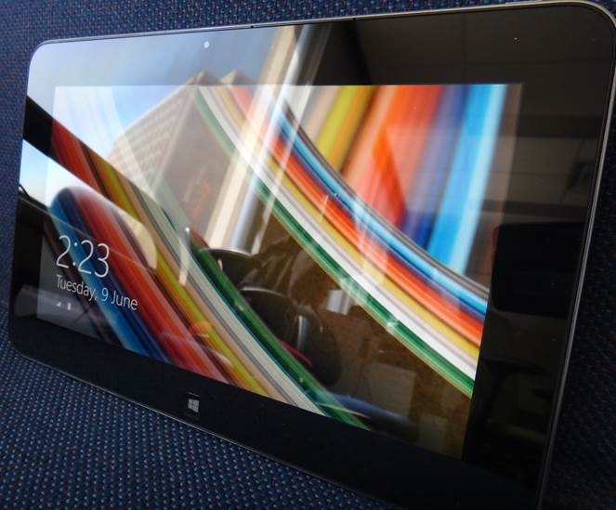
Tablets
The lightest and most portable
Touch interface:
Good/bad issues
“Oops!”
Good for ‘light’ work
Price : performance not the best among the categories

Slide 6
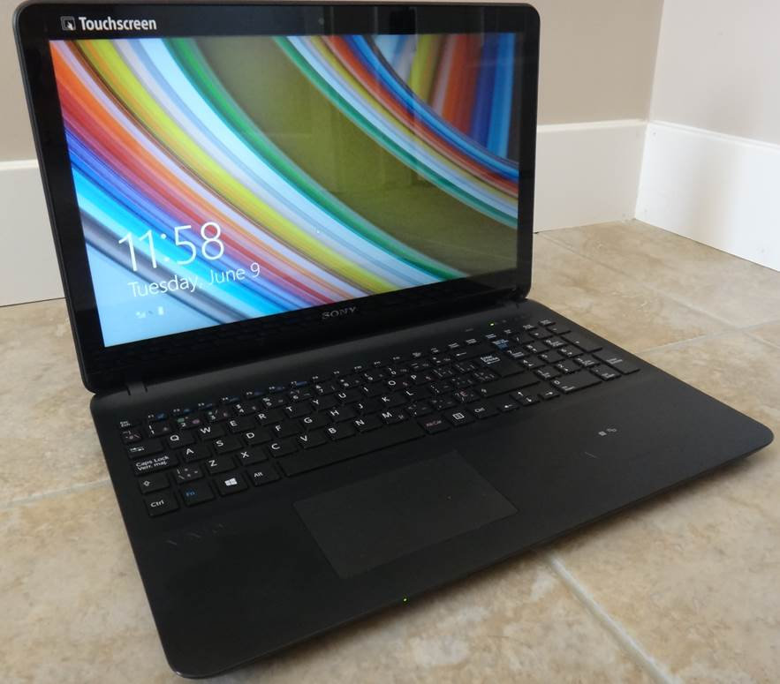
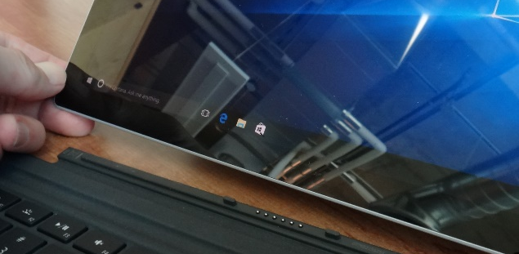
Laptops/Notebooks
Compared to tablets:
Larger display area
Adds CD or DVD as well as a physical keyboard but may include touch capability as well
“2 in 1” laptops: combine power of laptop and portability of tablet
Compared to desktops:
Portability
Price/performance, future expandability, choice of hardware not as good

Slide 7
“Specialized/Variant Laptops”
Ultrabooks
Ultra = thinner and lighter (increased portability)
All things being equal cost tends to be higher than a laptop (manufacturing in exact detail)
Netbooks
A cheaper but more portable form of a laptop (smaller and lower quality display, overall less powerful hardware).
Much less common with the rise of tablets but still the cheapest option if a built in physical keyboard is desired
Some common features on regular laptops are excluded (internal CD/DVD drive)
Comparison of netbooks vs. tablets (general technical and interaction issues over a model vs. model comparison)
http://www.ehow.com/info_8721028_difference-between-tablet-pc-netbook.html
http://www.pcadvisor.co.uk/buying-advice/tablets/3450587/netbook-vs-tablet/
http://blogs.canoe.ca/canoetech/signs-of-the-times/netbooks-vs-tablets/

Slide 8
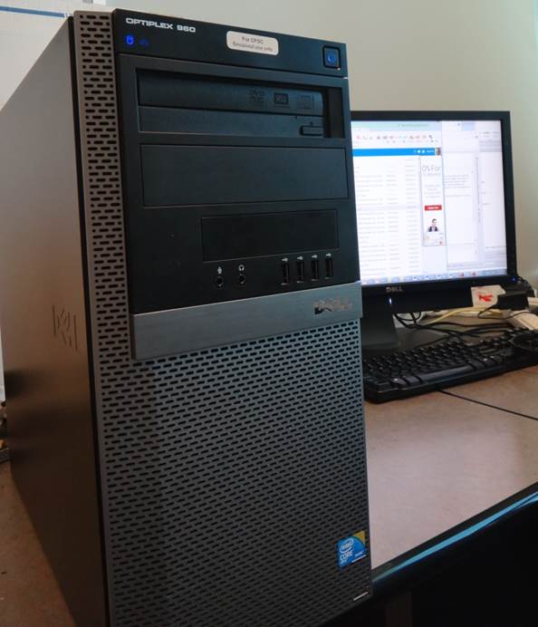
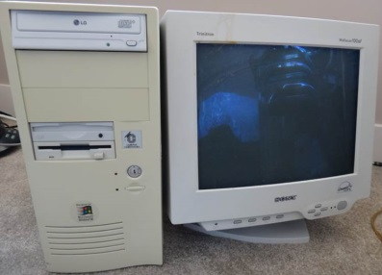
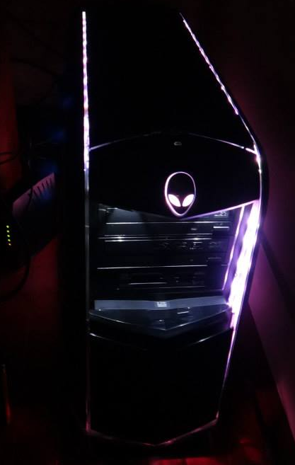
Desktop Computers
Everything is separate (monitor, computer etc.)
Allows for mixing and matching but more complex connections and it’s not portable).
Faulty components can be more easily replaced.
Larger ‘foot print’:
More space required
One benefit: greater expandability
Compared to portable laptops and tablets: Reduced costs/more options
They’ve come a long way in terms of aesthetics!

Slide 9
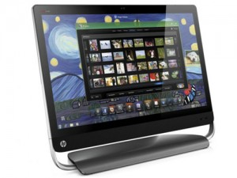
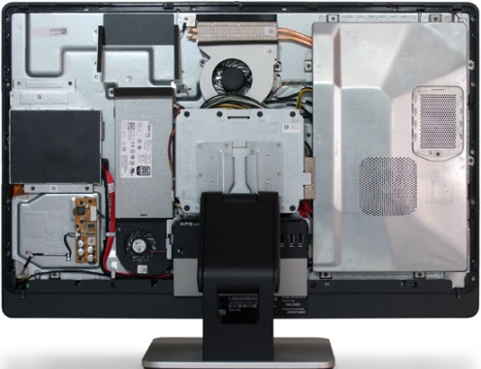
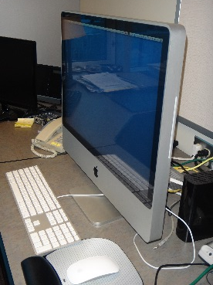
“All-In-One-Computers”
Although technically this includes tablets and laptops this is a unique actual category (commonly used term).
As the name implies everything is included together: monitor, computer, memory, storage
Commonly chosen when:
A desktop is desired but space is tight
Some portability is desired (better than a desktop but not as good as a laptop)
With few exceptions not expandable (plus: no hardware conflicts)
Somewhere in the middle between desktops and laptops in the balance between portability and hardware capabilities/power
Images (all accessed or produced in 2015)
Apple computer: James Tam
HP computer: http://gadgetynews.com/hp-omni-hd-allinone-pc-beats-audio-quadcore-power
Inside the case: http://www.tomshardware.co.uk/xps-one-27-touchscreen-all-in-one,review-32666-3.html

Slide 10
The Operating System (O/S): Purpose (If There Is Time)
Runs the computer
Intermediary between the physical hardware and the software
Determines factors such as:
The interface: familiarity, ease of use
Configurability of the computer “tweakability”
Security

Slide 11
The Operating System (O/S): MS-Windows “PC” (If There Is Time)
Most popular operating system for ‘traditional’ computers (desktop, laptops)
You have the greatest chance of finding a program or hardware on this operating system
Provides a high degree of flexibility ‘tweaking’
The popularity of Windows combined with how it allows programmers increased ability to tweak (configure/customize/add features) things can increase the probability of a security-issue (e.g., virus)

Slide 12
The Operating System (O/S): MAC (If There Is Time)
Some find it’s interface more “User friendly”
Some also find it more challenging to tweak/customize:
“Focus on consistency”: The operating system presents you with what the designers think you need to see (must sometimes dig) to find the rest or to change defaults
The fact that the operating system is less commonly used and software programmers are more constrained (e.g., a fairly stringent approval mechanism by Apple before an app may be posted in the “App store”) makes it less likely (but not impossible) to encounter security-related issues:
https://developer.apple.com/app-store/review/guidelines/

Slide 13
The Operating System (O/S): MAC (2, If There Is Time)
Also note that similar to other operating systems, security-related problems can occur because of the operating system itself (unaffected by the vetting of the App store)
http://www.forbes.com/sites/amitchowdhry/2014/12/26/why-apple-pushed-its-first-automatic-mac-os-x-security-update-this-week/

Slide 14
Large Units Of Measurement
Example usage (from the technical specifications shown earlier): 3.6GHz processor (G = Giga, Hz = processor oscillation speed)
Kilo: One thousand 1,000
Mega: One million 1,000,000
Giga: One billion 1,000,000,000
Tera: One trillion 1,000,000,000,000
Large units of measurement will be discussed again when processors and storage devices are covered

Slide 15
Basic Units Of Storage
On the computer all information is stored in binary (2 states e.g., on/off, pitted surface/smooth surface, connected/disconnected circuit)
A single off/on combination is referred to as a ‘bit’ (binary digit)
8 bits grouped together is referred to as a ‘byte’
off
on

Slide 16
Large Units Of Measurement And Storage
The amount of information that can be stored and transferred is typically measured in bytes rather than bits.
Kilobyte (KB) ~ a thousand bytes (1,024 = 2¹⁰)
Low quality preview ‘thumbnail’ images may range from a few thousand to tens of thousands of bytes in size.
Megabyte (MB) ~ a million bytes (1,048,576 = 2²⁰)
X 1,000
X 1,000,000
A typical image may range from ~20,000 Bytes / 20 KB to several million bytes (MB).
Audio files (e.g., MP3) are several Megabytes in size.
Streaming Internet video (compressed) ~several hundred Megabytes for a full movie.

Slide 17
Large Units Of Measurement And Storage (2)
Gigabyte (GB) ~ a billion bytes (1,073,741,824 = 2³⁰)
Terabyte (TB) ~ a trillion bytes (1,099,511,627,776 = 2⁴⁰)
X 1,000,000,000
Several hundred camera images or audio files
~ 30 minutes of DVD quality video (~1/4 of the information stored on a typical DVD)
X 1,000,000,000,000
Several hundred thousand images or audio files
~ 200 regular DVD’s (~32 Blu-ray) of information

Slide 18
File Sizes: Example Images

Slide 19
File Sizes: Audio Files

Slide 20
File Sizes: Videos
Lengths of the videos range from 30 seconds to 45 minutes

Slide 21
Most Important Hardware (When Choosing A Computer)
(This refers to hardware that distinguishes one computer from another computer, other pieces such as hardware such as some sort of network connection is also crucial but not really different from computer-to-computer).
Processor (CPU – or the APU for some AMD models)
Memory (RAM)
Storage (hard drive)

Slide 22
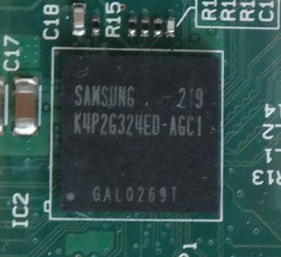
Main Processor (CPU: Central Processing Unit)
The ‘brains’ of the computer:
Determines program execution speed (not just calculation speed)
Benefits of a faster CPU
Programs are loaded faster (includes computer startup time)
Viewing videos and ripping music/videos to your computer may be faster and more free of ‘glitches’
(Of course!) Calculations are completed more quickly (e.g., evaluating the results of a spreadsheet)
ARM processor

Slide 23
CPU Clock speed
Aside from the processor model it’s the most common technical specification
It’s the speed at which the processor operates (oscillation rate)
Typical home-type computers (e.g., laptops, desktops) operate at low single digit unit Giga-clock speeds ~1 to 4 GHz
Note: Other than clock speeds there’s other factors that determines how fast a processor will run a program but all other things being equal a processor with a higher clock speed will run faster.
Computer from advertisement:
Processor: 3.6GHz 4th generation Intel Core

Slide 24
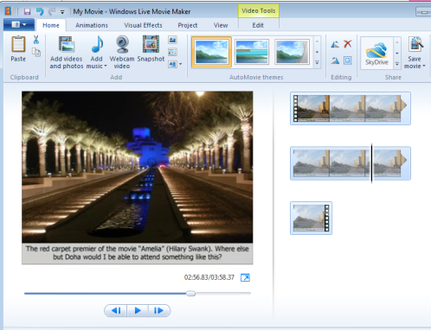
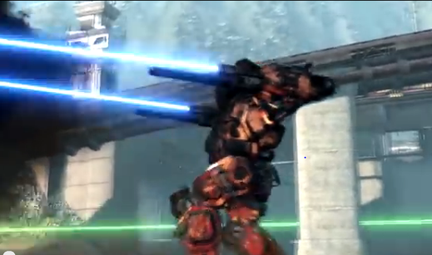
Multi-Core Processors
(Not to be confused with the model name of some Intel processors e.g., Core i3, Core i5, Core i7 etc.)
AMD manufacturers multi-core processors as well
The number of cores determines how many tasks that a computer can execute at the same time.
Single core computer:
Only appears to work on multiple tasks simultaneously.
Video editing
Playing a video game
Pause

Slide 25
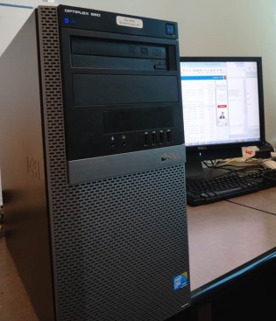
Processors: Multi-Core (2)
Dual-core processors: can work on two tasks simultaneously
First processing core: Video editing
Second processing core: Playing a video game

Slide 26
Processors: Multi-Core (3)
Other multi-core processors:
Quad core : 4 processing cores
6 core
8 core
For more information: comparing dual vs. quad core processors:
http://www.pcmag.com/article2/0,2817,2406293,00.asp

Slide 27
Processors: Multi-Core (4)
Having a processor with multiple cores can speed up execution even if only a single hardware intensive program (pushes the hardware of the computer) is running.
The program is written specifically to take advantage of multi-core technology.
Check the ‘system requirements’ or ‘technical requirements’ on the packaging or website e.g., Photoshop, Excel, Crysis (first person shooter by EA)
First core: runs one part of game
Second core: runs another part of the same game

Slide 28
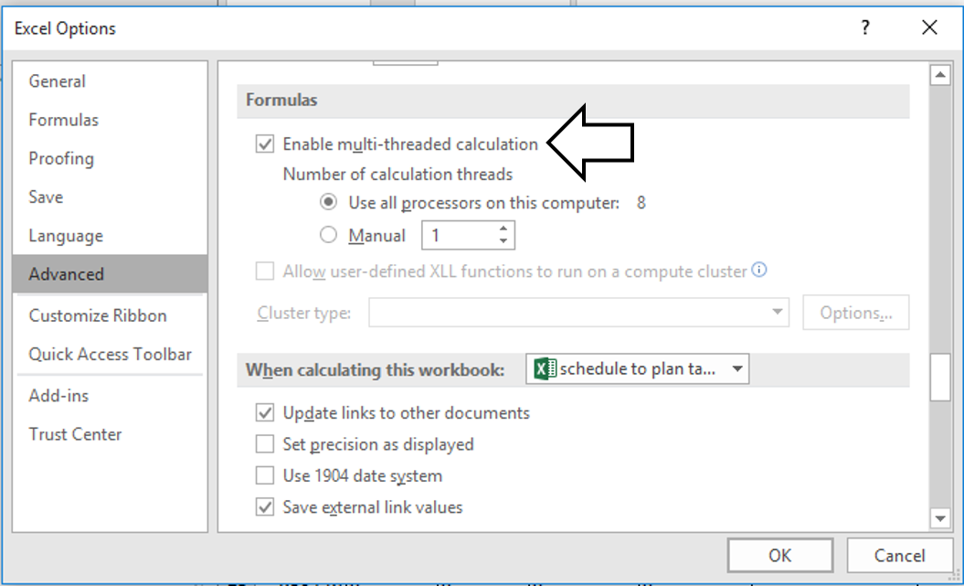
Example Program, MS-Excel: Optimal Performance With Multiple Cores

Slide 29
Will Multiple Cores Always Be Faster?
Simple answer: it depends
Advanced answer: look at actual computer usage e.g., Task manager (Windows), Activity Monitor (MAC OS-X)

Slide 30
Intel Processor Models¹
Another important factor determining execution speed
Intel processor models:
Pentium and Celeron (bargain basement entry level):
Very old low end chips
Unless you’re cash strapped avoid computers with these processors
(JT: until part way through 2013 I was running one of these for my main computer tasks!)
Core i3 (sensible entry level):
Dual core processors
For budget computers, good for basic every day computer use (word processing, browsing the web – you might want to avoid viewing videos extensively especially HD video)
Sources:
http://www.cnet.com/topics/desktops/buying-guide/
http://ark.intel.com/
http://www.intel.com/content/www/us/en/processors/processor-numbers.html

Slide 31
Intel Processor Models (2)
Core i5 (good for most tasks/most users)
Mainstream quad core processor line (a handful of lower end ones are dual core)
Common in many desktop models and all-in-one computers
Core i7 (for high end, powerful computer)
Higher end processor for hardware-intensive tasks (e.g., games, video and image editing)
For more information:
http://ark.intel.com/
http://www.intel.com/content/www/us/en/processors/processor-numbers.html
⬅Tam min
Computer from advertisement:
Processor: 3.6GHz 4th generation Intel Core i7-4790 processor

Slide 32
AMD Processor Models (If There Is Time)
We won’t spend time on these lines but reference links are available for more information.
AMD processors:
http://www.amd.com/en-us/products/processors/desktop
AMD vs. Intel: look at the speed tests performed with different software running (benchmarks).
E.g., http://www.tomshardware.com/t/cpus/
However brand definitely does matter in that you can’t freely mix and match between Intel and AMD.

Slide 33
Memory (RAM)
When a computer program is executed the instructions as well as any data currently needed (e.g., images, videos) is loaded into RAM from the storage device (usually the hard drive).
RAM is temporary storage (gone when you shut off or restart your computer).
Significantly faster than any storage device.
More expensive on a per unit basis than a storage device such as a hard drive.
The memory capacity of today’s computers are typically specified in single or double digit Gigabytes (recall that’s billions of bytes) .

Slide 34
How Much RAM?
Amount of RAM | Primary computer usage
< 4 GB | Basic: web browsing, email, word processing
4 – 8 GB | Multitasking: running a few applications simultaneously, playing simple/lower end games, watching regular (lower definition) movies, simple photo editing.
10 GB and above | Multitasking with regular applications or even with hardware-intensive applications such as games with higher resolution graphics (rules of thumb: “first person shooter” and/or 3D games rather than simpler adventure, role-playing, strategy games), video editing, 3D or extensive image editing (e.g., Photoshop), HD (high definition) entertainment
Tam
min→
Computer from advertisement:
Memory: 8 GB of RAM

Slide 35
Storage (Hard Drive)
All data that’s needed in the long term must be kept in some form of storage device.
Storage (hard drive): something that may not currently be needed but needed at some point in the future.
Memory (RAM): something that is currently used must be stored here.
Types of hard drives:
Magnetic hard drives
Stores information via magnetism
Solid state hard drives
Stores information without moving parts
The typical storage capacity of hard drives is measured in hundreds of Gigabytes or single digit Terabytes

Slide 36
Comparison Of Hard Drive Types
Magnetic hard drive (HDD)
Solid state hard drive (SSD)
Slower
Less expensive
Hard drives with the highest capacities are only magnetic
Less ‘durable’ (may be affected by magnetic fields, physical jarring, temperature extremes)
Faster (roughly double)
More expensive
Lower maximum storage capacity
More durable (no moving parts)

Slide 37
Capacity | Images (number): assume 1 MB per image | Songs (number): assumes 10 MB per song | Movies (hours): assumes 70 MB/hour | HD Movies (hours): assumes 2.4 GB/hour
256 GB | 256,000 | 25,600 | 3657 | 107
320 GB | 320,000 | 32,000 | 4571 | 133
500 GB | 500,000 | 50,000 | 7143 | 208
640 GB | 640,000 | 64,000 | 9143 | 267
750 GB | 750,000 | 75,000 | 10714 | 313
1 TB | 1,000,000 | 100,000 | 14286 | 417
2 TB | 2,000,000 | 200,000 | 28571 | 833
3 TB | 3,000,000 | 300,000 | 42857 | 1250
4 TB | 4,000,000 | 400,000 | 57143 | 1667
(SSD) Tam
range
Computer from advertisement:
Storage: 1 TB hard drive
(Magnetic) Tam
Range up to 32 TB

Slide 38
How Much Can You Actually Store?
Assume that your typical image or audio file is 2 MB apiece
1 TB drive ~ 1,000,000,000,000 bytes
2 MB file 2,000,000
Number of files (simple case 1 MB file, 1,000,000 bytes)
1,000,000,000,000 (drive capacity)
Divide by file size 1,000,000 bytes (average size will do)
= 1,000,000 files each 1 MB in size (for simplicity so we just cancel out zeros)
Number of files 2 MB file size
1,000,000 / 2 = 500,000 images or music files

Slide 39
Don’t Forgot: It’s Not All Free
Formatting a hard drive uses up some of it’s capacity
The operating system takes up space
Example: Windows 7 or 8.1 (source: http://windows.microsoft.com)
16 GB (32 bit), 20 GB (64 bit)
Productivity (work) application (source: https://products.office.com)
Example: MS-Office Professional Plus 2013 = 3 GB
A game (source: http://elderscrollsonline.info/system-requirements)
Elder Scrolls = 60 GB
With just Windows and 2 programs installed 83 GB has been used up (~8.3% of a 1 TB drive)

Slide 40
Hard Drive Tips
Bigger is often better: even higher capacity drives have come down significantly in price.
But for magnetic drives balance: storage capacity vs. speed (higher capacity drives tend to have lower rpm – slower revolution speed)
7,200 to 10,000 RPM
Or combine an SSD for speed with a magnetic drive for its high storage capacity (store smaller files than are less frequently accessed here).

Slide 41
Optical Drives
CD/DVD?
Do you play or rip music/videos?
If the answer is no then you might settle with a single inexpensive DVD drive
(Although many programs allow for Internet download some require an optical drive to install)

Slide 42
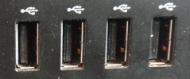
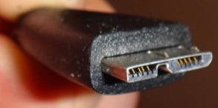
Ports (If There Is Time)
USB 3.0 ports enable blazing-fast transfer speeds with USB 3.0 devices
HDMI output lets you can watch your games and movies on the big screen
Connections to external devices.
USB (standard): get as many ports as possible, ‘hub’ devices don’t always work as well as advertised.
USB 3.0: need a few of these for USB 3.0 compatible external hard drives (backup of large amounts of data).
HDMI: allow display on a TV monitor or connections to some peripherals (cable box, game consoles)
SD: can be useful for connecting to some peripherals (devices that use SD cards such as cameras, e-readers, tablets)
But many use USB
(Other important ports e.g., video, audio, network are given in computers today)

Slide 43
Graphics (If There Is Time)
Computers need specialized hardware to ‘draw’
Goes back to computers even with primitive ‘graphics’ (colored formatted text)
Minimum: integrated graphics
Drawing is built into the basic hardware (CPU’s with this capability are referred to as the APU) or the hardware where the CPU is slotted (motherboard)
Higher quality: dedicated graphics
The computer includes additional hardware ‘dedicated’ to producing graphics “graphics card”:
Graphics processor (GPU)
Memory
Etc.

Slide 44
Integrated Graphics: Benefits And Drawbacks (If There Is Time)
Sufficient for most users tasks e.g., word processing, spreadsheets, 2D gaming
Benefits:
Reduced cost (hardware and power consumption)
Drawbacks:
Reduced speed: Tasks that involve graphics are handled by the existing hardware (CPU and memory)
May be especially noticeable if RAM is limited
Reduced graphics (of course!): you may be able to run programs employing 3D graphics but with limitations e.g., game runs at lower graphical quality (resolution), game runs slower (or both)

Slide 45
Dedicated Graphics (If There Is Time)
For serious 3D gaming , graphic design (e.g., editing 3D images)
Benefits:
Speed (graphic-related processes are handled by the GPU and graphics memory rather than the CPU and main memory)
Quality: higher quality graphics (of course!)
Drawbacks:
Cost (initial hardware and power consumption)

Slide 46
After This Section You Should Now Know
The different category of computers and computing devices: tablets, notebooks/laptops, ultrabooks, netbook, desktop all-in-ones as well as some of their strengths
What is an operating system, what is its purpose
The large units of measurement and how they apply to computer specifications
The basic units of storage: bits and bytes and how the groupings of bytes applies to hardware
Processor clock speed and reasonable values for computers of today
The effect of multiple processing cores on speed

Slide 47
After This Section You Should Now Know (2)
What is the function of RAM, how does it work, how it related to storage, what are reasonable amounts for computers of today
What the two main types of storage technology (magnetic and SSD) and how they compare, what is a reasonable amount for today’s computer usage
Common computer ports

Slide 48
Gaming Or Multi-Media Computers (Extra Optional Topic)
Games and video/image editing software requires powerful hardware with large storage capacities:
Rules of thumb:
Processor: multicores such as Intel Core i5/i7, and AMD's A6/A8/A10 and FX-series chips get a 6 core processor if you can afford it.
RAM: Minimum 6 – 8 GB
Ports: USB 3.0 can be handy (increased data transfer rates to external devices).
A dedicated graphics card is a must (and not one that is just built-in)
http://www.tomshardware.com/reviews/gaming-graphics-card-review,3107.html
http://gamingpchardware.hubpages.com/hub/best-new-graphics-cards

Slide 49
The Machines Of Tam (Extra Optional Topic)
Pre 2013
2013+
2.66 GHz Celeron
1 GB RAM
512 GB (originally ~80 GB)
Integrated graphics and sound (built into the motherboard and not separate cards)
i7-3960x (6 cores, 3.3 GHz)
32 GB RAM
512 GB SSD
1 TB HDD (but with several high capacity external USB drives)
Graphics: NVIDIA GeForce GTX 690
Sound: SB Recon 3D PCIe
P.S. for most of my CPSC undergraduate days I used an old Amiga2000HD: 7.14 MHz CPU, 1 MB chip RAM, 4 MB fast RAM, 1 GB hard drive, 32 kilobit modem

Slide 50
Additional Sources Of Information
Online buying guides:
http://www.pcmag.com/article2/0,2817,2357400,00.asp
http://www.bestbuy.ca/en-CA/research/desktop-computer-buying-guide/rc8771.aspx
http://www.amazon.com/gp/feature.html?ie=UTF8&docId=1000863131
Detailed technical specifications:
(Processors)
http://www.intel.com/content/www/us/en/processors/processor-numbers.html
http://products.amd.com/en-us/DesktopCPUResult.aspx

Slide 51
Images
“Unless otherwise indicated, all images were produced by James Tam

