Slide 1
The Internet
You would learn how to effectively search for information online as well as how to evaluate the quality of online sources.

Slide 2
Search Engines Rank Results According To Relevance

Slide 3
Making A Site More Noticeable (Higher Rank)
Search database built via search spiders (e.g., Google):
Add relevant keywords to your page.
The frequency and location of keywords may play a role in determining relevance.
Links (to your site) also affect ranking
Trying to artificially rank your page higher in search results may result in a page being put at the bottom of the list e.g., adding celebrity ‘gossip’ to my CPSC page may rank it higher but not relevant info for most visitors.
Search databases built via human researchers (e.g., Yahoo):
Make sure that your site is examined by the people who build the database.

Slide 4
Searching For Information On The Internet: Google
Easy? Just type in what you’re searching for…
…you may get the information that you were looking for plus much more!

Slide 5
You Will Learn Strategies For Narrowing Your Search Results (For Google But Largely Applies To Others):
Reducing the number of unrelated results.
Explicitly avoiding pages with certain words.
Searching for information from select pages.
Source (last accessed 2009): http://www.google.com/support/websearch and http://www.googleguide.com

Slide 6
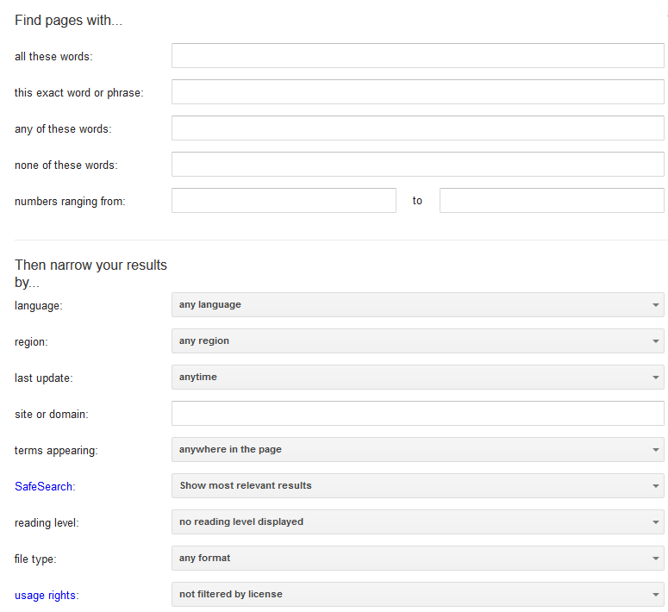
Employing These Search Strategies
Many (but not all) of the features can be found through an “Advanced Search” subpage of the Google site.
http://www.google.com/advanced_search
This leads you to a page with several options (to be covered shortly):

Slide 7
Searching For Exact Phrases
Sometimes you may be looking for information about a famous quote.
“This was their finest hour!” – Winston Churchill
Many results must be reviewed.
Unrelated websites show up: Their finest hour

Slide 8
Searching For Exact Phrases (2)
Enclosing the phrase that you are searching for in quotes will search for pages that contain only that specific phrase.
The desired phrased enclosed quotation marks.
Fewer but more relevant results show up

Slide 9
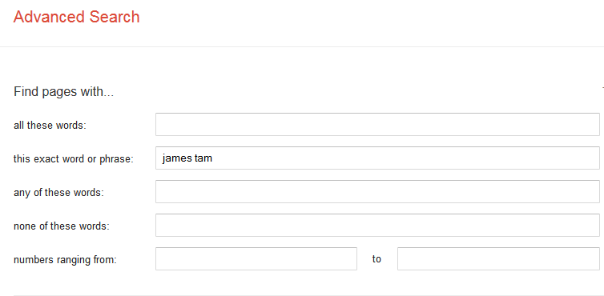
Searching Exact Phrases: Advanced Search
No other combinations are possible

Slide 10
Words That Are Commonly Ignored By Google
Stop words are ignored by search engines such as Google:
Common words
Reserved words
The search engine can be forced to include the stop words:
Use quotes
best places to eat in Calgary
Vs.
“best places to eat in Calgary”
Use the ‘plus’ operator.
Star Wars I
Vs.
Star Wars +I

Slide 11
What If More Than One Word Can Be Used?
Some concepts can be represented by using different words.
The ‘~’ operator includes synonyms in the search.
Example:
~cheap computers

Slide 12
The Search Criteria Is Incomplete/Partially Unknown
For example, searching for information on this person:
How is his name spelled?
Arnold Scwartzengger?
Arnold Schwartzenger?
Arnald Scwartzencker?
FYI it’s “Arnold Schwarzenegger”
Image: Koch/Munich Security Conference
Image: www.cnn.com (2015)
Note: many search engines try to ‘guess’ what you are thinking but sometimes software guesses wrong (think of “auto correct” on mobiles)
Also handy for less common words and phrases e.g., technical terms, foreign languages translated to English

Slide 13
Using The Wildcard In Searches

Slide 14
Using The Wildcard
Search engines such as Google have been refined to reduce but not entirely remove the need for wildcards.
Google may not provide useful alternatives when searching for technical terms or foreign words translated into English
Example: “Lei Sui, Lung” (English translation of the Chinese name of the famous martial artist/movie star: Bruce Lee)

Slide 15
Searching A Range
Searching numerical values within a certain min – max range
Range operator .. (multiple dots)
Example:
Qatar History 2000..2009
computer 2000 QR..5000 QR

Slide 16
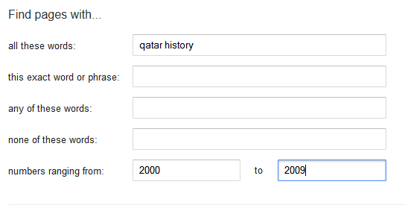
Range Searching: Advanced Search
Search criteria
Numerical range

Slide 17
Searching Among Alternatives
Normally when a word is included in the search box Google will try to find web pages that include all those words.
Example:
(All words – Logical “AND”)
cute wallpapers cats dogs
Vs.
cute wallpapers cat OR dogs
Example:
“Bruce Lee” OR “Little Dragon” OR “Lee Siu Lung”
“Wayne Gretzky” OR “The Great One“ OR Number 99” Or “Number ninety nine”

Slide 18
Searching Among Alternatives (2)
Note: Google is case sensitive in this situation! (OR must be upper case in order to search for alternatives).
To be or not to be
Vs.
To be OR not to be

Slide 19
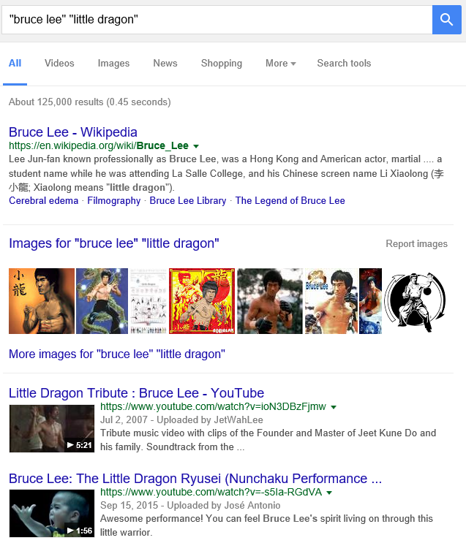
Example: Multiple Search Terms (Default)

Slide 20
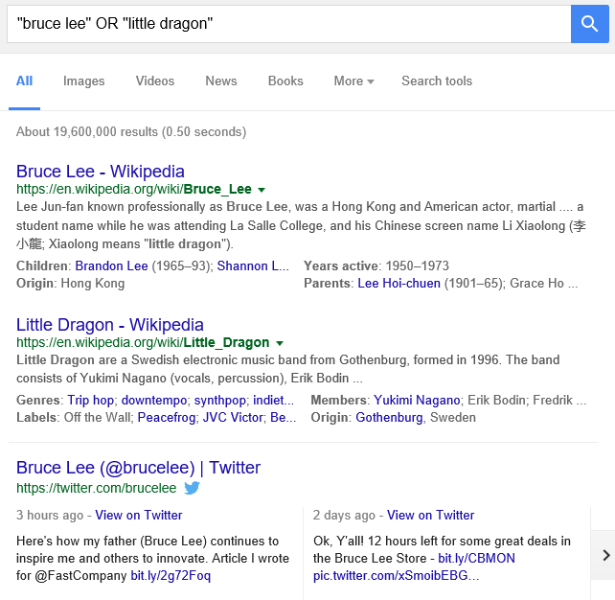
Example: Multiple Search Terms (“OR”)

Slide 21
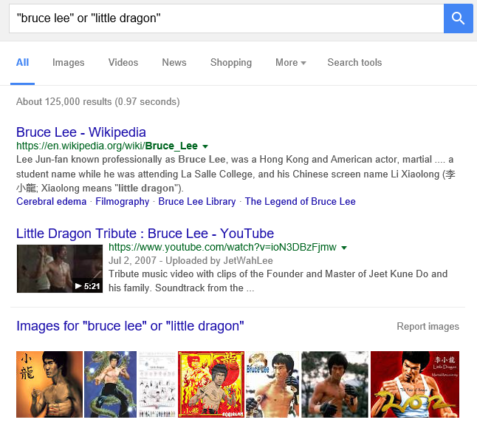
Example: Multiple Search Terms, OR - No Caps

Slide 22
Searching Alternatives: Advanced Search
All words that must appear
One of more of these words can appear

Slide 23
Using ‘OR’: Exceptions¹
Google was designed to approximate how people think and behave when searching for information.
Consequently exceptions to the rules are sometimes made.
Example²:
What you tell the search engine: “For better” OR “for worse”
What the search engine looks for: “For better or for worse”
1 From http://www.google.com/support/websearch
2 Google and other search engines may automatically assume you are looking for the Lynn Johnson comic strip (https://www.fborfw.com/) when you enter this phrase.

Slide 24
Excluding Words
There may be times when you want Google to exclude sites with certain words or phrases.
This can be done with the subtraction operator (subtract the words that follow the operator from search results).
Example:
“James Tam”
Vs.
“James Tam” -calgary

Slide 25
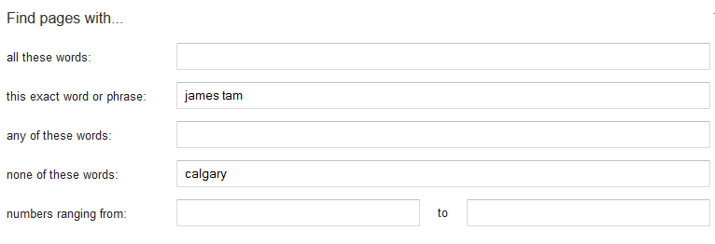
Excluding Words: Advanced Search
Exact search phrase
Excluded word

Slide 26
Site Specific Searches
Useful when a webpage is large and/or not well organized:
Searching the current webpage
Searching the entire site (and only that site)

Slide 27
Searching The Currently Viewed Web Page

Slide 28
Searching One Website
Involves searching one entire site (and not just the page from the site that is currently loaded into the web browser). Results from other sites will not be shown.
Use the ‘site’ keyword
Example:
Search only the University of Calgary website for the desired text
Results are only from the University of Calgary website

Slide 29
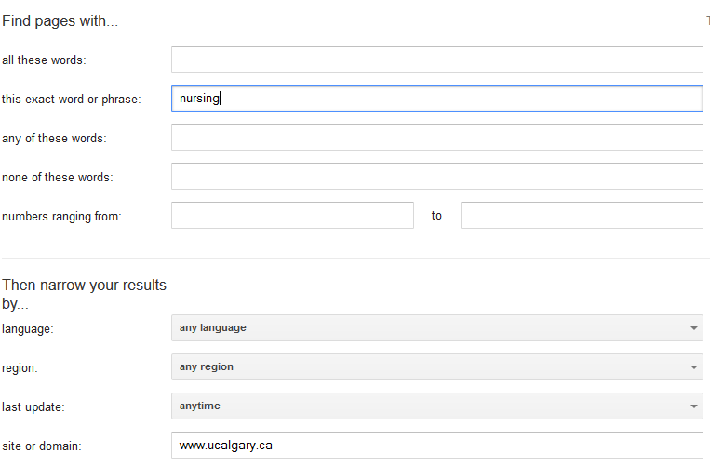
Searching One Website: Advanced Search
Information sought
Site being searched

Slide 30
Finding And Evaluating Information
This section is crafted for students who need to conduct research for an undergraduate course e.g., writing a paper
But the principles can be applied when researching information for personal reasons because it may improve the quality of the results (e.g., “Are there technical reasons why a MAC is any more or less secure than a Windows-PC?”)
Finding: Where to look for information
Evaluating: Determining the quality of information?

Slide 31
Finding Information
When conducting formal research (or even research for undergraduate courses) information sources should be evaluated for quality
Not all sources of information are equal in terms quality.
Contrast: a private individual’s personal blog vs. a website containing the current research being conducted by the experts in a particular field.
Where to start?
Check with your course instructor: what level of research is expected?
Journals and conference proceedings
Books
Online: websites

Slide 32
Journals And Conference Proceedings
Publications that describe the latest theories and research produced by domain experts
The quality of publications can vary
First tier “prestigious” venues only containing the best or higher quality work publications:
Second tier “average” publications:
However in terms of undergraduate research the quality of papers produced at either category should be sufficient (check with your course instructor)
Which ones are at least reasonably good ones? Start with the instructor’s publication list and look at the journals and conferences in which this person has published.
Overall the quality of the information is generally good
Since it is written by ‘experts’ for ‘experts’ it may be difficult for the typical student to read and understand

Slide 33
Journals And Conference Proceedings (2)
Examples (in case you’re curious):
http://www.sigchi.org/conferences/ “User-friendly technology”
http://cscw.acm.org/2015/ “Technology to support groups”

Slide 34
Books
Books: First look at the intended audience
General population books: with no background knowledge in the domain?
e.g., “A brief history of time” by Stephen Hawking
Probably too rudimentary for use in post-secondary courses.
Students: high school or post-secondary
May be at an appropriate level of detail (for the latter category) if you just want general knowledge of a topic (e.g., instead of taking a course)
Probably not specialized enough if you need to write a paper for a course
e.g., you are taking CPSC 203 there is a brief hardware introduction but the introduction is probably not sufficient if you need to write a paper on the specific hardware needed for high-end gaming computers

Slide 35
Online: Websites
Even more than the other sources, websites vary greatly in quality
The publishers of conference may host websites describing the latest research conducted by the experts
On the other hand: anyone can make their own website about a particular topic
Some things to keep in mind when evaluating the quality of a website:
Who is the author:
Widely regarded expert in the field
Industry expert (which field, is it similar to the one described in the website)
Does the person have any apparent conflicts or agendas e.g., a CEO of a computer manufacturing company writing a review of laptops (sometimes affiliations are not so obvious)
Are points backed by facts? Are those facts citing reputable sources?
Some present opinions as facts.

Slide 36
Online: Websites (2)
Who is the intended audience of the website:
Expert researchers?
General population?
Combination? E.g., www.mayoclinic.org, http://www.hopkinsmedicine.org
If the content is produced by a university or reputable research group then it’s probably correct
E.g., Mayo clinic, Johns Hopkins
But may or may not be targeted specifically to a ‘general’ audience and be of insufficient depth for your research
In general use websites with a strong degree of a caution.

Slide 37
Wikipedia
“Wikipedia is a collaboratively edited, multilingual, free Internet encyclopedia…” – from www.wikipedia.org
“Many eyes view it”
Q: Is this a good quality source of information when researching a topic?

Slide 38
Wikipedia (2)
Many ‘eyes’ view but are those the ‘right eyes’
Some topics require expert knowledge e.g., ‘Rocket science’
There is no guarantee that the experts in the area will be viewing, let alone actively editing Wikipedia documents
Furthermore the document that you view one day may not be the same one that you view on another day
Actively study the history of changes of a document and compare differences?
Subject to bias - extreme cases of “vandalism” has lead to “lock downs”
Yes files can be secured from further edits but consider what’s the point of a wiki (anyone on the web can edit)

Slide 39
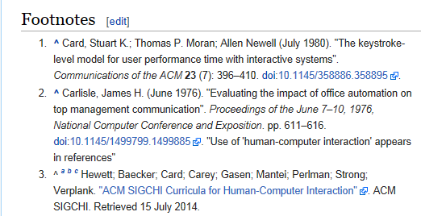
Using Wikipedia
Similar to regular paper encyclopedia or perhaps a newspaper article it’s a distillation of different sources of information.
Generally it is not accepted as a direct primary source (don’t directly cite a Wikipedia article in your research paper).
It may be a starting point to find good sources of information that can directly be cited.
Example: “Human-Computer interaction”
Wikipedia cites a good research conference (usability “user friendly” technology)

Slide 40
Using The University Library
Services provided for students:
From http://library.ucalgary.ca/student-support)
“As a student attending the University of Calgary, you have access to the books, journals and online resources of a major research institution. Your subject librarians are available for research assistance as well.
Your University of Calgary ONEcard is your library card, and gives students the following privileges:
Borrowing books with a loan period of two weeks for undergraduate students and a term loan for graduate students
Interlibrary loan
Off-campus access to Library Research Databases”

Slide 41
The University Library: Online Resources
The publications of many journals and conference proceedings can be accessed “for free” (licensed) through the university portal:
Requires login with the UC login credentials.
Combine it with an online web search:
Use regular search engines to find the relevant paper.
E.g., “Direct Stimulation of Angiotensin II Type 2 Receptor Initiated After Stroke Ameliorates Ischemic Brain Damage” – found via Google scholar
Then access the content of the paper through the university portal

Slide 42
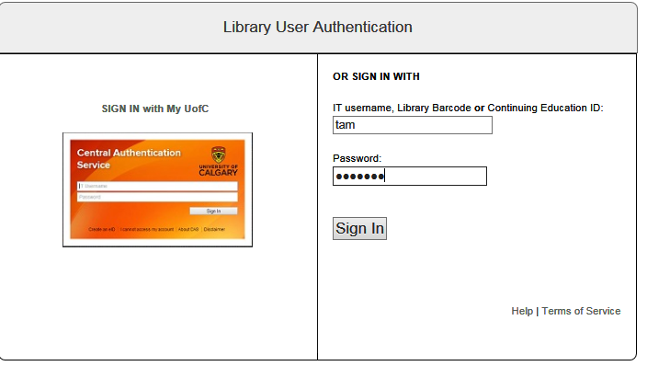
Authentication Is Require To Access The Article

Slide 43
Online Web Search Without The Library
The general Internet user does not have a license to access many good online resources.
After finding the publisher of the article: Journal of American Medical Association

Slide 44
After This Section You Should Now Know
How do search engines build up a database of websites using spiders
Some factors that can determine the ranking of search results

Slide 45
After This Section You Should Now Know (2)
Techniques for more effective web searches:
Searching for exact phrases: using quotes
How to include “stop words” in searches: quotes and the plus operator +
How to search for synonyms: ~
How to use the wildcard: *
Benefits of the wildcard vs. relying on “suggested searches”
Searching ranges: ..
Searching for alternates: OR
Excluding words and phrases: - (subtraction operator)
Conducting site specific searches:
Finding content within the webpage currently viewed: ‘find in page’
Searching for content within a particular website: site

Slide 46
After This Section You Should Now Know (3)
Sources for researching information (journals/conferences, books, websites)
Strengths and weaknesses
How to evaluated their value
How a website such as Wikipedia can and should not be used when conducting research
How the university library can complement a web search (licensed access to online resources)

