Slide 1
Databases, Part I: Storing Information
In this section you will learn about: how information is stored in databases, different database relations, ways of ensuring data validity
Online MS-Office information source: https://support.office.com/

Slide 2
Purpose Of A Database
This section: To store information
Francesco Rollandin/OpenClipart
Database: Customer information

Slide 3
Purpose Of A Database
Next section (database queries): To retrieve information information
Sale $$$
Sale $$$
Database: Customer information

Slide 4
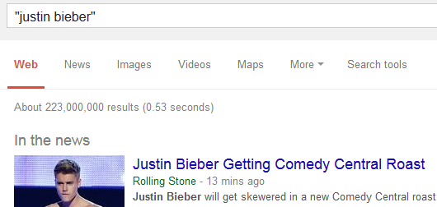
Databases: Storing / Retrieving Information
As you will see, implementing these two tasks aren’t as easy as it seems.
Information must be stored such that:
  Information can be quickly retrieved

Slide 5
Databases: Storing / Retrieving Information (2)
  The database is designed to reduce problems during maintenance (additions, modifications, deletions)
    Example: This comes up during database normalization (“if there is time”)
One employee has left and the whole department is gone?
Information Technology
Archie Bunker
Marketing Dept.
Loren Coleman
William McCloud
Finance & Accounting
Victor Davion
Omiko Kurita

Slide 6
With Bother With Databases?
Are used to store and retrieve information
Why bother, why not use a simple file as an alternative?
  E.g., tracking client information
MILES EDWARD O’BRIAN
DS9 Corp
Electrical engineering
2007 purchases: $10,0000,000
2006 purchases: $1,750,000
JAMIE SMYTHE
Cooperative services
Gasoline refining
2006 purchases: $5,000,0000
2005 purchases: $5,000,0000
2004 purchases: $5,000,0000
2003 purchases: $5,000,0000
2002 purchases: $5,000,0000
SCOTT BRUCE
Bryce Consulting
Investment analysis
2007 purchases: $500,000
2006 purchases: $1,500,000
2005 purchases: $2,500,000
2004 purchases: $500,000
Etc.
If the list is short then a simple text file may suffice
As the list grows organizing and updating the information becomes more challenging (duplicates or inaccuracies?)
Also searching the list according to specific criteria may become difficult
  e.g., Show all clients whose purchases in 2007 were between one and five million dollars
  e.g., Show all clients that made a purchase exceeding 10 million dollars.

Slide 7
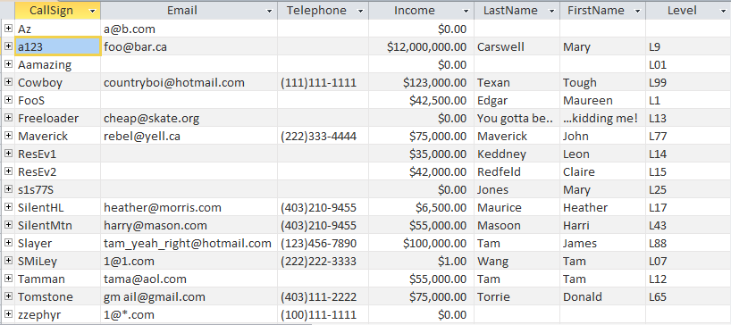
Storing Information In A Database
Information is stored in tables:
The ‘Gamers’ table

Slide 8
Storing Information In A Database (2)
Row = Record: An example instance of data within the table.
  Gamers Table: one row is an example instance of a gamer
Table
records
One record, ‘Harri Masoon’

Slide 9
Storing Information In A Database (3)
Column: are that attributes that we track for each record
  Gamers Table: each column specifies the information we store about the gamers in this database.
Attributes (‘fields’ in Access) of each record

Slide 10
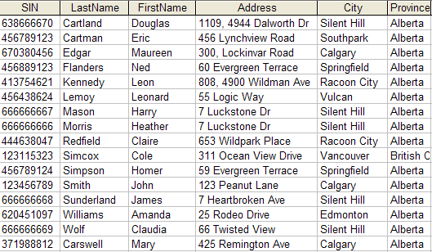
Primary Key
Each table should typically have one attribute designated as the primary key:
  The primary key must be guaranteed to be unique
  It must uniquely identify one record from another
Primary Key for table ‘Employees’ is the ‘SIN’ attribute

Slide 11
Choosing A Primary Key
A primary key must be unique to each record because it is the one thing that distinguishes them.
If there’s at least one instance where the attributes of two records can take on the same value that attribute cannot be a primary key. (When in doubt verify with your users).
If a primary key cannot be formed from a single attribute then several attributes can be combined into a composite key. (Each attribute is still a column but together they form a unique primary key for each record).
  E.g., CourseRegistrations table: Course name, course number, lecture section (CPSC 203 L01)
If a unique primary key still cannot be found then ‘invent’ one.
  E.g., StudentID#, SocialInsuranceNumber

Slide 12
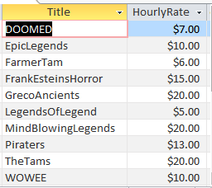
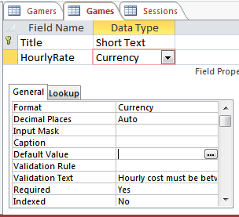
MS-Access: Views Of Your Database
Design view
  Typically start with this view
  Used to specify what attributes that a table will consist of:
    e.g., GAMES: Title, HourlyRate
  Used to specify the type, format and valid range of values
    e.g., SIN is attribute with 9 characters that must be in the format 000 000 000
    e.g., HourlyRate must be between $1 - $100
Datasheet view
Once the attributes have been specified in the Design view using the Datasheet view allows data entry for each record.

Slide 13
Example Problem: Online Games
This example can be found online:
  http://pages.cpsc.ucalgary.ca/~tamj/2017/203F/database/LectureExample.accdb
An online gaming server will allow several online different games to be played
Gamers can logon to play a particular game
A gamer playing a game will create a ‘session’ that tracks (among other things) the cost of the gaming session

Slide 14
Online Gamers: Information To Be Tracked
Online identifier: “Call sign”
Contact information: Email
Contact information: Telephone number
  Income: A (yearly) numeric figure
  Real life identifier: First and last name
  Overall ‘score’ (sum of the player’s accomplishments among multiple games): Level

Slide 15
Online Games: Information To Be Tracked
Name of the game: Title
  The cost of playing a game: Hourly rate

Slide 16
Gaming Sessions: Information To Be Tracked
Each time a player starts playing a game, billing information must be generated (attaches the bill to the correct player)
  Who played the game (who gets the bill)
  Which game was played (how much is the cost per time unit)
  How long was the game played (in conjunction with the cost per time unit it determines the amount for the bill)

Slide 17
Picking Tables
A table stores related information about an entity
  E.g.,
  Book: Title, author/authors, publisher, edition
  Product: Product name, price, description
The three groups of information (entities) in this problem appear to map to three database tables
  Gamers
  Games
  Sessions

Slide 18
Guidelines For Naming Tables¹
Create a unique and descriptive name.
  “CaloriesBurnedExercising” vs. “Workout”
Consider using the plural form of a name.
  “Games table” vs. “Game table”
Avoid the use of spaces in names.
  “Undergraduate students” vs. “Undergraduate_Students” vs. “UndergraduateStudents”
1 Based on the principles from “Databases demystified a self teaching guide” (McGraw Hill) Oppel A. pp 211

Slide 19
Guidelines For Naming Attributes²
Create a name that accurately, clearly and unambiguously identifies the characteristic that the attribute represents.
  “Name” vs. “FirstName”
Use the singular form of a name
  Tables store multiple records (e.g., GAMES table), attributes store a single piece of information (e.g., Title for a particular game)
  Do not fall into the pitfall of creating composite attributes (phone numbers - NO) vs. (home phone, cell phone etc. – YES)
Avoid the use of spaces in names (similar to tables).
1 Based on the principles from “Databases demystified a self teaching guide” (McGraw Hill) Oppel A. pp 211

Slide 20
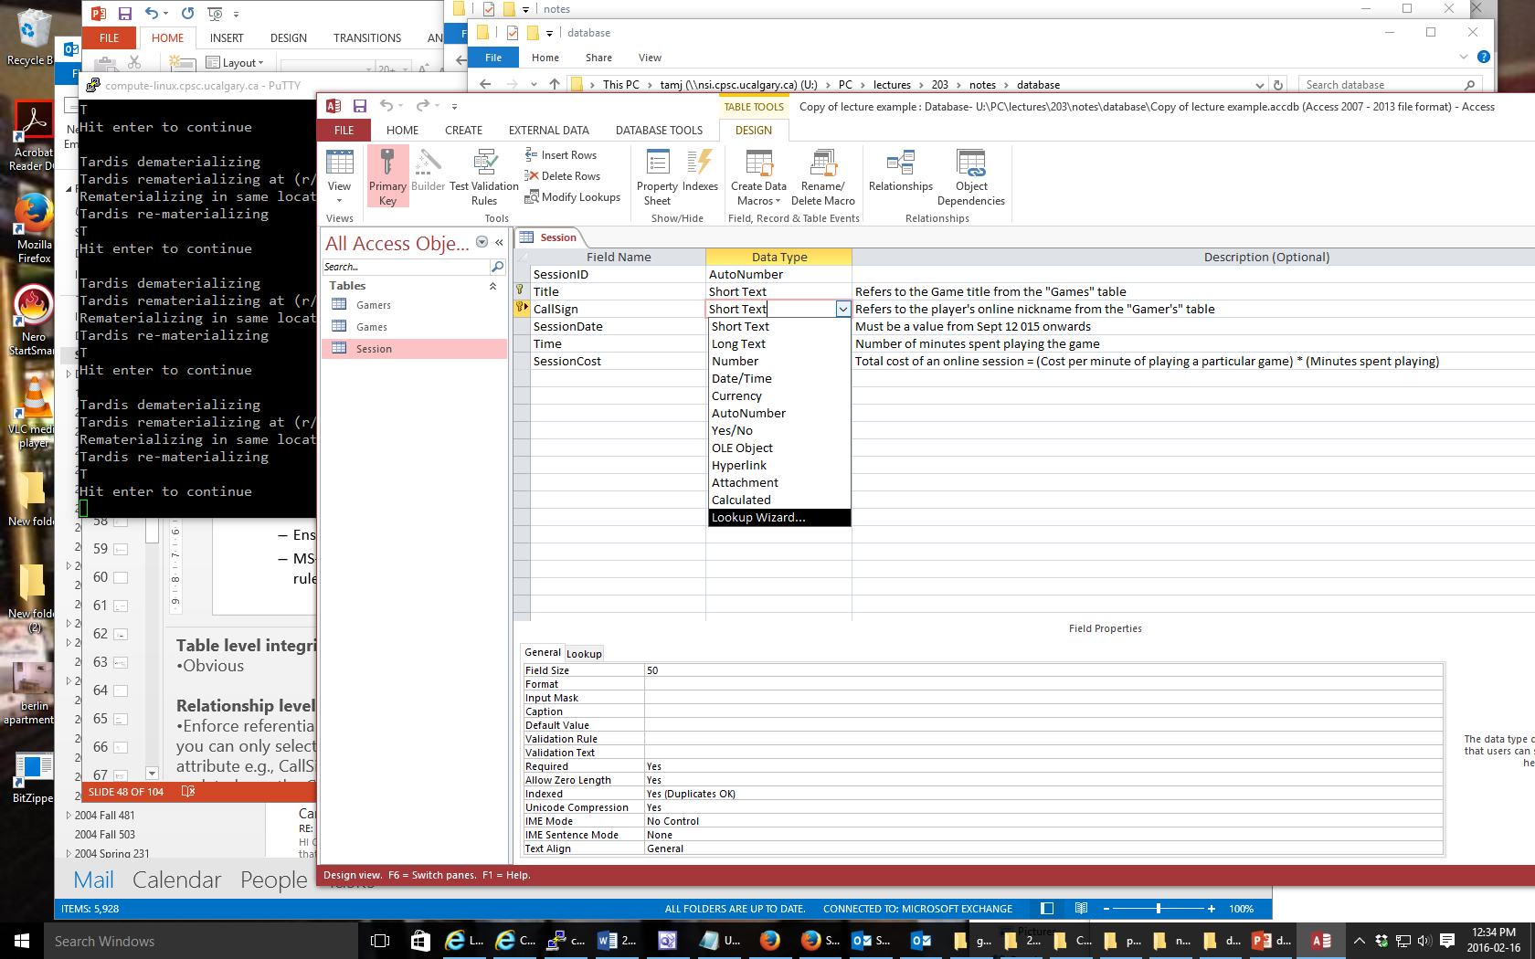
Type Of Data For An Attribute¹
  1 Source (last accessed 2017): https://support.office.com/ and the built in Office 2016 help system
Mostly you will select text
  Short text: max of 255 characters
  Long text: Up to 1 GB of characters (only the first 64,000 displayed)
  Text allows data to be entered in specific format (e.g. postal codes, phone numbers).
    Not to be used to constrain numeric ranges (e.g. age must be greater than 0).
AutoNumber
  Automatically generates a sequence of numbers 1,2,3..
  Useful for generating unique primary keys if you cannot come up with one
Obvious types: number, date/time, currency
Lookup wizard: when one table’s attribute refers to an attribute of another table (more on this later)

Slide 21
More Advanced Types (If There Is Time)
OLE (Object linking and embedding):
  Allows ‘objects’ to be inserted e.g. MS-Office documents, images (similar to an email attachment)
Hyperlink
  Enter the web address, clicking on the attribute will automatically pull up the webpage in the default browser.
Calculated
  Similar to how one cell in Excel can be derived from the values in other cells
  In Access ‘calculated’ allows for the attributes of a table to be mathematically calculated from the attributes of the same table (unless otherwise told explicitly don’t use this for the assignment).

Slide 22
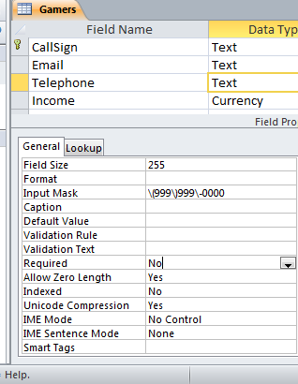
Null Values
Refers to the attributes of a record that are empty
Primary keys cannot be null but other attributes may be null
Entry of any attribute can be made mandatory

Slide 23
Gamers Table: Attributes
Gamer information to track:
  Online identifier: “Call sign”
  Contact information: Email
  Contact information: Telephone number
  Income: A (yearly) numeric figure
  Real life identifier: First and last name
  Overall score: Level
GAMERS
CallSign | Email | Telephone | Income | LastName | FirstName | Level

Slide 24
Games Table: Attributes
Game information to track:
  Name of the game: Title
  The cost of playing a game: Hourly rate
GAMES
Title | HourlyRate

Slide 25
Sessions Table: Attributes
Each time a player plays a game billing information must be generated.
  Who played the game
  Which game was played
  How long was the game played
This one is trickier!
  Identifying ‘who’: need to be 100% certain that the correct gamer has been identified (don’t bill the wrong person)
  Identifying ‘which’: again certainty is required because different games have different hourly rates (don’t bill for the wrong game and/or generate a bill for an incorrect amount)
  We need to “hold off” on creating a table until the above two requirements can be met

Slide 26
Refinements Needed: Gamers
Primary key?
GAMERS
CallSign | Email | Telephone | Income | LastName | FirstName | Level

Slide 27
Modified Table: Gamers
Primary key: CallSign
GAMERS
CallSign | Email | Telephone | Income | LastName | FirstName | Level

Slide 28
Refinements Needed: Games
Primary key?
GAMES
Title | HourlyRate

Slide 29
Modified Table: Games
Primary key: Title
GAMES
Title | HourlyRate

Slide 30
The Games Table Again
What if the game title was not guaranteed to be unique?
Primary key?

Slide 31
The Sessions Table Revisited
Recall: Each time a player logs in to play a game, billing information must be generated.
Some info need to generate a bill
  Who played the game
  Which game was played
The ‘who’ needed to identify the gamer and the ‘which’ needed to specify the game
Now that primary keys have been chosen for those two tables we can specify those two attributes (the primary keys unambiguously identify records from each table ‘who’, ‘which’)
SESSIONS
CallSign | Title

Slide 32
Foreign Key
An attribute in one table that refers to an attribute in another table:
  E.g. CallSign in the Sessions table actually refers to a players ‘call sign’ in the Gamers table
  Important because the CallSign is entered for the Gamers table and not for the Sessions table.
GAMERS
CallSign | Email | Telephone | Income | LastName | FirstName
Cowboy
SESSIONS
CallSign | Title
Cowboy | TheTams
GAMES
Title | HourlyRate
TheTams | $20

Slide 33
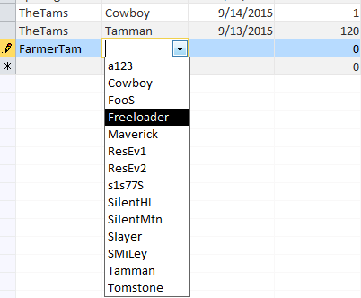
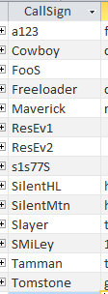
Purpose Of Foreign Keys
Using foreign keys can prevent errors
Example: when we create a login playing session, we can ensure that we only bill a player that already exists in the Gamers table.
(The same principle applies to the ‘Title’ foreign key)
Creating a new session
Gamers Table

Slide 34
Refinements Needed: Sessions
It’s determined that each player can only login once per day (client informs us about this limitation on usage)
Players can login and play over multiple dates
For each session we could store the login date and the duration (minutes):
SESSIONS
CallSign | Title | SessionDate | SessionDuration
Cowboy | TheTams | 9/13/2015 | 120

Slide 35
Refinements Needed: Sessions
Each row in the table is created when a gamer logins on a particular date
Primary key?
SESSIONS
CallSign | Title | SessionDate | SessionDuration
Cowboy | TheTams | 9/13/2015 | 120

Slide 36
Composite Key
Reminder: It’s a primary key that consists of multiple attributes (multiple columns in a database table)
Attribute1 | Attribute2 | Attribute3 | Attribute4

Slide 37
Modified Table: Sessions
Primary key (composite): CallSign, Title, Date
The creation of the primary key ‘makes sense’ intuitively for this example based on the previous restrictions.
What would be the primary key if a player could login multiple times in a day?
SESSIONS
CallSign | Title | SessionDate | SessionDuration
Cowboy | TheTams | 9/13/2015 | 120

Slide 38
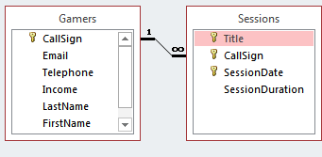
Relationships Between Tables
Relationships occur when an attribute of one table is a foreign key in another table.
Multiplicity: indicates how many instances of a particular item participates in the relationship:
  One to one
  One to many
  Many to many

Slide 39
Multiplicity
One to one relationships
  One entity participates in the relationship from the ‘left’ and one entity participates in the relationship from the ‘right’.
  Person : Head
  Gamers : CallSign
  This type of relationship is rare in databases e.g. “DepartmentHead” and “Department” vs. “SIN” and “Employee”
One to many relationships
  On one side of the relationship one entity participates in the relationship while on the other side: zero or more entities may participate in the relationship.
  This is the typical type of database relation
  Person : Hair
  Gamers : Sessions : Games

Slide 40
Multiplicity (2)
Many to many relationships
  On each side of the relationship zero or more entities may participate in the relationship.
  E.g., Travelers : Destinations
  A theoretical database relationship, not directly implemented
Travelers table
Destinations table
TravelerID | LastName | FirstName
1 | Tam | James
2 | Jones | Mary
3 | Smith | Jon
DestinationID | DestinationName
1 | Dubai
2 | Paris
3 | Cairo
4 | Vulcan

Slide 41
Multiplicity (3)
Many to many relationships
  Typically implemented as two one to many relationships in databases:
Travelers table
Destinations table
TravelerID | LastName | FirstName
1 | Tam | James
2 | Jones | Mary
3 | Smith | Jon
DestinationID | DestinationName
1 | Dubai
2 | Paris
3 | Cairo
4 | Vulcan
Trips table
TravelerID | DestinationID | Date
1 | 1 | Sept 1 2015
2 | 3 | Sept 1 2015
2 | 4 | Sept 8 2015

Slide 42
Many To Many: Ignoring The Rule
Travelers table
TravelerID | LastName | FirstName
1 | Tam | James
2 | Jones | Mary
3 | Smith | Jon
Dest¹ | Dest² | Dest³ | … | Dest^{n}
Dubai
Dubai | Cairo | Vulcan |  | Zimbobway
NY | Vulcan

Slide 43
Many To Many: Ignoring The Rule (2)
Destinations table
DestinationID | DestinationName
1 | Dubai
2 | Paris
3 | Cairo
4 | Vulcan
Trav¹ | Trav² | Trav³ | … | Trav^{n}
Alice | Bob | Bill |  | Zeek
Alice | Bill | Charlie
Alice | Bill
Jim | Karen
  (Gamers : Games) could be implemented as a many to many relationship (by-passing the Sessions table) but problems similar to the previous example would be encountered.

Slide 44
Primary-Foreign Keys Again
When there is a one to many relationship the primary key of the ‘one’ side becomes a foreign key on the ‘many’ side.
Examples:
  Gamers : Sessions
  Games : Sessions
1
Many
CallSign:
Primary key
CallSign:
Foreign key
1
Many
Title:
Primary key
Title:
Foreign key
This should make intuitive sense: the primary key uniquely identifies a record so it ‘should’ be on the ‘one’ rather than the many side

Slide 45
Diagrammatically Representing Database Tables
Entity-Relation diagrams (E-R Diagrams or E.R.D.s): show the attributes of a table
Format
TABLE NAME
Primary key
Attribute
Attribute
Example
GAMES
Title
HourlyRate

Slide 46
Diagrammatically Representing Relationships
ERDs Graphically represent relationships between tables as well as any enforced rules on multiplicity:
Person
1
1
Head
1
*
Person
1
Hairs
Person
Hairs
*
*
Travelers
Destinations
Travelers
Destinations
Gamers
*
Sessions
*
Games
1
1

Slide 47
The ERD For The Example Database
GAMERS
1
CallSign
Email
Telephone
Income
LastName
FirstName
Level
GAMES
1
Title
HourlyRate
SESSIONS
*
Title
CallSign
SessionDate
SessionDuration
*
Note: the line specifying relationships between tables goes from the primary key to the foreign key (e.g. ‘CallSign’ in ‘Gamers’ to ‘CallSign’ in ‘Sessions’

Slide 48
Data Integrity
High level description: prevent errors
Some uses (there are others)
  Type checking: prevent the wrong type of information from being entered e.g. alpha instead of numeric
  Range checking: prevent information outside the acceptable range from being entered (e.g. negative age)
  Format checking: prevent information in the wrong form from being entered (e.g. postal code N0N0N0 vs. N0N-0N0 vs. N0N 0N0)

Slide 49

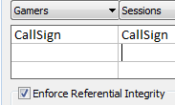
Types Of Data Integrity In Databases
Table-level integrity (entity integrity):
  Ensuring that no duplicate records exist.
  Implementation: no primary keys are null: MS-Access (automatic) indexed – no duplicates.
Relationship-level integrity (referential integrity):
  Ensuring that relationship between a pair of tables is sound and the records in the tables are synchronized when data is entered into, updated in or deleted from either table (MS-Access: only partially implemented).
  Partial implementation in Access: use ‘lookup’ for the ‘data type’ of an attribute & enforcing referential integrity.
Field/attribute -level integrity (domain integrity):
  Ensuring that the attributes are valid and accurate (the previous slides 3 examples)
  MS-Access implementation: input masks and validation rules.

Slide 50
Relationship Level Integrity
Create the foreign-primary key relationship (Design view)

Slide 51
Relationship Level Integrity: Creating The Relationship
Create the foreign-primary key relationship (Design view)

Slide 52
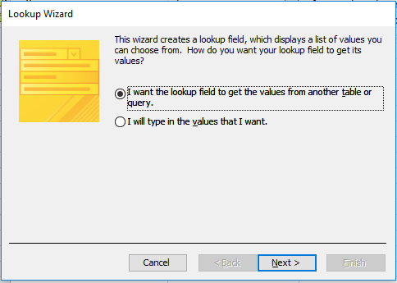
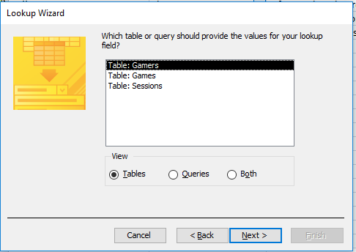
Relationship Level Integrity: Creating The Relationship (2)
Specify that the lookup value will come from another table
Specify the table (for CPSC 203)

Slide 53
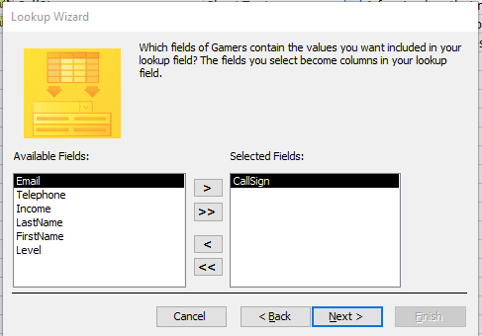
Relationship Level Integrity: Creating The Relationship (3)
Specify the foreign-primary key (attribute being looked up).
Later sub-steps
Click next.
No need to sort the results
Adjust column width if you wish

Slide 54
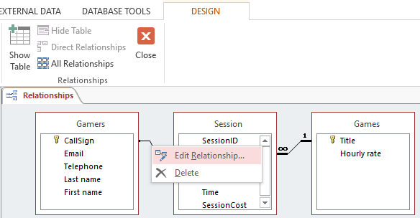
After Creating The Relationship
You may edit the relationship
Strengthen the relationship: “Enforce referential integrity”

Slide 55
Input Masks
Ensures the proper format for the data entered into the database
Example: SIN number must be entered as:
  <three digits> <space> <three digits> <space> <three digits>
  Invalid inputs:
    Abc def ghi
    321 22 4234
Online example: Telephone number format
  (<area code>)<3 digits>-<4 digits>
  Example:
    (403)210-9455

Slide 56
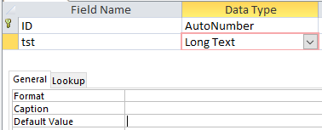
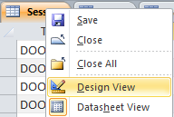
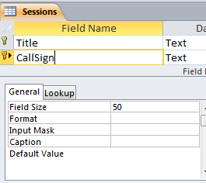
Defining Input Masks
(The data type needs to be ‘short text’ which is the default)
Switch to ‘design view’
Specify the required format under the ‘Input mask’ property of the appropriate table attribute

Slide 57


Use Of Input Masks
How it works: Constrains input allowed
  Can only enter a single digit
  Can only enter a single character
  Can only enter 5 digits (zip code)
  Etc.
Benefits:
  “Ignores” invalid inputs in real-time
  Specifies the format of data to be entered (data entry cues)

Slide 58
Some Characters That Define Input Masks
Source (last accessed Sept 2015):
  https://support.office.com/
Desired input | Character to enter as the input mask
A digit (0…9) can be entered | 9
A digit (0…9) must be entered | 0
Digits, space (default – data entry skipped), plus or minus sign | #
Alphabetic letter must be entered | L
Alphabetic letter can be entered | ?
Alphabetic letter or digit must be entered | A
Alphabetic letter or digit can be entered | a
Converts characters that follow to upper case | >
Converts characters that follow to lower case | <

Slide 59
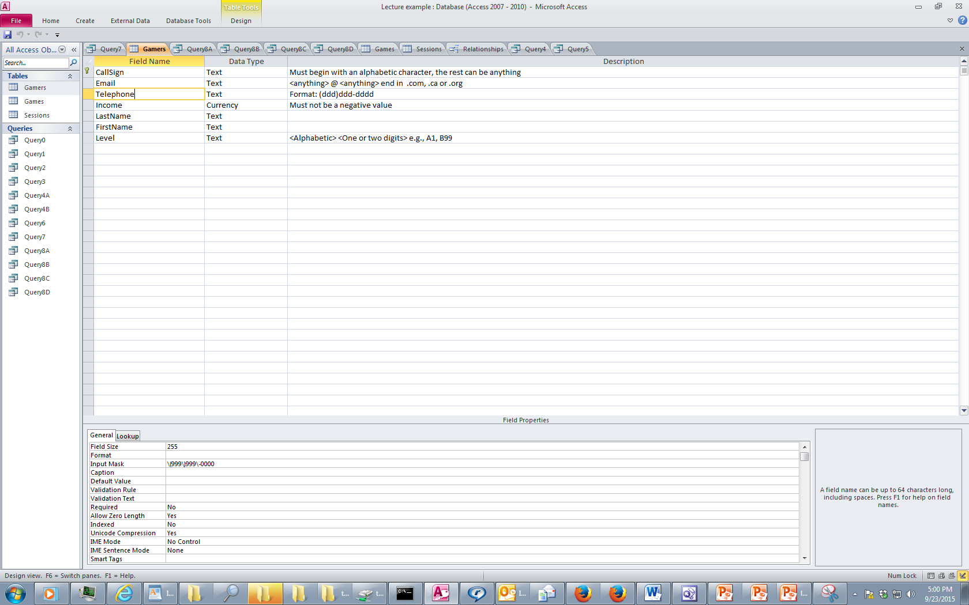
Characters That Are Displayed But Not Part Of The Table Attributes
Entering a slash ‘\’ into the input mask (design view) will display a character in the datasheet (data entry) view
  This can be a helpful data entry/formatting cue
    e.g. phone (area code)digits-digits

Slide 60
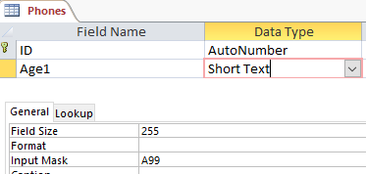

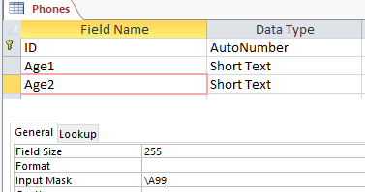
Characters That Are Displayed But Not Part Of The Table Attributes (2)
Note: the characters followed by a slash are NOT saved into the field of the database table
Example
Note: the data for the ‘A’ is saved for ‘Age1’ but not for ‘Age2’
This can make a significant difference when later searching the database ‘queries’
  ‘A12’ can show up as a result for ‘Age1’
  ‘A23’ will not show up as a result for ‘Age2’
Vs.

Slide 61
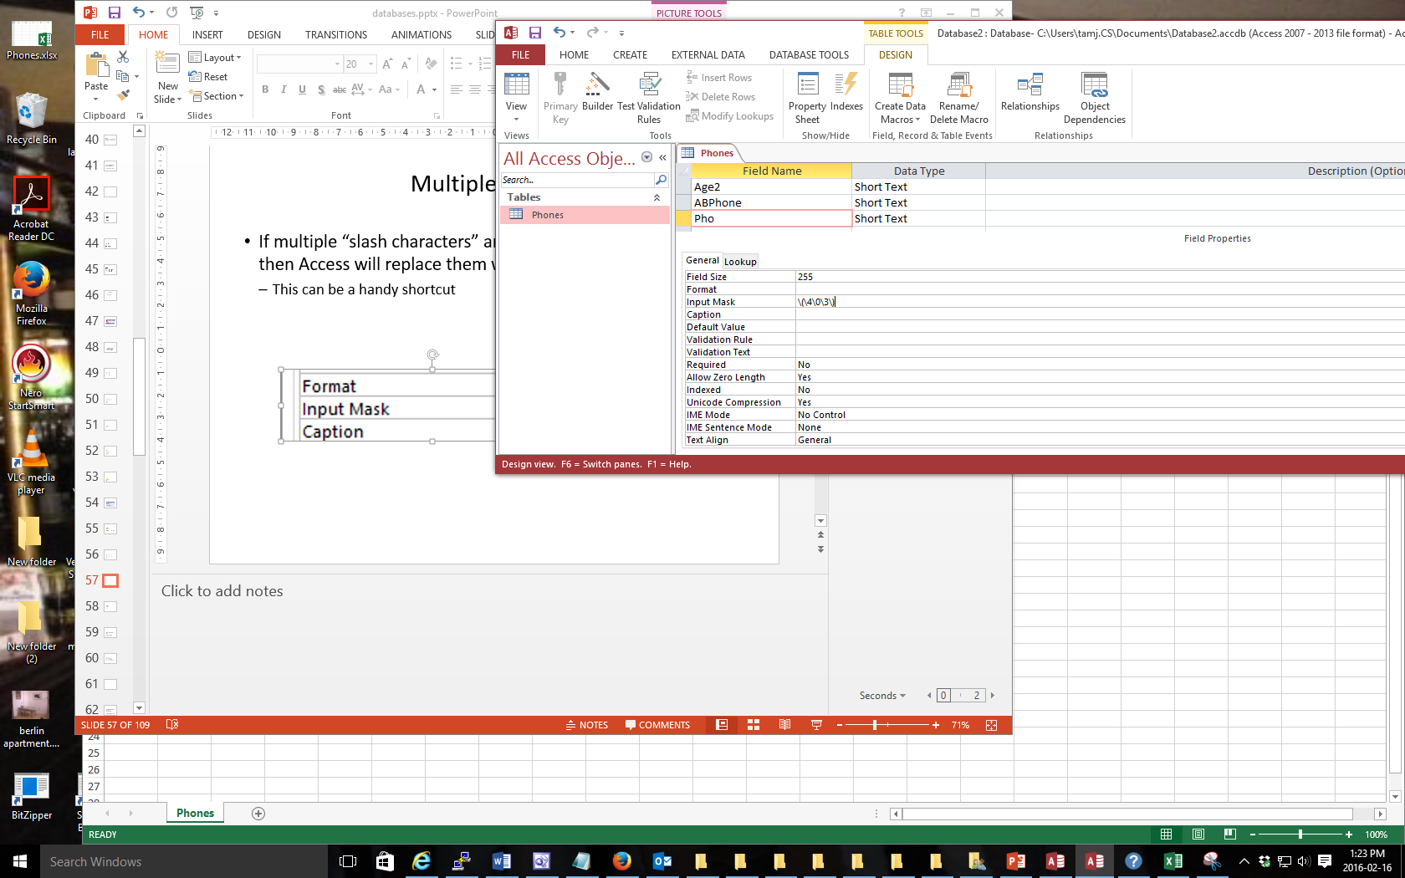

Multiple Slashes = Quotes
If multiple “slash characters” (along with other characters) are used in immediate succession then Access will replace them with double quotes
  This can be a handy shortcut

Slide 62


Input Masks: Include The Slashes Or Not
AGAIN: the character after the slash (or within the double quotes) will be displayed when the record is entered in the datasheet view.
Benefits
  A handy reminder of the format and type of data being entered
  Reduces the need for repetitive data entry (i.e. if always the same for each record why require that it’s entered each time) and reduces data entry errors (typos)
Drawback:
  AGAIN: the character after the slash (within the quotes) are not part of the attribute and cannot be entered or searched
  E.g. all phone numbers in the above example must display with a 403 area code but you cannot search for 403 area codes.

Slide 63


Input Masks: Online Database Example
Gamers table, telephone number: bracketed 3 digit area code, 3 digits, dash, 4 digits
Gamers table, level: always displays with ‘L’ at the beginning and then followed by one or two digits

Slide 64

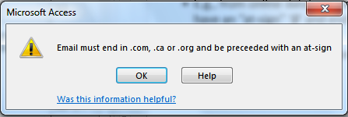
Validation Rules
Validation rules check the data is in the valid range.
  E.g., from online database example: Gamers table, income must be a non-negative value
Can also be used to specify a data format (format of a “character string”
    E.g., from online database example: Gamers table, a valid email must have an “at-sign” ‘@’ and end in one of the following suffixes ‘.ca’, ‘.com’, “.org”
    Unlike input masks validation rules allows useful error messages to be displayed

Slide 65
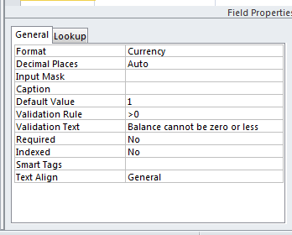
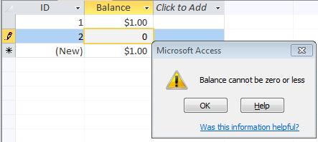
Validation Rules: Specifying Error Messages
“Validation text” & “default values”

Slide 66
Example Database: Application Of The Validation Rules
Gamers table
  CallSign: first character must be alphabetic
  Email: must include an ‘at-sign’ = @ and then end in: ‘.ca’, ‘.com’ or ‘.org’
  Income: no negative values
Games table
  HourlyRate: a dollar value from $1 to $100.
Sessions table
  SessionDate: date must be from Sept 12 2015 onwards
  SessionDuration: specifies the number of seconds in the range of 0 – 86,400

Slide 67

Validation Rules: Online Database Example (Single Range)
Gamers table: Income (non-negative only)

Slide 68
Validation Rules & Logic
Logic can combine the conditions specified in validation rules
AND (common)
  All conditions must be met before the data is deemed as valid
  Format:
  (Condition1) And (Condition 2)
  Example:
  >=0 And <=118
OR (rare for numeric ranges more common for character strings)
  At least one condition must be met before the data is deemed as valid
  Format:
  (Condition1) Or (Condition 2)
NOT (rare in databases)
  Format:
  Not (Condition)

Slide 69
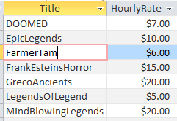
Validation Rules: Online Database Example (Two Ranges)
Games table: HourlyRate (a dollar value $1 - $100)
Student exercise: Sessions table, SessionDuration: Specifies the number of seconds from 0 – 86,400

Slide 70
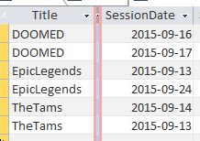
Validation Rules: Online Database Example (Date Ranges)
Sessions: SessionDate: date must be from Sept 12 2015 onwards:
  The date must be enclosed in a “number sign” pair #<date>#

Slide 71
Validation Rules: Specifying Character Strings
Character string: A sequence of characters (alpha, numeric and other characters) e.g. NX-01
Desired input | Value to enter into validation string | Example use
Alphabetic only (case insensitive) | [A-Z] | Like “[A-Z]” (single alpha) Like “[A-Z][A-Z]” (two alpha)
Digit only | [0-9] # | Like "[0-9]" (single digit) Like "[0-9][0-9]" (two digits) Like “###” (three digits)
Wildcards | * ? | Like “*” (anything) Like “?” (any single character)

Slide 72
The Wildcard
A value that can be used in place of other values.
Example: “The joker is wild” option in card games
Example: “*.docx” only documents ending in the suffix “.docx” with any name will be considered.
The start character ‘*’ is a wildcard because it can be substituted by zero or more characters
  Example documents that will considered
    resume.docx
    A.docx
    .docx fulfills the wildcard requirement but is not a valid filename.
  Example documents that won’t be considered
    resume.doc
    Me.jpg
The wildcard can be used in conjunction with validation rules

Slide 73

Validation Rules: Online Database Example (Simple Character String)
Gamers table: CallSign (first character must be alphabetic)
  O.K.
  Not O.K.

Slide 74

Validation Rules: Online Database Example (Complex Character String)
Gamers table: Email (must contain an ‘at-sign’ in the string and the string ends with ‘.com’, ‘.ca’, ‘.org’
  O.K.
  Not O.K.

Slide 75
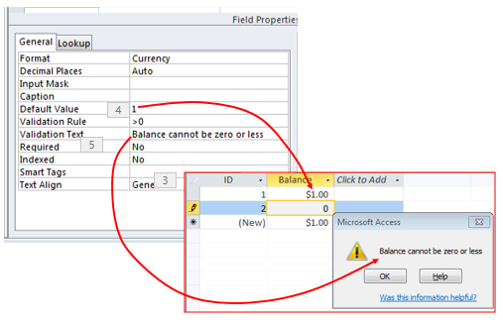
Input Masks Vs. Validation Rules: Error Handling
Input masks
  Can specify desired input beforehand, real-time error prevention
Validation Rules
  Default values can be specified
  Customized and detailed error messages can be created
    However, messages appear after erroneous data has been entered

Slide 76
Input Masks Vs. Validation Rules: Error Handling
Range checking e.g. age >= 0
  Use a validation rule
In general both can be used to check the format of the data
  E.g. <digit><digit><alpha>
Entering an arbitrary number of characters
  Use a validation rule: Use of the multi-character wildcard (not possible using an input mask)

Slide 77
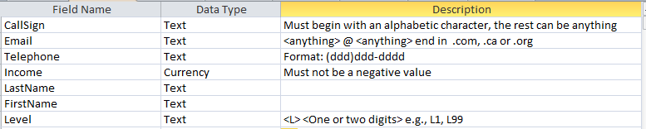
Documenting A Database
Documentation: Provides information about the database to the other people who will be working on database.
In MS-Access documentation can be entered in the “Description” column (under the Design view)
It can provide information about the type and format of the information to be stored.
  Can be used if errors are found. (Providing the original ‘intention’ if there is an error in the validation rules or the input mask can help others correct the error).

Slide 78
Database Forms And Normalization (If There Is Time)
A database form: design requirement of a database
Forms discussed in this class:
  First normal form (1NF), Second normal form (2NF), Third normal form (3NF)
  Earlier forms (e.g. 1NF) are less strict than later forms (2NF)
  Later forms (3NF) fulfill the requirements of earlier forms (2NF)
Database normalization: redesigning a database in order to bring it from a less strict form to one that is more strict.

Slide 79
Why Is Normalization Necessary?
Normalization is regarded as good style
My database ‘works’ that’s “good enough” why bother?
It also helps to prevent errors or problems which are caused by how the database is designed:
  e.g., insertion anomalies: difficulties when adding new information
  e.g., deletion anomalies: deleting information may result in the inadvertent loss of information

Slide 80
Example Database Table: Projects¹
1 From “Database Development for Dummies” by Allen G. Taylor
This table shows:
  ResearcherID: each professor working on a research project is given a computer generated login name.
  Research project: name of the projects worked on in a particular department.
    Professors can work on multiple projects
    Research projects can be initiated without a professor
  Location: room number of the research lab.
ResearcherID (PK) | Research projects (PK) | Location
aturing | Graph Coloring Traveling Salesman | QC-103 QC-201
rdescartes | Knapsack | QC-121
cbabbage | Traveling Salesman Knapsack | QC-201 QC-121
bowen | Knapsack | QC-121

Slide 81
Problem: Some Cells Can Contain Multiple Entries
Queries can be awkward to form
  E.g., Using the ‘Like’ operator is difficult because it must deal with special cases (or more entries in each cell).
  Example:
Research projects
Graph Coloring Traveling Salesman
Knapsack
Traveling Salesman Knapsack
Knapsack
With this format searching for projects under “Knapsack” won’t work correctly (some labs show up with others will not).

Slide 82
Databases In First Normal Form
1NF.: Each cell can contain at most one element (one value or a null value, the latter for non-primary key fields).
The previous table in first normal form:
ResearcherID (PK) | Research project (PK) | Location
aturing | Graph Coloring | QC-103
aturing | Traveling Salesman | QC-201
rdescartes | Knapsack | QC-121
cbabbage | Traveling Salesman | QC-201
cbabbage | Knapsack | QC-121
bowen | Knapsack | QC-121

Slide 83
First Normal Form: Critique
Improvements:
  Cells contain only one value which reduces some of the problems associated with forming queries.
Further improvements needed:
  There is redundancy in the table e.g., “aturing”
  It may be subject to modification (addition and deletion) anomalies.
ResearcherID | ResearchProject | Location
aturing | Graph Coloring | QC-103
aturing | Traveling Salesman | QC-201

Slide 84
Deletion Anomaly
Allan Turing (“aturing”) no longer works on the “Graph Coloring” project.
Before
After
Researcher ID | Research Project | Location
aturing | Graph Coloring | QC-103
aturing | Traveling Salesman | QC-201
rdescartes | Knapsack | QC-121
cbabbage | Traveling Salesman | QC-201
cbabbage | Knapsack | QC-121
bowen | Knapsack | QC-121
Researcher ID | ResearchProject | Location
aturing | Traveling Salesman | QC-103
rdescartes | Knapsack | QC-121
cbabbage | Traveling Salesman | QC-201
cbabbage | Knapsack | QC-121
bowen | Knapsack | QC-121

Slide 85
Insertion Anomalies
A new research project ‘UFO’ is added to the department and room ‘Area-57’ is to be used as the research lab but a researcher has not been hired.
This is an incomplete record that cannot yet be properly added to the database (PK = researcher and project name)
ResearcherID | Research project | Location
aturing | Graph Coloring | QC-103
aturing | Traveling Salesman | QC-201
rdescartes | Knapsack | QC-121
cbabbage | Traveling Salesman | QC-201
cbabbage | Knapsack | QC-121
bowen | Knapsack | QC-121

Slide 86
Problem With This Table
The ‘Projects’ table combines two related but separate concepts:
  Which research project a particular researcher working on
  What is the location of a particular project
It’s a sign that a single unique key cannot be assigned
By itself this isn’t necessarily a problem (i.e., ‘ResearcherID’ and ‘Research project’ form a composite primary key).
But the non-primary key element “Location” depends only on a part of the primary key (“Research project”) which can lead to anomalies.
ResearcherID | Research project | Location
aturing | Graphic Coloring | QC-103
aturing | Traveling Salesman | QC-201

Slide 87
Databases In Second Normal Form
Every non-primary key element must be dependent on the primary key (and the entire primary key if the key is composite).
The previous table split into two tables that are each in second normal form.
ResearchProject
ResearchLocation
ResearcherID | Project
aturing | Graph coloring
rdescartes | Knapsack
cbabbage | Traveling Salesman
bowen | Knapsack
Project | Location
Graph coloring | QC-103
Knapsack | QC-121
Traveling Salesman | QC-201

Slide 88
Critique Of Second Normal Form
Dependencies can still exist that affects the database but in a slightly more subtle fashion.
All non-key fields are dependent upon the primary key but some may be dependent in an indirect fashion.

Slide 89
Example¹: “SalaryRange” Table
ResearcherID | AcademicRank | RangeCode
eschroedinger | Full professor | 4
pdirac | Associate professor | 3
wheisenberg | Full professor | 4
hbethe | Assistant professor | 2
jwheeler | Adjunct professor | 1
Non-key fields whose values are dependent on the primary key (second normal form)
Primary key
1 From “Database Development for Dummies” by Allen G. Taylor

Slide 90
The Example In 2nd Normal Form Are Still Subject To Some Anomalies
Example Professor Dirac leaves the university.
Before
ResearcherID | AcademicRank | RangeCode
eschroedinger | Full professor | 4
pdirac | Associate professor | 3
wheisenberg | Full professor | 4
hbethe | Assistant professor | 2
jwheeler | Adjunct professor | 1
After
ResearcherID | AcademicRank | RangeCode
eschroedinger | Full professor | 4
wheisenberg | Full professor | 4
hbethe | Assistant professor | 2
jwheeler | Adjunct professor | 1

Slide 91
Problem With The Database (2nd Normal Form)
While both non-key elements are dependent upon the primary key, with “RangeCode” that dependency is indirect.
“RangeCode” is dependent upon “AcademicRank” which is in turn dependent upon “ResearcherID”.
This is referred to as a transitive dependency:
ResearcherID | AcademicRank | RangeCode
eschroedinger | Full professor | 4
pdirac | Associate professor | 3
RangeCode
AcademicRank
ResearcherID

Slide 92
Third Normal Form
A database in third normal form fulfills the requirements of second normal form and has no transitive dependencies.
Previous example in third normal form:
ResearcherRank
RankRange
ResearcherID | AcademicRank
eschroedinger | Full professor
pdirac | Associate professor
wheisenberg | Full professor
hbethe | Assistant professor
jwheeler | Adjunct professor
AcademicRank | Range Code
Full professor | 4
Associate professor | 3
Assistant professor | 2
Adjunct professor | 1

Slide 93
After This Section You Should Now Know
How a database is broken down into tables and how tables are broken down into it's component parts
What are the type of tables and the purpose of each
What is the purpose of a primary key
What is a foreign key
When table are related what is the rule for determining which table contains the primary vs. foreign key
What is a null value
What are forms of data integrity in databases
Guidelines for naming tables and the attributes of the tables
What are the three relationships that may exist between tables and how they differ

Slide 94
After This Section You Should Now Know (2)
How is a many-to-many relationship typically implemented in a database
The ERD representation of databases
(If there is time): What are the characteristics of a database in: first normal form, second normal form, third normal form (if there is time)

