Slide 1
CPSC 231:
Loops In Python
In this section of notes you will learn how to rerun parts of your program without duplicating instructions.

Slide 2

Repetition: Computer View
Continuing a process as long as a certain condition has been met.
Ask for age as long as the answer is negative (outside allowable range)
How old are?
How old are?
Minus 21!
Minus 21!

Slide 3
How To Determine If Loops Can Be Applied
Something needs to occur multiple times (generally it will repeat itself as long as some condition has been met).
Example 1:
Flowchart
Play again?
N
Play again?
Y
Run game again
END GAME
Re-running the entire program
Pseudo code
While the player wants to play
Run the game again

Slide 4
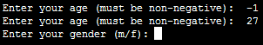
How To Determine If Loops Can Be Applied (2)
Example 2:
Re-running specific parts of the program
Flowchart
Pseudo code
Invalid input?
N
While input is invalid
Prompt user for input
Y
Ask for input again
…rest of program

Slide 5
Basic Structure Of Loops
Whether or not a part of a program repeats is determined by a loop control (typically the control is just a variable).
  Initialize the control to the starting value
  Testing the control against a stopping condition (Boolean expression)
  Executing the body of the loop (the part to be repeated)
  Update the value of the control

Slide 6
Types Of Loops
Pre-test loops
  Check the stopping condition before executing the body of the loop.
  The loop executes zero or more times.
Post-test loops
  Checking the stopping condition after executing the body of the loop.
  The loop executes one or more times.

Slide 7
Pre-Test Loops
Initialize loop control
Check if the repeating condition has been met
  If it’s been met then go to Step 3
  If it hasn’t been met then the loop ends
Execute the body of the loop (the part to be repeated)
Update the loop control
Go to step 2
Initialize loop control
Condition met?
No
Yes
Execute body
Update control
After the loop (done looping)

Slide 8
Post-Test Loops (Not Implemented In Python)
Initialize loop control (sometimes not needed because initialization occurs when the control is updated)
Execute the body of the loop (the part to be repeated)
Update the loop control
Check if the repetition condition has been met
  If the condition has been met then go through the loop again (go to Step 2)
  If the condition hasn’t been met then the loop ends.
Initialize loop control
Execute body
Update control
Condition met?
Yes
No
After the loop (done looping)

Slide 9
Pre-Test Loops In Python
While
For
Characteristics:
  The stopping condition is checked before the body executes.
  These types of loops execute zero or more times.

Slide 10
Post-Loops In Python
Note: this type of looping construct has not been implemented with this language.
But many other languages do implement post test loops.
Characteristics:
  The stopping condition is checked after the body executes.
  These types of loops execute one or more times.

Slide 11
The While Loop
This type of loop can be used if it’s not known in advance how many times that the loop will repeat (most powerful type of loop, any other type of loop can be simulated with a while loop).
  It can repeat so long as some arbitrary condition holds true.
Format:
(Simple condition)
  while (Boolean expression):
  body
  (Compound condition)
  while (Boolean expression) Boolean operator (Boolean expression):
  body

Slide 12
The While Loop (2)
Program name: while1.py
  i = 1
  while (i <= 3):
  print("i =", i)
  i = i + 1
  print("Done!")
1) Initialize control
2) Check condition
3) Execute body
4) Update control

Slide 13
The While Loop (2)
Program name: while1.py
  i = 1
  while (i <= 3):
  print("i =", i)
  i = i + 1
  print("Done!")

Slide 14
Tracing The While Loop
Execution
Variable
>python while1.py
i

Slide 15
Countdown Loop
Program name: while2.py
  i = 3
  while (i >= 1):
  print("i =", i)
  i = i - 1
  print("Done!")

Slide 16
Tracing The Count Down While Loop
Execution
Variable
>python while2.py
i

Slide 17
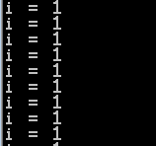
Common Mistakes: While Loops
Forgetting to include the basic parts of a loop.
  Updating the control
  i = 1
  while(i <= 4):
  print("i =", i)

Slide 18
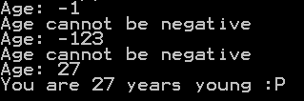
Practice Exercise
The following program that prompts for and displays the user’s age.
Modifications:
  As long as the user enters a negative age the program will continue prompting for age.
  After a valid age has been entered then stop the prompts and display the age.
age = int(input("Age: "))
print(age)

Slide 19
The For Loop
In Python a for-loop is used to step through a sequence e.g., count through a series of numbers or step through the lines in a file.
Syntax:
  for <name of loop control> in <something that can be iterated>:
  body
Program name: for1.py
  total = 0
  for i in range (1, 4, 1):
  total = total + i
  print("i=", i, "\ttotal=", total)
  print("Done!")
1) Initialize control
2) Check condition
4) Update control
3) Execute body

Slide 20

The For Loop
In Python a for-loop is used to step through a sequence
Syntax:
  for <name of loop control> in <something that can be iterated>:
  body
Program name: for1.py
  i = 0
  total = 0
  for i in range (1, 4, 1):
  total = total + i
  print("i=", i, "\ttotal=", total)
  print("Done!")

Slide 21
Tracing The First For Loop Example
Execution
Variables
>python for1.py
i
total

Slide 22
Counting Down With A For Loop
Program name: for2.py
  i = 0
  total = 0
  for i in range (3, 0, -1):
  total = total + i
  print("i = ", i, "\t total = ", total)
  print("Done!")

Slide 23
Tracing The Second For Loop Example
Execution
Variables
>python for2.py
i
total

Slide 24
For Loop: Stepping Through A Sequence Of Characters
Recall: A for-loop in Python can step through any iteratable sequence (number sequence, characters in a string, lines in a file).
Example: for3.py
  activity = input("What are you doing with dog now: ")
  print("We are taking the dog for a '", end="")
  for ch in activity:
  print(ch + "-", end="")
  print("'")

Slide 25
Erroneous For Loops
The logic of the loop is such that the end condition has already been reached with the start condition.
Example: for_error.py
for i in range (5, 0, 1):
  total = total + i
  print("i = ", i, "\t total = ", total)
  print("Done!")

Slide 26
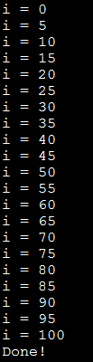
Loop Increments Need Not Be Limited To One
While: while_increment5.py
  i = 0
  while (i <= 100):
  print("i =", i)
  i = i + 5
  print("Done!")
For: for_increment5.py
  for i in range (0, 105, 5):
  print("i =", i)
  print("Done!")

Slide 27

Sentinel Controlled Loops
The stopping condition for the loop occurs when the ‘sentinel’ value is reached.
Program name: sum.py
  total = 0
  temp = 0
  while(temp >= 0):
  temp = input ("Enter a non-negative integer (negative to end
  series): ")
  temp = int(temp)
  if (temp >= 0):
  total = total + temp
  print("Sum total of the series:", total)
Q: What if the user just entered a single negative number?

Slide 28
Sentinel Controlled Loops (2)
Sentinel controlled loops are frequently used in conjunction with the error checking of input.
Example (sentinel value is one of the valid menu selections, repeat while selection is not one of these selections)
  selection = " "
  while selection not in ("a", "A", "r", "R", "m", "M", "q", "Q"):
  print("Menu options")
  print("(a)dd a new player to the game")
  print("(r)emove a player from the game")
  print("(m)odify player")
  print("(q)uit game")
  selection = input("Enter your selection: ")
  if selection not in ("a", "A", "r", "R", "m", "M", "q", "Q"):
  print("Please enter one of 'a', 'r', 'm' or 'q' ")

Slide 29
Recap: What Looping Constructs Are Available In Python/When To Use Them
Construct | When To Use
Pre-test loops | You want the stopping condition to be checked before the loop body is executed (typically used when you want a loop to execute zero or more times).
While | The most powerful looping construct: you can write a ‘while’ loop to mimic the behavior of any other type of loop. In general it should be used when you want a pre-test loop which can be used for most any arbitrary stopping condition e.g., execute the loop as long as the user doesn’t enter a negative number.
For | In Python it can be used to step through some sequence
Post-test: None in Python | You want to execute the body of the loop before checking the stopping condition (typically used to ensure that the body of the loop will execute at least once). The logic can be simulated with a while loop.

Slide 30

The Break Instruction
Q: What if the user just typed ‘abc’ and hit enter?
It is used to terminate the repetition of a loop which is separate from the main Boolean expression (it’s another, separate Boolean expression).
General structure:
  for (Condition 1): while (Condition 1):
  if (Condition 2): if (Condition 2):
  break break
Specific example (mostly for illustration purposes at this point): break.py
  str1 = input("Enter a series of lower case alphabetic characters: ")
  for temp in str1:
  if (temp < 'a') or (temp > 'z'):
  break
  print(temp)
  print("Done")

Slide 31
The Break Should Be Rarely Used
(while)
Boolean met?
N
Y
JT: While adding a single break may not always result in ‘spaghetti’ it’s the beginning of a bad habit that may result in difficult to trace programs
Instruction
N
(If)
Boolean met?
Y
…rest of program
Adding an extra exit point in a loop (aside from the Boolean expression in the while loop) may make it harder to trace execution (leads to ‘spaghetti’ programming).

Slide 32
An Alternate To Using A ‘Break’
Instead of an ‘if’ and ‘break’ inside the body of the loop
while (BE1):
if (BE2):
break
Add the second Boolean expression as part of the loop’s main Boolean expression
while (BE1) and not (BE2):

Slide 33
Another Alternative To Using A ‘Break’
If the Boolean expressions become too complex consider using a ‘flag’
flag = true
while (flag == true):
if (BE1):
flag == false
if (BE2)
flag == false
# Otherwise the flag remains set to true
# BE = A Boolean expression
Both of these approaches still provide the advantage of a single exit point from the loop.

Slide 34
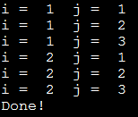
Nested Loops
One loop executes inside of another loop(s).
Example structure:
  Outer loop (runs n times)
  Inner loop (runs m times)
  Body of inner loop (runs n x m times)
Program name: nested.py
  i = 1
  while (i <= 2):
  j = 1
  while (j <= 3):
  print("i = ", i, " j = ", j)
  j = j + 1
  i = i + 1
  print("Done!")

Slide 35

Infinite Loops
Infinite loops never end (the stopping condition is never met).
They can be caused by logical errors:
  The loop control is never updated (Example 1 – below).
  The updating of the loop control never brings it closer to the stopping condition (Example 2 – next slide).
Example 1: infinite1.py
i = 1
while (i <= 10):
print("i = ", i)
i = i + 1
To stop a program with an infinite loop in Unix simultaneously press the <ctrl> and the <c> keys

Slide 36
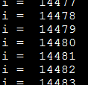
Infinite Loops (2)
Example 2: infinite2.py
i = 10
while (i > 0):
print("i = ", i)
i = i + 1
print("Done!")
To stop a program with an infinite loop in Unix simultaneously press the <ctrl> and the <c> keys

Slide 37
Testing Loops
Make sure that the loop executes the proper number of times.
Test conditions:
  Loop does not run
  Loop runs exactly once
  Loop runs exactly ‘n’ times

Slide 38
Testing Loops: An Example
Program name: testing.py
sum = 0
i = 1
last = 0
last = int(input("Enter the last number in the sequence to sum : "))
while (i <= last):
sum = sum + i
print("i = ", i)
i = i + 1
print("sum =", sum)

Slide 39
Extra Practice
Write a loop that will continue repeating if the user enters a value that is negative.
Write a program that will prompt the user for number and an exponent. Using a loop the program will calculate the value of the number raised to the exponent.
  To keep it simple you can limit the program to non-negative exponents.

Slide 40
Problem Solving: Using Loops For A More Complex Problem
Write a program that will prompt the user for the birth month and the day of birth.
The birth month must be a value from 1 – 12.
The day of birth must be a number that is one or greater while the maximum value will be determined by the maximum days in a particular month.
  Thirty days hath September,
  April, June, and November:
  All the rest have thirty-one,
  Except for February,
  Which hath twenty-eight days clear,
  And twenty-nine in each leap year.
    [JT’s note: for this example you can assume that a day of birth of 29 is always valid for February]

Slide 41
Problem Solving: Using Loops For A More Complex Problem (2)
The program will prompt first for the month and repeat the prompt as long as the value is not within the valid range.
Next the program will prompt for day of birth and repeatedly prompt for a value so long as day is valid for the particular month (see previous slide).
After receiving a valid month and day the program will display the month of birth and the day of birth.

Slide 42
Pseudo Code
A high level solution or algorithm that is not specified in a programming language.
Instead English-like statements are used.
  “A high-level description of the actions of a program or algorithm, using a mixture of English and informal programming language syntax” – Python for Everyone (Horstmann, Necaise)
Benefits: it allows the programmer to focus on the solution without spending a lot time worrying about details such as syntax.
When the pseudo code solution has been created then those details can be handled separately when the solution is translated into an actual program.
For difficult problems it may be beneficial to break the problem solving process into these steps.

Slide 43
A Pseudo Code Solution
While (month is not between 1 and 12) do
Prompt user for month
If (month is one with 31 days) then
while (month is not between 1 and 31) do
Prompt user for day
If (month is one with 30 days) then
while (month is not between 1 and 30) do
Prompt user for day
If (month has 29 days) then
while (month is not between 1 and 29) do
Prompt user for day
Show month and day of birth

Slide 44
Program Code Solution
Program name: calendar.py
  JAN = 1
  FEB = 2
  MAR = 3
  APR = 4
  MAY = 5
  JUN = 6
  JUL = 7
  AUG = 8
  SEP = 9
  OCT = 10
  NOV = 11
  DEC = 12

Slide 45
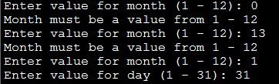
Program Code Solution (2)
  # Entering Month separate from day:
  # Once month value is entered it cannot be changed
  month = -1
  while (month < JAN) or (month > DEC):
  month = int(input("Enter value for month (1 - 12): "))
  if (month < JAN) or (month > DEC):
  print("Month must be a value from 1 - 12")
  # Months with 31 days
  if (month in (JAN,MAR,MAY,JUL,AUG,OCT,DEC)):
  day = -1
  while (day < 1) or (day > 31):
  day = int(input("Enter value for day (1 - 31): "))
  if (day < 1) or (day > 31):
  print("Day must be a value from 1 - 31")
…

Slide 46
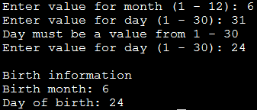
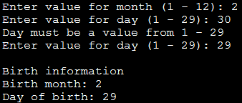
Program Code Solution (3)
  elif (month in (APR,JUN,SEP,NOV)):
  day = -1
  while (day < 1) or (day > 30):
  day = int(input("Enter value for day (1 - 30): "))
  if (day < 1) or (day > 30):
  print("Day must be a value from 1 - 30")
  elif (month == FEB):
  day = -1
  while (day < 1) or (day > 29):
  day = int(input("Enter value for day (1 - 29): "))
  if (day < 1) or (day > 29):
  print("Day must be a value from 1 - 29")
  print()
  print("Birth information")
  print("Birth month: %d" %month)
  print("Day of birth: %d" %day)

Slide 47



Example Of Using Named Constants
Results in ‘self documenting’ code
The program instructions provide clues as to how things work
Makes the program smaller
First version
Current version

Slide 48
Extra Practice
Modify the program so that the user can select a different month after a day has been entered.
  It will still prompt for and error check the month
  Next it will prompt for and error check the day
  If the combination is valid then the program will simply display the month/day.
  If the combination is not valid then the program will re-prompt for the month (repeat the process until a combination is valid).
How does this change in the program requirements change the solution?
  Try modifying the pseudo code solution before producing a solution in Python.

Slide 49
User-Friendly Software (If There Is Time)
In today’s world it’s not just sufficient to create software that has implemented a given set of operations.
If the person using the system cannot understand it or has troubles using common functions then the software or technology is useless.
Reference course: If you’re interested in more information:
  http://pages.cpsc.ucalgary.ca/~tamj/2008/481W/index.html

Slide 50
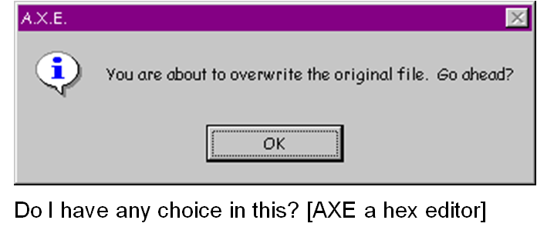
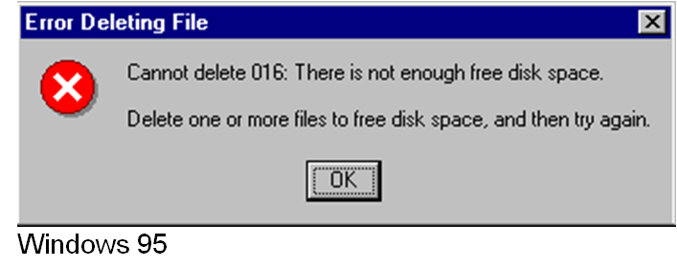
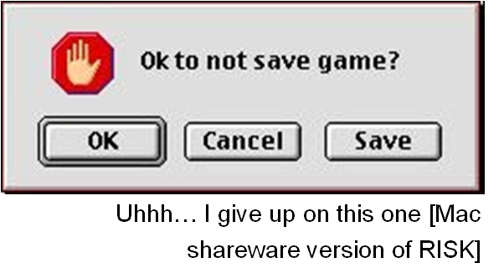
Not So Friendly Examples (If There Is Time)

Slide 51
Some Rules (Of Thumb) For Designing Software (If There Is Time)
(The following list comes from Jakob Nielsen’s 10 usability heuristics from the book “Usability Engineering”
  Minimize the user’s memory load
  Be consistent
  Provide feedback
  Provide clearly marked exits
  Deal with errors in a helpful and
  positive manner

Slide 52
Minimize The User’s Memory Load (If There Is Time)
Computers are good at ‘remembering’ large amounts of information.
People are not so good remembering things.

Slide 53
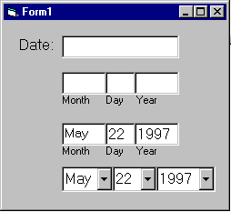
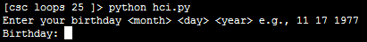
Minimize The User’s Memory Load (If There Is Time)
To reduce the memory load of the user:
  Describe required the input format, show examples of valid input, provide default inputs
Examples:
Example 1:
Example 2:

Slide 54
Be Consistent (If There Is Time)
Consistency of effects
  Same words, commands, actions will always have the same effect in equivalent situations
  Makes the system more predictable
  Reduces memory load
Consistency of layout
  Allows experienced users to predict where things should be (matches expectations)

Slide 55
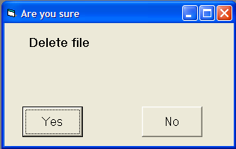
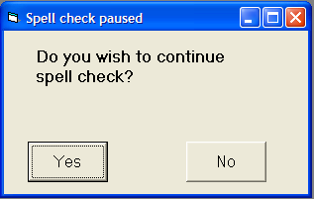
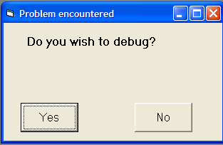
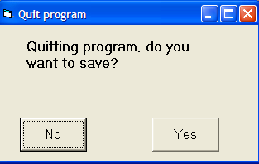
Be Consistent (If There Is Time)
Consistency of language and graphics
  Same information/controls in same location on all screens / dialog boxes forms follow boiler plate.
  Same visual appearance across the system (e.g. widgets).
Images courteously of James Tam

Slide 56
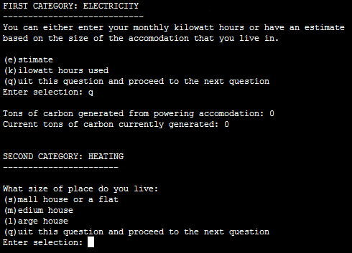
Be Consistent (If There Is Time)
This last option allows the user to proceed to the next question.

Slide 57
Provide Feedback (If There Is Time)
Letting the user know:
  What the program is currently doing: was the last command understood, has it finished with it’s current task, what task is it currently working on, how long will the current task take etc.

Slide 58
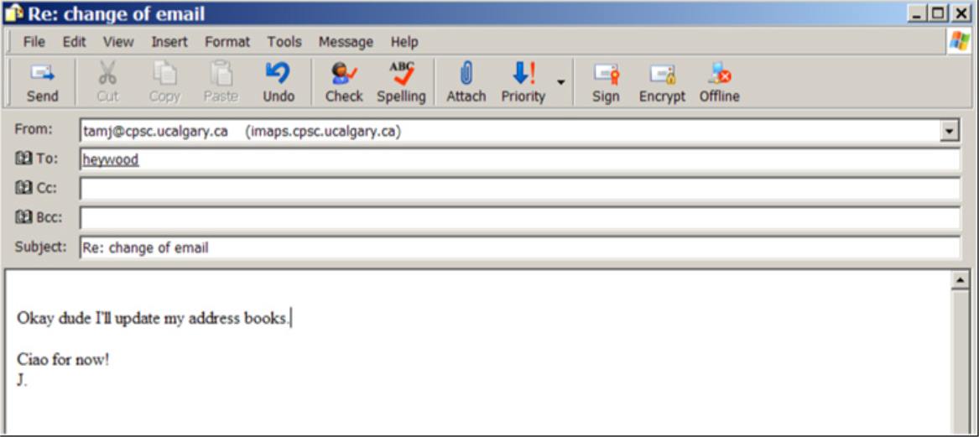
Provide Feedback (If There Is Time)
What is the program doing?
Outlook Express image courteously of James Tam

Slide 59
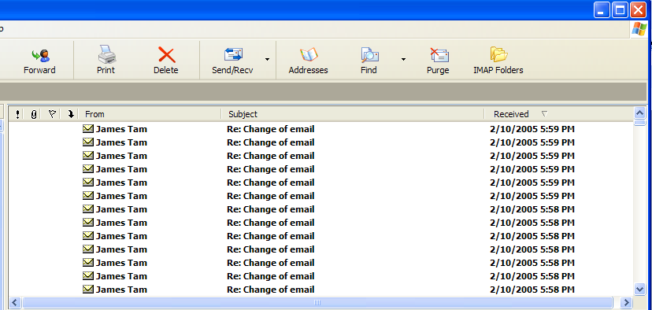
Provide Feedback (If There Is Time)
The rather unfortunate effect on the (poor) recipient.
Outlook Express image courteously of James Tam

Slide 60
Provide Feedback (If There Is Time)
In terms of this course, feedback is appropriate for instructions that may not successfully execute
  what the program is doing (e.g., opening a file),
  what errors may have occurred (e.g., could not open file),
  and why (e.g., file “input.txt” could not be found)
...it’s not hard to do and not only provides useful updates with the state of the program (“Is the program almost finished yet?”) but also some clues as to how to avoid the error (e.g., make sure that the input file is in the specified directory).
At this point your program should at least be able to provide some rudimentary feedback
  E.g., if a negative value is entered for age then the program can remind the user what is a valid value (the valid value should likely be shown to the user as he or she enters the value):
  age = int(input ("Enter age (0 – 114): "))

Slide 61
Provide Clearly Marked Exits (If There Is Time)
This should obviously mean that quitting the program should be self-evident (although this is not always the case with all programs!).
In a more subtle fashion it refers to providing the user the ability to reverse or take back past actions (e.g., the person was just experimenting with the program so it shouldn’t be ‘locked’ into mode that is difficult to exit).
Users should also be able to terminate lengthy operations as needed.

Slide 62
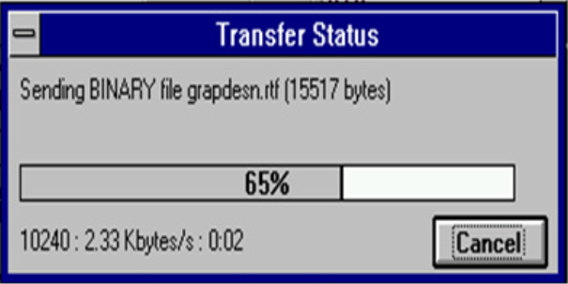
Provide Clearly Marked Exits (If There Is Time)
This doesn’t just mean providing an exit from the program but the ability to ‘exit’ (take back) the current action.
  Universal Undo/Redo
    e.g., <Ctrl>-<Z> and <Ctrl>-<Y>
  Progress indicator & Interrupt
  Length operations
Image: From the “HCI Hall of Shame”

Slide 63
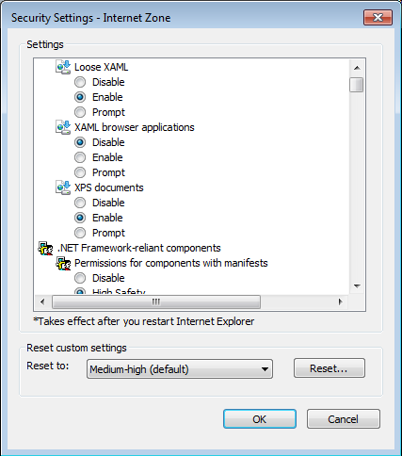
Provide Clearly Marked Exits (If There Is Time)
Restoring defaults
  Getting back original settings
What option did I change?
What was the original setting?
Allows for defaults to be quickly restored
Image: Internet Explorer security settings curtesy ofJames Tam

Slide 64
Provide Clearly Marked Exits (If There Is Time)
The user can skip or ‘exit’ any question
Image: An old CPSC 231 assignment curtesy of James Tam

Slide 65
Deal With Errors In A Helpful And
Positive Manner (If There Is Time)
(JT: with this the heuristic it states exactly what should be done).

Slide 66
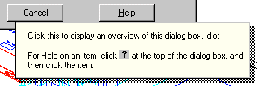
Rules Of Thumb For Error Messages (If There Is Time)
Polite and non-intimidating
  Don’t make people feel stupid
    Try again, bonehead!
Understandable
  Error 25
Specific
  Cannot open this document
  Cannot open “chapter 5” because the application “Microsoft Word”
  is not on your system
Helpful
  Cannot open “chapter 5” because the application “Microsoft Word”
  is not on your system. Open it with “WordPad” instead?
So obvious it could never happen?
No
Not
AutoCAD Mechanical
Why?
Better
Even better: A potentially helpful suggestion

Slide 67
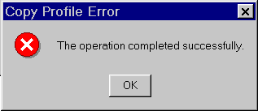
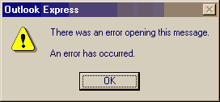
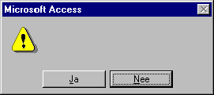
Examples Of Bad Error Messages (If There Is Time)
Images: From the “HCI Hall of Shame”

Slide 68
(If There Is Time)
“HIT ANY KEY TO CONTINUE”

Slide 69
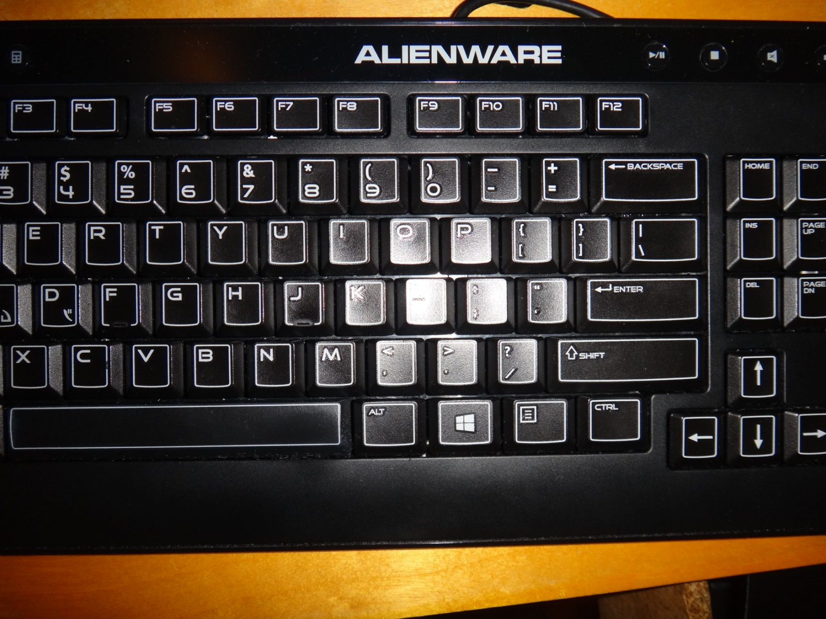
(If There Is Time)
THE “Any Key”
Image: Curtesy of James Tam

Slide 70
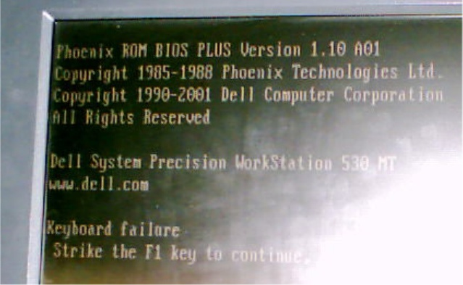
I’d Rather Deal With The ‘Any’ Key (If There Is Time)
Picture courtesy of James Tam: An error message from a Dell desktop computer

Slide 71
After This Section You Should Now Know
When and why are loops used in computer programs
What is the difference between pre-test loops and post-test loops
How to trace the execution of pre-test loops
How to properly write the code for a loop in a program
What are nested loops and how do you trace their execution
How to test loops
Some rules of thumb for interaction design (if there is time)
  Minimize the user’s memory load
  Be consistent
  Provide feedback
  Provide clearly marked exits
  Deal with errors in a helpful and
  positive manner

Slide 72
Copyright Notification
“Unless otherwise indicated, all images in this presentation are used with permission from Microsoft.”

