Slide 1
The History of Computers
You will learn about the developments in computing and other related technologies that were made from the 1940’s onward.

Slide 2
History Part II: The Electronic Computers
The ABC
The ENIAC
The British code breaking computers
Stored program computers

Slide 3
The People Behind The ABC (Atanasoff-Berry-Computer)
Images from “A history of computing technology” by Michael R. Williams (IEEE Press 1997)
John Atanasoff
  A professor at Iowa State College (now Iowa State university)
Clifford Berry
  A graduate student studying under Atanasoff

Slide 4
Motivations For Developing The ABC
Atanasoff was researching methods of solving complex mathematical equations.
He started by modifying the small IBM calculator that was leased to the college to see if it could solve these problems.

Slide 5
Motivations For Developing The ABC (2)
His modifications were extensive
The folks at IBM weren’t happy with the modifications

Slide 6

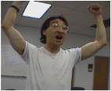
Motivations For Developing The ABC (3)
Wav file from “James Tam”
Atanasoff then decided to build his own machine.
Unfortunately this proved to be more of a daunting task than he first anticipated.
After a particularly frustrating night he decided to take a break from the lab.
This lead to an astonishing break through!

Slide 7
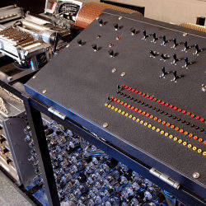
The First Electronic Computer: The ABC
Photo of replica ABC credit to: Bob Elbert / Iowa State University
After enlisting the aid of Berry and several years of hard work the ABC was nearly completed at a cost of $6000 (including the $450 paid to Berry) in 1942.
It was the first prototype electronic computer!

Slide 8
The First Electronic Computer: The ABC (2)
DATA ONLY
Capacitors
+/-
It used a form of regenerative memory that was similar to the kind used in modern RAM.
But it was not a stored program computer (not modern computer).
The machine was never fully completed

Slide 9
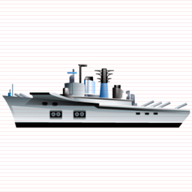
The Moore School Of Electrical Engineering
+
www.ciipartbest.com
-
It was a major provider of technical and computing resources for the US arm (Ordinance department, ballistics research lab)
Current approaches to calculate trajectories were too slow and work on the ENIAC was began to solve these problems.

Slide 10
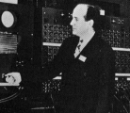
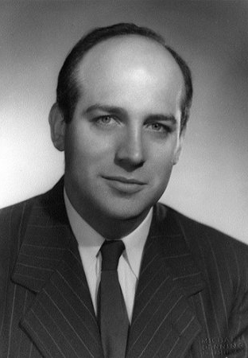
The People Behind The ENIAC
From www.computermuseum.li
Image © Michael Denning from www.computerhistory.org
John Mauchly
  A Physics professor at Ursin College.
  Produced the overall design of the ENIAC
J. Presper Eckert
  A lab instructor at the Moore School
  Designed the individual circuits of the ENIAC
Joseph Chedaker
  Supervised the construction team

Slide 11
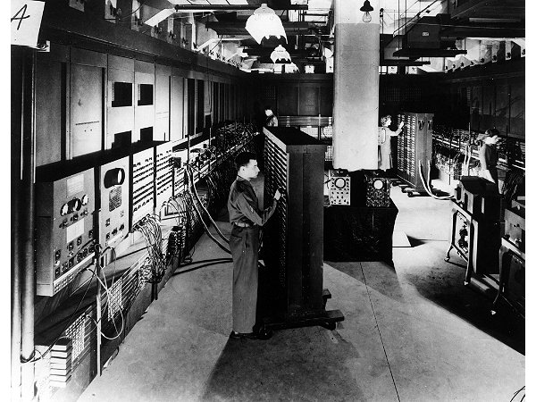
Second Electronic Computer: The ENIAC (Electronic Numerical Integrator Calculator)
Image © University of Pennsylvania
Completed in 1949 for $500,000
The machine was huge and required a great deal of resources
  Filled a room (x100 times bigger than comparable machines of the time)
  30 tons
  140,000 watts
  “…the most complex bit of electronic ever put together” (Michael R. Williams “A history of computing technology”).
    ~ wiring of the US telephone network

Slide 12
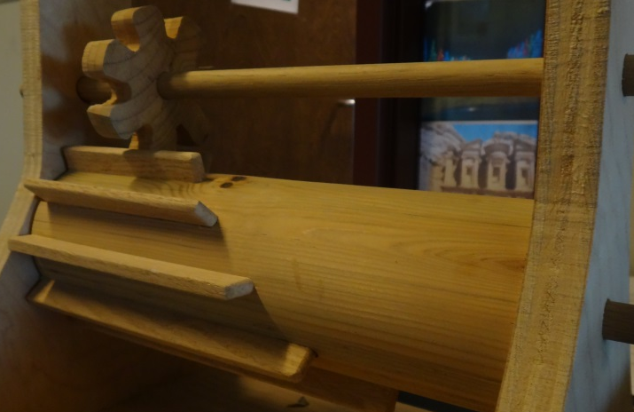
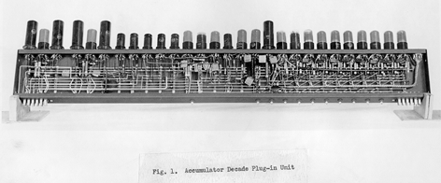
Second Electronic Computer: The ENIAC (2)
Many of the components were just electronic equivalents of the mechanical version.
E.g., to store a single digit:
Mechanical approach
ENIAC approach
Image of Leibniz’s “stepped drum” calculating machine: courtesy of James Tam
Image © University of Pennsylvania (from http://www.library.upenn.edu)

Slide 13
The ABC And The ENIAC
The ABC was the first prototype electronic computer (not quite completed): 1942.
The ENIAC was the first fully operational electronic computer (finished): 1949.

Slide 14
World War II: Code Breaking And Computing
The Allies
British code breaking machines/projects
  The machines of Bletchley Park (‘bombs’)
  The Robinsons
  The Colossus (and the Colossi!)
The Axis
Germany: the enigma machines

Slide 15
German Enigma Machines
Troop deployments:
Stalingrad: 10 divisions
Normandy: 3 divisions
%j*e82N,:
9*!jn3n2@#n+
R~&b4n#@’?
Enigma (setup to
Combination 456,118)
Enigma (setup to
Combination 456,118)
The Enigma machines: used before and during WWII by Germany as an encryption device.
There were two version: one for the military and one for business.
The sheer number of possible combinations (100 billion!) made mere possession of the machines useless.

Slide 16
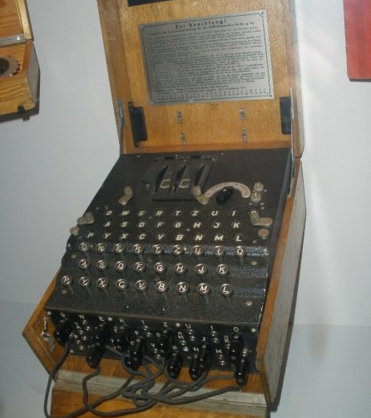
An Enigma Machine
Image courtesy of James Tam (Imperial War museum: London England)

Slide 17
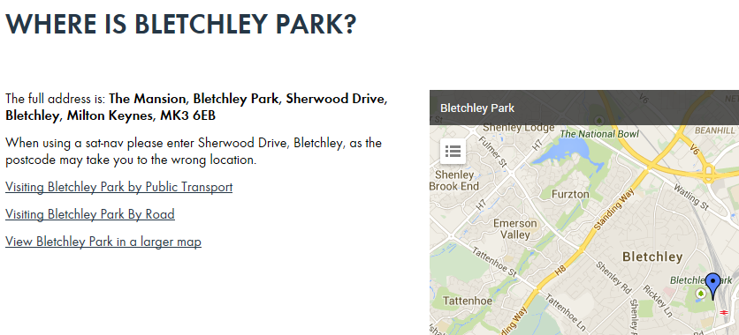
The British Code And Cipher School
Worked on deciphering the German codes at Bletchley Park outside of London:
Intelligence work involved a great deal of secrecy:
  Information was strictly on a “need to know basis” for the people working there.
  Even now much of the information is still classified “Official Secrets Act”: http://www.legislation.gov.uk/ukpga/1989/6/contents

Slide 18
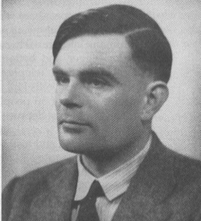
Alan Turing
A distinguished British Mathematician from Cambridge.
He worked at Bletchley Park as a code-breaker (contributed to the design of the machinery as well as applying his Mathematical knowledge).
A serious athlete!
  “Alan Turing achieved world-class Marathon standards. His best time of 2 hours, 46 minutes, 3 seconds, was only 11 minutes slower than the winner in the 1948 Olympic Games. In a 1948 cross-country race he finished ahead of Tom Richards who was to win the silver medal in the Olympics.”
  --
  From: http://www.turing.org.uk
Image from the History of Computing Technology by Michael R. Williams (Original: National Physical Laboratory)

Slide 19
British Code Breaking Machines
The ‘bombs’ were the first set of devices and were based on machines produced by the Poles.
  The combination of secrecy surrounding the work at Bletchley Park and the code names used, ‘work on bombs’ resulted in a great deal of confusion.
    “…but the only thing these bombs destroyed was the German Air Force message security” (Michael R. Williams “A History of Computing Technology”).
(Heath) Robinson machines
  Unreliable
  ‘Proof of concept’: showed that high speed electronic devices could still aid in the decoding process (Enigma)
The Colossus (eventually “the colossi”)
  Addressed the reliability problem of the Heath Robinson machines
  Miraculously the first one was completed in less than a year.
  “Many more” were soon requested (1944)

Slide 20
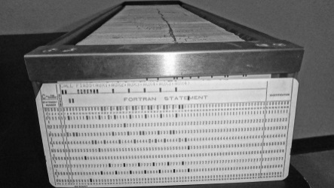
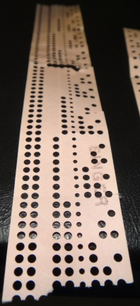
Before The First Stored Program Computers
Punch card/tape images courtesy of James Tam
Before these computers were developed existing machines received their instructions from:
  Punch card
  Punch tape
  Complex re-wiring

Slide 21
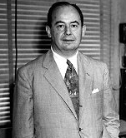
Stored Program Computer (SPC): Originator?
Image © Alan Richards from www.computerhistory.org
Why it’s important.
  It’s a fundamental part of modern computers and many electronics
The answer
  It’s shrouded in a great deal of controversy.
The location where the idea was developed
  The Moore School (the team that developed the ENIAC)
The person most widely credited with coming up with the idea
  John Von Neumann
  He received so much notoriety that modern computers are sometimes referred to as “Von Neumann machines”.

Slide 22
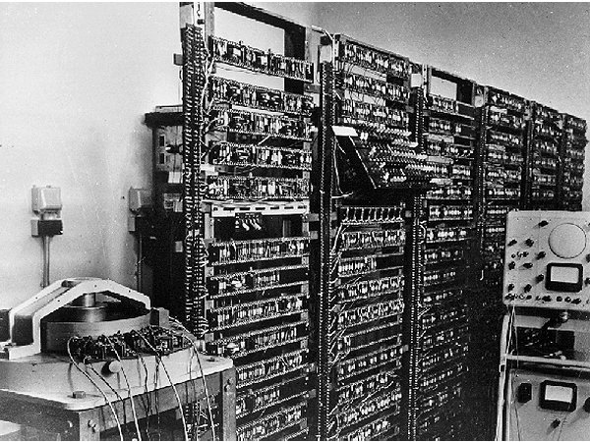
First SPC: The Manchester Machine
Image © University of Manchester from www.computerhistory.org
After the end of the war many of the people who worked at Bletchley Park obtained jobs at Manchester university.
In 1948 the Manchester machine was the first fully electronic machine that operated based on the instructions stored in it’s memory.
However the initial machine was extremely limited in it’s capabilities:
  The instruction set consisted of subtractions, conditional branches and a ‘stop’ instruction.

Slide 23
History Part III: Modern Times
History of the microcomputer
History of the Internet
User interfaces: command line, graphical user interfaces (GUI), the mouse

Slide 24
History Of The Microcomputer
The microprocessor
The first popular microcomputer for home users: Altair
Microsoft and it’s influence on Microcomputers
The IBM-PC
History of Apple computers
The attack of the clones and the rise of Microsoft

Slide 25
Recall: Computers Before The Microprocessor
Image © University of Pennsylvania

Slide 26
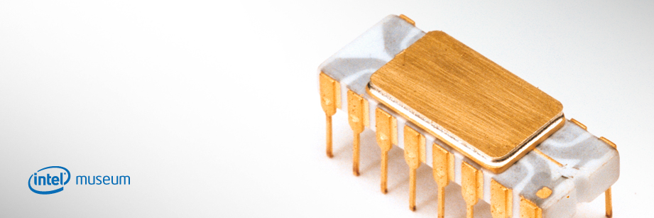
The First Microprocessor
From the “Intel museum” www.intel.com
Produced by Intel in the early 1970’s
It’s development revolutionized computers by allowing computers to be more widely used.

Slide 27
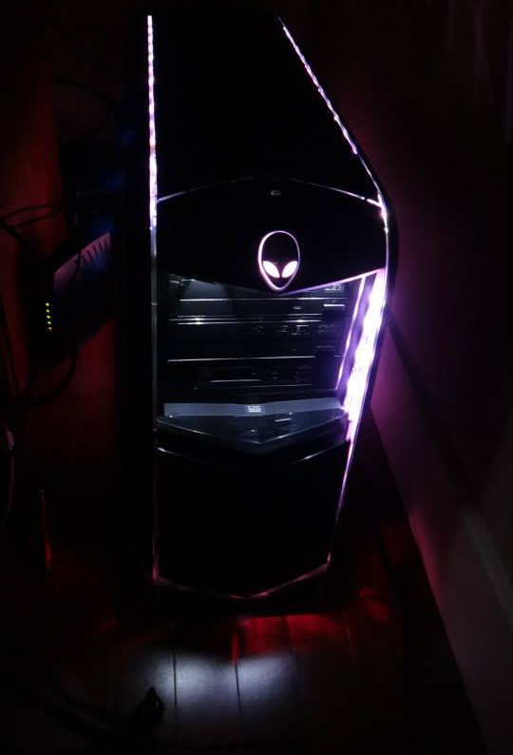
What Is A Microcomputer?
Image courtesy of James Tam
Sometimes it’s referred to as a ‘PC’ (Personal Computer)

Slide 28
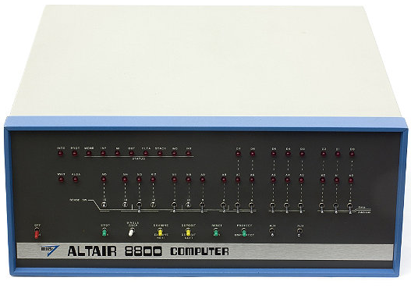
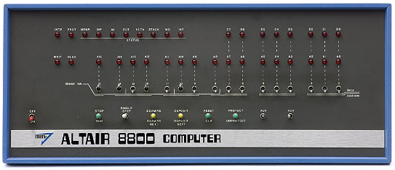
The First Popular Computer For Home Users: The Altair
Images © Mark Richards from www.computerhistory.org

Slide 29
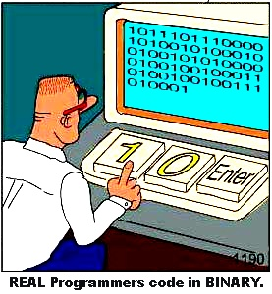
Note: Most Computer Users At The Time Were Extremely Technically-Oriented
Image by Chris Kania
http://www.kaniamania.com/

Slide 30

Microsoft’s Influence On Microcomputers
IBM OS???

Slide 31
Microsoft’s Influence On Microcomputers (2)
IBM approached two companies as possible vendors of an operating system to run it’s computers:
  Digital Research
  Microsoft
IBM and Microsoft worked out an arrangement to have a version of Microsoft’s DOS (Disk Operating System) run IBM computers: PC-DOS.

Slide 32
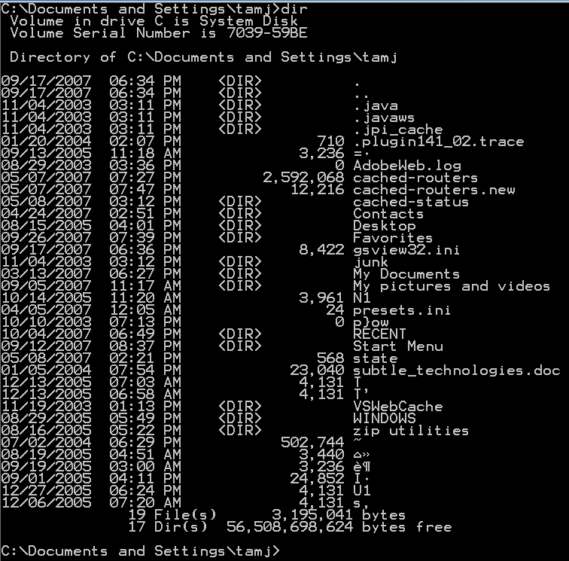
Microsoft’s Influence On Microcomputers (3)
Command
Effect of the command
The interface of PC/MS-DOS has been criticized as being user-unfriendly.

Slide 33
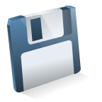
Microsoft’s Influence On Microcomputers (4)
Digital Research Inc.: CP/M operating system
Reboot
computer
Wrong disk!!!
However the interface of PC/MS-DOS was a significant improvement over other operating systems of the day.

Slide 34
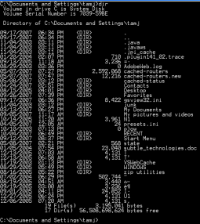
Microsoft’s Influence On Microcomputers (4)
PC/MS-DOS operating system
Abort,
retry, fail?
Wrong disk!!!
Correct disk
However the interface of PC/MS-DOS was a significant improvement over other operating systems.

Slide 35
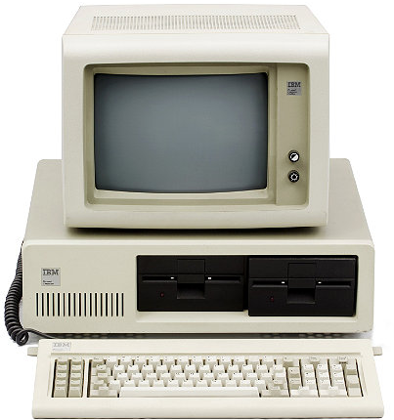
The IBM PC (Personal Computer: 1981)
www.computerhistory.org
IBM was a large company but a late comer into the microcomputer market.
As mentioned the IBM PC used an operating system produced by Microsoft.

Slide 36
The IBM PC (Personal Computer: 1981): 2
IBM PC
Word processing
Accounting software
Games
Spreadsheets
With the entry of IBM in the microcomputer market, many developers produced a plethora of software.

Slide 37
The IBM PC (Personal Computer: 1981): 3
Apple sales
IBM sales
Apple sales
IBM sales
There many other important microcomputer manufacturers (omitted for breviy)
Apple entered the microcomputer market sooner and already had an established market when IBM began to first market the PC.
Because of the prevalence of so much software the IBM-PC soon overtook the Apple in sales.

Slide 38
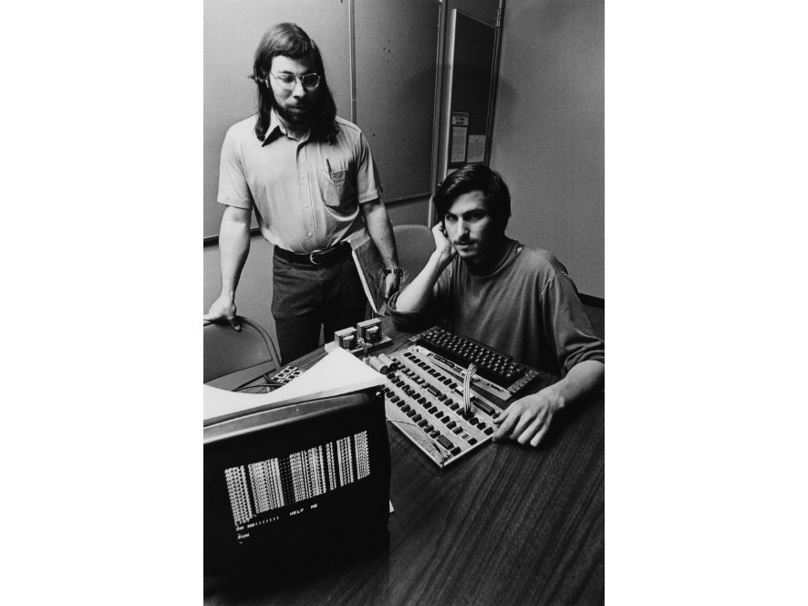
The History Of Apple Computers: Steve And Steve
Steve Wozniac
Steven Jobs
Images © Apple Computer, Inc. from www.computerhistory.org
Apple was founded by Steven Jobs and Steve Wozniac in Silicon Valley garage.

Slide 39

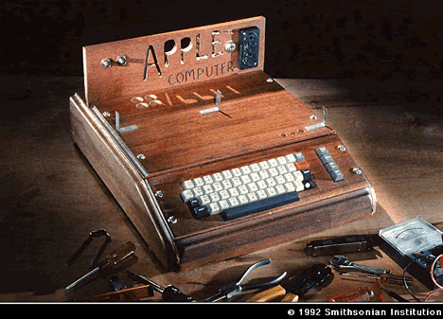
The Apple I Computer (1976)
Extras
It was far from the standard of a modern computer

Slide 40
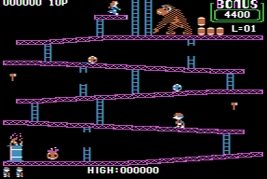
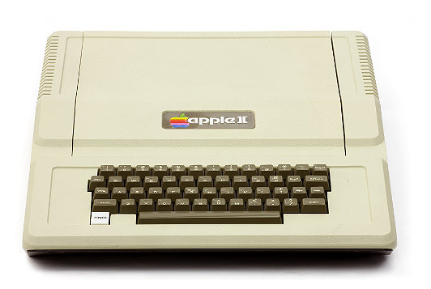
The Apple II Computer (1977)
Images
Apple II:
www.computerhistory.org
Donkey Kong: www.donkeykong.gamebub.com
It was a simpler and more powerful design than the Altair
The color graphics were superior to larger and more expensive computers
Strong selling points
  Name
  Appearance

Slide 41
The Apple II Computer (1977): 2
Images
Apple II:
www.computerhistory.org
Donkey Kong: www.donkeykong.gamebub.com
1 “Just for Fun” (Chapters 2,3) by Torvalds and Diamond
The storage device was primitive by today’s standards but actually sufficient to meet the needs of the time
VisiCalc: “It was the software tail that wagged the hardware dog”¹

Slide 42
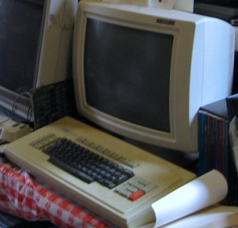
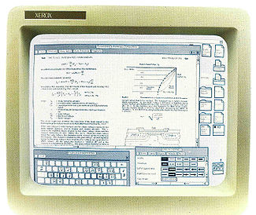
First Graphical Interface
Image of Xerox Star screen from Xerox brochure
Xerox star hardware picture: www.flickr.com/photos/mwichary
Contrary to popular belief it was not invented by Apple.
Xerox star: pioneered the GUI in 1981:
  Other GUI-based computers: Apple {Lisa (1983), McIntosh (1984)}, the Commodore Amiga 1000 (1985).
  Although it was a technical innovation the Star was regarded as a business failure.
  It was Apple (and others such as Commodore) who successfully mass marketed a GUI-based computer.

Slide 43
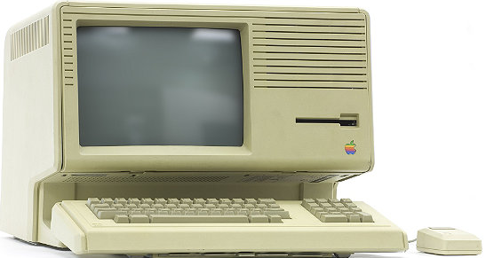
The Apple Lisa (1983)
Image © Mark Richards from www.computerhistory.org
The first GUI-based computer produced by Apple: the Lisa incorporated many of the features of the Xerox Star.
Like the Star it was expensive ($10K) and sales were weak.

Slide 44
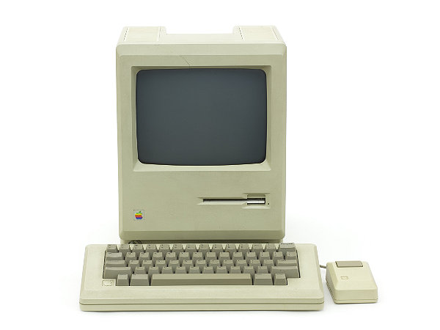
The Apple Macintosh (1984)
Image © Mark Richards from www.computerhistory.org
Apple’s next computer was the Macintosh
It incorporated the best features of the Lisa but was sold at a substantially lower price ~$2.4K
Compared to the IBM-PC it was a price/performance vs. ease of use tradeoff

Slide 45
The Attack Of The Clones
Apple sales
IBM sales
Although it was a late entry into the microcomputer market IBM eventually dominated.

Slide 46
The Attack Of The Clones (2)
Processor: Company A
Hard drive: Company B
Floppy drive: Company C
Expansion card: Company D
IBM-PC
Although the IBM-PC was marketed and sold under the IBM brand most of the parts were not manufactured in-house.

Slide 47
The Attack Of The Clones (3)
IBM-PC
Compaq clone
The parts manufacturers were free to sell their components to other companies.
About the same time that the IBM-PC was sold, three ex-employees of Texas Instruments founded their own company: Compaq.
  They conceived of the idea of producing their own copy of the IBM-PC under their own brand name.
  It would run under MS-DOS and be 100% compatible with application software written for the PC.
  The first IBM-PC clone was delivered by Compaq in 1983.

Slide 48
The Attack Of The Clones (4)
Compaq clone
IBM-PC
Mom and pop shop clone
Dell clone
This opened the flood gates for other computer manufacturers to produce their own clone computers.

Slide 49
The Attack Of The Clones (5)
Apple sales
IBM sales
Microsoft operating system
Apple sales
IBM sales
Compaq sales
Dell sales
Mom & pop shop sales
The result was that IBM eventually lost control over the computer architecture that it was the first one to market.

Slide 50
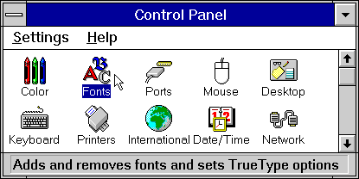
The Attack Of The Clones: The Rise Of Microsoft
Windows 3 image from www.microsoft.com
The loser of the clone war was IBM.
The real winner of the clone war was Microsoft.
By the 1990’s Microsoft developed an interface for MS-DOS that incorporated some of the features of the MAC GUI.

Slide 51
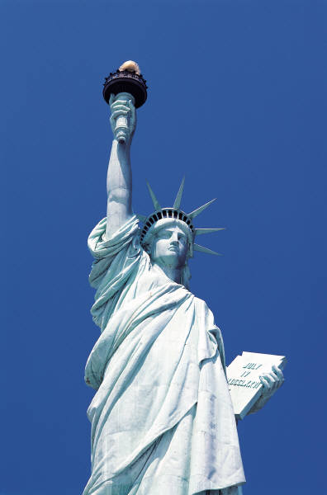
Origins Of The Internet
What was happening in the 1950’s
The Cold War

Slide 52
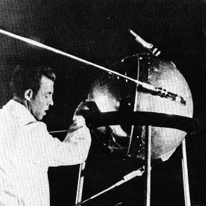
The Cold War And The Space Race
http://astroprofspage.com
At the same time that each side (USSR-USA) was trying to be dominant on the ground they also wanted to be dominant in space.
Both sides tried to be the first to send a satellite into space.
In the 1950’s it appeared that the USSR had a technological edge:
  Americans in 1957: A sophisticated three stage rocket was planned as the first human-made vehicle to be spent into space.
  The USSR in 1957: surprised the world by launching Sputnik I (first artificial satellite).
  The launch of Sputnik helped motivate the creation of ARPA (Advanced Research Projects Agency) in the US.
Notes:
52

Slide 53
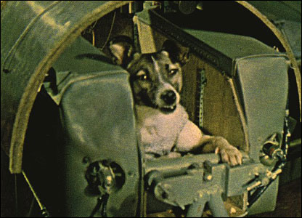
The Cold War And The Space Race (2)
Later in 1957 the USSR launched another satellite carrying the dog Laika “bark/barker” on a one way trip into space :’(
http://news.bbc.co.uk

Slide 54
ARPA
APRA was a branch of the ministry of defense.
The focus was on:
  Getting different types of computers communicating

Slide 55
ARPA (2)
In the early days of ARPA there 3 separate and incompatible networks to communicate with the 3 different research centers that worked with ARPA.
Project Genie (University of California, Berkley)
Interface 1
System Development group (Santa Monica)
Interface 2
MULTICS project SHOPPING (Massachusetts Institute of Technology (MIT))
Interface 3
Image credits: Microsoft
1 “A History of the Internet and the Digital Future” (Johnny Ryan, Reaktion Books)

Slide 56
ARPANET
The first computers were connected via ARPANET (Advanced Research Projects Agency Network).
The initial ARPANET consisted of 2 host computers which were connected at the start of 1969 (birth of the early Internet!) from the following locations:
  UCLA
  Stanford
  A standard protocol was used so the computers could communicate
UCLA
Stanford
Notes:
56

Slide 57
ARPANET (2)
UCLA
U of Utah
U of California
Stanford
Later additional hosts were added to the network (end of 1969) from:
  The University of California (Santa Barbara)
  The University of Utah

Slide 58
The First Data Sent On The Internet¹
Originally the message ‘login’ was to be transmitted.
But the transmission stopped (i.e., it “died” after the first two characters).
  …and thus ‘LO’ the Internet was born!
1 “On the Way to the Web” (Michael A. Banks, Wiley)

Slide 59
Important Milestones Of The Internet
In 1972
  The first "hot application” was introduced by Ray Tomlinson.
1989:
  The ideas behind the World Wide Web were first described in a paper.
1990:
  The ARPANET was shut down.
  The first “Internet” search program Archie was developed at McGill university.
1991:
  The World Wide Web was released to the public.

Slide 60
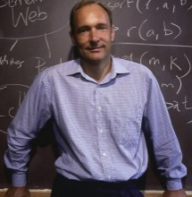
The History Of The World Wide Web
From www.computerhistory.org (2012)
Source http://www.w3.org/People/Berners-Lee/WorldWideWeb.html
Designed in 1989 by Tim Berners-Lee and scientists in Geneva who were interested in making it easier to share research documents.
Documents could be linked through a protocol called http (hyper text transfer protocol).
Documents were made available for free browsing and downloading from the web (substantially easier than the alternative).
1990:
  The first web browser “WorldWideWeb” (later renamed ‘Nexus’¹ was written.
1993:
  Mark Andreessen of NCSA (National Center for Super Computing Applications) launched Mosaic X the first popular web browser.

Slide 61
The History Of The World Wide Web (2)
From www.computerhistory.org
Prior to the advent of the WWW the Internet was largely used by a niche user group.
The advent of the WWW drastically changed that.
  Now some people even equate the World-Wide-Web with the Internet itself!

Slide 62
The Mouse
1962: ARPA (under JCR Licklider) provided a special fund to realize the vision of a “mechanically enhanced man”.
  It came out of a paper published by Licklider (before he joined ARPA) where he “…forecast a future that will involve a very close coupling between the human and electronic members of the [human-technology] partnership.”¹
Douglas Engelbart applied for funding.
1 “A History of Modern Computing” (Paul Ceruzzi: MIT Press 2003)

Slide 63
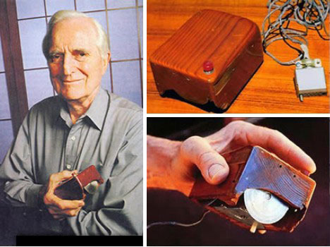
The Mouse (2)
Engelbart spent his time studying an experimenting with ways to improve communication between people and computers.
1967: he described (his most famous) invention, the mouse.
http://gajitz.com

Slide 64
You Should Now Know: History Part II
When were the different categories of computers completed and what were some of their distinguishing features:
  The computers of the electronic revolution
  The first SPC (stored program computer)
Who were the people who were involved in the creation of these machines.

Slide 65
You Should Now Know: History Part III
How the invention of the microprocessor revolutionized computing
What was the first computer that was successfully targeted specifically for the home user
What was the influence of Microsoft on microcomputers
The history of the IBM-PC
The foundation of Apple Computers
The history of some of Apple's early computers: Apple I, Apple II, Lisa, Macintosh
How IBM lost control over a computer architecture that it developed through the rise of clone computers
How the rise of clone computers lead to the market dominance of Microsoft in the microcomputer market

Slide 66
You Should Now Know: History Part III (2)
What was the first GUI-driven computer: Xerox Star
The early history of the Internet
  When did it first become operational
  How it works
  What were some major milestones and when did they occur
  When was the WWW invented and who was behind its creation
Computer Mouse
  Who invented the device
  When was it invented
  What was the motivation for its creation

