Slide 1
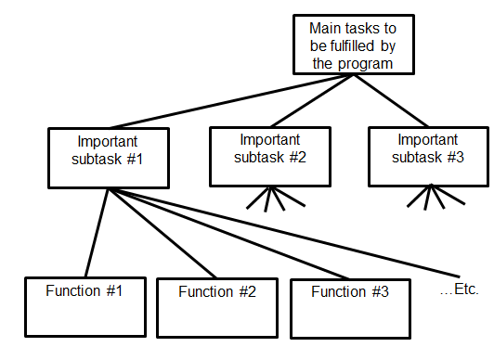

Introduction To CPSC 231
Python programming
Procedural programming
James Tam
Problem solving
Fun! Fun! Fun!

Slide 2


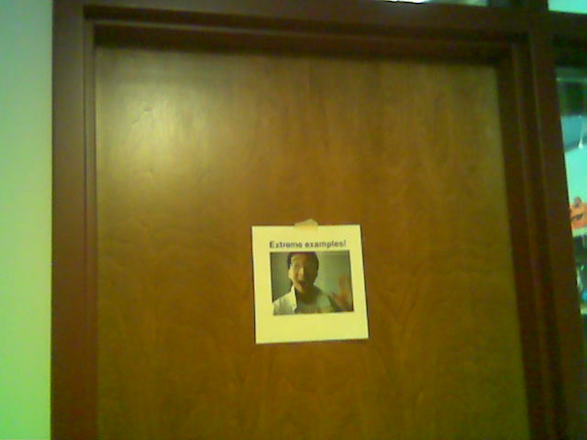
Administrative (James Tam)
Contact Information
  Office: ICT 707
  Email: tamj@cpsc.ucalgary.ca
  Make sure you specify the course name and number in the subject line of the email ‘CPSC 231’
Office hours
  Office hours: Tue 14:00 – 14:50, Thur 16:45 – 17:15
  If I’m not in my office give me a few minutes or check the lecture room.
  Email: (any time)
  Appointment: email, phone or call
  Drop by for urgent requests (but no guarantee that I will be in if it’s outside of my office hours!)
ICT 7th
Yes
E
My Office
No
x

Slide 3
Course Resources
Required resources:
  Course website: http://pages.cpsc.ucalgary.ca/~tamj/2016/231F/index.html (You must get the notes off the course webpage before lecture)
Recommended but not required:
  "Starting Out with Python"(Gaddis T.) Addison-Wesley.
  Alternatively you can access any book licensed by the university (‘for free”) on the library web site:
  (One of many books available) “Visual QuickStart guide” http://proquest.safaribooksonline.com.ezproxy.lib.ucalgary.ca/

Slide 4
How To Use The Course Resources
They are provided to support and supplement this class.
  The notes outline the topics to be covered
  At a minimum look through the notes to see the important topics.
  However the notes are just an outline and just looking at them without coming to class isn’t sufficient to do well
  You will get the details (e.g., explanations) during lecture time
    Take notes!

Slide 5
Your Engagement Level ---> Your Learning
+
Learning
Computer programs
Computer program

Slide 6
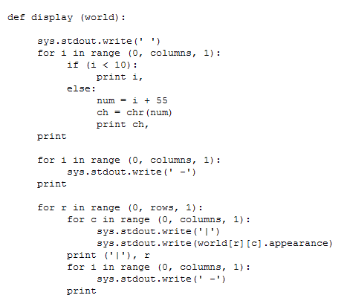
How To Use The Course Resources (2)

Slide 7
How To Use The Course Resources (2)
When you are in class make sure that you supplement the slides with your own notes (because you aren’t going to remember it in the exams if you don’t)
If you miss a class make sure that you catch up on what you missed (get someone’s class notes)
Notes:
7

Slide 8
How To Use The Course Resources (3)
What you are responsible for:
  Keeping up with the content in class which includes the topics covered but also announcements or assignment information whether you were present in the class or not.
  If you are absent, then you are responsible for getting the information from the other students in class.
    Make sure your UC registered email is correct and one you actually read (some course announcements will be sent to these emails)
  (I won’t be able to repeat the lecture content if you are absent…there’s just too many of you to make it practical and recall to get the most out of the class you need to be actively engaged)
However, after you’ve caught up by talking with a classmate:
  Ask for help if you need it
  There are no dumb questions
  …except for waiting until the exam

Slide 9

Tam’s “House Rules”
I will endeavor to keep the lecture within the prescribed time boundaries
You won’t pack up and end before time is up

Slide 10




Tam’s “House Rules”
No recordings/captures without permission during class please
(Recall that learning tends to increase with additional levels of engagement).

Slide 11
Evaluation Components
Eight mini assignments (4/100 of term grade)
Five full assignments (31/100 of term grade)
Two examinations (65/100 of term grade)

Slide 12
Assignments
You will create a working and executable computer program.
Use a text editor (similar to a word processor minus the fancy formatting capabilities) to create it and you will electronically submit the text file for marking.
Although you may be given some time in tutorial to work on your assignments (during the “open tutorial”) mostly you will complete your work on your own time.
  Don’t underestimate the time/effort required.
  Creating a good working program is harder than it may first appear.
Assignments will be marked by the tutorial instructor.
  He/she is the first step if you want to determine your grade or have questions about grading

Slide 13
Assignments (2)
Collaboration:
  Each student must work on his/her own assignment (no group work is allowed for this class)
  Each student must individually submit an assignment
  Students must not see each other’s assignment code
  Additional details will be provided later during the semester
You will electronically submit the file which contains your solution to the assignment via D2L:
  http://d2l.ucalgary.ca/
  (Find the appropriate course name/number and lecture section)

Slide 14
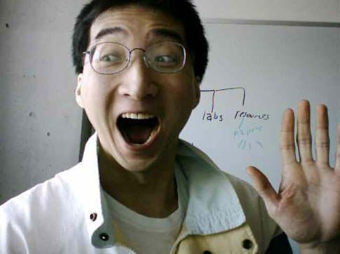
Submitting Assignments
Bottom line: it is each student’s responsibility to make sure that the correct version of the program was submitted on time.
Late assignments will not be accepted.
If you are ill then medical documentation is required.
  Contact your course instructor and not your tutorial instructor to get permission for a late submission
(Further details will be available during the term).
I am the ‘course instructor’ person

Slide 15
JT’s Helpful Hint: Electronically Submitting Work
Bad things sometimes happen!
  Sometimes it’s a technical failure (e.g., hardware failure)
  Sometimes it’s human error (e.g., oops, accidentally deleted)
Rules of thumb for assignment submissions:
  Do it early! (Get familiar with the system)
  Do it often! (If somehow real disaster strikes and you lose everything at least you will have a partially completed version that your TA can mark).
  Check your work.
    Don’t assume that everything worked out OK.
    Instead you should check everything (there should be a way to do this using the assignment submission mechanism)
    Don’t just check file names but at least take a look at the actual file contents (not only to check that the file wasn’t corrupted but also that you submitted the correct version).

Slide 16
Backing Up And Submitting Your Work
Bottom line: it is up to you to make sure things are done correctly and on time.
If you have questions beforehand then do ask (make sure you ask your questions early enough so you can receive an answer before the due time).
But don’t wait until after the due date (it’s too late).

Slide 17
Mini Assignments
There will be eight mini assignments worth 0.05/100 of the term grade for a total of 4/100 of term grade.
The focus is learning how to apply the technical concepts (e.g., branches, functions, loops etc.) by writing a small and relatively simple program.
Marking will focus on ‘functionality’: getting the program to work

Slide 18
Full Assignments
Similar to the mini assignments you will write a computer program
  The programs will be larger and more challenging than the mini-assignments (require a ‘tough’ problem to be solved).
Marking will not only be based on the functionality of your program but other criteria such as programming style and documentation (additional details will be provided during the semester as each assignment is released).
Total weight of the full assignments 29/100 of term grade
  Assignment 1: worth 4/100 (introduction to UNIX and writing programs)
  Assignment 2: worth 5/100 (introduction to simple programming concepts)
  Assignment 3: worth 6/100 (moderately challenging)
  Assignment 4: worth 7/100 (quite challenging)
  Assignment 5: worth 7/100 (quite challenging)

Slide 19
Examinations
There will be two examinations: midterm and final exam.
Midterm exam (common to all lectures, out of class)
  Proportion of the term grade: 25/100
  Thursday October 27 at 6 PM
Final exam (common to all lectures, out of class)
  Proportion of the term grade: 40/100
  Date/time/location determined by the Office the Registrar.
  You can find information about your final exams online via the university PeopleSoft portal.
Both exams will completed on paper (not in front of a computer).
You must pass the weighted average of the exam component to be awarded a grade of C- or higher in the class.

Slide 20
Examination Content
Multiple choice questions:
  Partial program traces e.g., what’s the program output
  Basic program structure e.g., find the errors, which function or operator is needed for a particular mathematical operation
  More examples and details coming during the semester
Written questions:
  Write a small/partial computer program.
  Trace the execution of a computer program e.g., what is the ‘output’.
  Conceptual (lower weight for this type of question) e.g., definition of a technical term.
  Likely there will be a smaller proportion of written questions on the midterm vs. the final.
I will be grading the exams.
  (I’ll do the best I can to get them done in a timely fashion but remember it’s a high enrollment class).

Slide 21
Examination Content (2)
More sample ‘exam type’ questions will be provided during the semester.
  Sometimes ‘on the fly’ in lecture so pay attention to these and take notes.

Slide 22
Estimating Your Term Grade
Your term grade is awarded as a grade point/letter e.g. 3.3/B+
As stated in the course information sheet (official signed document each major component will be awarded a grade point e.g. 0, 1.0, 1.3..
    Individual assignment
    Midterm exam
    Final exam
The mapping of raw score to grade point will be posted before each assignment is due (variation between assignments will occur).
The mapping of the midterm to grade point will be posted sometime after the midterm.
The mapping of final to grade point cannot be provided until after the official term marks have been released (Department policy).

Slide 23
Estimating Your Term Grade (2)
To determine your weighted term grade point simply multiply each grade point by the weight of each component.
Sum the weighted grade points to determine the term grade.
Simple and short example (not exactly the same as this term but it should be enough to give you an idea of how to do the specific calculations required this semester):
  Assignments: weight = 30%, example score = ‘A’
  Midterm: weight = 30%, example score = ‘B+’
  Final: weight = 40%, example score = ‘C-’
  Weighted assignments: 0.3 * 4.0 = 1.2
  Weighted midterm: 0.3 * 3.3 = 0.99
  Weighted final: 0.4 * 1.7 = 0.68
  Total term grade point = 1.2 + 0.99 + 0.68 = 2.87
Official university listing of letter grades/grade points: http://www.ucalgary.ca/pubs/calendar/current/f-2.html

Slide 24
Estimating Your Term Grade (3)
Use the spreadsheet on the course web page to estimate your term letter grade:
  http://pages.cpsc.ucalgary.ca/~tamj/2016/231F/grade_calculator.xlsx
The grade point to letter grade mapping employs the official university cutoffs:
  http://www.ucalgary.ca/pubs/calendar/current/f-2.html
  (I may employ a more lenient set of cutoffs at the end of term but the official cutoffs will provide you with a ‘worse case’ estimate of your grade).
Note: to keep things simple the formula in the spreadsheet does not check if the exam component was passed or not (you can do the check manually or add it in yourself)

Slide 25
Common Computer Skills Assumed
You know what a computer is!
You’ve used a computer in some form (e.g., turn on, turn off, open a file, played a game, gone online etc.)
You have experience using common applications (specifically email, web browsers, text editing using a word processor).

Slide 26

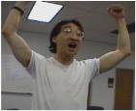
What This Course (CPSC 231) Is About
Writing/creating computer programs.
But it is not assumed that you have prior knowledge of Computer Science (or even experience writing programs)
It can be a lot of work.
  The course can be completed by students with a normal course load (many already have gotten through it!)
  But be cautious if you already have many other commitments
Late night ‘coding’
Satisfaction coming from solving that tough algorithm!
Wav file from “Tam”

Slide 27

Actual Practice: Common Interview Questions
  Besides looking at degrees granted and grades received, some tech companies (e.g., Google) may ask you questions that appear non-technical:
  You’re asked to solve puzzles during the interview.
There is a relationship between skill at solving puzzles (“problem solving”) and success in a (technically oriented) industry.
  You will develop these skills writing programs for this class.
Example list of questions
http://www.businessinsider.com/15-google-interview-questions-that-will-make-you-feel-stupid-2009-11

Slide 28
Course Goals
Know the basic structure of a computer program (rules for laying out a program and how the basic constructs such as repetition and branching work)
  If you don’t know and understand these concepts then your program won’t work at all and you can’t proceed to the next goals.
Develop basic problem solving and analysis skills.
  As mentioned this is a skill that you will need to develop for “the real world”
Learn good design principles.
  For example you may know how to get a program to run across the Internet but you may not know how to write a fun game that people will want to play on Facebook™.
  “This *%$#! App really sucks!”

Slide 29
How To Succeed
Successful people
Notes:
29

Slide 30
How To Succeed In This Course
Practice things yourself (not by getting the answer from someone/someplace else).
  How Computer Science works: You get better by doing things for yourself (this is a ‘hands-on’ field of study and work).
Providing solutions to assignments may be popular among students but useless for learning
What’s needed is for me to teach you the skills to solve any reasonable size problem
Similar to getting fit: you can’t just watch
You have to do it yourself

Slide 31
How To Succeed In This Course (2)
  Write lots programs.
    At the very least attempt every assignment.
    Try to do some additional practice work (some examples will be given in class, some practice assignments will be available on the course web page).
    Write lots of little ‘test’ programs to help you understand and apply the concepts being taught.
  Trace lots of code (computer programs)
    Involves reading through programs that other people have written, and executing it ‘by hand’ in order to understand how and why it works
    This is an essential skill.
    Relying on just running the program and observing the results won’t always work (errors?)

Slide 32
How To Succeed In This Course (3)
Make sure that you keep up with the material
  Many of the concepts taught later depend upon your knowledge of earlier concepts.
  Don’t let yourself fall behind!
  At least attempt all assignments!
Rule of thumb: don’t fall behind more than 1 week
:
Problem decomposition
Loops/repetition
Decisions/branching
Introduction to programming

Slide 33
How To Succeed In This Course (4)
If you find concepts unclear trying to research the answer on your own can be beneficial (because this is a ‘hands on’ field).
  Read alternate explanations of the concepts covered in class in the text book (or other textbooks: remember that electronic books accessible through the library-Safari are ‘free’).
  Looking at online resources:
    Remember academic resources online just like other online information may not always be a good source.
    Start with more reputable sources
      http://proquest.safaribooksonline.com.ezproxy.lib.ucalgary.ca/
      www.python.org
Addendum to the previous point #2 and a point raised earlier “ask questions”.
  If you are still unclear on concepts then make sure that you ask for help.
  Don’t wait too long to do this because latter concepts may strongly depend on your understanding of earlier concepts..

Slide 34
How To Succeed In This Course (5)
Look at the material before coming to lecture so you have a rough idea of what I will be talking about that day:
  Read the slides
  Look through the textbook(s)
When we get to more complicated programs that appear to ‘jump around’ in how they execute (“section: problem decomposition/functions”) just having an idea of the scope and components of the program beforehand can be useful when I cover it in class.

Slide 35
How To Succeed In This Course (6)
Start working on things as early as possible:
  Don't cram the material just before the exam, instead you should be studying the concepts as you learn them throughout the term.
  It’s important to work through and understand concepts *before* you start (full) assignments.
  If you try to learn a new concept and work out a solution for the assignment at the same time then you may become overwhelmed.
  Don’t start assignments the night (or day!) that they are due, they may take more time than you first thought (start as soon as possible).
  Some assignments may require the application of multiple concepts, not all the concepts have to be completely covered before you start working on an assignment.
    Start working based on what’s currently been covered (this will teach you how to decompose a program and work on it a part at a time).

Slide 36
How To Succeed In This Course: A Summary
Practice things yourself
Make sure that you keep up with the material
Look at the material before coming to lecture
Start working on things early

Slide 37
Computer Science: Labs And Tutorials (Reminder)
Labs (“Continuous Tutorial/CT”):
  Attendance is not required (no official registration)
  Q & A session: it will be used as an additional place where you can get help.
  Located near the technical “Help Desk”
  The CT schedule will be posted early in the semester.
Tutorials:
  They will be conducted by the Teaching Assistants (TA).
  A mandatory component of the course (registration in a specific section is required).
  Review of concepts covered in lecture (especially the more challenging ones).
  Discussion of assignment requirements.
  Assignment and exam feedback/return after grading is complete.

Slide 38
Computer Science: Labs And Tutorials (Reminder: 2)
(Tutorial information continued):
  Practice exercises.
  ‘Open tutorials’ will sometimes be held (extra CT/help time where TA’s will be available to help students).
More information about tutorials and labs is available on the course web site:
  http://pages.cpsc.ucalgary.ca/~tamj/2016/231F/index.html#Tutorial_and_lab_Information

Slide 39

Feedback
Wow I am the greatest speaker in the world!
What is he talking about???
Let me know how things are going in the course:
  Am I covering the material too slowly or too quickly.
  Can you read the slides and my hand writing.
  Can you hear me in the class.
  Etc.

