Slide 1
Introduction To Java Programming
You will learn about the process of creating Java programs and constructs for input, output, branching, looping and arrays.
Notes:
1

Slide 2
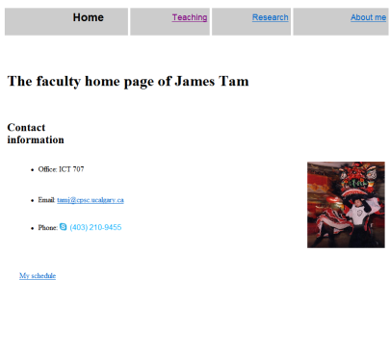
Java: Write Once, Run Anywhere
Consequence of Java’s history (coming later): platform-independence
Click on link to Applet
Mac user running Safari
Virtual machine translates byte code to
native Mac code and the Applet is run
Web page stored on Unix server
Byte code is downloaded
Byte code (part of web page)
Windows user running Internet Explorer

Slide 3
Java: Write Once, Run Anywhere
Consequence of Java’s history (coming later): platform-independence
Mac user running Safari
Web page stored on Unix server
Click on link to Applet
Byte code is downloaded
Byte code (part of web page)
Windows user running Internet Explorer
Virtual machine translates byte code to
native Windows code and the Applet is run

Slide 4
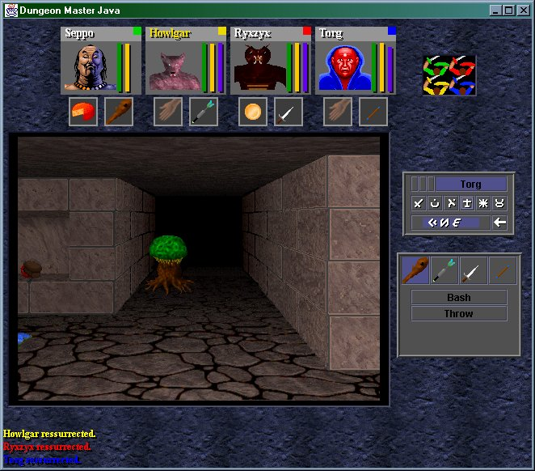
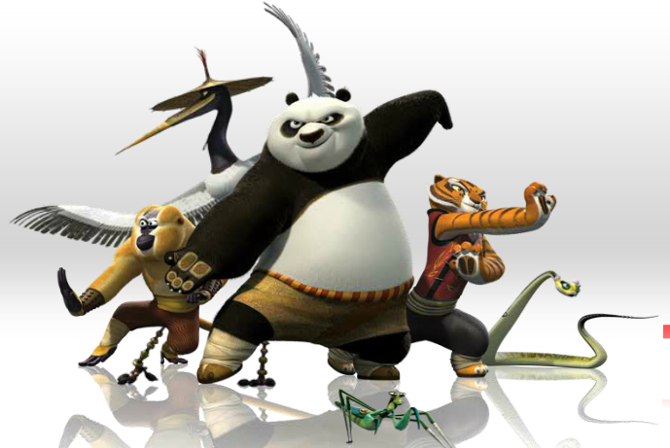
Java: Write Once, Run Anywhere (2)
But Java can also create standard (non-web based) programs
Kung Fu Panda:
Accessed 2013
screen grab from www.kunfupanda.com
Dungeon Master (Java version)
Accessed 2013
http://homepage.mac.com/aberfield/dmj/
Some examples of mobile Java games: http://www.mobilegamesarena.net

Slide 5
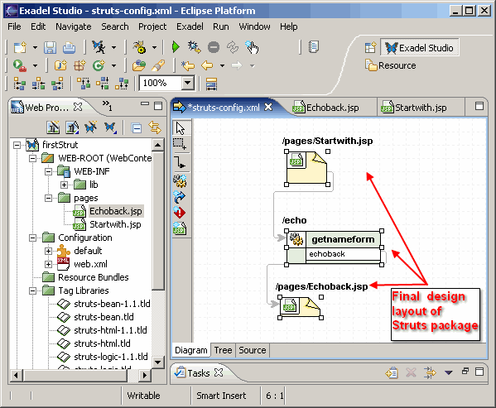
Java: Write Once, Run Anywhere (3)
Java has been used by large and reputable companies to create serious stand-alone applications.
Example:
  Eclipse¹: started as a programming environment created by IBM for developing Java programs. The program Eclipse was itself written in Java.
1 For more information: http://www.eclipse.org/downloads/

Slide 6
JT’s Note: IDE’s
There are many graphical development environments available for Java (e.g., Eclipse).
Learning one or more these environments prior to embarking on employment would be a valuable experience.
However it is not recommended that you use them for this course.
  You may have drastic problems configuring the environment (e.g., if you have to use example starting code).
  It’s easier programming without an IDE and then learning one later than the opposite (not all development teams can/will use them).
  With the size of the programs you will see in this class it would be a good learning experience to ‘work without a net’.
    Because you have to do it all yourself you will likely learn things better.

Slide 7
IDE’s: Bottom Line
Assignments must be submitted in the form of .java text files that will compile and run on the computer science network.
If you have problems with the IDE or getting your programs to work on our network then you will likely be on your own.

Slide 8
Official Online Java Documentation
“Getting started” tutorials:
  http://docs.oracle.com/javase/tutorial/

Slide 9
Compilation
Translating from a high level programming language such as Java or C++ to low level machine language (binary).
Python:
  One stage translation process from Python to machine.
  The translated instructions remain in memory.
Java
  Two stage process: 1) one time translation occurs Java to a generic binary that is common to many computers and many electronic devices (this creates a file) 2) when the program is run the generic binary is translated to machine language that is specific to the device.

Slide 10
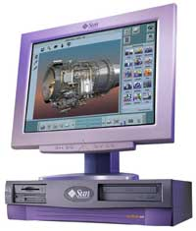

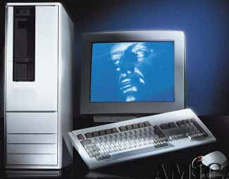
Compiled Programs With Different
Operating Systems: Multiple Compilers Needed
Windows compiler
Executable (Windows)
Computer program
Mac OS compiler
Executable (Mac)
UNIX compiler
Executable (UNIX)

Slide 11
A High Level View Of Translating/Executing Java Programs
Stage 1: Compilation
Filename.java
Java compiler “javac”
Filename.class
Java program
Java byte code (generic binary)

Slide 12
A High Level View Of Translating/Executing Java Programs (2)
Stage 2: Final translation and execution of the byte code
Machine language instruction (UNIX)
Filename.class
Java interpreter “java”
Machine language instruction (Windows)
Java byte code (generic binary)
Machine language instruction (Apple)

Slide 13
Which Java?
http://java.sun.com/javase/downloads/index.jsp
Java JDK (Java Development Kit), Standard Edition includes:
  JDK (Java development kit) – for developing Java software (creating Java programs).
  JRE (Java Runtime environment) –for running pre-created Java programs.
    Java Plug-in – a special version of the JRE designed to run through web browsers.
For consistency/fairness: Your graded work will be based on the version of Java installed on the CPSC network
  Only run your program using a remote connection program (e.g., Establish a remote login to a CPSC Linux computer) or test your code periodically on the network to make sure it’s compatible.

Slide 14
Location Of Online Examples For This Section
Course website:
  www.cpsc.ucalgary.ca/~tamj/219/examples/intro
UNIX directory:
  /home/219/examples/intro

Slide 15
Smallest Compilable And Executable Java Program
The name of the online example is: Smallest.java (Important note: the file name must match the word after the keyword ‘class’ below).
public class Smallest
{
public static void main(String[] args)
{
}
}
Smallest.java
public class Smallest
{
}

Slide 16
Creating/Translating/Running Java Programs: CPSC Network
Create the program: Use the editor of your choice (e.g. file name = Smallest.java)
  Example command line input: emacs Smallest.java
  Save the program as text files ending with a “.java” suffix
Translate the program: from Java to byte code format
  Intermediate binary for the architecture of a “virtual machine”
  Example command line input: javac Smallest.java
Translate and execute: The generic byte code translated into an actual hardware specific binary (interpret the byte code) and execute the binary
  Example command line input: java Smallest

Slide 17
Running The Java Compiler At Home
After installing Java you will need to indicate to the operating system where the java compiler has been installed (‘setting the path’).
  This is similar to Python.
For details of how to set your path variable for your particular operating system try the Sun or Java website.
Example of how to set the path in Windows (instructions should be version-independent)
  http://java.sun.com/j2se/1.4.2/install-windows.html (see step 5 on the web link)

Slide 18
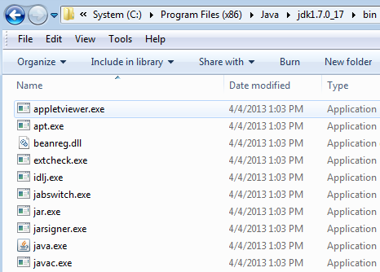

Alternative: Simple But A Hack
Create your Java programs in the same location as the Java compiler (example)

Slide 19
Documentation / Comments
Multi-line documentation
  /* Start of documentation
  */ End of documentation
  Don’t nest this form of documentation (syntax error)
Documentation for a single line
  //Everything until the end of the line is a comment

Slide 20
Review: What Should You Document
Program (or that portion of the program) author
What does the program as a while do e.g., tax program.
What are the specific features of the program e.g., it calculates personal or small business tax.
What are it’s limitations e.g., it only follows Canadian tax laws and cannot be used in the US. In Canada it doesn’t calculate taxes for organizations with yearly gross earnings over $1 billion.
What is the version of the program
  If you don’t use numbers for the different versions of your program then consider using dates (tie versions with program features).

Slide 21
Important Note
Each Java instruction must be followed by a semi-colon!
General format
Instruction1;
Instruction2;
Instruction3;
: :
Examples
int num = 0;
System.out.println(num);
: :

Slide 22
Java Output: Common Methods (~Function)
Print only the output specified (no other formatting: spaces, tabs, newlines)
  (Java)
  System.out.print();
  (Python)
  print(…, end="");
Print the output specified followed by a newline.
  (Java)
  System.out.println();
  (Python)
  print();

Slide 23
Java Output: Specifics
Format:
  System.out.print(<string or variable name one> + <string or variable name two>..);
  OR
  System.out.println(<string or variable name one> + <string or variable name two>..);
Examples (online program called “OutputExample1.java”)
public class OutputExample1
{
public static void main(String [] args)
{
int num = 123; // Details coming
  System.out.println("Good-night gracie!");
  System.out.print(num);
  System.out.println("num="+num);
  }
}

Slide 24
Output : Some Escape Sequences For Formatting
The escape sequence is placed between the quotes in print() or println() e.g., System.out.print("hi\tthere");
Escape sequence | Description
\t | Horizontal tab
\n | New line
\" | Double quote
\\ | Backslash

Slide 25
Variables
Unlike Python variables must be declared before they can be used.
Variable declaration:
  Creates a variable in memory.
  Specify the name of the variable as well as the type of information that it will store.
  E.g. int num;
  Although requiring variables to be explicitly declared appears to be an unnecessary chore it can actually be useful for minimizing insidious logic errors (example to follow shortly).
Using variables
  Only after a variable has been declared can it be used (e.g., assignment)
  E.g., num = 12;

Slide 26
Using Variables: A Contrast
Python
Java
Variables do not need to be declared before being used.
Easy to start programming.
Easy to make logic errors!
incomeTam = 25000
if (winLottery):
incomeSmith = 1000000
Syntax rule: variables must always be declared prior to use.
A little more work to get started.
Some logic errors may be prevented.
int incomeTam = 25000;
if (winLottery)
incomeSmith = 1000000;
Logic error: can be tricky to catch in a real (large and complex) program
Syntax error: compiler points out the source of the problem

Slide 27
Declaring Variables: Syntax
Format:
  <type of information> <name of variable>;
Example:
  char firstInitial;
Variables can be initialized (set to a starting value) as they’re declared:
  char firstInitial = 'j';
  String firstName = "James";
  int age = 30;

Slide 28
Some Built-In Types Of Variables In Java
Type | Description
byte | 8 bit integer
short | 16 bit integer
int | 32 bit integer
long | 64 bit integer
float | 32 bit real number (rare)
double | 64 bit real number (default for many operations)
char | 16 bit Unicode character (ASCII values and beyond)
boolean | True or false value
String | A sequence of characters between double quotes ("")
Notes:
boolean b = true;
if (b)
System.out.println("true");

Slide 29
Location Of Variable Declarations
public class <name of class>
{
public static void main (String[] args)
{
// Local variable declarations occur here
<< Program statements >>
...
}
}

Slide 30
Java Strings
Similar to Python strings: a sequence of characters indexed from zero to (length – 1)
  Don’t try to directly access elements via the index e.g., string1[0];
Unlike Python strings Java Strings only use double quotes
(In Java single quotes encloses a single character)
Format (creating string variable):
  String <string name> = "<value>";
Example (creating string variable):
  String username = "tamj";

Slide 31
Common String Methods
Examples useful methods:
Method | Description
string.charAt(int) | Retrieves character at the specified index
string.compareTo(String s) | Compares string with parameter: Zero returned if string and parameter equal Less than zero if the string comes before the parameter Greater than zero if the string comes after parameter
string.compareToIgnoreCase (String s) | As compareTo() but case insensitive
string.length() | Returns the length of the string
string.toLowerCase() | Converts alphabetic characters to lower case
string.toUpperCase() | Converts alphabetic characters to capitals
  For more info look under “class String”
  http://docs.oracle.com/javase/8/docs/api/

Slide 32

A String Example
The complete online program is called “String1.java”
String myString = "ab*cde";
System.out.println(myString.charAt(0) +
" " + myString.charAt(2));
System.out.println(myString.length());
System.out.println("-");
myString = myString.toUpperCase();
System.out.println(myString);
myString = myString.toLowerCase();
System.out.println(myString);
System.out.println("-");

Slide 33
A String Example (2)
// recall myString = "ab*cde"
System.out.println
(myString.compareToIgnoreCase("ab*cde"));
System.out.println
(myString.compareToIgnoreCase("zzz"));
System.out.println
(myString.compareToIgnoreCase("ab"));
ab*cde(zzz)
ab*cde(ab)

Slide 34
Style Hint: Initializing Variables
Always initialize your variables prior to using them!
  Do this whether it is syntactically required or not.
Example how not to approach (with some languages it’s a logic and not a syntax error):
  public class OutputExample1
  {
  public static void main (String [] args)
  {
  int num;
  System.out.print(num);
  }
  }
OutputExample1.java:7: error: variable num might not have been initialized
System.out.print(num);
^

Slide 35
Formatting Output: Elective Topic
It’s somewhat similar to Python.
The field width and places of precision (float point) can be specified.
Format (‘System.out.’ requirement excluded for brevity):
  printf("%<field width>d", price); // Integer
  printf("%<field width>s", price); // String
  printf("%<field width>.<precision>f", price); // Floating point
If field width greater than the size of the data:
  A positive field width will result in leading spaces (right justify).
  A negative field width will result in trailing spaces (left justify).

Slide 36

Formatting Output (2): Elective Topic
Name of the online example: FormattingExample.java
  public class FormattingExample
  {
  public static void main(String [] args)
  {
  String str = "123";
  int num = 123;
  double price = 1.999;
  System.out.printf("%-4s", str);
  System.out.printf("%5d", num);
  System.out.printf("%6.2f", price);
  }
  }
Notes:
‘123’ has a trailing space
123 has two leading spaces
1.999 rounded to decimal places and two leading spaces

Slide 37
Java Constants (“Final”)
Reminder: constants are like variables in that they have a name and store a certain type of information but unlike variables they CANNOT change. (Unlike Python this is syntactically enforced…hurrah!).
The syntactically enforced unchanging nature of constants is specified with the ‘final’ key word
Format:
  final <constant type> <CONSTANT NAME> = <value>;
Example:
final int SIZE = 100;
SIZE = 1000; // Syntax error

Slide 38
Location Of Constant Declarations
public class <name of class>
{
public static void main (String[] args)
{
// Local constant declarations occur here (for now)
// Local variable declarations
< Program statements >>
: :
}
}

Slide 39
Variable Naming Conventions In Java
Compiler requirements
  Can’t be a keyword nor can the names of the special constants: true, false or null be used
  Can be any combination of letters, numbers, underscore or dollar sign (first character must be a letter or underscore)
Common stylistic conventions
  The name should describe the purpose of the variable
  Avoid using the dollar sign
  With single word variable names, all characters are lower case
    e.g., double grades;
  Multiple words are separated by capitalizing the first letter of each word except for the first word
    e.g., String firstName = "James";

Slide 40
Java Keywords (Avoid Using As Identifiers)
abstract | boolean | break | byte | case | catch | char
class | const | continue | default | do | double | else
extends | final | finally | float | for | goto | if
implements | import | instanceof | int | interface | long | native
new | package | private | protected | public | return | short
static | super | switch | synchronized | this | throw | throws
transient | try | void | volatile | while

Slide 41
Common Operators
Operation | Operator | Example usage
Assignment | = | num = 123;
Addition | + | num = 2 + 2;
Subtraction | - | num = 5 – 2;
Multiplication | * | num = num * 2;
Division | / | num = 9 / 3;
Remainder | % | num = 9 % 2
Negation | - | -num;

Slide 42
Post/Pre Operators
Post/Pre Increment
A common shorthand notation used in several languages (e.g., Java, C, C++) which will increase a variable by one.
Post-increment
  num++;
Pre-increment
  ++num;
Pre vs. post operators will produce identical results if the increment is the only operation (two previous examples):
The specific difference between ‘post’ vs. ‘pre’ will be coming up shortly

Slide 43
Post/Pre Decrement
Operates in a similar fashion to post/pre decrement except that a variable is decreased by one.
Post decrement
  num--;
Pre decrement
  --num;

Slide 44

Post/Pre Operators
The name of the online example is: Order.java
public class Order
{
public static void main(String [] args)
{
int num = 5;
System.out.println(num);
num++;
System.out.println(num);
++num;
System.out.println(num);
System.out.println(++num);
System.out.println(num++);
}
}

Slide 45
Casting: Converting Between Types
Casting: the ability to convert between types.
  Of course the conversion between types must be logical otherwise an error will result e.g., multiplication on a String is a nonsensical operation
In Java unlike Python the conversion isn’t just limited to a limited number of functions.
  Consequently Python doesn’t have true ‘casting’ ability.
Format:
  <Variable name> = (type to convert to) <Variable name>;

Slide 46

Casting: Structure And Examples
The name of the online example: Casting.java
  public class Casting
  {
  public static void main(String [] args)
  {
  int intNum;
  double realNum;
  realNum = 1.9;
  // Storing more into less
  intNum = (int) realNum;
  System.out.println(intNum + " " + realNum);
  // Storing less into more
  realNum = intNum;
  System.out.println(intNum + " " + realNum);
  }
  }
Converting/casting types:
Simple but important concept
Going from ‘more’ to ‘less’ and ‘less’ to ‘more’: we’ll return back to this in the ‘hierarchies’ section (inheritance)

Slide 47
Accessing Pre-Created Java Libraries
It’s accomplished by placing an ‘import’ of the appropriate library at the top of your program.
Syntax:
  import <Full library name>;
Example:
  import java.util.Scanner;

Slide 48
Getting Text Input
You can use the pre-written methods (functions) in the Scanner class.
General structure:
Creating scanner entity (object)
import java.util.Scanner;
main (String [] args)
{
Scanner <name of scanner> = new Scanner(System.in);
<variable> = <name of scanner>.<method>();
}
Getting user input with a method

Slide 49
Getting Text Input (2)
The name of the online example: MyInput.java
  import java.util.Scanner;
  public class MyInput
  {
  public static void main(String [] args)
  {
  String name;
  int age;
  Scanner in = new Scanner(System.in);
  System.out.print("Enter your name: ");
  name = in.nextLine();
  System.out.print("Enter your age: ");
  age = in.nextInt();
  System.out.println("Hi " + name + " you're " + age); }
  }

Slide 50
Useful Methods Of Class Scanner¹
nextInt()
nextLong()
nextFloat()
nextDouble()
nextLine()
1 Online documentation: http://docs.oracle.com/javase/8/docs/api/

Slide 51
Reading A Single Character
Text menu driven programs may require this capability.
Example:
  GAME OPTIONS
  (a)dd a new player
  (l)oad a saved game
  (s)ave game
  (q)uit game
There’s different ways of handling this problem but one approach is to extract the first character from the string.
Partial example:
  String s = "boo";
  System.out.println(s.charAt(0));

Slide 52
Decision Making In Java
Java decision making constructs
  if
  if, else
  if, else-if
  switch

Slide 53
Decision Making: Logical Operators
Logical Operation | Python | Java
AND | and | &&
OR | or | ||
NOT | not | !

Slide 54
Java Relational Operators
if (operand relational operator operand)
Java Mathematical
operator equivalent Meaning Example
< < Less than 5 < 3
> > Greater than 5 > 3
== = Equal to 5 == 3
<= ≤ Less than or equal to 5 <= 5
>= ≥ Greater than or equal to 5 >= 4
!= ≠ Not equal to x != 5

Slide 55
Decision Making: If
Format:
if(Boolean Expression)
Body
Example:
if(x != y)
System.out.println("X and Y are not equal");
if ((x > 0) && (y > 0))
{
System.out.println("X and Y are positive");
}
Indenting the body of the branch is an important stylistic requirement of Java but unlike Python it is not enforced by the syntax of the language.
What distinguishes the body is either:
  A semi colon (single statement branch)
  Braces (a body that consists of single or multiple statements)

Slide 56
The ‘Body’
Single statement body
  if (num > 0)
  System.out.println("Part of body");
  System.out.println("Not part of body");
  System.out.println("Still not part of body");
Multi statement (compound) body
  if (num > 0)
  {
  System.out.println("Part of body");
  System.out.println("Part of body");
  }

Slide 57
Decision Making: If, Else
Format:
if(Boolean expression)
Body of if
else
Body of else
Example:
if (x < 0)
System.out.println("X is negative");
else
System.out.println("X is non-negative");

Slide 58
If, Else-If (Java)
If, Elif (Python)
Format:
if (Boolean expression)
Body of if
else if (Boolean expression)
Body of first else-if
...
else if (Boolean expression)
Body of last else-if
else
Body of else

Slide 59
If, Else-If (2)
Complete example: IfElseIfExample.java
if (gpa == 4)
{
System.out.println("A");
}
else if (gpa == 3)
{
System.out.println("B");
}
else if (gpa == 2)
{
System.out.println("C");
}

Slide 60
If, Else-If (2)
else if (gpa == 1)
{
System.out.println("D");
}
else if (gpa == 0)
{
System.out.println(“F");
}
else
{
System.out.println("Invalid gpa");
}

Slide 61
Alternative To Multiple Else-If’s: Switch
Use when checking for equality of: integer numbers or characters (safest to check only for these types even if later versions of Java support additional types).

Slide 62
Alternative To Multiple Else-If’s: Switch
Format (character-based switch):
switch (character variable name)
{
case '<character value>':
Body
break;
case '<character value>':
Body
break;
:
default:
Body
}
1 The type of variable in the brackets can be a byte, char, short, int or long
Important! The break is mandatory to separate Boolean expressions (must be used in all but the last).
The break transfers execution out of the switch construct, otherwise cases will ‘fall-through’

Slide 63
Alternative To Multiple Else-If’s: Switch (2)
Format (integer based switch):
switch (integer variable name)
{
case <integer value>:
Body
break;
case <integer value>:
Body
break;
:
default:
Body
}
1 The type of variable in the brackets can be a byte, char, short, int or long

Slide 64
The ‘Break’ Statement
‘Break’s is mandatory if cases are to be separated.
Example:
  int gpa = 3;
  char letter = ' ';
  switch (gpa) {
  case 4:
  letter = 'a';
  case 3:
  letter = 'b';
  case 2:
  letter = 'c';
  case 1:
  letter = 'd';
  case 0:
  letter = 'f';
  // Student receives an 'f'!
  }
  As mentioned without a break the switch will execute the first true case and all other cases will ‘fall through’

Slide 65
Switch: Benefit (Cleaner Code)
Benefit (when to use):
  It may produce simpler code than using an if, else-if (e.g., if there are multiple compound conditions)
  Contrast
switch(menu)
{
case 'a':
case 'A':
case 'N':
case 'n':
System.out.println("New player \
added");
break;
case 'Q':
case 'q':
  // Using if
  If ((menu == 'a') ||
  (menu == 'A') ||
  (menu == 'N') ||
  (menu == 'n'))
  System.out.println("New player added");
  else if ((menu == 'q') ||
  (menu == 'Q'))

Slide 66
Switch: Mix and Match Use Of ‘Break’
Name of the online example: SwitchExample.java (When to use a switch)
  import java.util.Scanner;
  public class SwitchExample
  {
  public static void main (String [] args)
  {
  final int FIRST = 0;
  String line;
  char letter;
  int gpa;
  Scanner in = new Scanner (System.in);
  System.out.print("Enter letter grade: ");

Slide 67
Switch: Mix and Match Use Of ‘Break’ (2)
line = in.nextLine ();
letter = line.charAt(FIRST);
switch (letter)
{
case 'A':
case 'a':
gpa = 4;
break;
case 'B':
case 'b':
gpa = 3;
break;
case 'C':
case 'c':
gpa = 2;
break;

Slide 68
Switch: Mix and Match Use Of ‘Break’ (3)
case 'D':
case 'd':
gpa = 1;
break;
case 'F':
case 'f':
gpa = 0;
break;
default:
gpa = -1;
} // End of switch (determining GPA)
System.out.println("Letter grade: " + letter);
System.out.println("Grade point: " + gpa);
}
}

Slide 69
Loops
Python loops
  for
  while
Java loops
  for
  while

Slide 70
While Loops
Format:
  while (Boolean expression)
  {
  Body
}
Example:
int i = 1;
while (i <= 10)
{
System.out.println(i);
i = i + 1;
}
i = 1
while (i <= 10):
print(i)
i = i + 1

Slide 71
For Loops
Format:
for (initialization; Boolean expression; update control)
{
Body
}
Example
for (i = 1; i <= 10; i++)
{
System.out.println(i);
}
for i in range (1, 11, 1):
print(i)

Slide 72
For Loops: Java Vs. Python
Unlike Python with most languages for loops are generally used as counting (e.g., up down).
Iterating through other series (such as lines in a file) is not possible.
Python example not possible in other languages
  inputFile = open("input.txt", "r")
  for line in inputFile:
  print(line)
In Java however the loop control update can be most any mathematical expression (even randomly assigned).
  for (i = 1; i <= 100; i = i * 5)
Notes:
for (i = 1; i <= 100; i = i * 5)
Because there is an assignment statement the update can be the result of a mathematical function

Slide 73
For Loops: Java Vs. Python (2)
Also note in Java that the stopping boundary is explicit.
  for (i = 1; i <= 10; i++)
  Vs.
  for i in range (1, 11, 1):

Slide 74
Common Mistake: Branches/Loops
Forgetting braces and that single statement bodies are specified by the first semi-colon.
(Partial) examples:
  while (i < 10)
  System.out.println(i);
  i = i + 1;
  while (i < 10);
  {
  System.out.println(i);
  i = i + 1;
  }
Body (logic error)
Body

Slide 75
Many Pre-Created Classes Have Been Created
Rule of thumb of real life: Before writing new program code to implement the features of your program you should check to see if a class has already been written with the features that you need.
Note: for some assignments you may have to implement all features yourself rather than use pre-written code.
  You may receive little or no credit otherwise.
The Java API is Sun Microsystems's collection of pre-built Java classes:
  http://java.sun.com/javase/8/docs/api/

Slide 76
Example: Generating Random Numbers (Probabilities)
Name of the (more complete example): DiceExample.java
  import java.util.Random;
  public class DiceExample
  {
  public static void main(String [] args)
  {
  final int SIDES = 6;
  Random generator = new Random();
  int result = -1;
  result = generator.nextInt(SIDES) + 1;
  System.out.println("1d6: " + result);
  result = generator.nextInt(SIDES) + 1;
  result = result + generator.nextInt(SIDES) + 1;
  result = result + generator.nextInt(SIDES) + 1;
  System.out.println("3d6: " + result);
  }
  }

Slide 77
Arrays
They are similar to Python lists.
  Specified with square brackets
  Indexed from 0 to (number elements-1)
Some differences:
  All elements must be of the same type e.g., array of integers cannot mix and match with floats
  Python has methods associated with lists although an array in Java has a ‘length’ attribute associated with it.
  Arrays cannot be dynamically resized (new array must be created).

Slide 78
Creating An Array
Format:
  <type> []₁ <name> = new <type> [<Number of elements>];
Example (common approach):
  final int MAX = 100;
  int [] grades = new int[MAX];
Example (Fixed size array declared and initialized – rarely used approach):
  int [] array = {1,2,3};
1 Each dimension must be specified by a set of square brackets e.g., two dimensional array requires two sets of brackets

Slide 79
Arrays: Complete Example
Name of the (more complete example): GradesExample.java
  public class GradesExample
  {
  public static void main(String [] args)
  {
  final int MAX = 10;
  int [] grades = new int[MAX];
  int i = 0;
  Random generator = new Random();

Slide 80
Arrays: Complete Example (2)
  for (i = 0; i < MAX; i++)
  {
  grades[i] = generator.nextInt(101);
  }
  for (i = 0; i < grades.length; i++)
  {
  System.out.println("Element #" + i + " grade " +
  grades[i]);
  }
  }
  }
Unlike Python lists you cannot pass an entire Java array in order to display the elements:
System.out.println(grades);

Slide 81
After This Section You Should Now Know
The basic structure required for creating a simple Java program as well as how to compile and run programs
How to document a Java program
How to perform text based input and output in Java
The declaration of constants and variables
Formatting output with the field width, precision and escape codes (elective)
Converting between types using the casting operator
What are the common mathematical and logical operators and how they work
The structure and syntax of decision making and looping constructs

Slide 82
After This Section You Should Now Know (2)
How to generate random numbers
How to create and work with Java arrays

Slide 83
Copyright Notification
“Unless otherwise indicated, all images in this presentation are used with permission from Microsoft.”

