Slide 1
Java History
Background information about Java and how the background affected it’s development

Slide 2
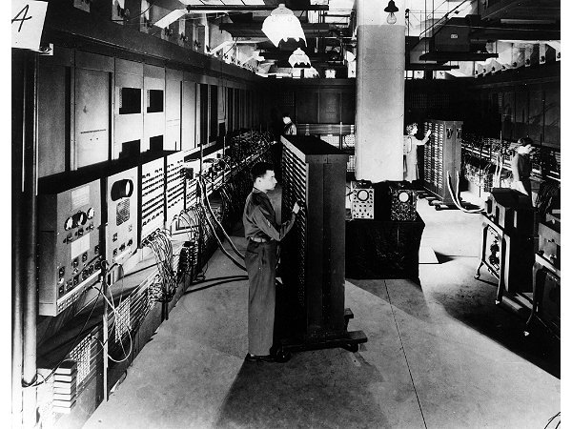
Java: History
Computers of the past
Image © University of Pennsylvania

Slide 3
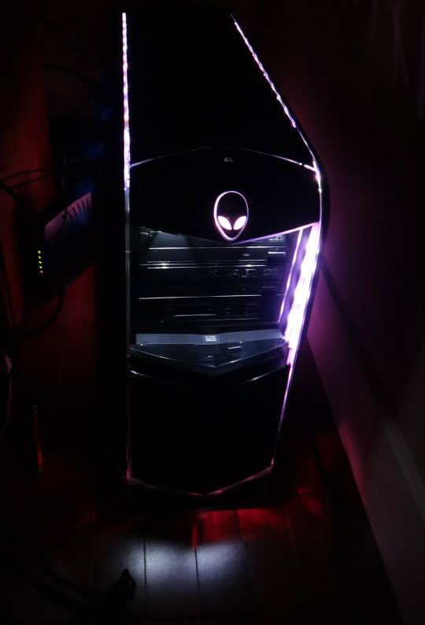
Java: History (2)
The invention of the microprocessor revolutionized computers
From the “Intel museum” www.intel.com
Image courtesy of James Tam

Slide 4
Java: History (3)
It was believed that the logical next step for microprocessors was to have them run intelligent consumer electronics.
“Smart homes”
“Smart washer-dryers”
“Smart vacuums”

Slide 5
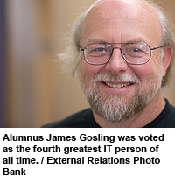
Java History (4)
Sun Microsystems funded an internal research project “Green” to investigate this opportunity.
Result: A programming language called “Oak”
Blatant advertisement: James Gosling was a graduate of the U of C Computer Science program

Slide 6
Java History (5)
Problem: There was already a programming language called Oak.
The “Green” team met at a local coffee shop to come up with another name...
Java!

Slide 7
Java: History (6)
The concept of intelligent devices didn’t catch on.
Project Green and work on the Java language was nearly canceled.

Slide 8
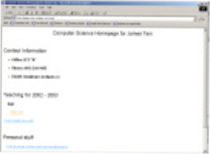
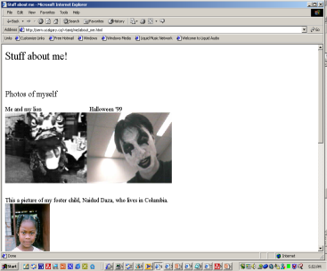
Java: History (7)
The popularity of the Internet resulted in Sun’s re-focusing of Java on computers.
Prior to the advent of Java, web pages allowed you to download only text and images.
Your computer at home running a web browser
Server containing a
web page
User clicks on a link
Images and text get downloaded

Slide 9
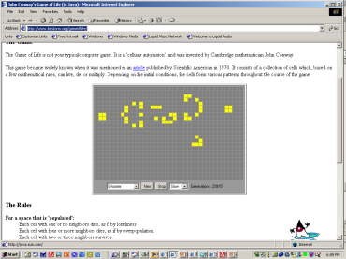
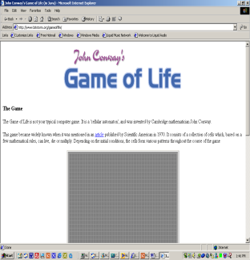
Java: History (8)
Java enabled web browsers allowed for the downloading of programs (Applets).
Java is still used in this context today:
Facebook (older version)
Hotmail (older version)
Your computer at home running a web browser
Server containing a
web page
User clicks on a link
Java applet downloaded
Java version of the Game of Life: http://www.bitstorm.org/gameoflife/
Online checkers: http://www.darkfish.com/checkers/index.html

Slide 10
Why ‘Javac’ & ‘Java’: Consequence Of Java History

Slide 11
Adding Java Code To A Webpage
The code can be run through a web browser instead of manually invoked via the command line.
These Java programs are ‘applets’
How to create a simple Java applet:
http://docs.oracle.com/javase/tutorial/deployment/applet/getStarted.html
How to get an applet to run when your web page is accessed
http://www.ehow.com/how_7306707_run-java-applet-html.html

Slide 12
References
http://www.oracle.com/technetwork/java/javase/overview/javahistory-index-198355.html

Slide 13
After This Section You Should Now Know
How Java was developed and the impact of its roots on the language
Major players and events in the development of Java

