Slide 1
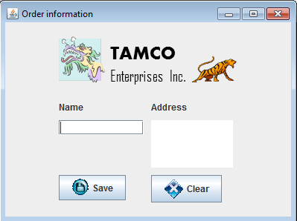
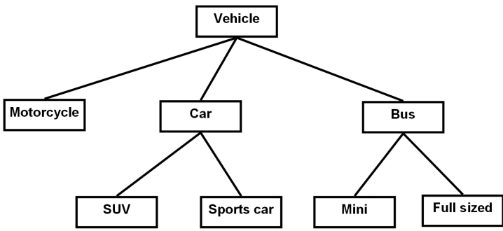
Introduction To CPSC 219
James Tam
Java
Object-Orientation
Graphical-user interfaces
Images courtesy of James Tam

Slide 2
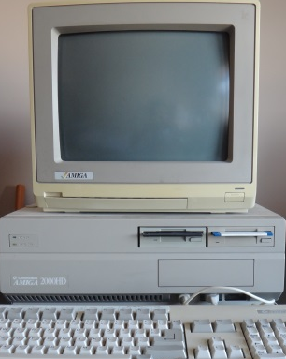
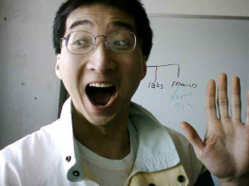
Then And Now…
CPSC 217: What was it like then
CPSC 219: What will it be like now
A Lot of work! (Psychedelic Amiga by James Tam)
…but don’t forget how much smarter you’ve became!
Image of James Tam: courtesy of James Tam
Even more work!!!

Slide 3
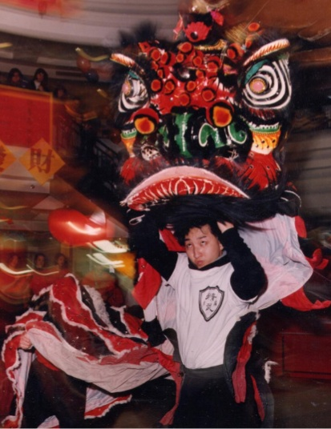

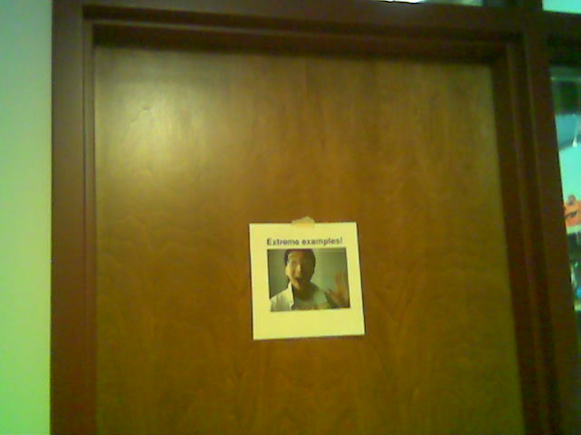
Administrative (James Tam)
Contact Information
  Office: ICT 707
  Email: tam@ucalgary.ca
  Please include the course name and number in the subject line: “CPSC 219”
Office hours
  Office hours: M (3:30 – 4:20 PM), T (2 – 2:50 PM)
  If I’m not in my office give me a few minutes or check the lecture room.
My Office
Images: courtesy of James Tam

Slide 4
Course Resources
Required resources:
  Course website: http://pages.cpsc.ucalgary.ca/~tamj/2016/219W/index.html
  Get the notes off the course webpage before lecture)
Recommended but not required:
  "Absolute Java (6th Ed)" Walter Savitch, (Pearson)
  Alternately you can pick out one of the ‘free’ online texts from the university library:
  http://proquest.safaribooksonline.com.ezproxy.lib.ucalgary.ca/

Slide 5
How To Use The Course Resources
They are provided to support and supplement this class.
  The notes outline the topics to be covered
  At a minimum look through the notes to see the important topics.
  However the notes are just an outline and just looking at them without coming to class isn’t sufficient to do well
  You will get the details (e.g., explanations) during lecture time
    Take notes!

Slide 6

Your Engagement Level ---> Your Learning
+
Learning
colourbox.com
Computer programs
Computer program

Slide 7
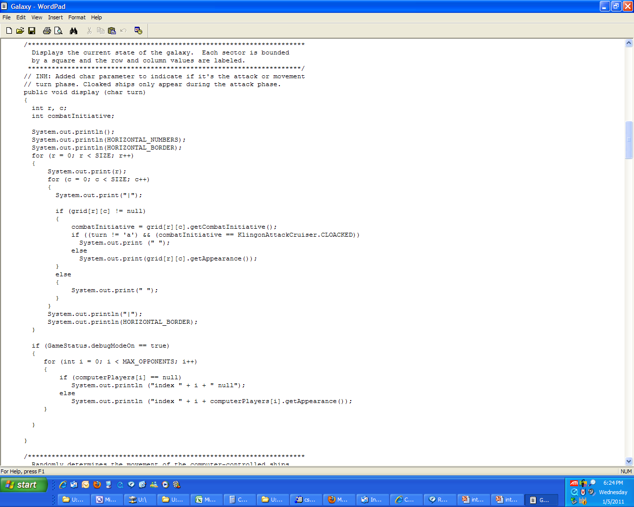
How To Use The Course Resources (2)
Notes:
7

Slide 8
How To Use The Course Resources (2)
If you miss a class make sure that you catch up on what you missed (get someone’s class notes)
...when you do make it to class make sure that you supplement the slides with your own notes (because you aren’t going to remember it in the exams if you don’t)
Notes:
8

Slide 9
How To Use The Course Resources (3)
What you are responsible for:
  Keeping up with the content in class which includes the topics covered but also announcements or assignment information whether you were present in the class or not.
  If you are absent, then you are responsible for getting the information from the other students in class.
  (I won’t be able to repeat the lecture content if you are absent…there’s just too many of you to make it practical and recall to get the most out of the class you need to be actively engaged)
However, after you’ve caught up by talking with a classmate:
  Ask for help if you need it
  There are no dumb questions
  …except for waiting until the exam

Slide 10
Tam’s “House Rules”
I will endeavor to keep the lecture within the prescribed time boundaries
You won’t pack up and leave before time is up

Slide 11





Tam’s “House Rules”
No recordings/captures without permission during class please
(Recall that learning tends to increase with additional levels of engagement).
Colourbox.com

Slide 12
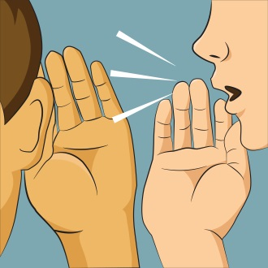

Tam’s “House Rules”
Quiet whispering is OK…
…but make sure if it is *quiet*. If it’s loud enough for me to hear then it’s likely that others are being disturbed by the noise as well.
Images from colourbox.com

Slide 13
233 Students: Assumed Knowledge
You completed CPSC 217 (or the equivalent) with a grade of C- or higher.
You do not need to know Python programming for this class.
  However sometimes I will refer briefly to Python programs just to contrast what (most/all) students already know with what they need to learn.
You are proficient at using common procedural programming tools e.g., branching, loops, decomposition into functions etc.
If you are new to the CPSC network then you should (quickly) familiarize yourself.
  One starting point (Topic #0):
  http://pages.cpsc.ucalgary.ca/~tamj/2016/219W/starting/index.html

Slide 14
How To Succeed In This Course: A Summary
Practice things yourself
Make sure that you keep up with the material
Look at the material before coming to lecture
Start working on things early

Slide 15
Evaluation Components
Bonus component (2% in total)
Assignments (35%)
Examinations (65%)

Slide 16
In Class Bonus Questions (2% Max Bonus On Term Grade)
They will be administered using TopHat Monacle
  https://app-ca.tophat.com
The questions will be ‘randomly’ administered during lecture (only) – no ‘make up’ questions
  You will be given ample notice before the first questions begin (they won’t start immediately)
  Note that the questions will act as a ‘bonus’ (you may potentially be awarded an “A” grade even if you receive no marks on the TopHat questions).
  The questions will be directly related to lecture material.

Slide 17
Assignments
There will be two types of assignments
  Full (regular) assignments (32%)
  Mini assignments (3%)
Full assignments (5 assignments, 32% total):
  Marking is based on a number of factors (such as program functionality, documentation, style)
  Assignment 1: worth 5%
  Assignment 2: worth 8%
  Assignment 3: worth 8%
  Assignment 4: worth 5%
  Assignment 5: worth 6%
Mini assignments (6 worth 0.5% each = 3% total)
  The goal is to create a small and relatively simple program in order to learn basic programming concepts such as Java syntax
  Marking is focused on program functionality

Slide 18
Assignments
Assignments must be individually completed and individually submitted.
  There is no group work allowed for this class.
  Students should not see the computer program code of other students.
Both types of assignments will be marked by the tutorial instructor.
  Grades will be posted in D2L
  You can contact him/her for the grade and/or the completed marking sheet.
  If you still have questions or issues after contacting your TA then feel free to contact your course instructor.

Slide 19
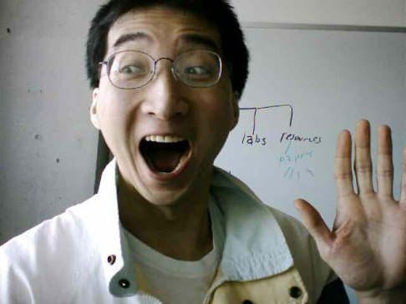
Submitting Assignments
Bottom line: it is each student’s responsibility to make sure that the correct version of the program was submitted on time.
Late assignments will not be accepted.
If you are ill then medical documentation is required.
  Contact your course instructor and not your tutorial instructor to get permission for a late submission
(Further details will be available during the term).
I am the ‘course instructor’ person

Slide 20
JT’s Helpful Hint: Electronically Submitting Work
Bad things sometimes happen!
  Sometimes it’s a technical failure (e.g., hardware failure)
  Sometimes it’s human error (e.g., oops, accidentally deleted)
Rules of thumb for assignment submissions:
  Do it early! (Get familiar with the system)
  Do it often! (If somehow real disaster strikes and you lose everything at least you will have a partially completed version that your TA can mark).
  Check your work.
    Don’t assume that everything worked out OK.
    Instead you should check everything (there should be a way to do this using the assignment submission mechanism)
    Don’t just check file names but at least take a look at the actual file contents (not only to check that the file wasn’t corrupted but also that you submitted the correct version).

Slide 21
Backing Up And Submitting Your Work
Bottom line: it is up to you to make sure things are done correctly and on time.
If you have questions beforehand then do ask (make sure you ask your questions early enough so you can receive an answer before the due time).
But don’t wait until after the due date (it’s too late).

Slide 22
Examinations
There will be three exams: two midterms and final.
Midterm examinations (together worth 30% of the overall term grade)
  Midterm #1: in class Feb 12
  Midterm #2: in class Mar 11
Final exam (worth 35% of the overall term grade
  Date/time/location determined by the Office the Registrar.
  (That means I find out these details at the same time that you do).
  You can find information about your final exams online via the university PeopleSoft portal.
All examinations will completed on paper (not in front of a computer).

Slide 23
Examinations (2)
Information about the examinations will be available on the main grid sometime before the respective test:
  Under the main index:
    Main grid: Course topics, lecture notes and individual assignment descriptions, exam information
  Hyperlink:
    http://pages.cpsc.ucalgary.ca/~tamj/2016/219W/index.html#Main_grid:_Course_topics,_lecture_notes_and_individual_assignment_descriptions,_exam_information
Note: you need to pass the weighted average of the exam component in order to receive a grade of C- or higher in this class.

Slide 24
Mapping Your Raw Score To A Grade Point
As stated in the course information sheet (official signed document) each major component will be awarded a grade point (and not a percentage) as the value used to determine the term grade.
  Components that are mapped to a grade point
    Each individual assignment
    Total score for in-lecture TopHat questions
    Midterm exams
    Final exam
The mapping of raw score to grade point will be posted before each assignment is due (variation between assignments may occur).
Mapping of TopHat bonus questions to grade point
The mapping of the midterm to grade point will be posted sometime after the midterm.
The mapping of final to grade point cannot be provided until after the official term marks have been released (Department policy).
Percent | 96 – 100 | 91 – 95 | 86 – 90 | 81 – 85 | 76 - 80 | 71 - 75 | 65 – 70 | 61 – 64 | 56 -60 | 51 - 55 | 46 - 50 | < 46
GPA | 4.0 | 3.7 | 3.3 | 3.0 | 2.7 | 2.3 | 2.0 | 1.7 | 1.3 | 1.0 | 0.7 | 0.0

Slide 25
Estimating Your Term Grade
To determine your weighted term grade point simply multiply each grade point by the weight of each component.
Sum the weighted grade points to determine the term grade.
Simple and short example (not exactly the same as this term but it should be enough to give you an idea of how to do the specific calculations required this semester):
  Assignments: weight = 30%, example score = A
  Midterm: weight = 30%, example score = B+
  Final: weight = 40%, example score = C-
  Weighted assignments: 0.3 * 4.0 = 1.2
  Weighted midterm: 0.3 * 3.3 = 0.99
  Weighted final: 0.4 * 1.7 = 0.68
  Total term grade point = 1.2 + 0.99 + 0.68 = 2.87
  (In this case the term letter is B-)

Slide 26
Estimating Your Term Grade (2)¹
Use the spreadsheet on the course web page to estimate your term letter grade:
  http://pages.cpsc.ucalgary.ca/~tamj/2016/219W/grade_calculator.xlsx
The grade point to letter grade mapping employs the official university cutoffs:
  http://www.ucalgary.ca/pubs/calendar/current/f-2.html
  (I may employ a more lenient set of cutoffs at the end of term but the official cutoffs will provide you with a ‘worse case’ estimate of your grade).
1 Note: to keep things simple the formula in the spreadsheet does not check if the exam component was passed or not (you can do the check manually or add it in yourself)

Slide 27
Why Grade Points?
It’s the official university grading system
  Alternatives are possible but require faculty level approval
Approval of anything other than a grade point system requires predetermined cutoffs at the start of the term e.g., >= 90% equals ‘A’ etc.
  Doesn’t allow for consideration that individual components may be more challenging than others (lower cutoffs)
Grade points are more lenient for grades on the lower-middle end of the scale
  Grade points: Getting an “A”/4.0 on the assignment component worth 30% of the term grade yields a minimum term grade of 1.2 (4.0 * 0.3) which equates to a term grade of ‘D’ (possibly higher)
  Percentages: Getting an “A” may roughly work out to 90% or higher (depending on the scale) which works out to a minimum term percent of 27% = 90% score * 30% weight…almost certainly an “F” for the term grade.

Slide 28
Examination Content
Multiple choice questions:
  Partial program traces e.g., what’s the program output
  Basic program structure e.g., find the errors, which function or operator is needed for a particular mathematical operation
  More examples and details coming during the semester
Written questions:
  Write a small/partial computer program.
  Trace the execution of a computer program e.g., what is the ‘output’.
  Conceptual (lower weight for this type of question) e.g., definition of a technical term.
  Likely there will be a smaller proportion of written questions on the midterm vs. the final.
I will be grading the exams.
  (I’ll do the best I can to get them done in a timely fashion but remember this is often a high enrollment class).

Slide 29
Examination Content (2)
More sample ‘exam type’ questions will be provided during the semester.
  Sometimes ‘on the fly’ in lecture so pay attention to these and take notes.

Slide 30

Feedback
Wow I am the greatest speaker in the world!
What is he talking about???
Let me know how things are going in the course:
  Am I covering the material too slowly or too quickly.
  Can you read the slides and my hand writing.
  Can you hear me in the class.
  Etc.
(Image copyrights unknown)

Slide 31
Copyright Notification
“Unless otherwise indicated, all images in this presentation are used with permission from Microsoft.”
Sound effects (due to budgetary constraints) were produced by James Tam

