Slide 1
JavaScript
You will learn more advanced html tags for creating graphical ‘GUI’ controls and the basics of JavaScript programming.
Pictures courtesy of James Tam

Slide 2
Advanced HTML
In the last section you learned how to use html to: format text, embed content and link to other pages.
In this section you will learn how to use HTML to create graphical controls such as buttons and input fields.

Slide 3

Creating GUI Controls
Format:
  <input type="<control type>" value="<Text description>"/>
Name of example: 1emptyControl.htm
  <input type="button" value="Press me"/>
Pressing the button does nothing! Why???
You need to write the JavaScript instructions to indicate what happens when the button press occurs (details come later)

Slide 4



Types Of GUI Controls
GUI control | HTML | Appearance
Button | <input type="button" value="Press"/>
Checkbox (select 1+) | <input type="checkbox" value="Checkbox one of many"/>
Password (input hidden) | <input type="password" value="def"/>
Radio (select exactly 1) | <input type="radio"/>
Text (single line input) | <input type="Text" value="Type a line of text here"/>
There’s numerous places online where you can find information about how to use these controls
Example:
https://msdn.microsoft.com/en-us/library/ms535260(v=vs.85).aspx

Slide 5
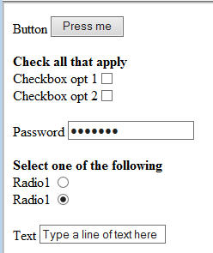

Graphical Controls: More Complete Example
Name of example: 2manyEmptyControls.htm
  Button <input type="button" value="Press me"/><br>
  <br>
  <b>Check all that apply</b><br>
  Checkbox opt 1<input type="checkbox"/><br>
  Checkbox opt 2<input type="checkbox"/><br>
  <br>
  Password <input type="password" value="default"/><br>
  <br>
  <b>Select one of the following</b><br>
  Radio1 <input type="radio"/><br>
  Radio2 <input type="radio" checked="checked"/><br>
  <br>
  Text <input type="Text" value="Type a line of text here"/>

Slide 6
Adding JavaScript To A Webpage
This is where you can augment a web page to make it interactive.
  JavaScript is separate from the webpage content (text, images, formatting tags)
  Enclose them with a <script> tag
  The JavaScript instructions must be defined within a function.

Slide 7
Where/How To Include Programs
A function is a series of instructions that run when an event occurs e.g., the user clicks on a button
JavaScript functions for this course are similar to functions you have seen in Excel except that you will be learning how write your own functions rather than using a pre-created one.
index.html
<script>
</script>
This is the <i>normal</i> <b>webpage content</b>
JavaScript function goes here

Slide 8
Running Programs Through A Webpage
Why bother?
Among other things adding a computer program to a webpage can make it more interactive.
  Error checking user input e.g., email format in a web form
  Allow visitors to play games
  Etc.
  With JavaScript you can write programs that can execute when a webpage is downloaded and viewed through a web browser.

Slide 9
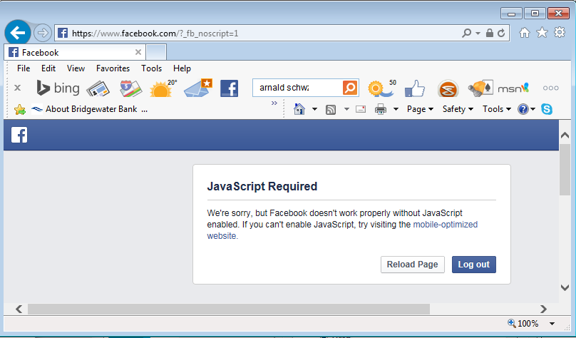
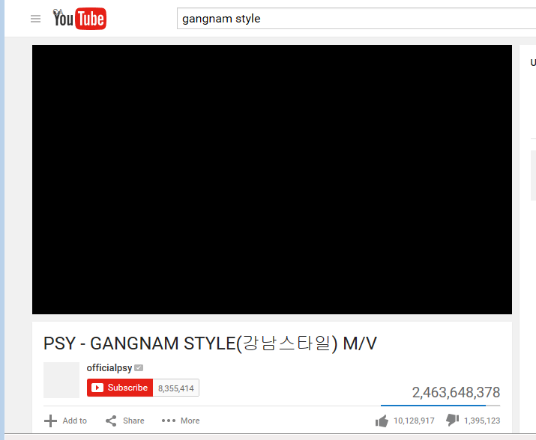
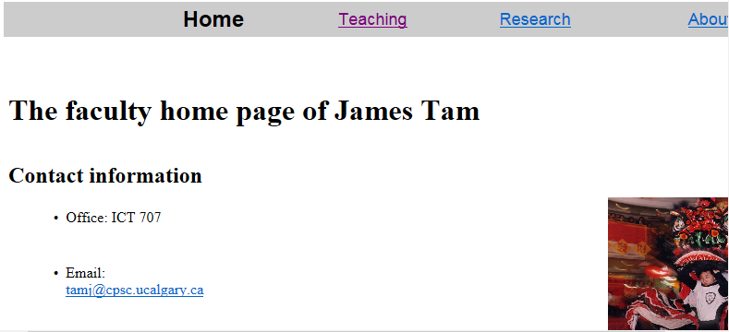
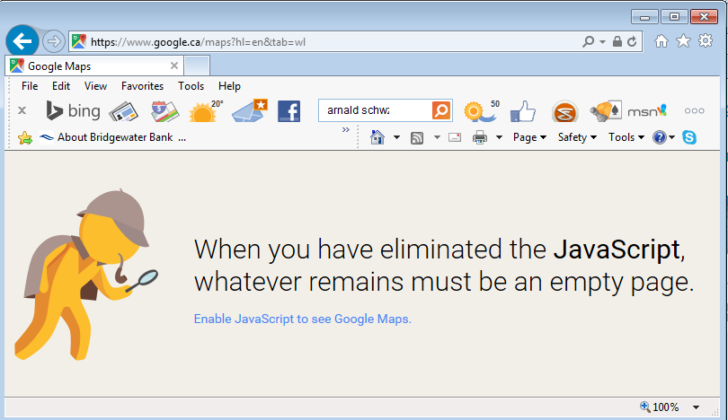
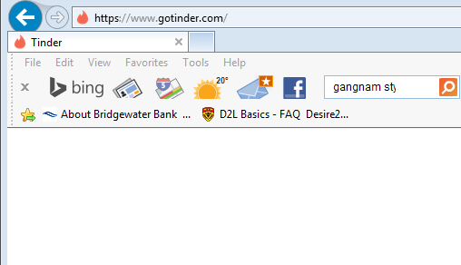
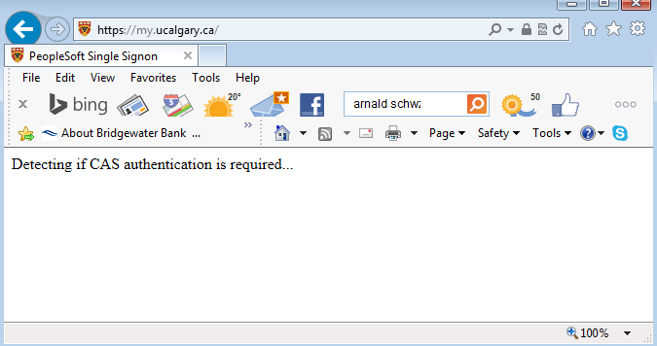
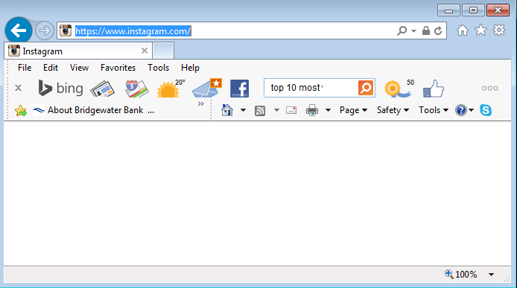
Many Popular Websites Rely On JavaScript
A-OK!

Slide 10
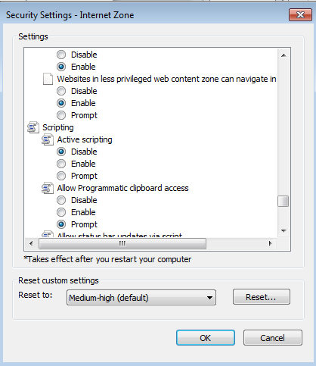
Enable/Disable Scripting (JavaScript)
IE: Tools->Internet Options->Security->Custom Level

Slide 11
Defining A JavaScript Function
All the instructions in your JavaScript program must be enclosed in a function.
Format:
  function <function name>()
  {
  }
Example:
  function saySmartResponse()
  {
  alert("Don't press that button");
  }
Instructions in body (indent 4 spaces);
index.html
<script>
Function start()
{
Instructions;
}
</script>
Webpage content

Slide 12
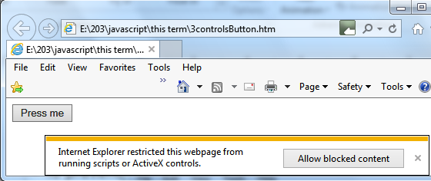
Online Security: Webpages That Include Programs (Example: JavaScript)
To prevent malicious software from running on your computer (JavaScript programs like any other software can be beneficial or malicious) most configurations may warn website visitors before these programs run.
Program #3 will run before the user enters a response but many of the examples that follow it will not.
Also note: although the example programs for this class are benign you should not make that assumption about other programs you encounter online.

Slide 13
Getting The GUI To React To User Input
Name of example: 3controlsButton.htm
  <script>
  function saySmartResponse()
  {
  alert("Don't press that button");
  }
  </script>
  <input type="button" value="Press me" onclick="saySmartResponse()"/>
onclick
When user clicks on the button

Slide 14
Common Mistake #1
Forgetting the semi-colon after each instruction.
  The semi-colon separates one instruction from another.
  function saySmartResponse()
  {
  alert("Instruction 1");
  alert("Instruction 2");
  }

Slide 15
Defining Multiple Functions
Normally a program consists of multiple functions:
    <script>
    function anotherFunction()
    {
    }
    function saySmartResponse()
    {
    alert("Don't press that button");
    anotherFunction();
    }
    </script>
For this class you need only define a single function (as shown in all/most of my examples)

Slide 16
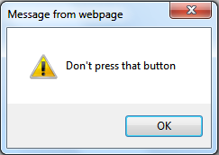
Displaying Output: Alert() Box
(Details of the previous example)
Creates a popup window that ‘outputs’ information to the webpage visitor
Useful for testing
  Is my program working?
  Which part is running?
Also useful for displaying status messages about the current state of the program
Format (basic version: displays a constant string, fixed message):
  alert(<"Message to display">);
Example:
  alert("Don't press that button");

Slide 17
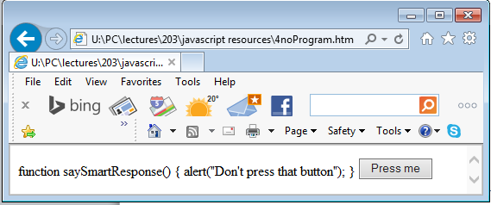
Common Mistake #2
Forgetting the opening and closing script tags
Name of example: 4noProgram.htm
  function saySmartResponse()
  {
  alert("Don't press that button");
  }
  <input type="button" value="Press me"
  onclick="saySmartResponse()"/>
Result

Slide 18
Variables
Used to temporarily store information at location in memory
Variables must be declared (created) before they can be used.
Format:
  var <variable name> = <value>;
Example:
  var num = -1;

Slide 19
A4: HTML Tags & JavaScript Programming
Important reminder: it is crucial that you test your submission by:
  Viewing the effect of the html tags in a web browser.
  Running the JavaScript program through the web browser to ensure that it properly fulfills assignment requirements.
Your submission must work on the 203 lab computers in order to be awarded credit.

Slide 20
Web Page Design And JavaScript Programming
It is not assumed that you have any prior experience writing computer programs (JavaScript or something else).
Consequently early examples and concepts will be quite rudimentary i.e., “we will teach programming gradually”
  This section of notes will only cover very rudimentary programming concepts.
  The next section covers more advanced but common and useful programming concepts.

Slide 21
Some Types Of Variables
Type of information stored | Example variable declaration
Whole numbers | var wholeNum = 2;
Real numbers | var realNum = 2.0;
Chararacters¹ | var aString = "xyz";
1) Any visible character you can type and more e.g., ‘Enter’ key

Slide 22
A Program With Variables
Name of example: 5variables.htm
  <script>
  function buttonPress()
  {
  var num = 2;
  var aString = "abc";
  alert("Num = " + num);
  alert("aString = " + aString);
  }
  </script>
  <input type="button" value="Press" onclick="buttonPress()"/><br>

Slide 23
Alert(): Displaying Multiple Pieces Of Information
Mixed output (strings and variables) must use the concatenation operator ‘+’ to connect the different types of information.
Format (Advanced: displays mixed output):
  alert(<"string"> + <contents of variable> +
  <"string"> + <contents of variable>...);
Examples:
  alert("num = " + num);
  alert("aString = " + aString);
"aNum=" : A literal string
num: : contents of a variable (slot in memory)

Slide 24
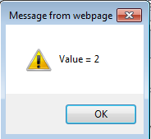
Common Mistake #3
A variable is just that – it can change as a program runs.
  <script>
  function buttonPress()
  {
  var num = 2;
  alert("Value = " + num);
  }
  </script>
Vs.
  <script>
  function buttonPress()
  {
  alert("Value = 2");
  }
  </script>

Slide 25
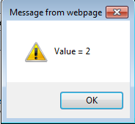
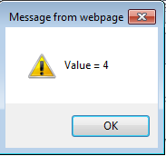
Common Mistake #3: Not Recognizing Variables Can Change
<script>
function buttonPress()
{
var num = 2;
alert("Value = " + num);
num = num * 2;
alert("Value = " + num);
}
</script>

Slide 26


Variables: Metaphor To Use
www.colourbox.com
Think of VBA variables like a “mailslot in memory”
Unlike an actual mailslot computer variables can only hold one piece of information
  Adding new information results in the old information being replaced by the new information
var num = -1;
num
-1 (default)
num
num = 1;
1
17
num = 17;

Slide 27
Programming Exercise #1: Variables
  Also each computer variable is separate location in memory.
  Each location can hold information independently of other locations.
    Note: This works differently than mathematical variables!
    What is the result?
var num1 = -1;
var num2 = -1;
num1 = 1;
num2 = num1;
num1 = 2

Slide 28
Variable Naming Conventions
Language requirements:
  Rules built into the JavaScript programming language.
  Somewhat analogous to the grammar of a ‘human’ language.
  If the language rules are violated then the typical outcome is the program cannot execute.
Style requirements:
  Approaches for producing a well written program.
  (The real life analogy is that something written in a human language may follow the grammar but may still be poorly written).
  If style requirements are not followed then the program can execute but there may be other problems (e.g., it is difficult to understand because it’s overly long and complex - more on this during the term).
    Your style mark may suffer for the assignments

Slide 29
Naming Variables: JavaScript Requirements
JavaScript language requirement (syntax ~ grammar)
  Name can be alphanumeric but the name cannot start with a number
  2num (Not OK) vs. num1 (OK)
  Spaces are not allowed
  First name (Not OK) vs. firstName (OK) OR first_name (OK)

Slide 30
Naming Variables: Style Requirements
Style requirement (~quality writing)
Variable names should be self-descriptive and lower case (except for multi-word variable names)
x, foo, AGE (Not OK)
vs. firstName, age, height (OK)

Slide 31
Variable Naming Conventions: Bottom Line
Both the language and style requirements must be followed when declaring your variables.
  Otherwise your program won’t work or your style mark component will suffer.

Slide 32
Operators
The common operators that you will see in JavaScript are the same as other languages and applications (such as MS-Excel)
Operation | JavaScript operator
Division | /
Modulo (remainder) | %
Multiplication | *
Subtraction | -
Addition₁ | +
1 Note:
Performs mathematical addition only if all the inputs are numeric
  e.g., 12 + 12 = 24
If one or more inputs are strings then a concatenation is performed
e.g., alert("Num = " + num);

Slide 33
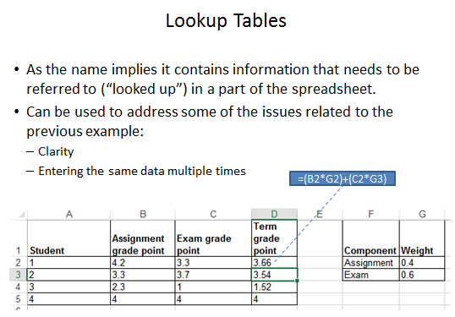
Review: Lookup Tables (For Constants)
Excel: Lookup tables are used to define values that do not typically change but are referred to in multiple parts of a spreadsheet.

Slide 34
Named Constants
They are similar to variables: a memory location that’s been given a name.
Unlike variables their contents cannot change.
The naming conventions for choosing variable names generally apply to constants but constants should be all UPPER CASE. (You can separate multiple words with an underscore).
Example const PI = 3.14
  PI = Named constant, 3.14 = Unnamed constant
They are capitalized so the reader of the program can quickly distinguish them from variables.

Slide 35
Declaring Named Constants
Note:
This program will not work in older web browsers that don’t support named constants (IE11 and earlier, older versions of Firefox and likely Chrome and Safari).
1 The expression can be any mathematical operation but can’t be the result of a function call
Format:
  Constants should be declared at the very start of the function (right after you start defining the function “function <function name>()”
  const <Name of constant> = <Expression>¹
  JT: the assignment is preceded by the keyword ‘const’ to indicate that it’s a constant
Name of example: 6constants.htm
  function buttonPress()
  {
  const AGE_MULTIPLIER = 7;
  var humanAge = 10;
  var catAge = humanAge * AGE_MULTIPLIER;
  alert("Age in person years: " + humanAge);
  alert("Age in cat years: " + catAge);
  }

Slide 36
Why Use Named Constants: Clarity
No ☹
Yes ☺
They can make your programs easier to read and understand
Example:
  income = 315 * 80
Vs.
  income = WORKING_DAYS_PER_YEAR * DAILY_PAY

Slide 37
Why Use Named Constants: Easier Maintenance
Changing the constant once will change the value throughout the program.
Abstracted example (not complete JavaScript code but enough to give you an idea of how using constants can be beneficial)
const GST = 0.07;
const GST = 0.05;
tax = price * gst;
Alert(tax); "
Alert(gst);
If (gst <= 0)
{
alert("tax cannot be negative!");
}
tax = price * gst;
Alert(tax); "
Alert(gst);
If (gst <= 0)
{
alert(“Tax cannot be negative!");
}

Slide 38
Program Documentation
It’s used to explain the workings of a program to the reader of the program (other people who write programs ‘programmers’).
It’s not meant for users of the program (or web page visitors)
  Typically it’s fairly technical in nature.
  It must be distinguished from JavaScript instructions (which are executed) because documentation should not execute.
<script>
Author: James Tam
Version: March 20, 2016
Learning concept:
* Creating and using variables
function buttonPress()
{
Etc.
When documentation not differentiated from instructions:
Error: I don’t know how to “Author: James Tam”

Slide 39
Single Line Documentation
Single line
  Everything after the quote until the end of the line will not be treated as a JavaScript instruction (not translated into machine language/binary).
// Everything to the end of the line is not counted as a
// JavaScript instruction (used to explain details of the
// program to other programmers.

Slide 40
Multi-Line Documentation
Multiple line
  Start of documentation uses /*
  End of documentation uses */
  Everything between is not counted as a JavaScript instruction
  /*
  Author: James Tam
  Tutorial: 888
  */

Slide 41
Program Documentation: Requirements For This Class
Your JavaScript assignment submission must include:
  Some evidence of a versioning system.
  As significant program features have been completed (tested and the errors removed/debugged) a new version should be saved in a separate file.
  List the program features (from the assignment description) and clearly indicate if the feature was completed or not completed.
index.html
index.Mar31.html
/* Version: March 31 completed
Program features:
1) Two nested loops running,
no output
*/
/* Version: March 31 completed
Program features:
1) Two nested loops running,
no output
*/

Slide 42
Program Documentation: Requirements For This Class (2)
DO NOT make edits to the working backup file(s).
  In the example the backup files are the ones with the date suffix.
Add new features to the copy.
That way if your current version becomes non-functional or is malfunctioning you still have a partially working backup.
index.April2.html
/* Version: April 2 completed
Program features:
1) Calculates & displays
products
Version : March 31 completed
1) Two nested loops running
*/
index.html
/* Version: April 2 completed
Program features:
1) Calculates & displays
products
Version : March 31 completed
1) Two nested loops running
*/
index.Mar31.html
/* Version: March 31 completed
Program features:
1) Two nested loops running
*/

Slide 43
Program Documentation: Requirements For This Class (3)
You only need to hand in the last version of your assignment (DOUBLE CHECK your submitted file to ensure that this truly is the case) to fulfill the ‘evidence of versioning’ requirement.
  We won’t have time to go through multiple versions (just check the last)
However even if you aren’t directly marked on the previous versions making them gives you a fall-back in case disaster strikes.
  You should back your current and previous versions in a place other than your computer.
index.html
/* Version: April 2 completed
Program features:
1) Calculates & displays
products
Version : March 31 completed
1) Two nested loops running
*/
Example of a student submission (JavaScript instructions excluded here for obvious reasons).

Slide 44
Minimum Documentation Needed For CPSC 203
// Version number (or date)
/*
A list of each program feature and an indication if the
feature was completed (yes or no).
Alternatively: just list in the documentation the
features that you actually completed (previous slides_.
*/
// (If applicable): explicit instructions on the name and
// location of any data files required. For a
// detailed example see the example from the next section
// (requires images to be in a specific folder).

Slide 45
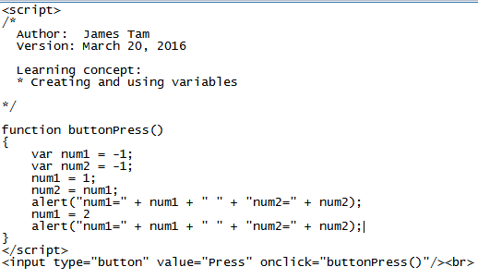
Required Header Documentation: Where
Within the ‘script’ tag but before your function.
Example documentation

Slide 46
Additional Documentation: Where
Can be used to explain in detail how parts of a complex program work (your discretion if needed for the assignment).
  <script>
  // Single line documentation
  /*
  Multi-line documentation
  */
  function <function name>()
  {
  // Extra:
  // If needed additional documentation
  // can be added here.
  }
  </script>
Location of required documentation
Extra additional documentation (only if you think it’s needed)

Slide 47
Documentation: Common Mistake #4
Take care not to nest multi-line comments
This is an error!
  /*
  /* Author: James Tam */
  Tutorial: 888
  */
Marks end of documentation
Invalid statement (not JavaScript)

Slide 48
Multiple Controls
If you need to identify one control from another then you can use the ‘id’ attribute when creating a control in the html tags
Format:
  id ="<Descriptive string>"
Example:
  <input type="text" id="text1"/>
When choosing a descriptive string to identify the control it’s a good idea to apply the same conventions used as when you are naming variables e.g., no spaces, good and self-descriptive names

Slide 49
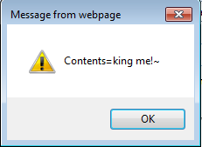

Example Of Using Multiple Controls: Identifying Controls
Name of example: 7multipleControls.htm
  <script>
  function buttonPress()
  {
  var text1 = document.getElementById("text1").value;
  alert("Contents=" + text1)
  }
  </script>
  <input type="button" value="Press me" onclick="buttonPress()"/><br>
  <input type="text" id="text1" value="default1"/><br>

Slide 50
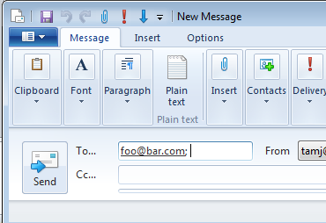
Sending Email: Basic Version (Same Constant Email Address)
Name of example: 8sendingEmail.htm
  <script>
  function buttonPress()
  {
  window.open("mailto:foo@bar.com");
  }
  </script>
  <input type="button" value="Send mail" onclick="buttonPress()"/>

Slide 51
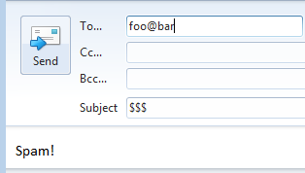
Sending Mail: Constant Email, Subject And Body
Name of example: 9sendingEmail.htm
  <script>
  function buttonPress()
  {
  window.open("mailto:foo@bar" + "?subject=$$$
  &body=Spam!");
  }
  </script>
  <input type="button" value="Send mail" onclick="buttonPress()"/>

Slide 52
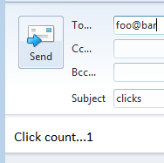
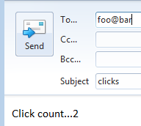
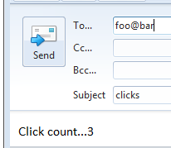
Sending Mail: Constant Email, Subject And Body Is Variable
Name of example: 10sendingEmail.htm
  <script>
  var count = 0;
  function buttonPress()
  {
  count = count + 1;
  window.open("mailto:foo@bar" +
  "?subject=clicks&body=Click count..."+count);
  }
  </script>
  <input type="button" value="Send mail" onclick="buttonPress()"/>
Creating ‘count’ outside of the function means that the previous count is retained

Slide 53
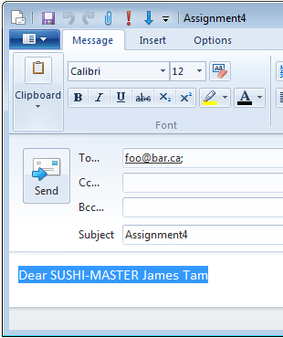
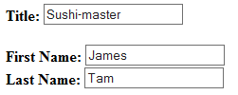
Sending Mail: Assignment
Constant fixed data: with some example email
Constant fixed data: subject is always the same
Variable data
Example: 6multipleControls.htm
One example of accessing the data value of a control

Slide 54
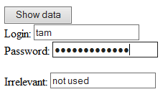
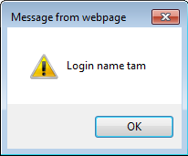
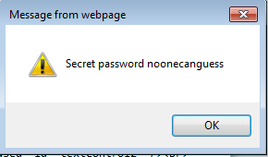
Accessing Data From Multiple GUI Controls
Name of example: 11getData.htm
  <script>
  function buttonPress()
  {
  var login = document.getElementById("textControl1").value;
  var password =
  document.getElementById("passWordControl1").value;
  alert("Login name "+ login);
  alert("Secret password "+ password);
  }
  </script>
  <input type="button" value="Show data" onclick="buttonPress()"/><br>
  Login: <input type="text" id="textControl1" /><br>
  Password: <input type="password" id="passwordControl1"/><br>
  <br>
  Irrelevant: <input type="text" value="not used" id="textControl2" /><br>

Slide 55
Acknowledgments
The functional requirements of the email program were based on the assignment description produced by James Tam
The different versions of the email program were based on a solution produced by Omar Addam

Slide 56
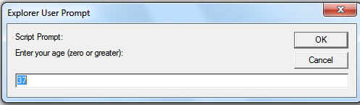
Getting User Input
Getting Input:
  Format:
  <variable> = prompt("<Prompting message>", "<default input>")
  Example (assume we create a variable called ‘age’):
  age = prompt("Enter your age (zero or greater):","37");

Slide 57
Getting JavaScript To Run Automatically
Name of example: 12getInputAutoRun.htm
  <script>
  function main()
  {
  var age = -1;
  age = prompt("Enter your age (zero or greater):","37");
  };
  window.onload=main;
  </script>

Slide 58
Additional Online Resources
http://www.w3schools.com/js/
https://msdn.microsoft.com/en-us/library/ie/ms535262(v=vs.85).aspx
http://trainingtools.com/online/javascript/index.htm

Slide 59
After This Section You Should Now Know
How to use html to create a graphical controls such as buttons
How to include JavaScript instructions via the <script> </script> tag
How to define a ‘sub-part’ of a program using a function definition
Getting a program to react to events (e.g., onclick) by defining a function
Displaying output via alert()
Defining variables with ‘var’
Variable naming conventions
Common operators: mathematical (+, -, *, /) and concatentation (+)

Slide 60
After This Section You Should Now Know (2)
How to declare and access named constants
What are the benefits of employing named constants
Single and multi-line documentation
What should be included in the documentation for the programs that you write for this class
In HTML: How to use the ‘id’ property to uniquely identify controls
JavaScript: How to use the document.getElementById(“<string>”) method to access a graphical control

Slide 61
After This Section You Should Now Know (3)
Different variations when sending email using JavaScript instructions
How to get a JavaScript program to automatically run when the web page is loaded into a web browser via window.onload()=<function name>
Getting input with a prompt()

