Slide 1
Databases
In this section you will learn about: how information is stored in databases, the different types of relations that can exist within a database, and how information can be retrieved via queries.
  Online MS-Office information source: https://support.office.com/

Slide 2
Purpose Of A Database
To store information
Francesco Rollandin/OpenClipart
Database: Customer information

Slide 3
Purpose Of A Database
To retrieve information information
Sale $$$
Sale $$$
Database: Customer information

Slide 4
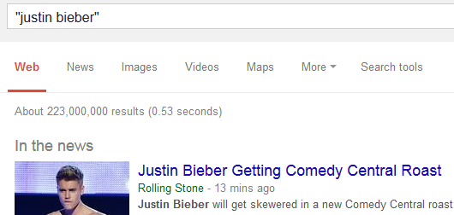
Databases: Storing / Retrieving Information
As you will see, implementing these two tasks aren’t as easy as it seems.
Information must be stored such that:
  Information can be quickly retrieved

Slide 5

Databases: Storing / Retrieving Information (2)
  The database is designed to reduce problems during maintenance (additions, modifications, deletions)
    Example: You may see this issue arise if talk about database normalization.
One employee has left and the whole department is gone?
Information Technology
Archie Bunker
Marketing Dept.
Loren Coleman
William McCloud
Finance & Accounting
Victor Davion
Ester Flowers

Slide 6
Databases: Storing / Retrieving Information (3)
  Minimizes redundancy:
Students data base table
ID | First Name | Last Name | Phone | Class 1 | Class 2
123456 | Jamie | Smyth | 553-3992 | CPSC 203, 01 | PSYC 205, 03
123457 | Stacey | Walls | 790-3992 | ACCT 321, 02 | FNCE 353, 05
123458 | Angel | Lam | 551-4993 | MATH 211, 02 | MATH 251, 01
Classes data base table
ClassName | ClassNumber | Lecture No | ClassDescription
CPSC | 203 | 01 | Introduction to Computers
CPSC | 231 | 01 | Introduction to Computer Science I
CPSC | 233 | 01 | Introduction to Computer Science II

Slide 7
With Bother With Databases?
Are used to store and retrieve information
Why bother, use a simple file as an alternative?
  E.g., tracking client information
MILES EDWARD O’BRIAN
DS9 Corp
Electrical engineering
2007 purchases: $10,0000,000
2006 purchases: $1,750,000
JAMIE SMYTHE
Cooperative services
Gasoline refining
2006 purchases: $5,000,0000
2005 purchases: $5,000,0000
2004 purchases: $5,000,0000
2003 purchases: $5,000,0000
2002 purchases: $5,000,0000
SCOTT BRUCE
Bryce Consulting
Investment analysis
2007 purchases: $500,000
2006 purchases: $1,500,000
2005 purchases: $2,500,000
2004 purchases: $500,000
Etc.
If the list is short then a simple text file may suffice
As the list grows organizing and updating the information becomes more challenging (duplicates or inaccuracies?)
Also searching the list according to specific criteria may become difficult
  e.g., Show all clients whose purchases in 2007 were between one and five million dollars
  e.g., Show all clients that made a purchase exceeding 10 million dollars.

Slide 8
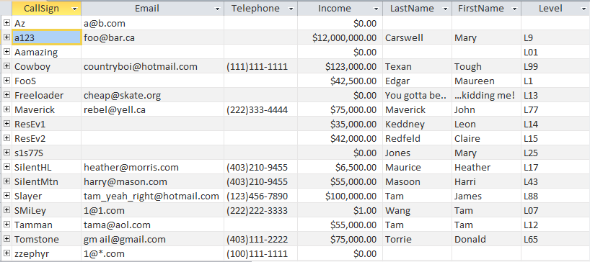
Storing Information In A Database
Information is stored in tables:
The ‘Gamers’ table

Slide 9
Storing Information In A Database (2)
Row = Record: An example instance of data within the table.
  Gamers Table: one row is an example instance of a gamer
Table
records
One record, ‘Harri Masoon’

Slide 10
Storing Information In A Database (3)
Column: are that attributes that we track for each record
  Gamers Table: each column specifies the information we store about the games in this database.
Attributes (‘fields’ in Access) of each record

Slide 11
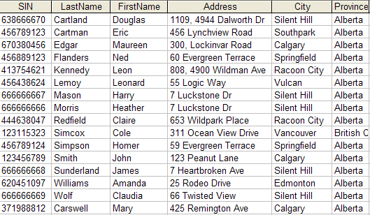
Primary Key
Each table should typically have one attribute designated as the primary key:
  The primary key must be guaranteed to be unique
  It must uniquely identify one record from another
Primary Key for table ‘Employees’ is the ‘SIN’ attribute

Slide 12
Choosing A Primary Key
A primary key must be unique to each record because it is the one thing that distinguishes them.
If there’s at least one instance where the attributes of two records can take on the same value then that attribute cannot be a primary key. (When in doubt verify with your users).
If a primary key cannot be formed from a single attribute then several attributes can be combined into a composite key. (Each attribute is still a column but together they form a unique primary key for each record).
  E.g., CourseRegistrations table: Course name, course number, lecture section (CPSC 203 L01)
If a unique primary key still cannot be found then ‘invent’ one.
  E.g., StudentID#, SocialInsuraneNumber

Slide 13
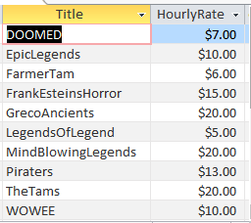
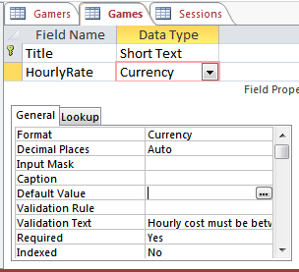
MS-Access: Views Of Your Database
Design view
  Typically start with this view
  Used to specify what attributes that a table will consist of:
    e.g., GAMES: Title, HourlyRate
  Used to specify the type and the format and valid range of values
    e.g., SIN is attribute with 9 characters that must be in the format 000 000 000
    e.g., HourlyRate must be between $1 - $100
Datasheet view
Once the attributes have been specified in the Design view using the Datasheet view allows data entry for each record.

Slide 14
Example Problem: Online Games
This example can be found online:
  http://pages.cpsc.ucalgary.ca/~tamj/2016/203W/database/LectureExample.accdb
An online gaming server will allow several online different games to be played
Gamers can logon to play a particular game
A gamer playing a game will create a ‘session’ that tracks (among other things) the cost of the gaming session

Slide 15
Online Gamers: Information To Be Tracked
Online identifier: “Call sign”
Contact information: Email
Contact information: Telephone number
  Income: A (yearly) numeric figure
  Real life identifier: First and last name
  Overall ‘score’ (sum of player’s accomplishments among multiple games): Level

Slide 16
Online Games: Information To Be Tracked
Name of the game: Title
  The cost of playing a game: Hourly rate

Slide 17
Gaming Sessions: Information To Be Tracked
Each time that a player starts playing a game billing information must be generated (allows the bill to be attached to the correct player)
  Who played the game (who gets the bill)
  Which game was played (how much is the cost per time unit)
  How long was the game played (in conjunction with the cost per time unit it determines the size of the bill)

Slide 18
Picking Tables
A table stores related information
  E.g.,
  Client: Client name, purchases, phone, address, email
  Product: Product name, price, description
The three groups of information in this problem appear to map to three database tables
  Gamers
  Games
  Sessions

Slide 19
Guidelines For Naming Tables
Create a unique and descriptive name.
  “VehicleMaintenanceRecords” vs. “CarDetails”
Do not use words that convey database or technical terminology (use real world terms)
  “File”, “Record”, “Table”
While names should be short avoid using acronyms and abbreviations unless they are well-known.
  “SC” = ???
Consider using the plural form of a name.
  “Games table” vs. “Game table”
Avoid the use of spaces in names.
  “Undergraduate students” vs. “Undergraduate_Students” vs. “UndergraduateStudents”

Slide 20
Guidelines For Naming Attributes
Select a unique and descriptive name (similar to tables).
Create a name that accurately, clearly and unambiguously identifies the characteristic that the attribute represents.
  “Name” vs. “FirstName”
While names should be short avoid using acronyms and abbreviations unless they are well-known (similar to tables).
Use the singular form of a name
  Tables store multiple records (e.g., GAMES table), attributes store a single piece of information (e.g., Title for a particular game)
Avoid the use of spaces in names (similar to tables).

Slide 21
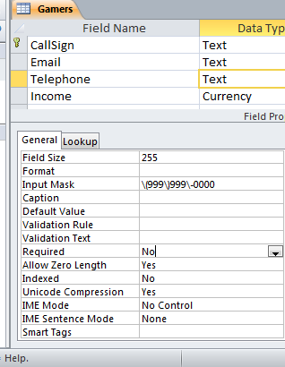
Null Values
Refers to the attributes of a record that are empty
Primary keys cannot be null but other attributes may be null
Entry of any attribute can be made mandatory

Slide 22
Gamers Table: Attributes
Gamer information to track:
  Online identifier: “Call sign”
  Contact information: Email
  Contact information: Telephone number
  Income: A (yearly) numeric figure
  Real life identifier: First and last name
  Overall score: Level
GAMERS
CallSign | Email | Telephone | Income | LastName | FirstName | Level

Slide 23
Games Table: Attributes
Game information to track:
  Name of the game: Title
  The cost of playing a game: Hourly rate
GAMES
Title | HourlyRate

Slide 24
Sessions Table: Attributes
Each time a player starts playing a game billing information must be generated.
  Who played the game
  Which game was played
  How long was the game played
This one is trickier!
  Identifying ‘who’: need to be 100% certain that the correct gamer has been identified (don’t bill the wrong person)
  Identifying ‘which’: again certainty is required because different games have different hourly rates (don’t bill for the wrong game and/or generate a bill for an incorrect amount)
  We need to “hold off” on creating a table until the above two requirements can be met

Slide 25
Refinements Needed: Gamers
Primary key?
GAMERS
CallSign | Email | Telephone | Income | LastName | FirstName | Level

Slide 26
Modified Table: Gamers
Primary key: CallSign
GAMERS
CallSign | Email | Telephone | Income | LastName | FirstName | Level

Slide 27
Refinements Needed: Games
Primary key?
GAMES
Title | HourlyRate

Slide 28
Modified Table: Games
Primary key: Title
GAMES
Title | HourlyRate

Slide 29
The Sessions Table Revisited
Recall: Each time that a player logs in to play a game billing information must be generated.
Some info need to generate a bill
  Who played the game
  Which game was played
The ‘who’ needed to identify the gamer and the ‘which’ needed to specify the game
Now that primary keys have been chosen for those two tables we can specify those two attributes
SESSIONS
CallSign | Title

Slide 30
Foreign Key
An attribute in one table that refers to an attribute in another table:
  E.g. CallSign in the Sessions table actually refers to a players call sign in the Gamers table
GAMERS
CallSign | Email | Telephone | Income | LastName | FirstName
Cowboy
SESSIONS
CallSign | Title
Cowboy | TheTams
GAMES
Title | HourlyRate
TheTams | $20

Slide 31
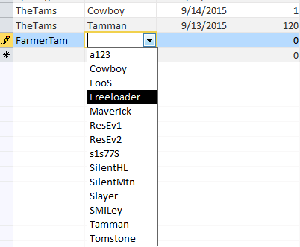
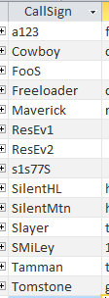
Purpose Of Foreign Keys
Using foreign keys can prevent errors
Example when we create a login playing session, we can ensure that we only bill a player that already exists in the Gamers table.
(The same principle applies to the ‘Title’ foreign key)
Creating a new session
Gamers Table

Slide 32
Refinements Needed: Sessions
It’s determined that each player can only login once per day.
Players can login and play over multiple dates
For each session we could store the login date and the duration (minutes):
SESSIONS
CallSign | Title | SessionDate | SessionDuration
Cowboy | TheTams | 9/13/2015 | 120

Slide 33
Refinements Needed: Sessions
Each row in the table is created when a gamer logins on a particular date
Primary key?
SESSIONS
CallSign | Title | SessionDate | SessionDuration
Cowboy | TheTams | 9/13/2015 | 120

Slide 34
Composite Key
Reminder: It’s a primary key that consists of multiple attributes (multiple columns in a database table)
Attribute1 | Attribute2 | Attribute3 | Attribute4

Slide 35
Modified Table: Sessions
Primary key (composite): CallSign, Title, Date
The creation of the primary key ‘makes sense’ intuitively for this example based on the previous restrictions.
SESSIONS
CallSign | Title | SessionDate | SessionDuration
Cowboy | TheTams | 9/13/2015 | 120

Slide 36
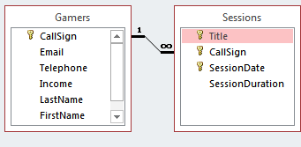
Relationships Between Tables
Relationships occur when an attribute of one table is a foreign key in another table.
Multiplicity: indicates how many instances of a particular item participates in the relationship:
  One to one
  One to many
  Many to many

Slide 37
Multiplicity
One to one relationships
  One entity participates in the relationship from the ‘left’ and one entity participates in the relationship from the ‘right’.
  Person : Head
  Gamers : CallSign
  This type of relationship is rare in databases
One to many relationships
  On one side of the relationship one entity participates in the relationship while on the other side: zero or more entities may participate in the relationship.
  Person : Hair
  Gamers : Sessions : Games

Slide 38
Multiplicity (2)
Many to many relationships
  On each side of the relationship zero or more entities may participate in the relationship.
  E.g., Travelers : Destinations
Travelers table
Destinations table
TravelerID | LastName | FirstName
1 | Tam | James
2 | Jones | Mary
3 | Smith | Jon
DestinationID | DestinationName
1 | Dubai
2 | Paris
3 | Cairo
4 | Vulcan

Slide 39
Multiplicity (3)
Many to many relationships
  Typically implemented as two one to many relationships in databases:
Travelers table
Destinations table
TravelerID | LastName | FirstName
1 | Tam | James
2 | Jones | Mary
3 | Smith | Jon
DestinationID | DestinationName
1 | Dubai
2 | Paris
3 | Cairo
4 | Vulcan
Trips table
TravelerID | DestinationID | Date
1 | 1 | Sept 1 2015
2 | 3 | Sept 1 2015
2 | 4 | Sept 8 2015

Slide 40
Many To Many: Ignoring The Rule
Travelers table
TravelerID | LastName | FirstName
1 | Tam | James
2 | Jones | Mary
3 | Smith | Jon
Dest¹ | Dest² | Dest³ | … | Dest^{n}
Dubai
Dubai | Cairo | Vulcan |  | Zimbobway
NY | Vulcan

Slide 41
Many To Many: Ignoring The Rule (2)
Destinations table
DestinationID | DestinationName
1 | Dubai
2 | Paris
3 | Cairo
4 | Vulcan
Trav¹ | Trav² | Trav³ | … | Trav^{n}
Alice | Bob | Bill |  | Zeek
Alice | Bill | Charlie
Alice | Bill
Jim | Karen
  (Gamers : Games) could be implemented as a many to many relationship (by-passing the Sessions table) but problems similar to the previous example would be encountered.

Slide 42
Primary-Foreign Keys Again
When there is a one to many relationship the primary key of the ‘one’ side becomes a foreign key on the ‘many’ side.
Examples:
  Gamers : Sessions
  Games : Sessions
1
Many
CallSign:
Primary key
CallSign:
Foreign key
1
Many
Title:
Primary key
Title:
Foreign key

Slide 43
Diagrammatically Representing Database Tables
Entity-Relation diagrams (E-R Diagrams or E.R.D.’s): show the attributes of a table
Format
TABLE NAME
Primary key
Attribute
Attribute
Example
GAMES
Title
HourlyRate

Slide 44
Diagrammatically Representing Relationships
ERDs Graphically represent relationships between tables as well as any enforced rules on multiplicity:
Person
1
1
Head
Person
1
*
Hairs
*
*
Travelers
Destinations
Gamers
*
Sessions
*
Games
1
1

Slide 45
The ERD For The Example Database
GAMERS
CallSign
Email
Telephone
Income
LastName
FirstName
Level
GAMES
1
1
Title
HourlyRate
SESSIONS
Title
CallSign
SessionDate
SessionDuration
*
*

Slide 46
Types Of Tables
Data tables
  Dynamic, will likely be manipulated over the life the database (add, delete, modify)
  All three tables used in the example: Gamers, Games, Session are data tables
Validation tables
  Used to ensure data integrity (to ‘lookup’ values)
  Typically it maps one value to another (e.g., product code to a product, an ISBN number to a book)
  Rarely (if ever) changes
  E.g., Faculties table (some of the codes actually used at the University of Calgary)
Code | FacultyName
AR | Arts
HA | Haskayne
SC | Science
RO | ???

Slide 47
Example Use Of Data Table
AR?
ED?
GS?
HA?
KN?
MD?
RO?
SC?
Faculties table:
Other tables in our database would ‘lookup’ the code from the rows of this database
  Lectures table:
Code | FacultyName | Department1 | Department2 | … | Department 10
SC | Science | Biology | Chemistry | … | Mathematics & statistics
AR | Art | Economics | Psychology | … | Women’s studies
ID | LastName | FirstName | Faculty | Program | …
11 111 111 | Tam | James | SC | CPSC
11 111 112 | Jones | Smith | AR | ENGL

Slide 48

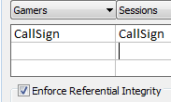
Types Of Data Integrity In Databases
Table-level integrity (entity integrity):
  Ensuring that no duplicate records exist.
  Implementation: no primary keys are null: MS-Access (automatic) indexed – no duplicates.
Relationship-level integrity (referential integrity):
  Ensuring that relationship between a pair of tables is sound and the records in the tables are synchronized when data is entered into, updated in or deleted from either table (MS-Access: only partially implemented).
  Implementation: use lookup values between tables
Field/attribute -level integrity (domain integrity):
  Ensuring that the attributes are valid and accurate.
  MS-Access implementation: input masks and validation rules.

Slide 49
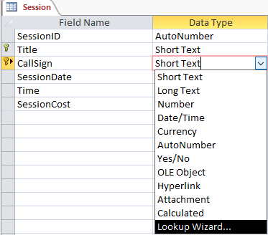
Relationship Level Integrity
Create the foreign-primary key relationship

Slide 50
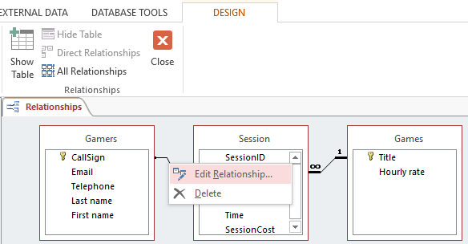
Relationship Level Integrity (2)
Edit the relationship
Strengthen the relationship: “Enforce referential integrity”

Slide 51
Input Masks
Ensures the proper format for the data entered into the database
Example: SIN number must be entered as:
  <three digits> <space> <three digits> <space> <three digits>
  Invalid inputs:
    Abc def ghi
    321 22 4234
Online example: Telephone number format
  (<area code>)<3 digits>-<4 digits>
  Example:
    (403)210-9455

Slide 52
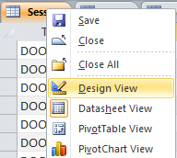
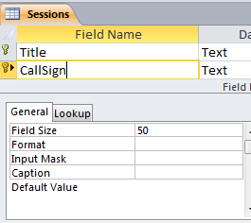
Defining Input Masks
Switch to ‘design view’
Specify the required format under the ‘Input mask’ property of the appropriate table attribute

Slide 53


Use Of Input Masks
Constrains input allowed
  Can only enter a single digit
  Can only enter a single character
  Can only enter 5 digits (zip code)
  Etc.
“Ignores” invalid inputs in real-time
Specifies the format of data to be entered (data entry cues)

Slide 54
Some Characters That Define Input Masks
Source (last accessed Sept 2015):
  https://support.office.com/
Desired input | Character to enter as the input mask
A digit (0…9) can be entered | 9
A digit (0…9) must be entered | 0
Digits, space (default – data entry skipped), plus or minus sign | #
Alphabetic letter must be entered | L
Alphabetic letter can be entered | ?
Alphabetic letter or digit must be entered | A
Alphabetic letter or digit can be entered | a
Converts characters that follow to upper case | >
Converts characters that follow to lower case | <

Slide 55
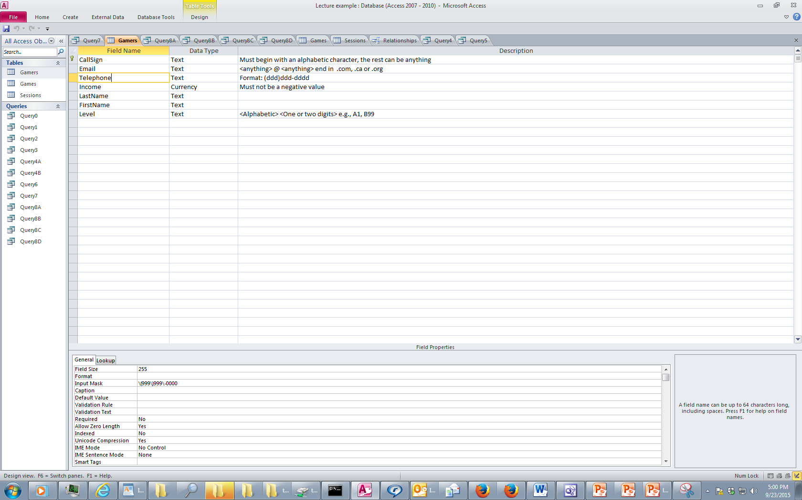
Data Entry Characters Not Part Of The Table Attributes
Entering a slash ‘\’ into the input mask (design view) will display a character in the datasheet view
  This can be a helpful data entry cue e.g. phone (area code)digits-digits

Slide 56
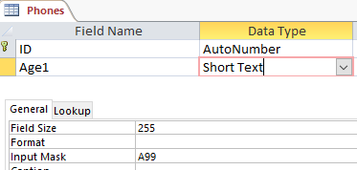

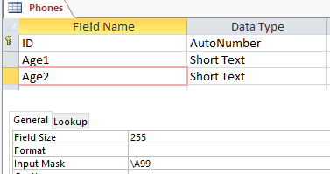
Data Entry Characters Not Part Of The Table Attributes (2)
Note: the characters followed by a slash are NOT saved into the field of the database table
Example
Note: the data for the ‘A’ is saved for ‘Age1’ but not for ‘Age2’
This can make a significant difference when later searching the database ‘queries’
‘A12’ can be a search criteria for ‘Age1’
‘A23’ cannot be search criteria for ‘Age2’
Vs.

Slide 57
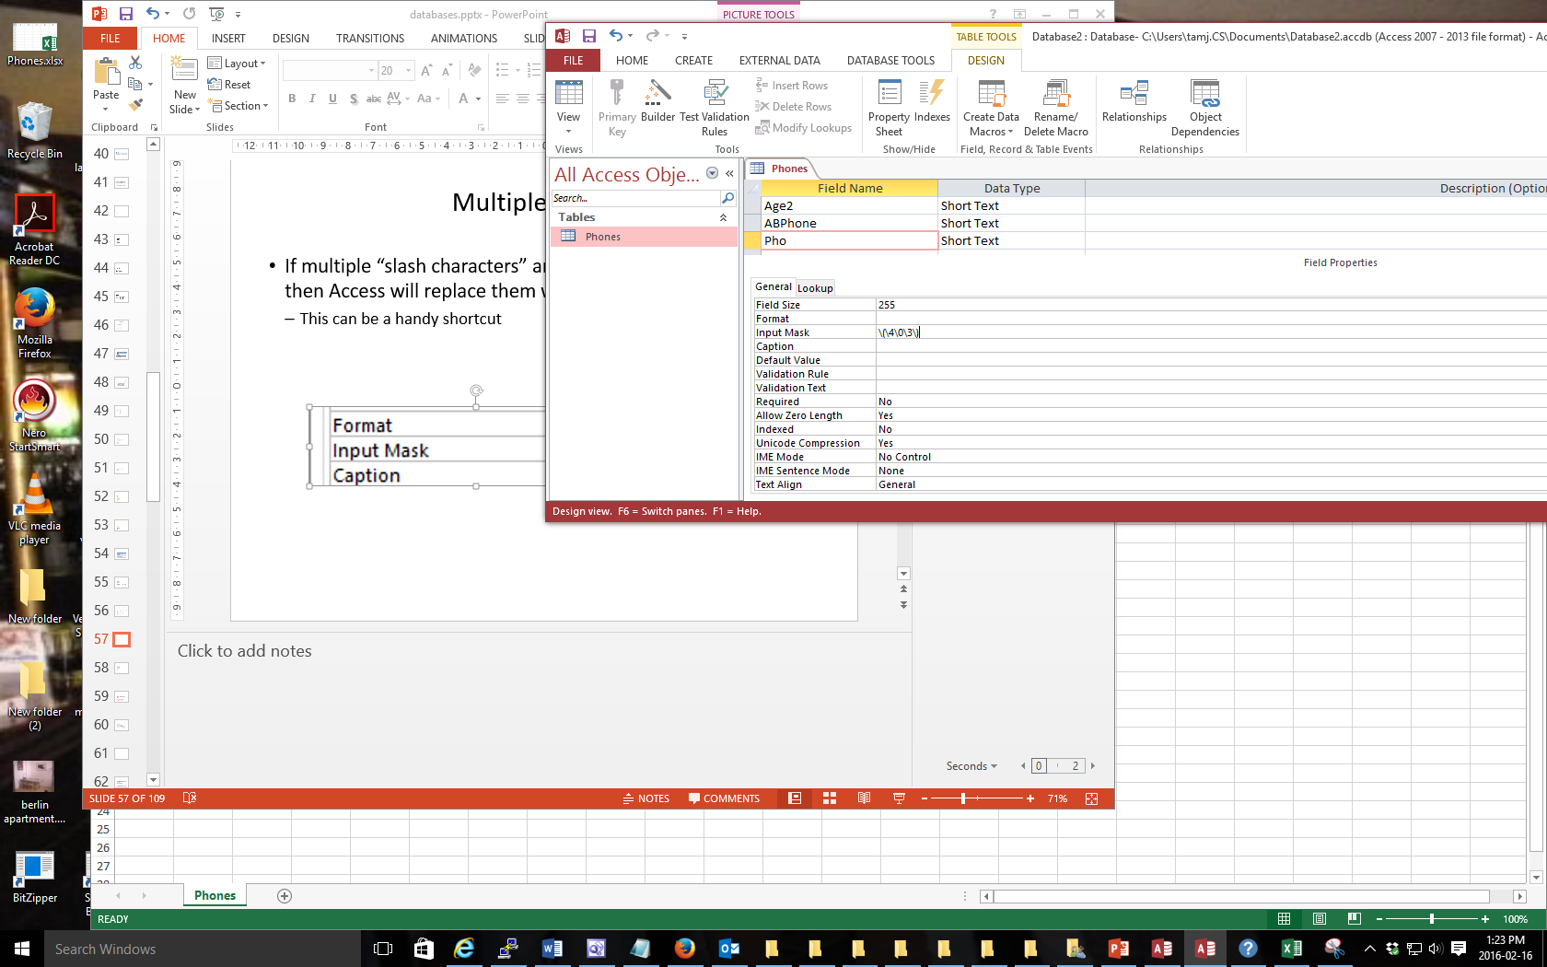

Multiple Slashes
If multiple “slash characters” are used in immediate succession then Access will replace them with double quotes
  This can be a handy shortcut

Slide 58


Input Masks: Include The Slashes Or Not
AGAIN: the character after the slash (or within the double quotes) will be displayed when the record is data entered in the datasheet view.
Benefits
  A handy reminder of the format and type of data being entered
  Reduces the need for repetitive data entry i.e. if the data must always be included for each record why require that it’s entered each time
Drawback:
  AGAIN: the character after the slash (within the quotes) are not part of the attribute and cannot be entered or searched under
  E.g. all phone numbers in the above example must display with a 403 area code.

Slide 59


Input Masks: Online Database Example
Gamers table: Telephone number
Gamers table: Level

Slide 60

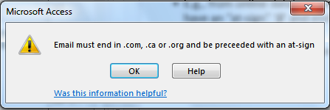
Validation Rules
Validation rules check the data is in the valid range.
  E.g., from online database example: Gamers table, income must be a non-negative value
Can also be used to specify a data format (format of a “character string”
    E.g., from online database example: Gamers table, a valid email must have an “at-sign” ‘@’ and end in one of the following suffixes ‘.ca’, ‘.com’, “.org”
    Unlike input masks validation rules allows useful error messages to be displayed

Slide 61
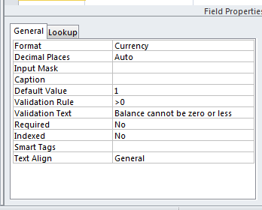
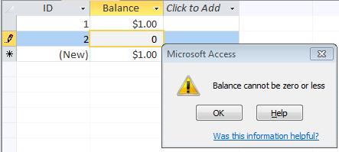
Validation Rules: Specifying Error Messages
“Validation text” & “default values”

Slide 62
Example Database: Application Of The Validation Rules
Gamers table
  CallSign: first character must be alphabetic
  Email: must include an ‘at-sign’/@ and then end in ‘.ca’, ‘.com’ or ‘.org’
  Income: no negative values
Games table
  HourlyRate: a dollar value from $1 to $100.
Sessions table
  SessionDate: date must be from Sept 12 2015 onwards
  SessionDuration: specifies the number of seconds from 0 – 86,400

Slide 63

Validation Rules: Online Database Example (Single Range)
Gamers table: Income (non-negative only)

Slide 64
Validation Rules & Logic
Logic can combine the conditions specified in validation rules
AND (common)
  All conditions must be met before the data is deemed as valid
  Format:
  (Condition1) And (Condition 2)
  Example:
  >=0 And <=118
OR (rare for ranges more common for character strings)
  At least one condition must be met before the data is deemed as valid
  Format:
  (Condition1) Or (Condition 2)
NOT (rare)
  Format:
  Not (Condition)

Slide 65
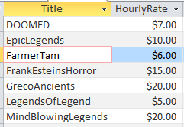
Validation Rules: Online Database Example (Two Ranges)
Gamers table: HourlyRate (a dollar value $1 - $100)
Student exercise: Sessions table, HourlyRate: Specifies the number of seconds from 0 – 86,400

Slide 66
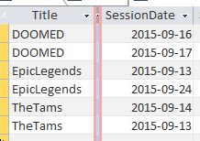
Validation Rules: Online Database Example (Date Ranges)
Sessions: SessionDate: date must be from Sept 12 2015 onwards:
  The date must be enclosed in a “number sign” pair #<date>#

Slide 67
Validation Rules: Specifying Character Strings
Character strings is a sequence of characters (alpha, numeric and other characters) e.g. NX-01
Desired input | Value to enter into validation string | Example use
Alphabetic only (case insensitive) | [A-Z] | Like “[A-Z]” (single alpha) Like “[A-Z][A-Z]” (two alpha)
Digit only | [0-9] # | Like "[0-9]" (single digit) Like "[0-9][0-9]" (two digits) Like “###” (three digits)
Wildcards | * | Like “*” (anything) Like “?” (any single character)

Slide 68
The Wildcard
A value that can be used in place of other values.
Example: “The joker is wild” option in card games
Example: “*.docx” documents only can be used to specify that only documents ending in the suffix “.docx” with any name will be considered.
The start character ‘*’ is a wildcard because it can be substituted by zero or more characters
  Example documents that will considered
    resume.docx
    A.docx
  Example documents that won’t be considered
    resume.doc
    Me.jpg
The wildcard can be used in conjunction with validation rules

Slide 69

Validation Rules: Online Database Example (Simple Character String)
Gamers table: CallSign (first character must be alphabetic)
  O.K.
  Not O.K.

Slide 70

Validation Rules: Online Database Example (Complex Character String)
Gamers table: Email (at-sign followed by ‘.com’, ‘.ca’, ‘.org’
  O.K.
  Not O.K.

Slide 71
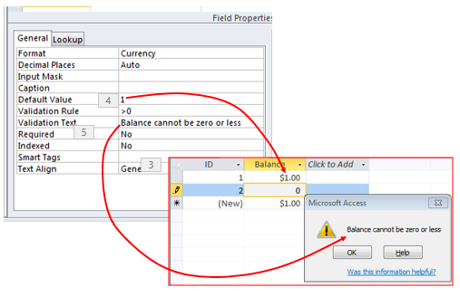
Input Masks Vs. Validation Rules: Error Handling
Input masks
  Can specify desired input beforehand, real-time error prevention
Validation Rules
  Default values can be specified
  Customized error messages can be created
  Messages appear after erroneous data has been entered

Slide 72
Input Masks Vs. Validation Rules: Error Handling
Range checking e.g. age >= 0
  Validation rules
Both can be used to check the general format of the data
  E.g. <digit><digit><alpha>
Entering an arbitrary number of characters
  Use of the multi-character wildcard in a validation rule

Slide 73
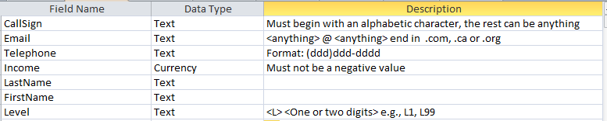
Documenting A Database
Documentation: Provides information about the database to the other people who will be working on database.
In MS-Access documentation can be entered in the “Description” column (under the Design view)
It can provide information about the type and format of the information to be stored.
  Can be used if errors are found. (Providing the original ‘intention’ if there is an error in the validation rules or the input mask can help others correct the error).

Slide 74
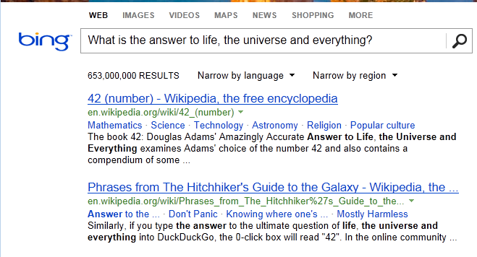
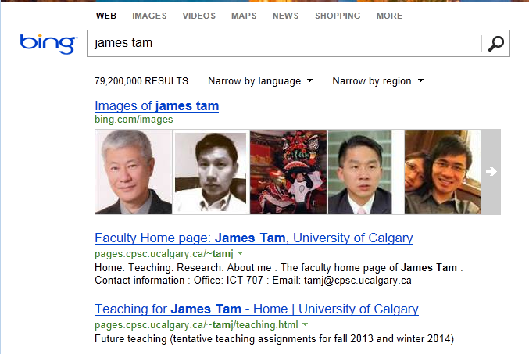
Database Queries
Queries are questions ‘asked’ of/to the database in order to retrieve information.
“What is the answer to life, the universe and everything”
– The Hitchhiker's Guide to the Galaxy (Del Rey 1979)
– The Hitchhiker’s Guide to the Galaxy (BBC 1981)

Slide 75
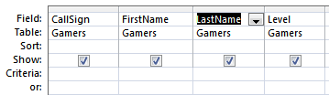
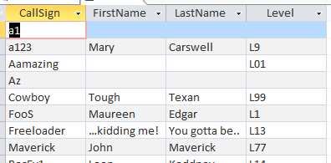
Retrieving Data Via Queries
Data retrieval occurs through the use of ‘queries’:
  A query is a question asked of the data in the database.
  May be worded to show only the parts of the database for which the answer to the question is true OR it be worded to just show the values of the attributes specified in the query
  Example: What is the CallSign, FirstName, LastName and Level rate of every gamer in the Gamers Table:
Query (graphical form is an Access specific query)
Result of the query

Slide 76
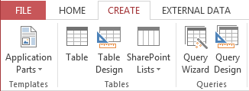
Forming Queries Graphically In Access
Create->Query Design

Slide 77
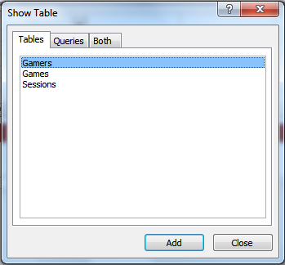
Forming Queries Graphically In Access (2)
Select the desire table or tables

Slide 78
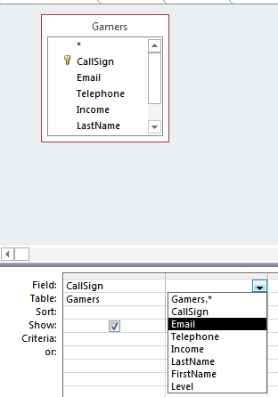
Forming Queries Graphically In Access (3)
Select the attributes of the table

Slide 79
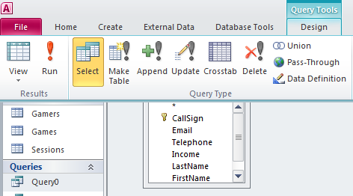
Forming Queries Graphically In Access (4)
Run the query to view the results

Slide 80
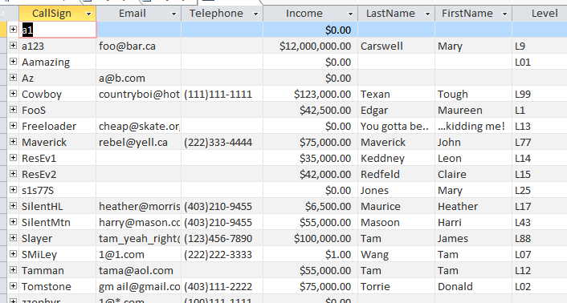

Query #1: Specifying Query Criteria
  What is the CallSign & Email & and FirstName of all gamers with last name of Tam?
{
}
{
}

Slide 81
SQL (Structured Query Language)
It’s the universal language for querying a database (very widely used!)
Unlike graphical queries the statements are portable between different database programs.
Queries are formed using text descriptions (can be more powerful but more complex than graphical queries):
  SELECT: Specifies the relevant attributes of which tables are involved in the query e.g., CallSign attribute of the Gamers table
  FROM: Lists the tables from which the data is to be selected
  WHERE: Provides the conditions to determine if a particular row shows or doesn’t show as a result
  ORDER BY: Specifies the order in which rows are to be returned;
Note: Capitalizing of the above four words is a standard SQL convention.

Slide 82
Example SQL Query
  Example: What is the CallSign, FirstName, LastName and Level of every gamer in the Gamers Table:
  Graphical Access query:
  SQL:
    SELECT Gamers.CallSign, Gamers.FirstName,
    Gamers.LastName, Gamers.Level
    FROM Gamers;

Slide 83
CPSC 203: Forming Queries
You need to know how to form and evaluate queries graphically or using SQL

Slide 84
Queries Can Span Multiple Tables
This is referred to as a ‘join’ because the results join data from multiple tables

Slide 85
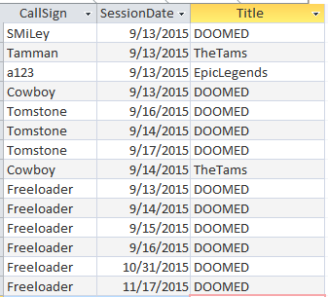
Query #2: Multi-Table Queries
What is the: CallSign (Gamers), Title (Games) and Date (Sessions) of every game played by a gamer our database.
  A gamer must have played at least one game (created a game session)
  A game must have been played by at least one gamer

Slide 86
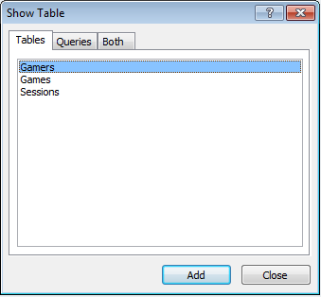

Query #2: Access
Add the desired tables to the query
Select the attributes of these tables relevant to the query

Slide 87
Query #2: SQL
Slightly modified form generated from Access
SELECT Gamers.CallSign, Sessions.SessionDate, Games.Title
FROM Games INNER JOIN (Gamers INNER JOIN Sessions ON
Gamers.CallSign = Sessions.CallSign)
ON (Games.Title = Sessions.Title);

Slide 88
Query #2: SQL
(Query reformatted with animations)
SELECT Gamers.CallSign, Sessions.SessionDate, Games.Title
FROM Games INNER JOIN (Gamers INNER JOIN Sessions ON Gamers.CallSign = Sessions.CallSign) ON (Games.Title = Sessions.Title);

Slide 89
Calculated Values
In Access they are attributes /columns of the query that are derived from one or more attributes/columns of the tables used in the query
GAMES Table
Title | RatePerMinute
TheTams | $0.33
(In the query this value is derived from the hourly rate)
RatePerMinute:
[HourlyRate] / 60

Slide 90

Specifying Calculated Values (Access Specific)
Graphically (DesignView)
  Format:
  <Query column name>:
  <Attribute name or constant> <expression>
  <Attribute name or constant> <expression>...
  <Attribute name or constant>
  Example:
  RatePerMinute: [HourlyRate] / 60

Slide 91
Specifying Calculated Values (SQL)
  Format:
  SELECT <Table name.Attribute name¹>,
  <Table name.Attribute name²>, ...
  <Attribute name or constant> <expression>
  <Attribute name or constant> <expression> ...
  <Attribute name or constant> AS <Query column name>
  <Table name.Attribute name^{n}>
  Example:
SELECT Games.Title, Sessions.SessionDate, Games.HourlyRate, [HourlyRate]/60 AS RatePerMinute

Slide 92

Query #3: Calculated Values
Show the Title, SessionDate, HourlyRate, RatePerMinute, SessionDuration and the SessionCost of games that were played.
Note: A conversion is needed
  Cost for playing a game is cost/hour
  Session duration is listed in minutes so the cost is converted from cost/hour to cost/minute (divide hourly rates in ‘Games’ by 60).

Slide 93

Query # 3: Graphical Access Query
“Calculated Values” were used: The results of some columns were not stored in tables but derived from the values in other columns
RatePerMinute:
[HourlyRate] / 60
SessionCost:
[RatePerMinute] * [SessionDuration]

Slide 94
Query #3: SQL Form
SELECT Games.Title, Sessions.SessionDate, Games.HourlyRate, [HourlyRate]/60 AS RatePerMinute, Sessions.SessionDuration, [RatePerMinute]*[SessionDuration] AS SessionCost
FROM Games INNER JOIN Sessions ON Games.Title = Sessions.Title;

Slide 95
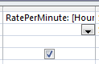
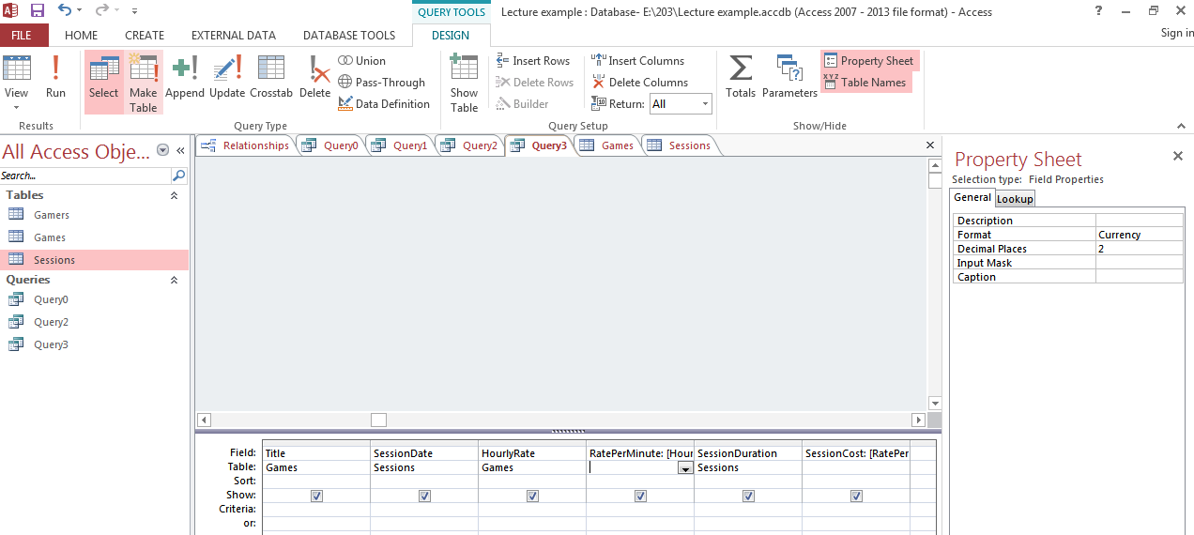
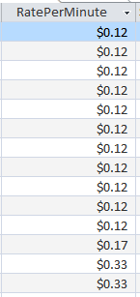
Access: Cleaning Up The Results
Select the attribute
Ribbon: Select the design tab,
  Select the property sheet option

Slide 96
Logical Operators
Operation | Description | MS-Access operator
AND | All conditions must be true for the result to be true. If any condition is false then the entire result is false. | And
OR | All conditions must be false for the result to be false. If any condition is true then the entire result is true. | Or

Slide 97

Relational Operators
Operator | Description
< | Less than
<= | Less than , equal to
> | Greater than
>= | Greater than, equal to
= | Equal to
<> | Not equal to

Slide 98
SQL: Reminder ‘Where’ Clause
SELECT: Specifies the relevant attributes of which tables are involved in the query e.g., CallSign attribute of the Gamers table
FROM: Lists the tables from which the data is to be selected
WHERE: Provides the conditions to determine if a particular row shows or doesn’t show as a result
Format
  WHERE: <Boolean expression> <logic operator>
  <Boolean expression>
Examples:
  WHERE: Client.Age >= 0 AND Client.Age <= 114
  WHERE: Client.LastName = "Tam"

Slide 99

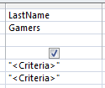
Query #4: Logical-OR
Show the CallSign, LastName & FirstName of all employees whose last name is “Maurice” or “Masoon”.
Note that query criteria specified within a column will have the logical OR operation applied.

Slide 100
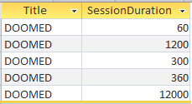
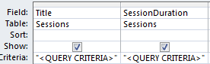
Query #5: Logical-AND
Show all online sessions of the game title “DOOMED” which had a session lasting an hour or more.
Note that query criteria specified between columns will have the logical AND operation applied to them.

Slide 101
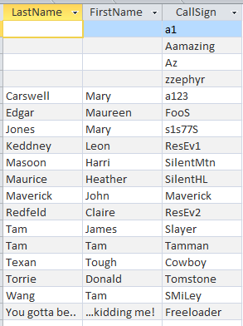
Ordering Queries
Query results can be ranked according to the attributes of a table.

Slide 102
Query #6: Ordering Queries
Show the CallSign, LastName and FirstName of all the gamers in ascending order sorted first by last name, then by first name and finally by call sign.
Use the “SORT” property (MS-Access) “ORDER BY” property (SQL)

Slide 103
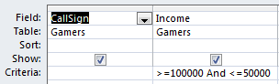

Query #7: Contradictory Conditions
Take care not to specify queries that can never be true!
Example:
  Show the CallSign and Income of all gamers with an income $50,000 or lower AND $100,000 or higher.
SELECT Gamers.CallSign, Gamers.Income
FROM Gamers
WHERE (Gamers.Income >=100000 And
Gamers.Income
<=50000);

Slide 104
Queries 8{A-D}: Using The Wildcard In Queries
Similar to validation rules, the wild card can be used in queries when only partial information is known.
Example: last name schwar*
Use the ‘Like’ operator under ‘Criteria’ (MS-Access) or ‘Where’ (SQL)

Slide 105
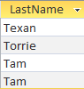



Wild Card: Example Queries
Show last name when LastName begins with ‘t’
Show first and last name when FirstName ends with ‘m’
SELECT Gamers.LastName
FROM Gamers
WHERE
(Gamers.LastName Like "t*");
SELECT Gamers.FirstName, Gamers.LastName
FROM Gamers
WHERE
(Gamers.FirstName Like "*m");

Slide 106
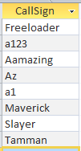

Wild Card: Example Queries (2)
Show the call sign when there’s an ‘a’ anywhere (call sign).
SELECT Gamers.CallSign
FROM Gamers
WHERE
(Gamers.CallSign Like "*a*");

Slide 107

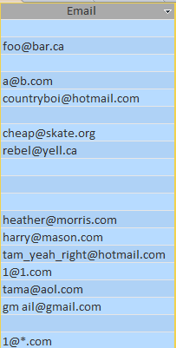
Single Character Wildcard ‘?’
Show .com emails with only a single character between the ‘@’ and the ‘.com’
(Any number of characters before the at-sign)
Query design
Table to query:
SELECT Gamers.Email
FROM Gamers
WHERE
(Gamers.Email Like
"*@?.com");

Slide 108
Database Forms And Normalization (If There Is Time)
A database form: a database that meets a particular design requirement
  Forms discussed in this class: First normal form (1NF), Second normal form (2NF), Third normal form (3NF)
  Earlier forms (e.g. 1NF) are less strict than later forms (2NF)
  Later forms (3NF) fulfill the requirements of earlier forms (2NF)
Database normalization: redesigning a database in order to bring it from a less strict form to one that is more strict.

Slide 109
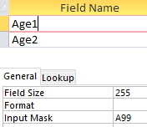
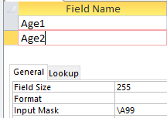

Input Masks: The Slash And The Query
There’s a separate database example to illustrate: “Extra database - input mask and queries”
Recall: input mask in the design view
In the Datasheet view the ‘A’ character is displayed with the rest of the attribute data

Slide 110

Exported Table: Excel Spreadsheet
As can be seen the data following the slash is displayed in the table but not actually stored

Slide 111


Query Results: age1
The data in ‘age1’ can be queried ‘a’ is part of the attribute

Slide 112


Query Results: age2
The data in ‘age2’ DOES NOT include ‘a’ as part of the attribute.
Querying for this data ‘a’ will produce no results

Slide 113
Why Is Normalization Necessary?
Normalization is regarded as good style
My database ‘works’ that’s “good enough” why bother?
It also helps to prevent errors or problems which are caused by how the database is designed:
  e.g., insertion anomalies: difficulties when adding new information
  e.g., deletion anomalies: deleting information may result in the inadvertent loss of information

Slide 114
Example Database Table: Projects¹
This table shows:
  ResearcherID: each professor working on a research project is given a computer generated login name.
  Research project: name of the projects worked on in a particular department.
    Professors can work on multiple projects
    Research projects can be initiated without a professor
  Location: room number of the research lab.
ResearcherID (PK) | Research projects (PK) | Location
aturing | Graph Coloring Traveling Salesman | QC-103 QC-201
rdescartes | Knapsack | QC-121
cbabbage | Traveling Salesman Knapsack | QC-201 QC-121
bowen | Knapsack | QC-121
1 From “Database Development for Dummies” by Allen G. Taylor

Slide 115
Problem: Some Cells Can Contain Multiple Entries
Queries can be awkward to form
  E.g., Using the ‘Like’ operator is difficult because it must deal with special cases (or more entries in each cell).
  Example:
Research projects
Graph Coloring Traveling Salesman
Knapsack
Traveling Salesman Knapsack
Knapsack
With this format searching for projects under “Knapsack” won’t work correctly (some labs show up with others will not).

Slide 116
Databases In First Normal Form
1NF.: Each cell can contain at most one element (one value or a null value, the latter for non-primary key fields).
The previous table in first normal form:
ResearcherID (PK) | Research project (PK) | Location
aturing | Graph Coloring | QC-103
aturing | Traveling Salesman | QC-201
rdescartes | Knapsack | QC-121
cbabbage | Traveling Salesman | QC-201
cbabbage | Knapsack | QC-121
bowen | Knapsack | QC-121

Slide 117
First Normal Form: Critique
Improvements:
  Cells contain only one value which reduces some of the problems associated with forming queries.
Further improvements needed:
  There is redundancy in the table e.g., “aturing”
  It may be subject to modification (addition and deletion) anomalies.
ResearcherID | ResearchProject | Location
aturing | Graph Coloring | QC-103
aturing | Traveling Salesman | QC-201

Slide 118
Deletion Anomaly
Allan Turing (“aturing”) no longer works on the “Graph Coloring” project.
Before
After
Researcher ID | Research Project | Location
aturing | Graph Coloring | QC-103
aturing | Traveling Salesman | QC-201
rdescartes | Knapsack | QC-121
cbabbage | Traveling Salesman | QC-201
cbabbage | Knapsack | QC-121
bowen | Knapsack | QC-121
Researcher ID | ResearchProject | Location
aturing | Traveling Salesman | QC-103
rdescartes | Knapsack | QC-121
cbabbage | Traveling Salesman | QC-201
cbabbage | Knapsack | QC-121
bowen | Knapsack | QC-121

Slide 119
Insertion Anomalies
A new research project ‘UFO’ is added to the department and room ‘Area-57’ is to be used as the research lab but a researcher has not been hired.
This is an incomplete record that cannot yet be properly added to the database (PK = researcher and project name)
ResearcherID | Research project | Location
aturing | Graph Coloring | QC-103
aturing | Traveling Salesman | QC-201
rdescartes | Knapsack | QC-121
cbabbage | Traveling Salesman | QC-201
cbabbage | Knapsack | QC-121
bowen | Knapsack | QC-121

Slide 120
Problem With This Table
The ‘Projects’ table combines two related but separate concepts:
  Which research project a particular researcher working on
  What is the location of a particular project
It’s a sign that a single unique key cannot be assigned
By itself this isn’t necessarily a problem (i.e., ‘ResearcherID’ and ‘Research project’ form a composite primary key).
But the non-primary key element “Location” depends only on a part of the primary key (“Research project”) which can lead to anomalies.
ResearcherID | Research project | Location
aturing | Graphic Coloring | QC-103
aturing | Traveling Salesman | QC-201

Slide 121
Databases In Second Normal Form
Every non-primary key element must be dependent on the primary key (and the entire primary key if the key is composite).
The previous table split into two tables that are each in second normal form.
ResearchProject
ResearchLocation
ResearcherID | Project
aturing | Graph coloring
rdescartes | Knapsack
cbabbage | Traveling Salesman
bowen | Knapsack
Project | Location
Graph coloring | QC-103
Knapsack | QC-121
Traveling Salesman | QC-201

Slide 122
Critique Of Second Normal Form
Dependencies can still exist that affects the database but in a slightly more subtle fashion.
All non-key fields are dependent upon the primary key but some may be dependent in an indirect fashion.

Slide 123
Example¹: “SalaryRange” Table
ResearcherID | AcademicRank | RangeCode
eschroedinger | Full professor | 4
pdirac | Associate professor | 3
wheisenberg | Full professor | 4
hbethe | Assistant professor | 2
jwheeler | Adjunct professor | 1
Non-key fields whose values are dependent on the primary key (second normal form)
Primary key
1 From “Database Development for Dummies” by Allen G. Taylor

Slide 124
The Example In 2nd Normal Form Are Still Subject To Some Anomalies
Example Professor Dirac leaves the university.
Before
ResearcherID | AcademicRank | RangeCode
eschroedinger | Full professor | 4
pdirac | Associate professor | 3
wheisenberg | Full professor | 4
hbethe | Assistant professor | 2
jwheeler | Adjunct professor | 1
After
ResearcherID | AcademicRank | RangeCode
eschroedinger | Full professor | 4
wheisenberg | Full professor | 4
hbethe | Assistant professor | 2
jwheeler | Adjunct professor | 1

Slide 125
Problem With The Database (2nd Normal Form)
While both non-key elements are dependent upon the primary key, with “RangeCode” that dependency is indirect.
“RangeCode” is dependent upon “AcademicRank” which is in turn dependent upon “ResearcherID”.
This is referred to as a transitive dependency:
ResearcherID | AcademicRank | RangeCode
eschroedinger | Full professor | 4
pdirac | Associate professor | 3
RangeCode
AcademicRank
ResearcherID

Slide 126
Third Normal Form
A database in third normal form fulfills the requirements of second normal form and has no transitive dependencies.
Previous example in third normal form:
ResearcherRank
RankRange
ResearcherID | AcademicRank
eschroedinger | Full professor
pdirac | Associate professor
wheisenberg | Full professor
hbethe | Assistant professor
jwheeler | Adjunct professor
AcademicRank | Range Code
Full professor | 4
Associate professor | 3
Assistant professor | 2
Adjunct professor | 1

Slide 127
After This Section You Should Now Know
How a database is broken down into tables and how tables are broken down into it's component parts
What are the type of tables and the purpose of each
What is the purpose of a primary key
What is a foreign key
When table are related what is the rule for determining which table contains the primary vs. foreign key
What is a null value
What are forms of data integrity in databases
Guidelines for naming tables and the attributes of the tables
What are the three relationships that may exist between tables and how they differ

Slide 128
After This Section You Should Now Know (2)
How is a many-to-many relationship typically implemented in a database
The ERD representation of databases
How to form different queries in order to retrieve data from a database
How contradictions can result in no query results
How wildcards can be used in queries
What is database normalization, what are the different forms and how to convert from one form to another
How to normalize a database
What are the characteristics of a database in: first normal form, second normal form, third normal form

