Slide 1
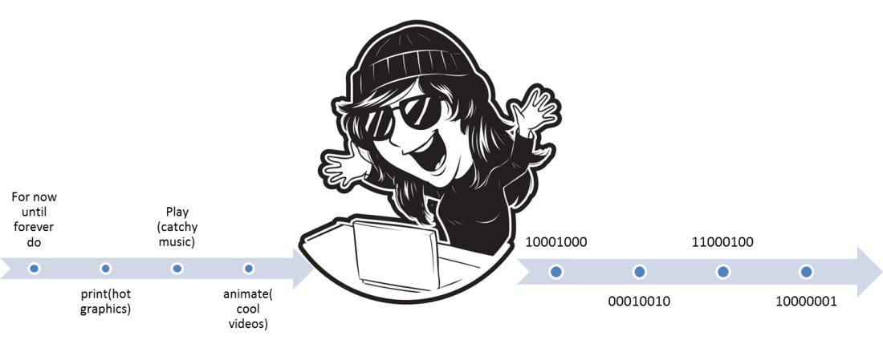


CPSC 203
Computer programming
Spreadsheet
Database
Introduction to practical problem solving
(James Tam)
Images: Colourbox.com

Slide 2
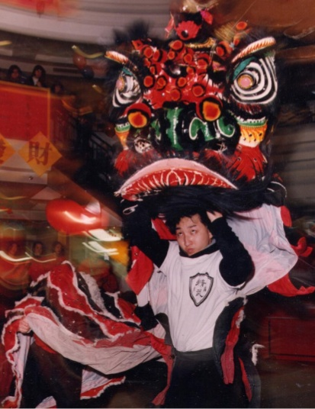

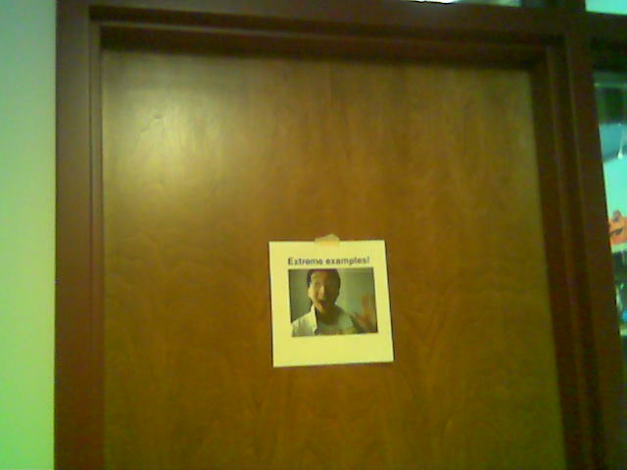
Administrative (James Tam)
Contact Information
  Office: ICT 707
  Email: tam@ucalgary.ca
  Make sure you specify the course name and number in the subject line of the email ‘CPSC 203’
Office hours
  Office hours: M (3:30 – 4:20 PM), T (2 – 2:50 PM)
  If I’m not in my office give me a few minutes or check the lecture room.
My Office
Images: courtesy of James Tam

Slide 3
Course Resources
Required resources:
  Course website: http://www.cpsc.ucalgary.ca/~tamj/2016/203W (You must get the slides off the course webpage before lecture)
Additional resources (external) will be provided for these topics
  Computer fundamentals
  Spreadsheets
  Databases
  Creating web pages & web-based computer programs
  Hard copies can be purchased at “Bound and copied”: https://www.su.ucalgary.ca/programs-services/student-services/bound-copied/

Slide 4
How To Use The Course Resources
They are provided to support and supplement this class.
  The notes outline the topics to be covered
  At a minimum look through the notes to see the important topics.
  However the notes are just an outline and just looking at them without coming to class isn’t sufficient to do well
  You will get additional details (e.g., explanations) during lecture time
    Take notes!
    If you miss a lecture then get a copy of the in-class notes from another student (who takes detailed notes)

Slide 5

Your Engagement Level ---> Your Learning
+
Learning
colourbox.com
Create: spreadsheets, databases
Write:
Computer programs

Slide 6
Tam’s “House Rules”
I always endeavor to keep the lecture within the prescribed time boundaries
You won’t pack up and leave before time is up

Slide 7





Tam’s “House Rules”
No recordings/captures without permission during class please
(Recall that learning tends to increase with additional levels of engagement).
Colourbox.com

Slide 8


Tam’s “House Rules”
Quiet whispering is OK…
…but make sure if it is *quiet*. If it’s loud enough for me to hear then it’s likely that others are being disturbed by the noise as well.
Images from colourbox.com

Slide 9
Learning Objectives
Understand basic technological concepts, such but not limited to: the key parts of a computer, the Internet and computer security.
Practical thinking and problem solving by using pre-created software such as MS-Office. This involves using the built in functionality of the office suite.
Learning the mechanics of building a web page as basic design principles. Practical thinking and problem solving skills will be developed by augmenting a web page with computer software (written by the student)

Slide 10

Course Outcomes
You get to learn 3! Count ‘em 3 commonly used software packages!
But wait-there’s more!!!
Data-base!!!
Advanced word processing!!!
Spread-sheet!!!
SALE!!!

Slide 11
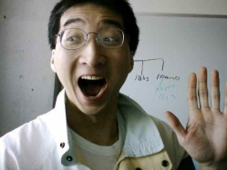

Course Outcomes (2)
  Employer XYZ wants to hire an Access © database developer or someone familiar with SQL queries now.
  This is what’s hot, hot, hot
  But what’s hot today may not look so good tomorrow
  Technology changes: get used to it

Slide 12
Course Outcomes (3)
You will not only learn how to use existing technologies (spreadsheet, database, word processor) but also how to problem solve and create your own new software.
Problem solving is required in the programming component: VBA office macros or augmenting a web page by writing supplementary software.
Some corporations have recognized the relationship between problem solving skills and success in the work world:
  E.g., “Killer” interview questions
    Google
    http://www.businessinsider.com/15-google-interview-questions-that-will-make-you-feel-stupid-2009-11?op=1
    Apple
    http://www.businessinsider.com/apple-interview-questions-2011-5#how-do-you-test-the-prototype-of-the-vending-machine-5

Slide 13
Evaluation Components
Assignments
Examinations
In class bonus quiz questions

Slide 14
Assignments (35% Of Term Grade)
(Partial) A1: Advanced word processing features (Word): 5% of term grade
A2: Spreadsheet (Excel): 10% of term grade
A3: Database (Access): 10% of term grade
A4: Program writing: 10% of term grade

Slide 15
Assignments
Assignments must be individually completed and individually submitted.
  There is no group work allowed for this class.
  Students should not see the assignment solutions produced by other students.
Assignments will be marked by the tutorial instructor.
  Grades will be posted in D2L
  You can contact him/her for the grade and/or the completed marking sheet.
  If you still have questions or issues after contacting your TA then feel free to contact your course instructor.

Slide 16

Submitting Assignments
Bottom line: it is each student’s responsibility to make sure that the correct version of the program was submitted on time.
Late assignments will not be accepted.
If you are ill then medical documentation is required.
  Contact your course instructor and not your tutorial instructor to get permission for a late submission
(Further details will be available during the term).
I am the ‘course instructor’ person

Slide 17
JT’s Helpful Hint: Electronically Submitting Work
Bad things sometimes happen!
  Sometimes it’s a technical failure (e.g., hardware failure)
  Sometimes it’s human error (e.g., oops, accidentally deleted)
Rules of thumb for assignment submissions:
  Do it early! (Get familiar with the system)
  Do it often! (If somehow real disaster strikes and you lose everything at least you will have a partially completed version that your TA can mark).
  Check your work.
    Don’t assume that everything worked out OK.
    Instead you should check everything (click on the submitted file(s) to download them back to your computer)
    Don’t just check file names but at least take a look at the actual file contents (not only to check that the file wasn’t corrupted but also that you submitted the correct version).

Slide 18
How To Verify Submissions In DropBox
Go to the assignment: Assessments->DropBox
Click on the desired assignment that you want to verify
View the specific submitted files for the assignment
Downloading the submitted files
Open the submitted files

Slide 19
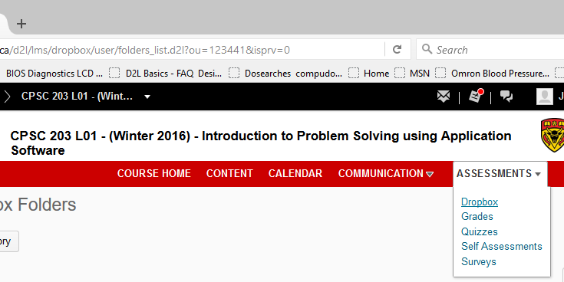
1: Assessments->DropBox

Slide 20
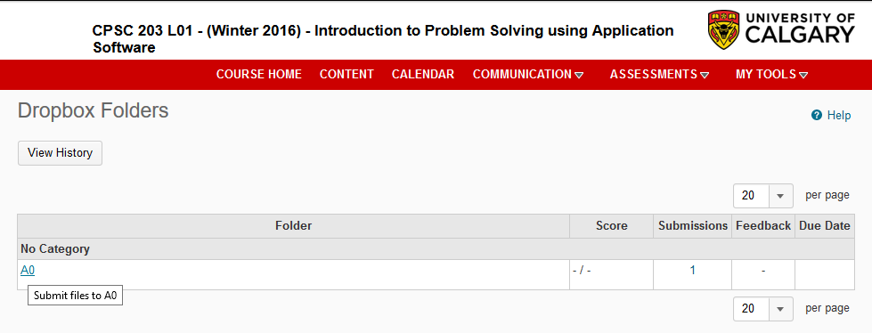
2: Click On The Desired Assignment To Verify
In this case there is currently just a single assignment ‘A0’

Slide 21
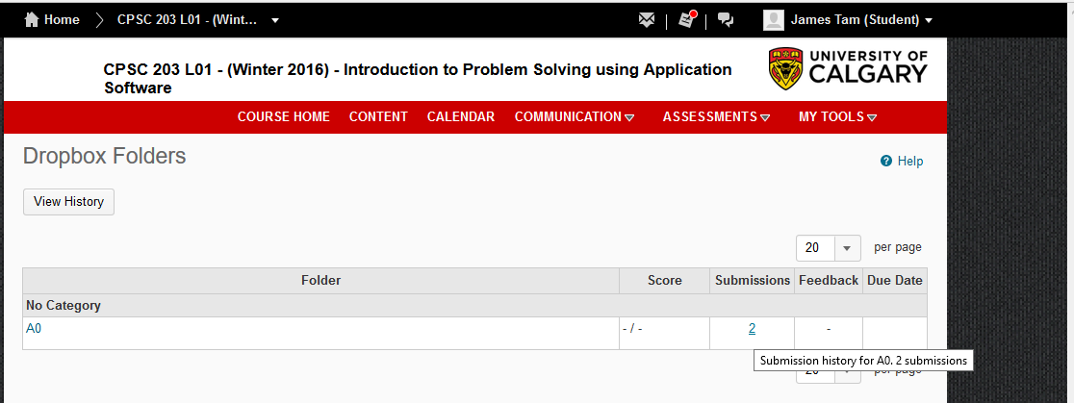
3: Viewing submitted files
Click under ‘submissions’

Slide 22
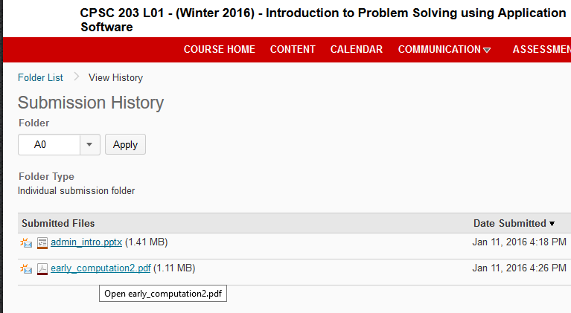
4: Downloading Files To Verify Submissions
Don’t just view the file names and think things are okay!
Download the files

Slide 23
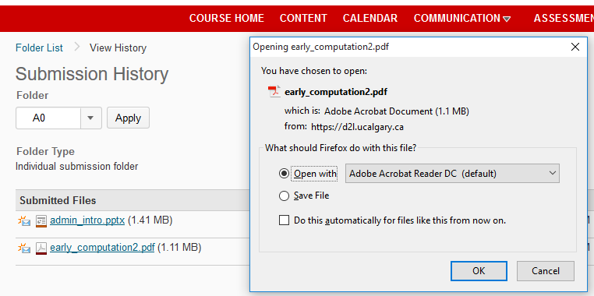
5: Opening And Viewing The Files
Look through the files in order to verify contents
  Double check if the file was not corrupted
  Only you will know if this is the correct version

Slide 24
Backing Up And Submitting Your Work
Bottom line: it is up to you to make sure things are done correctly and on time.
If you have questions beforehand then do ask (make sure you ask your questions early enough so you can receive an answer before the due time).
But don’t wait until after the due date (it’s too late).
What you submit as of the due date/time is what will be marked.
  Late submissions won’t be accepted

Slide 25
Assignments: Software Version¹
It is your responsibility to make sure that your submission works on the machines in MS 237.
A1 – A3 (MS-Office assignments)
  We use a Windows machine to mark whatever you submit
  The latest version of Office is required
  U of C students should be able to access Office 365 “for free” (while they are current students)
    Info: http://www.ucalgary.ca/it/office365/faqs
    Accessing (need a UC account):
      http://www.ucalgary.ca/it/services/office-365 (click on the link “Access 0365 online”)
      http://office365.ucalgary.ca/
      If have trouble accessing: contact university UC-IT
The program written for A4 must be executable on the lab computers/online

Slide 26
In Class Bonus Questions (2% Bonus On Term Grade)
They will be administered using TopHat Monacle
  https://app-ca.tophat.com
The questions will be ‘randomly’ administered during lecture (only) – no ‘make up’ questions
  You will be given ample notice before the first questions begin (they won’t start immediately)
  Note that the questions will act as a ‘bonus’ (you may potentially be awarded an “A” grade even if you receive no marks on the TopHat questions).
  The questions will be directly related to lecture material.

Slide 27
Examinations (65% Of Term Grade)
A mix of short answer and multiple choice questions
Closed book (don’t bring anything into the exam: just yourself and writing implements)
Midterm examination (25% of term grade)
  Scheduled by your course instructor and will occur during the semester
  Thursday, March 3 from 5:00 to 6:15 PM in ST 140
  (Note that it is outside of normal lecture time)
Final examination (40% of term grade)
  Cumulative but with a focus on topics covered after the midterm
  The exam occurs during the regular end of term examination period so it will be scheduled by the Office of the Registrar

Slide 28
Mapping Your Raw Score To A Grade Point
As stated in the course information sheet (official signed document) each major component will be awarded a grade point (and not a percentage) as the value used to determine the term grade.
  Components that are mapped to a grade point
    Each individual assignment
    Total score for in-lecture TopHat questions
    Midterm exam
    Final exam
The mapping of raw score to grade point will be posted before each assignment is due (variation between assignments may occur).
Mapping of TopHat bonus questions to grade point
The mapping of the midterm to grade point will be posted sometime after the midterm.
The mapping of final to grade point cannot be provided until after the official term marks have been released (Department policy).
Percent | 96 – 100 | 91 – 95 | 86 – 90 | 81 – 85 | 76 - 80 | 71 - 75 | 65 – 70 | 61 – 64 | 56 -60 | 51 - 55 | 46 - 50 | < 46
GPA | 4.0 | 3.7 | 3.3 | 3.0 | 2.7 | 2.3 | 2.0 | 1.7 | 1.3 | 1.0 | 0.7 | 0.0

Slide 29
Estimating Your Term Grade (2)
To determine your weighted term grade point simply multiply each grade point by the weight of each component.
  Percentages won’t be used to determine the term grade
Sum the weighted grade points to determine the term grade.
Simple and short example (not exactly the same as this term but it should be enough to give you an idea of how to do the specific calculations required this semester):
    Assignments: weight = 30%, example score = A
    Midterm: weight = 30%, example score = B+
    Final: weight = 40%, example score = C-
    Weighted assignments: 0.3 * 4.0 = 1.2
    Weighted midterm: 0.3 * 3.3 = 0.99
    Weighted final: 0.4 * 1.7 = 0.68
    Total term grade point = 1.2 + 0.99 + 0.68 = 2.87
  (In this case the term letter is B-)

Slide 30
Estimating Your Term Grade (3)
Use the spreadsheet on the course web page to estimate your term letter grade:
  http://pages.cpsc.ucalgary.ca/~tamj/2016/203W/grade_calculator.xlsx
The grade point to letter grade mapping employs the official university cutoffs:
  http://www.ucalgary.ca/pubs/calendar/current/f-2.html
  (I may employ a more lenient set of cutoffs at the end of term but the official cutoffs will provide you with a ‘worse case’ estimate of your grade).

Slide 31
Why Grade Points?
It’s the official university grading system
  Alternatives are possible but require faculty level approval
Approval of anything other than a grade point system requires predetermined cutoffs at the start of the term e.g., >= 90% equals ‘A’ etc.
  Doesn’t allow for consideration that individual components may be more challenging than others (lower cutoffs)
Grade points are more lenient for grades on the lower-middle end of the scale
  Grade points: Getting an “A”/4.0 on the assignment component worth 30% of the term grade yields a minimum term grade of 1.2 (4.0 * 0.3) which equates to a term grade of ‘D’ (possibly higher)
  Percentages: Getting an “A” may roughly work out to 90% or higher (depending on the scale) which works out to a minimum term percent of 27% = 90% score * 30% weight…almost certainly an “F” for the term grade.

Slide 32
Program Writing: Never Programmed Before?
You aren’t alone! In fact during most semesters this applies to the majority of students.
Although you will create a program for this class (and be tested on this material during the final exam) this class is not designed for computer science majors
  This means that we will “go slow”, repeat important concepts etc. - the programming component is ‘lighter’ than for majors.
  But the programs produced for this class are more ‘practical’

Slide 33
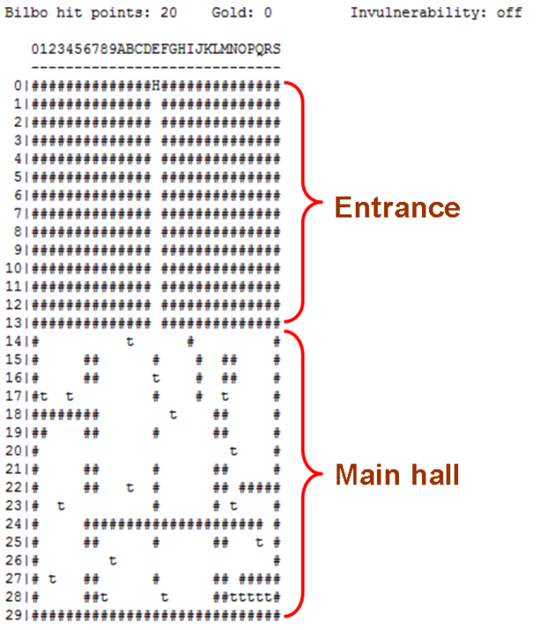
Assignments: 203 vs. 217
Program size (CPSC 217 non-majors programming class):
  A text-based computer game “The hobbit”: 677 line program
Program size (this class):
  VBA (changing the capabilities of MS-Word): 60 line program
  JavaScript (running a program through a web page): 70 line program

Slide 34
Final Exam: Programming Questions
Average grades (programming questions, final exam):
  The values indicate that the typical student shows a reasonable grasp of the material (i.e., they did “get through it”)
  In order to do well you need to be coming to class and doing extra work:
    The absolute minimum workload is to complete the assignment
    The more practice you get, the more skilled and knowledgeable you will become
Notes:
Average final exam grades (programming): 65% - 70%

Slide 35

What If 203 Still Isn’t Technical Enough For You?
Think this course is too easy?
There are other introductory courses that may be of interest.
Both are introductions to problem solving by writing/creating computer programs.
  For the following classes program writing (“programming”) is required for almost all assignments/lecture topics
  CPSC 217: For non-Computer Science majors
  CPSC 231: For Computer Science majors
Image of James curtesy of James Tam, other images from Microsoft

Slide 36

Feedback
Wow I am the greatest speaker in the world!
What is he talking about???
Let me know how things are going in the course:
  Am I covering the material too slowly or too quickly.
  Can you read the slides and my hand writing.
  Can you hear me in the class.
  Etc.
(Image copyrights unknown)

Slide 37
Copyright Notification
“Unless otherwise indicated, all images in this presentation are used with permission from Microsoft.”

