Slide 1
Style and Formatting
Presentation, layout and labeling

Slide 2
Explicit data and formulas
Labeling requirement should be obvious
Explicit formulas: compare the formulas on the next two slides

Slide 3
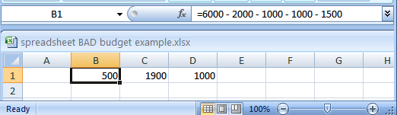
Label formulas:
Similar to data unless the formula is very obvious to the reader of the spreadsheet (and not the author) label all parts.
  Most of the time it won’t be obvious so label most everything.
  This is a very poor design

Slide 4
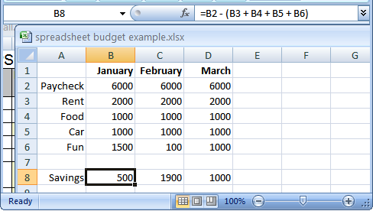
Previous example: Explicitly labeled formulas
Whenever possible label the different parts of a calculation to make easier for the reader to interpret and understand how your calculations work.

Slide 5
Note
With the previous examples the need for labeling is obvious it won’t be so obvious in other cases

Slide 6
Functionality
Obviously values should be computed by Excel and not determined externally and manually entered.

Slide 7
Designing spreadsheets: Rules of thumb
Do not directly enter values as data that can be calculated from other values.
  Example
    Assignment grade (assume one assignment) = 4.3 (data in cell A2)
    Exam grade (assume only one exam) = 3.3 (data in cell B2)
    Term grade point =(A2*0.4)+(B2*0.6) OR enter 3.66?
      Obviously the first approach is better
      However there are still problems!
Notes:
* How point is to use a spreadsheet to do the calculations for you.

Slide 8
Functionality: Design for clarity and allow for future changes
“However the formula should be well designed so that changes to the spreadsheet will have a minimal effect e.g., the impact of changing cutoffs should be minimized”
  E.g., if (<cell with grade %> >= 90, “A”
  Vs.
  if (<cell with grade %> >= 90, <Lookup cell in table>

Slide 9
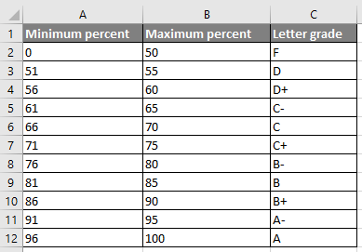
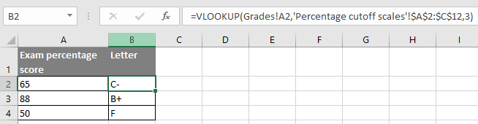
Using lookup tables
Creating an explicit lookup table follows a few spreadsheet design principles
  Don’t manually enter data when it can be derived (cut-offs)
  Explicitly label data
  Absolute and relative addressing employed where appropriate
    (Percentage: relative)
    (Cut-offs: absolute)
    Why?

Slide 10
Fonts and font effects

Slide 11
Fonts and font effects
Example fonts:
  Ariel
  Calibri
  Helvetica
  Times New Roman
Font effects:
  Italics
  Bold
  Underline
  Normal
Font sizes: 10 point, 12 point etc.

Slide 12
Fonts and font effects (2)
As a rule of thumb use no more than 3 sizes and font effects in a particular document.
  Similar to color, their overuse reduces their effectiveness and makes it harder to interpret meaning.
  Also if you don’t know much about fonts just stick to the common or default ones provided (Ariel, Calibri, Helvetica, Times New Roman)
  If you’re not sure if a font is a good one for a particular situation then it probably isn’t:
    (This is a real font called “Wing dings”): wing dings

Slide 13
Color
Not explicitly marked in the assignment but in case they ask

Slide 14
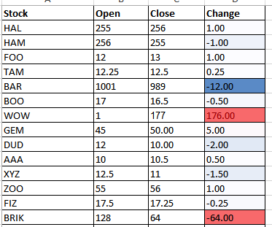
Color: Properly used
When used sparingly color can draw attention to important information.
This is an especially valuable tool when there is a large amount of information.
  The information may be “all there” but don’t make it any harder than it has to be for the viewer to find it.

Slide 15
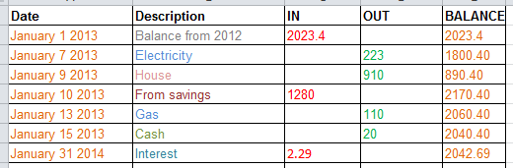
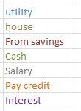
Color misused
The overuse of color:
  Reduces it’s ability to make information stand out.
  Makes it harder to understand what information is mapped to a particular color.
Notes:
Some color mappings you might be able to figure out: date, cash in, cash out, balance because the information is communicated in other ways (labels and arranged in columns)
But the information that only uses color to group is harder to discern

Slide 16
Sparse use of color
Easy to ‘pick out’ the color differences if color is not overused
  Find all reds: easy!

Slide 17
Sparse use of color
Find all reds:
  It’s possible but the more colors that are used, the more challenging is the task (only 5 colors ued)

Slide 18
Alignment & whitespace
(Not the same things: one could for example be consistent but consistantly bad)
In class I talked about the 4 principles of C.R.A.P.

Slide 19
C.R.A.P.¹
Simple design principles that can be applied in a variety of situations
Contrast
Repetition
Alignment
Proximity
1 From “The non-designers type book” by Robin Williams (Peach Pit express)

Slide 20
Contrast & repetition
  Contrast:
  Make different things look significantly different
Repetition (Consistency):
  Repeat conventions throughout the interface to tie elements together

Slide 21
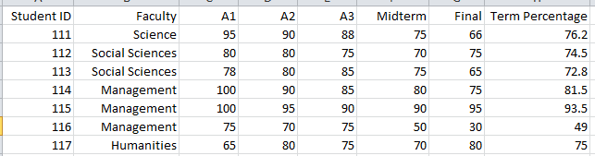
Example: No contrast
Poor representation:

Slide 22
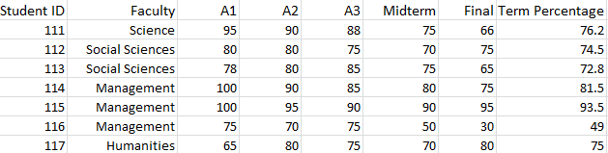
Example: Weak contrast
Still a poor representation:
  You would lose style marks
Notes:
Font size of headings slightly increased
In a small no document it may not make a big deal
In a large document with say many sub headings (you often scan headings to determine if you read the contents) this can make it harder than it has to be to find the necessary information

Slide 23
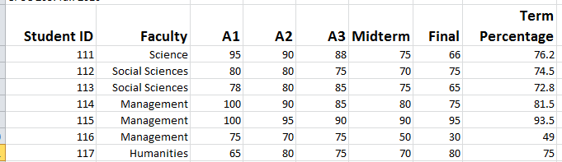
Example: Headings stand out
Good contrast:
  If contrast is not (or weakly) employed for a small set of data it may not be a large issue.
  But for larger data sets (“real data”) it may make it more work than is necessary.
Repetition:
  Same fonts, font sizes and font effects used in the headings vs. the data.
  Makes it easier to see and understand the structure
Notes:
No so bad if the sheet is small
Can be harder to find relevant information if there’s a lot of data to look through

Slide 24
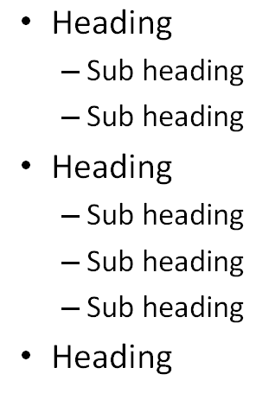
Alignment
It can be used to structure a document (represents hierarchical relationships).

Slide 25
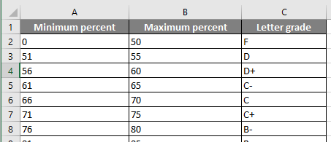
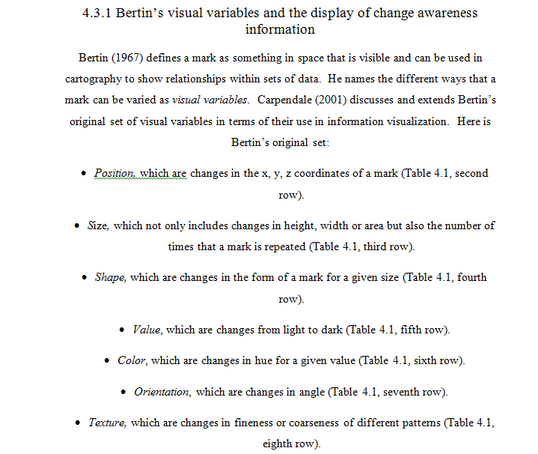
Center alignment
Sometimes it looks unformatted and often unprofessional
Also center alignment violates the consistency/repetition principle (headings vs. data not consistently aligned)

Slide 26
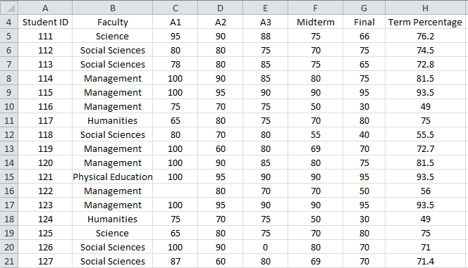
Center alignment
While sparing use of center alignment can be used to provide contrast it should NEVER be used as the default in documents such as spreadsheets.

Slide 27
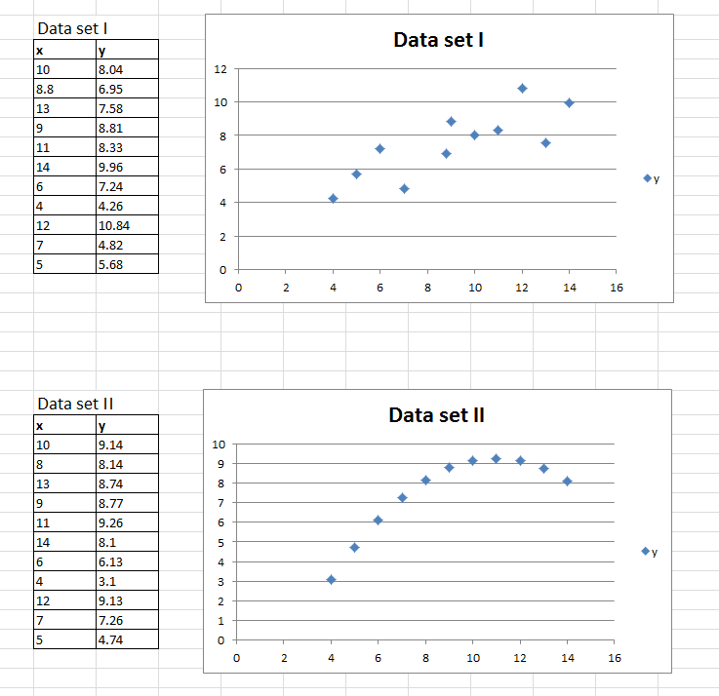
Proximity
Related items are in close proximity
Unrelated items are separated
Data (‘Data set I’) and the visual plot of the data are related so they are in close proximity
Unrelated data sets employ negative proximity (‘white space’) to separate them
Notes:
Table and graph for each data set are in close proximity
Data sets are separated

Slide 28
Type of graph
Graph (appropriate type used, is information clearly represented):

Slide 29
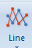
Ways Of graphically representing information
Pie chart
Bar graph
Line graph

Slide 30
Pie vharts
Good for showing proportions, how much of the whole does each item contribute.
It’s poor for showing exact numeric values.

Slide 31
Bar and line graphs
  For showing trends
  Comparing functions

Slide 32
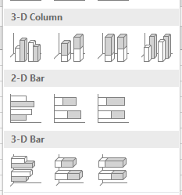
Graph for the assignment
The Excel name of the graph you are to use is a ‘column chart’
  Think of it as a specialized version of a bar graph (vertical rather than horizontal)

Slide 33
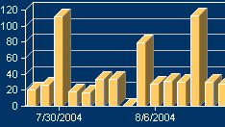
Graphs: Final note
Keep it simple!
Avoid ‘fancy’ special effects that may detract from the clear display of your graph
Both of the examples below are examples of the poor use of graphs
Use of 3D combined with distracting textures
Unnecessary 3D effects

