Slide 1
Spreadsheets
You will learn about some important features of spreadsheets, as well as a few principles for designing and representing information.
  Online MS-Office information source: https://support.office.com/

Slide 2
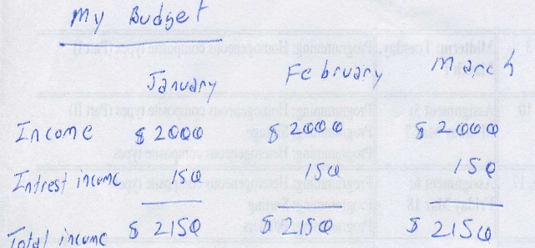
Background
Electronic spreadsheets evolved out of paper worksheets.
  Calculations were manually calculated and entered in columns and rows on paper often drawn with grids.
Making changes could be awkward:
  Correcting errors
  Attempting variations :
    e.g., for a personal budget what would be the effect of living in a 1 bedroom vs. 2 bedroom apartment
    e.g., going on a vacation to Vulcan, Alberta vs. going to Dubai, U.A.E.
    e.g., how would my term grade change if I received a “B” vs. “B+” on the final exam

Slide 3
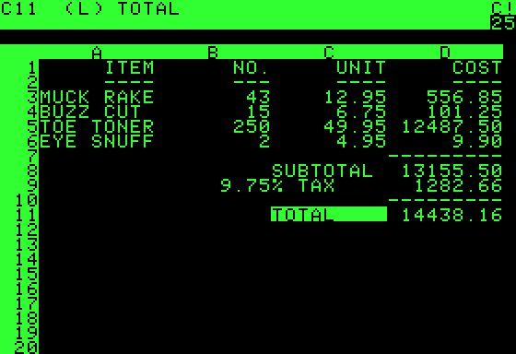
The First Spreadsheet
Early versions of electronic spreadsheets were primitive but could still automate calculations.
  So popular Visicalc was “The software tail that wags (and sells) the personal computer dog.” – Ben Rosen (Compaq)
VISICALC for the Apple II computer: Image from: http://www.cultofmac.com (last accessed Jan 2015)

Slide 4
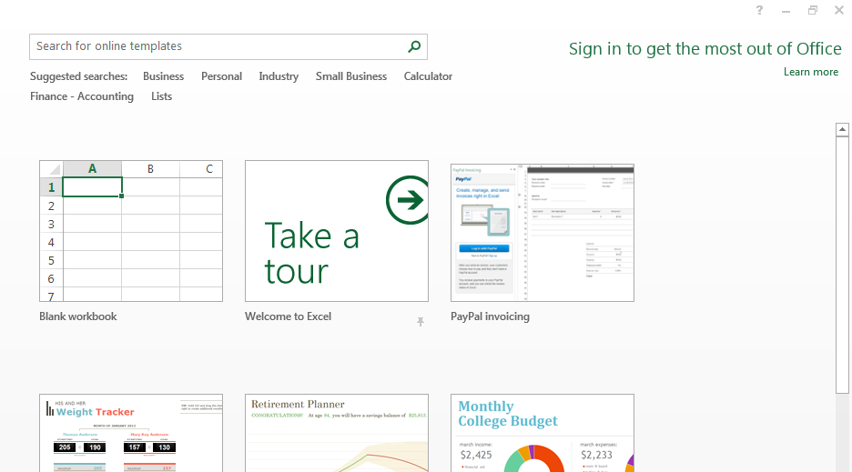
Getting Started: Creating A New Blank SpreadSheet (Excel: “Workbook”)
Starting from Windows 7 (Similar to starting other programs):
  Start button->All programs->Microsoft Office->Microsoft Excel
Once Excel started, creating a new sheet:

Slide 5
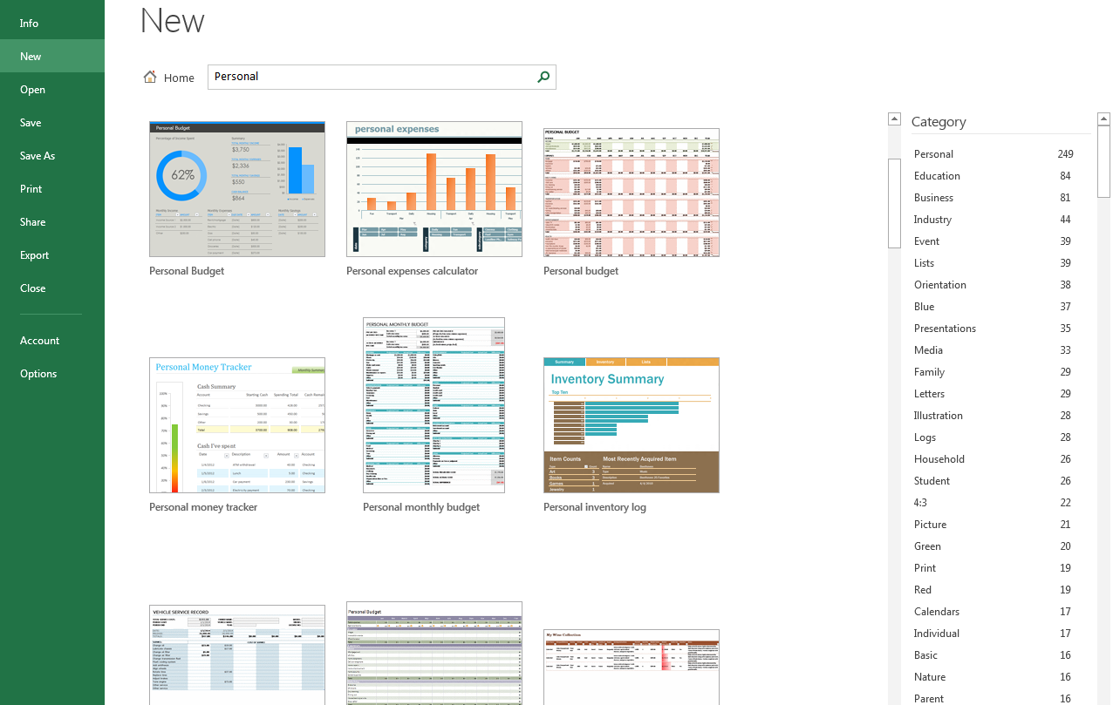
Templates
Pre-created spreadsheets for many types of problems

Slide 6
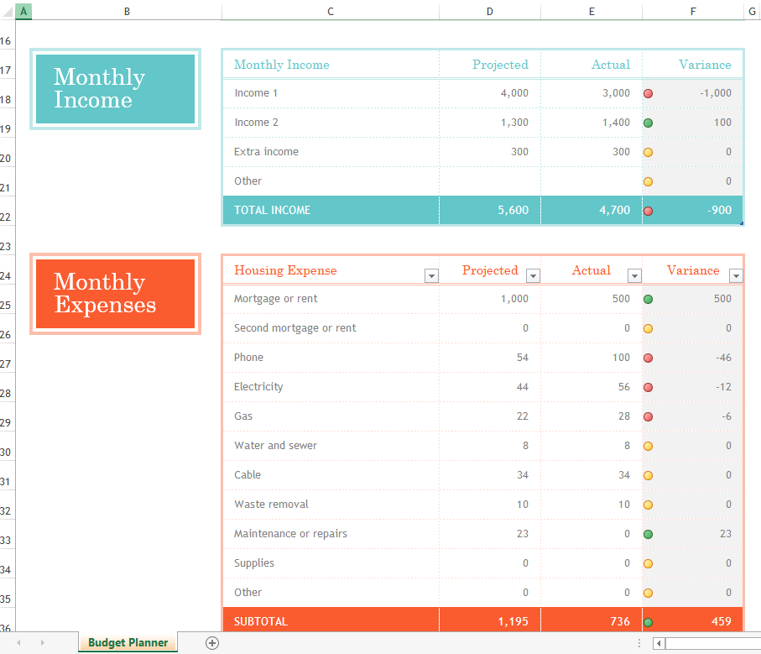
Example Template

Slide 7
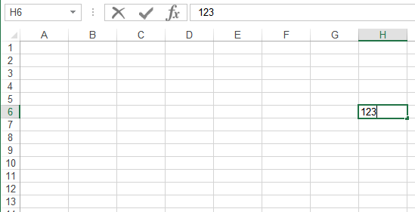
Spreadsheets 101
Column headings
Coordinates of current cell
Row numbers
Current cell
Contents of current cell

Slide 8
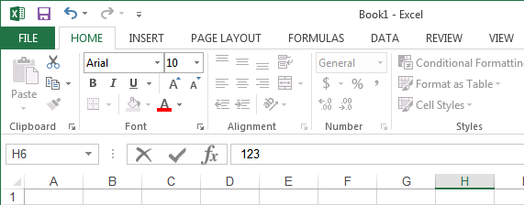
The Excel Ribbon
Tabs are used to group related functions

Slide 9


High Level View Of Each Tab
File **:
  Functions associated with documents (creating, opening, saving, printing etc.)
Home (default) **:
  Many of the most commonly used functions (such as formatting fonts, cells and numerical data)
Insert:
  Tables, illustrations, apps, charts, graphs, text, and symbols
Page layout:
  Page setup (many similar to print options)
Formulas *:
  Location and groupings of the pre-created built-in mathematical formulas

Slide 10
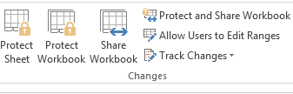
High Level View Of Each Tab (2)
Data:
  Arranging, organizing existing data (e.g., sort)
Review:
  Spell checking, thesaurus, translation, adding comments, and change tracking
View (different views of the same data):
  Workbook Views, Show, Zoom, Window, and Macros

Slide 11
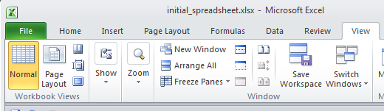
“Freezing” Panes: How/Why
Often used to lock the view so that crucial labels always stay onscreen regardless of which part of the sheet you are viewing

Slide 12
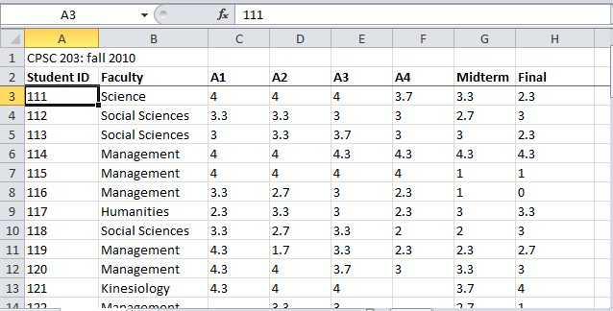
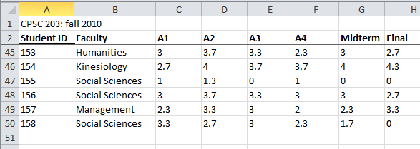
Freezing Panes: Effect On Example Spreadsheet

Slide 13
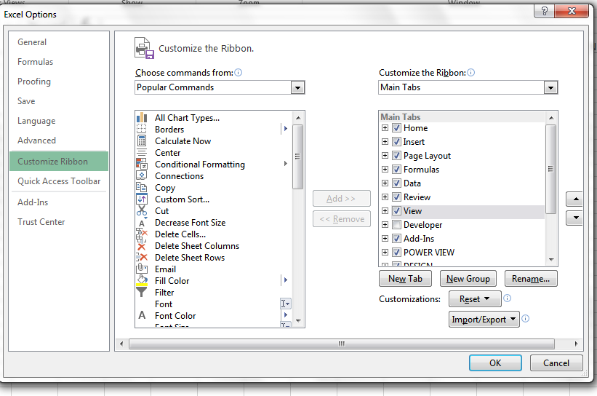
Customizing The Ribbon
Select the “File” Ribbon and then “options”
File -> Options

Slide 14
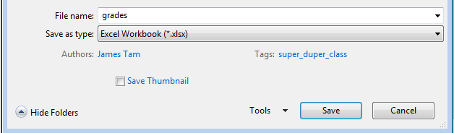
Saving Work
This feature is implemented in a similar fashion among the different MS-Office products
“Save”: save document under current name
“Save as”: allows the document to be saved under a different name
  But additional information such as: ‘tags’ and ‘titles’ may be entered

Slide 15
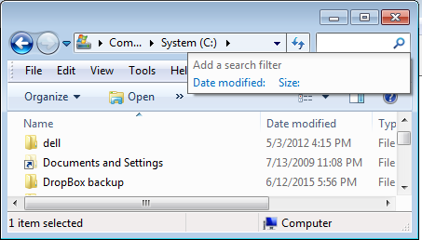
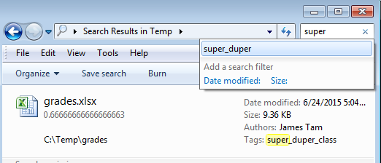
Example Using Tags
Separate from the file name but may still be used as search criteria

Slide 16
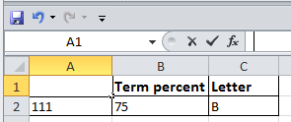
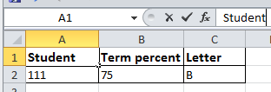
Entering Data
Click on cell to enter the data
Type in cell contents

Slide 17



Contents Of A Cell: Types
Raw data: also referred to as ‘constants’
Labels: describe the contents of another cell
Formula: values derived from the raw data (e.g., calculations, lookup values)

Slide 18


Specifying Formulas
In Excel all formulas must be preceded by the ‘=‘ symbol to distinguish it from a label
Example spreadsheet: 1_formulas
  Label
  2 + 2
  Formula
  = 2 + 2

Slide 19
Basic Mathematical Operators
Example spreadsheet: 2_operators
Mathematical operation | Excel operator | Example
Assignment | = | = 888
Addition | + | = 2 + 2
Subtraction | - | = 7 – 2
Multiplication | * | = 3 * 3
Division | / | = 3 / 4
Exponent | ^ | = 3 ^ 2

Slide 20
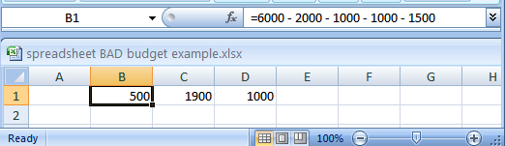
Label Formulas
Similar to data unless the formula is very obvious to the reader of the spreadsheet (and not the author) label all parts.
  Most of the time it won’t be obvious so label most everything.

Slide 21
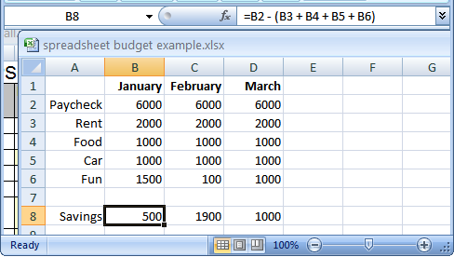
Previous Example: Explicitly Labeled Formulas
Whenever possible label the different parts of a calculation to make easier for the reader to interpret and understand how your calculations work.

Slide 22

Designing Spreadsheets: Rules Of Thumb
Do not directly enter values as data that can be derived from other values (calculation example)
  Example
    Assignment grade (assume one assignment) = 4.2 (data in cell A2)
    Exam grade (assume only one exam) = 3.3 (data in cell B2)
    Term grade point =(A2*0.4)+(B2*0.6) OR enter 3.66?
4.2
3.3
=(A2*0.4)+(B2*0.6)
A2
B2

Slide 23
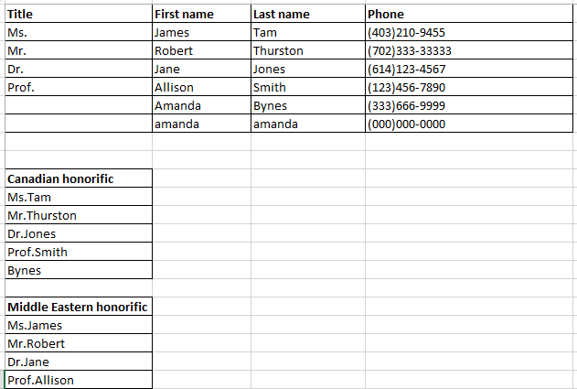
Designing Spreadsheets: Rules Of Thumb (2)
Do not directly enter values as data that can be derived from other values (example used to illustrate style, formula explained later)
10_extracting_connecting_text – details of string functions will be described later (just know now that text can also be derived)
=CONCATENATE(A2,C2)
=CONCATENATE(A2,B2)

Slide 24
Designing Spreadsheets: Rules Of Thumb (3)
Label information so it can be clearly understood

Slide 25
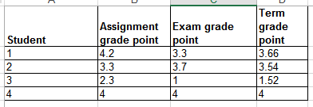
Designing Spreadsheets: Rules Of Thumb (4)
Never enter the same information more than once
  Advantages: reduces size and complexity of the sheet, making changes can be easier.
  Seems obvious? Not always
  Example: What if the previous spreadsheet were used to calculate the grades for a class full of students?
  Some would create the sheet this way:
  Example spreadsheet: 3_grades_formulas
=(B2*0.4)+(C2*0.6)
=(B3*0.4)+(C3*0.6)
Etc.

Slide 26
Designing Spreadsheets: Rules Of Thumb (5)
=(B2*0.4)+(C2*0.6)
  Issues:
    Clarity: What does the 0.4 & 0.6 refer to (sometimes not so obvious)?
    Making changes: What if the value of each component (40% assignments, 60% exams) changed?
=(B3*0.4)+(C3*0.6)
Etc.

Slide 27
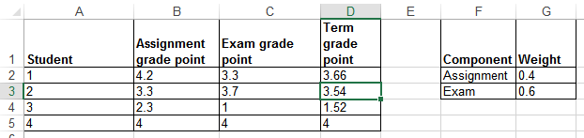
Lookup Tables
As the name implies it contains information that needs to be referred to (“looked up”) in a part of the spreadsheet.
Can be used to address some of the issues related to the previous example:
  Clarity
  Entering the same data multiple times
=(B2*G2)+(C2*G3)

Slide 28
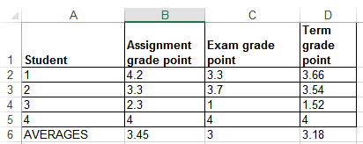
Mathematical Functions
As mentioned calculations must be preceded with an equals sign (actually an assignment operator) e.g., = 2 * 2
The formula can either be directly entered (custom formula) or you can use one of the pre-created ones that come built into the spreadsheet.
Example spreadsheet: 4_grades_lookup
=(D2+D3+D4+D5)/4
=AVERAGE(D2:D5)

Slide 29
Order Of Operation
When a series of operators from same level are encountered in a cell the expression is evaluated from in order in which they appear (left to right).
  2 + 3 * 3 Equals 11
  8 / 2 ^ 2 Equals 2
Level | Operation | Symbol
1 | Brackets (inner before outer) | ()
2 | Exponent | ^
3 | Multiplication, Division | * /
4 | Addition, Subtraction | + -

Slide 30
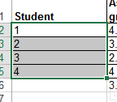
Autofill
Allows for a series (constant or addition by a constant amount) to be extended
  E.g., The series “1, 2, 3” (can be extended to include “…4, 5, 6”)
Steps:
  Highlight the cells containing the series to extend (selecting one cell just repeats the contents of that one cell).
  Move the mouse pointer to the ‘handle’ at the bottom right

Slide 31
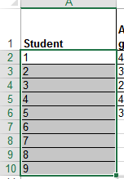
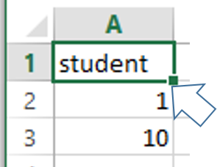
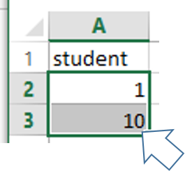
Autofill (2)
    Drag the mouse as far down as you wish the series to be extended to.
Extra practice: what would be the autofill result of:
1
2

Slide 32
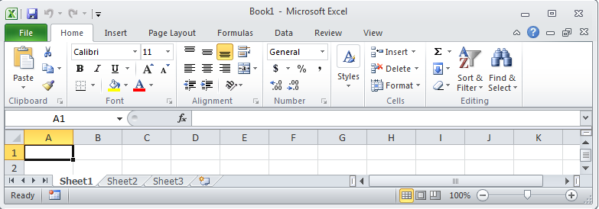
Worksheets
Each spreadsheet can consist of multiple worksheets.
Create new worksheet
Worksheet
Spreadsheet

Slide 33
When To Use Multiple Worksheets
Rules of thumb:
  When there are multiple sheets of related information, each group of information can be stored in it’s own worksheet (self contained)
Grades for lecture 01
(worksheet)
Grades for lecture 02
(worksheet)
Grades for lecture 03
(worksheet)
Grades for all sections(spreadsheet)
Budget for dad (worksheet)
Budget for mom
(worksheet)
Budget for sunny-boy
(worksheet)
Family budget (spreadsheet)

Slide 34
When Not To Use Multiple Worksheets
If the information consists of groups of unrelated information then the information about each group should be stored in a separate spreadsheet/workbook rather than implementing it a spreadsheet with multiple worksheets.
Grades for mom (spreadsheet)
Expenses for the family business (spreadsheet)
Daily calorie intake for dad (spreadsheet)

Slide 35

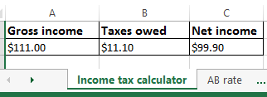
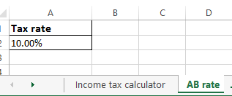
Referring To Other Worksheets
One worksheet can refer to information stored in another worksheet.
Example spreadsheet:
  5_multiple_worksheet_example
JT’s tip:
For examples like this you might want to take extra “in-class” notes
(It could be hard to understand the concepts at a level sufficient for the exam if you just look at the slides)

Slide 36
References Between Spreadsheets
In a fashion similar to using multiple worksheets, one spreadsheet can refer to information stored in another spreadsheet.
Example spreadsheets:
  6A_multiple_spreadsheet_example
  6B_multiple_spreadsheet_example

Slide 37
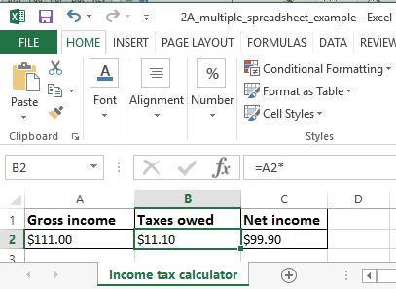
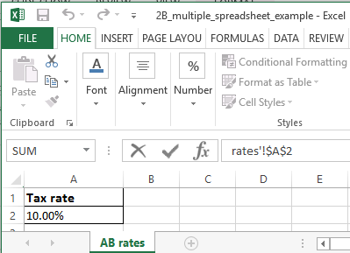
  6A_multiple_spreadsheet_example
  6B_multiple_spreadsheet_example
=A2*'[6B_multiple_spreadsheet_example.xlsx]AB rates'!$A$2

Slide 38
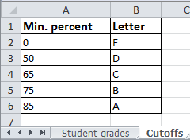
Why Use Cross References?
A typical reason why one worksheet may refer to another or one spreadsheet may refer to another is that the second worksheet or spreadsheet contains data that needs to be “looked up” (e.g., a lookup table)
Examples where cross reference lookups may be needed:
  Grade cutoffs
  Tax brackets
  Product numbers (lookup a product number to get more information about the product)

Slide 39
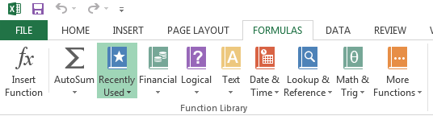
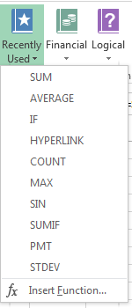
Pre-Created Excel Formulas

Slide 40
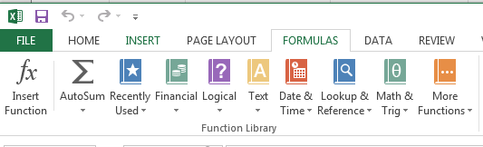
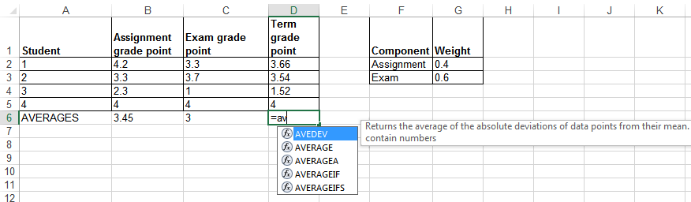
What Function Is Right For Your Situation?
Excel provides reminders.
Recall the location of built in functions.
Also Excel provides “name completion”

Slide 41
Input Format For Excel Functions
Required input is typically a range of cells
  Format:
  =function(<start cell> : <end cell>)
  Example:
  =average(A1:A3)
Alternatively input may be fixed inputs (type data directly into the brackets)
  =average(20,30,10)
  =lower("Jim *the JeT* TAM")
Optional function arguments
  Distinguished by the use of square brackets [option]
  find(<find text>, <within text>, [<start position>])

Slide 42
Basic Statistics
Example spreadsheet:
  7_basic_statistics
Example formulas: sum(), average(), min(), max()
General usage:
  Each formula requires as input a series of numbers
  E.g., formula(1,2,3):
    Sum = 6 , =sum(1,2,3)
    Average = 2 , =average(1,2,3)
    Min = 1 , =min(1,2,3)
    Max = 3 , =max(1,2,3)

Slide 43
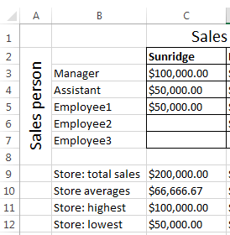
Basic Statistics (2)
The series of numbers can allow refer to a range of cells
  formula(<start cell> : <end cell>)
=SUM(C3:C7)
=AVERAGE(C3:C7)
=MAX(C3:C7)
=MIN(C3:C7)

Slide 44
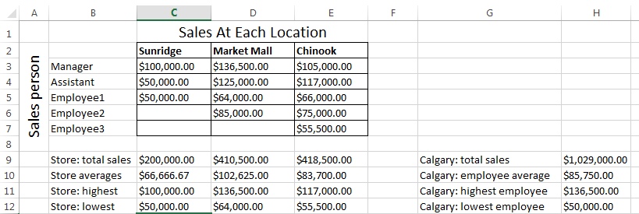
Basic Statistics (3)
Ranges can span multiple rows and columns
=SUM(C3:E7)

Slide 45
Counting Functions
All of these functions tally up the number of cells that do or do not contain a certain type of data e.g., numbers
General usage (all these formulas will require this information although one requires additional data).
  function(<start cell range> : <end cell range>)
  An array (list) of numbers can be the function argument but this is rare e.g., =COUNT(1,"A",2)
Example spreadsheet:
  8_counting_functions

Slide 46
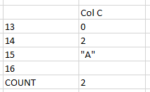
Counting Functions: Count()
Counts the number of cells within the specified range that contain numbers
https://support.office.com/en-US/article/COUNT-function-A59CD7FC-B623-4D93-87A4-D23BF411294C
=COUNT(C13:C16)

Slide 47
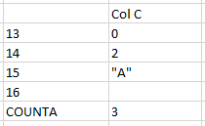
Counting Functions: Counta()
Counta()
  Counts the number of cells within the specified range that aren’t empty
  https://support.office.com/en-US/article/COUNTA-function-7DC98875-D5C1-46F1-9A82-53F3219E2509
=COUNTA(C13:C16)

Slide 48
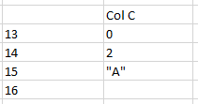
Counting Functions: Countblank()
Countblank()
  Counts the number of empty cells within the specified range
  https://support.office.com/en-US/article/COUNTBLANK-function-6A92D772-675C-4BEE-B346-24AF6BD3AC22
=COUNTBLANK(C13:C16)

Slide 49
String
A series of characters which include alphabetic characters, numeric digits and special characters such as space, punctuation or other symbols (#,$...).
String is another name for text

Slide 50
Excel String Functions
Functions that act on strings
Converting or changing alphabetic text
  Change text from one form to another
  lower(), upper(), proper()
Processing text
  Remove spaces
  Trim()
Connecting text:
  connecting a string or a part of that string with another string e.g. title with surname or first name
  concatenate()

Slide 51
Excel String Functions (2)
Extract selected portions of text:
  A specific number of characters from some position are to be extracted from a string e.g., area code or country code from a phone number
  left(), right(), mid()
Searching text (useful support function when extracting text)
  Finds the starting position of one string within another string
  find()

Slide 52
Functions That Convert Text
Example spreadsheet:
  “9_converting_text”
  lower()
    Converts non-lower case alphabetic characters to lower case
    https://support.office.com/en-US/article/LOWER-function-3F21DF02-A80C-44B2-AFAF-81358F9FDEB4
  upper()
    Converts non-upper case alphabetic characters to upper case
    https://support.office.com/en-US/article/UPPER-function-C11F29B3-D1A3-4537-8DF6-04D0049963D6
  proper()
    For alphabetic text it converts the letters to ‘proper’ format:
      All letters are lower case except for the first letter of each word (which is capitalized)
    https://support.office.com/en-US/article/PROPER-function-52A5A283-E8B2-49BE-8506-B2887B889F94

Slide 53
Functions For Extracting And Connecting Text
Example spreadsheet:
  “10_extracting_connecting_text”
trim():
  Removes leading or trailing spaces (ignores single spaces within text)
  Format: trim(<string>)
  Examples:
    Trim(" james ")
    Trim("a b ")
  https://support.office.com/en-US/article/TRIM-function-410388FA-C5DF-49C6-B16C-9E5630B479F9
concatenate():
  Connects two or more strings
  Format: concatenate(string1, string2…)
    A string can be fixed e.g., concatenate(“wa”,”sup”) or the address of a cell e.g., concatenate(A1,”!”)
  https://support.office.com/en-US/article/CONCATENATE-function-8F8AE884-2CA8-4F7A-B093-75D702BEA31D

Slide 54
Functions For Extracting And Connecting Text (2)
left():
  Extracts the specified number of characters from the left side of the specified string.
  Format: left(<string>, <length>)
    String: the source string to extra characters from
    Length: the number of characters to extract
  https://support.office.com/en-US/article/Left-Function-D5897BF6-91F5-4BF8-853A-B63D7DE09681
  Examples:
    =left("Foo bar",2)
    =left("Foo bar",0)
    =LEFT("Foo",10)

Slide 55
Functions For Extracting And Connecting Text (3)
right():
  Extracts the specified number of characters from the right side of the string
  Format: right(<string>, <length>)
  https://support.office.com/en-US/article/Right-Function-C02A18A8-B224-437E-AABA-1B785C6C61BF
  Examples:
    =RIGHT("Foo!bar",2)
    =RIGHT("Foo",10)

Slide 56
Functions For Extracting And Connecting Text (4)
mid():
  Starting at the specified position, the function extracts the specified number of characters from the string
  Format: mid(<string>, <start>, <length>)
    String: the source string to extra characters from
    Start: the position in the string in which extraction should begin
    Length: the length of the sub-string to extract (sub-string begins at the position specified with the ‘start’ argument)
  https://support.office.com/en-US/article/Mid-Function-427E6895-822C-44EE-B34A-564A28F2532C
  Examples:
    =MID("not too hot",2,4)
    =MID("not too hot",8,55)
    =MID("not too hot",0,5)
    =MID("not too hot",7,0)

Slide 57
Functions For Extracting And Connecting Text (5)
find():
  Finds the starting position of one string within another string
  Format:
    find(<find text>, <within text>, [<start position>])
      Find text: search for the first occurrence of the find text within the within text
      Within text: the string on which the search is performed
      Start number (optional): the position of the ‘within text’ that you want the search to being
  https://support.office.com/en-US/article/FIND-function-06213F91-B5BE-4544-8B0B-2FD5A775436F
  Examples:
    =FIND("me", "james")
    =FIND("la","fa-la-la-la-la")
    =FIND("la","fa-la-la-la-la",6)
    =FIND("x","XYZ")

Slide 58
Combinations: Find(), Mid()
The return value of one function can be used as the argument of another function.
Consider this example
  Cell A10 contains the string “Apt #709, 944 Dallas Dr. NW”
  You wish to extract the apartment number information #ddd into a substring
  Assume that apartment numbers are always preceded by the number sign #
  Also you assume that apartment numbers are three digits in length
  You cannot make assumptions about the information that precedes the number sign (zero to ‘infinity’)
  Find() can be use to determine the start location of the apartment in the string
    FIND("#",A10)
  The start position of the apartment information can be used as one of the arguments for an extraction function

Slide 59
Combinations: Find(), Mid(): 2
  =MID(A10, ,4)
  But you can’t always assume that the apartment information begins at position five.
    “Apt #709, 944 Dallas Dr. NW”
    “#123, 4944 Dalton Dr NW”
    So the return value from find() must be used to first determine the location of the apartment information.
    Next this information is used as one of the arguments for the mid(), string extraction function.
    All together: “=MID(A10,FIND("#",A10),4)”
5
FIND("#",A10)
5
=MID(A10, ,4)

Slide 60
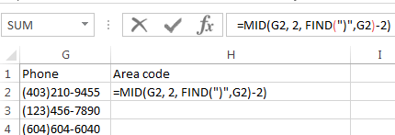
Why Bother?
When would you ever use Excel functions this way?
Sometimes the data has already been entered into the sheet
  Data may combine fields or include extraneous information:
  403-123-4567 (postal code and phone number combined, dash)
  (403)111-2222 (as above but adds additional brackets)
Labor saving
  Retyping a large dataset may be time consuming
  Solve the problem once and then reuse (copy and paste) the trimming formula wherever else it is needed

Slide 61
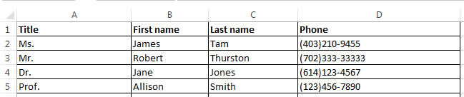
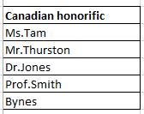
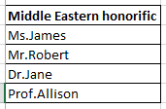
Why Bother? (2)
Different views of the same data may be needed (from an earlier example sheet): 10_extracting_connecting_text
  In Canada the proper greeting will be “Dr. Jones”
  =CONCATENATE(A2,C2)
  In other countries the proper greeting will be “Dr. Harry”
  =CONCATENATE(A2,B2)

Slide 62
Why Bother? (3)
It may useful to be familiar with these functions for the future!
    Job interviews, the exams, the bonus feature of A2 ;)

Slide 63
Lecture Exercise #1: String Functions

Slide 64
Lecture Exercise #1: String Functions

Slide 65
Lecture Exercise #2: Tracing String Functions

Slide 66
Lecture Exercise #3: String Functions (You Do)

Slide 67
Date And Time Functions
Example spreadsheet:
  “11_date_time”
today()
  Displays the current date (month/day/year) e.g., 07/15/2015
now()
  Displays the current date (as above) and time (hour/minute with a 24 hour clock) e.g., 18:42
Both: determine the time/date based on the settings of the computer on which the worksheet is run.
  Updates occur when the files is opened or when the spreadsheet recalculates new values.

Slide 68
‘If-Else’ (Branching)
Grade point >= 1.0
Function returns one value if a condition has been met.
  “If condition met do an action”
Function can return another value if the condition hasn’t been met.
  “Else if the condition not met do another action”
Boolean (logic): either true or false that the condition was met
True
False
“Passed”
“Failed”

Slide 69
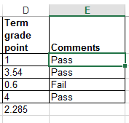
Applying Branches: Grade Example
In column ‘E’ the sheet will display “Pass” if term grade point is 1.0 or greater “Fail” otherwise.
  Example spreadsheet: 12_if_else_pass_fail
Condition
Action: condition true
=IF (D2>=1, "Pass", "Fail")
Action: condition false - “else case”

Slide 70
Format: If-Else
Format:
  =if (<condition to check>,
  <return value: condition true>,
  [<return value: condition false>])
Example:
  =IF(D2>=3, "Pass", "Fail")
Note: the return value is not limited only to text
https://support.office.com/en-US/article/IF-function-69aed7c9-4e8a-4755-a9bc-aa8bbff73be2?CorrelationId=6aeb3056-a94b-47ac-af6e-90dff250a029

Slide 71
Comparators
Math | Excel | Meaning
< | < | Less than
> | > | Greater than
= | = | Equal to
≤ | <= | Less than, equal to
≥ | >= | Greater than, equal to
≠ | <> | Not equal to

Slide 72
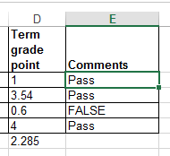
If: Specifying Only The True Case
If only a return value for the true case has been specified:
  When the condition has not been met (false that the condition has been met) i.e., “Has the student passed the course?”…literally the text “FALSE” will be displayed.
  No spreadsheet example has been provided because this implementation is incorrect
    To see the result you can edit the previous sheet and just delete the false case “Fail” message (‘Column E’ data).
=IF(D2>=1,"Pass")

Slide 73
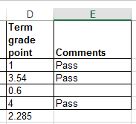
If: Specifying Only The True Case (2)
Consequently:
  Even if a specific return value is desired only for the ‘if condition case’ (true that the condition has been met)
  Something, even an empty message, should be specified for the ‘else case’ (false that the condition has been met).
Previous example: amended
  Example spreadsheet: 13_if_pass_only
=IF(D2>=1,"Pass","")

Slide 74
Nested Conditions
Conditions that are dependent upon or are affected by previous conditions.
‘Nesting’ refers to conditions that are ‘inside of other conditions’
Example (assume that the respondent previously indicated that his or her birthplace was an Alberta city)
Select the AB city in which you were born
  Airdrie
  Calgary
  Edmonton
  …
  Selecting Airdrie excludes the possibility of selecting Calgary
  Cities listed later are ‘nested’ in earlier selections)

Slide 75
Nested Conditions (2)
Applies when different conditions must be checked but at most only one applies (exactly 0 or 1 conditions can be true)
Example:
  Display “Perfect” if grade point is 4.0 or greater
  Display “Excellent” if grade point is 3.0 or greater but less than 4.0
  Display “Adequate” if grade point is 2.0 or greater but less than 3.0
  Display “Pass” if grade point is 1.0 or greater but less than 2.0
  Otherwise display “Fail”
Example spreadsheet: 14_nested_if_grades

Slide 76
Previous Grade Example: Specifying Conditions
GPA >= 4.0?
True
“Perfect”
False
Nesting
Later conditions are described as being ‘nested’ within earlier conditions
The GPA cases for 3.0, 2.0, 1.0 are described as being ‘nested’ within the 4.0 case (only checked if the previous case proves to be false)
GPA >= 3.0?
True
“Excellent”
False
GPA >= 2.0?
True
“Adequate”
False
GPA >= 1.0?
True
“Pass”
False
“Fail”

Slide 77
Nested “If’s”
Format:
  =IF(<condition to check>,<return: true>,[<return: condition false>])
Example:
  =IF(D5>=4,"Perfect", )
Another if-check
if (<condition to check>, <return: true>, <return: false>)
IF(D5>=3,"Excellent","")

Slide 78
Previous Example: Initial Cases
If GPA >= 4.0 “Perfect”, if 3.0 <= GPA < 4.0, “Excellent”
TRUE >= 4.0
TRUE >= 3.0
FALSE >= 4.0

Slide 79
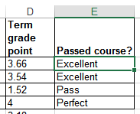
Previous Example: Nested Solution
T
=IF(D2>=4,"Perfect",
IF(D2>=3,"Excellent",
IF(D2>=2,"Adequate",
IF(D2>=1,"Pass",
"Fail"))))
F
=IF(D2>=4,"Perfect",IF(D2>=3,"Excellent",IF(D2>=2,"Adequate",IF(D2>=1,"Pass","Fail"))))

Slide 80
Lookup Tables
Can (should/must) be employed instead of many nested IF’s.
  Easier to enter, update, understand.
Requirements of previous example:
  0 <= GPA < 1: Fail
  1 <= GPA < 2 : Pass
  2 <= GPA < 3 : Adequate
  3 <= GPA < 4 : Excellent
  GPA >= 4 : Perfect
Previous solution:
=IF(D2>=4,"Perfect",IF(D2>=3,"Excellent",IF(D2>=2,"Adequate",IF(D2>=1,"Pass","Fail"))))

Slide 81
Lookup Functions
The lookup functions that will be covered this semester will be used in conjunction with a lookup table or tables.
Two lookup functions covered include:
  LOOKUP()
  VLOOKUP()
  (Not that the ‘IF’ is not classified as a lookup function!)
For a complete list of lookup functions in Excel:
  https://support.office.com/en-US/article/Lookup-and-reference-functions-reference-8aa21a3a-b56a-4055-8257-3ec89df2b23e

Slide 82

LOOKUP
https://support.office.com/en-US/article/LOOKUP-function-446D94AF-663B-451D-8251-369D5E3864CB
Typical use:
  Looking up a value from one column (“a vector”)
  Return a value from another column (“a vector”)
  (According to Microsoft): if you want to look up values from multiple columns (“an array”) then the VLOOKUP function should be used instead of LOOKUP.
=CONCATENATE(F1, LOOKUP(B2,E4:E5,F4:F5))
LOOKUP(B2,E4:E5,F4:F5)

Slide 83
LOOKUP (2)
Format:
  LOOKUP(<Lookup value>,
  <Lookup column (vector) Start : End>,
  <result column (vector) Start : End>)

Slide 84


LOOKUP (3)
Example spreadsheet: 15_lookup
Row 2 data
  =LOOKUP(D2, D11:D15, E11:E15)
Cell:
Contains value to find in table e.g., a grade point
Lookup column:
Start : End
cell coordinates
Result column:
Start : End
Cell coordinates

Slide 85

LOOKUP (4)
=LOOKUP(D3,D11:D15,E11:E15)
D
E
Min. GPA | Comment
0 | Fail
1 | Pass
2 | Adequate
3 | Excellent
4 | Perfect
11
12
13
14
15
>3.54?
>3.54?
>3.54?
>3.54?
⬅ Backup and use this value Return “Excellent”
>3.54?..Yes!
  LOOKUP table Values must be sorted in ascending order

Slide 86


LOOKUP: Multi-Column Lookup Table
Name of example spreadsheet: 16_lookup_multiple_columns
Lookup table
LOOKUP function

Slide 87
VLOOKUP
A more complicated (but more powerful) version of a lookup function.
https://support.office.com/en-US/article/VLOOKUP-function-0BBC8083-26FE-4963-8AB8-93A18AD188A1
Format:
  VLOOKUP(<Lookup value>,
  <Lookup table Start : End>,
  <Lookup table Column specifying the return value>,
  [<Exact match required?>])
Example:
  =VLOOKUP(D2, D11:E15, 2)
Cell:
Contains value to find in table e.g., a grade point
Lookup table:
Start : End
cell coordinates
Lookup table:
Column value to return
(1 = first col. ‘D’,
2 = second col. ‘E’)

Slide 88

VLOOKUP: Previous Example
=VLOOKUP(D2,D11:E15,2)
D
E
Min. GPA | Comment
0 | Fail
1 | Pass
2 | Adequate
3 | Excellent
4 | Perfect
11
12
13
14
15
  Example spreadsheet: 17_vlookup

Slide 89


VLOOKUP: Multi-Column Lookup Table
Name of example spreadsheet: 18_vlookup_multiple_columns
Lookup table
Lookup function

Slide 90
VLOOKUP: Optional Value = TRUE (True = Approximate matches allowed)
VLOOKUP(=VLOOKUP(D2,D11:E15,2,TRUE))
TRUE (works like LOOKUP so values must be sorted)
  Look for an approximate match.
  If an exact match is not found, the next largest value that is less than lookup value is returned.
  If T/F value is omitted then the function assumes a ‘TRUE’ value.
GPA = 3.54
Min. GPA | Comment
0 | Fail
1 | Pass
2 | Adequate
3 | Excellent
4 | Perfect
>3.54?
>3.54?
>3.54?
>3.54?
⬅ Backup and use this value Return “Excellent”
>3.54?..No!

Slide 91


VLOOKUP: Optional Value = FALSE (False = Approximate matches Not allowed, exact matches required)
VLOOKUP(=VLOOKUP(D2,D11:E15,2,FALSE))
FALSE:
  Looks only for an exact match
  If a match is found then the value at the specified location is returned.
  Else if no match is found the an error message is displayed.
  Table values do not have to be sorted.

Slide 92
VLOOKUP: Optional Value = TRUE/FALSE
TRUE
  Use when looking a value in a range of values (must be in ascending order) E.g. grades, tax brackets
FALSE:
  Use when there is an exact value to lookup (order is not important) e.g., SIN numbers, product ID number
Income range | Min for range | Tax rate
0 - $20,000 | 0 | 0%
> $20,000 | 20,000 | 10%
Product number | Name | Price
B00KAI3KW2 | Xbox One | $449
B00BGA9WK2 | Playstation 4 | $449
Notes:
Not in order

Slide 93


Example: Sensible Use Of False/VLOOKUP
Name of example spreadsheet: 19_vlookup_false
Reminder:
  Use when exact matches are required
  Lookup table does not have to be sorted
Lookup table
Lookup function

Slide 94
Looking Values: If Function Vs. Lookup Functions
Multiple If’s:
  Can be used if there are only a handful of conditions to check (rule of thumb: 2 – 3 max e.g., 2 conditions)
  Complex and error prone for anything else (e.g. 5 conditions)
Lookup functions
  Steeper learning curve (but a “one-time investment”)
  Once learned the formulas are simpler (no nesting) and less error prone
=IF(D2>=3, "Honors",IF(D2>=0, "Pass","Fail"))
=IF(D2>=4,"Perfect",IF(D2>=3,"Excellent",IF(D2>=2,"Adequate",IF(D2>=1,"Pass","Fail"))))
  =VLOOKUP(D2, D11:E15, 2)
Min. GPA | Comment
0 | Fail
1 | Pass
… | …

Slide 95
When To Use The If-Function
When multiple conditions must be checked
  Combined with the logical operators (typically AND, OR although NOT may also be used)

Slide 96
Logical Operations In Excel
The basic logical operations: AND, OR, NOT can be invoked as functions in Excel
  All function inputs can only be a True or False value.
Format:
  AND(<True or False>,<True or False>...)
  OR(<True or False>,<True or False>...)
  NOT (<True or False>)
Examples (spreadsheet name: 20_logic
  AND(C1>=45,D1="John Smith") # Requires all
  OR(C1>=0,D2>=0) # Requires at least one
  NOT(AA12) # AA12 Must contain a logical: TRUE, FALSE Value

Slide 97

Logic And IF’s: Example
The honor roll for each semester requires that grade point is 3.7 or greater and a full load of at least 5 courses must be taken.
AND Example: Honor roll
  Signify when a student has met the honor roll requirements with an “H”, blank cell otherwise.
Example spreadsheet: 21_if_logic
=IF(AND(B5>=3.7,C5>=5),"H","")

Slide 98


Logic And IF’s: Example (2)
OR Example: Hiring if at least one requirement met (work experience of 5+ years, grade requirement of 3.7 or higher)
E12
=IF(OR(E12>=5,G16>3.7),"1+ requirement met","")
G16

Slide 99
Lecture Exercise #4: Branching (And Other) Functions

Slide 100
Conditional Counting Functions
Increases a tally count if one or conditions have been met
COUNTIF(): count if a particular condition has been met
COUNTIFS(): count if all conditions have been met

Slide 101
Counting Functions Based On Conditions: Countif()
Counts the number of cells that meets a particular requirement
  https://support.office.com/en-US/article/COUNTIF-function-E0DE10C6-F885-4E71-ABB4-1F464816DF34
=COUNTIF(C13:C16,">0")

Slide 102
Counting Functions Based On Conditions: Countif(), 2
=COUNTIF(C13:C16,"B")

Slide 103
Counting Functions Based On Conditions: Countifs(), 3
Can be used when multiple requirements must be met:
  Counts the number of cells that meets all in a series of multiple requirements
  https://support.office.com/en-US/article/COUNTIFS-function-DDA3DC6E-F74E-4AEE-88BC-AA8C2A866842
Format:
  =countifs(
  <range 1>, <criteria 1>,
  … <optional additional range>, [<optional additional
  criteria>])
Example spreadsheet: 22_conditional_counting_formulas
  =countifs(A1:A10,"A", B2:B7, ">=100")

Slide 104


Counting Functions: Countifs(), 4
Col C
Col D
14
15
16
17
18
19
Specify: count number of employees that met the
quota for both months

Slide 105
Conditional Formatting
A very practical example of how conditional branching “if’s” can be applied.
Use of conditional formatting will be covered in tutorial.

Slide 106
Methods Of Referring To Cells
Absolute:
  The formula won't change if you copy/cut and paste the formula or if the spreadsheet changes in size
Relative
  The formula changes depending how far that the formula is moved or how much the spreadsheet is changed in size.

Slide 107

Absolute Reference
When a reference to an cell or range of cells doesn’t change when the contents of a cell or cells is copied or the sheet changes in size.
Assumption
Row 10 sums row 4 – 9.
Original formula (B12)
=$B$1-B10
Copied (C12)
=$B$1-C10

Slide 108
Absolute Reference (2)
Original formula (B12)
=$B$1-B10
Copied (C12)
=$B$1-C10
Absolute reference
Absolute reference
Absolute reference because the same (absolute) reference to cell B1 is made when the formula is copied.

Slide 109
Absolute Reference (3)
Typically it’s used in conjunction with constants (data that won’t change).
References to B1 are absolute because income doesn’t change
Original formula (B12)
=$B$1-B10
Copied (C12)
=$B$1-C10

Slide 110
Relative Reference
A reference to a cell or group of cells that may change if the cell/cells are copied or the sheet changes in size.
Original formula (B12)
=$B$1-B10
Copied (C12)
=$B$1-C10

Slide 111
Relative Reference (2)
Reminder:
Total expenses (row 10) is a calculated value. It sums rows 4 – 9.
Original formula (B12)
=$B$1-B10
Copied (C12)
=$B$1-C10
Relative reference
Relative reference
Relative reference because the copied formula will change relative to how far it’s copied.

Slide 112
Relative Reference (3)
Typically it’s used with variable data (that may change over time or in different parts of the sheet).
Total expenses may change from month-to-month so references will likely be relative.
Original formula (B12)
=$B$1-B10
Copied (C12)
=$B$1-C10

Slide 113
Cell References: Important Details
Format: specify absolute cell references with a dollar sign ‘$’ immediately in front of the row or column value.
  [<dollar sign for column>]<column> [<dollar sign for row>]<row>
Examples:
  Relative column, relative row: A1
  Relative column absolute row: A$1
  Absolute column, relative row: $A1
  Absolute column, absolute row: $A$1

Slide 114

Absolute, Relative And Mixed References: Examples¹
Example | Reference type | Copied result
$A$1 | Absolute column Absolute row | $A$1
A$1 | Relative column Absolute row | C$1
$A1 | Absolute column Relative row | $A3
A1 | Relative column Relative row | C3
1 Examples from the Excel 2003 Help System

Slide 115

Absolute, Relative References: Example
Example spreadsheet: 23_absolute_relative
To E7
To G8
COLUMN F
ROWS
11
12
13
14
Original formulas (result)
=$C$4 (4)
=B$3 (1)
=$A2 (2)
=A2 (2)
To D14
To G16

Slide 116
Absolute/Relative Applied To A Previous Example
Which part of the formula should be:
  Absolute?
  Relative?
  Why?
= (B3*G3)+(C3*G4)
= (B4*G4)+(C4*G5)

Slide 117
Lecture Exercise #5: Absolute, Relative Addressing (If There Is Time)

Slide 118
Testing Spreadsheets
Test formulas to ensure that they are correct.
  Enter a few test values and see if the results match expectations.
  Simple interest example:
  Amount = Principle + (Principle * Interest rate * Time)
  E.g., $100 at 10% for 3 years
  Amount = 100 + (100 * 0.1 * 3)
  = 100 + (30)
  = $130
  Some example test cases:
  Nothing to invest: principle is nothing, everything else non-zero.
  Interest rates are rock bottom: zero interest rates, everything else non-zero
  No time passed: time is zero, everything else non-zero.
  Normal case: Non zero values for: principle, interest or time.

Slide 119

Example Testing A Formula
<- All non-zero
<- No principle
<- No interest
<- No time elapsed

Slide 120
Testing Ranges
Min. GPA | Comment
0 | Fail
1 | Pass
2 | Adequate
3 | Excellent
4 | Perfect
The following are the minimum test cases
Provide test values for each range
  In this example try grade points of 0, 1, 2, 3, 4
Also for at least one of the ranges test the boundaries (just above and below)
  Example: testing the boundary for 1 / “Pass”
    Slightly below a boundary value e.g., 0.9 should return “Fail”
    Slightly above a boundary value e.g., 1.1 should return “Pass”
Total test cases for this example: 7 tests

Slide 121

Example: Good Design And Testing
Previous grading example: the following will likely be data (cannot be calculated from other values in the sheet)
Values that will be determined by the data
  Term grade point (calculated), comments (lookup)s

Slide 122

Term Grade Point
How should this value be calculated?
First step: make it mathematically correct
  Assignment: proportion of term grade = 40%
  Exam: proportion of term grade = 60%

Slide 123
Term Grade Point (2)
Second step: make sure that you follow good style:
  Be ‘lazy’, minimalize your work!
    If a value can be determined by existing data then don’t manually enter the value e.g., term grade point can be calculated by the grade points of each component and their weights.
      Future grade changes are easier to make
      Also reduces errors)
      Allow for reuse of the formula (copy-and-paste): correct application of absolute vs. relative addressing
Derive it, don’t type it
Once

Slide 124

Term Letter Grade
How should this value be derived?
  Use the cutoff values in the table below.
  Remember it must be correct AND it should follow good style conventions.

Slide 125
Absolute, Relative: Completed Example
  Spreadsheet solution name (don’t look at contents before we go over the concepts in lecture) 24_DONT_LOOK_B4_CLASS_ vlookup_absolute_relative_addressing

Slide 126
After This Section You Should Now Know
The benefit of electronic over paper spreadsheets
Spreadsheets 101: The basic layout and components of a spreadsheet
What is a worksheet
  When to use multiple spreadsheets vs. multiple worksheets
  How to reference data in other spreadsheets or worksheets (cross references)
How Excel groups functions according to tabs on the ribbon
  What are the most commonly used tabs and what some of the functions available on those tabs
Entering data: manually and via autofill
How to freeze data

Slide 127
After This Section You Should Now Know (2)
Tags
  How to do tag a spreadsheet
  What is the benefit of using tags
Common mathematical operators and the order of operation
What is the difference between constants (data) and calculations (formulas)
  How is a formula differentiated from data
The three rules of thumb for designing spreadsheets
  Don’t make something data if it can be derived
  Label everything
  Don’t duplicate data

Slide 128
After This Section You Should Now Know (3)
Lookup tables
  How to create a use a lookup table
Formulas:
  Directly entering custom formulas
  Using built-in pre-created formulas
  What is the order of operation for common operators
How to format cells using the “format cell” option
  What is the effect of different numeric formatting options
How to use basic statistical formulas: sum(), average(), min(), max()
How to use counting functions: count(), counta(), countblank, countif(), countifs()

Slide 129
After This Section You Should Now Know (4)
How to use string functions: lower(), upper, proper(), trim(), concatenate(), find(), left(), right(), mid()
How to use the today(), now() functions
How to use ‘if-else’ for branches that return different values
  The different ways of expressing logical comparators
  How to write or evaluate nested ‘if’s’
Logical operations in Excel: AND, OR, NOT
  How to write or evaluate logical operations
  How to apply the logical operations in conjunction with the ‘if-else’
How to use the LOOKUP(), VLOOKUP function

Slide 130
After This Section You Should Now Know (5)
How to come up with set of reasonable test cases for a spreadsheet
  Formulas and ranges
What is the difference between an absolute vs. relative cell reference and when to use each one

Slide 131
Copyright Notification
“Unless otherwise indicated, all images in this presentation are used with permission from Microsoft.”
Images of spreadsheets (save VisiCalc) are curtesy of James Tam

