Slide 1
Computer Security
In this section you will learn about different types of security threats and how to reduce your risk. Also privacy issues that are relevant to security will be discussed.

Slide 2

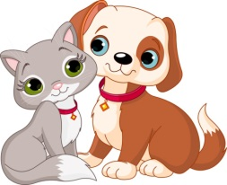
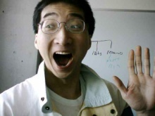
Test
You get a file attachment in a message, from which of the following people would should you accept it and why?
???
A total stranger
Someone you’ve only met on the Internet
Colourbox.com
Your best friend
Colourbox.com
This guy!!!

Slide 3
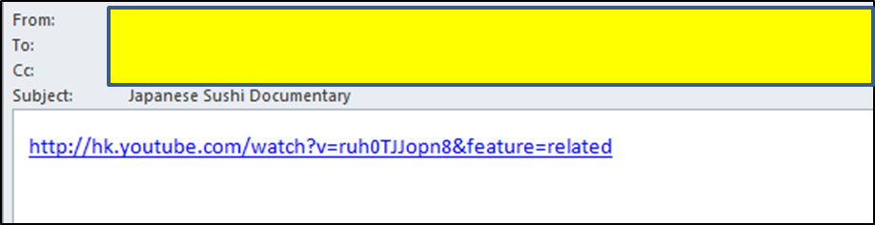
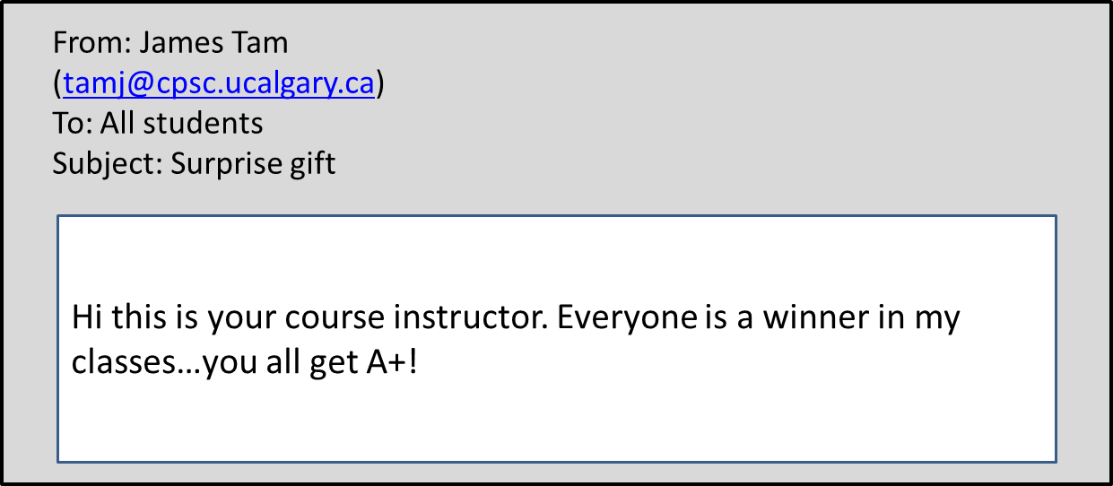
Examples
Click here to get your grade

Slide 4
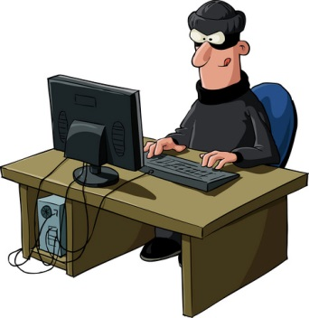
Hacker
A generic term for a person that writes malicious software (e.g., a virus that damages your computer) or tries to break into a computer system.
From: www.colourbox.com
One of many examples today: “Hacker attack leaves women angry, worried”
A security breach that exposed such personal information as the addresses and birth dates of more than 160,000 women enrolled in a mammography registry is raising questions about protecting people's privacy while at the same time making information available for much-needed research, an expert on bioethics said….
…from the Winston Salem Journal

Slide 5
“Hacked” Computer System
Refers to a computer system in which the security system has been compromised.
  “…to gain access to a computer illegally” (www.m-w.com)
  “To use one's skill in computer programming to gain illegal or unauthorized access to a file or network” (http://www.thefreedictionary.com)
  Allow access to the data on the computer(s)
It can be done in many ways:
  Sometimes it’s as simple as getting an administrator password
Sometimes this term is used in popular culture (even by news media outlets) for less serious security issues.

Slide 6
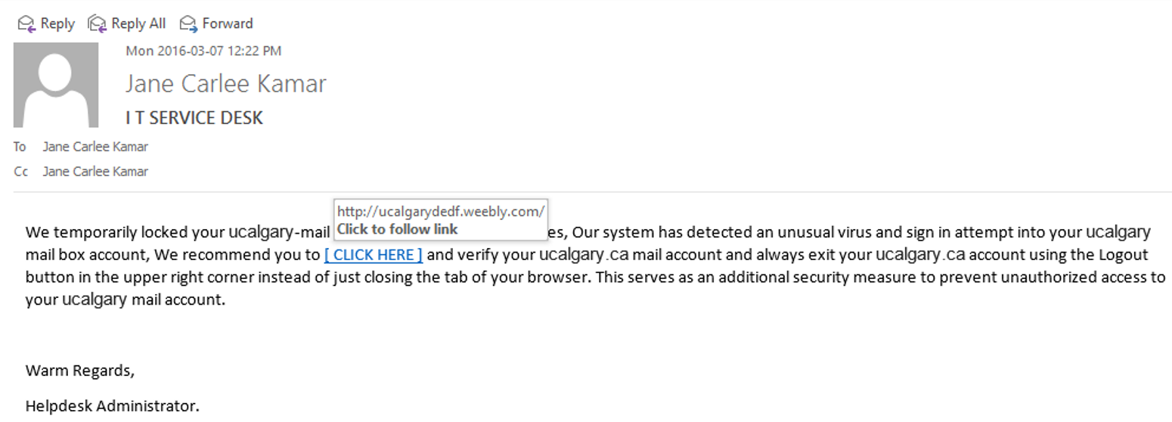
Phishing
An attempt to get another person to reveal personal or confidential information (such as passwords) through trickery.

Slide 7
Denial Of Service Attack
An attempt to make a service unavailable
  Repeatedly sending requests for information to the computer system
  “Crashing” the computer system that is under attack
The ‘attackers’ (owners of the computer(s) from which the attack has been launched) may be unaware of their involvement
  “Mydoom/MyDoom” infected computers
Symptoms
  Computer running more slowly
  Some processes taking up resources (processor time, memory – Task manager)
  Increase in network usage (ISP)

Slide 8
How Do The Following Affect Your Security?
My financial institution/workplace/university computer system has been:
  Hacked?
  Suffered from a Denial of service attack?
    http://montrealgazette.com/news/local-news/youve-been-hacked
Users of my financial institution/workplace/university computer system have fallen for a phishing scam?

Slide 9
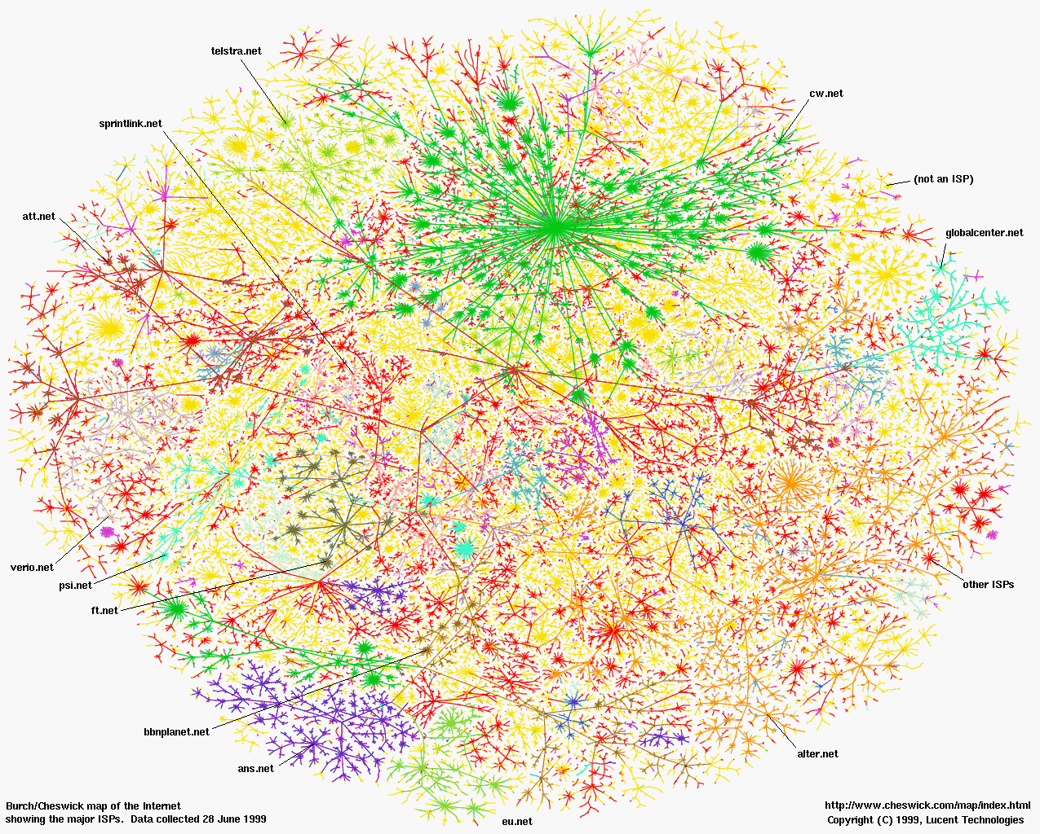

How To Guarantee Security Against Threats Such As Viruses
Disconnect your computer from the Internet
Leave your computer and devices off all the time
Put your computer in a vault
From: www.colourbox.com

Slide 10
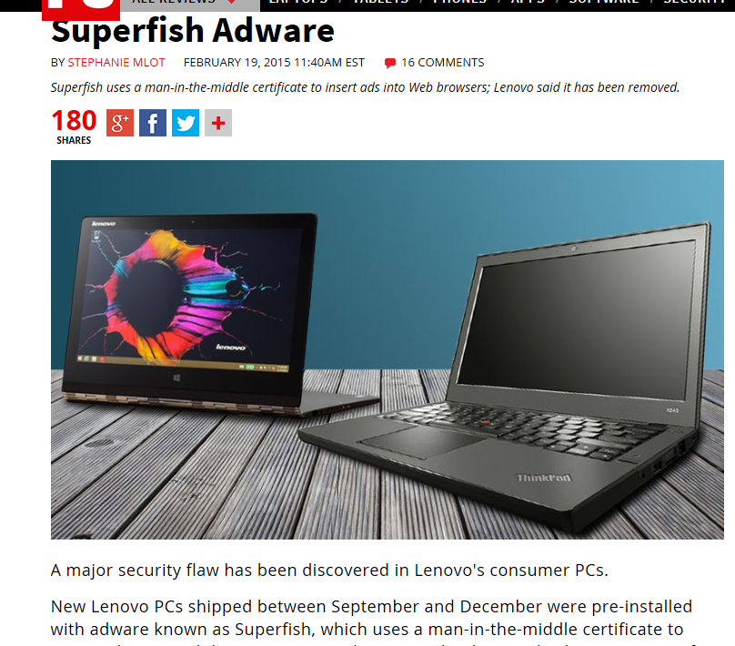
How To Guarantee Security Against Threats Such As Viruses (2)
“Simple”: just buy a brand new computer!
  Think again!
From PC mag (2015): http://www.pcmag.com/article2/0,2817,2477006,00.asp

Slide 11
How To Guarantee Security Against Threats Such As Viruses (3)
“Simple”:
  “Simple solution #1”: Just ‘nuke’ my computer (wipe all the drives and reinstall everything)
  “Simple solution #2”: Use a computer with an operating system other than MS-Windows like MAC-OS or Linux.
Computer hardware (i.e. not MS-Windows specific) can be infected with malicious software)
  This ‘infection’ cannot be removed by formatting the hard drive
  From
  http://www.forbes.com/sites/thomasbrewster/2015/03/18/hacking-tails-with-rootkits/
For more information on ‘infecting’ computer hardware with malicious software (CanWest security conference 2015)
https://cansecwest.com/agenda.html

Slide 12
How To Guarantee Security Against Threats Such As Viruses (4)
Lesson:
  You are never guaranteed to have 100% protection.
  Taking precautions (e.g., getting anti-virus software) provide a reduced chance of an infection or other security-related problem.

Slide 13
Malware (“Malicious Software”)
A program designed to infiltrate or damage a computer.
Most references to computer viruses are actually references to malware.
  The distinction is important because programs written to protect you from a virus may not offer you full protection against other forms of malware (you need a specialized program)
Categories of Malware:
  Computer viruses
  Worms
  Macro Viruses
  Trojans / Trojan Horses
  Spyware
  Note: there is much overlap between these categories e.g., a Trojan may also include spyware.

Slide 14
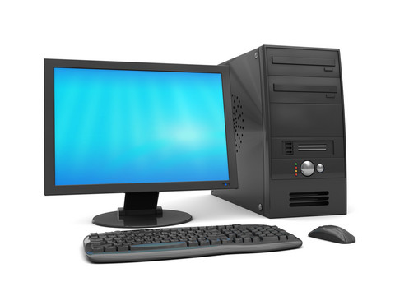
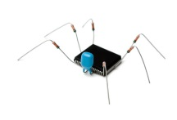


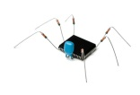
Computer Virus
Similar to a biological virus
The Internet
The infection and the replication process may or may not produce noticeable symptoms
Images from: www.colourbox.com

Slide 15
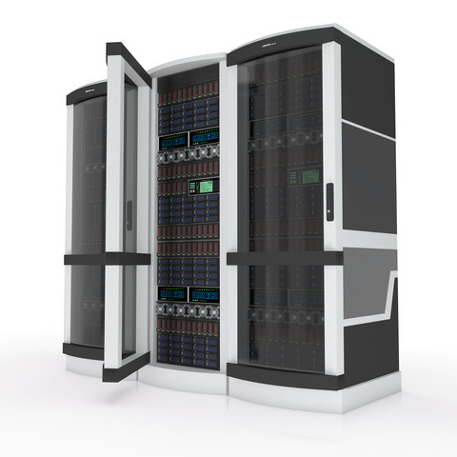

Computer Virus: Objective
For early virus writers the goal was simply infiltration of a computer or network.
At most the virus would result in some minor mischief
Department of National Defense
Woohoo I made it in!
Your PC is stoned!
Images from www.colourbox.com

Slide 16
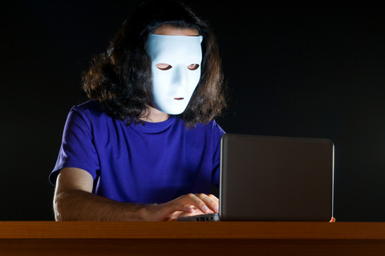
Computer Virus: Objective (2)
Some viruses were designed to be malicious or were ‘mutated’ into a malicious version.
Department of National Defense
Woohoo I made it in!
Your PC is stoned!
…and your hard drives are erased too!
Images from www.colourbox.com

Slide 17


Computer Virus: Objective (4)
Now a virus infection may be related to business or national espionage.
  This means that ‘serious’ resources can be put into ‘hacking’.
Woohoo I made it in! (rival company)
Department of National Defense
$$$
Woohoo I made it in! (Foreign intelligence agency)
National secrets
Images from www.colourbox.com

Slide 18
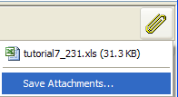
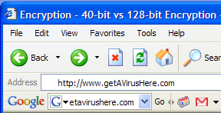
Computer Virus: Spread
Require human-intervention to spread:
  Opening email attachments
  Web-based: just going to a website can result in a infection “drive-by download”

Slide 19
I Can’t Get Infected Just Going To A Website!
Impossible you say?
  Come hither
  http://pages.cpsc.ucalgary.ca/~tamj/2016/203F/example_webpages/

Slide 20
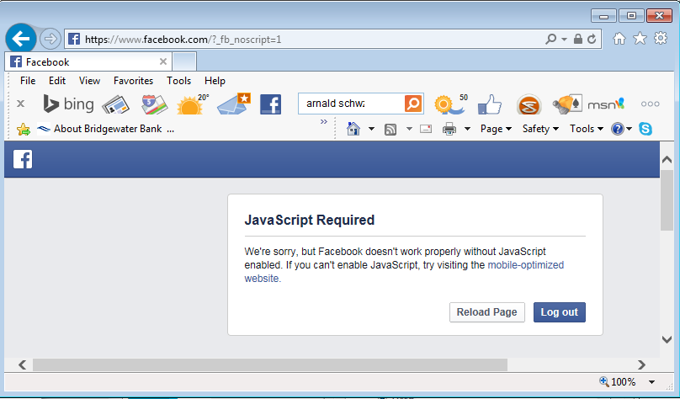
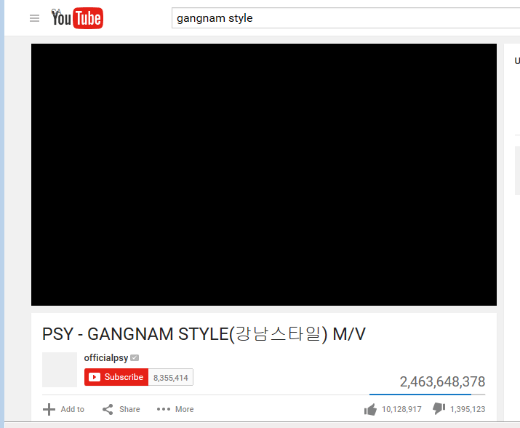
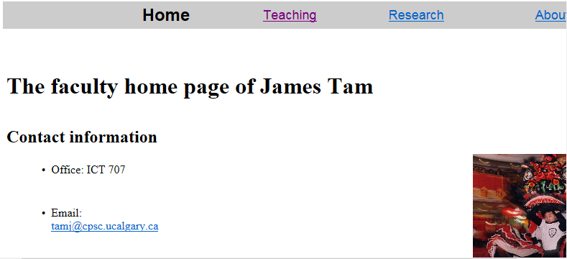
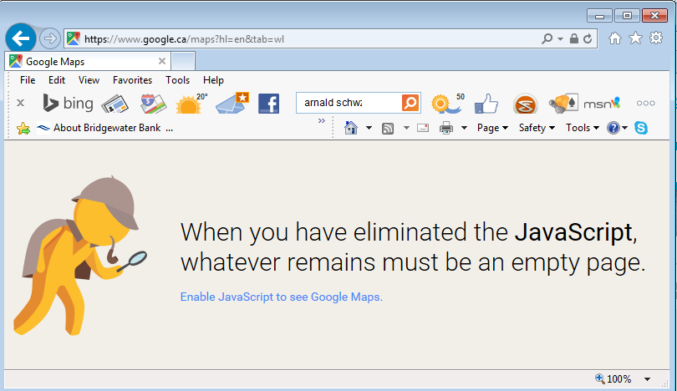
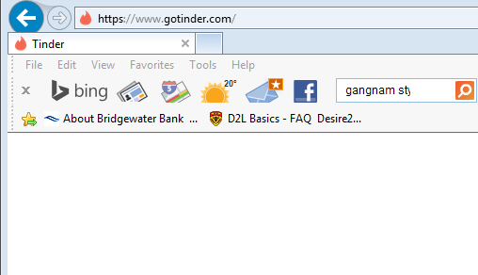
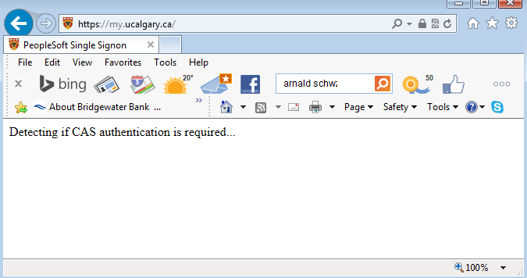
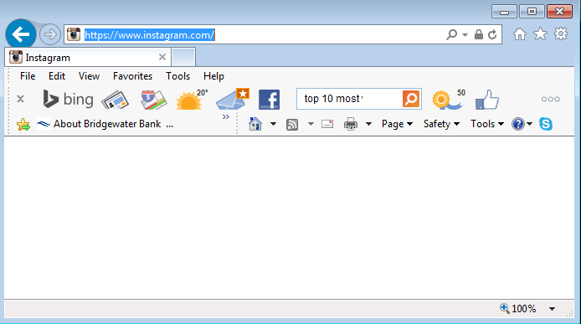
“Just Disable Web Scripts: Problem Solved!....NOT”
A-OK!

Slide 21
“Top 10 Celebs [JT: Searching For Info. About Them] Most Likely To Give You A Computer Virus”¹
2013
1) Lily Collins
2) Avril Lavigne
3) Sandra Bullock
4) Kathy Griffin
5) Zoe Saldana
6) Katy Perry
7) Britney Spears
8) Jon Hamm
9) Adriana Lima
10) Emma Roberts
2012
1) Emma Watson
2) Jessica Biel
3) Eva Mendes
4) Selena Gomez
5) Halle Berry
6) Megan Fox (up from #15!)
7) Shakira
8) Cameron Diaz
9) Salma Hayek
10) Sofia Vergara
2011
1) Heidi Klum
2) Cameron Diaz
3) Piers Morgan
4) Jessica Biel
5) Katherine Heigl
6) Mila Kunis
7) Anna Paquin
8) Adriana Lima
9) Scarlett Johansson
10) Tie! Emma Stone, Brad Pitt and Rachel McAdams
1 Source: http://www.mcafee.com/us/microsites/most-dangerous-celebrities/index.html

Slide 22
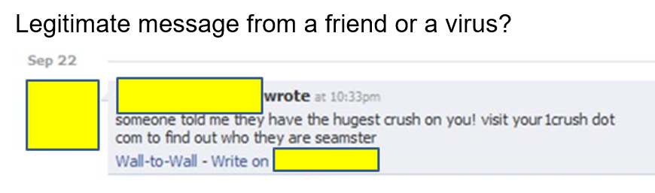
Computer Virus: Avoiding?
“Solution”: Just don’t go to *bad* websites
  “Trusted websites may inadvertently be used as part of a virus attack.
Examples:
  Facebook Virus Infecting 'Friends' List: Prompts Users to Download Video
    http://www.canada.com/globaltv/ontario/story.html?id=48291ac4-f3c5-465c-b172-80299e4ca5dc
  Provocative messages from your contacts that tempts viewers to follow a link:

Slide 23
Computer Virus: Avoiding?
  Also it’s not just personal accounts that can be hacked but also the entire website itself or the company’s computers/database.
    http://www.ibtimes.com/hacks-cost-sony-pictures-entertainment-15-million-investigation-cleanup-costs-1850048
    http://money.cnn.com/2014/01/10/technology/security/target-hack-tips/index.html
  The means you can get infected by just visiting one of your favorite websites (without clicking on potentially malicious links)

Slide 24
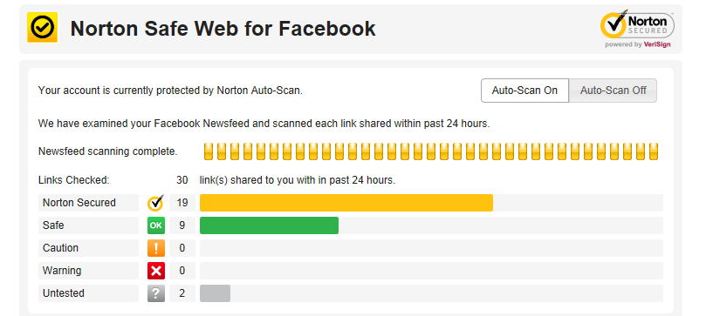
Useful Side Note: Evaluating Security Of Facebook Links

Slide 25
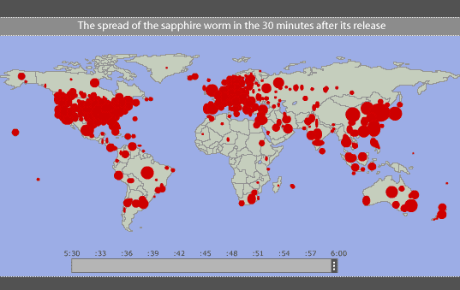
Worms
Unlike a virus a Worm can spread without human intervention.
  Many worms have automatically infected computers e.g., ‘Slammer’ (2003)
For detailed information (Symantec anti-virus)
  http://www.symantec.com/security_response/writeup.jsp?docid=2003-012502-3306-99
Image and facts from www.pbs.org (Accessed in 2015)
At it’s peak Slammer doubled in size every 8.5 seconds
Within 10 minutes it infected 90% of the worlds vulnerable host computers

Slide 26
Worm: Consequences Of An Infection
Worms are designed to automatically spread themselves (ties up computer resources trying to infect other computers ).
They may have other negative effects similar to a virus.
  “My computer is so slow”
  My computer is acting ‘funny’

Slide 27
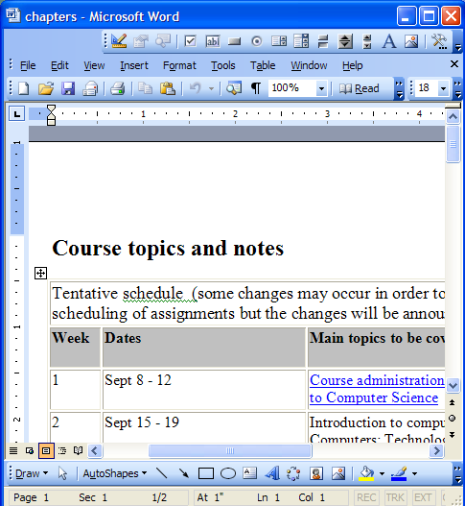
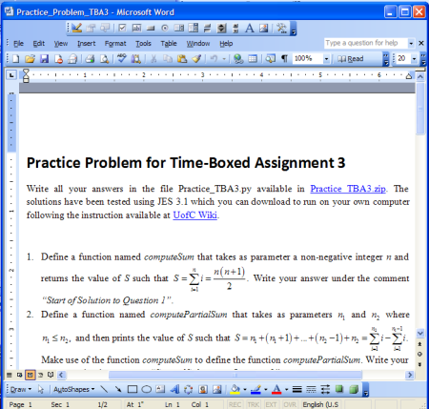

Macro Viruses
Macros can be added to many types of documents.
  They provide useful functions e.g., allow for some tedious tasks to be automated.
A macro virus is a malicious program that’s imbedded as a macro in a file.
Macro viruses replicate through the application that’s associated with the file (e.g., an MS-Word document).
Documents made with that application contain the infection
Original document: infected

Slide 28
Consequences Of Getting A Macro Virus Infection
Not only the original infected document spawns infections but ANY document created with that application is infected if the ‘template’ document e.g., ‘Normal.dot’ has been compromised
  (An example from VBA programming)
    Word macro that adds the Normal template to the collection of currently opened documents (where it may be edited by the macro).
    Set wordDocument = Documents.Add("Normal.dot")

Slide 29
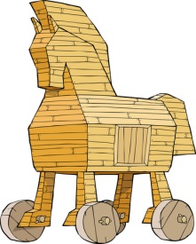
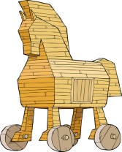
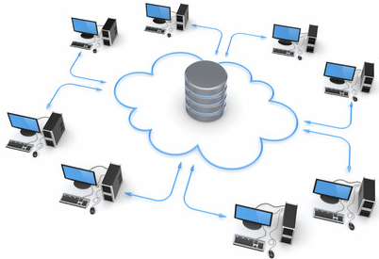
Trojans / Trojan Horse
They are imbedded in a program or file that looks useful or interesting.
Adding ‘useful’ phone apps outside of the sanctioned App-store
Some new application that allows you save videos from Youtube_{TM}!
Get a cheap hacked version of some commercial software (e.g., via ‘torrent’, ‘warez’ sites)
Download a special viewer to see “astonishing” pictures/videos of your favorite celebrity.
Images from www.colourbox.com

Slide 30
Consequences Of A Trojan Infection
A Trojan tricks users into infecting their computer by “letting in” the malicious program
  E.g., you install what you think is a useful program only to have a malicious program bundled in
The backdoor program can have negative effects similar to a virus infection.

Slide 31
Protection Against These Forms Of Malware
Malware discussed so far
  Viruses
  Worms
  Macro Viruses
  Trojans / Trojan Horses

Slide 32
Protection Against These Forms Of Malware
Use an anti-virus program:
  Something is better than nothing (some are free!)
    Many Internet providers give something out for free if you’re a subscriber
  But try to get a program from an established company (better than a free version or a version produced by a smaller or less experienced company).
    McAfee: http://www.mcafee.com
    Norton: http://www.norton.com
    Kaspersky: www.kaspersky.com
    Windows (Windows security essentials is available for free download while Windows defender is built into Windows 8+): http://windows.microsoft.com/en-CA/windows/security-essentials-download
  But make sure that you update your program and the virus definitions on a regular basis.

Slide 33
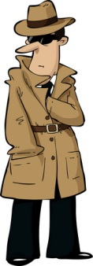
Spyware
From www.colourbox.com
Secretly gathers information about your computer and computer usage and transmits this information back to the author.
In some cases the process may be fairly legitimate in other cases it may be more nefarious.
Spyware may also take the form of a program that is installed with another (potentially useful) program making it similar to a Trojan.
From the software usage agreement from some company ‘X’:
(From Internet Privacy for Dummies “The first spyware?”
“You hereby grant company X [JT: actual name removed] the right to access and use the used computing power and storage space on your computer/s and/or Internet access or bandwidth for the aggregation of content and use in distributed computing.”

Slide 34

Spyware (2)
Some forms of spyware are relatively benign and record generic information about your computer.
However some forms of spyware record and transmit highly confidential information.
  Some do this by recording and sending all the text that you enter with the infected computer.
  Others may be more selective (e.g., it recognizes when you’re about enter information into a password field and only send passwords and other login information).
  A few may even transmit as a live video your computer desktop and send the video to the creator of the spyware.
From www.colourbox.com

Slide 35
What Does Spyware Information Look Like?
A program that records to a file what you are currently doing on your computer.
(This is not meant as ‘spyware’ but instead is used to help troubleshoot technical problems.
  “What did the user do?”
  (Windows 7: Problem Steps Recorder)
  (Windows 10: Steps Recorder or PSR)

Slide 36
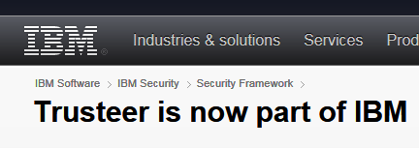
Banking Anti-Spyware Software
When you login to some banking sites they offer the ability to download additional free software to reduce the effectiveness of spyware.
  Example: Trusteer is used by a number of Canadian banks.
  (Among other things) this software can prevent spyware from making screen grabs of sensitive banking information when you are at an affiliated financial institution.

Slide 37
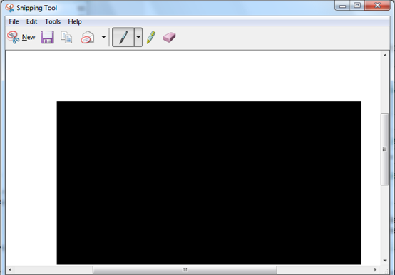
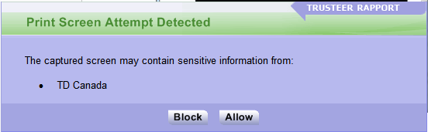
Attempted Automatic Screen Grab Attempts

Slide 38
Protecting Against Spyware
Some anti-virus programs have begun to expand their services to protect against spyware.
However there are programs that are dedicated solely to protecting against spyware.
Some examples:
  Ad Aware: www.lavasoft.com
  Spy Sweeper: www.webroot.com
  Spybot: www.spybot.com
Similar to an anti-virus program you should update your anti-spyware program and the spyware definitions on a regular basis.

Slide 39
Keystroke Loggers
A specialized form of spyware
Record some or all of the information entered on a keyboard.
They may be used for fairly legitimate purposes:
  Trouble shooting errors
  Monitoring and evaluating employee performance
  Crime prevention
A keystroke logger can be hardware or software based.
Keystroke loggers can also be a form of spyware that was unknowingly installed.

Slide 40
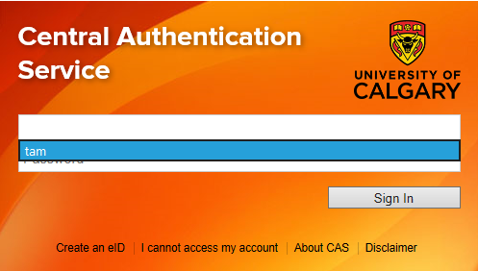
Preventing/Mitigating The Effect Of Keystroke Loggers
Install an anti-spyware program.
Get a firewall: monitors and controls traffic coming into or out of your network
Minimize the typing of sensitive information with automatic form fillers:
Use one-time passwords or change your passwords frequently.

Slide 41
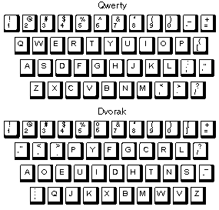
Preventing/Mitigating The Effect Of Keystroke Loggers (2)
Use an alternative keyboard layout:
Fully custom keyboard layouts can be created using tools like the Microsoft Keyboard Layout Creator.

Slide 42
Preventing/Mitigating The Effect Of Keystroke Loggers (3)
Using low tech methods can also be fairly effective for some keystroke loggers by ‘scrambling’ the text entered or by minimizing (or avoiding altogether) the amount of text actually typed in.

Slide 43
Preventing/Mitigating The Effect Of Keystroke Loggers (4)
Two step authentication
  Password
  One time code

Slide 44
Other Electronic Counter-Measures Against Malware
Defensive measures discussed thus far:
  Getting a good anti-virus program
  Getting a good anti-spyware program
Update your operating system (not only for Windows) and key software (e.g., web browsers and programs that run into conjunction with them such as programs that play videos, email readers, MS-Office).
  Some forms of Malware take advantage of vulnerabilities in the operating system and anti-virus programs and anti-spyware programs are ineffective against them e.g., the Sasser Worm (2004).
  Updates for Windows and other programs may not only fix bugs and add new features but can also patch these security vulnerabilities.
Get a firewall (and turn it on/configure the security settings).
  Software firewalls may get turned off (consider a hardware firewall)

Slide 45
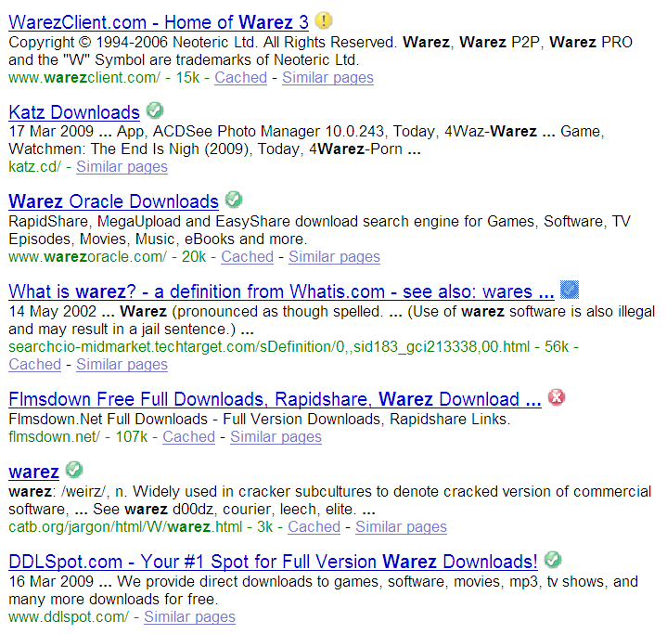
Non-Electronic Based Defenses
(Note this list is far from comprehensive).
Be cautious of all email attachments.
Be cautious going to unfamiliar websites.
  Some security programs (e.g., McAfee) and web sites evaluate other websites.

Slide 46
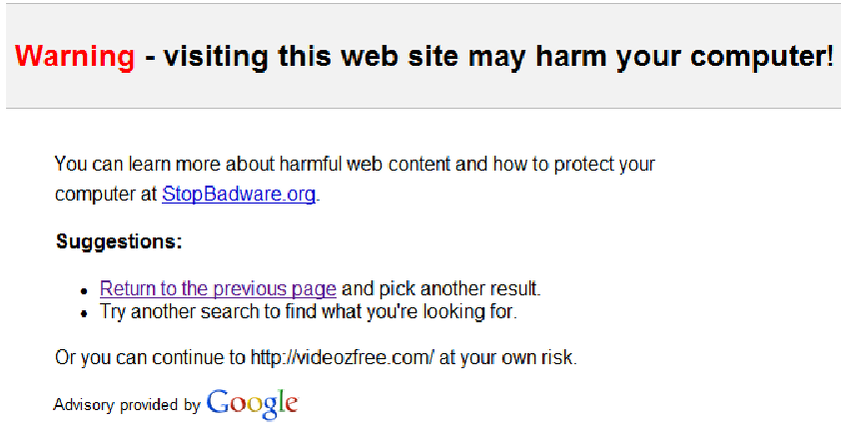
Non-Electronic Based Defenses (2)
  Some search engines (e.g., Google) may block access to sites that may infect or otherwise harm your computer.
From www.codinghorror.com

Slide 47
Non-Electronic Based Defenses (3)
Only download software from sites that you are familiar with or ones that have a good reputation.
Alternatively look for software reviewed from reputable sites
  e.g., www.tomshardware.com, www.pcmag.com
  These sites may or may not provide direct downloads but at least you will have the names of programs that you can then search for.

Slide 48
Non-Electronic Based Defenses (4)
Some types of files are riskier than others.
One way of determining the risk level is to examine the file suffix / file extension (furthest on the right and follows the period in the name of the file).
Files with the following extensions are dangerous to download: .exe, .pif, and .scr (source: www.microsoft.com)
Lower risk file types: .txt, .bmp, .jpg and .gif
Some viruses use files with two extensions to make dangerous files look like safe files e.g., Document.txt.exe or Photos.jpg.exe
  (This is similar to how “.doc” files can be disguised to appear as “.docx” documents (VBA macro programming section).
A more complete list:
  https://technet.microsoft.com/en-us/library/cc179163%28v=office.14%29.aspx

Slide 49
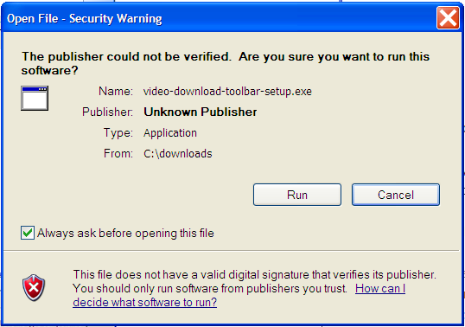
Non-Electronic Based Defenses (4)
When you install the program check the publisher information.
  Installing software from known publishers increases your risk.
  The identity of ‘known’ publishers is electronically certified by companies such as VeriSign.
Example software with an ‘unknown’ publisher (but this particular example isn’t necessarily malware).

Slide 50
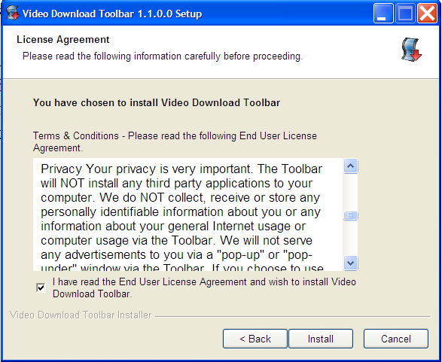
Non-Electronic Based Defenses (5)
When you install the program read the Terms of Use.
  Sometimes buried in the text is an implicit agreement to include additional programs or features along with the program that you are installing.
  Some of these ‘extras’ may be regarded as Spyware.
An example license agreement for the “terms of use” for the software. (This example isn’t necessarily malware).

Slide 51
Non-Electronic Based Defenses (6)
When you install the program pay attention to the extra ‘add-ons’.
  This is a program that tries to install itself when you are installing another program.
  Some may be legitimate programs.
  Others may be more sketchy.
Some newer browsers may block third party add-on software

Slide 52
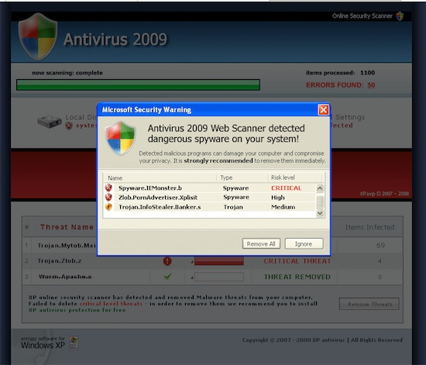
Is This A Trap? How To Avoid?
A popup comes up looking like something legitimate from Windows. How do avoid installing malware when you see this window?
From: www.thegeekreview.com

Slide 53
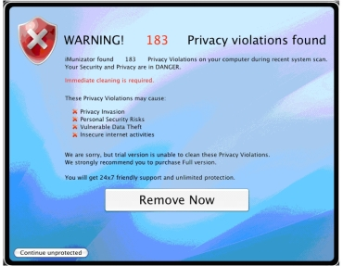
Scareware
In-and-of itself this is not necessarily a malicious program.
It’s an authentic looking message giving you a fake warning about problems with your computer.
  Virus infection
  Damaged operating system files slowing down your computer
From: http://www.symantec.com

Slide 54
Scareware (2)
Typically pops up while browsing a web site.
It may simply be an elaborate ruse to get people to try their product.
In other cases trying to remove a problem that doesn’t exist may actually create new problems:
  Malware infection
  Credit card theft
Try closing your browser or even rebooting your computer and see if the messages persist.
Examine the messages carefully, are they originating from a security program currently installed on your computer?
  E.g., “Tam secureguard sez’ u r infected”
  Try running your own anti-virus software and see if the “security software” shows up as an infection.

Slide 55
Information On Avoiding Scareware Pitfalls
Example tips (From Microsoft):
  Promises of money for little or no effort.
  Deals that sound too good to be true.
  Alarmist messages and threats of account closures.
    Check the return email address
    Don’t click on the links provided to ‘fix’ the problem
    Use common sense e.g., would a computer tech administrator require personal information to ‘verify your email account information’
  Requests to donate to a charitable organization after a disaster that has been in the news.
    Just donate directly via the website rather than using the email
  Bad grammar and misspellings.
For more information:
  http://www.microsoft.com/security/pc-security/antivirus-rogue.aspx

Slide 56
Some Security Issues While Browsing The Web
Incorrect web site names
Browser hijacking
Storing financial information
Saving previously entered data

Slide 57


Incorrect Website Names
Lets buy something at Amazon
Person behind the fake website
www.amazn.com
Visa number: 123 456 ….
Visa number:
123 456 ….
Think this could never happen to you?
http://www.ucal.gary.ca/

Slide 58
Incorrect Website Names
How to mitigate
Use a reputable search engine to find the desired website
“Favorite” or “bookmark” websites and then access the website using this way rather than typing it manually each time.

Slide 59
Browser Hijacking
A program that takes over your web browser:
  Changes your default home page
  Changes your favorites/bookmarks in your browser
  Causes a storm of pop-up windows to appear
  Redirects the browser to certain web pages
  Redirects the browser away from certain web pages (e.g., websites run by companies that product anti-virus software)
Common sources
  ‘Free’ software (Trojan)
  Email attachments
  Drive-by downloads (covered earlier)

Slide 60
Storing Financial Information
Even if you enter your information at the correct web site the convenience must be balanced out vs. security concerns:
Lets buy something online
Visa #123 456…
www.buyit.com
Buy this!
Buy that!
Buy the other thing!
www.buyit.com
Access to merchant’s hacked database
Visa #123 456…

Slide 61
Storing Financial Information (2)
Balance the convenience of having this information stored with the merchant (so you don’t have fill it) and the additional security (foiling spyware such as keystroke loggers) vs. the probability of having it stolen from the merchant.
Consider:
  The size of the merchant (large with the resources to spend money on security vs. a tiny home business).
  The merchant’s reputation and history (keep in mind that quite often merchants legally don’t have to disclose security breaches).
  Any security measures that they care to describe (specific measures, e.g., 128 bit encryption, rather than just vague guarantees about protecting your information).

Slide 62
Saving Previously Entered Information
Even storing information on your own computer must balance convenience against some security concerns.

Slide 63
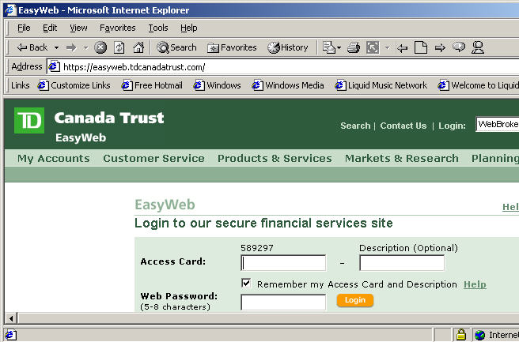
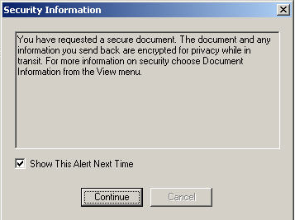
Transmitting Information On The Internet
Many protocols transmit packets in an unencrypted format.
  Email
  Http
Indicators that a web page employs encryption
Internet Explorer
General

Slide 64
What Is Encryption?
“Scrambling” information sent across a network (or the Internet)
Example:
  Original message: MARY HAD A LITTLE LAMB
  Encrypted message: LZQX GZC Z KHSSKD KZLA
The sending computer encrypts the information
The encrypted information is sent along the network/Internet
The receiving computer decrypts the information

Slide 65
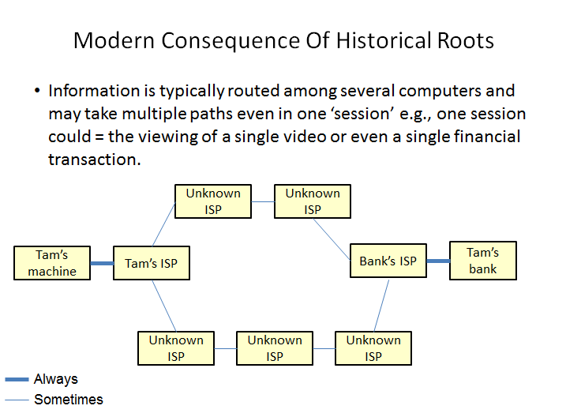
Why Bother With Encryption?
I “trust” the website that I am dealing with!
Keep in mind how the Internet is set up:
Strong encryption means that the administrators of the intermediate computers cannot view the information

Slide 66
Choosing A Good Password
Even with the best encryption, if the password is weak a brute force approach can ‘crack’ your security.
  Because computers of today perform math quickly and a brute force approach is just mathematically going through possible combinations a poorly chosen password can eventually be determined.
  E.g. 3 binary digit password and “brute force” hack
    000
    001
    010
    011
    100
    101
    110
    111
  2 raised to the number of bits = number of combinations

Slide 67
Choosing A Good Password (2)
The more bits used, the harder it is to guess (‘crack’) the password
2¹ = 2 combinations
2² = 4 combinations
2³ = 8 combinations
…
2²⁴ ~ 16 million combinations
2³² ~ 4 billion combinations

Slide 68
Choosing A Good Password (3)
Using different characters makes it even harder to guess a password
  E.g. same case alpha
    Using a single alpha (lower case) = 26 combinations
    Using two alpha (lower case) = 26 x 26 combinations
  E.g. mixed case alpha
    Using a single alpha (upper and lower case) = 52 combinations
  E.g. mixed case alpha and digits
    Using a single alpha (52 mixed alpha plus 10 digits) = 62 combinations

Slide 69
Guides For Password Security
Things to avoid in passwords
  Never choose something of direct personal meaning to yourself that someone can guess
    Name, birthdate, address, pet’s name etc.
Things to guide your choice of a password
  Avoid using dictionary words (that part of the password can be easily guessed)
  Use a mix of alpha (mix case), numeric, “special characters”
  E.g. Marieieie-is_mEye:-)BaE

Slide 70
Interacting With Parts Of The Internet
The World Wide Web (WWW) is only one part of the Internet (albeit a very popular part).
There are other parts (e.g., file transfers, email etc.)
Your computer interacts with these parts of the Internet through that computer’s ‘logical ports’ (numbers)
Email: port #25
Http: port #80
Remote login, telnet: port #23
The Internet

Slide 71
Evaluating The Effectiveness Of Your Firewall
Firewalls may help to secure your computer by blocking ports with security problems.
  General rule of thumb: if you don’t use a port then don’t open it for access with your firewall.
  E.g. Port 25 is frequently used to send spam mail
If you are unsure of how to configure your firewall:
  Use the default or recommended configuration
  Use a trusted source to evaluate the security of your firewall
  Example “Shields up”
    https://www.grc.com/x/ne.dll?bh0bkyd2
  Some firewalls do all or most of the configuration of the ports for you (e.g., Norton).

Slide 72
General Ways Of Increasing Your Computer Security
Install an anti-virus program from a reputable company.
  Update the definitions on a regular basis.
Install an anti-spyware program from a reputable company.
  Update the definitions on a regular basis.
Add a firewall.
  Make sure that it’s properly configured.
  (Don’t use the default password)
Update your operating system and programs on a regular basis.
  The updates not only provide bug/error fixes but may also patch up security flaws.

Slide 73
General Ways Of Increasing Your Computer Security (2)
If your computer appears to be acting abnormal then you may try scanning for suspicious processes.
Use utilities like the Task Manager to see what processes are running and if unfamiliar ones are taking up most of your processor time.

Slide 74
Privacy And The Internet
Is it a big deal?
Think of all the public figures whose past online activity have come back to haunt them.
Here’s a few extreme cases that effected people who weren’t public figures:
  Unrepentant on Facebook? Expect jail time (from CNN:
    http://www.cnn.com/2008/CRIME/07/18/facebook.evidence.ap/index.html)
  Teacher arrested for pro-Columbine blog post
    http://www.cnn.com/2007/US/law/12/04/blog.arrest.ap/index.html
If you’re not a public figure then is privacy and information listed online important to you?
  Planning to ever apply for a job that is important to you?
    http://www.management-issues.com/2006/10/27/research/your-digital-dirt-can-come-back-to-haunt-you.asp
  Ever planning to go on a date?

Slide 75
Privacy And The Internet (2)
The Internet (and especially the web) is not a private place.
What you (or someone else) posts there is not only viewable by the world at large but is likely to remain available (in some form) even should the offending information be removed.
  E.g. 1, search engines often save old information about web sites
  E.g. 2, there are specific web sites that provide archived versions of the web that go back many years.
  E.g. 3, the terms of use for some web sites imply that any content (text, pictures, videos) uploaded to their site by users may be available indefinitely even if the user later removes the content from the site.

Slide 76
Posting Information
While providing and sharing personal details is one of the main benefits of social networking sites such as Facebook, MySpace, Twitter etc. this must balanced out vs. the potential costs of providing too much information.
  Providing too information about your personal details may make you a target of identity theft.
  It may also make it easier for direct marketers to target their wares (because they know your likes and dislikes).
  There is also the possibility of becoming the target of crime.
This isn’t to say that you should never post anything online, just think about the potential consequences.
Also pay attention to what other people post about you!
  E.g., “Tagged” online images of you.
  But reverse image searches are now possible (not tagged)

Slide 77
Posting Information (2)
The more information that you post about yourself the more vulnerable that you may become.
  “The sinister side of social networking”, CNN: http://www.cnn.com/2007/WORLD/europe/09/07/ww.sinistersocial/index.html
Posting one of the following in isolation may not be a problem but the more pieces of information that are posted the more problems that may arise.
  Information that you should be less willing to give out to everyone:
    Your financial information e.g., Social Insurance number, credit card and bank information (obvious?).
    Your address and/or phone numbers.
    Your full name (you might want to check what information can someone get from this with even a simple web search).

Slide 78
Posting Information (3)
  (Potentially sensitive information that is less obvious):
    “Entertaining” pictures of yourself.
    Your likes and dislikes e.g., favorite color, make and model of your first car, your pet’s name etc.
    Information about yourself that isn’t financially related or providing contact information e.g., your pet’s name, mother’s maiden name
    Your full date of birth (or partial birth date along with your age).
    Status information e.g., announcing online that you will be out of town for a period of time while at the same time there’s clues (direct or indirect) about where you live.

Slide 79
Online Privacy: Considerations
Your “real” friends have as much personal information about you online that they have in the real world.
  What’s the problem with posting personal details?
Don’t forget though that the web site operator also has access to this information
  Providing this information to your online friends may be the same as giving it the website administrators.
  Read their terms of use because they may be allowed to share this information to other companies)
  Or ‘app’ or websites that you ‘like’ may be able to access your personal details

Slide 80
Online Privacy: Considerations (2)
Keep in mind that your friends may also be subject to identity theft.
  Did your real-world friend actually set up the account and is the one who is currently using it or does someone else have access to it).
  Your friend could get ‘hacked’.
  Keep these two points in mind as you post (even if you set ‘friend’s only’ access to your online account
  Finally even if the account of your online friend is indeed accessed only be your friend and if you think that your friend may never be hacked (big if) consider your friend’s security settings
    In the past Facebook would allow for insecure (http) login
      Not encrypted!
    It was only after a few years of operation that logins can only be done securely (https)

Slide 81
After This Section You Should Now Know
What is malware
  What are some common categories of malware
  How do the different forms of malware get onto your computer
  What are the consequences of having a malware infection on your computer
  How to protect against malware
Electronic and non-electronic defensive measures against malware
What is scareware and how it can be a security threat
What are some common web-based security issues and how to mitigate some of them
What is a browser cookie
What are the different types of cookies and how do they differ

Slide 82
After This Section You Should Now Know (2)
What is a logical port and how do firewalls increase security by closing ports
What is encryption and how does it tie into security
General ways of increasing the security of your computer
The importance of protecting your online privacy
What is the potential cost of having your personal information online
How to minimize the risks of providing information online

