Slide 1
Code Reuse Through Hierarchies
You will learn about different ways of creating class hierarchies to better organize and group attributes and methods in order to facilitate code reuse

Slide 2



Real Life Hiearchies
Base entity:
Attributes: age, height, weight
Actions: eat(), sleep(), excrete(), multiply()
Derived entity:”martial artist” has all attributes and actions of base entity plus
Attributes: belt/level
Actions: ironPalmStrike(),shadowlessKick()
Derived entity: ‘spy’ has all attributes and actions of base entity plus
Attributes: territory, code name e.g. 0-0TAM
Actions: stealth(), codebreaking(), lockPicking()

Slide 3
Review: Association Relation Between Classes
public class Car {
private Engine anEngine;
  private Lights carLights;
  public start() {
  anEngine.ignite();
  carLight.turnOn();
  }
}
public class Engine {
public boolean ignite() {
.. }
}
public class Lights {
private boolean isOn;
public void turnOn() {
isOn = true;}
}
One type of association relationship is a ‘has-a’ relation (also known as “aggregation”).
  E.g. 1, A car <has-a> engine.
  E.g. 2, A lecture <has-a> student.
Typically this type of relationship exists between classes when a class is an attribute of another class.

Slide 4
A New Type Of Association: Is-A (Inheritance)
An inheritance relation exists between two classes if one class is a more specific variant type of another class
Vehicle
Motorcycle
Car
Bus
SUV
Sports car
Mini
Full sized

Slide 5
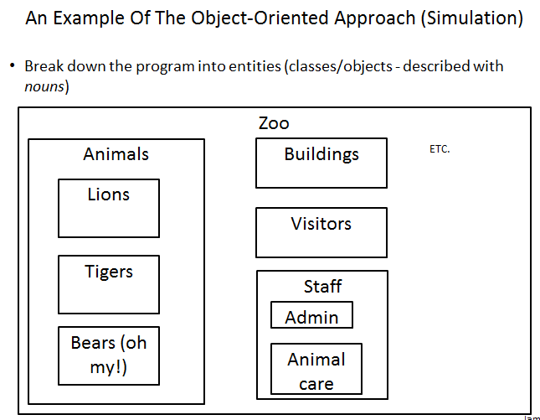
Recall O-O Approach: Finding Candidate Classes

Slide 6
What If There Are Commonalities Between Classes
Examples:
  All birds ‘fly’
  Some types of animals ‘swim’: fish, penguins, some snakes, crocodiles, some birds
  All animals ‘eat’, ‘drink’, ‘sleep’ etc.
  Under the current approach you would have the same behaviors repeated over and over!
Hawk
King Penguin
Lion
eat()
sleep()
drink()
eat()
sleep()
drink()
eat()
sleep()
drink()
Waste!
Waste!
Waste!

Slide 7
New Technique: Inheritance
When designing an Object-Oriented program, look for common behaviors and attributes
  E.g., color, species, eat(), drink(), sleep()
  These commonalities are defined in a ‘parent’ class
Animal
-color
-species
+eat()
+sleep()
+drink()

Slide 8
New Technique : Inheritance (2)
These commonalities are defined in a ‘parent’ class
  Classes that are derived from (are more specific versions) of the parent class are referred to a ‘child’ classes.
As appropriate other ‘child’ classes will directly include or ‘inherit’ all the non-private attributes and behaviors of the parent class.
  ‘Privates’ are still accessible through public methods.
Animal
-color
-species
+eat()
+sleep()
+drink()
Hawk
King Penguin
Lion

Slide 9
Defining A Class That Inherits From Another
This means that a Lion object AUTOMATICALLY has all the capabilities of an Animal object
The only attributes and methods that need to be specified are the ones unique to a lion
Format:
  public class <Name of child class> extends <Name of parent class>
  {
  // Definition of child class – only what is unique to
  // this class
  }
Example:
  public class Lion extends Animal
  {
  public void roar() {
  System.out.println("Rawr!");
  }
  }

Slide 10
First Inheritance Example
Location of the full online example:
  /home/233/examples/hierarchies/1basicExample

Slide 11

Class Person
public class Person
{
private int age;
public Person() {
age = 0;
}
public Person(int anAge) {
age = anAge;
}
public void doPersonStuff() {
System.out.println("Eat, sleep, drink, execrete, be" +
" fruitful");
}
}
Image of James Tam curtesy of James Tam

Slide 12
Class Hero: A Hero Is A Person
public class Hero extends Person {
}
This automatically gives instances of class Hero all the capabilities of an instance of class Person

Slide 13

Class Hero: A Person But A Whole Lot More
public class Hero extends Person
{
private int heroicCount;
public Hero()
{
heroicCount = 0;
}
public void doHeroStuff()
{
System.out.println("Saving the world for: truth!," +
" justice!, and all that good " +
" stuff!");
heroicCount++;
}
}
Image of super James Tam curtesy of James Tam

Slide 14

The Driver Class: Person Vs. Hero
public class Driver
{
public static void main(String [] args)
{
Person bob = new Person();
bob.doPersonStuff();
System.out.println();
Hero clark = new Hero();
clark.doPersonStuff();
clark.doHeroStuff();
}
}

Slide 15
Benefit Of Employing Inheritance
Code reuse:
  The common and accessible attributes and methods of the parent will automatically be available in all the children.
Person
+doPersonStuff()
Accountant
Hero
Teacher

Slide 16
New Terminology: Method Overriding
Overriding occurs when the parent class has a different version of a method than was implemented in the child class.
Person
+doPersonStuff()
Hero
+doPersonStuff()

Slide 17
Reminder: Method Overridding Vs. Method Overloading
Method overriding: different versions of a method in parent vs. child
Method overloading: different versions of a method in a single class definition
Person
+doPersonStuff()
Hero
+Hero()
+Hero(int)
+Hero(int,String)
+doPersonStuff()

Slide 18
Method Overriding Example
Location of the complete example:
  /home/233/examples/hierarchies/2overriding

Slide 19
Class Hero
public class Hero extends Person
{
// New method: the rest of the class is the same as the
// previous version
public void doPersonStuff()
{
System.out.println("Pffff I need not go about " +
"mundane nicities such as eating!");
}
}

Slide 20
The Driver Class (Included For Reference)
public class Driver
{
public static void main(String [] args)
{
Person bob = new Person();
bob.doPersonStuff();
System.out.println();
Hero clark = new Hero();
clark.doPersonStuff();
...
}
}

Slide 21
Overridding: Who Do We Call?
bob.doPersonStuff();
clark.doPersonStuff();

Slide 22
New Term: Binding
When a reference and a method are specified together, binding determines which version of the method is called.
If neither method overloading nor method overriding are employed then binding is very easy to determine.
public class Person {
private int age;
public Person() {
age = 0;
}
Person jim = new Person();
jim.setAge(27);
public setAge(int anAge) {
age = anAge;
}
}

Slide 23
New Term: Binding (2)
Early binding: determined at compile time (by ‘javac’)
  Parameter list determines
Late binding: determined at run time (by ‘java’)
  The type of the implicit parameter (“this” reference) determines

Slide 24
Method Overloading Vs. Method Overriding
Distinguishes overloaded methods
Method Overloading (what you should know)
  Multiple method implementations for the same class
  Each method has the same name but the type, number or order of the parameters is different (signatures are not the same)
  The method that is actually called is determined at program compile time (early binding).
  i.e., <reference name>.<method name>(parameter list);

Slide 25
Method Overloading Vs. Method Overriding (2)
Binding at compile time (early)
Examples of method overloading:
  public class Foo
  {
  public void display( ) { }
  public void display(int i) { }
  public void display(char ch) { }
  }
  Foo f = new Foo ();
  f.display( );
  f.display(10);
  f.display(‘c’);

Slide 26
Method Overloading Vs. Method Overriding (3)
The type of the reference (implicit parameter “this”) distinguishes overridden methods
Method Overriding
  The method is implemented differently between the parent and child classes.
  Each method has the same return value, name and parameter list (identical signatures).
  The method that is actually called is determined at program run time (late binding).
  i.e., <reference name>.<method name> (parameter list);

Slide 27
Example Overriding: The Type Of The Reference Determines The Method Called
public class Person {
public void doPersonStuff() {
...
}
}
public class Hero extends Person {
public void doPersonStuff() {
...
}
}
// Bob is a Person
bob.doPersonstuff();
// Clarke is a Hero
clark.doPersonStuff();

Slide 28
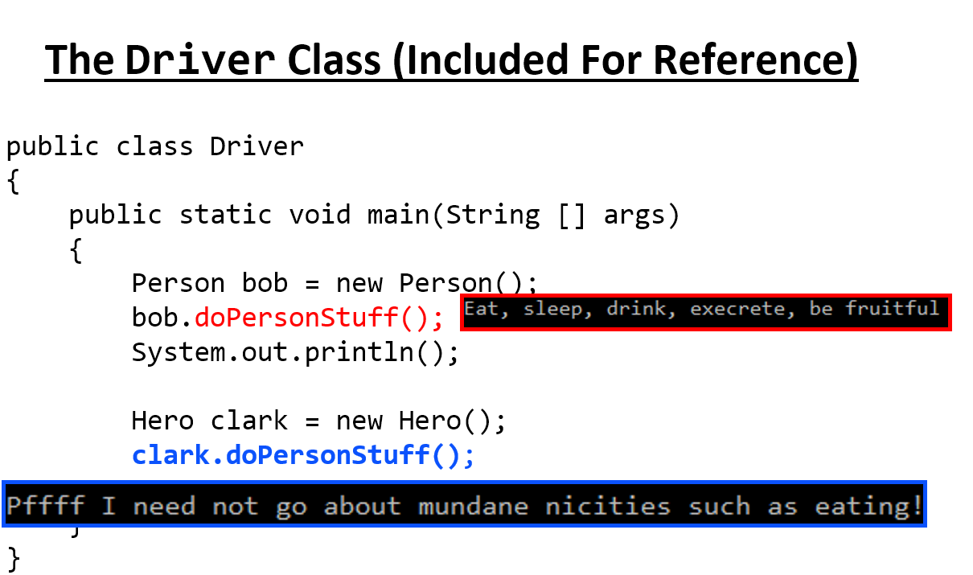
New Terminology: Polymorphism
Poly = many Morphic = forms
A polymorphic method has an implementation in the parent class and a different implementation the child class.
Polymorphism: the specific method called will be automatically be determined without any type checking needed (the type of reference determines which method is called)
Recall the example:

Slide 29
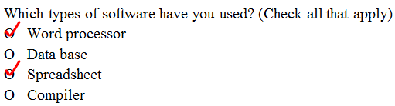
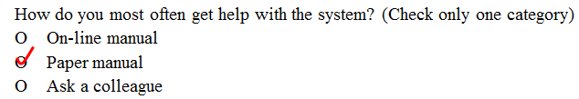
New Terminology: Super-class Vs. Sub-class
All people
on the earth
Superclass (Button)
(Superset –
Bigger)
All people
in Canada
Subclass (RadioButton)
(Subset - smaller)

Slide 30

The ‘Super’ Keyword
Used to access the parts of the super-class.
Format:
  <super>.<method or attribute>
Example:
  public void doPersonStuff()
  {
  System.out.println("Pffff I need not go about mundane"+
  " nicities such as eating!");
  super.doPersonStuff();
Parent’s version of method

Slide 31
Super Keyword: When It’s Needed
You only need this keyword when accessing non-unique methods or attributes (exist in both the super and sub-classes).
Without the super keyword then the sub-class will be accessed
Person
+doPersonStuff()
For a ‘Hero’ to access super class method (use ‘super’) super.doPersonStuff()
Hero
For a ‘Hero’ to access this classes version (no super keyword) doPersonStuff()
+doPersonStuff ()

Slide 32
Super Keyword: When It’s Not Needed
If that method or attribute exists in only one class definition then there is no ambiguity.
Person
For a ‘Hero’ doPersonStuff ()
(No such method in class Hero to be confused with this method).
+doPersonStuff ()
Hero
For a ‘Hero’ doHeroStuff()
+doHeroStuff ()

Slide 33
Something Especially Good?
Note: There Is No Super.Super In Java

Slide 34
Using The Super Keword
Location of the complete example:
  /home/233/examples/hierarchies/3super
  Note: this example illustrated the use of the super keyword in conjunction with a method “doPersonStuff”.
  As long as access permissions allow it, any attribute or method in the super class can be accessed in the same way using the ‘super’ keyword.

Slide 35
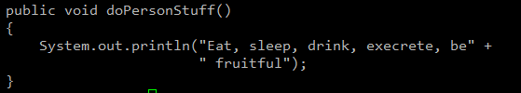
Class Hero: Using The Super Keyword
public class Hero extends Person
{
public void doPersonStuff()
{
System.out.println("Pffff I need not go about mundane" +
" nicities such as eating!");
timeDelay();
super.doPersonStuff();
timeDelay();
// Hero specific output
System.out.println("...well actually I do :$");
}
private void timeDelay()
{
final long DELAY_TIME = 1999999999;
for (long i = 0; i <= DELAY_TIME; i++);
}
}
For any Person

Slide 36
Using The Super Keyword Again
This fourth example illustrates the use of this keyword with the constructor and the (new to this example) toString() method
Note how the toString() method delegates some behavior to the parent class and implements some of the behaviors in the child class.
Location of the full example:
  /home/233/examples/hierarchies/4superConstructors

Slide 37
Class Person
public class Person {
private int age;
public Person() {
age = 0;
}
public Person(int anAge) {
age = anAge;
}
public void doPersonStuff() {
System.out.println("Eat, sleep, drink, execrete, be" +
" fruitful");
}

Slide 38
Class Person (2)
// NEW
public String toString()
{
String s = "";
s = s + "Age of the person: " + age;
return(s);
}
}

Slide 39
Class Hero: Using Super()
public class Hero extends Person
{
private int heroicCount;
public Hero() {
super();
heroicCount = 0;
}
public Hero(int anAge) {
super(anAge);
heroicCount = 0;
}
public void doHeroStuff() {
...
heroicCount++;
}
public Person() {
age = 0;
}
public Person(int anAge) {
age = anAge;
}

Slide 40
Class Hero: Using Super() : 2
public String toString()
{
String s = super.toString();
if (s != null)
s = s + "\n" + "Count of noble and heroic deeds " +
heroicCount;
return(s);
}
// Class Person
public String toString()
{
String s = "";
s = s + "Age of the person: " + age;
return(s);
}

Slide 41
The Driver Class
public Person(int anAge){
age = anAge;
}
public class Driver
{
public static void main(String [] args)
{
Person bob = new Person(55);
Hero clark = new Hero(25);
public Hero(int anAge){
super(anAge);
heroicCount = 0;
}
public Person(int anAge){
age = anAge;
}

Slide 42
The Driver Class: 2
System.out.println("Bob\n" + bob);
System.out.println("Clark\n" + clark);
}
}
public String toString()
{
String s = "";
s = s + "Age of the person: " + age;
return(s);
}
public String toString() // Hero
{
String s = super.toString();
if (s != null)
s = s + "\n" + "Count of noble and heroic deeds " +
heroicCount;
return(s);
}
public String toString() // Person
{
String s = "";
s = s + "Age of the person: " + age;
return(s);
}

Slide 43
Example 4 Synposis
Using the super keyword to access the parent constructors
User the super keyword to acess the parent implementation of toString()
Both method calls would delegate some of the required behaviors to the parent (access modify parent class attributes) and then the child implement the remaining behavior (access child class attributes)

Slide 44
Keep In Mind: Inheritance Is A One Way Relationship!
A Hero is a Person but a Person is not a Hero!
That means that while the sub-class can access the super-class parts but the super-class cannot access the sub-class parts.
New (sub) class
  New attributes
  New behaviors
Existing (super) class
  Attributes
  Behaviors

Slide 45
Access Modifiers And Inheritance
Private ‘-‘: still works as-is, private attributes and methods can only be accessed within that classes’ methods.
  Child classes, similar to other classes must access private attributes through public methods.
Public ‘+’: still works as-is, public attributes and methods can be accessed anywhere.
New level of access, Protected ‘#’: can access the method or attribute in the class or its sub-classes.

Slide 46
Summary: Levels Of Access Permissions
Access level | Accessible to
 | Same class | Subclass | Not a subclass
Public | Yes | Yes | Yes
Protected | Yes | Yes | No
Private | Yes | No | No

Slide 47
Levels Of Access Permission: An Example
public class P
{
private int num1;
protected int num2;
public int num3;
// Can access num1, num2 & num3 here.
}
public class C extends P
{
// Can’t access num1 here
// Can access num2, num3
}
public class Driver
{
// Can’t access num1 here and generally can’t access num2
// here
// Can access num3 here
}

Slide 48
General Rules Of Thumb
Variable attributes should not have protected access but instead should be private.
Most methods should be public.
Methods that are used only by the parent and child classes should be made protected.

Slide 49
Updated Scoping Rules
When referring to an identifier in a method of a class
  Look in the local memory space for that method
  Look in the definition of the class
  New: Look in the definition of the parent class

Slide 50
Updated Scoping Rules (2)
public class P
{
}
public class C extends P
{
public void method ()
{
}
}
<<< Third: Parent’s attribute >>>
Similar to how local variables can shadow attributes, the child attributes can shadow parent attributes.
<<< Second: Attribute>>>
<<< First: Local >>>
Reference to an identifier e.g., ‘num’

Slide 51
Updated Scoping Rules: A Trace
Location of the full online example:
  /home/233/examples/hierarchies/5scope

Slide 52

Scoping Rules: Review Code (1 Class)
public class Driver {
public static void main(String [] args) {
System.out.println("REVIEW");
System.out.println("------");
P p = new P();
p.method1();
System.out.println();
public class P {
protected int x = 1;
private int y = 2;
public void method1() {
int x = 10;
int y = 20;
System.out.println("P.method1()");
System.out.println("Locals shadow attributes");
System.out.println("x/y: " + x + " " + y);
}

Slide 53

Scoping Rules: Review Code (1 Class): 2
p.method2();
System.out.println();
public void method2()
{
int x = 10;
int y = 20;
System.out.println("P.method2()");
System.out.println("Loc x/y: " + x + " " + y);
System.out.println("Attr x/y: " + this.x + " " +
this.y);
}

Slide 54
Updated Scoping Rules
System.out.println("NEW: INHERITANCE HIERARCHIES");
System.out.println("----------------------------");
C c = new C();
c.method1();
// Child
public class C extends P {
private int x = 3;
private int z = 4;
public void method1() {
System.out.println("C.method1()");
System.out.println("Child attributes");
System.out.println("x/z: " + this.x + " " +
this.z);
}

Slide 55
Updated Scoping Rules (2)
c.method2();
// Child
public void method2() {
int x = 100;
int y = 200;
int z = 300;
System.out.println("C.method2()");
System.out.println("Local shadows all");
System.out.println("x/y/z: " + x + " " + y + " " +
z);
}

Slide 56
Updated Scoping Rules (3)
c.method3();
public class P
{
protected int x = 1;
private int y = 2;
// Child
public void method3() {
int x = 100;
int y = 200;
int z = 300;
System.out.println("C.method3()");
System.out.println("Loc x/y/z: " + x + " " + y + " " + z);
System.out.println("P(x/y): " + super.x + " " + super.getY());
// super.y : syntax errror, access permission violated
System.out.println("C(x/z): " + this.x + " " + this.z);
}

Slide 57
The Final Modifier (Inheritance)
What you know: the keyword final means unchanging (used in conjunction with the declaration of constants)
Methods preceded by the final modifier cannot be overridden
  e.g., public final void cannot_override()
Classes preceded by the final modifier cannot be extended
  e.g., final public class CANT_BE_EXTENDED

Slide 58
Review: Casting
The casting operator can be used to convert between types.
Format:
  <Variable name> = (type to convert to) <Variable name>;
Example (casting needed: going from more to less)
  double full_amount = 1.9;
  int dollars = (int) full_amount;
Example (casting not needed: going from less to more)
  int dollars = 2;
  double full_amount = dollars;

Slide 59
Real Life Examples: Expectations Vs. Reality
You are owed $100
Getting more than expected: acceptable
You receive $1000
You are owed $100
Getting less than expected: not acceptable
You receive $10

Slide 60
Real Life Examples: Expectations Vs. Reality (2)
You are owed $100
Misrepresenting reality: still not acceptable in the end
Cash $10
$100

Slide 61
Example Inheritance Hierarchy
StarShip
+attack()
FedStarShip
KlingStarShip
+attack()
+attack()
+utterBattleCry()

Slide 62
Casting And Inheritance (Up)
Because the child class IS-A parent class you can substitute instances of a subclass for instances of a superclass.
StarShip
+attack()
√
You can substitute a KlingStarShip for a StarShip
FedStarShip
KlingStarShip
+attack()
+regenerate()
+attack()
+utterBattleCry()
You can substitute a FedStarShip for a StarShip

Slide 63
Casting And Inheritance (Down)
You cannot substitute instances of a superclass for instances of a subclass
  Why?
StarShip
+attack()
You cannot substitute a StarShip for a FedStarShip or a KlingStarShip
x
FedStarShip
KlingStarShip
+attack()
+regenerate()
+attack()
+utterBattleCry()

Slide 64
Reminder: Operations Depends On Type
Sometimes the same symbol performs different operations depending upon the type of the operands/inputs.
Example:
  int num1 = 2;
  int num2 = 3;
  num1 = num1 + num2;
  Vs.
  String aString = "foo" + "bar";
Some operations won’t work on some types
Example:
  String aString = 2 / 3;
Notes:
64

Slide 65
Reminder: Behavior Depends Upon Class Type
The methods that can be invoked by an object depend on the class definition
Example:
  class X class Y
  { {
  method1() { method2() {
  } }
  } }
  X x1 = new X();
  x1.method1(); // Yes
  Y y1= new Y();
  y1.method1(); // No
Notes:
65

Slide 66
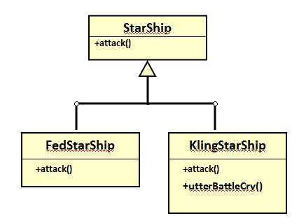
Casting And Inheritance
x
x
x
StarShip regular = new StarShip();
KlingStarShip kling = new KlingStarShip();
regular.utterBattleCry(); // Inappropriate action for type
regular = kling;
regular.utterBattleCry(); // I think I point to the wrong type
((KlingStarShip) regular).utterBattleCry(); // I think I point
// to the correct
// type (NOT!)
regular = new StarShip();
kling = (KlingStarShip) regular; // Dangerous cast
kling.utterBattleCry(); // Inappropriate action for type

Slide 67
Caution About Class Casting: Check First!
When casting between classes only use the casting operator if you are sure of the type!
Check if an object is of a particular type is via the instanceof operator
(When used in an expression the instanceof operator returns a boolean result)
Format:
  if (<reference name> instanceof <class name>)
Example:
  if (supPerson instanceof Person)

Slide 68
Instanceof Example
Location of the full example:
  /home/233/examples/hierarchies/6typeCheck
Person
Dog
Type ‘Person’
+doDailyTasks()
+bark()
Type ‘Dog’
Not type ‘Person’
Hero
Type ‘Person’
+doHeroStuff ()

Slide 69

Driver.main()
Person regPerson = new Person();
Hero supPerson = new Hero();
Dog rover = new Dog();
// Instanceof checks if the object is a certain type or
// a subclass of that type (e.g., a Hero is a Person)
if (regPerson instanceof Person)
System.out.println("regPerson is a type of Person");
if (supPerson instanceof Person)
System.out.println("supPerson is also a type of Person");
// Checks for non-hierarchical: Compiler prevents nonsensical
// checks
//if (rover instanceof Person)
// System.out.println("Rover is also a type of Person");

Slide 70
Driver.main(): 2
if (supPerson instanceof Hero)
System.out.println("supPerson is a type of Hero");
// Checks within hierarchy: Compiler doesn't prevent
if (regPerson instanceof Hero)
System.out.println("[Should never appear]: regPerson is a
type of Hero");

Slide 71
Containers: Homogeneous
Recall that arrays must be homogeneous: all elements must be of the same type e.g., int [] grades
Again recall: A child class is an instance of the parent (a more specific instance with more capabilities).
If a container, such as an array is needed for use in conjunction with an inheritance hierarchy then the type of each element can simply be the parent.
  StarShip [] array = new StarShip[2];
  array[0] = new StarShip(); // [0] wants a StarShip, gets a StarShip
  array[1] = new KlingStarShip(); // [1] wants a StarShip, gets a
  // KlingStarShip (even better!)
StarShip
+attack()
KlingStarShip
+utterBattleCry()

Slide 72
The Parent Of All Classes
You’ve already employed inheritance.
Class Object is at the top of the inheritance hierarchy.
Inheritance from class Object is implicit.
All other classes automatically inherit its attributes and methods (left and right are logically the same)
  class Person class Person extends Object
  { {
  } }
  e.g., “toString()” are available to its child classes
For more information about this class see the url:
  http://docs.oracle.com/javase/7/docs/api/java/lang/Object.html

Slide 73
The Parent Of All Classes (2)
This means that if you want to have an array that can contain any type of Java object then it can be an array of type Object.
  Object [] array = new Object[SIZE];
Built-in array-like classes such as class Vector (an array that ‘automatically’ resizes itself consists of an array attribute whose type is class Object)
  For more information on class Vector:
  http://docs.oracle.com/javase/6/docs/api/java/util/Vector.html

Slide 74
Determining Type: Hierarchies
As mentioned: normally type checking should not be needed for a polymorphic method (the child class overrides a parent method).
  No instanceof needed
However type checking is needed if a method specific to the child is being invoked.
    Check with instanceof is needed
Person
+doDailyTasks()
Hero
+doDailyTasks()
StarShip
+attack()
KlingStarShip
+utterBattleCry()

Slide 75
Example: Containers With ‘Different’ Types
Location of the full example:
  /home/233/examples/hierarchies/7hierarchiesContainment

Slide 76
Driver Class: SpaceSimulator
public class SpaceSimulator
{
public static void main(String [] args)
{
Galaxy alpha = new Galaxy();
alpha.display();
alpha.runSimulatedAttacks();
}
}

Slide 77
Class Galaxy
public class Galaxy {
public static final int SIZE = 4;
private StarShip [][] grid;

Slide 78

Class Galaxy (2)
public Galaxy () {
boolean squareOccupied = false;
grid = new StarShip [SIZE][SIZE];
int r;
int c;
int hull;
for (r = 0; r < SIZE; r++) {
for (c = 0; c < SIZE; c++)
{
grid[r][c] = null;
}
}
grid[0][0] = new FedStarShip();
grid[0][1] = new KlingStarShip();
grid[1][0] = new StarShip();
}

Slide 79
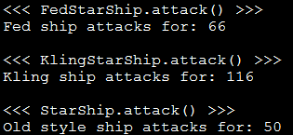
Class Galaxy (3)
public void runSimulatedAttacks() {
int damage;
damage = grid[0][0].attack();
System.out.println("Fed ship attacks for: " + damage);
System.out.println();
damage = grid[0][1].attack();
System.out.println("Kling ship attacks for: " + damage);
System.out.println();
damage = grid[1][0].attack();
System.out.println("Old style ship attacks for: " +
damage);
System.out.println();
Type check not needed because:
attack() method is overridden / polymorphic

Slide 80

Class Galaxy (4)
/* Won't work because it's an array of references
to StarShips not KlingStarShips.
grid[1][0].utterBattleCry(); */
if (grid[0][0] instanceof KlingStarShip)
((KlingStarShip) grid[0][0]).utterBattleCry();
if (grid[0][1] instanceof KlingStarShip)
((KlingStarShip) grid[0][1]).utterBattleCry();
if (grid[1][0] instanceof KlingStarShip)
((KlingStarShip) grid[1][0]).utterBattleCry();
}
} // End runSimulatedAttacks()
Type check ‘instanceof’ needed because:
Array of StarShips but utterBattleCry() unique to KlingStarShip

Slide 81
Class StarShip
public class StarShip {
public static final int MAX_HULL = 400;
public static final char DEFAULT_APPEARANCE = 'C';
public static final int MAX_DAMAGE = 50;
private char appearance;
private int hullValue;
public StarShip () {
appearance = DEFAULT_APPEARANCE;
hullValue = MAX_HULL;
}
public StarShip (int hull) {
appearance = DEFAULT_APPEARANCE;
hullValue = hull;
}

Slide 82
Class StarShip (2)
public StarShip (char newAppearance) {
this();
appearance = newAppearance;
}
public int attack() {
System.out.println("<<< StarShip.attack() >>>");
return(MAX_DAMAGE);
}

Slide 83
Class StarShip (3): Get()’s, Set()’s
public char getAppearance () {
return appearance;
}
public int getHullValue() {
return(hullValue);
}
public void setAppearance(char newAppearance) {
appearance = newAppearance;
}
public void setHull(int newHullValue) {
hullValue = newHullValue;
}
}

Slide 84
Class FedStarShip
public class FedStarShip extends StarShip {
public static final int MAX_HULL = 800;
public static final char DEFAULT_APPEARANCE = 'F';
public static final int MAX_DIE_ROLL = 6;
public static final int DIE_ROLL_BOOSTER = 1;
public static final int NUM_DICE = 20;
public FedStarShip() {
super();
setHull(MAX_HULL); // 800 not 400 due to shadowing
setAppearance(DEFAULT_APPEARANCE); // ‘F’ not ‘C’
}
Shadows parent constants

Slide 85
Class FedStarShip (2)
// Overridden / polymorphic method
public int attack() {
System.out.println("<<< FedStarShip.attack() >>>");
Random aGenerator = new Random();
int i = 0;
int tempDamage = 0;
int totalDamage = 0;
for (i = 0; i < NUM_DICE; i++)
{
tempDamage = aGenerator.nextInt(MAX_DIE_ROLL) +
DIE_ROLL_BOOSTER;
totalDamage = totalDamage + tempDamage;
}
return(totalDamage);
}
}
20
6
1

Slide 86
Class KlingStarShip
public class KlingStarShip extends StarShip {
public static final char DEFAULT_APPEARANCE = 'K';
public static final int MAX_DIE_ROLL = 12;
public static final int DIE_ROLL_BOOSTER = 1;
public static final int NUM_DICE = 20;
public KlingStarShip() {
super();
setAppearance(DEFAULT_APPEARANCE);
}
// Unique to KlingStarShip objects
public void utterBattleCry() {
System.out.println("Heghlu'meH QaQ jajvam!");
}
}

Slide 87
Class KlingStarShip (2)
// Overridden / polymorphic method
public int attack() {
System.out.println("<<< KlingStarShip.attack() >>>");
Random aGenerator = new Random();
int i = 0;
int tempDamage = 0;
int totalDamage = 0;
for (i = 0; i < NUM_DICE; i++) {
tempDamage = aGenerator.nextInt(MAX_DIE_ROLL) +
DIE_ROLL_BOOSTER;
totalDamage = totalDamage + tempDamage;
}
return(totalDamage);
}
20
12
1

Slide 88
Multiple Inheritance
What happens if some behaviors or attributes are common to a group of classes but some of those classes include behaviors shared with other groups?
Or some groups of classes share some behaviors but not others?
Flyers
Swimmers
WaterBreathers
fly()
swim()
Hawk
Eagle
Duck
Dolphin
Fish

Slide 89

Multiple Inheritance (2)
It is implemented in some languages e.g., C++
It is not implemented in other languages e.g., Java
Pro: It allows for more than one parent class
  (JT: rarely needed but nice to have that capability for that odd exceptional case).
Con: Languages that allow for multiple inheritance require a more complex implementation even for single inheritance (classes only have one parent) cases.
WingedFlyer
MachineFlyer
fly()
fly()
BirdMan
Human
Hawk
Eagle

Slide 90
Java Interfaces
Similar to a class
Provides a design guide rather than implementation details
Specifies what methods should be implemented but not how
  An important design tool: Agreement for the interfaces should occur very early before program code has been written.
  (Specify the signature of methods so each part of the project can proceed with minimal coupling between classes).
  Changing the method body rather than the method signature won’t ‘break’ code.
It’s a design tool so they cannot be instantiated

Slide 91
Interfaces: Format
Format for defining an interface
public interface <name of interface>
{
constants
methods to be implemented by the class that realizes this
interface
}
Format for realizing / implementing the interface
public class <name of class> implements <name of interface>
{
attributes
methods actually implemented by this class
}

Slide 92

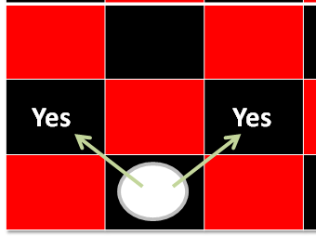
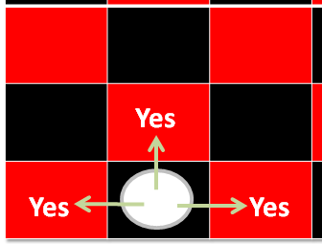
Interfaces: A Checkers Example
Regular rules²
Regular board¹
Variant rules²
1 From www.allaboutfungames.com)
2 Board images from “Tam”

Slide 93
Interface Board
public interface Board
{
public static final int SIZE = 8;
public void displayBoard();
public void initializeBoard();
public void movePiece();
boolean moveValid(int xSource,
int ySource,
int xDestination,
int yDestination);
...
}

Slide 94
Class RegularBoard
public class RegularBoard implements Board
{
public void displayBoard()
{
...
}
public void initializeBoard()
{
...
}

Slide 95
Class RegularBoard (2)
public void movePiece() {
// Get (x, y) coordinates for the source and destination
if (moveValid(xS, yS, xD, yD) == true)
// Actually move the piece
else
// Don’t move piece and display error message
}
public boolean moveValid(int xSource, int ySource,
int xDestination,
int yDestination)
{
if (moving forward diagonally)
return(true);
else
return(false);
}
} // End of class RegularBoard

Slide 96
Class VariantBoard
public class VariantBoard implements Board
{
public void displayBoard ()
{
...
}
public void initializeBoard ()
{
...
}

Slide 97
Class VariantBoard (2)
public void movePiece() {
// Get (x, y) coordinates for the source and destination
if (moveValid (xS, yS, xD, yD) == true)
// Actually move the piece
else
// Don’t move piece and display error message
}
public boolean moveValid(int xSource, int ySource,
int xDestination,
int yDestination)
{
if (moving straight-forward or straight side-ways)
return(true);
else
return(false);
}
} // End of class VariantBoard

Slide 98
Interfaces: Recapping The Example
Interface Board
  No state (variable data) or behavior (body of the method is empty)
  Specifies the behaviors that a board should exhibit e.g., clear screen
  This is done by listing the methods that must be implemented by classes that implement the interface.
Class RegularBoard and VariantBoard
  Can have state and methods
  They must implement all the methods specified by the interface ‘Board’ (but can also implement other methods too)

Slide 99
Specifying Interfaces In UML
<< interface >>
Interface name
method specification
Realization / Implements
Class name
method implementation

Slide 100
Alternate UML Representation (Lollipop Notation)
Interface name
Class name
method implementation

Slide 101
Implementing Multiple Interfaces
Java allows for this.
Interface1
Interface2
Interface3
Class

Slide 102
Implementing Multiple Interfaces
Format:
public class <class name> implements <interface name 1>,
<interface name 2>, <interface name 3>…
{
}

Slide 103
Multiple Implementations Vs. Multiple Inheritance
class <class name 1> extends <class name 2>, <class name 3>…
{
}
A class can implement multiple interfaces
Classes in Java cannot extend more than one class
Again: multiple inheritance is not possible in Java but is possible in other languages such as C++:
  Multiple inheritance (mock up code)

Slide 104
Multiple Implementations Vs.
Multiple Inheritance (2)
Parent class 1
Parent class 2
Parent class 3
Child class
Multiple inheritance: conceptual view representing using UML

Slide 105
Abstract Classes (Java)
Classes that cannot be instantiated.
A hybrid between regular classes and interfaces.Some methods may be implemented while others are only specified (no body).
Used when the parent class:
  specifies a default implementation of some methods,
  but cannot define a complete default implementation of other methods (implementation must be specified by the child class).
Format:
  public abstract class <class name>
  {
  <public/private/protected> abstract method ();
  }

Slide 106
Abstract Classes (Java): 2
1) From “Big Java” by C. Horstmann pp. 449 – 500.
Example¹:
  public abstract class BankAccount
  {
  protected float balance;
  public void displayBalance()
  {
  System.out.println("Balance $" + balance);
  }
  public abstract void deductFees() ;
  }

Slide 107
Another Example For Using An Abstract Class
RegularBoard
<< interface >>
Board
CheckerBoard
{abstract}
+moveValid()
+SIZE:int
+displayBoard()
+initializeBoard()
+movePiece()
+moveValid()
+displayBoard()
+initializeBoard()
+movePiece()
+moveValid()
VariantBoard
+moveValid()

Slide 108
You Should Now Know
What is inheritance, when to employ it, how to employ it in Java
  How casting works within an inheritance hierarchy
    When the instanceof operator should and should not be used to check for type in an inheritance hierarchy
  What is the effect of the keyword "final" on inheritance relationships
  What is method overriding
    How does it differ from method overloading
    What is polymorphism
What are the benefits of employing inheritance

Slide 109
You Should Now Know (2)
How does the ‘protected’ level of access permission work, how do private and public access permissions work with an inheritance hierarchy.
  Under what situations should each level of permission be employed
Updated scoping rules (includes inheritance) and how shadowing works with an inheritance hierarchy
How the ‘super’ keyword works, when it is and is not needed
Class Object is the parent of all classes in Java
  Capabilities inherited from the parent (if you refer to the API for class Object)
How homogeneous composite types (such as arrays) can appear to contain multiple types within one container

Slide 110
You Should Now Know (3)
What are interfaces/types
  How do types differ from classes
  How to implement and use interfaces in Java
  When interfaces should be employed
What are abstract classes in Java and how do they differ from non-abstract classes and interfaces.
  When to employ abstract classes vs. interfaces vs. ‘regular’ classes
How to read/write UML notations for inheritance and interfaces.
What is the difference between early and late binding
What is multiple inheritance
  How does it differ from multiple implementations
  What are its advantages and disadvantages

Slide 111
Copyright Notification
“Unless otherwise indicated, all images in this presentation are used with permission from Microsoft.”

