Slide 1
Code Reuse Through Hierarchies
You will learn about different ways of creating class hierarchies to better organize and group attributes and methods in order to facilitate code reuse

Slide 2
Review: Association Relation Between Classes
public class Car {
private Engine anEngine;
  private Lights carLights;
  public start () {
  anEngine.ignite ();
  carLight.turnOn ();
  }
}
public class Engine {
public boolean ignite () {
.. }
}
public class Lights {
private boolean isOn;
public void turnOn () {
isOn = true;}
}
One type of association relationship is a ‘has-a’ relation (also known as “aggregation”).
  E.g. 1, A car <has-a> engine.
  E.g. 2, A lecture <has-a> student.
Typically this type of relationship exists between classes when a class is an attribute of another class.

Slide 3
A New Type Of Association: Is-A (Inheritance)
An inheritance relation exists between two classes if one class is a more specific variant type of another class
Vehicle
Motorcycle
Car
Bus
SUV
Sports car
Mini
Full sized

Slide 4
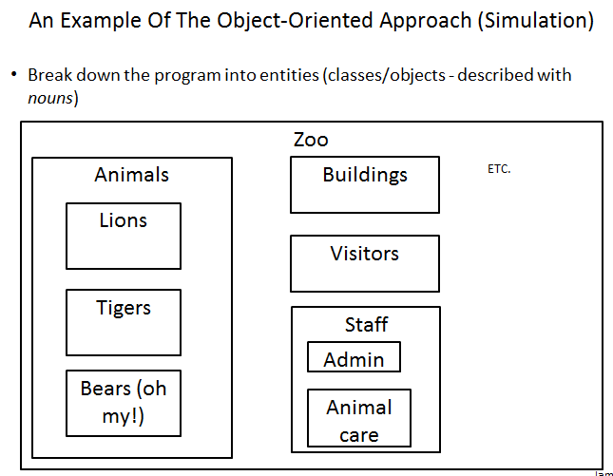
Recall O-O Approach: Finding Candidate Classes

Slide 5
What If There Are Commonalities Between Classes
Examples:
  All birds ‘fly’
  Some types of animals ‘swim’: fish, penguins, some snakes, crocodiles, some birds
  All animals ‘eat’, ‘drink’, ‘sleep’ etc.
  Under the current approach you would have the same behaviors repeated over and over!
Hawk
King Penguin
Lion
eat()
sleep()
drink()
eat()
sleep()
drink()
eat()
sleep()
drink()
Waste!
Waste!
Waste!

Slide 6
New Technique: Inheritance
When designing an Object-Oriented program, look for common behaviors and attributes
  E.g., color, species, eat(), drink(), sleep()
These commonalities are defined in a ‘parent’ class
Animal
color
species
eat()
sleep()
drink()

Slide 7
New Technique : Inheritance (2)
These commonalities are defined in a ‘parent’ class
As appropriate other ‘child’ classes will directly include or ‘inherit’ all the non-private attributes and behaviors of the parent class.
  ‘Privates’ are still accessible through public methods.
Animal
color
species
eat()
sleep()
drink()
Hawk
King Penguin
Lion

Slide 8
Defining A Class That Inherits From Another
This means that a Lion object AUTOMATICALLY has all the capabilities of an Animal object
The only attributes and methods that need to be specified are the ones unique to a lion
Format:
  public class <Name of child class> extends <Name of parent class>
  {
  // Definition of child class – only what is unique to
  // this class
  }
Example:
  public class Lion extends Animal
  {
  public void roar() {
  System.out.println("Rawr!");
  }
  }

Slide 9
First Inheritance Example
Location of the full online example:
  /home/219/examples/hierarchies/1basicExample

Slide 10

Class Person
public class Person {
public static final long DELAY_TIME = 1999999999;
private void delayTime() {
for (long i = 0; i <= DELAY_TIME; i++);
}
public void doDailyTasks() {
System.out.println("I am sleeping: zzzZZZZzzz");
delayTime();
System.out.println("I am eating: yum! yum! yum!");
delayTime();
System.out.println("I am drinking: hic, hic, hic");
delayTime();
System.out.println("I am execrating: :P :P :P");
}
}
Image of James Tam curtesy of James Tam

Slide 11
Class Person: Private Method
public class Person {
public static final long DELAY_TIME = 1999999999;
private void delayTime() {
for (long i = 0; i <= DELAY_TIME; i++);
}
public void doDailyTasks() {
System.out.println("I am sleeping: zzzZZZZzzz");
delayTime();
System.out.println("I am eating: yum! yum! yum!");
delayTime();
System.out.println("I am drinking: hic, hic, hic");
delayTime();
System.out.println("I am execrating: :P :P :P");
}
}
‘Helper’ methods, only called internally, are often set to ‘private’

Slide 12
Class Hero: It Is A Person
public class Hero extends Person {
}
This automatically gives instances of this class all the capabilities of an instance of class Person

Slide 13

Class Hero: A Person But A Whole Lot More
public class Hero extends Person {
private int heroicCount;
public Hero() {
heroicCount = 0;
}
public void doHeroStuff() {
System.out.println("I AM SAVING THE DAY FOR: TRUTH!
JUSTICE!...AND ALL THAT GOOD
STUFF!!!");
heroicCount++;
}
public int getHeroicCount() {
return(heroicCount);
}
}
Image of super James Tam curtesy of James Tam

Slide 14


The Driver Class: Person Vs. Hero
public class Driver
{
public static void main(String [] args)
{
Person bob = new Person();
bob.doDailyTasks();
System.out.println();
Hero clark = new Hero();
clark.doDailyTasks();
clark.doHeroStuff();
}
}

Slide 15
Benefit Of Employing Inheritance
Code reuse:
  The common and accessible attributes and methods of the parent will automatically be available in all the children.
Person
+doDailyTasks()
Accountant
Hero
Teacher

Slide 16
New Terminology: Method Overriding
Overriding occurs when the child class has a different version of a method than was implemented in the parent.
Person
+doDailyTasks()
Hero
+doDailyTasks()

Slide 17
Method Overriding Example
Location of the complete example:
  /home/219/examples/hierarchies/2overriding
Person
+doDailyTasks()
Hero
+doDailyTasks()

Slide 18
Class Hero
public class Hero extends Person
{
// New method: the rest of the class is the same as the
// previous version
public void doDailyTasks()
{
System.out.println("Pffff I need not go about mundane
nicities such as eating!");
}
}

Slide 19
The Driver Class (Included For Reference)
public class Driver
{
public static void main(String [] args)
{
Person bob = new Person();
bob.doDailyTasks();
System.out.println();
Hero clark = new Hero();
clark.doDailyTasks();
clark.doHeroStuff();
}
}

Slide 20
Overriding: The Type Of The Reference Determines The Method
public class Person {
public void doDailyTasks() {
...
}
}
public class Hero extends Person {
public void doDailyTasks() {
...
}
}
// Bob is a Person
bob.doDailyTasks();
// Clarke is a Hero
clark.doDailyTasks();

Slide 21
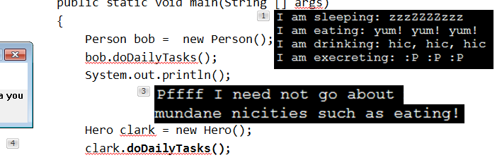
New Terminology: Polymorphism
Poly = many Morphic = forms
A polymorphic method is a method that has an implementation in the parent class and a different implementation the child class.
Polymorphism: the specific method called will be automatically be determined without any type checking needed.
Recall the example:

Slide 22
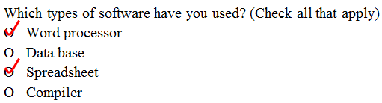
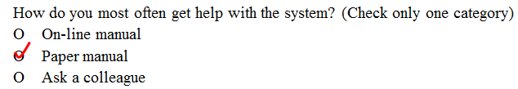
New Terminology: Super-class Vs. Sub-class
All people
on the earth
Superclass (Button)
(Superset –
Bigger)
All people
in Canada
Subclass (RadioButton)
(Subset - smaller)

Slide 23
Inheritance Is A One Way Relationship!
A Hero is a Person but a Person is not a Hero!
That means that while the sub-class can access the super-class but the super-class cannot access the sub-class
New class
  New attributes
  New behaviors
Existing class
  Attributes
  Behaviors

Slide 24
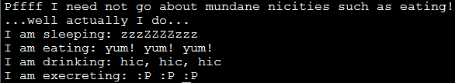
The ‘Super’ Keyword
Used to access the parts of the super-class.
Format:
  <super>.<method or attribute>
Example:
  public void doDailyTasks() {
  System.out.println("Pffff I need not go about mundane
  nicities such as eating!");
  System.out.println("...well actually I do...");
  super.doDailyTasks();
  }
Parent’s version of method

Slide 25
Super Keyword: When It’s Needed
You only need this keyword when accessing non-unique methods or attributes (exist in both the super and sub-classes).
Without the super keyword then the sub-class will be accessed
Person
+doDailyTasks()
For a ‘Hero’ access super class method (use ‘super’) super.doDailyTasks()
Hero
For a ‘Hero’ access this classes’ version (no super keyword) doDailyTasks()
+doDailyTasks()

Slide 26
Super Keyword: When It’s Not Needed
If that method or attribute exists in only one class definition then there is no ambiguity.
Person
For a ‘Hero’ doDailyTasks()
+doDailyTasks()
Hero
For a ‘Hero’ doHeroStuff()
+doHeroStuff ()

Slide 27
Something Especially Good?
Note: There Is No Super.Super In Java

Slide 28
Calling The Super Class Constructor: Just Super()
This results in a call to the super classes’ constructor
(Useful for initializing the attributes that are defined in the super class)

Slide 29
Calling The Super Class Constructor
Location of the full example:
  /home/219/examples/hierarchies/3superConstructors

Slide 30
Class Person
public class Person
{
private int age;
public Person() {
age = 0;
}
public Person(int anAge) {
age = anAge;
}
public int getAge() {
return(age);
}

Slide 31
Class Person (2)
public String toString()
{
String s = "";
s = s + "Age of person: " + age + "\n";
return(s);
}
}

Slide 32
Class Hero: Using Super()
public class Hero extends Person
{
private int heroicCount;
public Hero() {
super();
heroicCount = 0;
}
public Hero(int anAge) {
super(anAge);
heroicCount = 0;
}
public void doHeroStuff() {
heroicCount++;
}
public Person() {
age = 0;
}
public Person(int anAge) {
age = anAge;
}

Slide 33
Class Hero (2): Using Super()
public String toString()
{
String s = "";
s = s + "Age of person: "
+ age + "\n";
return(s);
}
public int getHeroicCount() {
return(heroicCount);
}
public String toString () {
String s = super.toString();
if (s != null) {
s = s + "Count of brave and heroic deeds: " +
heroicCount + "\n";
}
return(s);
}
}

Slide 34
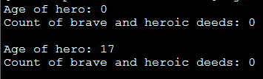
The Driver Class
public class Driver
{
public static void main(String [] args)
{
Hero clark = new Hero();
Hero peter = new Hero(17);
System.out.println(clark);
System.out.println(peter);
}
}
public Person() {
age = 0;
}
public Person(int anAge) {
age = anAge;
}

Slide 35
Access Modifiers And Inheritance
Private ‘-‘: still works as-is, private attributes and methods can only be accessed within that classes’ methods.
  Child classes, similar to other classes must access private attributes through public methods.
Public ‘+’: still works as-is, public attributes and methods can be accessed anywhere.
New level of access, Protected ‘#’: can access the method or attribute in the class or its sub-classes.

Slide 36
Summary: Levels Of Access Permissions
Access level | Accessible to
 | Same class | Subclass | Not a subclass
Public | Yes | Yes | Yes
Protected | Yes | Yes | No
Private | Yes | No | No

Slide 37
Levels Of Access Permission: An Example
public class P
{
private int num1;
protected int num2;
public int num3;
// Can access num1, num2 & num3 here.
}
public class C extends P
{
// Can’t access num1 here
// Can access num2, num3
}
public class Driver
{
// Can’t access num1 here and generally can’t access num2 here
// Can access num3 here
}

Slide 38
General Rules Of Thumb
Variable attributes should not have protected access but instead should be private.
Most methods should be public.
Methods that are used only by the parent and child classes should be made protected.

Slide 39
Updated Scoping Rules
When referring to an identifier in a method of a class
  Look in the local memory space for that method
  Look in the definition of the class
  Look in the definition of the classes’ parent

Slide 40
Updated Scoping Rules (2)
public class P
{
}
public class C extends P
{
public void method ()
{
}
}
<<< Third: Parent’s attribute >>>
Similar to how local variables can shadow attributes, the child attributes can shadow parent attributes.
<<< Second: Attribute>>>
<<< First: Local >>>
Reference to an identifier e.g., ‘num’

Slide 41
Updated Scoping Rules: A Trace
Location of the full online example:
  /home/219/examples/hierarchies/4scope

Slide 42
Parent: Class P
public class P {
protected int x = 1;
protected int a = 2;
public void method1() {
System.out.println("P.method1()");
System.out.println("x/a: " + x + " " + a);
}
public void method2() {
int a = 3;
System.out.println("P.method2()");
System.out.println("x/a: " + x + " " + a);
}
}

Slide 43
Child: Class C
public class C extends P
{
private int x = 3;
private int y = 4;
public void method1()
{
System.out.println("C.method1()");
int z = 5;
int x = 6;
System.out.println("x/y/z/a: " + x +
" " + y + " " + z + " " + a);
}
}

Slide 44
The Driver Class
public class Driver {
public static void main(String [] args) {
// Case 1
P p = new P();
p.method1();
// Case 2
p.method2();
// Case 3
C c = new C();
c.method1();
// Case 4
c.method2();
}
}

Slide 45
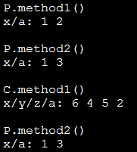
Case 1
class P
{
protected int x = 1;
protected int a = 2;
public void method1()
{
System.out.println("P.method1()");
System.out.println("x/a: " + x + " " + a);
}

Slide 46
Case 2
class P
{
protected int x = 1;
protected int a = 2;
public void method2()
{
int a = 3;
System.out.println("P.method2()");
System.out.println("x/a: " + x + " " + a);
}
}

Slide 47
Case 3
class P {
protected int x = 1;
protected int a = 2;
}
public class C extends P {
private int x = 3;
private int y = 4;
public void method1() {
System.out.println("C.method1()");
int z = 5;
int x = 6;
System.out.println("x/y/z/a: " + x +
" " + y + " " + z + " " + a);
}
}

Slide 48
Case 4: Just Call The Parent, No Child
class P {
protected int x = 1;
protected int a = 2;
public void method1() { }
public void method2() {
int a = 3;
System.out.println("P.method2()");
System.out.println("x/a: " + x + " " + a);
}
}
public class C extends P {
private int x = 3;
private int y = 4;
public void method1() { }
}
c.method2();

Slide 49
The Final Modifier (Inheritance)
What you know: the keyword final means unchanging (used in conjunction with the declaration of constants)
Methods preceded by the final modifier cannot be overridden
  e.g., public final void displayTwo ()
Classes preceded by the final modifier cannot be extended
  e.g., final public class ParentFoo

Slide 50
Reminder: Casting
The casting operator can be used to convert between types.
Format:
  <Variable name> = (type to convert to) <Variable name>;
Example (casting needed: going from more to less)
  double full_amount = 1.9;
  int dollars = (int) full_amount;
Example (casting not needed: going from less to more)
  int dollars = 2;
  double full_amount = dollars;

Slide 51
Real Life Examples: Expectations Vs. Reality
You are owed $100
Getting more than expected: acceptable
You receive $1000
You are owed $100
Getting less than expected: not acceptable
You receive $10

Slide 52
Real Life Examples: Expectations Vs. Reality (2)
You are owed $100
Misrepresenting reality: still not acceptable in the end
Cash $10
$100

Slide 53
Example Inheritance Hierarchy
StarShip
+attack()
FedStarShip
KlingStarShip
+attack()
+attack()
+utterBattleCry()

Slide 54
Casting And Inheritance (Up)
Because the child class IS-A parent class you can substitute instances of a subclass for instances of a superclass.
StarShip
+attack()
√
You can substitute a KlingStarShip for a StarShip
FedStarShip
KlingStarShip
+attack()
+attack()
+utterBattleCry()
You can substitute a FedStarShip for a StarShip

Slide 55
Casting And Inheritance (Down)
You cannot substitute instances of a superclass for instances of a subclass
StarShip
+attack()
You cannot substitute a StarShip for a FedStarShip or a KlingStarShip
x
FedStarShip
KlingStarShip
+attack()
+attack()
+utterBattleCry()

Slide 56
Reminder: Operations Depends On Type
Sometimes the same symbol performs different operations depending upon the type of the operands/inputs.
Example:
  int num1 = 2;
  int num2 = 3;
  num1 = num1 + num2;
  Vs.
  String str = “foo” + “bar”;
Some operations won’t work on some types
Example:
  String str = 2 / 3;
Notes:
56

Slide 57
Reminder: Behavior Depends Upon Class Type
The methods that can be invoked by an object depend on the class definition
Example:
  class X class Y
  { {
  method1() { method2() {
  } }
  } }
  X anX = new X();
  anX.method1(); // Yes
  Y aY= new Y();
  aY.method1(); // No
Notes:
57

Slide 58
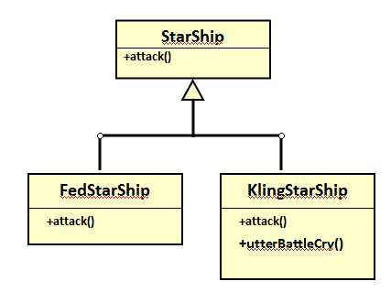
Casting And Inheritance
x
x
x
StarShip regular = new StarShip();
KlingStarShip kling = new KlingStarShip();
regular.utterBattleCry(); // Inappropriate action for type
regular = kling;
regular.utterBattleCry(); // I think I point to the wrong type
((KlingStarShip) regular).utterBattleCry(); // I know I point to
the correct type
regular = new StarShip();
kling = (KlingStarShip) regular; // Dangerous cast
kling.utterBattleCry(); // Inappropriate action for type

Slide 59
Caution About Class Casting: Check First!
When casting between classes only use the cast operator if you are sure of the type!
Check if an object is of a particular type is via the instanceof operator
(When used in an expression the instanceof operator returns a boolean result)
Format:
  if (<reference name> instanceof <class name>)
Example:
  if (supPerson instanceof Person)

Slide 60
Instanceof Example
Location of the full example:
  /home/219/examples/hierarchies/5typeCheck
Person
Dog
Type ‘Person’
+doDailyTasks()
+bark()
Type ‘Dog’
Not type ‘Person’
Hero
Type ‘Person’
+doHeroStuff ()

Slide 61

Driver.main()
Person regPerson = new Person();
Hero supPerson = new Hero();
Dog rover = new Dog();
// Instanceof checks if the object is a certain type or
// a subclass of that type (e.g., a Hero is a Person)
if (regPerson instanceof Person)
System.out.println("regPerson is a type of Person");
if (supPerson instanceof Person)
System.out.println("supPerson is also a type of Person");
// Checks for non-hierarchical: Compiler prevents nonsensical
// checks
//if (rover instanceof Person)
// System.out.println("Rover is also a type of Person");

Slide 62
Driver.main(): 2
if (supPerson instanceof Hero)
System.out.println("supPerson is a type of Hero");
// Checks within hierarchy: Compiler doesn't prevent
if (regPerson instanceof Hero)
System.out.println("[Should never appear]: regPerson is a
type of Hero");

Slide 63
Containers: Homogeneous
Recall that arrays must be homogeneous: all elements must be of the same type e.g., int [] grades
Recall: A child class is an instance of the parent (a more specific instance with more capabilities).
If a container, such as an array is needed for use in conjunction with an inheritance hierarchy then the type of each element can simply be the parent.
  StarShip [] array = new StarShip[2];
  array[0] = new StarShip(); // [0] wants a StarShip, gets a StarShip
  array[1] = new KlingStarShip(); // [1] wants a StarShip, gets a
  // KlingStarShip (even better!)
StarShip
+attack()
KlingStarShip
+utterBattleCry()

Slide 64
The Parent Of All Classes
You’ve already employed inheritance.
Class Object is at the top of the inheritance hierarchy.
Inheritance from class Object is implicit.
All other classes automatically inherit its attributes and methods (left and right are logically the same)
  class Person class Person extends Object
  { {
  } }
  e.g., “toString()” are available to its child classes
For more information about this class see the url:
  http://docs.oracle.com/javase/7/docs/api/java/lang/Object.html

Slide 65
The Parent Of All Classes (2)
This means that if you want to have an array that can contain any type of Java object then it can be an array of type Object.
  Object [] array = new Object[SIZE];
Built-in array-like classes such as class Vector (an array that ‘automatically’ resizes itself consists of an array attribute whose type is class Object)
  For more information on class Vector:
  http://docs.oracle.com/javase/6/docs/api/java/util/Vector.html

Slide 66
Determining Type: Hierarchies
As mentioned: normally type checking should not be needed for a polymorphic method (the child class overrides a parent method).
  No instanceof needed
However type checking is needed if a method specific to the child is being invoked.
    Check with instanceof is needed
Person
+doDailyTasks()
Hero
+doDailyTasks()
StarShip
+attack()
KlingStarShip
+utterBattleCry()

Slide 67
Example: Containers With ‘Different’ Types
Location of the full example:
  /home/219/examples/hierarchies/6hierarchiesContainment

Slide 68
Driver Class: SpaceSimulator
public class SpaceSimulator
{
public static void main(String [] args)
{
Galaxy alpha = new Galaxy();
alpha.display();
alpha.runSimulatedAttacks();
}
}

Slide 69
Class Galaxy
public class Galaxy {
public static final int SIZE = 4;
private StarShip [][] grid;

Slide 70

Class Galaxy (2)
public Galaxy () {
boolean squareOccupied = false;
grid = new StarShip [SIZE][SIZE];
int r;
int c;
int hull;
for (r = 0; r < SIZE; r++) {
for (c = 0; c < SIZE; c++)
{
grid[r][c] = null;
}
}
grid[0][0] = new FedStarShip();
grid[0][1] = new KlingStarShip();
grid[1][0] = new StarShip();
}

Slide 71
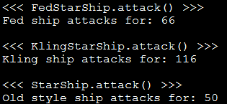
Class Galaxy (3)
public void runSimulatedAttacks() {
int damage;
damage = grid[0][0].attack();
System.out.println("Fed ship attacks for: " + damage);
System.out.println();
damage = grid[0][1].attack();
System.out.println("Kling ship attacks for: " + damage);
System.out.println();
damage = grid[1][0].attack();
System.out.println("Old style ship attacks for: " +
damage);
System.out.println();
Type check not needed because:
attack() method is overridden / polymorphic

Slide 72

Class Galaxy (4)
/* Won't work because it's array of references to
StarShips not KlingStarShips.
grid[1][0].utterBattleCry(); */
if (grid[0][0] instanceof KlingStarShip)
((KlingStarShip) grid[0][0]).utterBattleCry();
if (grid[0][1] instanceof KlingStarShip)
((KlingStarShip) grid[0][1]).utterBattleCry();
if (grid[1][0] instanceof KlingStarShip)
((KlingStarShip) grid[1][0]).utterBattleCry();
}
} // End runSimulatedAttacks()
Type check ‘instanceof’ needed because:
Array of StarShips but utterBattleCry() unique to KlingStarShip

Slide 73
Class StarShip
public class StarShip {
public static final int MAX_HULL = 400;
public static final char DEFAULT_APPEARANCE = 'C';
public static final int MAX_DAMAGE = 50;
private char appearance;
private int hullValue;
public StarShip () {
appearance = DEFAULT_APPEARANCE;
hullValue = MAX_HULL;
}
public StarShip (int hull) {
appearance = DEFAULT_APPEARANCE;
hullValue = hull;
}

Slide 74
Class StarShip (2)
public StarShip (char newAppearance) {
this();
appearance = newAppearance;
}
public int attack() {
System.out.println("<<< StarShip.attack() >>>");
return(MAX_DAMAGE);
}

Slide 75
Class StarShip (3): Get()’s, Set()’s
public char getAppearance () {
return appearance;
}
public int getHullValue() {
return(hullValue);
}
public void setAppearance(char newAppearance) {
appearance = newAppearance;
}
public void setHull(int newHullValue) {
hullValue = newHullValue;
}
}

Slide 76
Class FedStarShip
public class FedStarShip extends StarShip {
public static final int MAX_HULL = 800;
public static final char DEFAULT_APPEARANCE = 'F';
public static final int MAX_DIE_ROLL = 6;
public static final int DIE_ROLL_BOOSTER = 1;
public static final int NUM_DICE = 20;
public FedStarShip() {
super();
setHull(MAX_HULL); // 800 not 400 due to shadowing
setAppearance(DEFAULT_APPEARANCE); // ‘F’ not ‘C’
}
Shadows parent constants

Slide 77
Class FedStarShip (2)
// Overridden / polymorphic method
public int attack() {
System.out.println("<<< FedStarShip.attack() >>>");
Random aGenerator = new Random();
int i = 0;
int tempDamage = 0;
int totalDamage = 0;
for (i = 0; i < NUM_DICE; i++)
{
tempDamage = aGenerator.nextInt(MAX_DIE_ROLL) +
DIE_ROLL_BOOSTER;
totalDamage = totalDamage + tempDamage;
}
return(totalDamage);
}
}
20
6
1

Slide 78
Class KlingStarShip
public class KlingStarShip extends StarShip {
public static final char DEFAULT_APPEARANCE = 'K';
public static final int MAX_DIE_ROLL = 12;
public static final int DIE_ROLL_BOOSTER = 1;
public static final int NUM_DICE = 20;
public KlingStarShip() {
super();
setAppearance(DEFAULT_APPEARANCE);
}
// Unique to KlingStarShip objects
public void utterBattleCry() {
System.out.println("Heghlu'meH QaQ jajvam!");
}
}

Slide 79
Class KlingStarShip (2)
// Overridden / polymorphic method
public int attack() {
System.out.println("<<< KlingStarShip.attack() >>>");
Random aGenerator = new Random();
int i = 0;
int tempDamage = 0;
int totalDamage = 0;
for (i = 0; i < NUM_DICE; i++) {
tempDamage = aGenerator.nextInt(MAX_DIE_ROLL) +
DIE_ROLL_BOOSTER;
totalDamage = totalDamage + tempDamage;
}
return(totalDamage);
}
20
12
1

Slide 80
New Terminology: Binding
When a method is invoked, binding is the process of determining which method definition will be executed.
If neither method overloading nor method overriding are employed then binding is very easy to determine.
public class Person {
private int age;
public Person() {
age = 0;
}
Person jim = new Person();
jim.setAge(27);
public setAge(int anAge) {
age = anAge;
}
}

Slide 81
Method Overloading Vs. Method Overriding
Distinguishes overloaded methods
Method Overloading (what you should know)
  Multiple method implementations for the same class
  Each method has the same name but the type, number or order of the parameters is different (signatures are not the same)
  The method that is actually called is determined at program compile time (early binding).
  i.e., <reference name>.<method name>(parameter list);

Slide 82
Method Overloading Vs. Method Overriding (2)
Binding at compile time (early)
Examples of method overloading:
  public class Foo
  {
  public void display( ) { }
  public void display(int i) { }
  public void display(char ch) { }
  }
  Foo f = new Foo ();
  f.display( );
  f.display(10);
  f.display(‘c’);

Slide 83
Method Overloading Vs. Method Overriding (3)
The type of the reference (implicit parameter “this”) distinguishes overridden methods
Method Overriding
  The method is implemented differently between the parent and child classes.
  Each method has the same return value, name and parameter list (identical signatures).
  The method that is actually called is determined at program run time (late binding).
  i.e., <reference name>.<method name> (parameter list);

Slide 84
Method Overloading Vs. Method Overriding (4)
Example of method overriding:
public class Person {
public void doDailyTasks() {
...
}
}
public class Hero extends Person {
public void doDailyTasks() {
...
}
}
Hero clarke = new Hero();
clarke.doDailyTasks()
Binding at run time (early)

Slide 85
Multiple Inheritance
But what happens if some behaviors or attributes are common to a group of classes but some of those classes include behaviors shared with other groups?
Or some groups of classes share some behaviors but not others?
Flyers
Swimmers
WaterBreathers
fly()
swim()
Hawk
Eagle
Duck
Dolphin
Fish

Slide 86

Multiple Inheritance (2)
It is implemented in some languages e.g., C++
It is not implemented in other languages e.g., Java
Pro: It allows for more than one parent class
  (JT: rarely needed but nice to have that capability for that odd exceptional case).
Con: Languages that allow for multiple inheritance require a more complex implementation even for single inheritance (classes only have one parent) cases.
WingedFlyer
MachineFlyer
fly()
fly()
Hawk
Eagle
BirdMan
Human

Slide 87
Java Interfaces
Similar to a class
Provides a design guide rather than implementation details
Specifies what methods should be implemented but not how
  An important design tool: Agreement for the interfaces should occur very early before program code has been written.
  (Specify the signature of methods so each part of the project can proceed with minimal coupling between classes).
  Changing the method body rather than the method signature won’t ‘break’ code.
It’s a design tool so they cannot be instantiated

Slide 88
Interfaces: Format
Format for defining an interface
public interface <name of interface>
{
constants
methods to be implemented by the class that realizes this
interface
}
Format for realizing / implementing the interface
public class <name of class> implements <name of interface>
{
attributes
methods actually implemented by this class
}

Slide 89

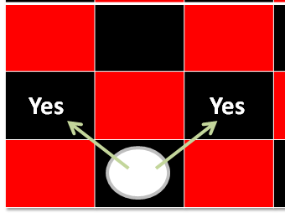
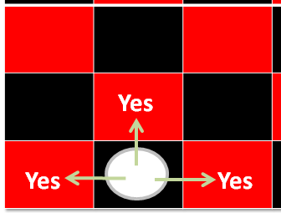
Interfaces: A Checkers Example
Regular rules²
Regular board¹
Variant rules²
1 From www.allaboutfungames.com)
2 Board images from “Tam”

Slide 90
Interface Board
public interface Board
{
public static final int SIZE = 8;
public void displayBoard();
public void initializeBoard();
public void movePiece();
boolean moveValid(int xSource,
int ySource,
int xDestination,
int yDestination);
...
}

Slide 91
Class RegularBoard
public class RegularBoard implements Board
{
public void displayBoard()
{
...
}
public void initializeBoard()
{
...
}

Slide 92
Class RegularBoard (2)
public void movePiece() {
// Get (x, y) coordinates for the source and destination
if (moveValid(xS, yS, xD, yD) == true)
// Actually move the piece
else
// Don’t move piece and display error message
}
public boolean moveValid(int xSource, int ySource,
int xDestination,
int yDestination)
{
if (moving forward diagonally)
return(true);
else
return(false);
}
} // End of class RegularBoard

Slide 93
Class VariantBoard
public class VariantBoard implements Board
{
public void displayBoard ()
{
...
}
public void initializeBoard ()
{
...
}

Slide 94
Class VariantBoard (2)
public void movePiece() {
// Get (x, y) coordinates for the source and destination
if (moveValid (xS, yS, xD, yD) == true)
// Actually move the piece
else
// Don’t move piece and display error message
}
public boolean moveValid(int xSource, int ySource,
int xDestination, int yDestination)
{
if (moving straight-forward or straight side-ways)
return(true);
else
return(false);
}
} // End of class VariantBoard

Slide 95
Interfaces: Recapping The Example
Interface Board
  No state (variable data) or behavior (body of the method is empty)
  Specifies the behaviors that a board should exhibit e.g., clear screen
  This is done by listing the methods that must be implemented by classes that implement the interface.
Class RegularBoard and VariantBoard
  Can have state and methods
  They must implement all the methods specified by the interface ‘Board’ (but can also implement other methods too)

Slide 96
Specifying Interfaces In UML
<< interface >>
Interface name
method specification
Realization / Implements
Class name
method implementation

Slide 97
Alternate UML Representation (Lollipop Notation)
Interface name
Class name
method implementation

Slide 98
Implementing Multiple Interfaces
Java allows for this.
Interface1
Interface2
Interface3
Class

Slide 99
Implementing Multiple Interfaces
Format:
public class <class name> implements <interface name 1>,
<interface name 2>, <interface name 3>…
{
}

Slide 100
Multiple Implementations Vs. Multiple Inheritance
class <class name 1> extends <class name 2>, <class name 3>…
{
}
A class can implement multiple interfaces
Classes in Java cannot extend more than one class
Again multiple inheritance is not possible in Java but is possible in other languages such as C++:
  Multiple inheritance (mock up code)

Slide 101
Multiple Implementations Vs.
Multiple Inheritance (2)
Parent class 1
Parent class 2
Parent class 3
Child class
Multiple inheritance: conceptual view representing using UML

Slide 102
Abstract Classes (Java)
Classes that cannot be instantiated.
A hybrid between regular classes and interfaces.
Some methods may be implemented while others are only specified (no body).
Used when the parent class:
  specifies a default implementation of some methods,
  but cannot define a complete default implementation of other methods (implementation must be specified by the child class).
Format:
  public abstract class <class name>
  {
  <public/private/protected> abstract method ();
  }

Slide 103
Abstract Classes (Java): 2
1) From “Big Java” by C. Horstmann pp. 449 – 500.
Example¹:
  public abstract class BankAccount
  {
  protected float balance;
  public void displayBalance()
  {
  System.out.println("Balance $" + balance);
  }
  public abstract void deductFees() ;
  }

Slide 104
Another Example For Using An Abstract Class
RegularBoard
<< interface >>
Board
CheckerBoard
{abstract}
+moveValid()
+SIZE:int
+displayBoard()
+initializeBoard()
+movePiece()
+moveValid()
+displayBoard()
+initializeBoard()
+movePiece()
+moveValid()
VariantBoard
+moveValid()

Slide 105
You Should Now Know
What is inheritance, when to employ it, how to employ it in Java
  How casting works within an inheritance hierarchy
    When the instanceof operator should and should not be used to check for type in an inheritance hierarchy
  What is the effect of the keyword "final" on inheritance relationships
  What is method overriding
    How does it differ from method overloading
    What is polymorphism
What are the benefits of employing inheritance

Slide 106
You Should Now Know (2)
How does the ‘protected’ level of access permission work, how do private and public access permissions work with an inheritance hierarchy.
  Under what situations should each level of permission be employed
Updated scoping rules (includes inheritance) and how shadowing works with an inheritance hierarchy
How the ‘super’ keyword works, when it is and is not needed
Class Object is the parent of all classes in Java
  Capabilities inherited from the parent (if you refer to the API for class Object)
How homogeneous composite types (such as arrays) can appear to contain multiple types within one container

Slide 107
You Should Now Know (3)
What are interfaces/types
  How do types differ from classes
  How to implement and use interfaces in Java
  When interfaces should be employed
What are abstract classes in Java and how do they differ from non-abstract classes and interfaces.
  When to employ abstract classes vs. interfaces vs. ‘regular’ classes
How to read/write UML notations for inheritance and interfaces.
What is the difference between early and late binding
What is multiple inheritance
  How does it differ from multiple implementations
  What are its advantages and disadvantages

