Slide 1
Introduction To Java Programming
You will learn about the process of creating Java programs and constructs for input, output, branching, looping and arrays.
Notes:
1

Slide 2
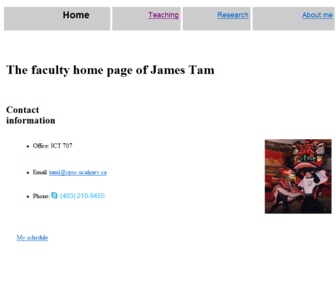
Java: Write Once, Run Anywhere
Consequence of Java’s history (coming later): platform-independence
Click on link to Applet
Mac user running Safari
Virtual machine translates byte code to
native Mac code and the Applet is run
Web page stored on Unix server
Byte code is downloaded
Byte code (part of web page)
Windows user running Internet Explorer

Slide 3
Java: Write Once, Run Anywhere
Consequence of Java’s history (coming later): platform-independence
Mac user running Safari
Web page stored on Unix server
Click on link to Applet
Byte code is downloaded
Byte code (part of web page)
Windows user running Internet Explorer
Virtual machine translates byte code to
native Windows code and the Applet is run

Slide 4
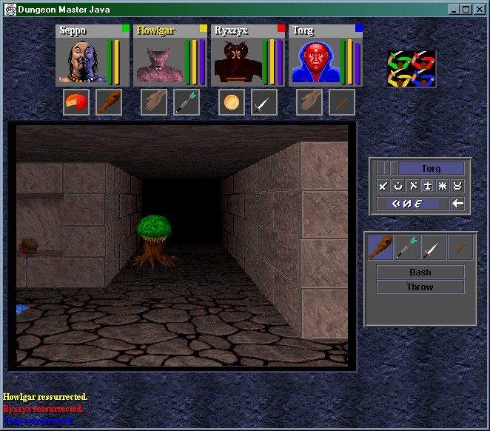
Java: Write Once, Run Anywhere (2)
But Java can also create standard (non-web based) programs
Kung Fu Panda:
Accessed 2013
screen grab from www.kunfupanda.com
Dungeon Master (Java version)
Accessed 2013
http://homepage.mac.com/aberfield/dmj/
Some examples of mobile Java games: http://www.mobilegamesarena.net

Slide 5
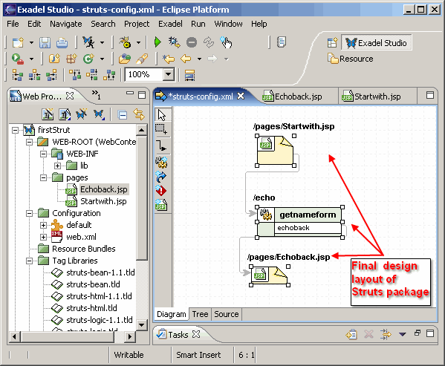
Java: Write Once, Run Anywhere (3)
Java has been used by large and reputable companies to create serious stand-alone applications.
Example:
Eclipse¹: started as a programming environment created by IBM for developing Java programs. The program Eclipse was itself written in Java.
1 For more information: http://www.eclipse.org/downloads/

Slide 6
JT’s Note: IDE’s
There are many graphical development environments available for Java (e.g., Eclipse).
Learning one or more these environments prior to embarking on employment would be a valuable experience.
However it is not recommended that you use them for this course.
You may have drastic problems configuring the environment (e.g., if you have to use example starting code).
It’s easier programming without an IDE and then learning one later than the opposite (not all development teams can/will use them).
With the size of the programs you will see in this class it would be a good learning experience to ‘work without a net’.
Because you have to do it all yourself you will likely learn things better.
Bottom line: if you have problems with the IDE then you will likely be on your own.

Slide 7
Official Online Documentation
“Getting started” tutorials:
http://docs.oracle.com/javase/tutorial/

Slide 8
Compilation
Translating from a high level programming language such as Java or C++ to low level machine language (binary).
Python:
One stage translation process from Python to machine.
The translated instructions remain in memory.
Java
Two stage process: 1) one time translation occurs Java to a generic binary that is common to many computers and many electronic devices (this creates a file) 2) when the program is run the generic binary is translated to machine language that is specific to the device.

Slide 9
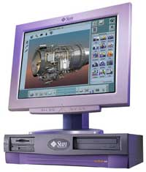
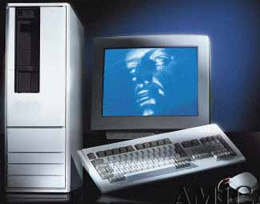
Compiled Programs With Different Operating Systems: Multiple Compilers Needed
Windows compiler
Executable (Windows)
Computer program
Mac OS compiler
Executable (Mac)
UNIX compiler
Executable (UNIX)

Slide 10
A High Level View Of Translating/Executing Java Programs
Stage 1: Compilation
Filename.java
Java compiler “javac”
Filename.class
Java program
Java byte code (generic binary)

Slide 11
A High Level View Of Translating/Executing Java Programs (2)
Stage 2: Final translation and execution of the byte code
Machine language instruction (UNIX)
Filename.class
Java interpreter “java”
Machine language instruction (Windows)
Java byte code (generic binary)
Machine language instruction (Apple)

Slide 12
Which Java?
http://java.sun.com/javase/downloads/index.jsp
Java JDK (Java Development Kit), Standard Edition includes:
JDK (Java development kit) – for developing Java software (creating Java programs).
JRE (Java Runtime environment) –for running pre-created Java programs.
Java Plug-in – a special version of the JRE designed to run through web browsers.
For consistency/fairness: Your graded work will be based on the version of Java installed on the CPSC network
Only run your program using a remote connection program (e.g., SSH to a CPSC Linux computer) or test your code periodically on the network to make sure it’s compatible.
It’s your responsibility to ensure compatibility.
If the program doesn’t work on the Lunix computers in the lab then it will only receive partial marks (at most).

Slide 13
Location Of Online Examples For This Section
Course website:
www.cpsc.ucalgary.ca/~tamj/219/examples/intro
UNIX directory:
/home/219/examples/intro

Slide 14
Smallest Compilable And Executable Java Program
The name of the online example is: Smallest.java (Important note: the file name must match the word after the keyword ‘class’ below).
public class Smallest
{
public static void main (String[] args)
{
}
}
Smallest.java
public class Smallest
{
}

Slide 15
Creating, Compiling And Running Java Programs On The Computer Science Network
Type it in with the text editor of your choice
Java program
filename.java
(Unix file)
Java compiler
javac
Java byte code
filename.class
(UNIX file)
To compile the program at the command line type "javac filename.java"
Java Interpreter
java
To run the interpreter, at the command line type "java filename"

Slide 16
Compiling The Smallest.java Program
Smallest.java
public class Smallest
{
public static void main (String[] args)
{
}
}
Type “javac Smallest.java”
javac
Smallest.class
(Java byte code)
10000100000001000 00100100000001001
: :

Slide 17
Running The Smallest.java Program
Smallest.class
(Java byte code)
10000100000001000 00100100000001001
: :
java
Type “java Smallest”
(Platform/Operating specific binary
10100111000001000 00100111001111001
: :

Slide 18
Running The Java Compiler At Home
After installing Java you will need to indicate to the operating system where the java compiler has been installed (‘setting the path’).
This is similar to Python.
For details of how to set your path variable for your particular operating system try the Sun or Java website.
Example of how to set the path in Windows:
http://java.sun.com/j2se/1.4.2/install-windows.html (see step 5 on the web link)
Alternatively: create your Java programs in the same location as the Java compiler.

Slide 19
Documentation / Comments
Multi-line documentation
/* Start of documentation
*/ End of documentation
Documentation for a single line
//Everything until the end of the line is a comment

Slide 20
Review: What Should You Document
Program (or that portion of the program) author
What does the program as a while do e.g., tax program.
What are the specific features of the program e.g., it calculates personal or small business tax.
What are it’s limitations e.g., it only follows Canadian tax laws and cannot be used in the US. In Canada it doesn’t calculate taxes for organizations with yearly gross earnings over $1 billion.
What is the version of the program
If you don’t use numbers for the different versions of your program then consider using dates (tie versions with program features).

Slide 21
Important Note
Each Java instruction must be followed by a semi-colon!
General format
Instruction1;
Instruction2;
Instruction3;
: :
Examples
int num = 0;
System.out.println(num);
: :

Slide 22
Java Output
Format:
System.out.print(<string or variable name one> + <string or variable name two>..);
OR
System.out.println(<string or variable name one> + <string or variable name two>..);
Examples (online program called “OutputExample1.java”)
public class OutputExample1
{
public static void main(String [] args)
{
int num = 123; // More on this shortly
System.out.println("Good-night gracie!");
System.out.print(num);
System.out.println("num="+num);
}
}

Slide 23
Output : Some Escape Sequences For Formatting
Escape sequence | Description
\t | Horizontal tab
\n | New line
\" | Double quote
\\ | Backslash

Slide 24
Variables
Unlike Python variables must be declared before they can be used.
Variable declaration:
Creates a variable in memory.
Specify the name of the variable as well as the type of information that it will store.
E.g. int num;
Although requiring variables to be explicitly declared appears to be an unnecessary chore it can actually be useful for minimizing insidious logic errors (example to follow shortly).
Using variables
Only after a variable has been declared can it be used (e.g., assignment)
E.g., num = 12;

Slide 25
Using Variables: A Contrast
Python
Java
Variables do not need to be declared before being used.
Easy to start programming.
Easy to make logic errors!
incomeTam = 25000
if (winLottery):
incomeSmith = 1000000
Syntactically variables must always be declared prior to use.
A little more work to get started.
Some logic errors may be prevented.
int incomeTam = 25000;
if (winLottery)
incomeSmith = 1000000;
Logic error: can be tricky to catch in a real (large and complex) program
Syntax error: compiler points out the source of the problem

Slide 26
Declaring Variables: Syntax
Format:
<type of information> <name of variable>;
Example:
char firstInitial;
Variables can be initialized (set to a starting value) as they’re declared:
char firstInitial = 'j';
int age = 30;

Slide 27
Some Built-In Types Of Variables In Java
Type | Description
byte | 8 bit signed integer
short | 16 but signed integer
int | 32 bit signed integer
long | 64 bit signed integer
float | 32 bit signed real number (rare)
double | 64 bit signed real number (compiler default)
char | 16 bit Unicode character (ASCII values and beyond)
boolean | True or false value
String | A sequence of characters between double quotes ("")

Slide 28
Location Of Variable Declarations
public class <name of class>
{
public static void main (String[] args)
{
// Local variable declarations occur here
<< Program statements >>
: :
}
}

Slide 29
Style Hint: Initializing Variables
Always initialize your variables prior to using them!
Do this whether it is syntactically required or not.
Example how not to approach (with some languages it’s a logic and not a syntax error):
public class OutputExample1
{
public static void main (String [] args)
{
int num;
System.out.print(num);
}
}
OutputExample1.java:7: error: variable num might not have been initialized
System.out.print(num);
^

Slide 30
Formatting Output
It’s somewhat similar to Python.
The field width and places of precision (float point) can be specified.
Format (‘System.out.’ requirement excluded for brevity):
printf("%<field width>d", price); // Integer
printf("%<field width>s", price); // String
printf("%<field width>.<precision>f", price); // Floating point
If field width greater than the size of the data:
A positive field width will result in leading spaces (right justify).
A negative field width will result in trailing spaces (left justify).

Slide 31
Formatting Output (2)
Name of the online example: FormatttingOutput.java
public class FormattingExample
{
public static void main(String [] args)
{
String str = "123";
int num = 123;
double price = 1.999;
System.out.printf("%-4s", str);
System.out.printf("%5d", num);
System.out.printf("%6.2f", price);
}
}

Slide 32
Java Constants (“Final”)
Reminder: constants are like variables in that they have a name and store a certain type of information but unlike variables they CANNOT change. (Unlike Python this is syntactically enforced…hurrah!).
Format:
final <constant type> <CONSTANT NAME> = <value>;
Example:
final int SIZE = 100;

Slide 33
Location Of Constant Declarations
public class <name of class>
{
public static void main (String[] args)
{
// Local constant declarations occur here (for now)
// Local variable declarations
< Program statements >>
: :
}
}

Slide 34
Variable Naming Conventions In Java
Compiler requirements
Can’t be a keyword nor can the names of the special constants: true, false or null be used
Can be any combination of letters, numbers, underscore or dollar sign (first character must be a letter or underscore)
Common stylistic conventions
The name should describe the purpose of the variable
Avoid using the dollar sign
With single word variable names, all characters are lower case
e.g., double grades;
Multiple words are separated by capitalizing the first letter of each word except for the first word
e.g., String firstName = “James”;

Slide 35
Java Keywords
abstract | boolean | break | byte | case | catch | char
class | const | continue | default | do | double | else
extends | final | finally | float | for | goto | if
implements | import | instanceof | int | interface | long | native
new | package | private | protected | public | return | short
static | super | switch | synchronized | this | throw | throws
transient | try | void | volatile | while

Slide 36
Common Java Operators / Operator Precedence
Precedence level | Operator | Description
1 | expression++ expression-- | Post-increment Post-decrement
2 | ++expression --expression + - ! ~ (type) | Pre-increment Pre-decrement Unary plus Unary minus Logical negation Bitwise complement Cast

Slide 37
Common Java Operators / Operator Precedence
Precedence level | Operator | Description
3 | * / % | Multiplication Division Remainder/modulus
4 | + - | Addition or String concatenation Subtraction
5 | << >> | Left bitwise shift Right bitwise shift

Slide 38
Common Java Operators / Operator Precedence
Precedence level | Operator | Description
6 | < <= > >= | Less than Less than, equal to Greater than Greater than, equal to
7 | = = != | Equal to Not equal to
8 | & | Bitwise AND
9 | ^ | Bitwise exclusive OR

Slide 39
Common Java Operators / Operator Precedence
Precedence level | Operator | Description
10 | | | Bitwise OR
11 | && | Logical AND
12 | || | Logical OR

Slide 40
Common Java Operators / Operator Precedence
Precedence level | Operator | Description
13 | = += -= *= /= %= &= ^= |= <<= >>= | Assignment Add, assignment Subtract, assignment Multiply, assignment Division, assignment Remainder, assignment Bitwise AND, assignment Bitwise XOR, assignment Bitwise OR, assignment Left shift, assignment Right shift, assignment

Slide 41
Post/Pre Operators
The name of the online example is: Order1.java
public class Order1
{
public static void main (String [] args)
{
int num = 5;
System.out.println(num);
num++;
System.out.println(num);
++num;
System.out.println(num);
System.out.println(++num);
System.out.println(num++);
}
}

Slide 42
Post/Pre Operators (2)
The name of the online example is: Order2.java
public class Order2
{
public static void main (String [] args)
{
int num1;
int num2;
num1 = 5;
num2 = ++num1 * num1++;
System.out.println("num1=" + num1);
System.out.println("num2=" + num2);
}
}

Slide 43
Unary Operator/Order/Associativity
The name of the online example: Unary_Order3.java
public class Unary_Order3.java
{
public static void main (String [] args)
{
int num = 5;
System.out.println(num);
num = num * -num;
System.out.println(num);
}
}

Slide 44
Casting: Converting Between Types
Casting: the ability to convert between types.
Of course the conversion between types must be logical otherwise an error will result.
In Java unlike Python the conversion isn’t just limited to a limited number of functions.
Consequently Python doesn’t have true ‘casting’ ability.
Format:
<Variable name> = (type to convert to) <Variable name>;

Slide 45
Casting: Structure And Examples
The name of the online example: Casting.java
public class Casting {
public static void main(String [] args) {
int num1;
double num2;
String str1;
num2 = 1.9;
str1 = "123";
num1 = (int) num2; // Cast needed to explicitly convert
System.out.println(num1 + " " + num2);
num2 = num1; // Cast not needed: going from less to more
System.out.println(num1 + " " + num2);
}
}

Slide 46
Accessing Pre-Created Java Libraries
It’s accomplished by placing an ‘import’ of the appropriate library at the top of your program.
Syntax:
import <Full library name>;
Example:
import java.util.Scanner;

Slide 47
Getting Text Input
You can use the pre-written methods (functions) in the Scanner class.
General structure:
import java.util.Scanner;
main (String [] args)
{
Scanner <name of scanner> = new Scanner (System.in);
<variable> = <name of scanner>.<method> ();
}

Slide 48
Getting Text Input (2)
The name of the online example: MyInput.java
import java.util.Scanner;
public class MyInput
{
public static void main (String [] args)
{
String name;
int age;
Scanner in = new Scanner (System.in);
System.out.print ("Enter your age: ");
age = in.nextInt ();
in.nextLine ();
System.out.print ("Enter your name: ");
name = in.nextLine ();
System.out.println ("Age: " +age +"\t Name:" + name);
}
}

Slide 49
Useful Methods Of Class Scanner¹
nextInt()
nextLong()
nextFloat()
nextDouble()
nextLine()
1 Online documentation: http://docs.oracle.com/javase/8/docs/api/

Slide 50
Reading A Single Character
Text menu driven programs may require this capability.
Example:
GAME OPTIONS
(a)dd a new player
(l)oad a saved game
(s)ave game
(q)uit game
There’s different ways of handling this problem but one approach is to extract the first character from the string.
Partial example:
String s = "boo";
System.out.println(s.charAt(0));

Slide 51
Reading A Single Character
Name of the (more complete example): MyInputChar.java
import java.util.Scanner;
public class MyInputChar
{
public static void main (String [] args)
{
final int FIRST = 0;
String selection;
Scanner in = new Scanner (System.in);
System.out.println("GAME OPTIONS");
System.out.println("(a)dd a new player");
System.out.println("(l)oad a saved game");
System.out.println("(s)ave game");
System.out.println("(q)uit game");
System.out.print("Enter your selection: ");

Slide 52
Reading A Single Character (2)
selection = in.nextLine ();
System.out.println ("Selection: " +
selection.charAt(FIRST));
}
}

Slide 53
Decision Making In Java
Java decision making constructs
if
if, else
if, else-if
switch

Slide 54
Decision Making: Logical Operators
Logical Operation | Python | Java
AND | and | &&
OR | or | ||
NOT | not | !

Slide 55
Decision Making: If
Format:
if(Boolean Expression)
Body
Example:
if(x != y)
System.out.println("X and Y are not equal");
if ((x > 0) && (y > 0))
{
System.out.println("X and Y are positive");
}
Indenting the body of the branch is an important stylistic requirement of Java but unlike Python it is not enforced by the syntax of the language.
What distinguishes the body is either:
A semi colon (single statement branch)
Braces (a body that consists of single or multiple statements)

Slide 56
Decision Making: If, Else
Format:
if(Boolean expression)
Body of if
else
Body of else
Example:
if (x < 0)
System.out.println("X is negative");
else
System.out.println("X is non-negative");

Slide 57
If, Else-If (Java) If, Elif (Python)
Format:
if (Boolean expression)
Body of if
else if (Boolean expression)
Body of first else-if
: : :
else if (Boolean expression)
Body of last else-if
else
Body of else

Slide 58
If, Else-If (2)
Example: SwitchExample.java
if (gpa == 4)
{
System.out.println("A");
}
else if (gpa == 3)
{
System.out.println("B");
}
else if (gpa == 2)
{
System.out.println("C");
}

Slide 59
If, Else-If (2)
else if (gpa == 1)
{
System.out.println("D");
}
else if (gpa == 0)
{
System.out.println(“F");
}
else
{
System.out.println("Invalid gpa");
}

Slide 60
Alternative To Multiple Else-If’s: Switch
Format (character-based switch):
switch (character variable name)
{
case '<character value>':
Body
break;
case '<character value>':
Body
break;
:
default:
Body
}
1 The type of variable in the brackets can be a byte, char, short, int or long
Important! The break is mandatory to separate Boolean expressions (must be used in all but the last).
The break transfers execution out of the switch construct, otherwise cases will ‘fall-through’

Slide 61
Alternative To Multiple Else-If’s: Switch (2)
Format (integer based switch):
switch (integer variable name)
{
case <integer value>:
Body
break;
case <integer value>:
Body
break;
:
default:
Body
}
1 The type of variable in the brackets can be a byte, char, short, int or long

Slide 62
The ‘Break’ Statement
‘Break’s is mandatory if cases are to be separated.
Example:
int gpa = 3;
char letter = ' ';
switch (gpa) {
case 4:
letter = 'a';
case 3:
letter = 'b';
case 2:
letter = 'c';
case 1:
letter = 'd';
case 0:
letter = 'f';
// Student receives an 'f'!
}
As mentioned without a break the switch will execute the first true case and all other cases will ‘fall through’

Slide 63
Switch: When To Use/When Not To Use
Benefit (when to use):
It may produce simpler code than using an if, else-if (e.g., if there are multiple compound conditions)
Contrast
switch(menu) {
case ‘a’:
case ‘A’:
case ‘N’:
case ‘n’:
System.out.println(“New player \
added”);
break;
case ‘Q’:
case ‘q’:
// Using if
If ((menu == ‘a’) ||
(menu == ‘A’) ||
(menu == ‘N’) ||
(menu == ‘n’))
System.out.println(“New player added”);
else if ((menu == ‘q’) ||
(menu == ‘Q’))
User enters a, A, N, n
Outside of switch

Slide 64
Switch: When To Use/When Not To Use (2)
Name of the online example: SwitchExample.java (When to use)
import java.util.Scanner;
public class SwitchExample
{
public static void main (String [] args)
{
final int FIRST = 0;
String line;
char letter;
int gpa;
Scanner in = new Scanner (System.in);
System.out.print("Enter letter grade: ");

Slide 65
Switch: When To Use/When Not To Use (3)
line = in.nextLine ();
letter = line.charAt(FIRST);
switch (letter)
{
case 'A':
case 'a':
gpa = 4;
break;
case 'B':
case 'b':
gpa = 3;
break;
case 'C':
case 'c':
gpa = 2;
break;

Slide 66
Switch: When To Use/When Not To Use (4)
case 'D':
case 'd':
gpa = 1;
break;
case 'F':
case 'f':
gpa = 0;
break;
default:
gpa = -1;
} // End of switch (determining GPA)
System.out.println("Letter grade: " + letter);
System.out.println("Grade point: " + gpa);
}
}

Slide 67
Switch: When To Use/When Not To Use (5)
When a switch can’t be used:
For data types other than characters or integers (Java 1.6 and earlier)
Boolean expressions that aren’t mutually exclusive:
As shown a switch can sometimes replace an ‘if, else-if’ construct
A switch usually cannot replace a series of ‘if’ branches).
Example when not to use a switch:
if (x > 0)
System.out.print(“X coordinate right of the origin”);
if (y > 0)
System.out.print(“Y coordinate above the origin”);
Example of when not to use a switch (Java 1.6 and earlier):
String name = in.readLine()
switch (name)
{
}

Slide 68
Loops
Python loops
Pre-test loops: for, while
Java Pre-test loops
For
While
Java Post-test loop
Do-while

Slide 69
While Loops
Format:
While (Boolean expression)
{
Body
}
Example:
int i = 1;
while (i <= 10)
{
System.out.println(i);
i = i + 1;
}
i = 0
while (i < 10):
print(i)
i = i + 1

Slide 70
For Loops
Format:
for (initialization; Boolean expression; update control)
{
Body
}
Example
for (i = 1; i <= 10; i++)
{
System.out.println(i);
}
for i in range (1, 11, 1):
print(i)

Slide 71
For Loops: Java Vs. Python
Unlike Python with most languages for loops are generally used as counting (e.g., up down).
Iterating through other series (such as lines in a file) is not possible.
Python example not possible in other languages
inputFile = open(“input.txt”,”r”)
for line in inputFile:
print(line)
In Java however the loop control can be updated by most any mathematical expression (even randomly assigned).
for (i = 1; i <= 100; i = i * 5)
Notes:
for (i = 1; i <= 100; i = i * 5)
Because there is an assignment statement the update can be the result of a mathematical function

Slide 72
For Loops: Java Vs. Python (2)
Also note in Java that the stopping boundary is explicit.
for (i = 1; i <= 10; i++)
Vs.
for i in range (1, 11, 1):

Slide 73
Post-Test Loop: Do-While
Recall Pre-test loops generally execute zero or more times.
Example:
i = 100
while (i < 10) {
// Body never executes
}
Post-test loops evaluate the Boolean expression after the body of the loop has executed.
This means that post test loops will execute one or more times.
General structure:
i = Start value
do
Body
} while(condition)

Slide 74
Do-While Loops
Format:
do {
Body
}
while (Boolean expression);
Example:
int i = 1;
do {
System.out.println(i);
i++;
}
while (i <= 10);

Slide 75
When To Use Post-Test (Do-While) Loops
Useful when you need to guarantee execution occurring at least once.
Example: the loop body encloses the whole program
do
{
// Play game
} while (Player doesn’t quit)

Slide 76
Common Mistake: Branches/Loops
Forgetting braces and that single statement bodies are specified by the first semi-colon.
(Partial) examples:
while (i < 10)
System.out.println(i);
i = i + 1;
while (i < 10);
{
System.out.println(i);
i = i + 1;
}
Body
Body

Slide 77
Many Pre-Created Classes Have Been Created
Rule of thumb of real life: Before writing new program code to implement the features of your program you should check to see if a class has already been written with the features that you need.
Note: for some assignments you may have to implement all features yourself rather than use pre-written code.
You may receive little or no credit otherwise.
The Java API is Sun Microsystems's collection of pre-built Java classes:
http://java.sun.com/javase/7/docs/api/

Slide 78
Example: Generating Random Numbers (Probabilities)
Name of the (more complete example): DiceExample.java
public class DiceExample
{
public static void main(String [] args)
{
final int SIDES = 6;
Random generator = new Random();
int result = -1;
result = generator.nextInt(SIDES) + 1;
System.out.println("1d6: " + result);
result = generator.nextInt(SIDES) + 1;
result = result + generator.nextInt(SIDES) + 1;
result = result + generator.nextInt(SIDES) + 1;
System.out.println("3d6: " + result);
}
}

Slide 79
Arrays
They are similar to Python lists.
Specified with square brackets
Indexed from 0 to (number elements-1)
Some differences:
All elements must be of the same type e.g., array of integers cannot mix and match with floats
Python has methods associated with lists although an array in Java has a ‘length’ attribute associated with it.
Arrays cannot be dynamically resized (new array must be created).

Slide 80
Creating An Array
Format:
<type> []₁ <name> = new <type> [<Number of elements>];
Example (common approach):
final int MAX = 100;
int [] grades = new int [MAX];
Example (Fixed size array declared and initialized – rarely used approach):
int [] array = {1,2,3};
1 Each dimension must be specified by a set of square brackets e.g., two dimensional array requires two sets of brackets

Slide 81
Arrays: Complete Example
Name of the (more complete example): GradesExample.java
public class GradesExample
{
public static void main(String [] args)
{
final int MAX = 10;
int [] grades = new int [MAX];
int i = 0;
Random generator = new Random();

Slide 82
Arrays: Complete Example (2)
for (i = 0; i < MAX; i++)
{
grades[i] = generator.nextInt(101);
}
for (i = 0; i < grades.length; i++)
{
System.out.println("Element #" + i + " grade " +
grades[i]);
}
}
}

Slide 83
After This Section You Should Now Know
The basic structure required for creating a simple Java program as well as how to compile and run programs
How to document a Java program
How to perform text based input and output in Java
The declaration of constants and variables
Formatting output with the field width, precision and escape codes
Converting between types using the casting operator
What are the common Java operators and how they work
The structure and syntax of decision making and looping constructs

Slide 84
After This Section You Should Now Know (2)
How to generate random numbers
How to create and work with Java arrays

Slide 85
Copyright Notification
“Unless otherwise indicated, all images in this presentation are used with permission from Microsoft.”

