Slide 1
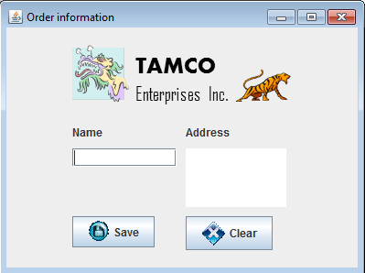
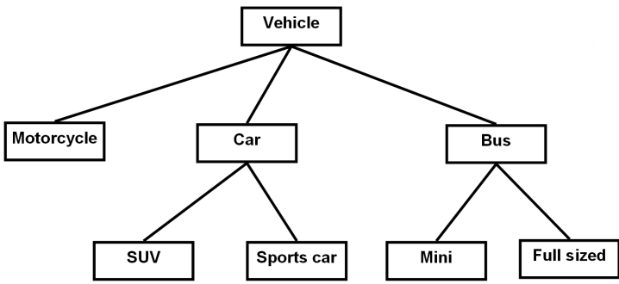
Introduction To CPSC 219
James Tam
Java
Object-Orientation
Graphical-user interfaces

Slide 2

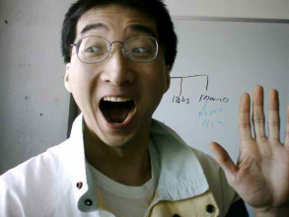
Then And Now…
CPSC 217: What was it like then
CPSC 219: What will it be like now
A Lot of work! (Image copyright unknown)
Even more work!!!
…but don’t forget how much smarter you’ve became!

Slide 3

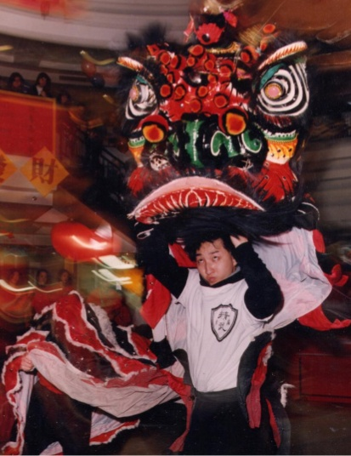
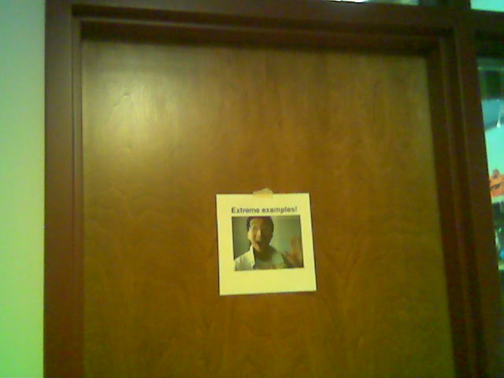
Administrative (James Tam)
Contact Information
  Office: ICT 707
  Email: tamj@cpsc.ucalgary.ca
Office hours
  Office hours: Tue 11:00 – 11:50, Thur 14:00 – 14:50
  If I’m not in my office give me a few minutes or check the lecture room.
  Email: (any time)
  Appointment: email, phone or call
  Drop by for urgent requests (but no guarantee that I will be in if it’s outside of my office hours!)
ICT 7th
Yes
E
My Office
No
x
Images: courtesy of James Tam

Slide 4
Course Resources
Required resources:
  Course website: http://www.cpsc.ucalgary.ca/~tamj/219(Get the notes off the course webpage before lecture)
Recommended but not required:
  "Absolute Java (5th Ed)" Walter Savitch, (Pearson)
  Alternately you can pick out one of the ‘free’ online texts from the university library:
  http://proquest.safaribooksonline.com.ezproxy.lib.ucalgary.ca/

Slide 5
How To Use The Course Resources
They are provided to support and supplement this class.
  The notes outline the topics to be covered
  At a minimum look through the notes to see the important topics.
  However the notes are just an outline and just looking at them without coming to class isn’t sufficient to do well
  You will get the details (e.g., explanations) during lecture time
    Take notes!

Slide 6
Your Engagement Level ---> Your Learning
+
Learning
Computer programs
Computer program

Slide 7
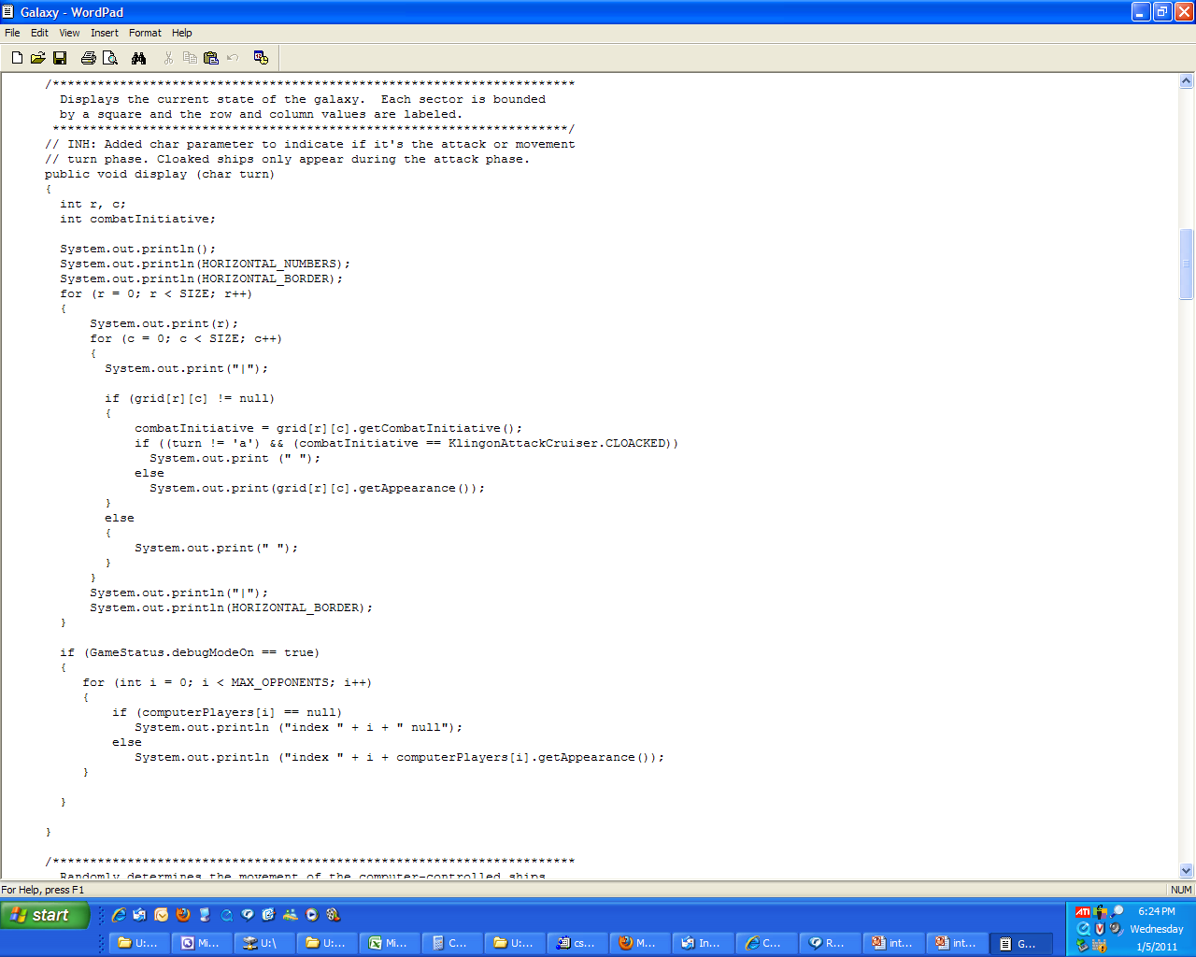
How To Use The Course Resources (2)
Notes:
7

Slide 8
How To Use The Course Resources (2)
If you miss a class make sure that you catch up on what you missed (get someone’s class notes)
...when you do make it to class make sure that you supplement the slides with your own notes (because you aren’t going to remember it in the exams if you don’t)
Notes:
8

Slide 9
How To Use The Course Resources (3)
What you are responsible for:
  Keeping up with the content in class which includes the topics covered but also announcements or assignment information whether you were present in the class or not.
  If you are absent, then you are responsible for getting the information from the other students in class.
    Make sure your UC registered email is correct and one you actually read (some course announcements will be sent to these emails)
    NEW! Your UC registered email just became your university email
  (I won’t be able to repeat the lecture content if you are absent…there’s just too many of you to make it practical and recall to get the most out of the class you need to be actively engaged)
However, after you’ve caught up by talking with a classmate:
  Ask for help if you need it
  There are no dumb questions
  …except for waiting until the exam

Slide 10
Tam’s “House Rules”
I will endeavor to keep the lecture within the prescribed time boundaries
You won’t pack up and end before time is up

Slide 11




Tam’s “House Rules”
No recordings/captures without permission during class please
(Recall that learning tends to increase with additional levels of engagement).

Slide 12
219 Students: Assumed Knowledge
You completed CPSC 217 (or the equivalent) with a grade of C- or higher.
You do not need to know Python programming for this class.
  However sometimes I will refer briefly to Python programs just to contrast what (most/all) students already know with what they need to learn.
You are proficient at using common procedural programming tools e.g., branching, loops, decomposition into functions etc.
If you are new to the CPSC network then you should (quickly) familiarize yourself.
  One starting point (Topic #0):
  http://pages.cpsc.ucalgary.ca/~tamj/219/starting/index.html

Slide 13
How To Succeed In This Course: A Summary
Practice things yourself
Make sure that you keep up with the material
Look at the material before coming to lecture
Start working on things early

Slide 14
Evaluation Components
Assignments (35%)
Examinations (65%)
Bonus component: in-lecture questions using TopHat Monacle (1%)

Slide 15
Assignments
There will be two types of assignments
  Full (regular) assignments (32%)
  Mini assignments (3%)
Full assignments (5):
  Marking is based on a number of factors (such as program functionality, documentation, style)
  Assignment 1: worth 5%
  Assignment 2: worth 8%
  Assignment 3: worth 8%
  Assignment 4: worth 5%
  Assignment 5: worth 6%
Mini assignments (3 worth 1% each)
  The goal is to create a small and relatively simple program in order to learn basic programming concepts such as Java syntax
  Marking is focused on program functionality

Slide 16
Assignments
Assignments must be individually completed and individually submitted.
  There is no group work allowed for this class.
  Students should not see the computer program code of other students.
Both types of assignments will be marked by the tutorial instructor.
  You can contact him/her for the grade and/or the completed marking sheet.

Slide 17
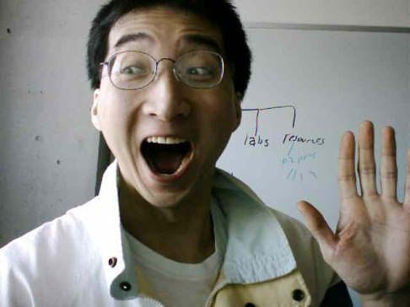
Submitting Assignments
Bottom line: it is each student’s responsibility to make sure that the correct version of the program was submitted on time.
Late assignments will not be accepted.
If you are ill then medical documentation is required.
  Contact your course instructor and not your tutorial instructor to get permission for a late submission
(Further details will be available during the term).
I am the ‘course instructor’ person
Image of James Tam: courtesy of James Tam

Slide 18
JT’s Helpful Hint: Electronically Submitting Work
Bad things sometimes happen!
  Sometimes it’s a technical failure (e.g., hardware failure)
  Sometimes it’s human error (e.g., oops, accidentally deleted)
Rules of thumb for assignment submissions:
  Do it early! (Get familiar with the system)
  Do it often! (If somehow real disaster strikes and you lose everything at least you will have a partially completed version that your TA can mark).
  Check your work.
    Don’t assume that everything worked out OK.
    Instead you should check everything (there should be a way to do this using the assignment submission mechanism)
    Don’t just check file names but at least take a look at the actual file contents (not only to check that the file wasn’t corrupted but also that you submitted the correct version).

Slide 19
Backing Up And Submitting Your Work
Bottom line: it is up to you to make sure things are done correctly and on time.
If you have questions beforehand then do ask (make sure you ask your questions early enough so you can receive an answer before the due time).
But don’t wait until after the due date (it’s too late).

Slide 20
Examinations
There will be three exams: two midterms and final.
Midterm exam (worth 15% each x 2 = 30%)
  I set the date:
  Midterm I: Friday February 13 (second part of lecture)
  Midterm II: Friday March 13 (second part of lecture)
  (More information can be found on the course web site)
    Section title:
      “Course topics, lecture notes and assignment descriptions, exam information”
    Hyperlink (see this for information about preparing for the exam)
      http://pages.cpsc.ucalgary.ca/~tamj/219/index.html#Course_topics,_lecture_notes_and_assignment_descriptions,exam_information

Slide 21
Examinations (2)
Final exam (worth 35%)
  Date/time/location determined by the Office the Registrar.
  (That means I find out these details at the same time that you do).
  You can find information about your final exams online via the university PeopleSoft portal.
All will completed on paper (not in front of a computer).
Note: you need to pass the weighted average of the exam component in order to receive a grade of C- or higher in this class.

Slide 22
Estimating Your Term Grade (2)
To determine your weighted term grade point simply multiply each grade point by the weight of each component.
Sum the weighted grade points to determine the term grade.
Simple and short example (not exactly the same as this term but it should be enough to give you an idea of how to do the specific calculations required this semester):
  Assignments: weight = 30%, example score = A
  Midterm: weight = 30%, example score = B+
  Final: weight = 40%, example score = C-
  Weighted assignments: 0.3 * 4.0 = 1.2
  Weighted midterm: 0.3 * 3.3 = 0.99
  Weighted final: 0.4 * 1.7 = 0.68
  Total term grade point = 1.2 + 0.99 + 0.68 = 2.87
  (In this case the term letter is B-)
Official university listing of letter grades/grade points: http://www.ucalgary.ca/pubs/calendar/current/f-2.html

Slide 23
Estimating Your Term Grade (3)^{1, 2}
1 The grade point to letter grade mapping employs the official university cutoffs:
http://www.ucalgary.ca/pubs/calendar/current/f-2.html
(I may employ a more lenient set of cutoffs at the end of term but the official cutoffs will provide you with a ‘worse case’ estimate of your grade).
2 Note: to keep things simple the formula in the spreadsheet does not check if the exam component was passed or not (you can do the check manually or add it in yourself)

Slide 24
Examination Content
Multiple choice questions:
  Partial program traces e.g., what’s the program output
  Basic program structure e.g., find the errors, which function or operator is needed for a particular mathematical operation
  More examples and details coming during the semester
Written questions:
  Write a small/partial computer program.
  Trace the execution of a computer program e.g., what is the ‘output’.
  Conceptual (lower weight for this type of question) e.g., definition of a technical term.
  Likely there will be a smaller proportion of written questions on the midterm vs. the final.
I will be grading the exams.
  (I’ll do the best I can to get them done in a timely fashion but remember it’s a high enrollment class).

Slide 25
Examination Content (2)
More sample ‘exam type’ questions will be provided during the semester.
  Sometimes ‘on the fly’ in lecture so pay attention to these and take notes.

Slide 26
Computer Science: Labs And Tutorials (Reminder)
Labs (“Continuous Tutorial/CT”):
  Attendance is not required (no official registration)
  Q & A session: it will be used as an additional place where you can get help.
  Located near the technical “Help Desk”
  The CT schedule will be posted early in the semester.
Tutorials:
  They will be conducted by the Teaching Assistants (TA).
  A mandatory component of the course (registration in a specific section is required).
  Review of concepts covered in lecture (especially the more challenging ones).
  Discussion of assignment requirements.

Slide 27
Computer Science: Labs And Tutorials (Reminder: 2)
(Tutorial information continued):
  Practice exercises.
  ‘Open tutorials’ will sometimes be held (extra CT/help time where TA’s will be available to help students).
More information about tutorials and labs is available on the course web site:
    http://pages.cpsc.ucalgary.ca/~tamj/219/index.html#Tutorial_and_lab_Information

Slide 28

Feedback
Wow I am the greatest speaker in the world!
What is he talking about???
Let me know how things are going in the course:
  Am I covering the material too slowly or too quickly.
  Can you read the slides and my hand writing.
  Can you hear me in the class.
  Etc.
(Image copyrights unknown)

Slide 29
Copyright Notification
“Unless otherwise indicated, all images in this presentation are used with permission from Microsoft.”
Sound effects (due to budgetary constraints) were produced by James Tam

